Slide 1
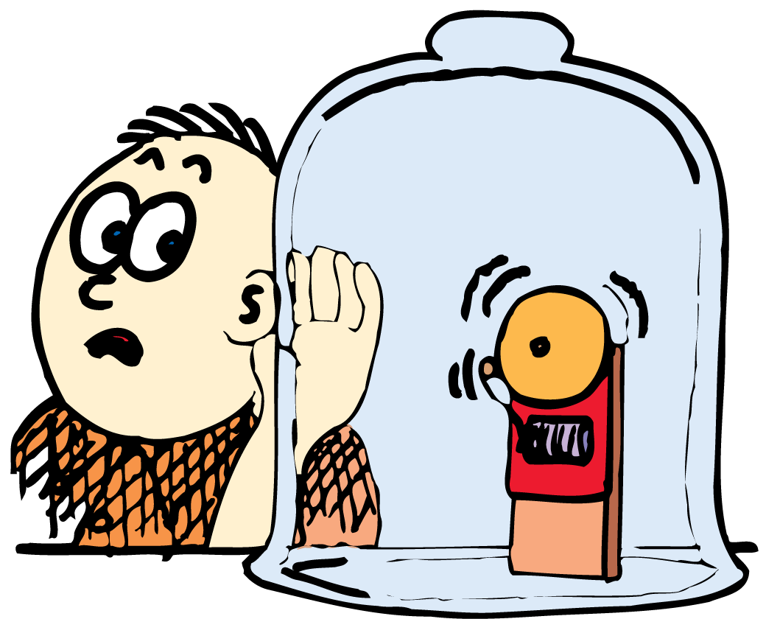
Sound is a form of energy that spreads out through space.

Slide 2
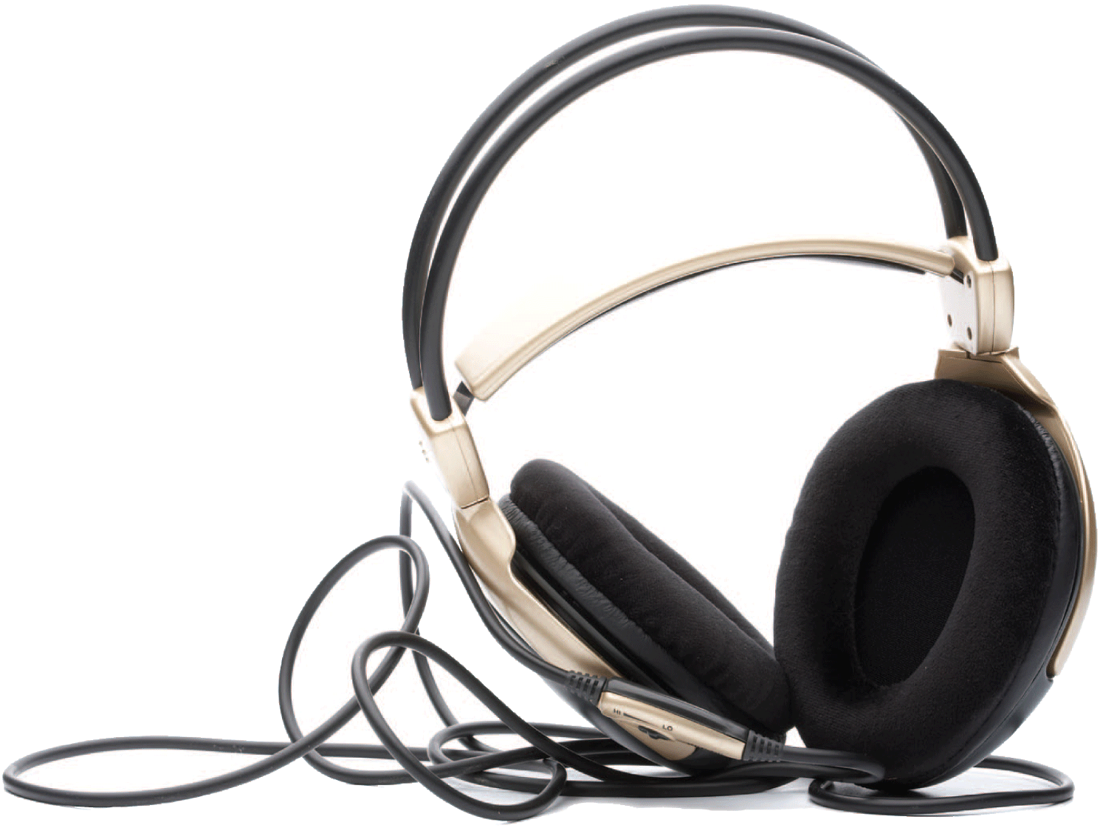
When a singer sings, the vocal chords in the singer’s throat vibrate, causing adjacent air molecules to vibrate. A series of ripples in the form of a longitudinal wave travels through the air. Vibrations in the eardrum send rhythmic electrical impulses into your brain and you hear the voice of the singer.

Slide 3
26.1 The Origin of Sound
All sounds originate in the vibrations of material objects.

Slide 4
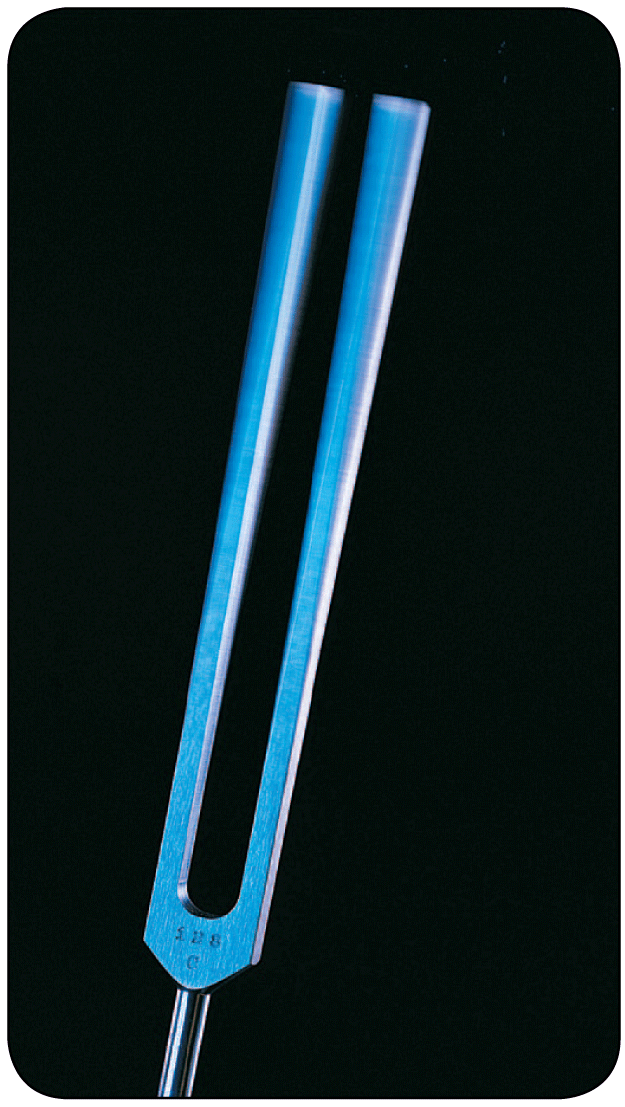
26.1 The Origin of Sound
The source of all sound waves is vibration.

Slide 5
26.1 The Origin of Sound
In a piano, violin, or guitar, a sound wave is produced by vibrating strings.
In a saxophone, a reed vibrates; in a flute, a fluttering column of air at the mouthpiece vibrates.
Your voice results from the vibration of your vocal chords.

Slide 6
26.1 The Origin of Sound
In each case, the original vibration stimulates the vibration of something larger or more massive.
the sounding board of a stringed instrument
the air column within a reed or wind instrument
the air in the throat and mouth of a singer
This vibrating material then sends a disturbance through a surrounding medium, air, in the form of longitudinal waves.
The frequency of the sound waves produced equals the frequency of the vibrating source.

Slide 7
26.1 The Origin of Sound
We describe our subjective impression about the frequency of sound by the word pitch.
A high-pitched sound like that from a piccolo has a high vibration frequency.
A low-pitched sound like that from a foghorn has a low vibration frequency.

Slide 8
26.1 The Origin of Sound
A young person can normally hear pitches with frequencies from about 20 to 20,000 hertz.
As we grow older, our hearing range shrinks, especially at the high-frequency end.

Slide 9
26.1 The Origin of Sound
Sound waves with frequencies below 20 hertz are called infrasonic.
Sound waves with frequencies above 20,000 hertz are called ultrasonic.
Humans cannot hear infrasonic or ultrasonic sound waves. Dogs, however, can hear frequencies of 40,000 Hz or more. Bats can hear sounds at over 100,000 Hz.

Slide 10
26.1 The Origin of Sound
What is the source of all sound?

Slide 11
26.2 Sound in Air
As a source of sound vibrates, a series of compressions and rarefactions travels outward from the source.

Slide 12
26.2 Sound in Air
Clap your hands and you produce a sound pulse that goes out in all directions.
Each particle moves back and forth along the direction of motion of the expanding wave.

Slide 13
26.2 Sound in Air
A compression travels along the spring similar to the way a sound wave travels in air.

Slide 14
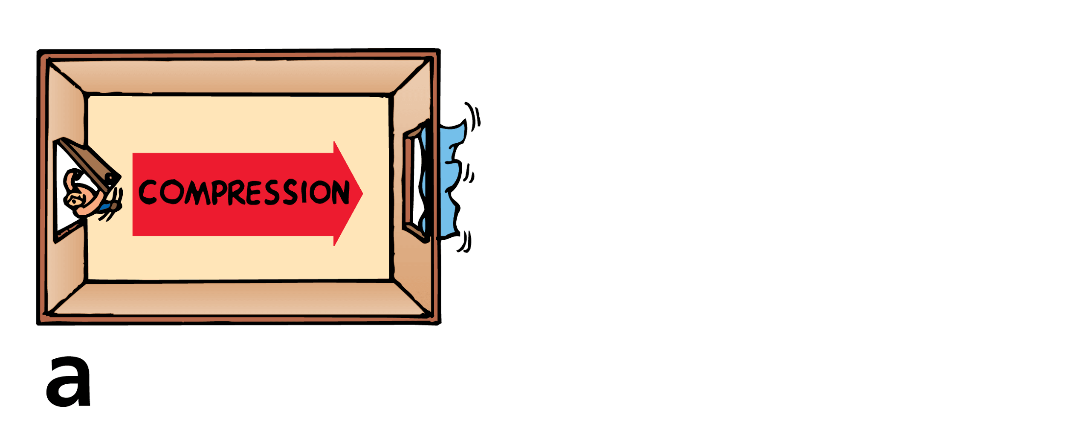
26.2 Sound in Air
Opening and closing a door produces compressions and rarefactions.
When the door is opened, a compression travels across the room.

Slide 15
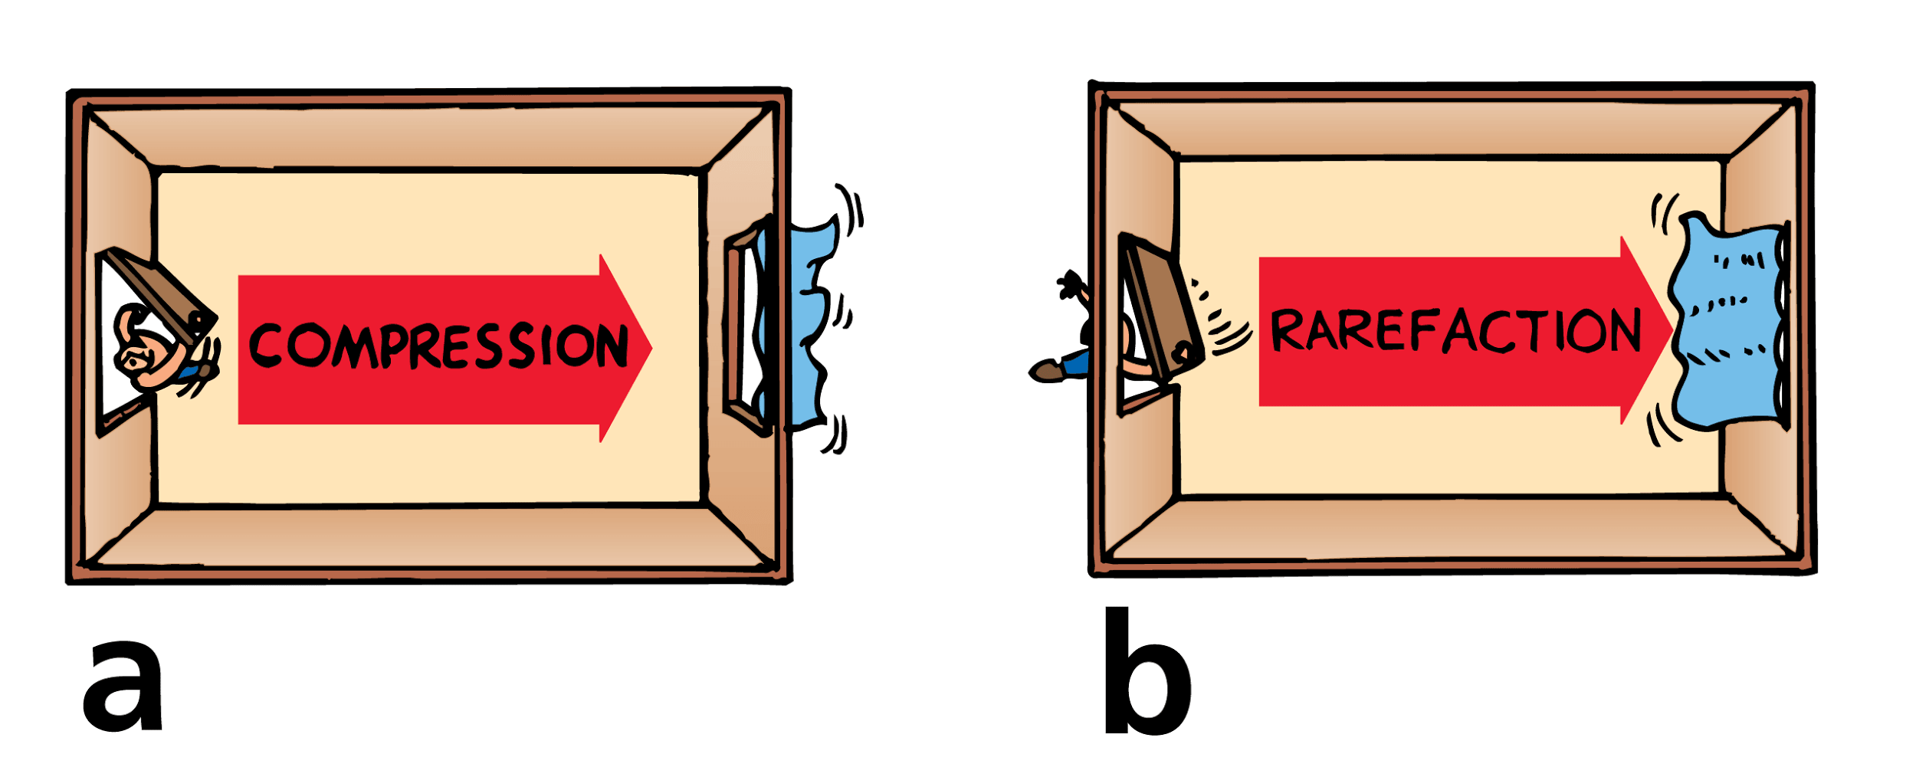
26.2 Sound in Air
Opening and closing a door produces compressions and rarefactions.
When the door is opened, a compression travels across the room.
When the door is closed, a rarefaction travels across the room.

Slide 16
26.2 Sound in Air
When you quickly open a door, you can imagine the door pushing the molecules next to it into their neighbors.
Neighboring molecules then push into their neighbors, and so on, like a compression wave moving along a spring.
A pulse of compressed air moves from the door to the curtain, pushing the curtain out the window.
This pulse of compressed air is called a compression.

Slide 17
26.2 Sound in Air
When you quickly close the door, the door pushes neighboring air molecules out of the room.
This produces an area of low pressure next to the door. Nearby molecules move in, leaving a zone of lower pressure behind them.
Molecules then move into these regions, resulting in a low-pressure pulse moving from the door to the curtain.
This pulse of low-pressure air is called a rarefaction.

Slide 18
26.2 Sound in Air
For all wave motion, it is not the medium that travels across the room, but a pulse that travels.
In both cases the pulse travels from the door to the curtain.
We know this because in both cases the curtain moves after the door is opened or closed.

Slide 19
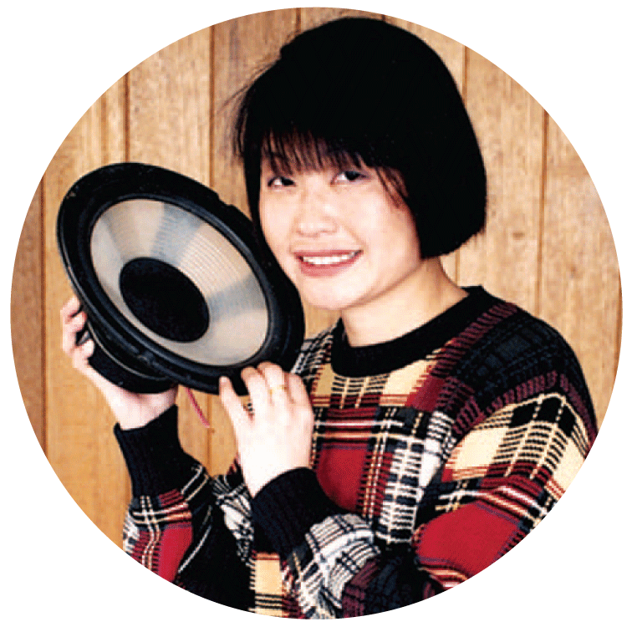
26.2 Sound in Air
On a much smaller but more rapid scale, this is what happens when a tuning fork is struck or when a speaker produces music.
The vibrations of the tuning fork and the waves it produces are considerably higher in frequency and lower in amplitude than in the case of the swinging door.
You don’t notice the effect of sound waves on the curtain, but you are well aware of them when they meet your sensitive eardrums.

Slide 20
26.2 Sound in Air
Consider sound waves in a tube.
When the prong of a tuning fork next to the tube moves toward the tube, a compression enters the tube.
When the prong swings away, in the opposite direction, a rarefaction follows the compression.
As the source vibrates, a series of compressions and rarefactions is produced.

Slide 21
26.2 Sound in Air
How does a sound wave travel through air?

Slide 22
26.3 Media That Transmit Sound
Sound travels in solids, liquids, and gases.

Slide 23
26.3 Media That Transmit Sound
Most sounds you hear are transmitted through the air.
Put your ear to a metal fence and have a friend tap it far away. Sound is transmitted louder and faster by the metal than by the air.
Click two rocks together underwater while your ear is submerged. You’ll hear the clicking sound very clearly.
Solids and liquids are generally good conductors of sound.

Slide 24
26.3 Media That Transmit Sound
The speed of sound differs in different materials.
In general, sound is transmitted faster in liquids than in gases, and still faster in solids.

Slide 25
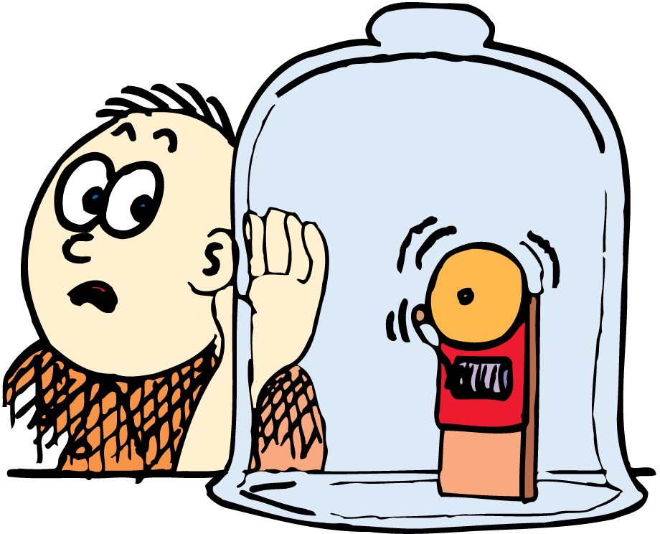
26.3 Media That Transmit Sound
Sound cannot travel in a vacuum.
The transmission of sound requires a medium. There may be vibrations, but if there is nothing to compress and expand, there can be no sound.
Sound can be heard from the ringing bell when air is inside the jar, but not when the air is removed.

Slide 26
26.3 Media That Transmit Sound
What media transmit sound?

Slide 27
26.4 Speed of Sound
The speed of sound in a gas depends on the temperature of the gas and the mass of the particles in the gas.
The speed of sound in a material depends on the material’s elasticity.

Slide 28
26.4 Speed of Sound
If you watch a distant person hammering, the sound of the blow takes time to reach your ears, so you see the blow and then hear it.
You hear thunder after you see the lightning.
These experiences are evidence that sound is much slower than light.

Slide 29
26.4 Speed of Sound
The speed of sound in dry air at 0°C is about 330 meters per second, or about 1200 kilometers per hour.
This is about one-millionth the speed of light.
Increased temperatures increase this speed slightly—faster-moving molecules bump into each other more often.
For each degree increase in air temperature above 0°C, the speed of sound in air increases by about 0.60 m/s.

Slide 30
26.4 Speed of Sound
The speed of sound in a gas also depends on the mass of its particles.
Lighter particles such as hydrogen molecules and helium atoms move faster and transmit sound much more quickly than heavier gases such as oxygen and nitrogen.

Slide 31
26.4 Speed of Sound
The speed of sound in a solid material depends not on the material’s density, but on its elasticity. Elasticity is the ability of a material to change shape in response to an applied force, and then resume its initial shape.
Steel is very elastic.
Putty is inelastic.
Sound travels about 15 times faster in steel than in air, and about four times faster in water than in air.

Slide 32
26.4 Speed of Sound
think!
How far away is a storm if you note a 3-second delay between a lightning flash and the sound of thunder?

Slide 33
26.4 Speed of Sound
think!
How far away is a storm if you note a 3-second delay between a lightning flash and the sound of thunder?
Answer:
For a speed of sound in air of 340 m/s, the distance is (340 m/s) × (3 s) = about 1000 m or 1 km. Time for the light is negligible, so the storm is about 1 km away.

Slide 34
26.4 Speed of Sound
What determines the speed of sound in a medium?

Slide 35
26.5 Loudness
Sound intensity is objective and is measured by instruments. Loudness, on the other hand, is a physiological sensation sensed in the brain.

Slide 36
26.5 Loudness
The intensity of a sound is proportional to the square of the amplitude of a sound wave.
Loudness, however, differs for different people, although it is related to sound intensity.
The unit of intensity for sound is the decibel (dB), after Alexander Graham Bell, inventor of the telephone.

Slide 37
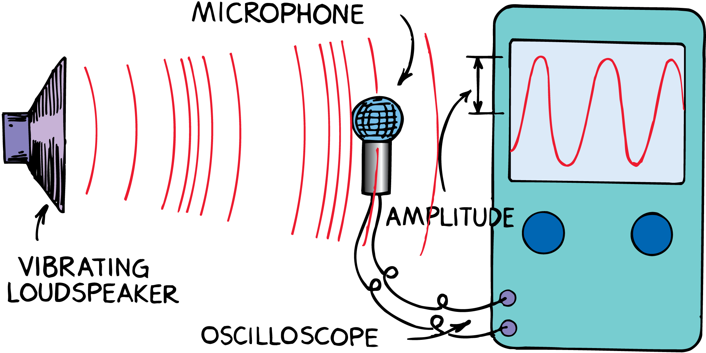
26.5 Loudness
The speaker vibrates in rhythm with an electric signal. The sound sets up similar vibrations in the microphone, which are displayed on the screen of an oscilloscope.

Slide 38
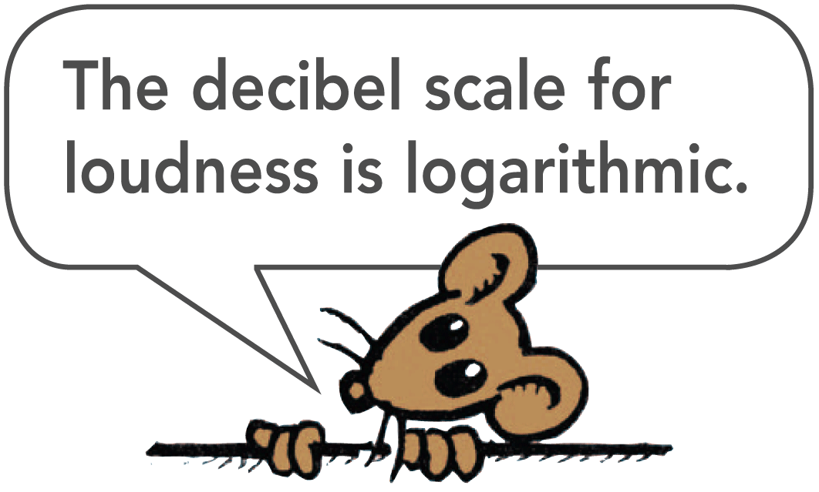
26.5 Loudness
Starting with zero at the threshold normal hearing, an increase of each 10 dB means that sound intensity increases by a factor of 10.
A sound of 10 dB is 10 times as intense as sound of 0 dB.
20 dB is not twice but 10 times as intense as 10 dB, or 100 times as intense as the threshold of hearing.
A 60-dB sound is 100 times as intense as a 40-dB sound.

Slide 39
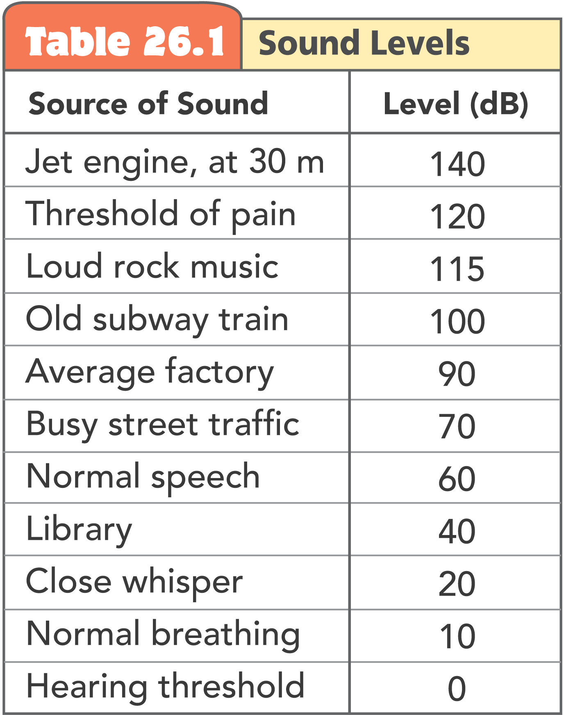
26.5 Loudness

Slide 40
26.5 Loudness
Hearing damage begins at 85 decibels. The damage depends on the length of exposure and on frequency characteristics.
A single burst of sound can produce vibrations intense enough to tear apart the organ of Corti, the receptor organ in the inner ear.
Less intense, but severe, noise can interfere with cellular processes in the organ and cause its eventual breakdown.
Unfortunately, the cells of the organ do not regenerate.

Slide 41
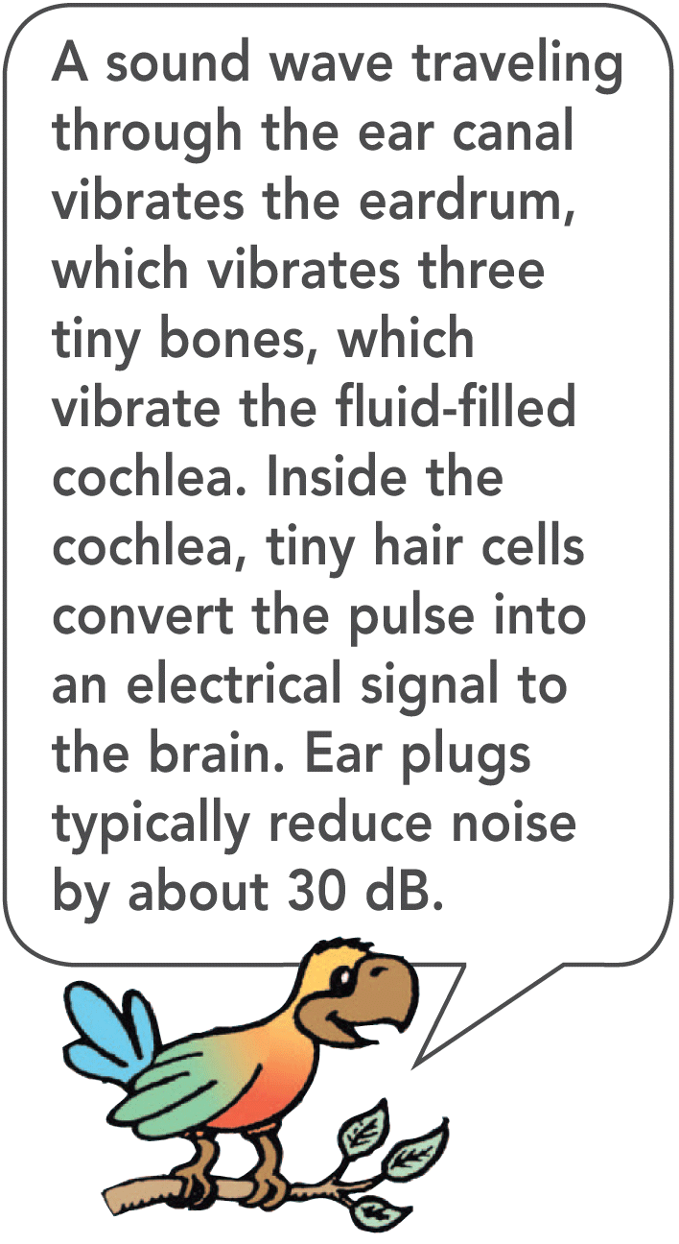
26.5 Loudness

Slide 42
26.5 Loudness
What is the difference between sound intensity and loudness?

Slide 43
26.6 Natural Frequency
When any object composed of an elastic material is disturbed, it vibrates at its own special set of frequencies, which together form its special sound.

Slide 44
26.6 Natural Frequency
Drop a wrench and a baseball bat on the floor, and you hear distinctly different sounds.
Objects vibrate differently when they strike the floor.
We speak of an object’s natural frequency, the frequency at which an object vibrates when it is disturbed.

Slide 45
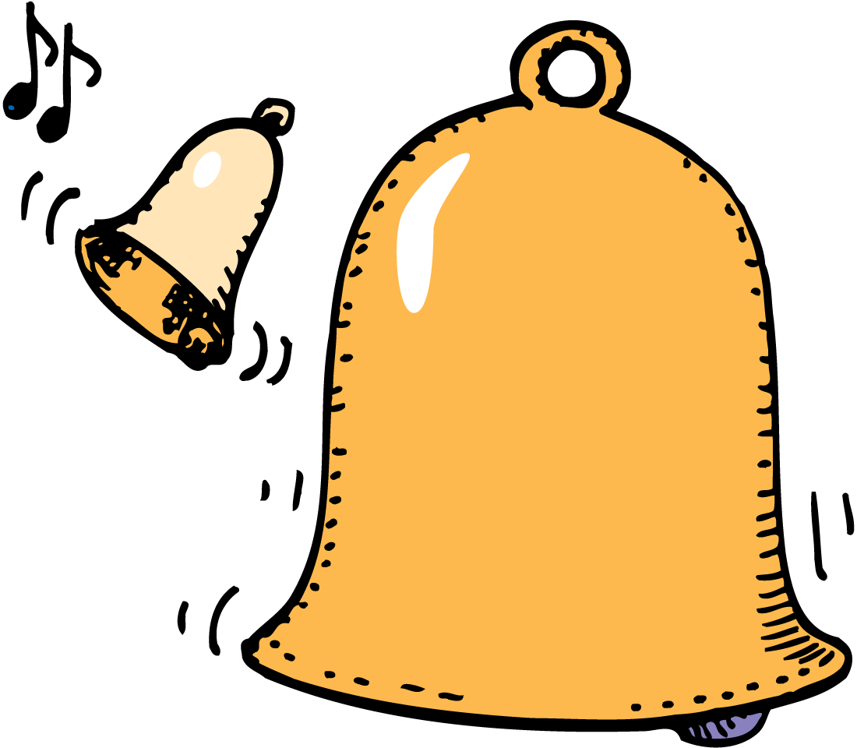
26.6 Natural Frequency
Natural frequency depends on the elasticity and shape of the object.
The natural frequency of the smaller bell is higher than that of the big bell, and it rings at a higher pitch.

Slide 46
26.6 Natural Frequency
Most things—planets, atoms, and almost everything in between—have a springiness and vibrate at one or more natural frequencies.
A natural frequency is one at which minimum energy is required to produce forced vibrations and the least amount of energy is required to continue this vibration.

Slide 47
26.6 Natural Frequency
What happens when an elastic material is disturbed?

Slide 48
26.7 Forced Vibration
Sounding boards are an important part of all stringed musical instruments because they are forced into vibration and produce the sound.

Slide 49
26.7 Forced Vibration
An unmounted tuning fork makes a faint sound.
Strike a tuning fork while holding its base on a tabletop, and the sound is relatively loud because the table is forced to vibrate.
Its larger surface sets more air in motion.
A forced vibration occurs when an object is made to vibrate by another vibrating object that is nearby.

Slide 50
26.7 Forced Vibration
The vibration of guitar strings in an acoustical guitar would be faint if they weren’t transmitted to the guitar’s wooden body.
The mechanism in a music box is mounted on a sounding board.
Without the sounding board, the sound the music box mechanism makes is barely audible.

Slide 51
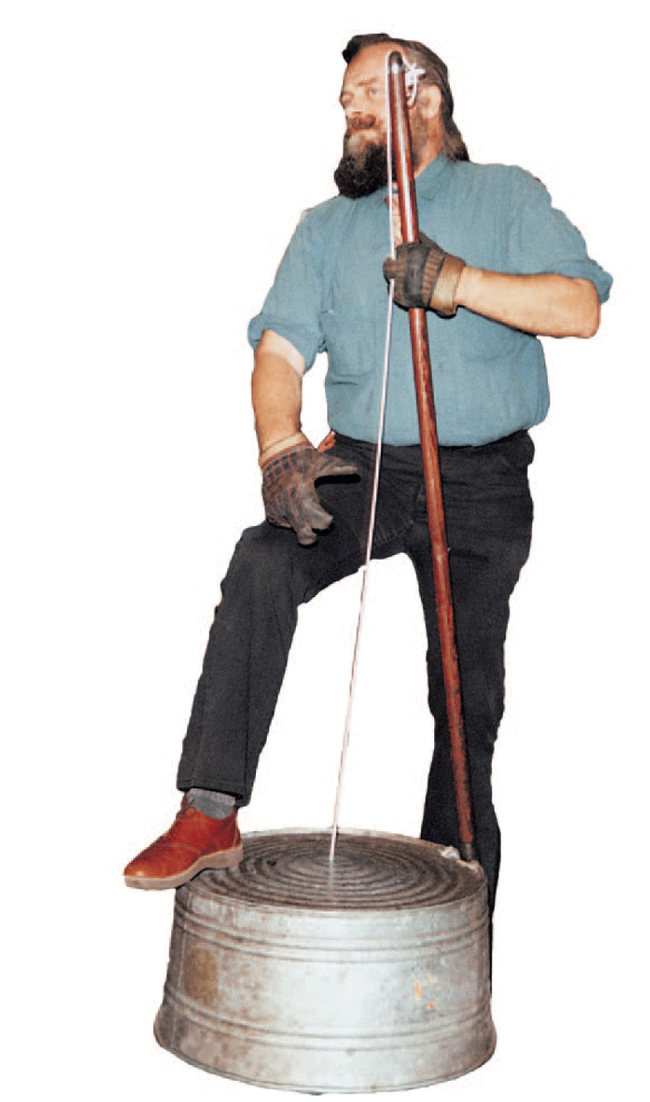
26.7 Forced Vibration
When the string is plucked, the washtub is set into forced vibration and serves as a sounding board.

Slide 52
26.7 Forced Vibration
Why are sounding boards an important part of stringed instruments?

Slide 53
26.8 Resonance
An object resonates when there is a force to pull it back to its starting position and enough energy to keep it vibrating.

Slide 54
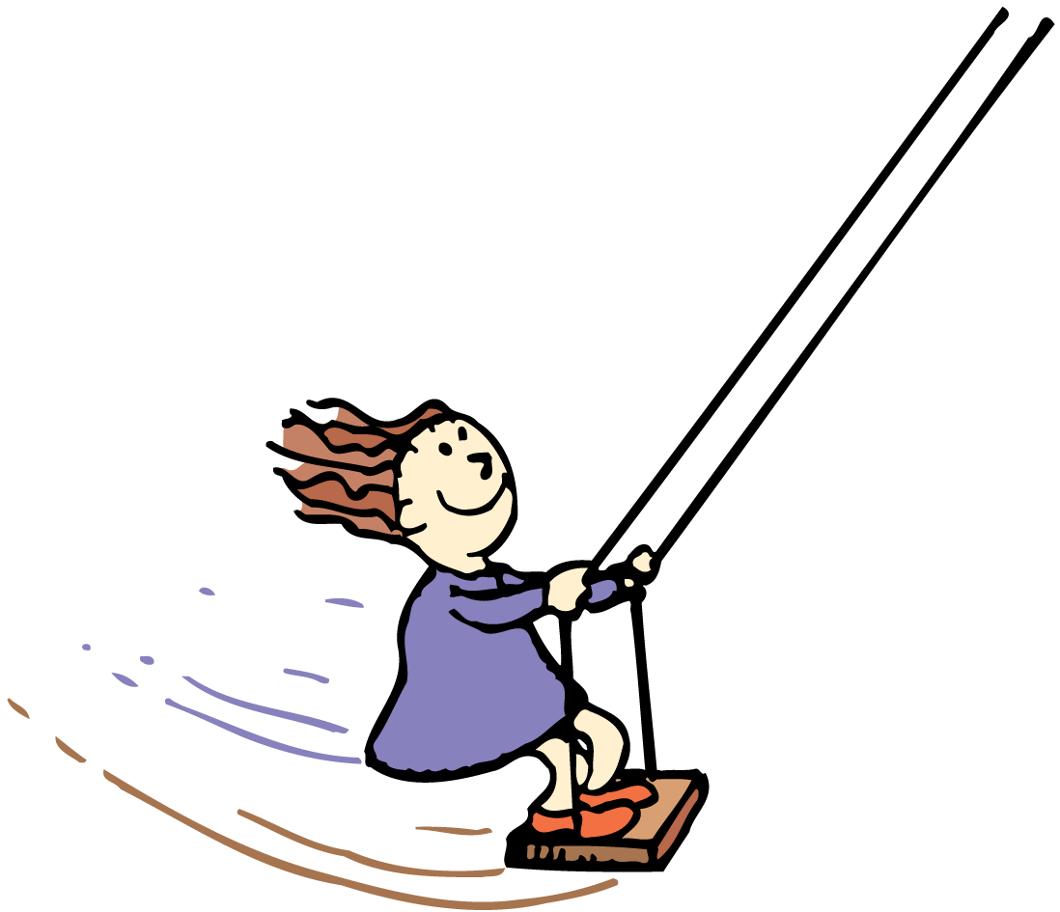
26.8 Resonance
If the frequency of a forced vibration matches an object’s natural frequency, resonance dramatically increases the amplitude.
You pump a swing in rhythm with the swing’s natural frequency.
Timing is more important than the force with which you pump.
Even small pumps or pushes in rhythm with the natural frequency of the swinging motion produce large amplitudes.

Slide 55
26.8 Resonance
If two tuning forks are adjusted to the same frequency, striking one fork sets the other fork into vibration.
Each compression of a sound wave gives the prong a tiny push.
The frequency of these pushes matches the natural frequency of the fork, so the pushes increase the amplitude of the fork’s vibration.
The pushes occur at the right time and are repeatedly in the same direction as the instantaneous motion of the fork.

Slide 56
26.8 Resonance
The first compression gives the fork a tiny push.

Slide 57
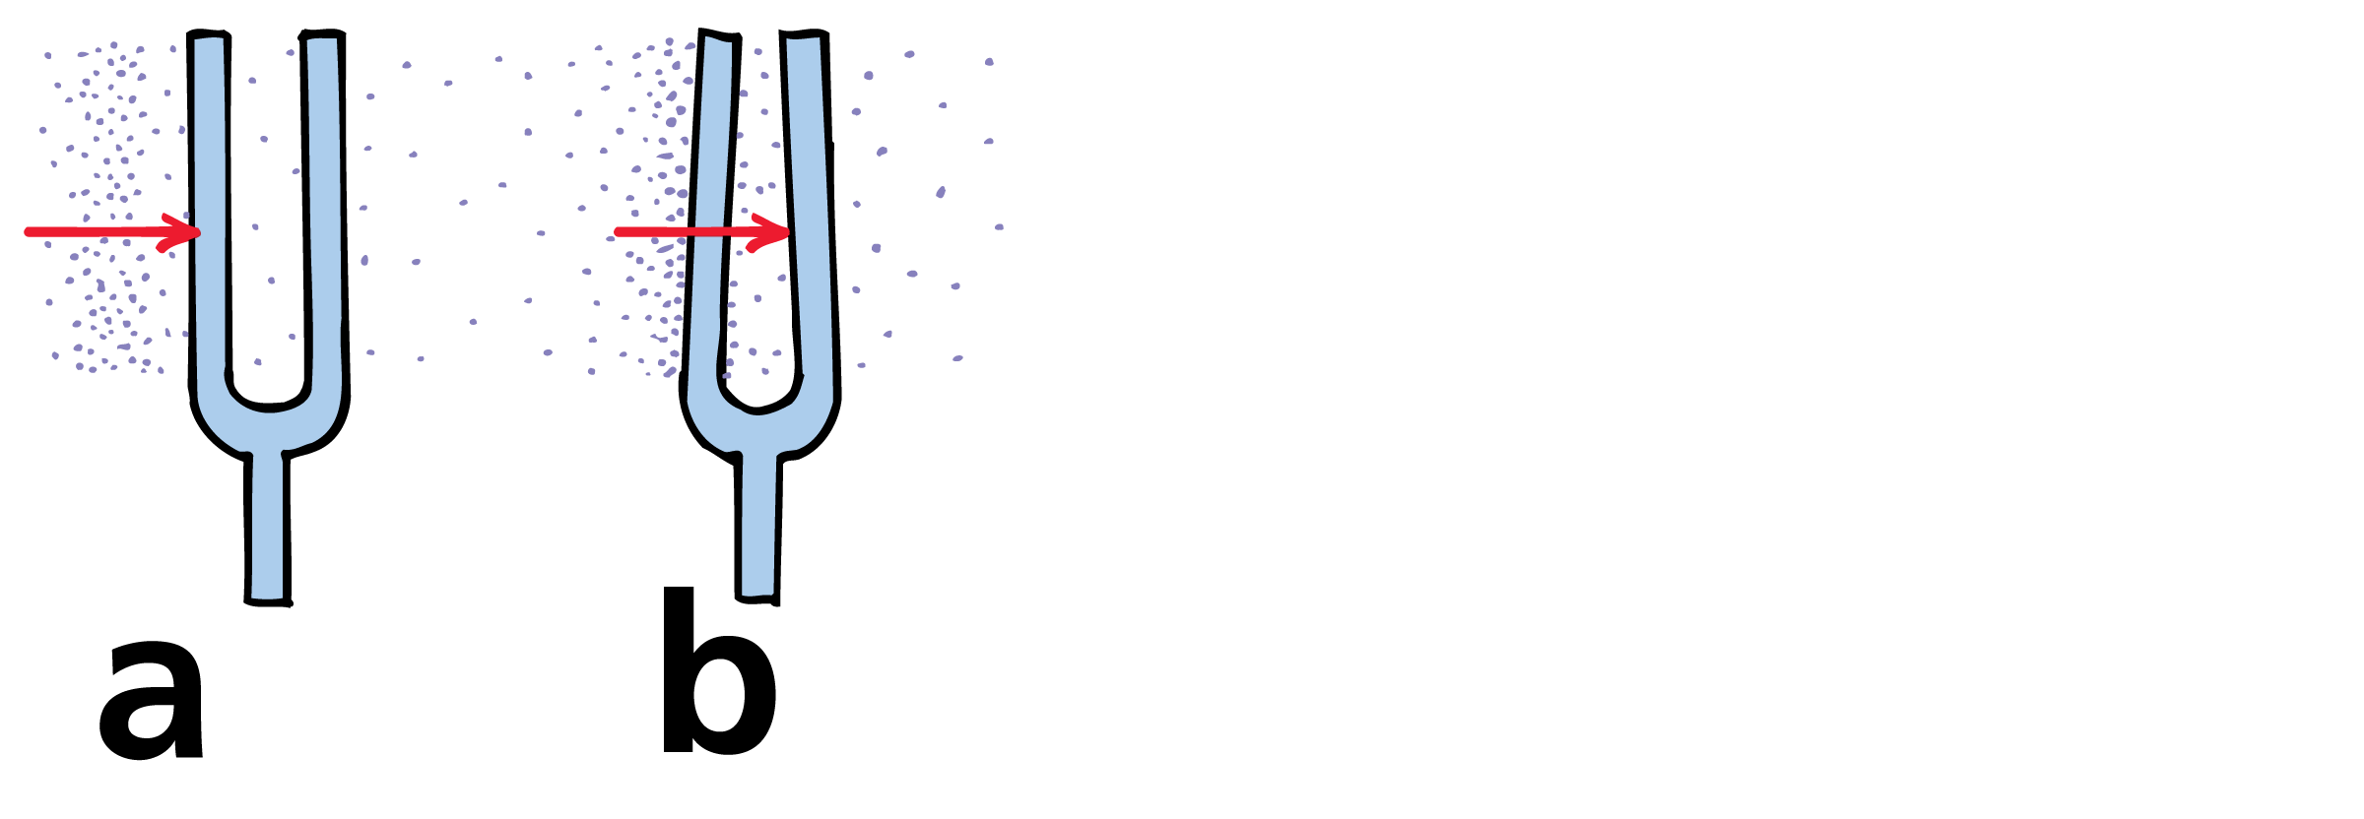
26.8 Resonance
The first compression gives the fork a tiny push.
The fork bends.

Slide 58
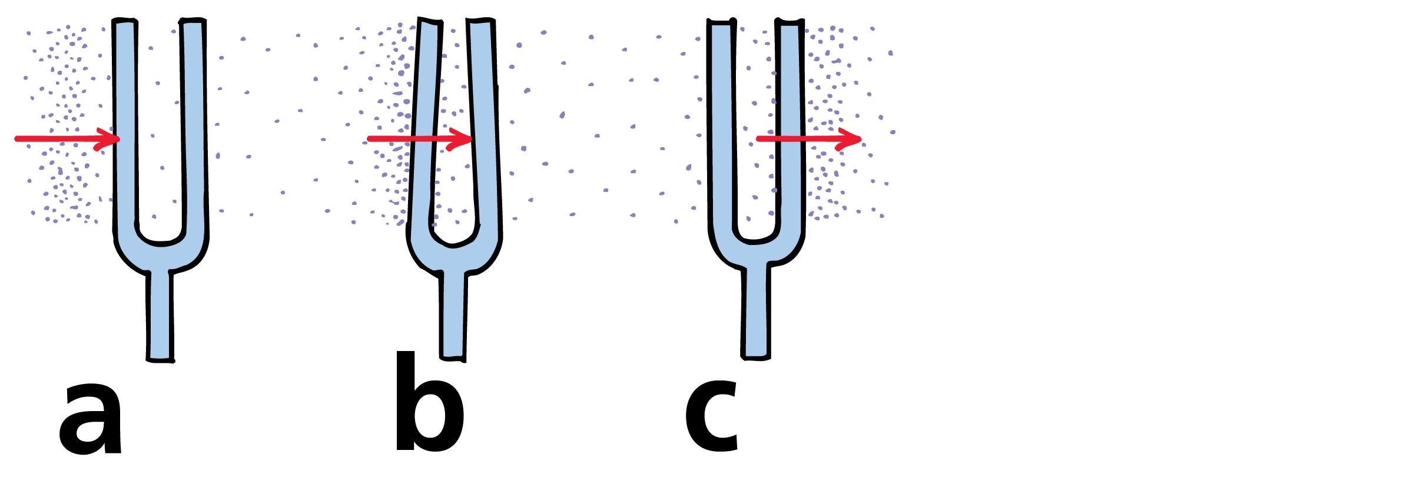
26.8 Resonance
The first compression gives the fork a tiny push.
The fork bends.
The fork returns to its initial position.

Slide 59
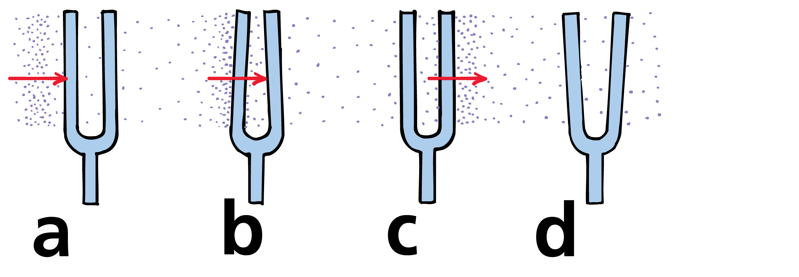
26.8 Resonance
The first compression gives the fork a tiny push.
The fork bends.
The fork returns to its initial position.
It keeps moving and overshoots in the opposite direction.

Slide 60
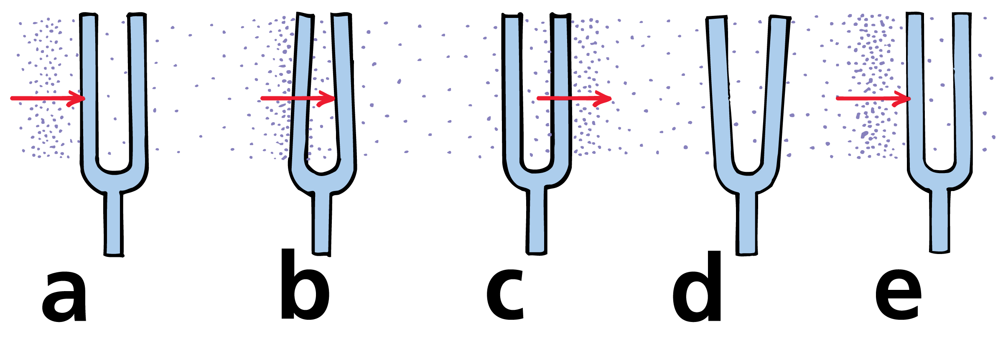
26.8 Resonance
The first compression gives the fork a tiny push.
The fork bends.
The fork returns to its initial position.
It keeps moving and overshoots in the opposite direction.
When it returns to its initial position, the next compression arrives to repeat the cycle.

Slide 61
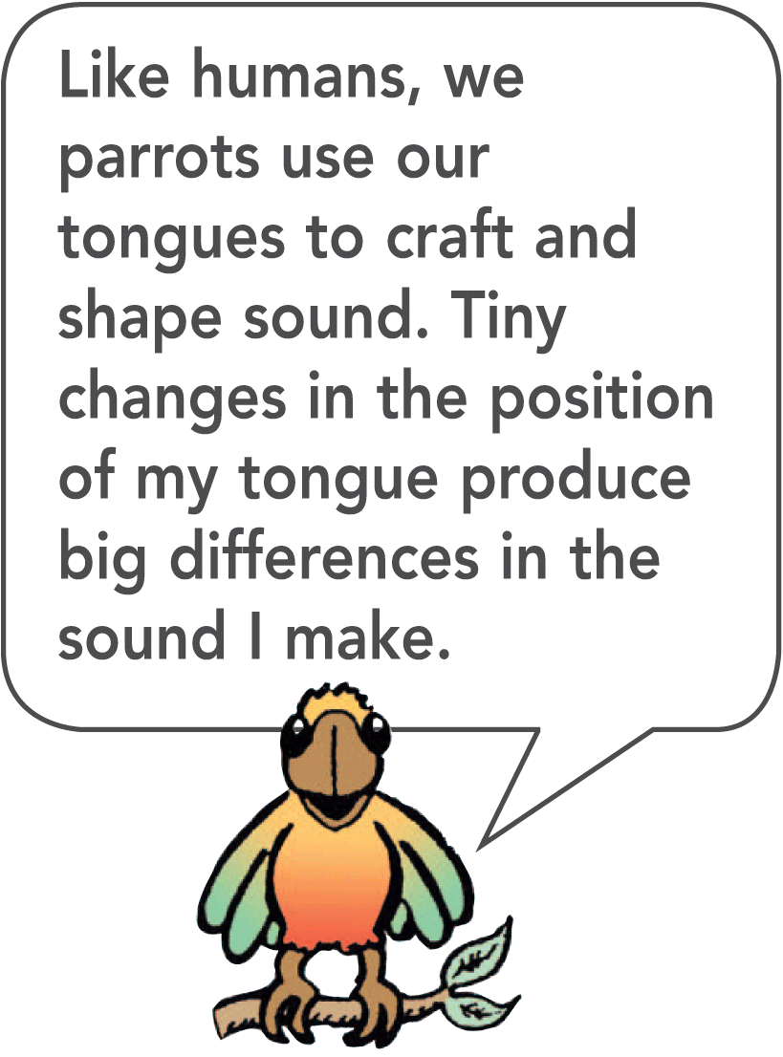
26.8 Resonance
If the forks are not adjusted for matched frequencies, the timing of pushes will be off and resonance will not occur.
When you tune a radio, you are adjusting the natural frequency of its electronics to one of the many incoming signals.
The radio then resonates to one station at a time.

Slide 62
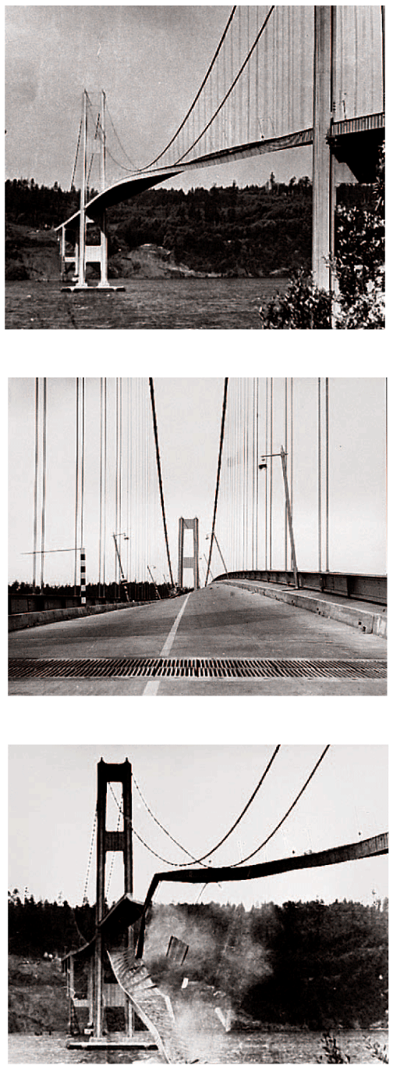
26.8 Resonance
Resonance occurs whenever successive impulses are applied to a vibrating object in rhythm with its natural frequency.
The Tacoma Narrows Bridge collapse was caused by resonance.
Wind produced a force that resonated with the natural frequency of the bridge. Amplitude increased steadily over several hours until the bridge collapsed.

Slide 63
26.8 Resonance
What causes resonance?

Slide 64
26.9 Interference
When constructive interference occurs with sound waves, the listener hears a louder sound. When destructive interference occurs, the listener hears a fainter sound or no sound at all.

Slide 65
26.9 Interference
Sound waves, like any waves, can be made to interfere.
For sound, the crest of a wave corresponds to a compression.
The trough of a wave corresponds to a rarefaction.
When the crests of one wave overlap the crests of another wave, there is constructive interference.
When the crests of one wave overlap the troughs of another wave, there is destructive interference.

Slide 66
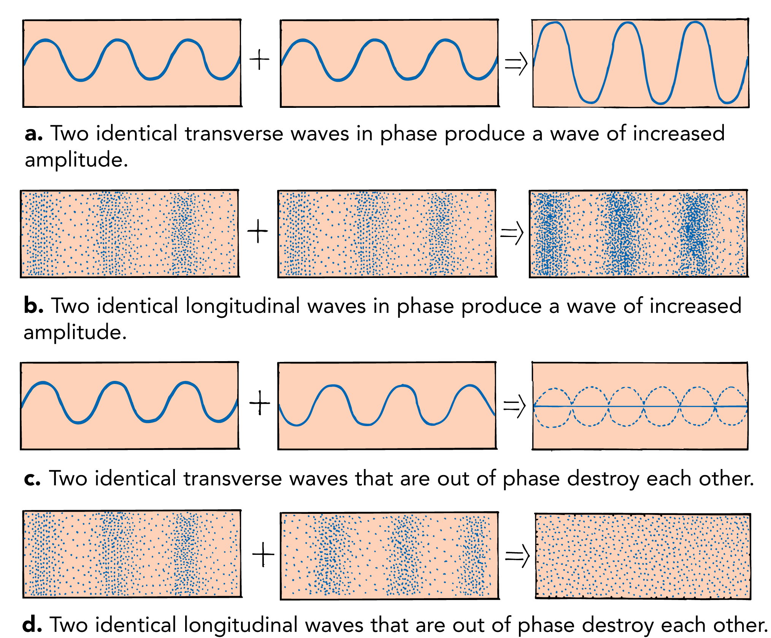
26.9 Interference
Both transverse and longitudinal waves display wave interference when they are superimposed.

Slide 67
26.9 Interference
A listener equally distant from two sound speakers that trigger identical sound waves of constant frequency hears louder sound.
The waves add because the compressions and rarefactions arrive in phase.
If the distance between the two speakers and the listener differs by a half wavelength, rarefactions from one speaker arrive at the same time as compressions from the other.
This causes destructive interference.

Slide 68
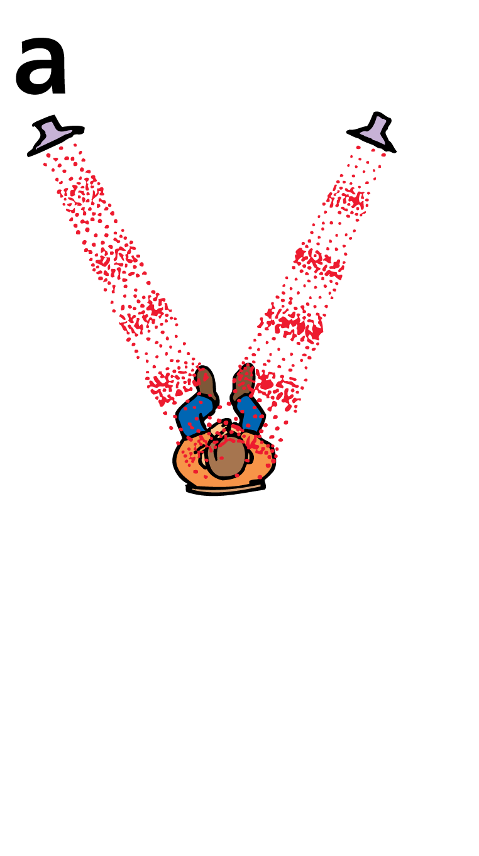
26.9 Interference
Waves arrive in phase.

Slide 69
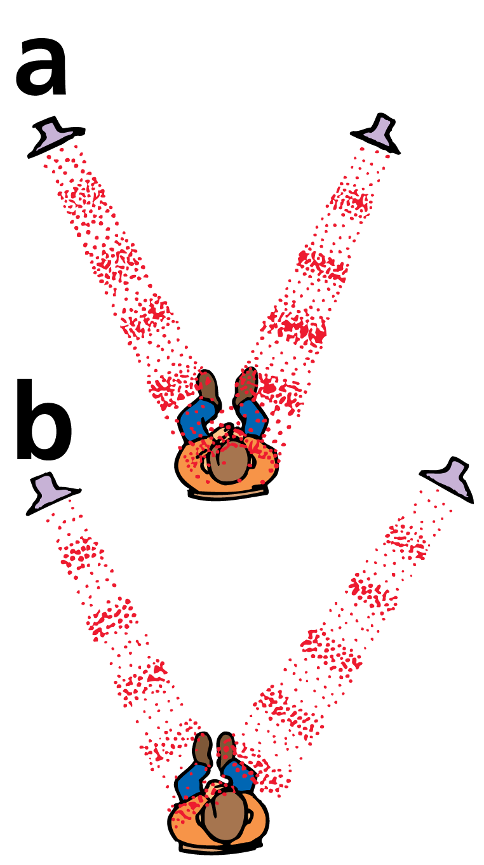
26.9 Interference
Waves arrive in phase.
Waves arrive out of phase.

Slide 70
26.9 Interference
Destructive interference of sound waves is usually not a problem.
There is usually enough reflection of sound to fill in canceled spots.
Sometimes “dead spots” occur in poorly designed theaters and gymnasiums.
Reflected sound waves interfere with unreflected waves to form zones of low amplitude.

Slide 71
26.9 Interference
Destructive sound interference is used in antinoise technology.
Noisy devices such as jackhammers have microphones that send the sound of the device to electronic microchips.
The microchips create mirror-image wave patterns that are fed to earphones worn by the operator.
Sound waves from the hammer are neutralized by mirror-image waves in the earphones.

Slide 72
26.9 Interference
In some automobiles, noise-detecting microphones inside the car pick up engine or road noise.
Speakers in the car then emit an opposite signal that cancels out those noises, so the human ear can’t detect them.
The cabins of some airplanes are now quieted with antinoise technology.

Slide 73
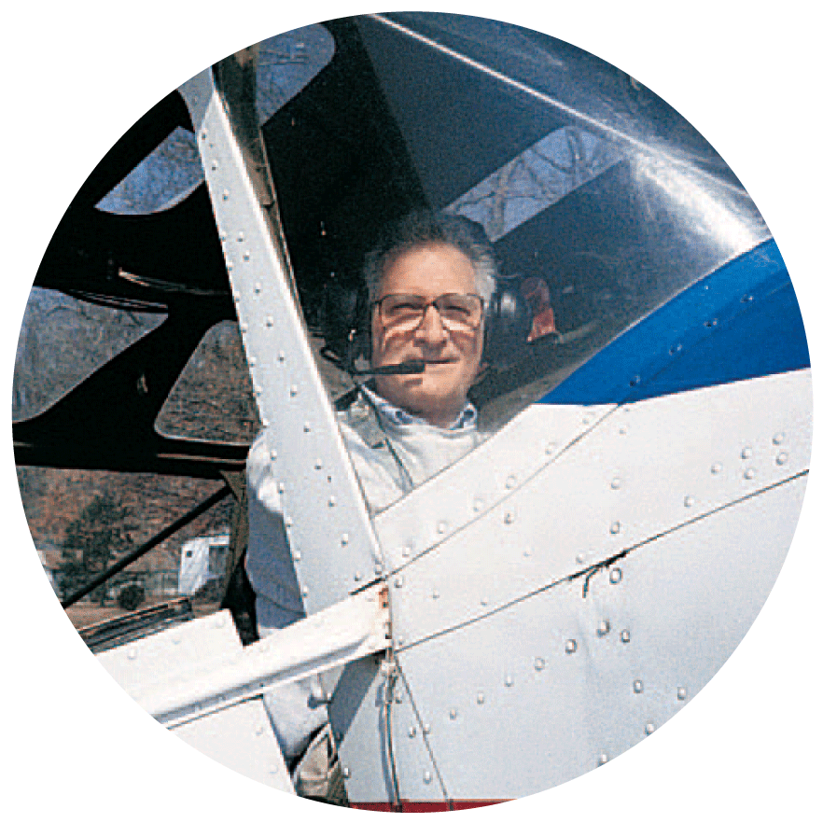
26.9 Interference
Ken Ford tows gliders in quiet comfort when he wears his noise-canceling earphones.

Slide 74
26.9 Interference
What are the effects of constructive and destructive interference?

Slide 75
26.10 Beats
When two tones of slightly different frequency are sounded together, a regular fluctuation in the loudness of the combined sounds is heard.

Slide 76
26.10 Beats
When two tones of slightly different frequency are sounded together the sound is loud, then faint, then loud, then faint, and so on.
This periodic variation in the loudness of sound is called beats.
Beats can be heard when two slightly mismatched tuning forks are sounded together.

Slide 77
26.10 Beats
The vibrations of the forks will be momentarily in step, then out of step, then in again, and so on.
When the combined waves reach your ears in step, the sound is a maximum.
When the forks are out of step, a compression from one fork is met with a rarefaction from the other, resulting in a minimum.
The sound that reaches your ears throbs between maximum and minimum loudness and produces a tremolo effect.

Slide 78
26.10 Beats
Walk with someone who has a different stride, and at times you are both in step, at other times you are both out of step.
In general, the number of times you are in step in each unit of time is equal to the difference in the frequencies of your steps.

Slide 79
26.10 Beats
This applies also to a pair of tuning forks.
When one fork vibrates 264 times per second, and the other fork vibrates 262 times per second, they are in step twice each second.
A beat frequency of 2 hertz is heard.

Slide 80
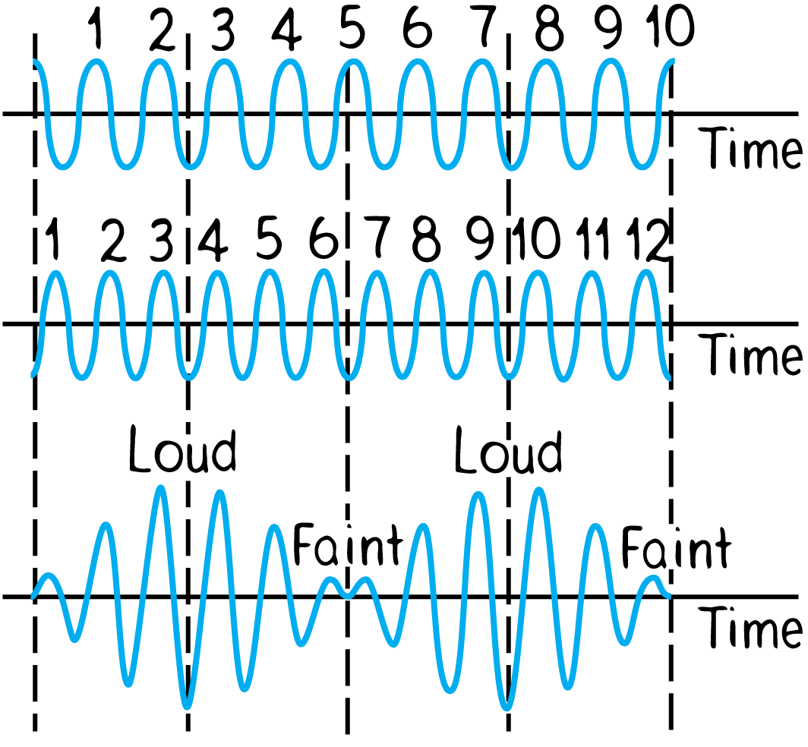
26.10 Beats
Representations of a 10-Hz sound wave and a 12-Hz sound wave during a 1-second time interval. The two waves overlap to produce a composite wave with a beat frequency of 2 Hz.

Slide 81
26.10 Beats
Although the separate waves are of constant amplitude, we see amplitude variations in a superposed wave form.
This variation is produced by the interference of the two superposed waves.
Maximum amplitude of the composite wave occurs when both waves are in phase.
Minimum amplitude occurs when both waves are completely out of phase.

Slide 82
26.10 Beats
If you overlap two combs of different teeth spacings, you’ll see a moiré pattern that is related to beats. The number of beats per length will equal the difference in the number of teeth per length for the two combs.

Slide 83
26.10 Beats
Beats can occur with any kind of wave and are a practical way to compare frequencies.
To tune a piano, a piano tuner listens for beats produced between a standard tuning fork and a particular string on the piano.
When the frequencies are identical, the beats disappear.
The members of an orchestra tune up by listening for beats between their instruments and a standard tone.

Slide 84
26.10 Beats
think!
What is the beat frequency when a 262-Hz and a 266-Hz tuning fork are sounded together? A 262-Hz and a 272-Hz?

Slide 85
26.10 Beats
think!
What is the beat frequency when a 262-Hz and a 266-Hz tuning fork are sounded together? A 262-Hz and a 272-Hz?
Answer:
The 262-Hz and 266-Hz forks will produce 4 beats per second, that is, 4 Hz (266 Hz minus 262 Hz). The 262-Hz and 272-Hz forks will sound like a tone at 267 Hz beating 10 times per second, or 10 Hz.

Slide 86
26.10 Beats
What causes beats?

Slide 87
Assessment Questions
The sound waves that humans cannot hear are those with frequencies
from 20 to 20,000 Hz.
below 20 Hz.
above 20,000 Hz.
both B and C

Slide 88
Assessment Questions
The sound waves that humans cannot hear are those with frequencies
from 20 to 20,000 Hz.
below 20 Hz.
above 20,000 Hz.
both B and C
Answer: D

Slide 89
Assessment Questions
Sound travels in air by a series of
compressions.
rarefactions.
both compressions and rarefactions.
pitches.

Slide 90
Assessment Questions
Sound travels in air by a series of
compressions.
rarefactions.
both compressions and rarefactions.
pitches.
Answer: C

Slide 91
Assessment Questions
Sound travels faster in
a vacuum compared to liquids.
gases compared to liquids.
gases compared to solids.
solids compared to gases.

Slide 92
Assessment Questions
Sound travels faster in
a vacuum compared to liquids.
gases compared to liquids.
gases compared to solids.
solids compared to gases.
Answer: D

Slide 93
Assessment Questions
The speed of sound varies with
amplitude.
frequency.
temperature.
pitch.

Slide 94
Assessment Questions
The speed of sound varies with
amplitude.
frequency.
temperature.
pitch.
Answer: C

Slide 95
Assessment Questions
The loudness of a sound is most closely related to its
frequency.
period.
wavelength.
intensity.

Slide 96
Assessment Questions
The loudness of a sound is most closely related to its
frequency.
period.
wavelength.
intensity.
Answer: D

Slide 97
Assessment Questions
When you tap various objects they produce characteristic sounds that are related to
wavelength.
amplitude.
period.
natural frequency.

Slide 98
Assessment Questions
When you tap various objects they produce characteristic sounds that are related to
wavelength.
amplitude.
period.
natural frequency.
Answer: D

Slide 99
Assessment Questions
When the surface of a guitar is made to vibrate we say it undergoes
forced vibration.
resonance.
refraction.
amplitude reduction.

Slide 100
Assessment Questions
When the surface of a guitar is made to vibrate we say it undergoes
forced vibration.
resonance.
refraction.
amplitude reduction.
Answer: A

Slide 101
Assessment Questions
When an object is set into vibration by a wave having a frequency that matches the natural frequency of the object, what occurs is
forced vibration.
resonance.
refraction.
amplitude reduction.

Slide 102
Assessment Questions
When an object is set into vibration by a wave having a frequency that matches the natural frequency of the object, what occurs is
forced vibration.
resonance.
refraction.
amplitude reduction.
Answer: B

Slide 103
Assessment Questions
Noise-canceling devices such as jackhammer earphones make use of sound
destruction.
interference.
resonance.
amplification.

Slide 104
Assessment Questions
Noise-canceling devices such as jackhammer earphones make use of sound
destruction.
interference.
resonance.
amplification.
Answer: B

Slide 105
Assessment Questions
The phenomenon of beats is the result of sound
destruction.
interference.
resonance.
amplification.

Slide 106
Assessment Questions
The phenomenon of beats is the result of sound
destruction.
interference.
resonance.
amplification.
Answer: B

