Slide 1
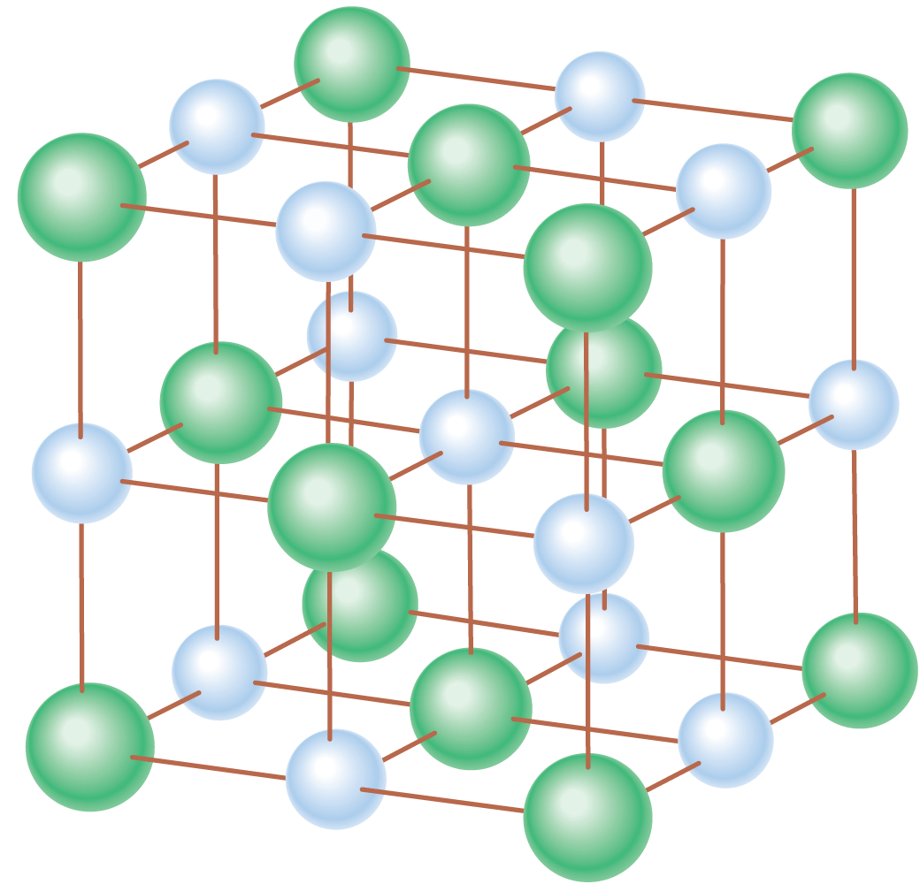
Solids can be described in terms of crystal structure, density, and elasticity.

Slide 2
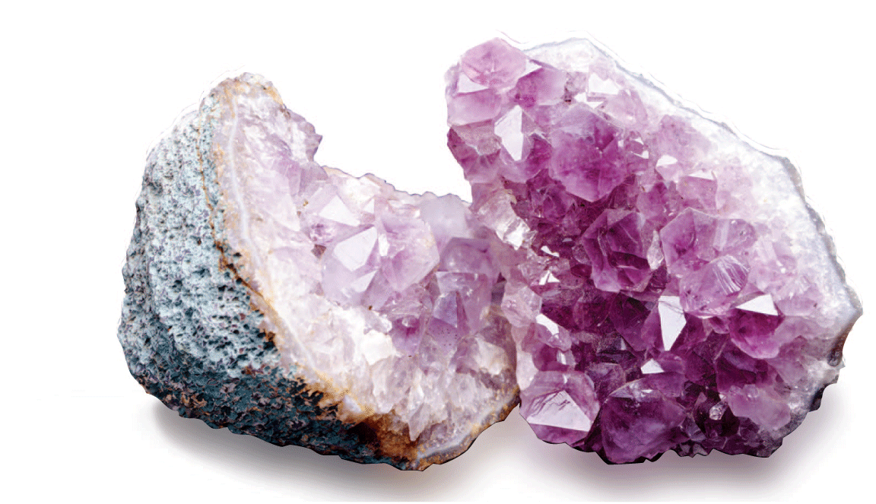
Humans have been classifying and using solid materials for many thousands of years. Not until recent times has the discovery of atoms and their interactions made it possible to understand the structure of materials. We have progressed from being finders and assemblers of materials to actual makers of materials.

Slide 3
18.1 Crystal Structure
The shape of a crystal mirrors the geometric arrangement of atoms within the crystal.

Slide 4
18.1 Crystal Structure
Minerals such as quartz, mica, or galena have many smooth, flat surfaces at angles to one another.
The minerals are made of crystals, or regular geometric shapes whose components are arranged in an orderly, repeating pattern.
The mineral samples themselves may have very irregular shapes, as if they were small units stuck together.

Slide 5
18.1 Crystal Structure
Not all crystals are evident to the naked eye.
Their existence in many solids was not discovered until X-rays became a tool of research early in the twentieth century.

Slide 6
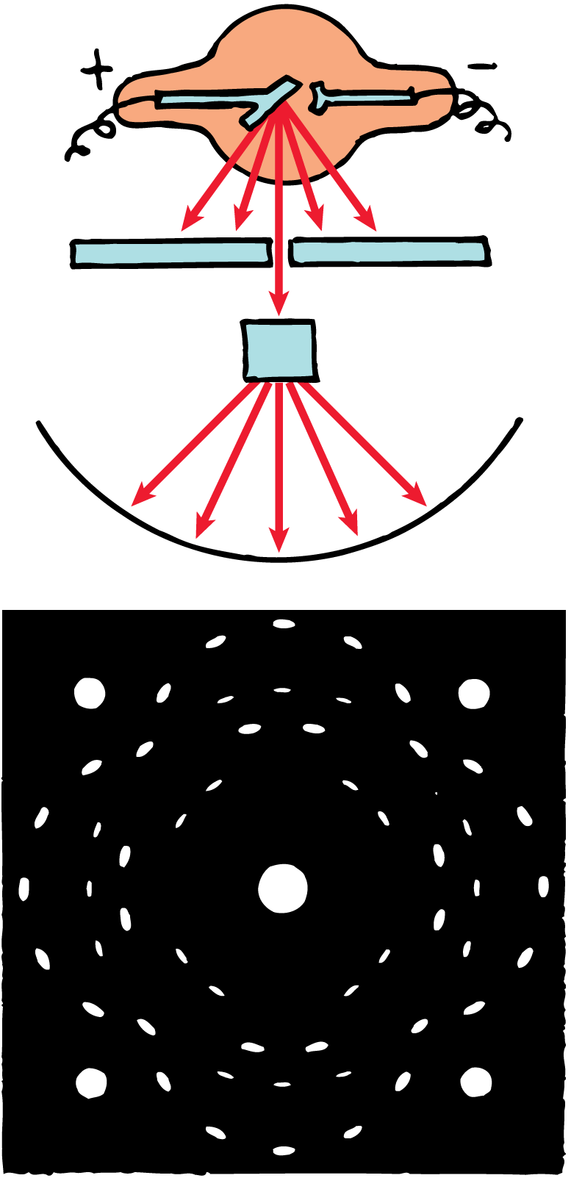
18.1 Crystal Structure
When X-rays pass through a crystal of common table salt (sodium chloride), they produce a distinctive pattern on photographic film.

Slide 7
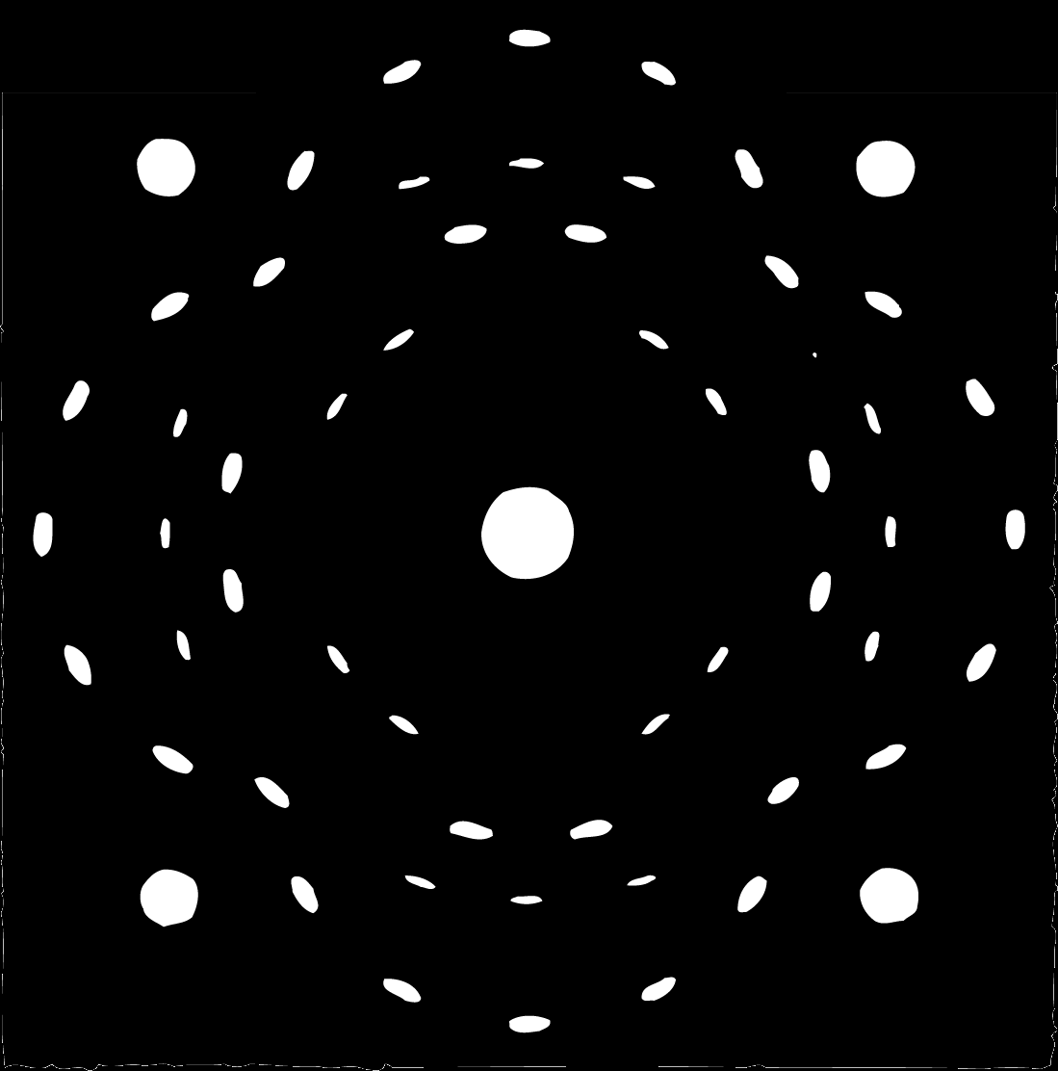
18.1 Crystal Structure
The radiation that penetrates the crystal produces the pattern shown on the photographic film beyond the crystal.
The white spot in the center is caused by the main unscattered beam of X-rays.
The size and arrangement of the other spots indicate the arrangement of sodium and chlorine atoms in the crystal.
All crystals of sodium chloride produce this same design.

Slide 8
18.1 Crystal Structure
The patterns made by X-rays on photographic film show that the atoms in a crystal have an orderly arrangement.
Every crystalline structure has its own unique X-ray pattern.

Slide 9
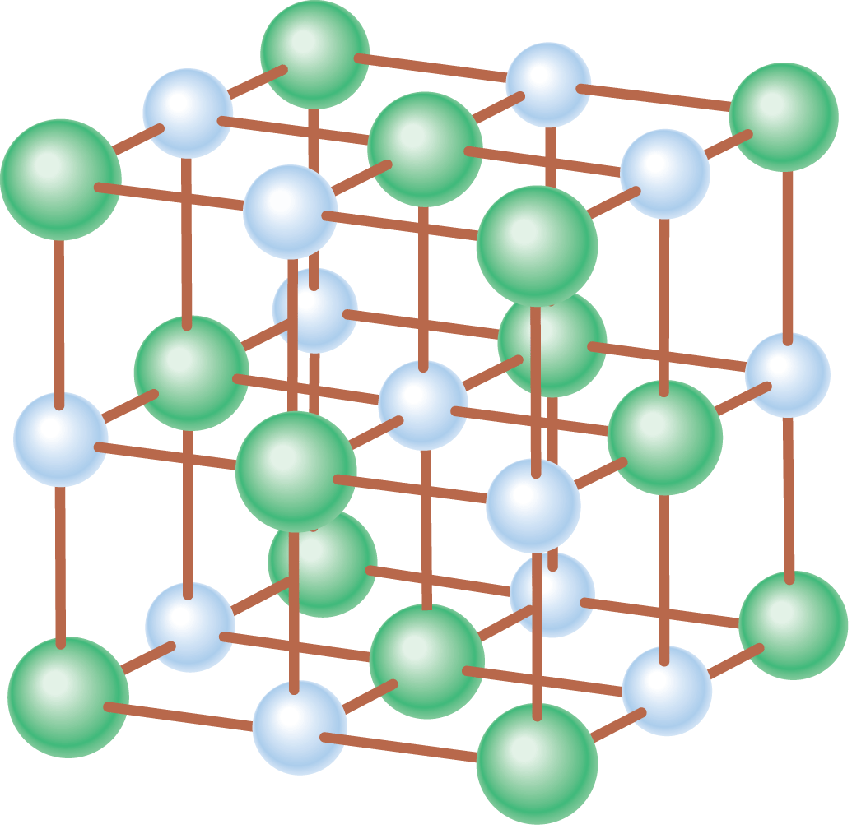
18.1 Crystal Structure
In this model of a sodium chloride crystal, the large spheres represent chloride ions, and the small ones represent sodium ions.

Slide 10
18.1 Crystal Structure
Metals such as iron, copper, and gold have relatively simple crystal structures.
Tin and cobalt are only slightly more complex.
You can see metal crystals if you look carefully at a metal surface that has been cleaned (etched) with acid.
You can also see them on the surface of galvanized iron that has been exposed to the weather.

Slide 11
18.1 Crystal Structure
What determines the shape of a crystal?

Slide 12
18.2 Density
The density of a material depends upon the masses of the individual atoms that make it up, and the spacing between those atoms.

Slide 13
18.2 Density
One of the properties of solids, as well as liquids and even gases, is the measure of how tightly the material is packed together.
Density is a measure of how much matter occupies a given space; it is the amount of mass per unit volume:

Slide 14
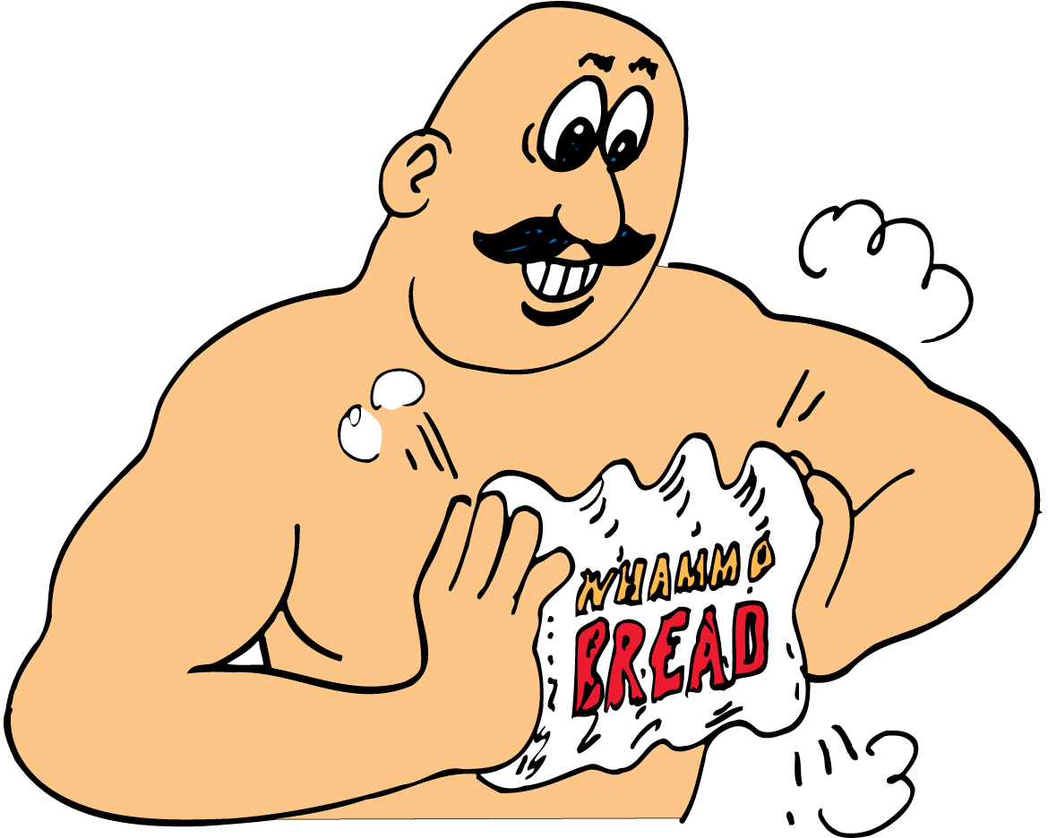
18.2 Density
When the loaf of bread is squeezed, its volume decreases and its density increases.

Slide 15
18.2 Density
Density is a property of a material; it doesn’t matter how much you have.
A pure iron nail has the same density as a pure iron frying pan.
The pan may have 100 times as many iron atoms and 100 times as much mass, so it will take up 100 times as much space.
The mass per unit volume for the iron nail and the iron frying pan is the same.

Slide 16
18.2 Density
Iridium is the densest substance on Earth.
Individual iridium atoms are less massive than atoms of gold, mercury, lead, or uranium, but the close spacing of iridium atoms in an iridium crystal gives it the greatest density.
A cubic centimeter of iridium contains more atoms than a cubic centimeter of gold or uranium.

Slide 17
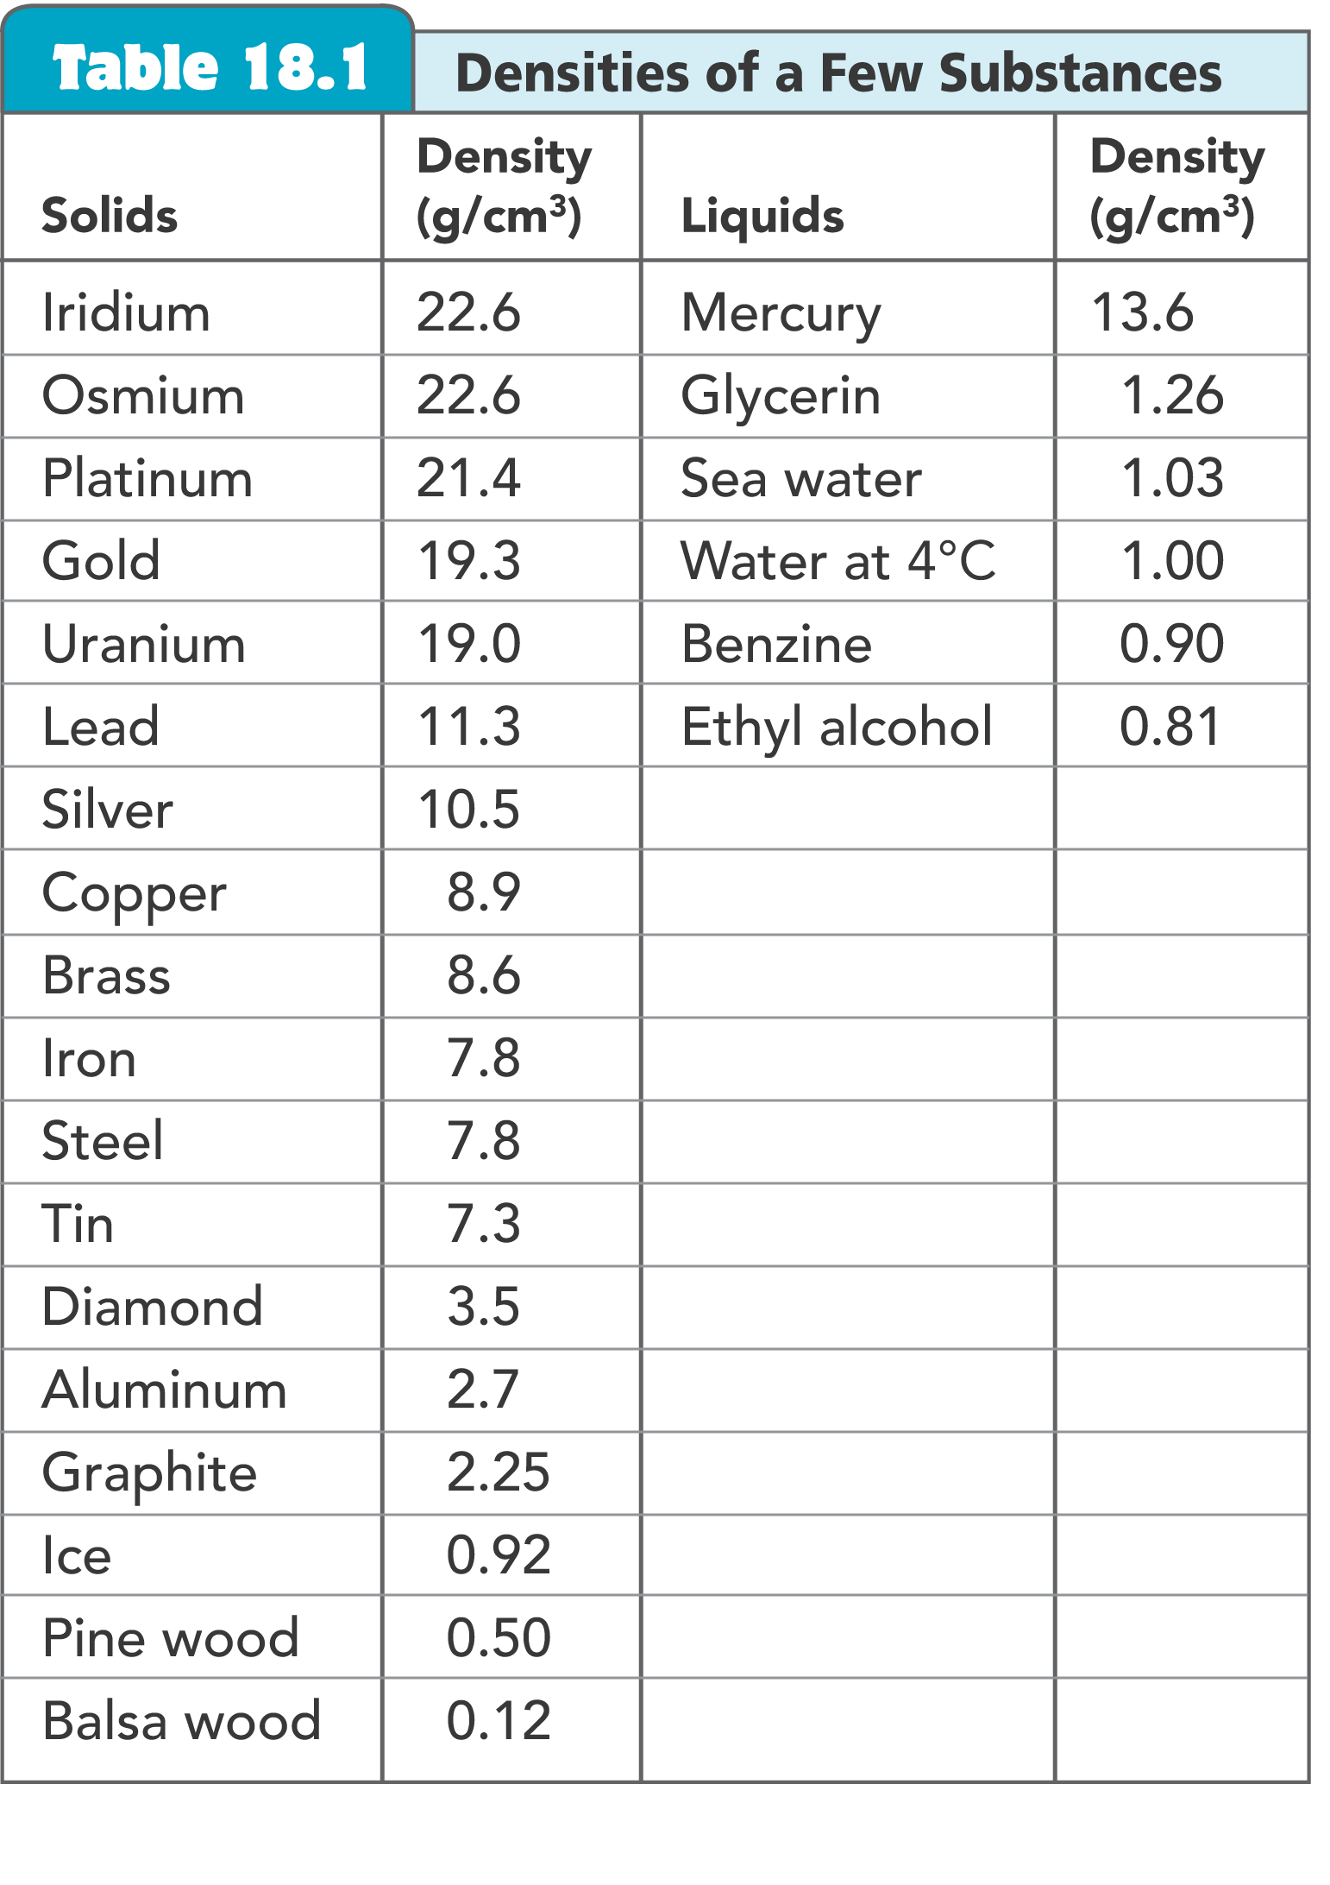
18.2 Density

Slide 18
18.2 Density
Density varies somewhat with temperature and pressure, so, except for water, densities are given at 0°C and atmospheric pressure.
Water at 4°C has a density of 1.00 g/cm³.
The gram was originally defined as the mass of a cubic centimeter of water at a temperature of 4°C.
A gold brick, with a density of 19.3 g/cm³, is 19.3 times more massive than an equal volume of water.

Slide 19
18.2 Density
A quantity known as weight density can be expressed by the amount of weight a body has per unit volume:
Weight density is commonly used when discussing liquid pressure.

Slide 20
18.2 Density
A standard measure of density is specific gravity—the ratio of the mass of a substance to the mass of an equal volume of water.
A substance that weighs five times as much as an equal volume of water has a specific gravity of 5.
Specific gravity is a ratio of the density of a material to the density of water.
Specific gravity has no units.

Slide 21
18.2 Density
think!
Which has greater density—1 kg of water or 10 kg of water? 5 kg of lead or 10 kg of aluminum?

Slide 22
18.2 Density
think!
Which has greater density—1 kg of water or 10 kg of water? 5 kg of lead or 10 kg of aluminum?
Answer:
The density of any amount of water (at 4°C) is 1.00 g/cm³. Any amount of lead always has a greater density than any amount of aluminum.

Slide 23
18.2 Density
think!
The density of gold is 19.3 g/cm³. What is its specific gravity?

Slide 24
18.2 Density
think!
The density of gold is 19.3 g/cm³. What is its specific gravity?
Answer:

Slide 25
18.2 Density
What determines the density of a material?

Slide 26
18.3 Elasticity
A body’s elasticity describes how much it changes shape when a deforming force acts on it, and how well it returns to its original shape when the deforming force is removed.

Slide 27
18.3 Elasticity
Hang a weight on a spring and the spring stretches. Add additional weights and the spring stretches still more.
Remove the weights and the spring returns to its original length.
A material that returns to its original shape after it has been stretched or compressed is said to be elastic.

Slide 28
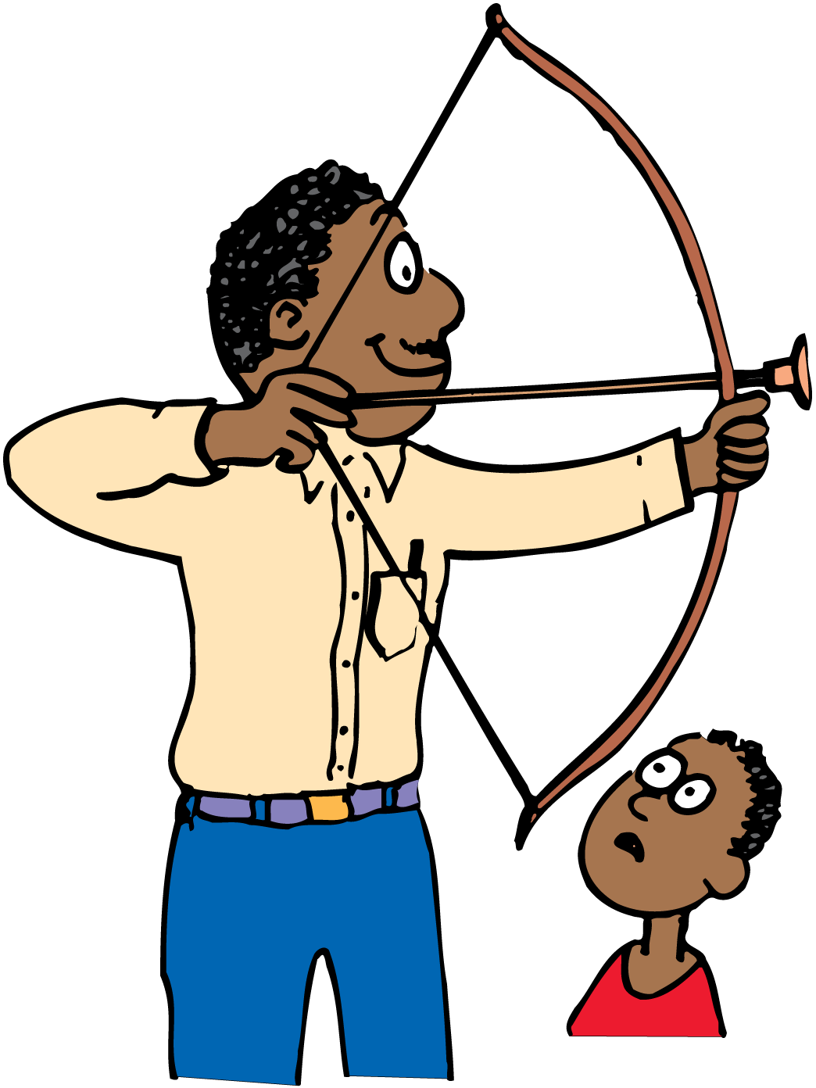
18.3 Elasticity
When a bat hits a baseball, it temporarily changes the ball’s shape.
When an archer shoots an arrow, he first bends the bow, which springs back to its original form when the arrow is released.
The spring, the baseball, and the bow are elastic objects.

Slide 29
18.3 Elasticity
Not all materials return to their original shape when a deforming force is applied and then removed.
Materials that do not resume their original shape after being distorted are said to be inelastic.
Clay, putty, and dough are inelastic materials. Lead is also inelastic, since it is easy to distort it permanently.

Slide 30
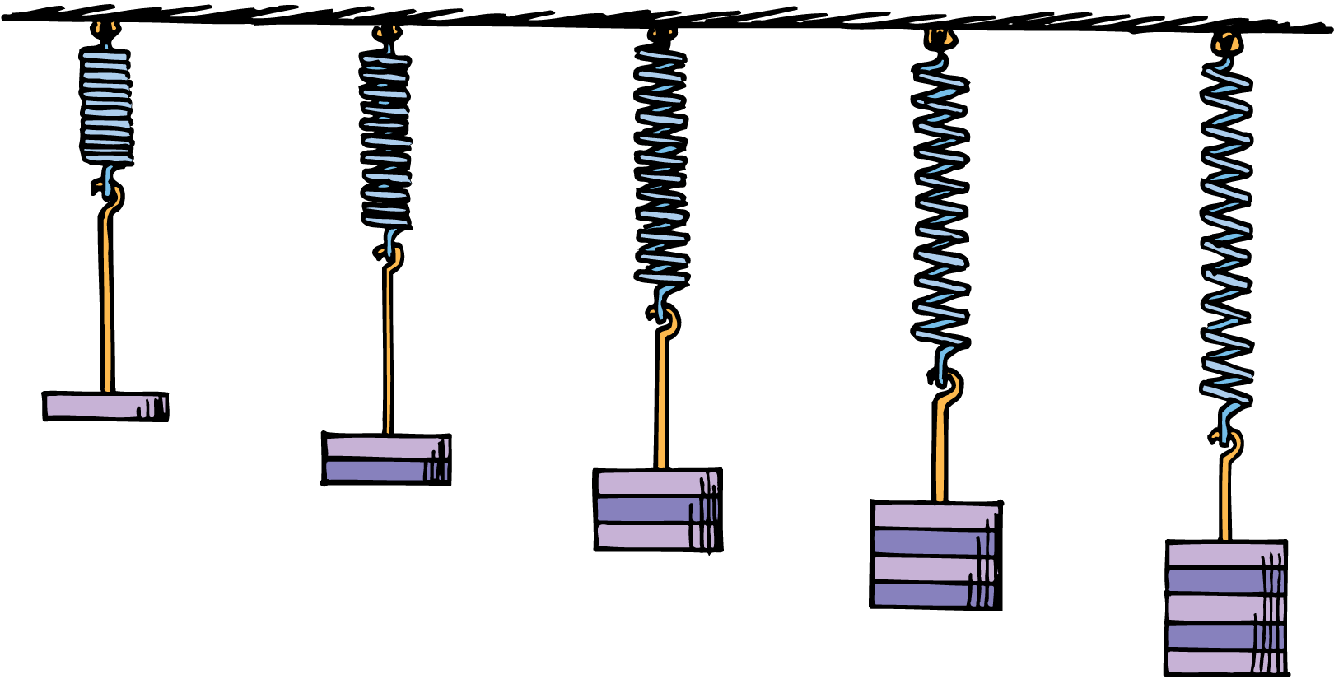
18.3 Elasticity
When you hang a weight on a spring, the weight applies a force to the spring and it stretches in direct proportion to the applied force.
According to Hooke’s law, the amount of stretch (or compression), x, is directly proportional to the applied force F.
Double the force and you double the stretch; triple the force and you get three times the stretch, and so on: F ~ ∆x

Slide 31
18.3 Elasticity
If an elastic material is stretched or compressed more than a certain amount, it will not return to its original state.
The distance at which permanent distortion occurs is called the elastic limit.
Hooke’s law holds only as long as the force does not stretch or compress the material beyond its elastic limit.

Slide 32
18.3 Elasticity
think!
A tree branch is found to obey Hooke’s law. When a 20-kg load is hung from the end of it, the branch sags 10 cm. If a 40-kg load is hung from the same place, how much will the branch sag? What would you find if a 60-kg load were hung from the same place? (Assume none of these loads makes the branch sag beyond its elastic limit.)

Slide 33
18.3 Elasticity
think!
A tree branch is found to obey Hooke’s law. When a 20-kg load is hung from the end of it, the branch sags 10 cm. If a 40-kg load is hung from the same place, how much will the branch sag? What would you find if a 60-kg load were hung from the same place? (Assume none of these loads makes the branch sag beyond its elastic limit.)
Answer:
A 40-kg load has twice the weight of a 20-kg load. In accord with Hooke’s law, F ~∆x, the branch should sag 20 cm. The weight of the 60-kg load will make the branch sag 30 cm.

Slide 34
18.3 Elasticity
think!
If a force of 10 N stretches a certain spring 4 cm, how much stretch will occur for an applied force of 15 N?

Slide 35
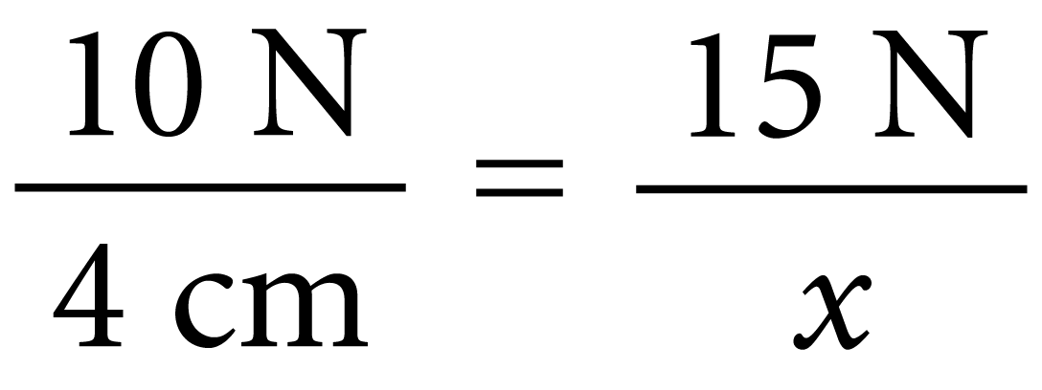
18.3 Elasticity
think!
If a force of 10 N stretches a certain spring 4 cm, how much stretch will occur for an applied force of 15 N?
Answer:
The spring will stretch 6 cm. By ratio and proportion:
Then x = (15 N) × (4 cm)/(10 N) = 6 cm.

Slide 36
18.3 Elasticity
What characteristics are described by an object’s elasticity?

Slide 37
18.4 Compression and Tension
A horizontal beam supported at one or both ends is under stress from the load it supports, including its own weight. It undergoes a stress of both compression and tension (stretching).

Slide 38
18.4 Compression and Tension
Steel is an excellent elastic material. It can be stretched and it can be compressed.
Because of its strength and elastic properties, steel is used to make not only springs but also construction girders.
Vertical steel girders undergo only slight compression.
A 25-meter-long vertical girder is compressed about a millimeter when it carries a 10-ton load.

Slide 39
18.4 Compression and Tension
Most deformation occurs when girders are used horizontally, where the tendency is to sag under heavy loads.
The girder sags because of its own weight and because of the load it carries at its end.

Slide 40
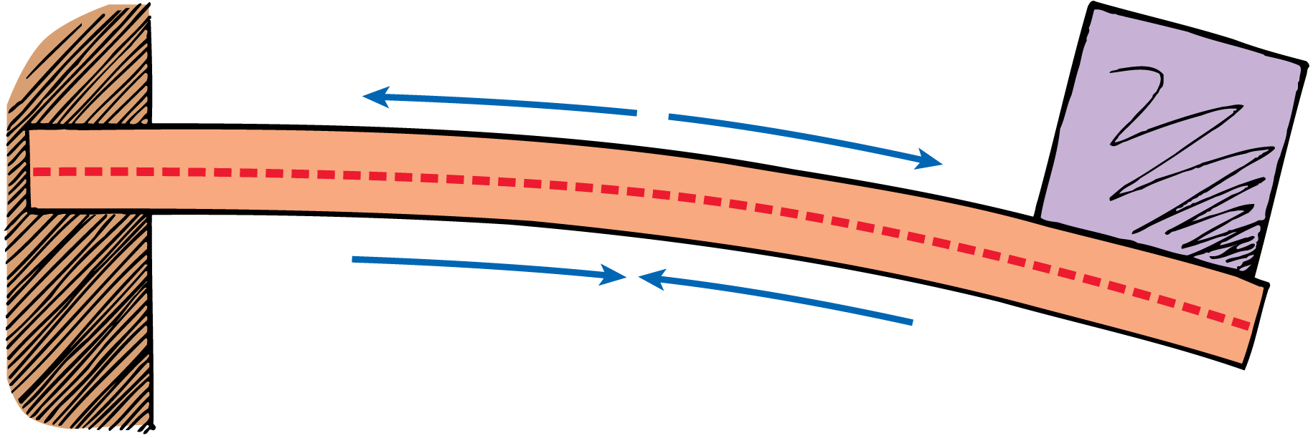
18.4 Compression and Tension
The top part of the beam is stretched and the bottom part is compressed. The middle portion is neither stretched nor compressed. (Note that a beam in this position is known as a cantilever beam.)

Slide 41
18.4 Compression and Tension
Neutral Layer
The top part of the horizontal beam is stretched. Atoms are tugged away from one another and the top part is slightly longer.
The bottom part of the beam is compressed. Atoms there are pushed toward one another, so the bottom part is slightly shorter.
Between the top and bottom, there is a region that is neither stretched nor compressed. This is the neutral layer.

Slide 42
18.4 Compression and Tension
Consider a beam that is supported at both ends, and carries a load in the middle.
The top of the beam is in compression and the bottom is in tension.
Again, there is a neutral layer along the middle portion of the length of the beam.

Slide 43
18.4 Compression and Tension
I-Beams
The cross section of many steel girders has the form of the capital letter I.
Most of the material in these I-beams is concentrated in the top and bottom parts, called the flanges.
The piece joining the bars, called the web, is thinner.

Slide 44
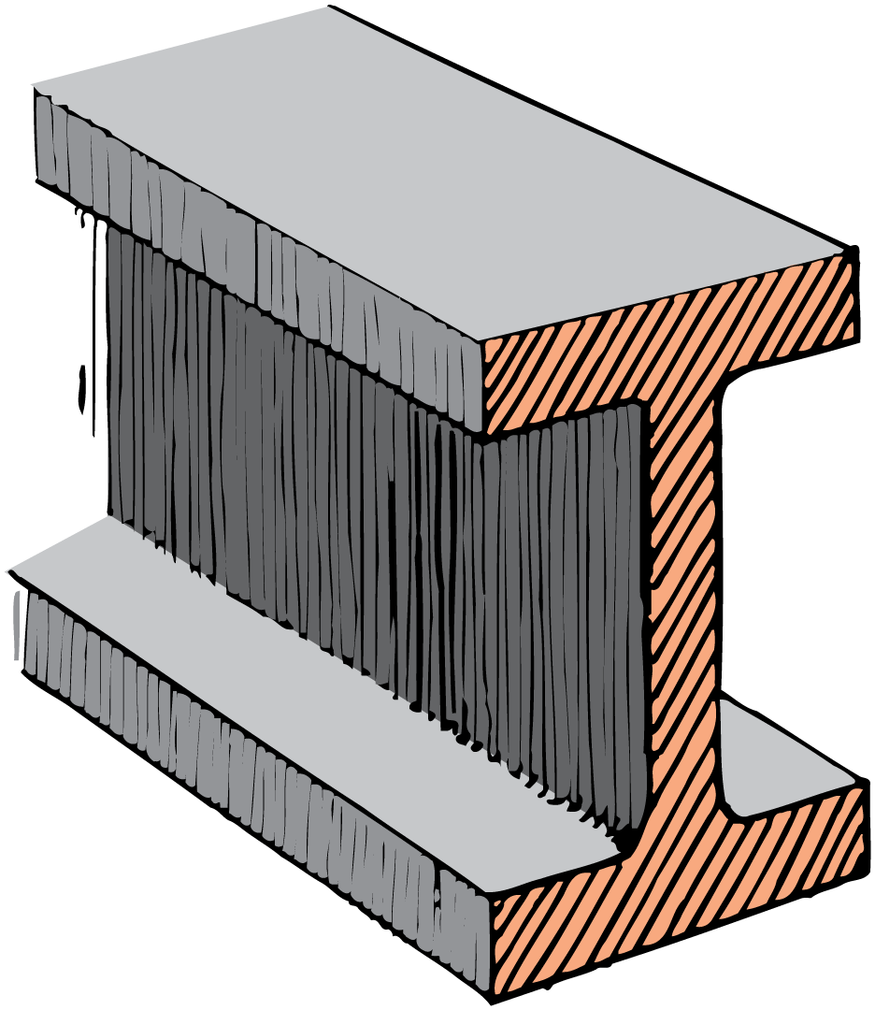
18.4 Compression and Tension
An I-beam is like a solid bar with some of the steel scooped from its middle where it is needed least. The beam is therefore lighter for nearly the same strength.

Slide 45
18.4 Compression and Tension
The stress is predominantly in the top and bottom flanges when the beam is used horizontally in construction.
One flange is stretched while the other is compressed. The web is a region of low stress that holds the top and bottom flanges apart.
Heavier loads are supported by farther-apart flanges.

Slide 46
18.4 Compression and Tension
think!
If you make a hole horizontally through the tree branch, what location weakens it the least—the top, the middle, or the bottom?

Slide 47
18.4 Compression and Tension
think!
If you make a hole horizontally through the tree branch, what location weakens it the least—the top, the middle, or the bottom?
Answer:
The middle. Fibers in the top part of the branch are stretched and fibers in the lower part are compressed. In the neutral layer, the hole will not affect the strength of the branch.

Slide 48
18.4 Compression and Tension
How is a horizontal beam affected by the load it supports?

Slide 49
18.5 Scaling
When linear dimensions are enlarged, the cross-sectional area (as well as the total surface area) grows as the square of the enlargement, whereas volume and weight grow as the cube of the enlargement. As the linear size of an object increases, the volume grows faster than the total surface area.

Slide 50
18.5 Scaling
An ant can carry the weight of several ants on its back, whereas a strong elephant could not even carry one elephant on its back.
If an ant were scaled up to the size of an elephant, would it be several times stronger than an elephant?
Such an ant would not be able to lift its own weight off the ground. Its legs would be too thin for its weight and would likely break.

Slide 51
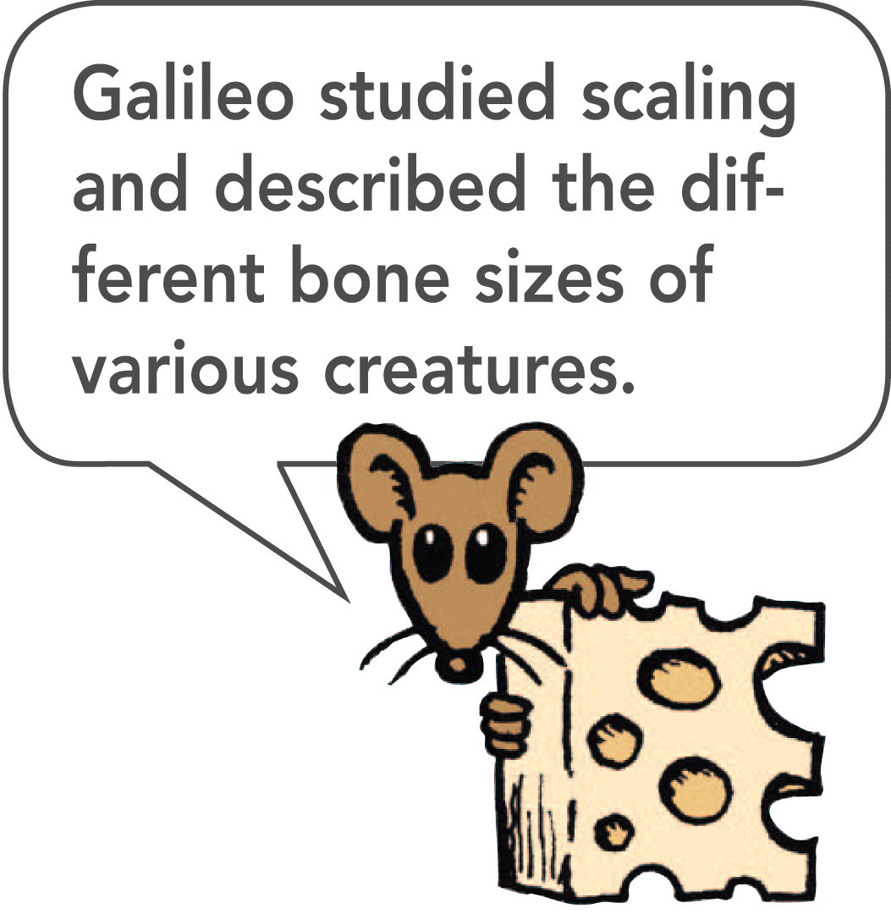
18.5 Scaling
The proportions of things in nature are in accord with their size.
The study of how size affects the relationship between weight, strength, and surface area is known as scaling.
As the size of a thing increases, it grows heavier much faster than it grows stronger.

Slide 52
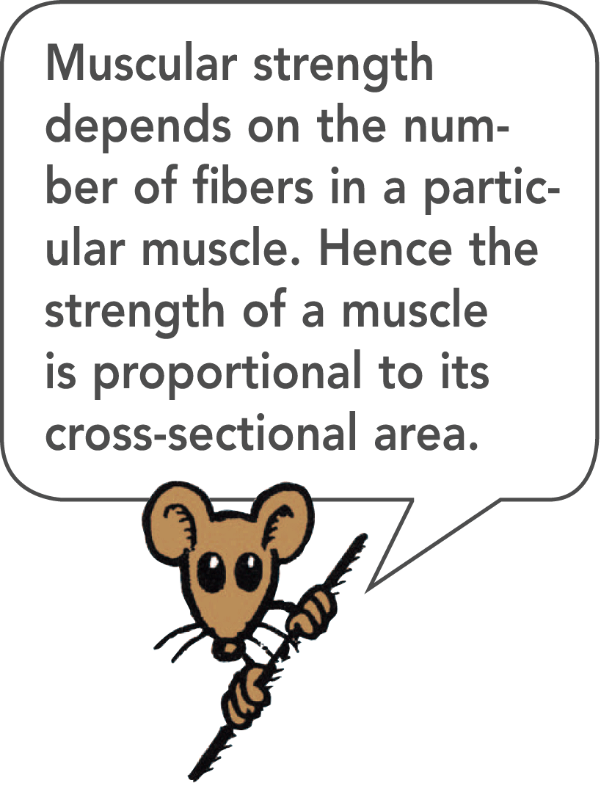
18.5 Scaling
How Scaling Affects Strength
Weight depends on volume, and strength comes from the area of the cross section of limbs—tree limbs or animal limbs.
A 1-cm cube has a cross section of 1 cm² and its volume is 1 cm³.
A cube of the same material that has double the linear dimensions has a cross-sectional area of 4 cm² and a volume of 8 cm³.

Slide 53
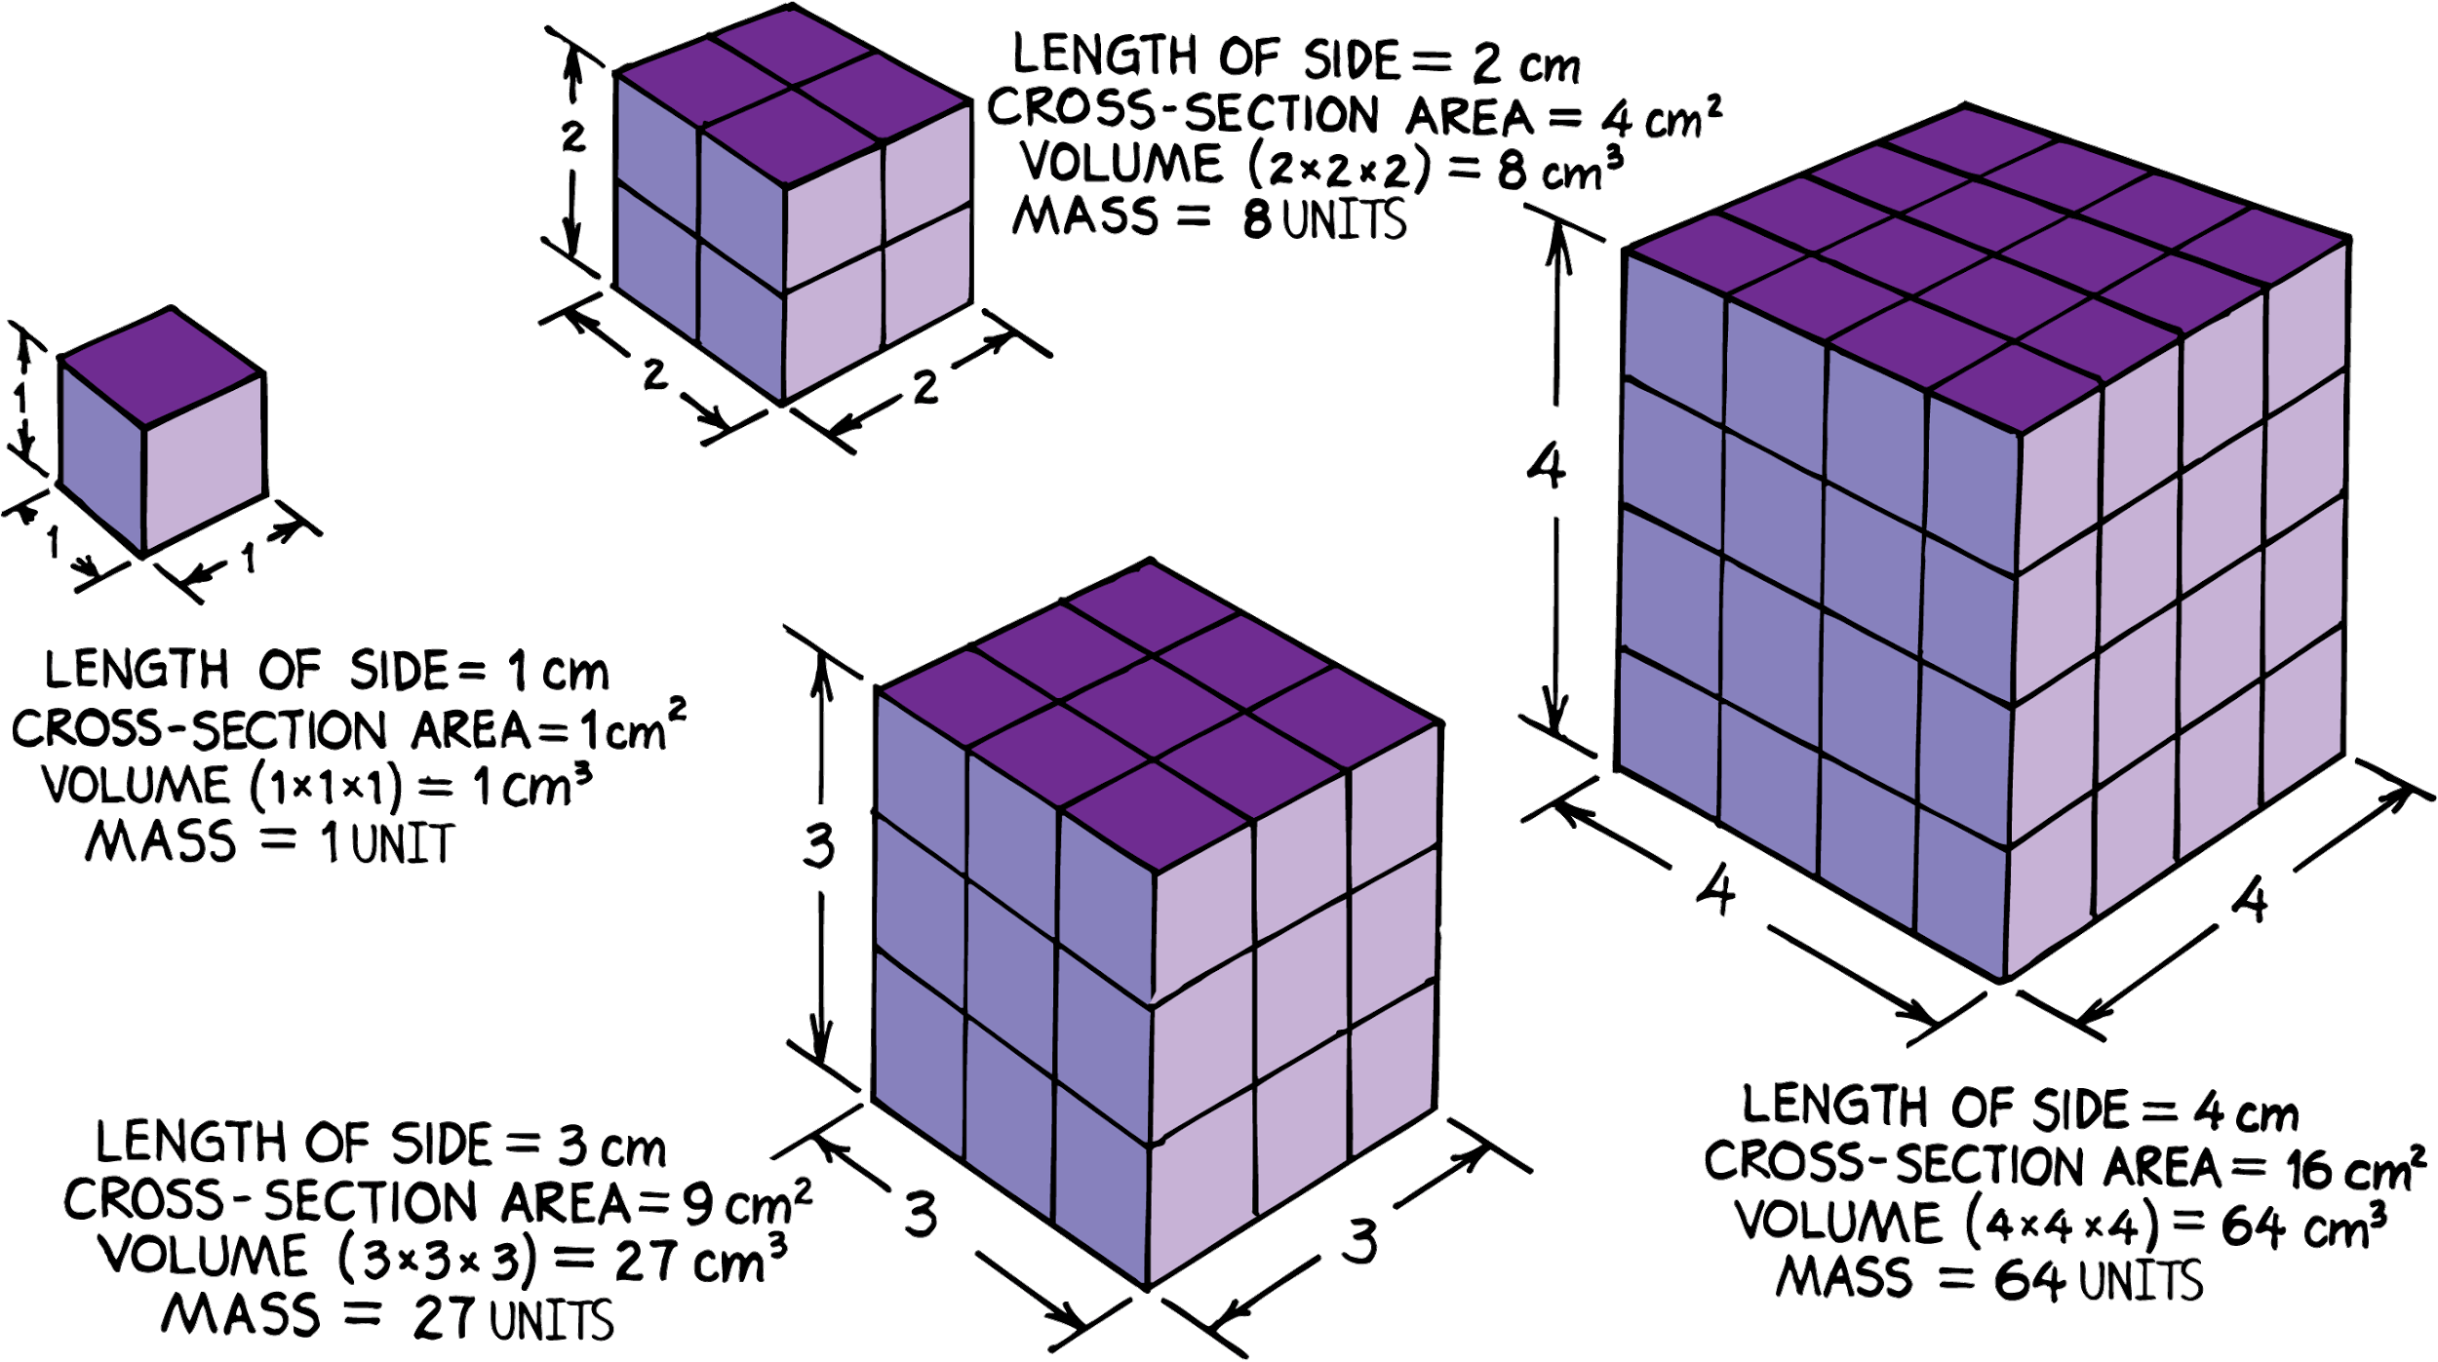
18.5 Scaling
If the linear dimensions of an object are multiplied by some number, the area will grow by the square of the number, and the volume (and mass) will grow by the cube of the number.

Slide 54
18.5 Scaling
Consider an athlete who can lift his weight with one arm.
Scaled up to twice his size, every linear dimension would be enlarged by a factor of 2.
His twice-as-thick arms would have four times the cross-sectional area, so he would be four times as strong.
His volume would be eight times as great, so he would be eight times as heavy.
For comparable effort, he could lift only half his weight. In relation to his weight, he would be weaker than before.

Slide 55
18.5 Scaling
Weight grows as the cube of linear enlargement, while strength grows as the square of linear enlargement.
Compare the thick legs of large animals to those of small animals: an elephant and a deer, or a tarantula and a daddy longlegs.

Slide 56
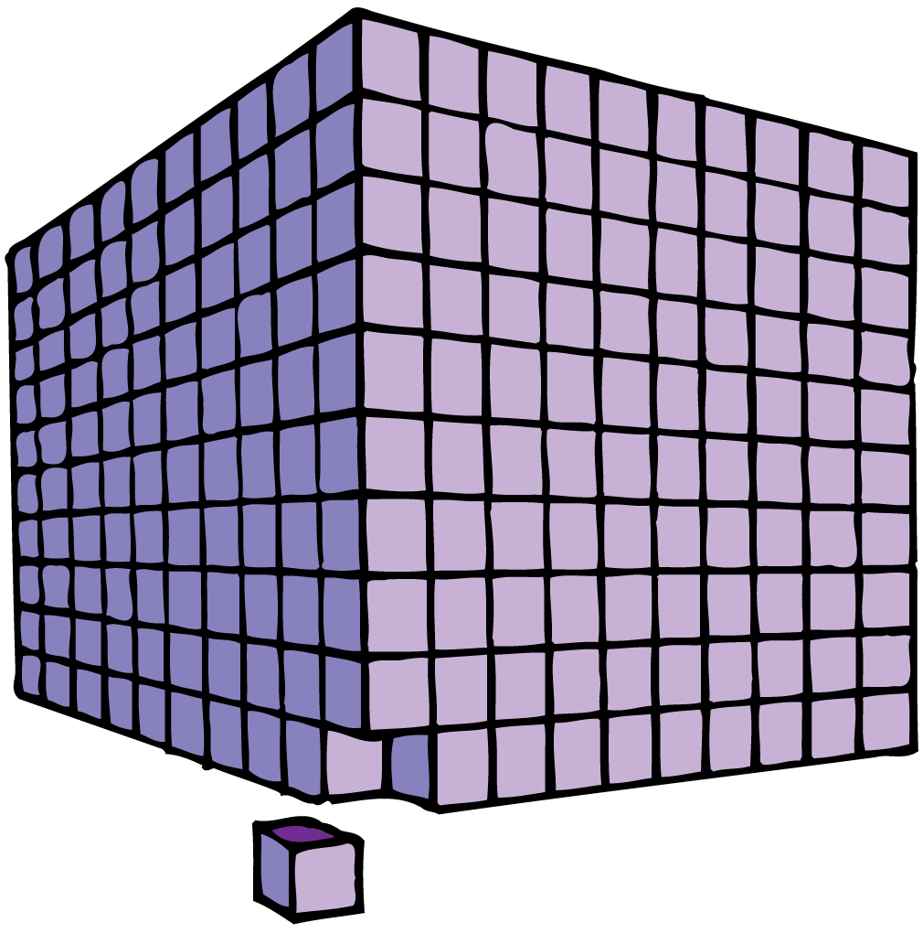
18.5 Scaling
think!
Suppose a cube 1 cm long on each side were scaled up to a cube 10 cm long. What would be the volume of the scaled-up cube? What would be its cross-sectional surface area? Its total surface area?

Slide 57
18.5 Scaling
think!
Suppose a cube 1 cm long on each side were scaled up to a cube 10 cm long. What would be the volume of the scaled-up cube? What would be its cross-sectional surface area? Its total surface area?
Answer:
Volume of the scaled-up cube is (10 cm)³, or 1000 cm³. Its cross-sectional surface area is (10 cm)², or 100 cm². Its total surface area = 6 × 100 cm² = 600 cm².

Slide 58
18.5 Scaling
If the linear dimensions of an object double, by how much will the cross-sectional area grow?

Slide 59
18.5 Scaling
How Scaling Affects Surface Area vs. Volume
How does surface area compare with volume?
Volume grows as the cube of the enlargement, and both cross-sectional area and total surface area grow as the square of the enlargement.
As an object grows, the ratio of surface area to volume decreases.

Slide 60
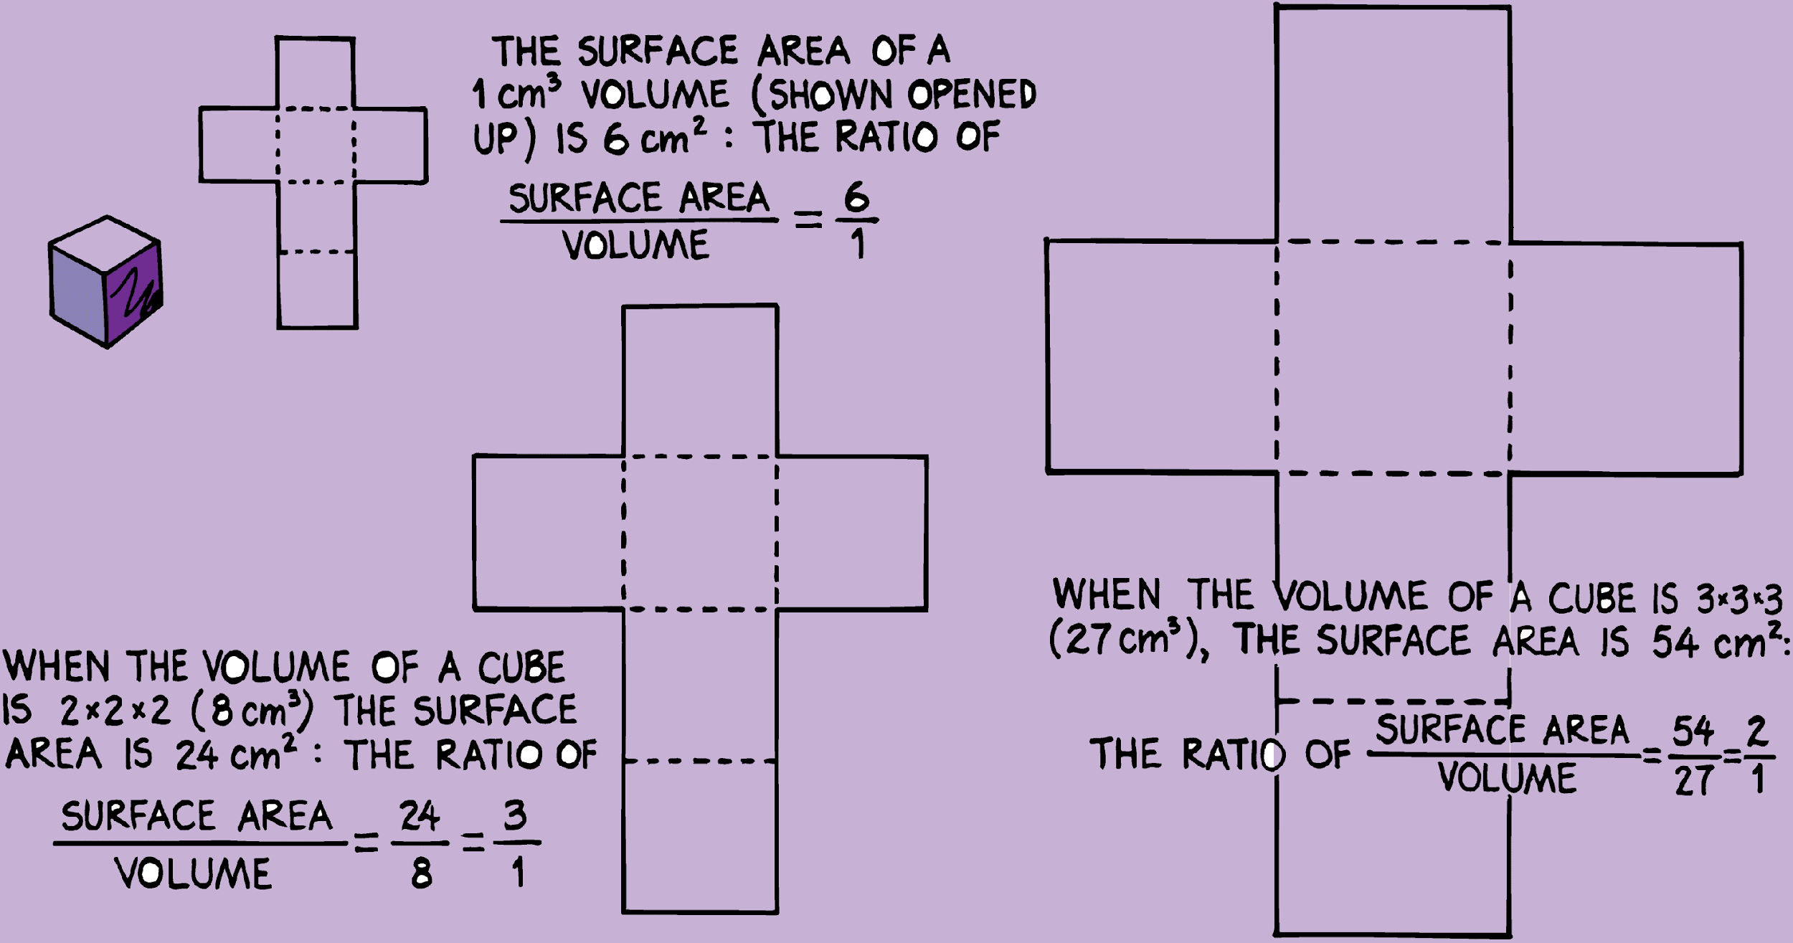
18.5 Scaling
As an object grows proportionally in all directions, there is a greater increase in volume than in surface area.

Slide 61
18.5 Scaling
Smaller objects have more surface area per kilogram.
Cooling occurs at the surfaces of objects, so crushed ice will cool a drink faster than an ice cube of the same mass.
Crushed ice presents more surface area to the beverage.

Slide 62
18.5 Scaling
The rusting of iron is also a surface phenomenon.
The greater the amount of surface exposed to the air, the faster rusting takes place.
Small filings and “steel wool” are soon eaten away. The same mass of iron in a solid cube or sphere rusts very little in comparison.

Slide 63
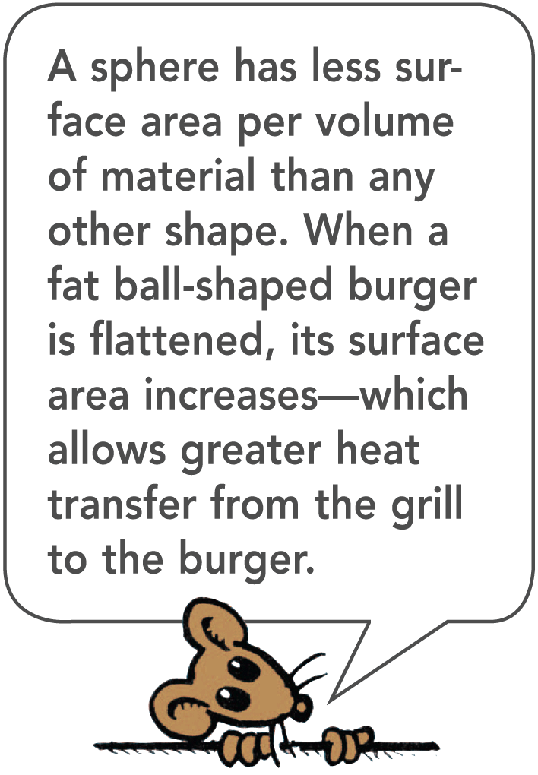
18.5 Scaling
Chunks of coal burn, while coal dust explodes when ignited.
Thin French fries cook faster in oil than fat fries.
Flat hamburgers cook faster than meatballs of the same mass.
Large raindrops fall faster than small raindrops.

Slide 64
18.5 Scaling
How Scaling Affects Living Organisms
The big ears of elephants are not for better hearing, but for better cooling.
An animal generates heat proportional to its mass (or volume), but the heat that it can dissipate is proportional to its surface area.
If an elephant did not have large ears, it would not have enough surface area to cool its huge mass.

Slide 65
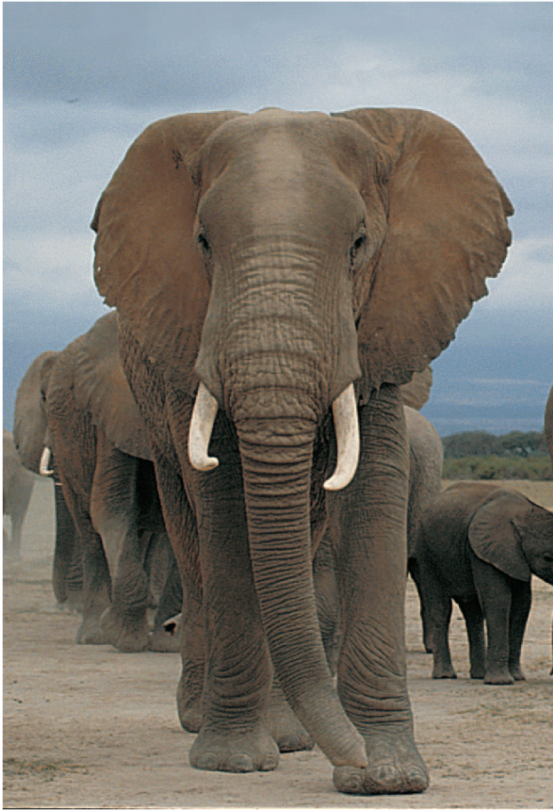
18.5 Scaling
The African elephant has less surface area compared with its weight than other animals. Its large ears significantly increase the surface area through which heat is dissipated, and promote cooling.

Slide 66
18.5 Scaling
A cell obtains nourishment by diffusion through its surface.
As it grows, its surface area enlarges, but not fast enough to keep up with the cell’s volume.
This puts a limit on the growth of a living cell.

Slide 67
18.5 Scaling
Air resistance depends on the surface area of the moving object.
If you fell off a cliff, even with air resistance, your speed would increase at the rate of very nearly 1 g—unless you wore a parachute.
Small animals need no parachute. They have plenty of surface area relative to their small weights.
An insect can fall from the top of a tree without harm.

Slide 68
18.5 Scaling
The rate of heartbeat in a mammal is related to size.
The heart of a tiny shrew beats about 20 times as fast as the heart of an elephant.
In general, small mammals live fast and die young; larger animals live at a leisurely pace and live longer.

Slide 69
18.5 Scaling
If the linear dimensions of an object double, by how much will the volume grow?

Slide 70
Assessment Questions
The crystals that make up minerals are composed of
atoms with a definite geometrical arrangement.
molecules that perpetually move.
X-ray patterns.
three-dimensional chessboards.

Slide 71
Assessment Questions
The crystals that make up minerals are composed of
atoms with a definite geometrical arrangement.
molecules that perpetually move.
X-ray patterns.
three-dimensional chessboards.
Answer: A

Slide 72
Assessment Questions
Specific gravity and density
are one and the same thing.
have the same magnitudes.
are seldom related.
have the same units.

Slide 73
Assessment Questions
Specific gravity and density
are one and the same thing.
have the same magnitudes.
are seldom related.
have the same units.
Answer: B

Slide 74
Assessment Questions
According to Hooke’s law, if you hang by a tree branch and note how much it bends, then hanging with twice the weight
produces half the bend.
produces the same bend if the branch doesn’t break.
normally produces twice the bend.
bends the branch four times as much.

Slide 75
Assessment Questions
According to Hooke’s law, if you hang by a tree branch and note how much it bends, then hanging with twice the weight
produces half the bend.
produces the same bend if the branch doesn’t break.
normally produces twice the bend.
bends the branch four times as much.
Answer: C

Slide 76
Assessment Questions
When you bend the branch of a tree,
one side of the branch is under tension while the other is under compression.
both sides of the branch are stretched.
both sides of the branch are compressed.
the branch is in a neutral state.

Slide 77
Assessment Questions
When you bend the branch of a tree,
one side of the branch is under tension while the other is under compression.
both sides of the branch are stretched.
both sides of the branch are compressed.
the branch is in a neutral state.
Answer: A

Slide 78
Assessment Questions
When you increase the scale of an object by three times its linear size, the surface area increases by
three and the volume by nine.
three and the volume by twenty-seven.
nine and the volume by twenty-seven.
four and the volume by eight.

Slide 79
Assessment Questions
When you increase the scale of an object by three times its linear size, the surface area increases by
three and the volume by nine.
three and the volume by twenty-seven.
nine and the volume by twenty-seven.
four and the volume by eight.
Answer: C

