Slide 1
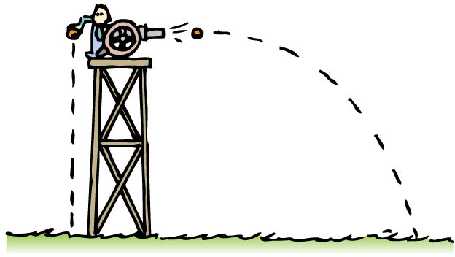
Projectile motion can be described by the horizontal and vertical components of motion.

Slide 2
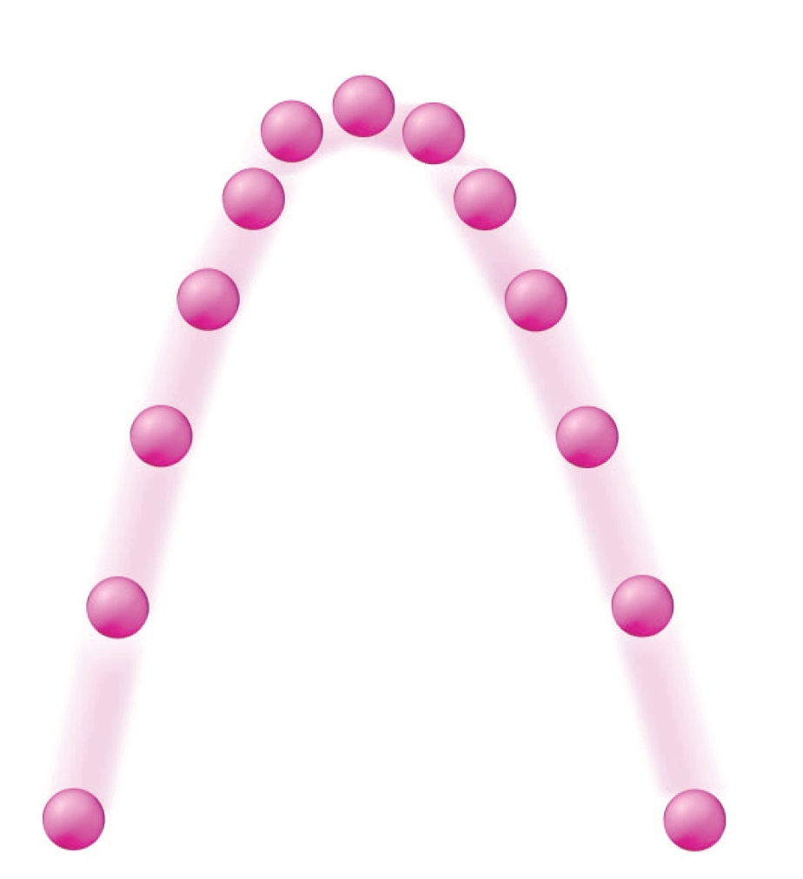
In the previous chapter we studied simple straight-line motion—linear motion.
Now we extend these ideas to nonlinear motion—motion along a curved path. Throw a baseball and the path it follows is a combination of constant-velocity horizontal motion and accelerated vertical motion.

Slide 3
5.1 Vector and Scalar Quantities
A vector quantity includes both magnitude and direction, but a scalar quantity includes only magnitude.

Slide 4
5.1 Vector and Scalar Quantities
A quantity that requires both magnitude and direction for a complete description is a vector quantity.
Velocity is a vector quantity, as is acceleration.
Other quantities, such as momentum, are also vector quantities.

Slide 5
5.1 Vector and Scalar Quantities
A quantity that is completely described by magnitude is a scalar quantity. Scalars can be added, subtracted, multiplied, and divided like ordinary numbers.
When 3 kg of sand is added to 1 kg of cement, the resulting mixture has a mass of 4 kg.
When 5 liters of water are poured from a pail that has 8 liters of water in it, the resulting volume is 3 liters.
If a scheduled 60-minute trip has a 15-minute delay, the trip takes 75 minutes.

Slide 6
5.1 Vector and Scalar Quantities
How does a scalar quantity differ from a vector quantity?

Slide 7
5.2 Velocity Vectors
The resultant of two perpendicular vectors is the diagonal of a rectangle constructed with the two vectors as sides.

Slide 8
5.2 Velocity Vectors
By using a scale of 1 cm = 20 km/h and drawing a 3-cm-long vector that points to the right, you represent a velocity of 60 km/h to the right (east).

Slide 9
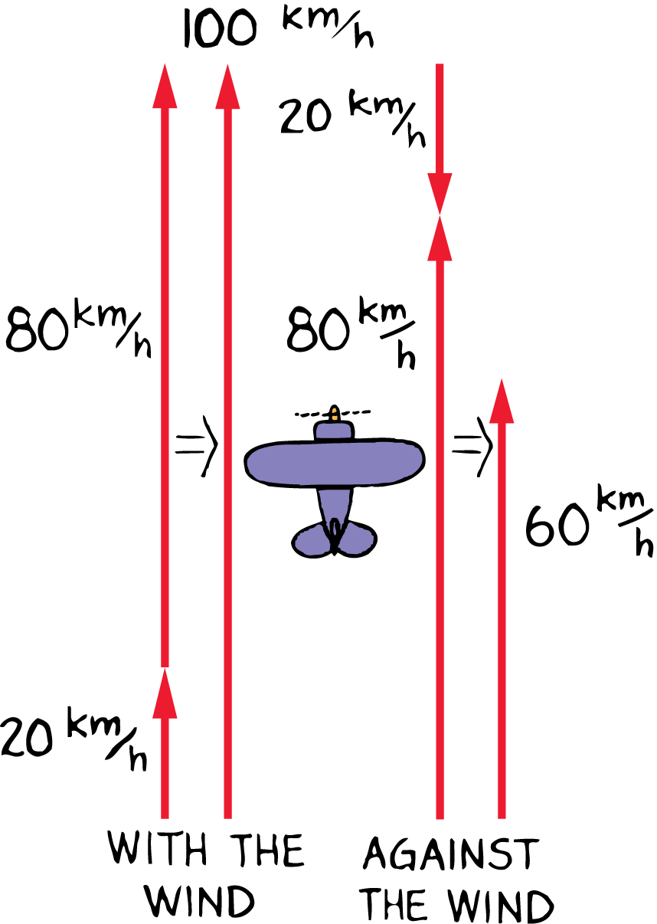
5.2 Velocity Vectors
The airplane’s velocity relative to the ground depends on the airplane’s velocity relative to the air and on the wind’s velocity.

Slide 10
5.2 Velocity Vectors
The velocity of something is often the result of combining two or more other velocities.
If a small airplane is flying north at 80 km/h relative to the surrounding air and a tailwind blows north at a velocity of 20 km/h, the plane travels 100 kilometers in one hour relative to the ground below.
What if the plane flies into the wind rather than with the wind? The velocity vectors are now in opposite directions.
The resulting speed of the airplane is 60 km/h.

Slide 11
5.2 Velocity Vectors
Now consider an 80-km/h airplane flying north caught in a strong crosswind of 60 km/h blowing from west to east.
The plane’s speed relative to the ground can be found by adding the two vectors.
The result of adding these two vectors, called the resultant, is the diagonal of the rectangle described by the two vectors.

Slide 12
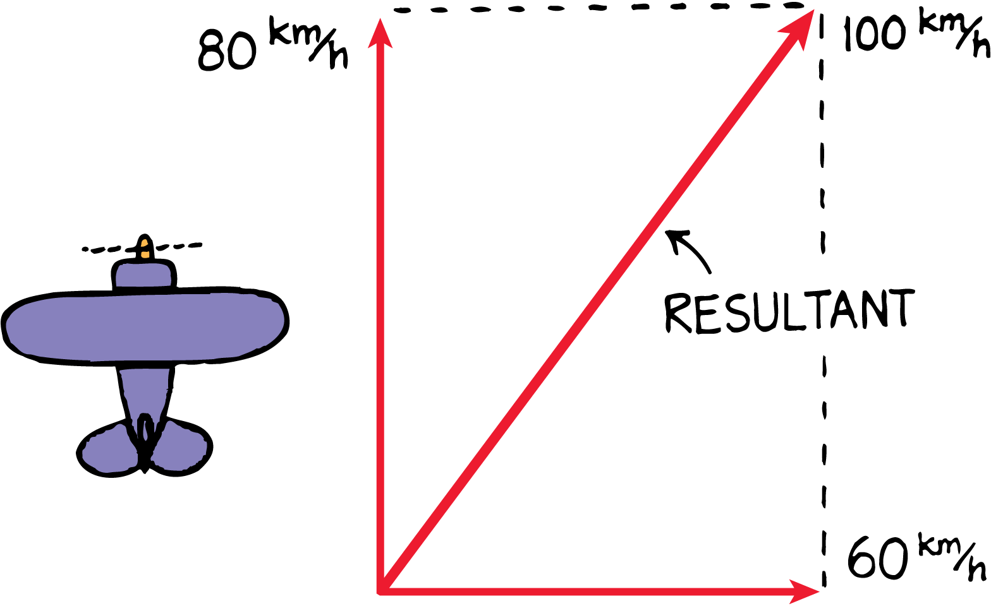
5.2 Velocity Vectors
An 80-km/h airplane flying in a 60-km/h crosswind has a resultant speed of 100 km/h relative to the ground.

Slide 13
5.2 Velocity Vectors
The 3-unit and 4-unit vectors at right angles add to produce a resultant vector of 5 units, at 37° from the horizontal.

Slide 14
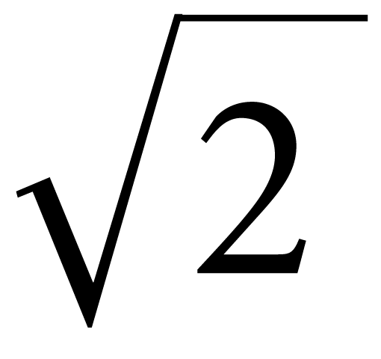
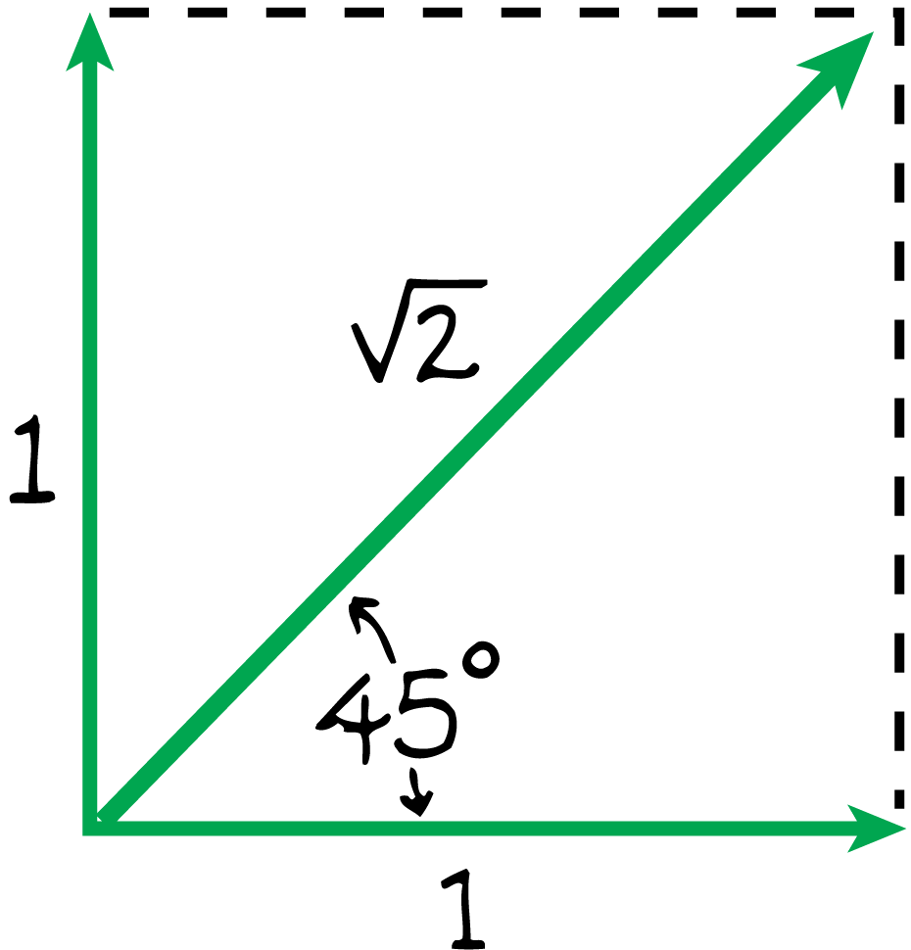
5.2 Velocity Vectors
The diagonal of a square is , or 1.414, times the length of one of its sides.

Slide 15
5.2 Velocity Vectors
think!
Suppose that an airplane normally flying at 80 km/h encounters wind at a right angle to its forward motion—a crosswind. Will the airplane fly faster or slower than 80 km/h?

Slide 16
5.2 Velocity Vectors
think!
Suppose that an airplane normally flying at 80 km/h encounters wind at a right angle to its forward motion—a crosswind. Will the airplane fly faster or slower than 80 km/h?
Answer: A crosswind would increase the speed of the airplane and blow it off course by a predictable amount.

Slide 17
5.2 Velocity Vectors
What is the resultant of two perpendicular vectors?

Slide 18
5.3 Components of Vectors
The perpendicular components of a vector are independent of each other.

Slide 19
5.3 Components of Vectors
Often we will need to change a single vector into an equivalent set of two component vectors at right angles to each other:
Any vector can be “resolved” into two component vectors at right angles to each other.
Two vectors at right angles that add up to a given vector are known as the components of the given vector.
The process of determining the components of a vector is called resolution.

Slide 20
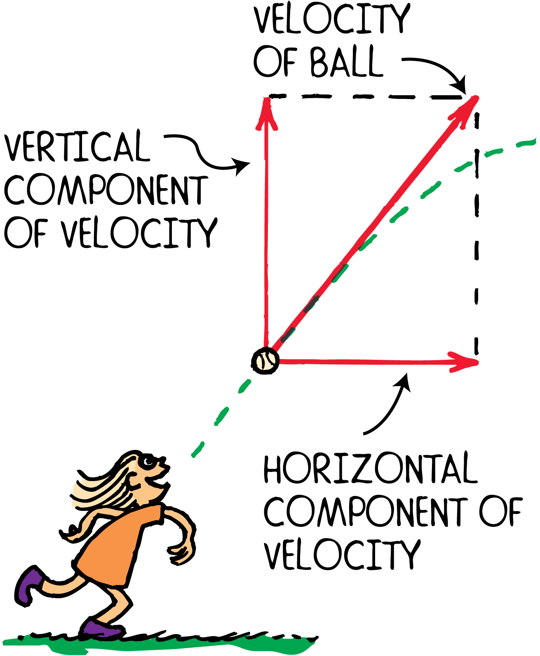
5.3 Components of Vectors
A ball’s velocity can be resolved into horizontal and vertical components.

Slide 21
5.3 Components of Vectors
Vectors X and Y are the horizontal and vertical components of a vector V.

Slide 22
5.3 Components of Vectors
How do components of a vector affect each other?

Slide 23
5.4 Projectile Motion
The horizontal component of motion for a projectile is just like the horizontal motion of a ball rolling freely along a level surface without friction.
The vertical component of a projectile’s velocity is like the motion for a freely falling object.

Slide 24
5.4 Projectile Motion
A projectile is any object that moves through the air or space, acted on only by gravity (and air resistance, if any).
A cannonball shot from a cannon, a stone thrown into the air, a ball rolling off the edge of a table, a spacecraft circling Earth—all of these are examples of projectiles.

Slide 25
5.4 Projectile Motion
Projectiles near the surface of Earth follow a curved path that at first seems rather complicated.
These paths are surprisingly simple when we look at the horizontal and vertical components of motion separately.

Slide 26
5.4 Projectile Motion
Projectile motion can be separated into components.
Roll a ball along a horizontal surface, and its velocity is constant because no component of gravitational force acts horizontally.

Slide 27
5.4 Projectile Motion
Projectile motion can be separated into components.
Roll a ball along a horizontal surface, and its velocity is constant because no component of gravitational force acts horizontally.
Drop it, and it accelerates downward and covers a greater vertical distance each second.

Slide 28
5.4 Projectile Motion
Most important, the horizontal component of motion for a projectile is completely independent of the vertical component of motion.
Each component is independent of the other.
Their combined effects produce the variety of curved paths that projectiles follow.

Slide 29
5.4 Projectile Motion
Describe the components of projectile motion.

Slide 30
5.5 Projectiles Launched Horizontally
The downward motion of a horizontally launched projectile is the same as that of free fall.

Slide 31
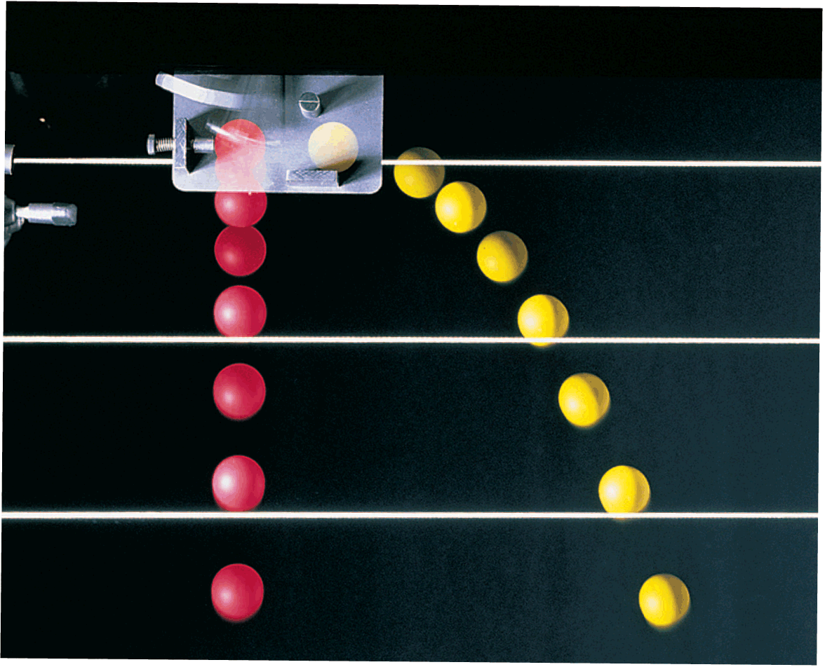
5.5 Projectiles Launched Horizontally
A strobe-light photo of two balls released simultaneously–one ball drops freely while the other one is projected horizontally.

Slide 32
5.5 Projectiles Launched Horizontally
There are two important things to notice in the photo of two balls falling simultaneously:
The ball’s horizontal component of motion remains constant. Gravity acts only downward, so the only acceleration of the ball is downward.
Both balls fall the same vertical distance in the same time. The vertical distance fallen has nothing to do with the horizontal component of motion.

Slide 33
5.5 Projectiles Launched Horizontally
The ball moves the same horizontal distance in the equal time intervals because no horizontal component of force is acting on it.
The path traced by a projectile accelerating in the vertical direction while moving at constant horizontal velocity is a parabola.
When air resistance is small enough to neglect, the curved paths are parabolic.

Slide 34
5.5 Projectiles Launched Horizontally
think!
At the instant a horizontally pointed cannon is fired, a cannonball held at the cannon’s side is released and drops to the ground. Which cannonball strikes the ground first, the one fired from the cannon or the one dropped?

Slide 35
5.5 Projectiles Launched Horizontally
think!
At the instant a horizontally pointed cannon is fired, a cannonball held at the cannon’s side is released and drops to the ground. Which cannonball strikes the ground first, the one fired from the cannon or the one dropped?
Answer: Both cannonballs fall the same vertical distance with the same acceleration g and therefore strike the ground at the same time.

Slide 36
5.5 Projectiles Launched Horizontally
Describe the downward motion of a horizontally launched projectile.

Slide 37
5.6 Projectiles Launched at an Angle
The vertical distance a projectile falls below an imaginary straight-line path increases continually with time and is equal to 5t² meters.

Slide 38
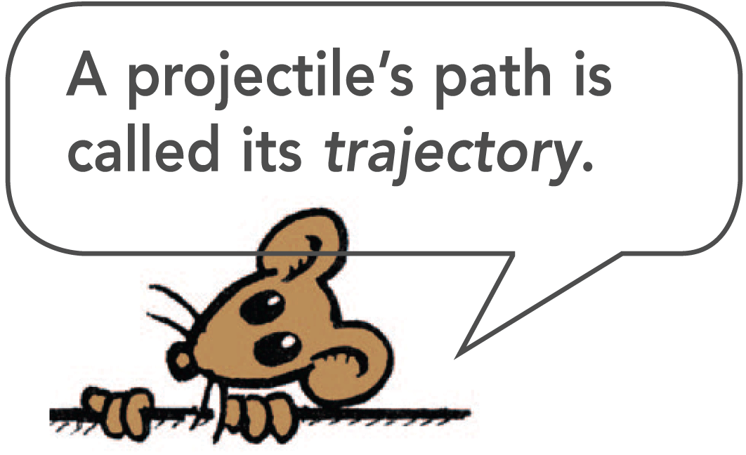
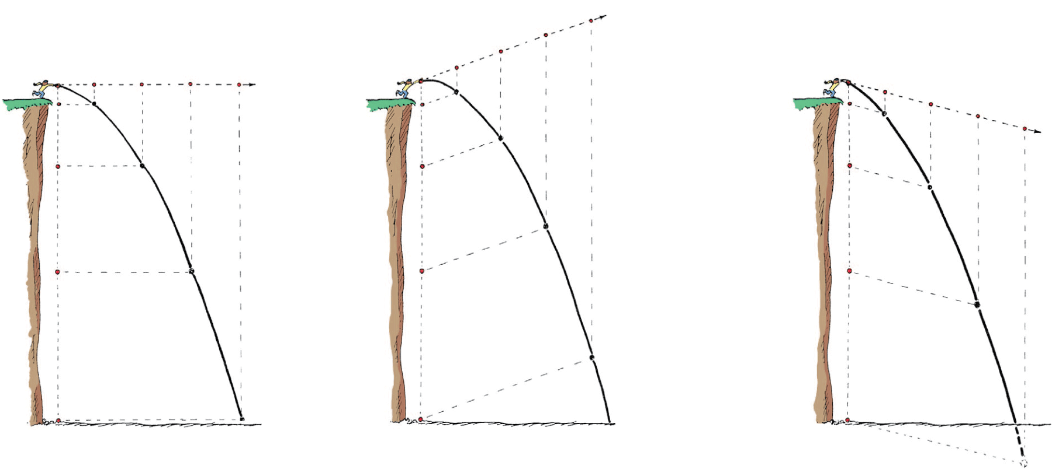
5.6 Projectiles Launched at an Angle
No matter the angle at which a projectile is launched, the vertical distance of fall beneath the idealized straight-line path (dashed straight lines) is the same for equal times.

Slide 39
5.6 Projectiles Launched at an Angle
The dashed straight lines show the ideal trajectories of the stones if there were no gravity.
Notice that the vertical distance that the stone falls beneath the idealized straight-line paths is the same for equal times.
This vertical distance is independent of what’s happening horizontally.

Slide 40
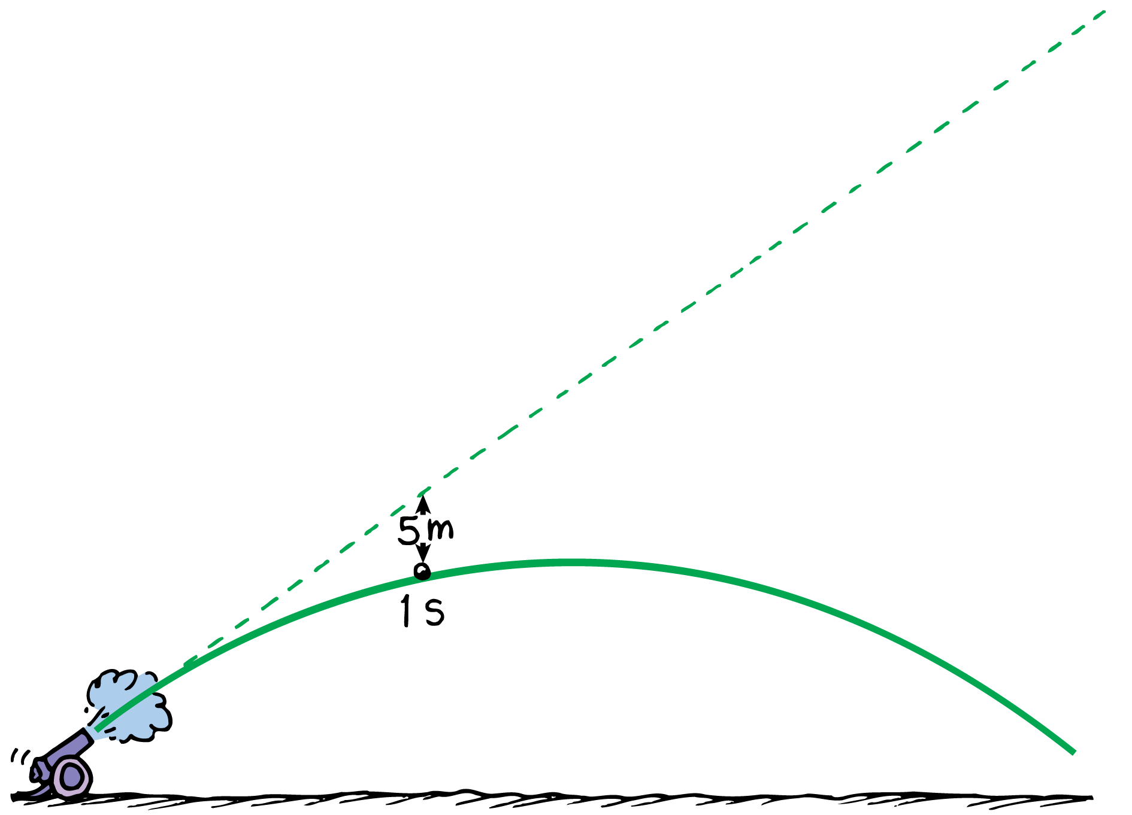
5.6 Projectiles Launched at an Angle
With no gravity the projectile would follow the straight-line path (dashed line). But because of gravity it falls beneath this line the same vertical distance it would fall if it were released from rest.

Slide 41
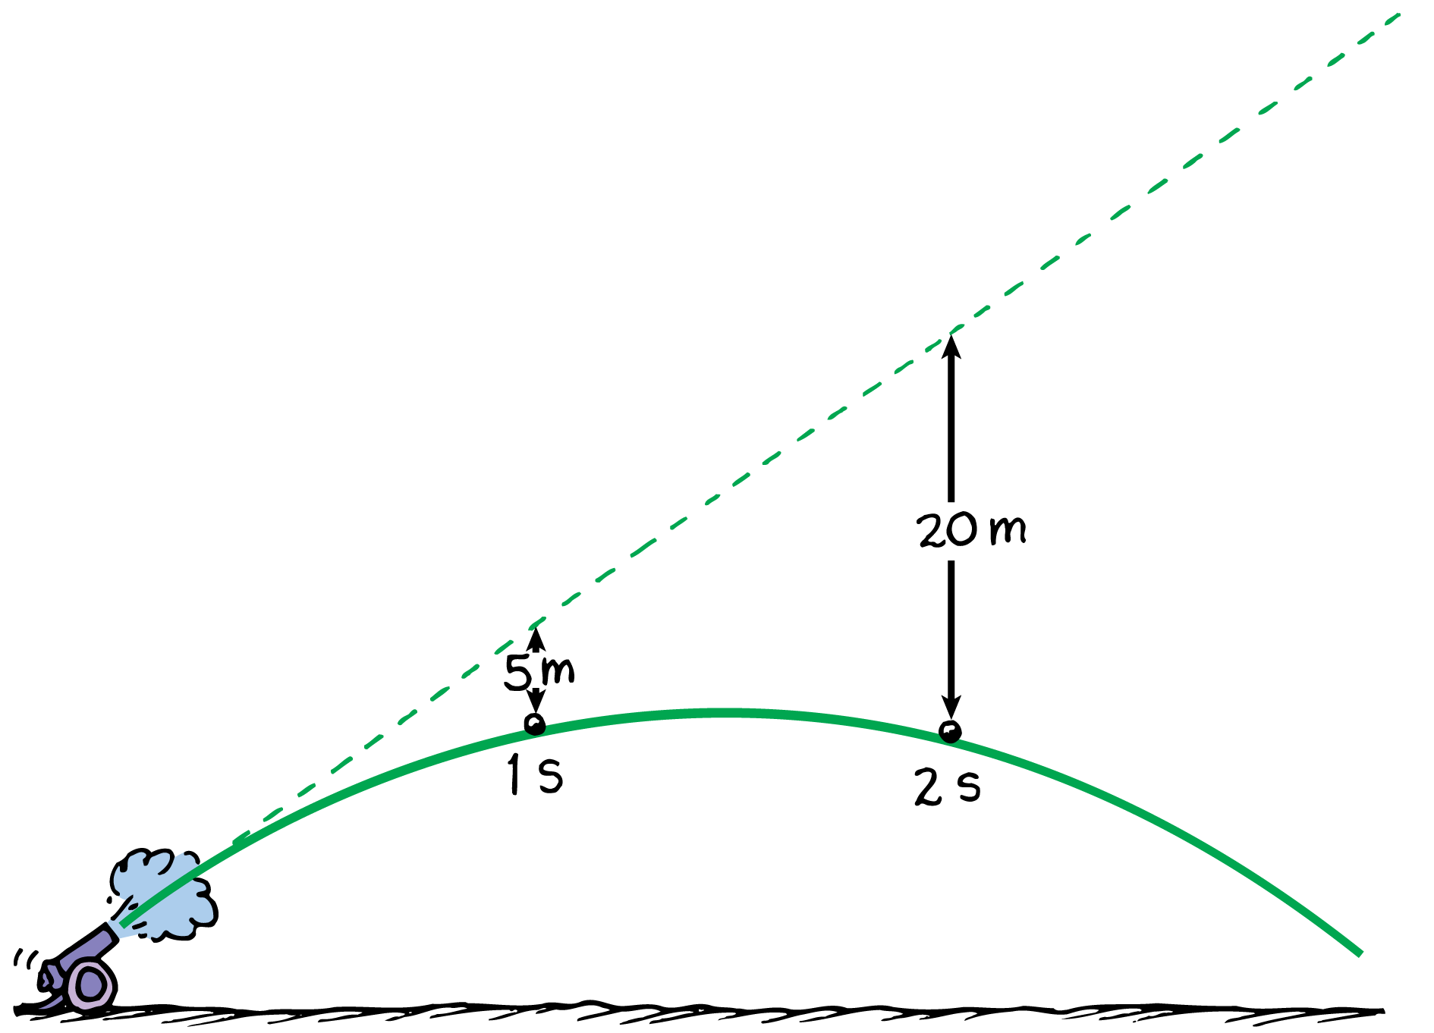
5.6 Projectiles Launched at an Angle
With no gravity the projectile would follow the straight-line path (dashed line). But because of gravity it falls beneath this line the same vertical distance it would fall if it were released from rest.

Slide 42
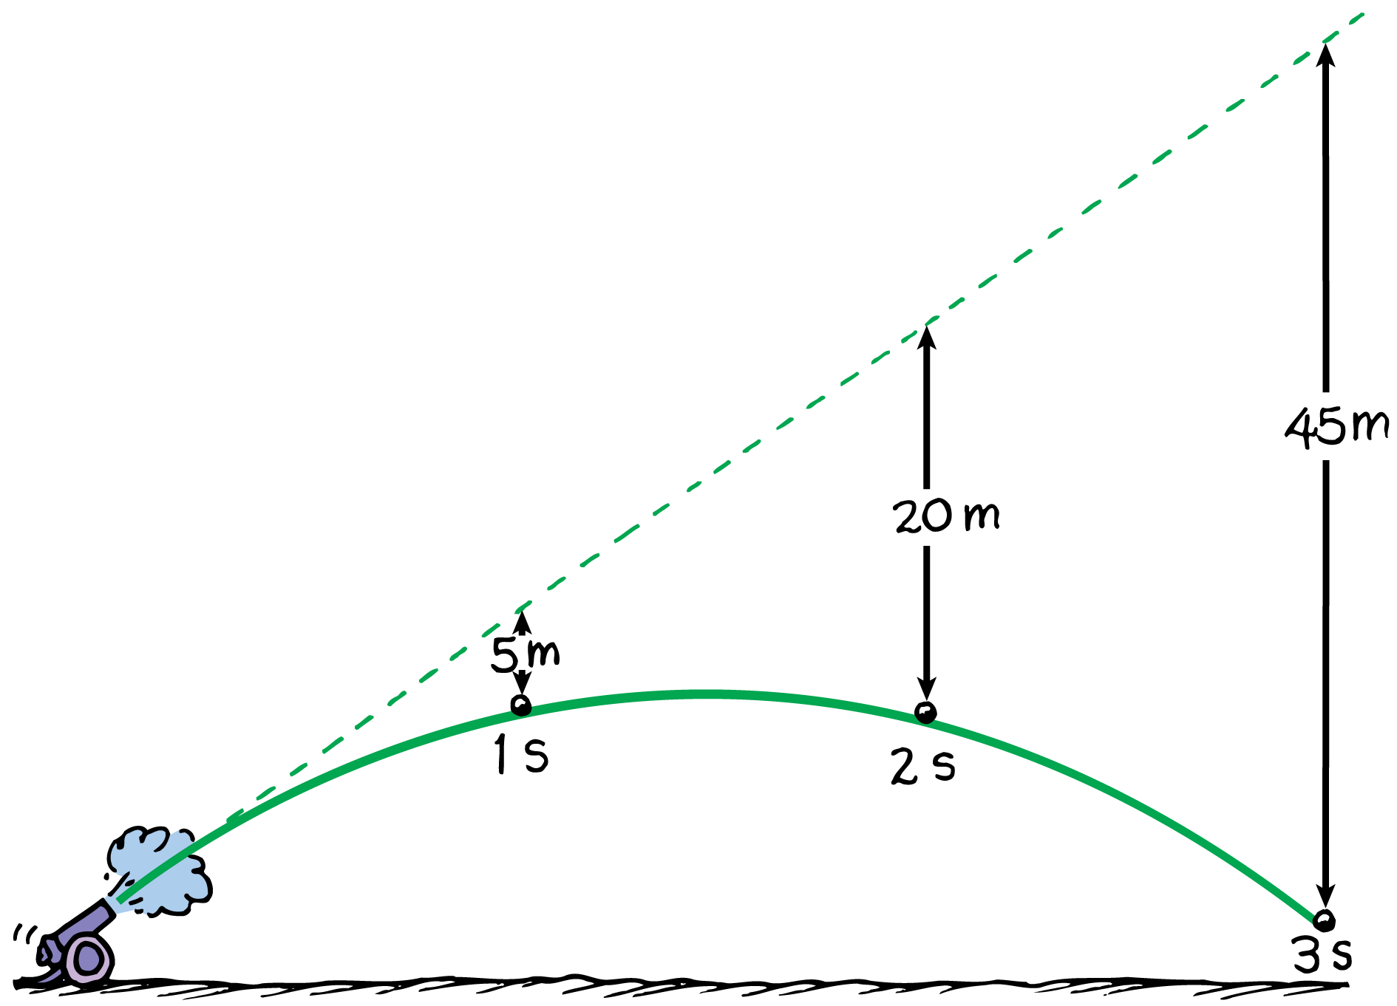
5.6 Projectiles Launched at an Angle
With no gravity the projectile would follow the straight-line path (dashed line). But because of gravity it falls beneath this line the same vertical distance it would fall if it were released from rest.

Slide 43
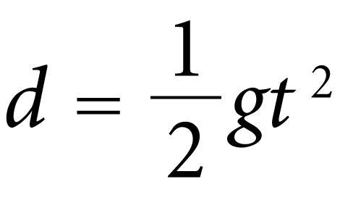
5.6 Projectiles Launched at an Angle
If there were no gravity the cannonball would follow the straight-line path shown by the dashed line.
The vertical distance it falls beneath any point on the dashed line is the same vertical distance it would fall if it were dropped from rest:

Slide 44
5.6 Projectiles Launched at an Angle
Height
For the component vectors of the cannonball’s motion, the horizontal component is always the same and only the vertical component changes.
At the top of the path the vertical component shrinks to zero, so the velocity there is the same as the horizontal component of velocity at all other points.
Everywhere else the magnitude of velocity is greater, just as the diagonal of a rectangle is greater than either of its sides.

Slide 45
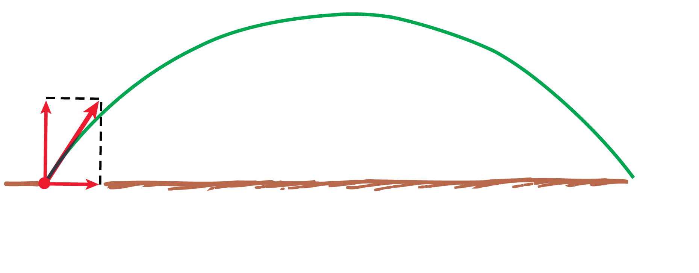
5.6 Projectiles Launched at an Angle
The velocity of a projectile is shown at various points along its path. Notice that the vertical component changes while the horizontal component does not. Air resistance is neglected.

Slide 46
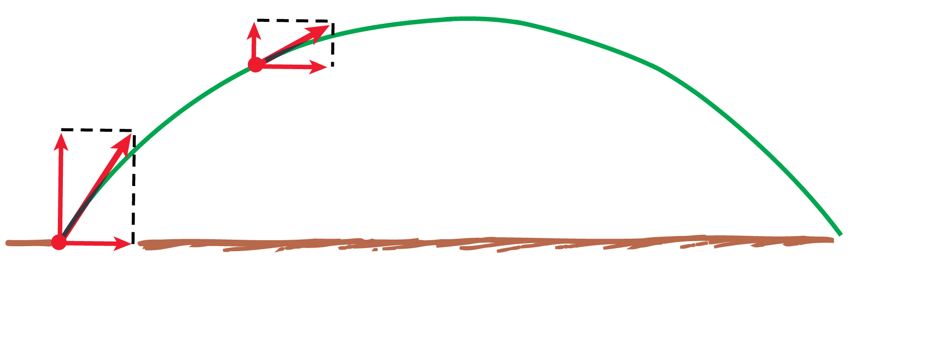
5.6 Projectiles Launched at an Angle
The velocity of a projectile is shown at various points along its path. Notice that the vertical component changes while the horizontal component does not. Air resistance is neglected.

Slide 47
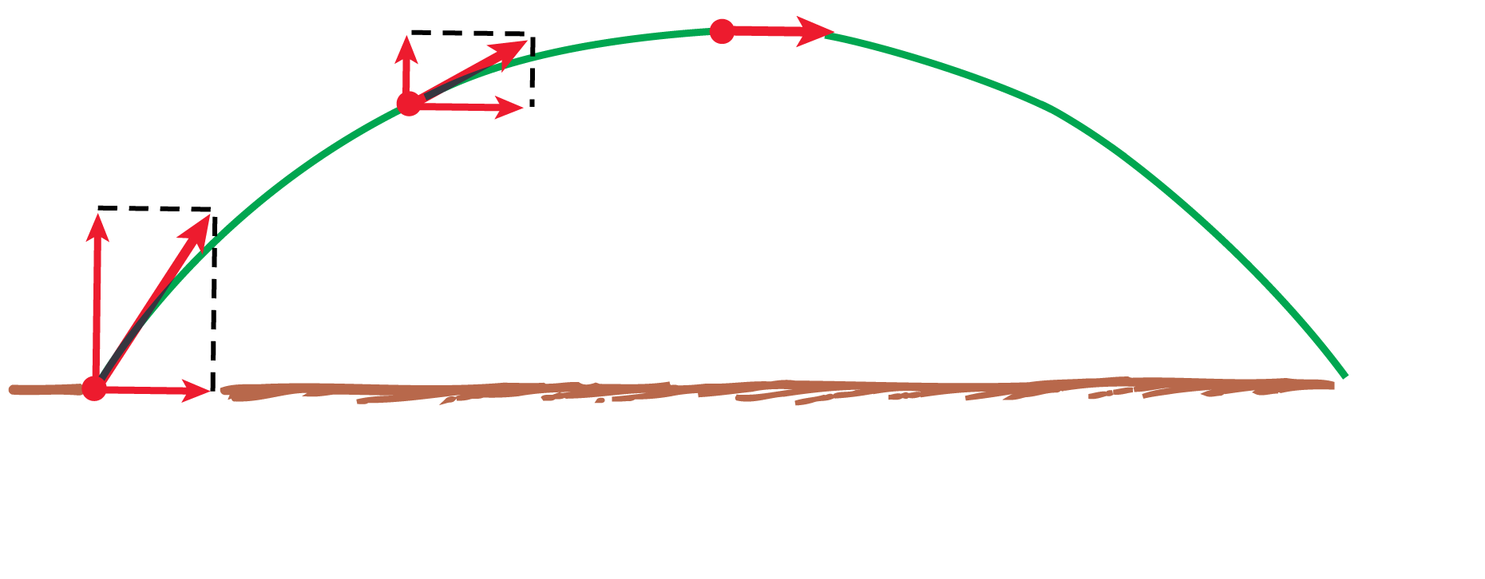
5.6 Projectiles Launched at an Angle
The velocity of a projectile is shown at various points along its path. Notice that the vertical component changes while the horizontal component does not. Air resistance is neglected.

Slide 48
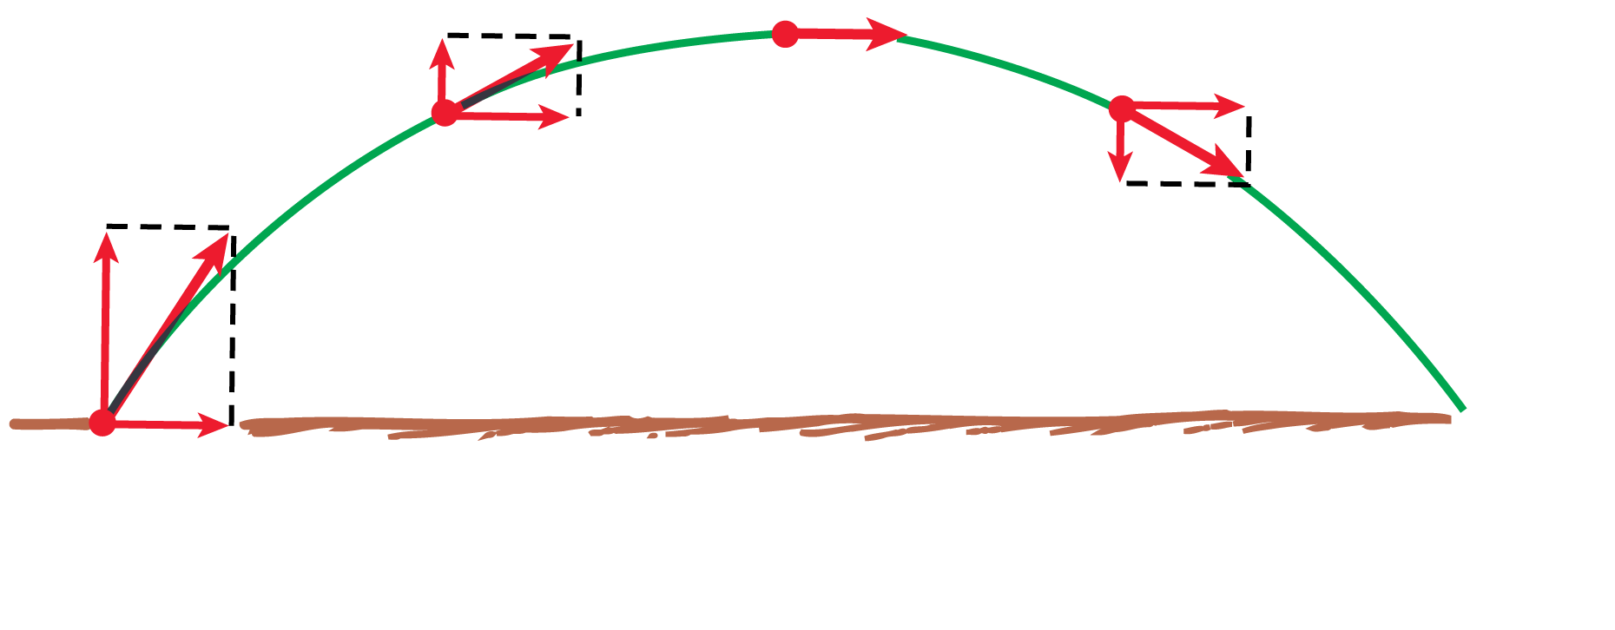
5.6 Projectiles Launched at an Angle
The velocity of a projectile is shown at various points along its path. Notice that the vertical component changes while the horizontal component does not. Air resistance is neglected.

Slide 49
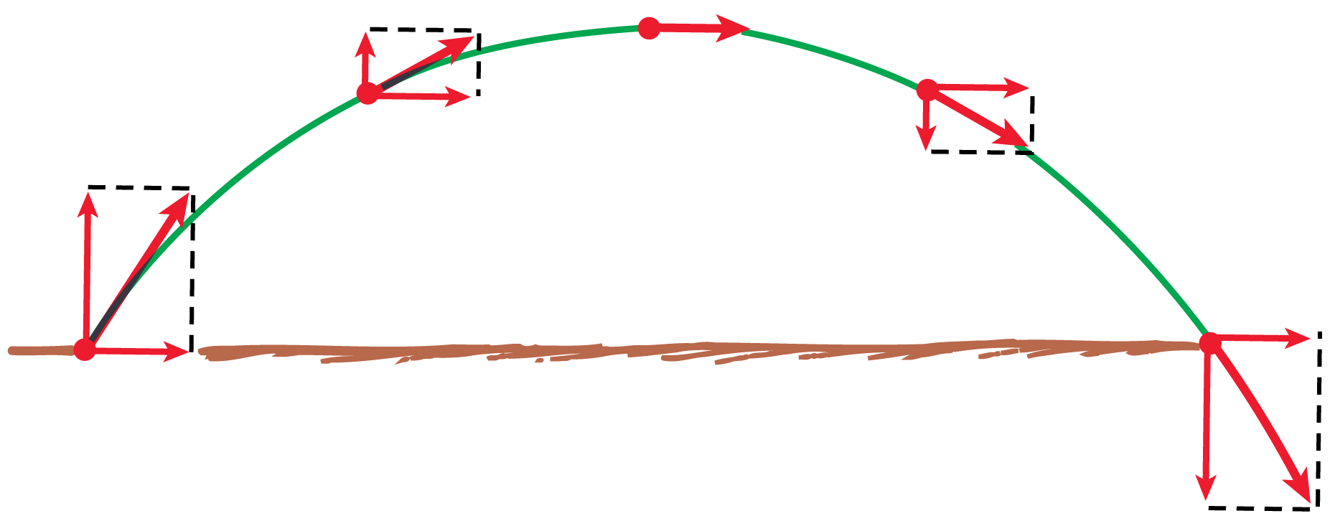
5.6 Projectiles Launched at an Angle
The velocity of a projectile is shown at various points along its path. Notice that the vertical component changes while the horizontal component does not. Air resistance is neglected.

Slide 50
5.6 Projectiles Launched at an Angle
Range
The angle at which the projectile is launched affects the distance that it travels.

Slide 51
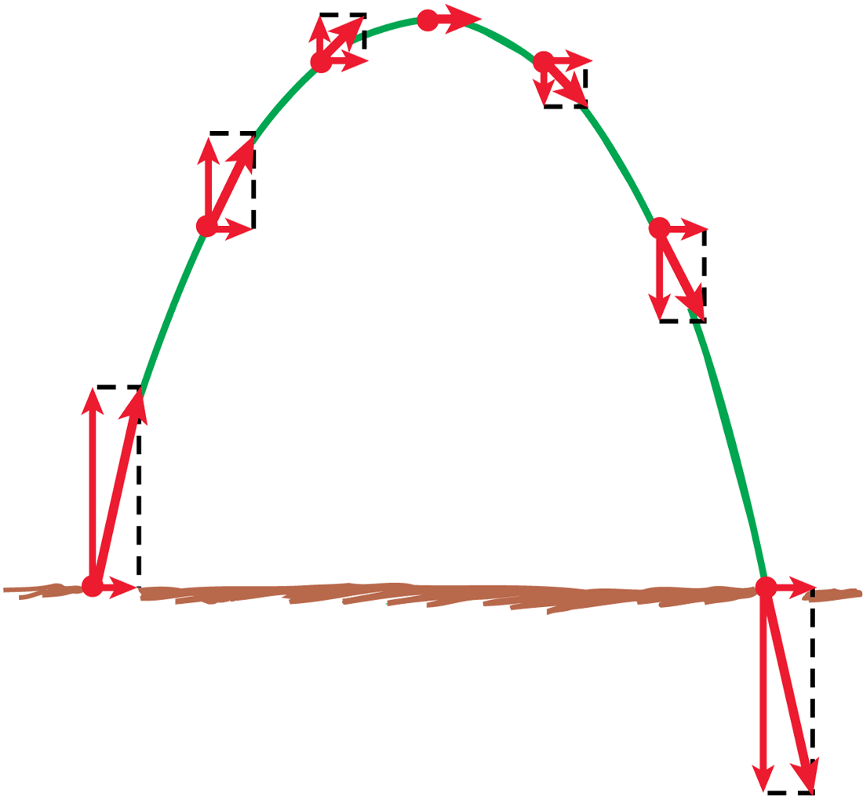
5.6 Projectiles Launched at an Angle
Both projectiles have the same launching speed.
The initial velocity vector has a greater vertical component than when the projection angle is less. This greater component results in a higher path.
The horizontal component is less, so the range is less.

Slide 52
5.6 Projectiles Launched at an Angle
Horizontal Ranges
Projectiles that are launched at the same speed but at different angles reach different heights (altitude) above the ground.
They also travel different horizontal distances, that is, they have different horizontal ranges.

Slide 53
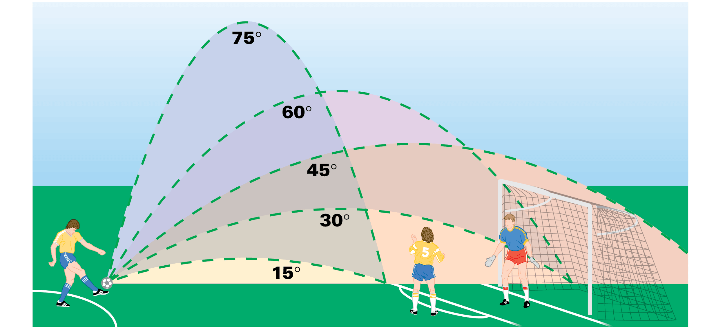
5.6 Projectiles Launched at an Angle
The paths of projectiles launched at the same speed but at different angles. The paths neglect air resistance.

Slide 54
5.6 Projectiles Launched at an Angle
The same range is obtained for two different projection angles—angles that add up to 90°.
An object thrown into the air at an angle of 60° will have the same range as at 30° with the same speed.
Maximum range is usually attained at an angle of 45°.

Slide 55
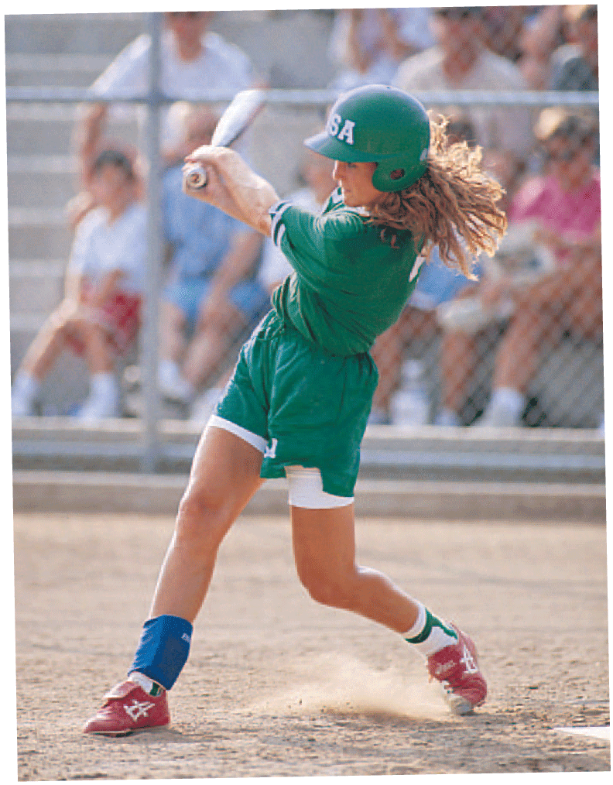
5.6 Projectiles Launched at an Angle
Maximum range is attained when the ball is batted at an angle of nearly 45°.

Slide 56
5.6 Projectiles Launched at an Angle
Speed
Without air resistance, a projectile will reach maximum height in the same time it takes to fall from that height to the ground.
The deceleration due to gravity going up is the same as the acceleration due to gravity coming down.
The projectile hits the ground with the same speed it had when it was projected upward from the ground.

Slide 57
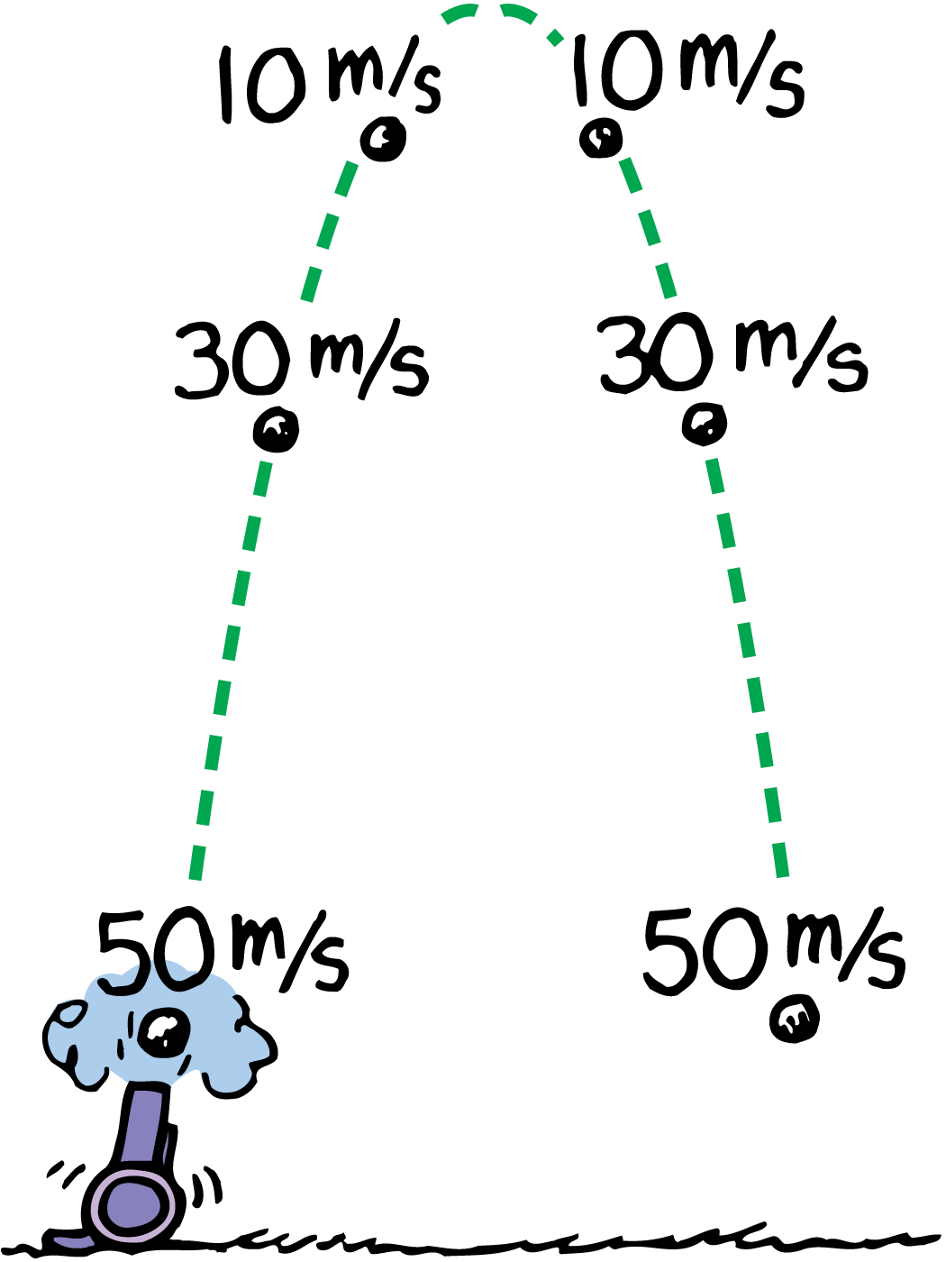
5.6 Projectiles Launched at an Angle
Without air resistance, the speed lost while the cannonball is going up equals the speed gained while it is coming down.
The time to go up equals the time to come down.

Slide 58
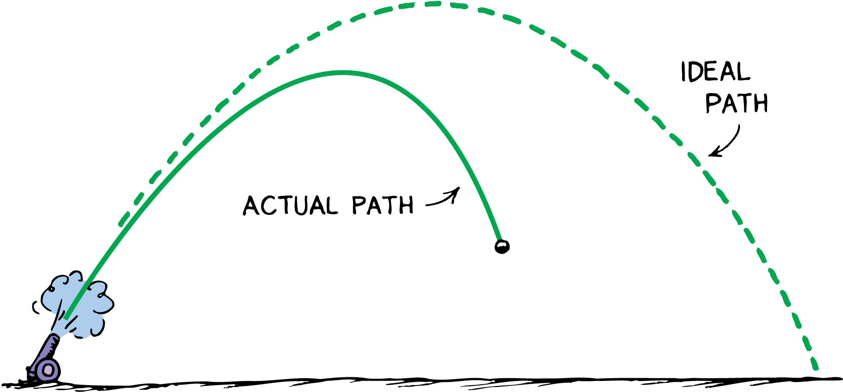
5.6 Projectiles Launched at an Angle
In the presence of air resistance, the path of a high-speed projectile falls below the idealized parabola and follows the solid curve.

Slide 59
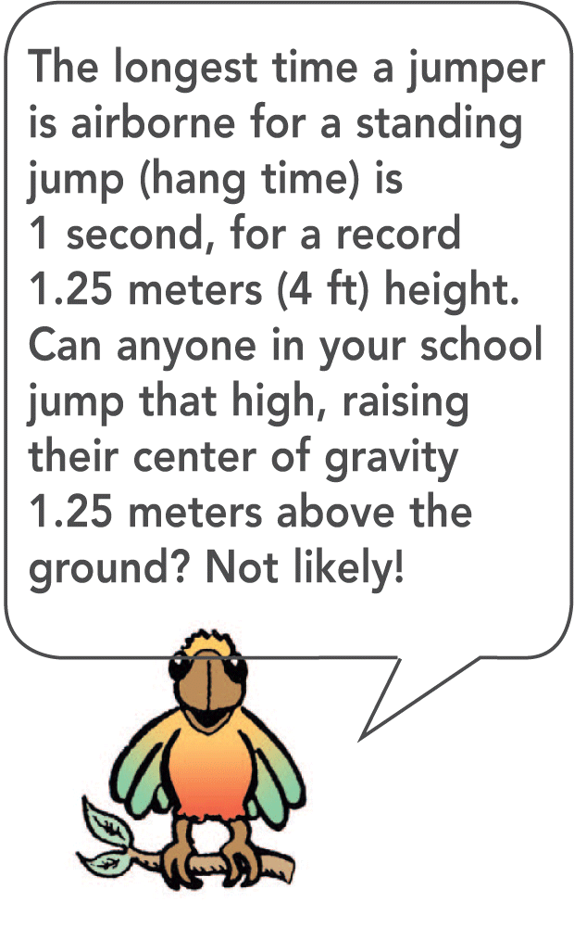
5.6 Projectiles Launched at an Angle

Slide 60
5.6 Projectiles Launched at an Angle
think!
A projectile is launched at an angle into the air. Neglecting air resistance, what is its vertical acceleration? Its horizontal acceleration?

Slide 61
5.6 Projectiles Launched at an Angle
think!
A projectile is launched at an angle into the air. Neglecting air resistance, what is its vertical acceleration? Its horizontal acceleration?
Answer: Its vertical acceleration is g because the force of gravity is downward. Its horizontal acceleration is zero because no horizontal force acts on it.

Slide 62
5.6 Projectiles Launched at an Angle
think!
At what point in its path does a projectile have minimum speed?

Slide 63
5.6 Projectiles Launched at an Angle
think!
At what point in its path does a projectile have minimum speed?
Answer: The minimum speed of a projectile occurs at the top of its path. If it is launched vertically, its speed at the top is zero. If it is projected at an angle, the vertical component of velocity is still zero at the top, leaving only the horizontal component.

Slide 64
5.6 Projectiles Launched at an Angle
Describe how far below an imaginary straight-line path a projectile falls.

Slide 65
Assessment Questions
Which of these expresses a vector quantity?
10 kg
10 kg to the north
10 m/s
10 m/s to the north

Slide 66
Assessment Questions
Which of these expresses a vector quantity?
10 kg
10 kg to the north
10 m/s
10 m/s to the north
Answer: D

Slide 67
Assessment Questions
An ultra-light aircraft traveling north at 40 km/h in a 30-km/h crosswind (at right angles) has a groundspeed of
30 km/h.
40 km/h.
50 km/h.
60 km/h.

Slide 68
Assessment Questions
An ultra-light aircraft traveling north at 40 km/h in a 30-km/h crosswind (at right angles) has a groundspeed of
30 km/h.
40 km/h.
50 km/h.
60 km/h.
Answer: C

Slide 69
Assessment Questions
A ball launched into the air at 45° to the horizontal initially has
equal horizontal and vertical components.
components that do not change in flight.
components that affect each other throughout flight.
a greater component of velocity than the vertical component.

Slide 70
Assessment Questions
A ball launched into the air at 45° to the horizontal initially has
equal horizontal and vertical components.
components that do not change in flight.
components that affect each other throughout flight.
a greater component of velocity than the vertical component.
Answer: A

Slide 71
Assessment Questions
When no air resistance acts on a fast-moving baseball, its acceleration is
downward, g.
due to a combination of constant horizontal motion and accelerated downward motion.
opposite to the force of gravity.
at right angles.

Slide 72
Assessment Questions
When no air resistance acts on a fast-moving baseball, its acceleration is
downward, g.
due to a combination of constant horizontal motion and accelerated downward motion.
opposite to the force of gravity.
at right angles.
Answer: A

Slide 73
Assessment Questions
When no air resistance acts on a projectile, its horizontal acceleration is
g.
at right angles to g.
upward, g.
zero.

Slide 74
Assessment Questions
When no air resistance acts on a projectile, its horizontal acceleration is
g.
at right angles to g.
upward, g.
zero.
Answer: D

Slide 75
Assessment Questions
Without air resistance, the time for a vertically tossed ball to return to where it was thrown is
10 m/s for every second in the air.
the same as the time going upward.
less than the time going upward.
more than the time going upward.

Slide 76
Assessment Questions
Without air resistance, the time for a vertically tossed ball to return to where it was thrown is
10 m/s for every second in the air.
the same as the time going upward.
less than the time going upward.
more than the time going upward.
Answer: B

