Slide 1
For every force, there is an equal and opposite force.

Slide 2
7.1 Forces and Interactions
A force is always part of a mutual action that involves another force.

Slide 3
7.1 Forces and Interactions
In the simplest sense, a force is a push or a pull.
A mutual action is an interaction between one thing and another.

Slide 4
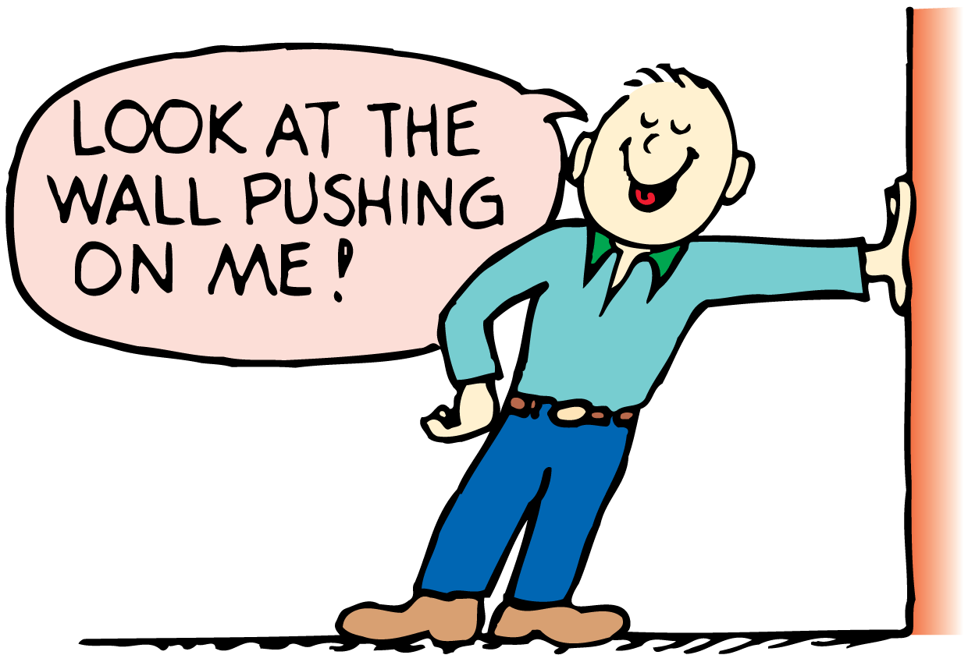
7.1 Forces and Interactions
When you push on the wall, the wall pushes on you.

Slide 5
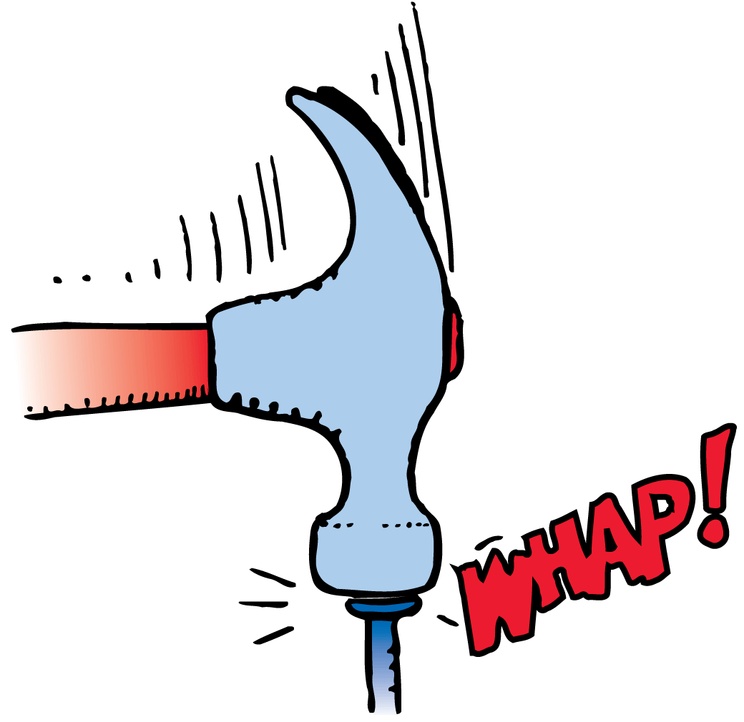
7.1 Forces and Interactions
The interaction that drives the nail is the same as the one that halts the hammer.

Slide 6
7.1 Forces and Interactions
A hammer exerts a force on the nail and drives it into a board.
There must also be a force exerted on the hammer to halt it in the process.
Newton reasoned that while the hammer exerts a force on the nail, the nail exerts a force on the hammer.
In the interaction, there are a pair of forces, one acting on the nail and the other acting on the hammer.

Slide 7
7.1 Forces and Interactions
think!
Does a stick of dynamite contain force? Explain.

Slide 8
7.1 Forces and Interactions
think!
Does a stick of dynamite contain force? Explain.
Answer: No. Force is not something an object has, like mass. Force is an interaction between one object and another. An object may possess the capability of exerting a force on another object, but it cannot possess force as a thing in itself. Later we will see that something like a stick of dynamite possesses energy.

Slide 9
7.1 Forces and Interactions
Why do forces always occur in pairs?

Slide 10
7.2 Newton’s Third Law
Newton’s third law states that whenever one object exerts a force on a second object, the second object exerts an equal and opposite force on the first object.

Slide 11
7.2 Newton’s Third Law
Newton’s third law describes the relationship between two forces in an interaction.
One force is called the action force.
The other force is called the reaction force.
Neither force exists without the other.
They are equal in strength and opposite in direction.
They occur at the same time (simultaneously).

Slide 12
7.2 Newton’s Third Law
Newton’s third law is often stated: “To every action there is always an equal opposing reaction.”
It doesn’t matter which force we call action and which we call reaction.

Slide 13
7.2 Newton’s Third Law
In every interaction, the forces always occur in pairs.
You push against the floor, and the floor simultaneously pushes against you.
The tires of a car interact with the road to produce the car’s motion. The tires push against the road, and the road simultaneously pushes back on the tires.
When swimming, you push the water backward, and the water pushes you forward.

Slide 14
7.2 Newton’s Third Law
The interactions in these examples depend on friction.
A person trying to walk on ice, where friction is minimal, may not be able to exert an action force against the ice.
Without the action force there cannot be a reaction force, and thus there is no resulting forward motion.

Slide 15
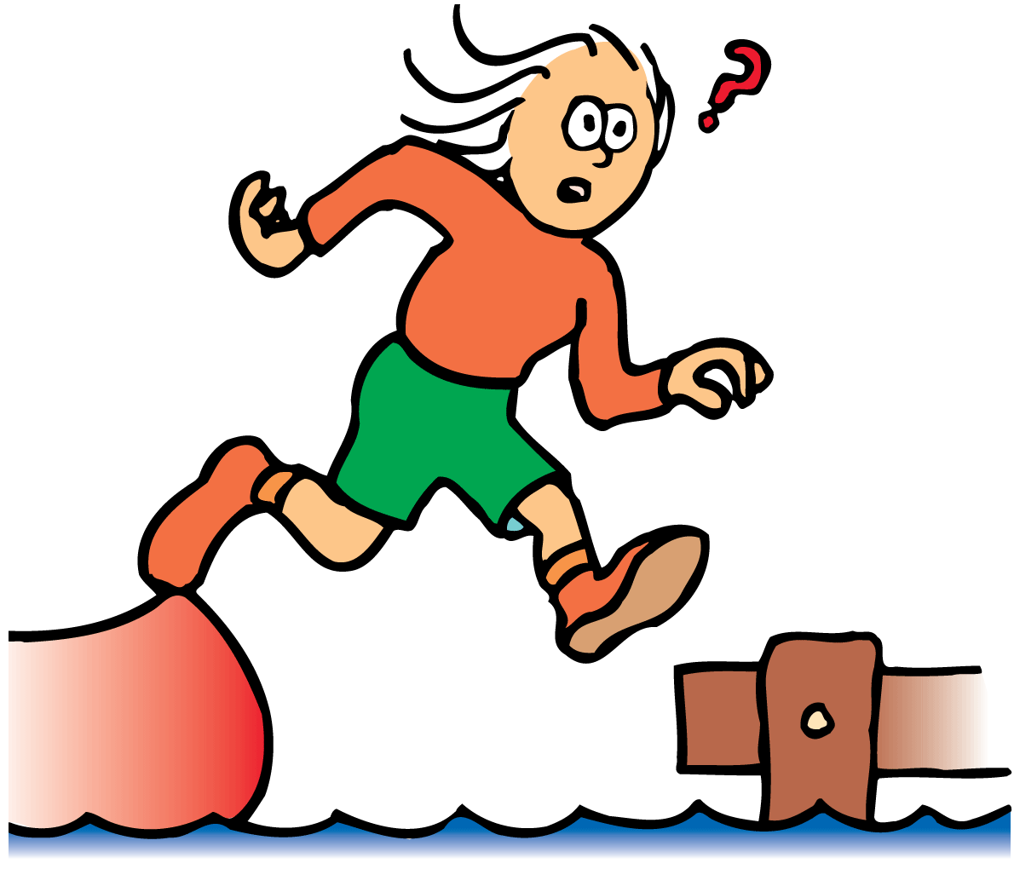
7.2 Newton’s Third Law
When the girl jumps to shore, the boat moves backward.

Slide 16
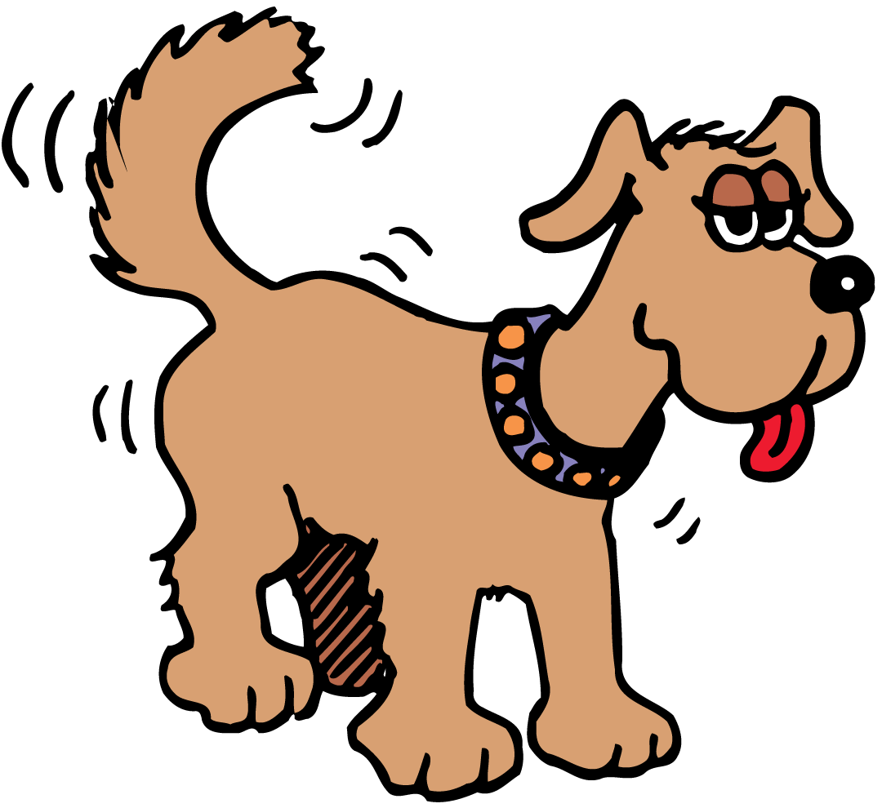
7.2 Newton’s Third Law
The dog wags the tail and the tail wags the dog.

Slide 17
7.2 Newton’s Third Law
What happens when an object exerts a force on another object?

Slide 18
7.3 Identifying Action and Reaction
To identify a pair of action-reaction forces, first identify the interacting objects A and B, and if the action is A on B, the reaction is B on A.

Slide 19
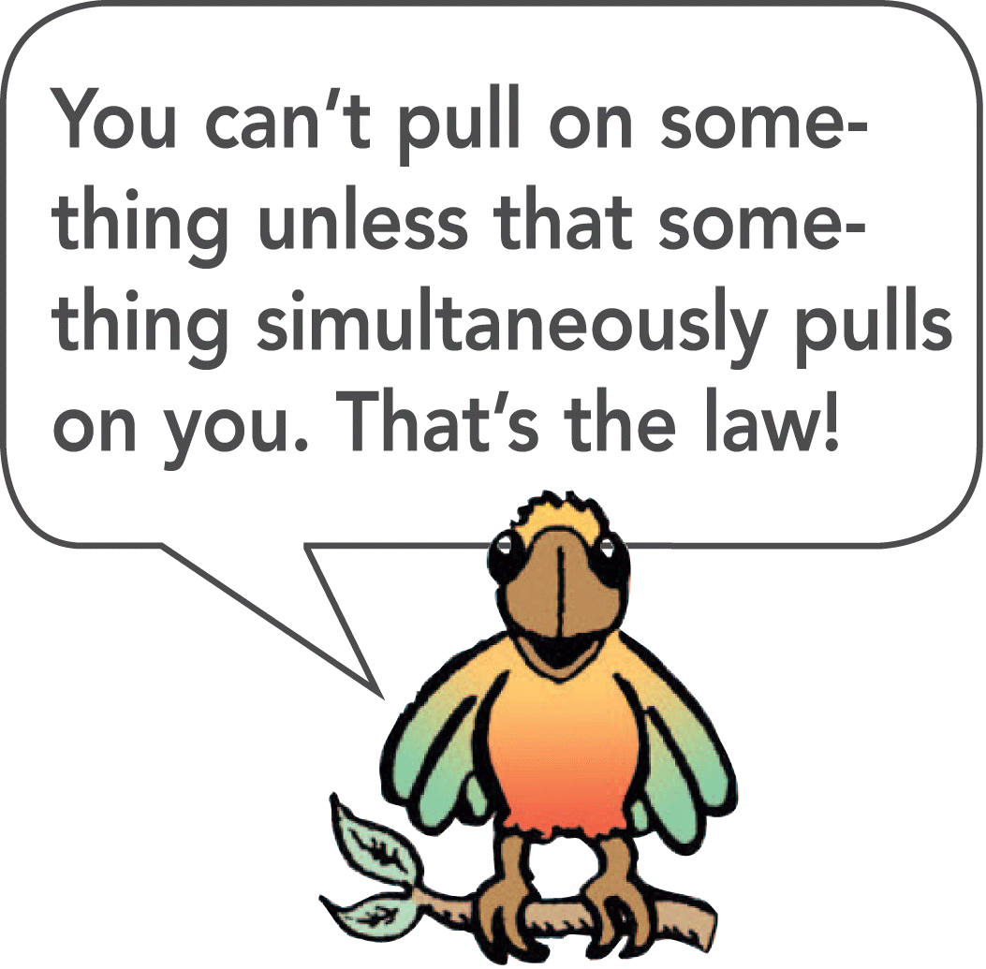
7.3 Identifying Action and Reaction
There is a simple recipe for treating action and reaction forces:
First identify the interaction. Let’s say one object, A, interacts with another object, B.
The action and reaction forces are stated in the form:
Action: Object A exerts a force on object B.
Reaction: Object B exerts a force on object A.

Slide 20
7.3 Identifying Action and Reaction
Sometimes the identity of the pair of action and reaction forces in an interaction is not immediately obvious.
For example, what are the action and reaction forces in the case of a falling boulder?
If we call the action Earth exerting a force on the boulder, then the reaction is the boulder simultaneously exerting a force on Earth.

Slide 21
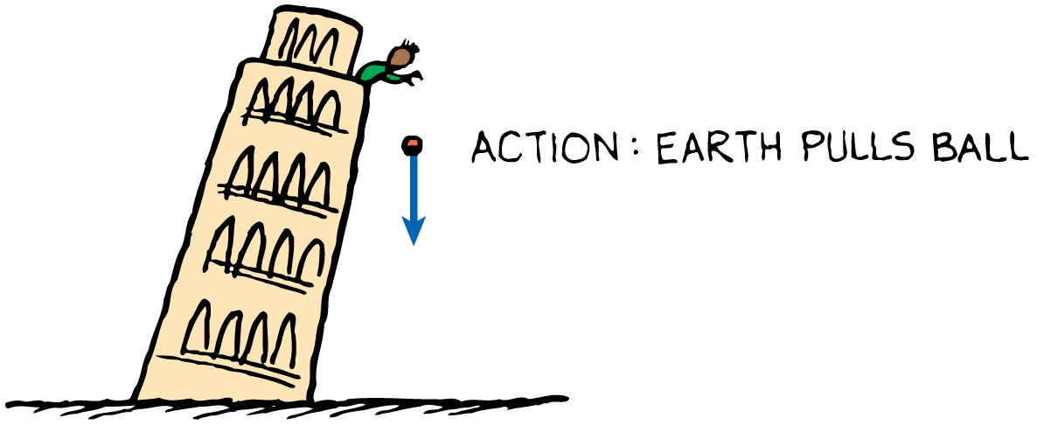
7.3 Identifying Action and Reaction
When action is A exerts force on B, the reaction is simply B exerts force on A.

Slide 22
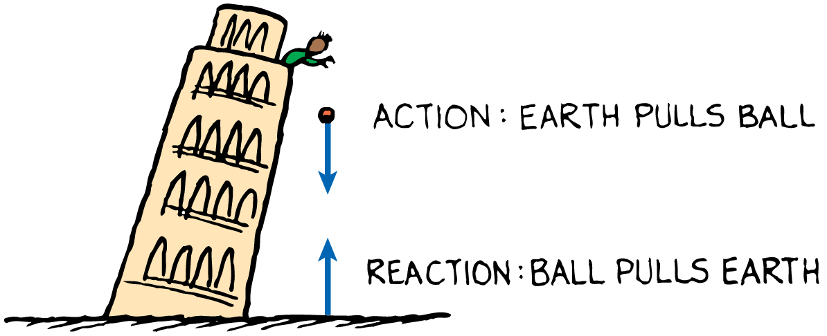
7.3 Identifying Action and Reaction
When action is A exerts force on B, the reaction is simply B exerts force on A.

Slide 23
7.3 Identifying Action and Reaction
think!
We know that Earth pulls on the moon. Does the moon also pull on Earth? If so, which pull is stronger?

Slide 24
7.3 Identifying Action and Reaction
think!
We know that Earth pulls on the moon. Does the moon also pull on Earth? If so, which pull is stronger?
Answer: Asking which pull is stronger is like asking which distance is greater—between New York and San Francisco, or between San Francisco and New York. The distances either way are the same. It is the same with force pairs. Both Earth and moon pull on each other with equal and opposite forces.

Slide 25
7.3 Identifying Action and Reaction
How do you identify the action-reaction forces in an interaction?

Slide 26
7.4 Action and Reaction on Different Masses
A given force exerted on a small mass produces a greater acceleration than the same force exerted on a large mass.

Slide 27
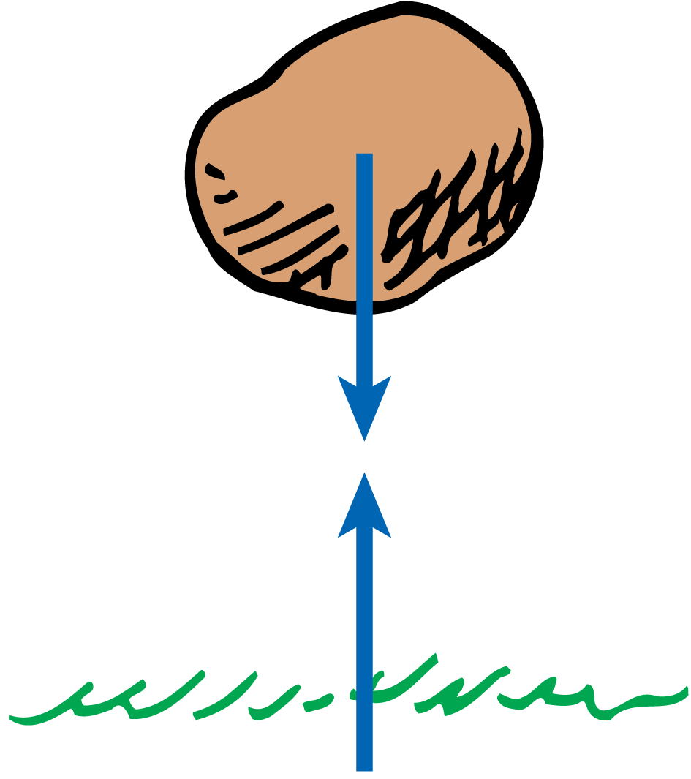
7.4 Action and Reaction on Different Masses
Earth is pulled up by the boulder with just as much force as the boulder is pulled down by Earth.

Slide 28
7.4 Action and Reaction on Different Masses
In the interaction between the boulder and Earth, the boulder pulls up on Earth with as much force as Earth pulls down on the boulder.
The forces are equal in strength and opposite in direction.
The boulder falls to Earth and Earth falls to the boulder, but the distance Earth falls is much less.

Slide 29
7.4 Action and Reaction on Different Masses
Although the pair of forces between the boulder and Earth is the same, the masses are quite unequal.
Acceleration is not only proportional to the net force, but it is also inversely proportional to the mass.
Because Earth has a huge mass, we don’t sense its infinitesimally small acceleration.

Slide 30
7.4 Action and Reaction on Different Masses
Force and Mass
When a cannon is fired, there is an interaction between the cannon and the cannonball.
The force the cannon exerts on the cannonball is exactly equal and opposite to the force the cannonball exerts on the cannon.
You might expect the cannon to kick more than it does.
The cannonball moves so fast compared with the cannon.
According to Newton’s second law, we must also consider the masses.

Slide 31
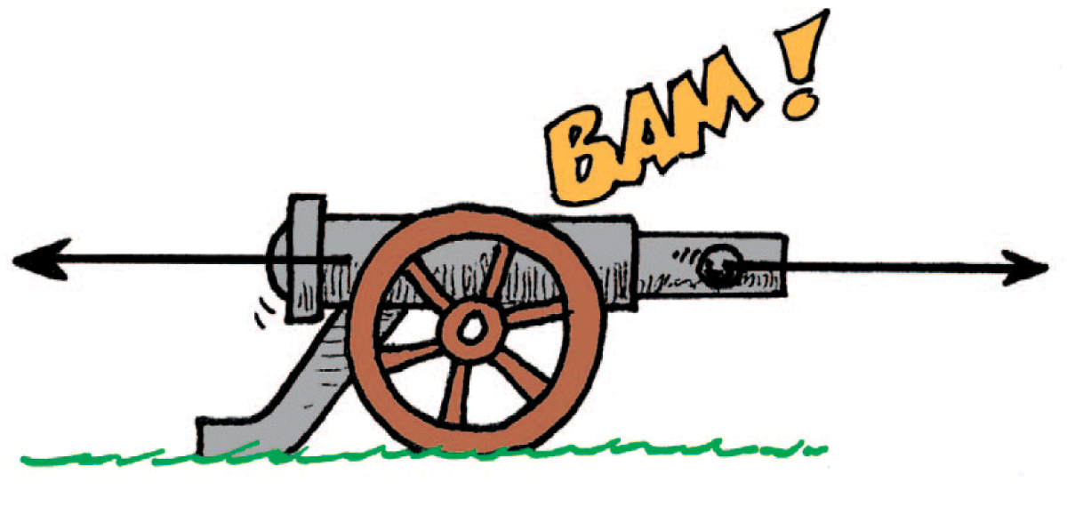
7.4 Action and Reaction on Different Masses
The cannonball undergoes more acceleration than the cannon because its mass is much smaller.

Slide 32
7.4 Action and Reaction on Different Masses
F represents both the action and reaction forces; m (large), the mass of the cannon; and m (small), the mass of the cannonball.
Do you see why the change in the velocity of the cannonball is greater compared with the change in velocity of the cannon?

Slide 33
7.4 Action and Reaction on Different Masses
We can extend the basic idea of a cannon recoiling from the cannonball it launches to understand rocket propulsion.

Slide 34
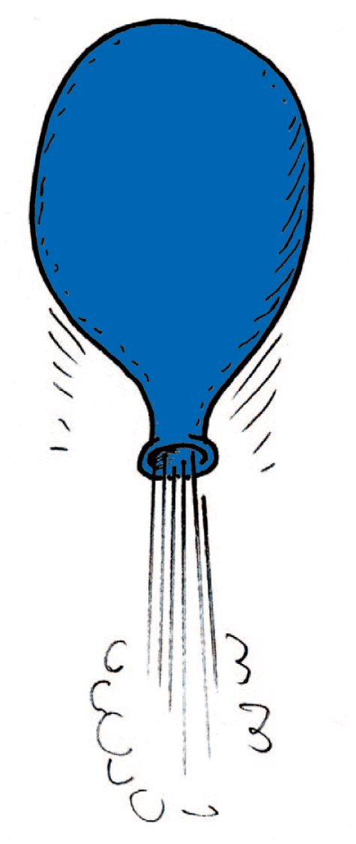
7.4 Action and Reaction on Different Masses
The balloon recoils from the escaping air and climbs upward.

Slide 35
7.4 Action and Reaction on Different Masses
If a balloon is released and allowed to move, it accelerates as the air comes out.
A rocket accelerates in much the same way—it continually recoils from the exhaust gases ejected from its engine.
Each molecule of exhaust gas acts like a tiny molecular cannonball shot downward from the rocket.

Slide 36
7.4 Action and Reaction on Different Masses
A common misconception is that a rocket is propelled by the impact of exhaust gases against the atmosphere.
Both the rocket and recoiling cannon accelerate because of the reaction forces created by the “cannonballs” they fire—air or no air.
In fact, rockets work better above the atmosphere where there is no air resistance.

Slide 37
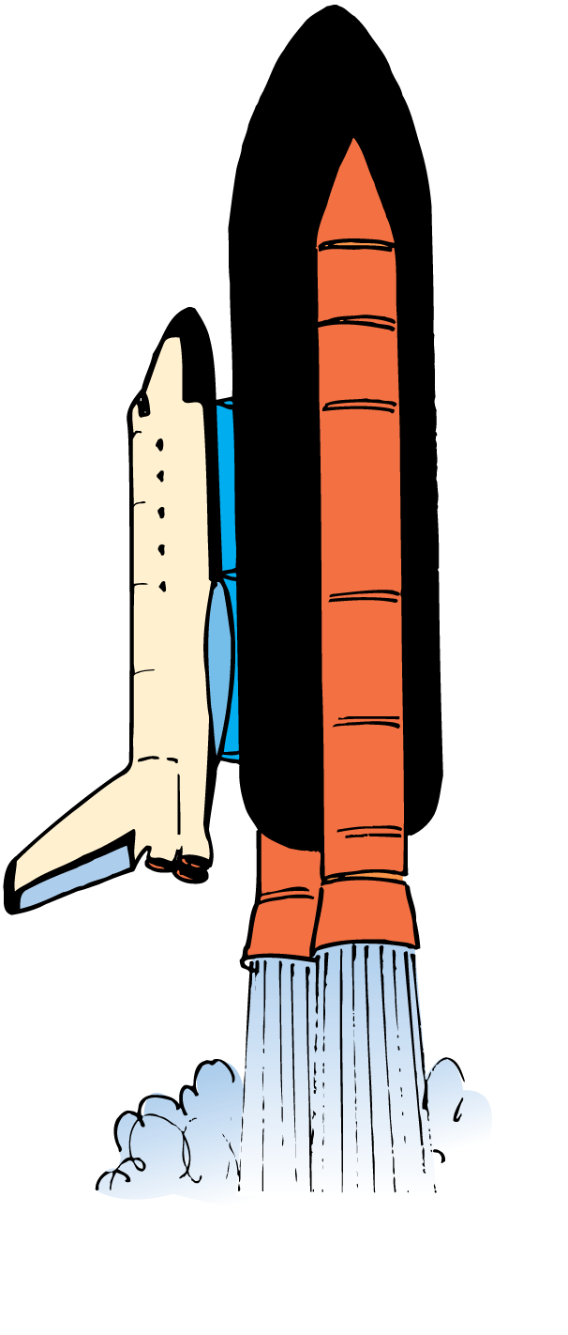
7.4 Action and Reaction on Different Masses
The rocket recoils from the “molecular cannonballs” it fires and climbs upward.

Slide 38
7.4 Action and Reaction on Different Masses
Lift
Using Newton’s third law, we can understand how a helicopter gets its lifting force.
The whirling blades force air particles downward (action).
The air forces the blades upward (reaction).
This upward reaction force is called lift.
When lift equals the weight of the craft, the helicopter hovers in midair. When lift is greater, the helicopter climbs upward.

Slide 39
7.4 Action and Reaction on Different Masses
Birds and airplanes also fly because of action and reaction forces.
When a bird is soaring, the shape of its wings deflects air downward. The air in turn pushes the bird upward.
The slightly tilted wings of an airplane also deflect oncoming air downward and produce lift.

Slide 40
7.4 Action and Reaction on Different Masses
think!
A tug of war occurs between boys and girls on a polished floor that’s somewhat slippery. If the boys are wearing socks and the girls are wearing rubber-soled shoes, who will surely win, and why?

Slide 41
7.4 Action and Reaction on Different Masses
think!
A tug of war occurs between boys and girls on a polished floor that’s somewhat slippery. If the boys are wearing socks and the girls are wearing rubber-soled shoes, who will surely win, and why?
Answer: The girls will win. The force of friction is greater between the girls’ feet and the floor than between the boys’ feet and the floor. When both the girls and the boys exert action forces on the floor, the floor exerts a greater reaction force on the girls’ feet. The girls stay at rest and the boys slide toward the girls.

Slide 42
7.4 Action and Reaction on Different Masses
Why do objects that experience the same amount of force accelerate at different rates?

Slide 43
7.5 Defining Systems
Action and reaction forces do not cancel each other when either of the forces is external to the system being considered.

Slide 44
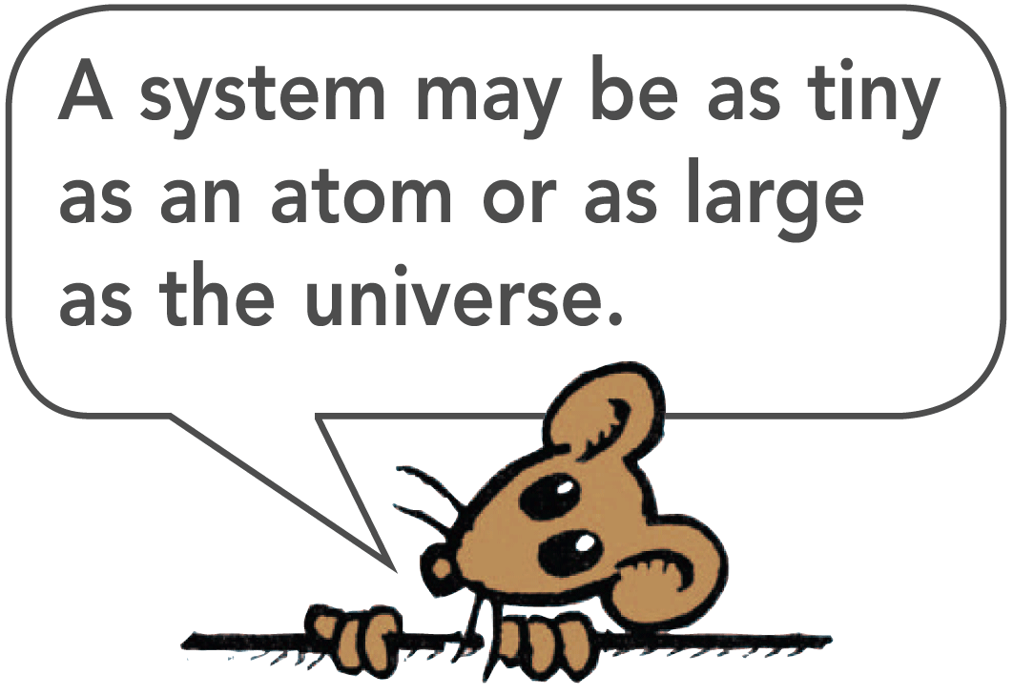
7.5 Defining Systems
Since action and reaction forces are equal and opposite, why don’t they cancel to zero?
To answer this question, we must consider the system involved.

Slide 45
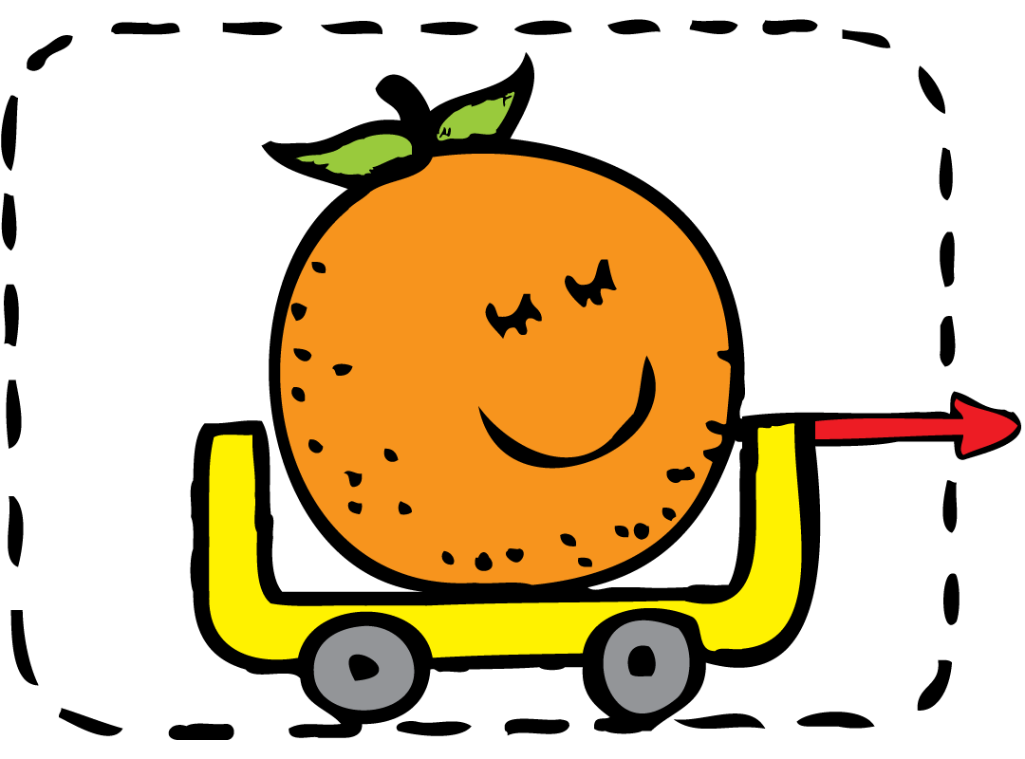
7.5 Defining Systems
A force acts on the orange, and the orange accelerates to the right.
The dashed line surrounding the orange encloses and defines the system.

Slide 46
7.5 Defining Systems
The vector that pokes outside the dashed line represents an external force on the system.
The system (that is, the orange) accelerates in accord with Newton’s second law.

Slide 47
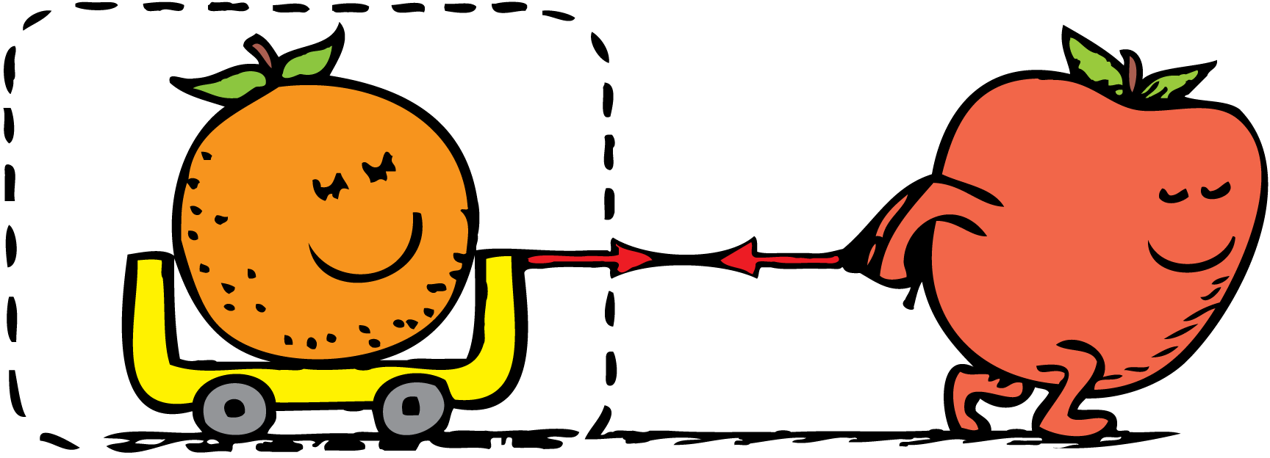
7.5 Defining Systems
The force on the orange, provided by the apple, is not cancelled by the reaction force on the apple. The orange still accelerates.

Slide 48
7.5 Defining Systems
The force is provided by an apple, which doesn’t change our analysis. The apple is outside the system.
The fact that the orange simultaneously exerts a force on the apple, which is external to the system, may affect the apple (another system), but not the orange.
You can’t cancel a force on the orange with a force on the apple. So in this case the action and reaction forces don’t cancel.

Slide 49
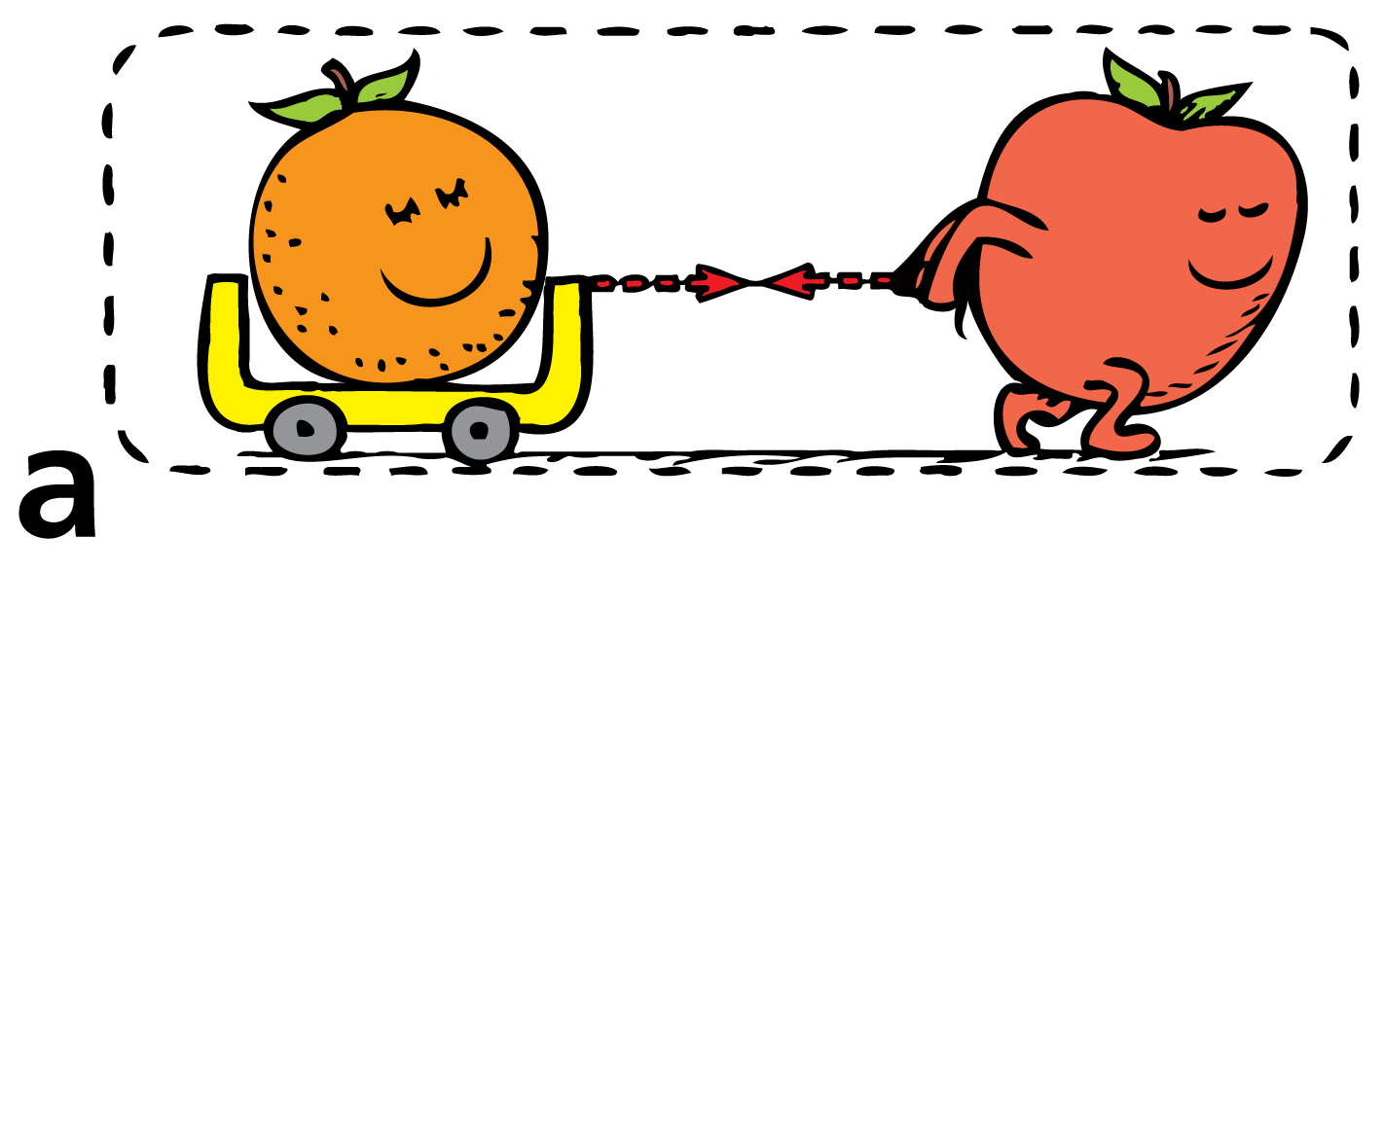
7.5 Defining Systems
Action and reaction forces cancel.

Slide 50
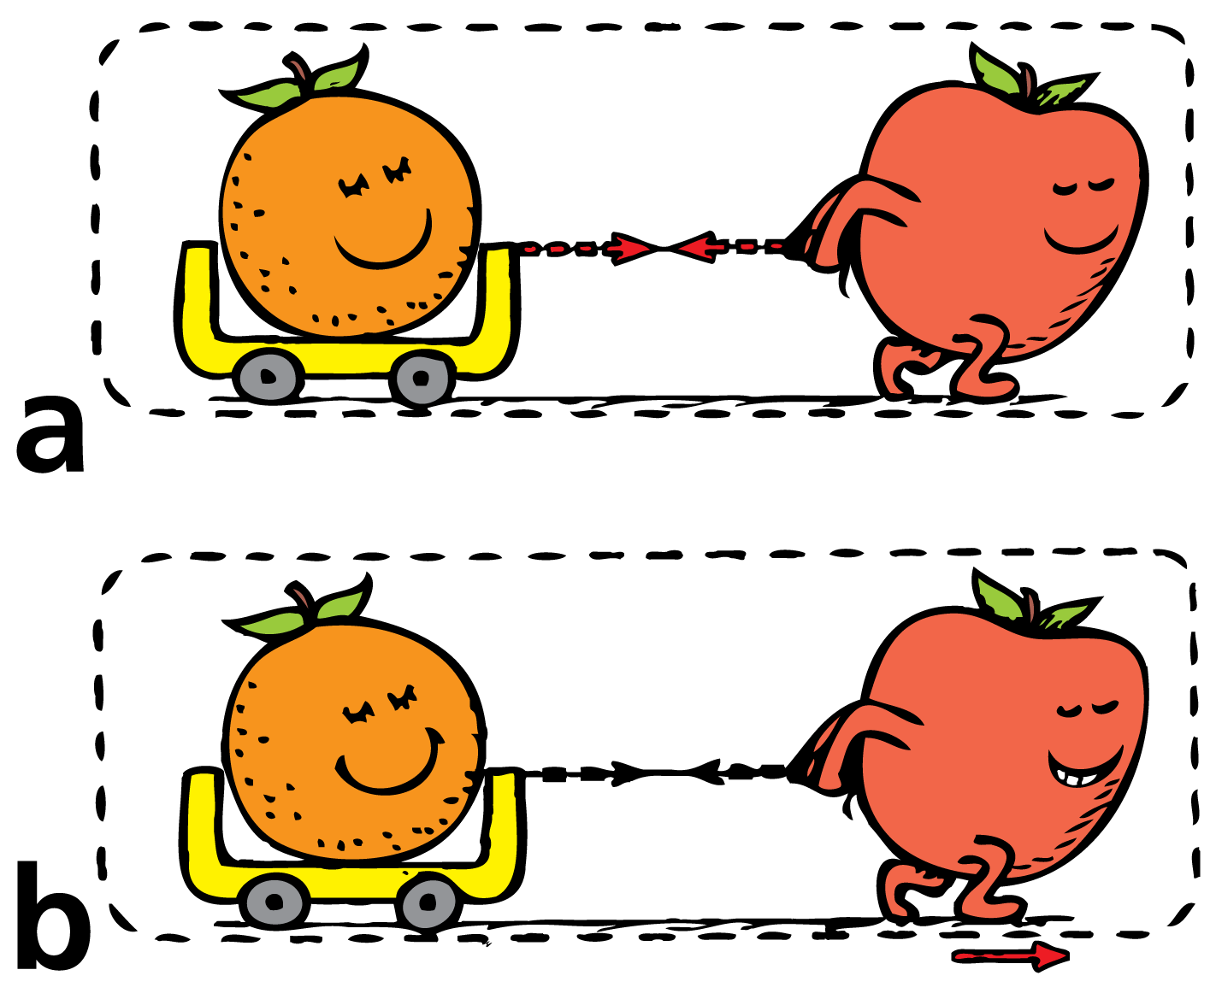
7.5 Defining Systems
Action and reaction forces cancel.
When the floor pushes on the apple (reaction to the apple’s push on the floor), the orange-apple system accelerates.

Slide 51
7.5 Defining Systems
When the force pair is internal to the orange-apple system, the forces do cancel each other. They play no role in accelerating the system.
A force external to the system is needed for acceleration.
When the apple pushes against the floor, the floor simultaneously pushes on the apple—an external force on the system.
The system accelerates to the right.

Slide 52
7.5 Defining Systems
Inside a baseball, trillions of interatomic forces hold the ball together but play no role in accelerating the ball. They are part of action-reaction pairs within the ball, but they combine to zero.
If the action-reaction forces are internal to the system, then they cancel and the system does not accelerate.
A force external to the ball, such as a swinging bat provides, is needed to accelerate the ball.

Slide 53
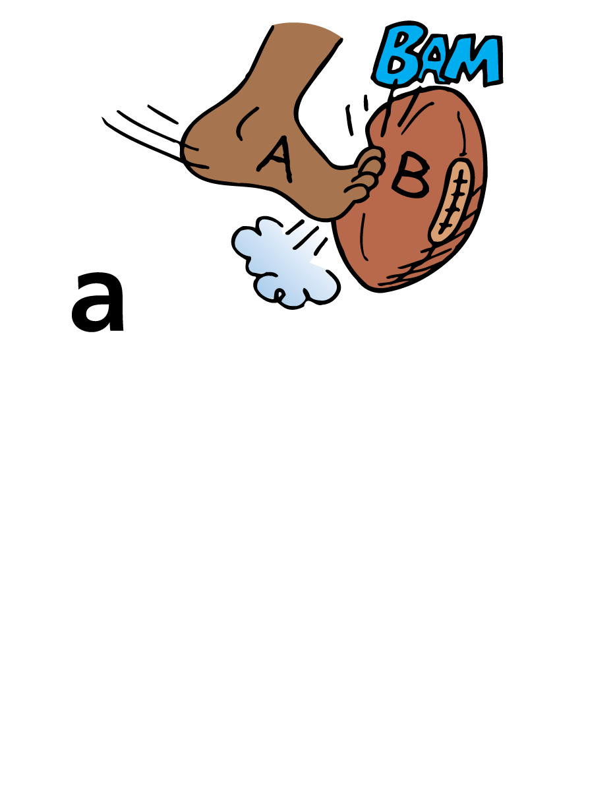
7.5 Defining Systems
A football is kicked.
A acts on B and B accelerates.

Slide 54
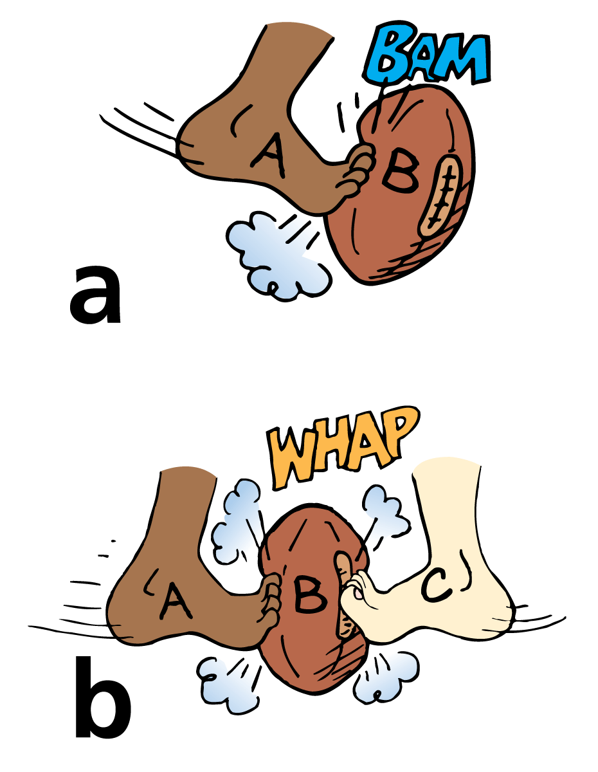
7.5 Defining Systems
A football is kicked.
A acts on B and B accelerates.
Both A and C act on B. They can cancel each other so B does not accelerate.

Slide 55
7.5 Defining Systems
When there is one interaction between the foot and the football, the ball accelerates.
If two kicks on the ball are simultaneous, equal, and opposite, then the net force on the ball is zero.
The opposing forces act on the same object, not on different objects, so they do not make up an action-reaction pair.

Slide 56
7.5 Defining Systems
think!
Suppose a friend who hears about Newton’s third law says that you can’t move a football by kicking it because the reaction force by the kicked ball would be equal and opposite to your kicking force. The net force would be zero, so no matter how hard you kick, the ball won’t move! What do you say to your friend?

Slide 57
7.5 Defining Systems
think!
Suppose a friend who hears about Newton’s third law says that you can’t move a football by kicking it because the reaction force by the kicked ball would be equal and opposite to your kicking force. The net force would be zero, so no matter how hard you kick, the ball won’t move! What do you say to your friend?
Answer: If you kick a football, it will accelerate. No other force has been applied to the ball. Tell your friend that you can’t cancel a force on the ball with a force on your foot.

Slide 58
7.5 Defining Systems
Why don’t action-reaction forces cancel each other?

Slide 59
7.6 The Horse-Cart Problem
If the horse in the horse-cart system pushes the ground with a greater force than it pulls on the cart, there is a net force on the horse, and the horse-cart system accelerates.

Slide 60
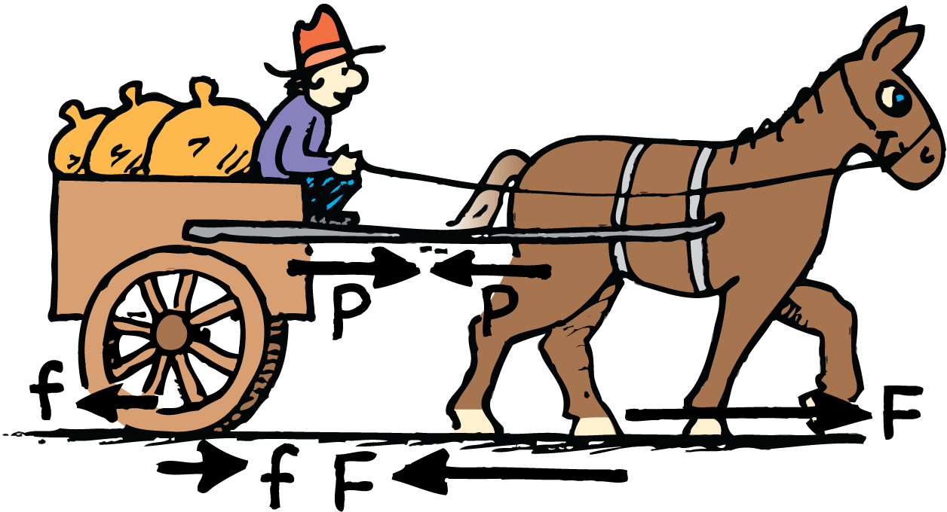
7.6 The Horse-Cart Problem
All the pairs of forces that act on the horse and cart are shown. The acceleration of the horse-cart system is due to the net force F – f.

Slide 61
7.6 The Horse-Cart Problem
Will the horse’s pull on the cart be canceled by the opposite and equal pull by the cart on the horse, thus making acceleration impossible?
From the farmer’s point of view, the only concern is with the force that is exerted on the cart system.
The net force on the cart, divided by the mass of the cart, is the acceleration.
The farmer doesn’t care about the reaction on the horse.

Slide 62
7.6 The Horse-Cart Problem
Now look at the horse system.
The opposite reaction force by the cart on the horse restrains the horse.
Without this force, the horse could freely gallop to the market.
The horse moves forward by interacting with the ground.
When the horse pushes backward on the ground, the ground simultaneously pushes forward on the horse.

Slide 63
7.6 The Horse-Cart Problem
Look at the horse-cart system as a whole.
The pull of the horse on the cart and the reaction of the cart on the horse are internal forces within the system.
They contribute nothing to the acceleration of the horse-cart system. They cancel and can be neglected.

Slide 64
7.6 The Horse-Cart Problem
To move across the ground, there must be an interaction between the horse-cart system and the ground.
It is the outside reaction by the ground that pushes the system.

Slide 65
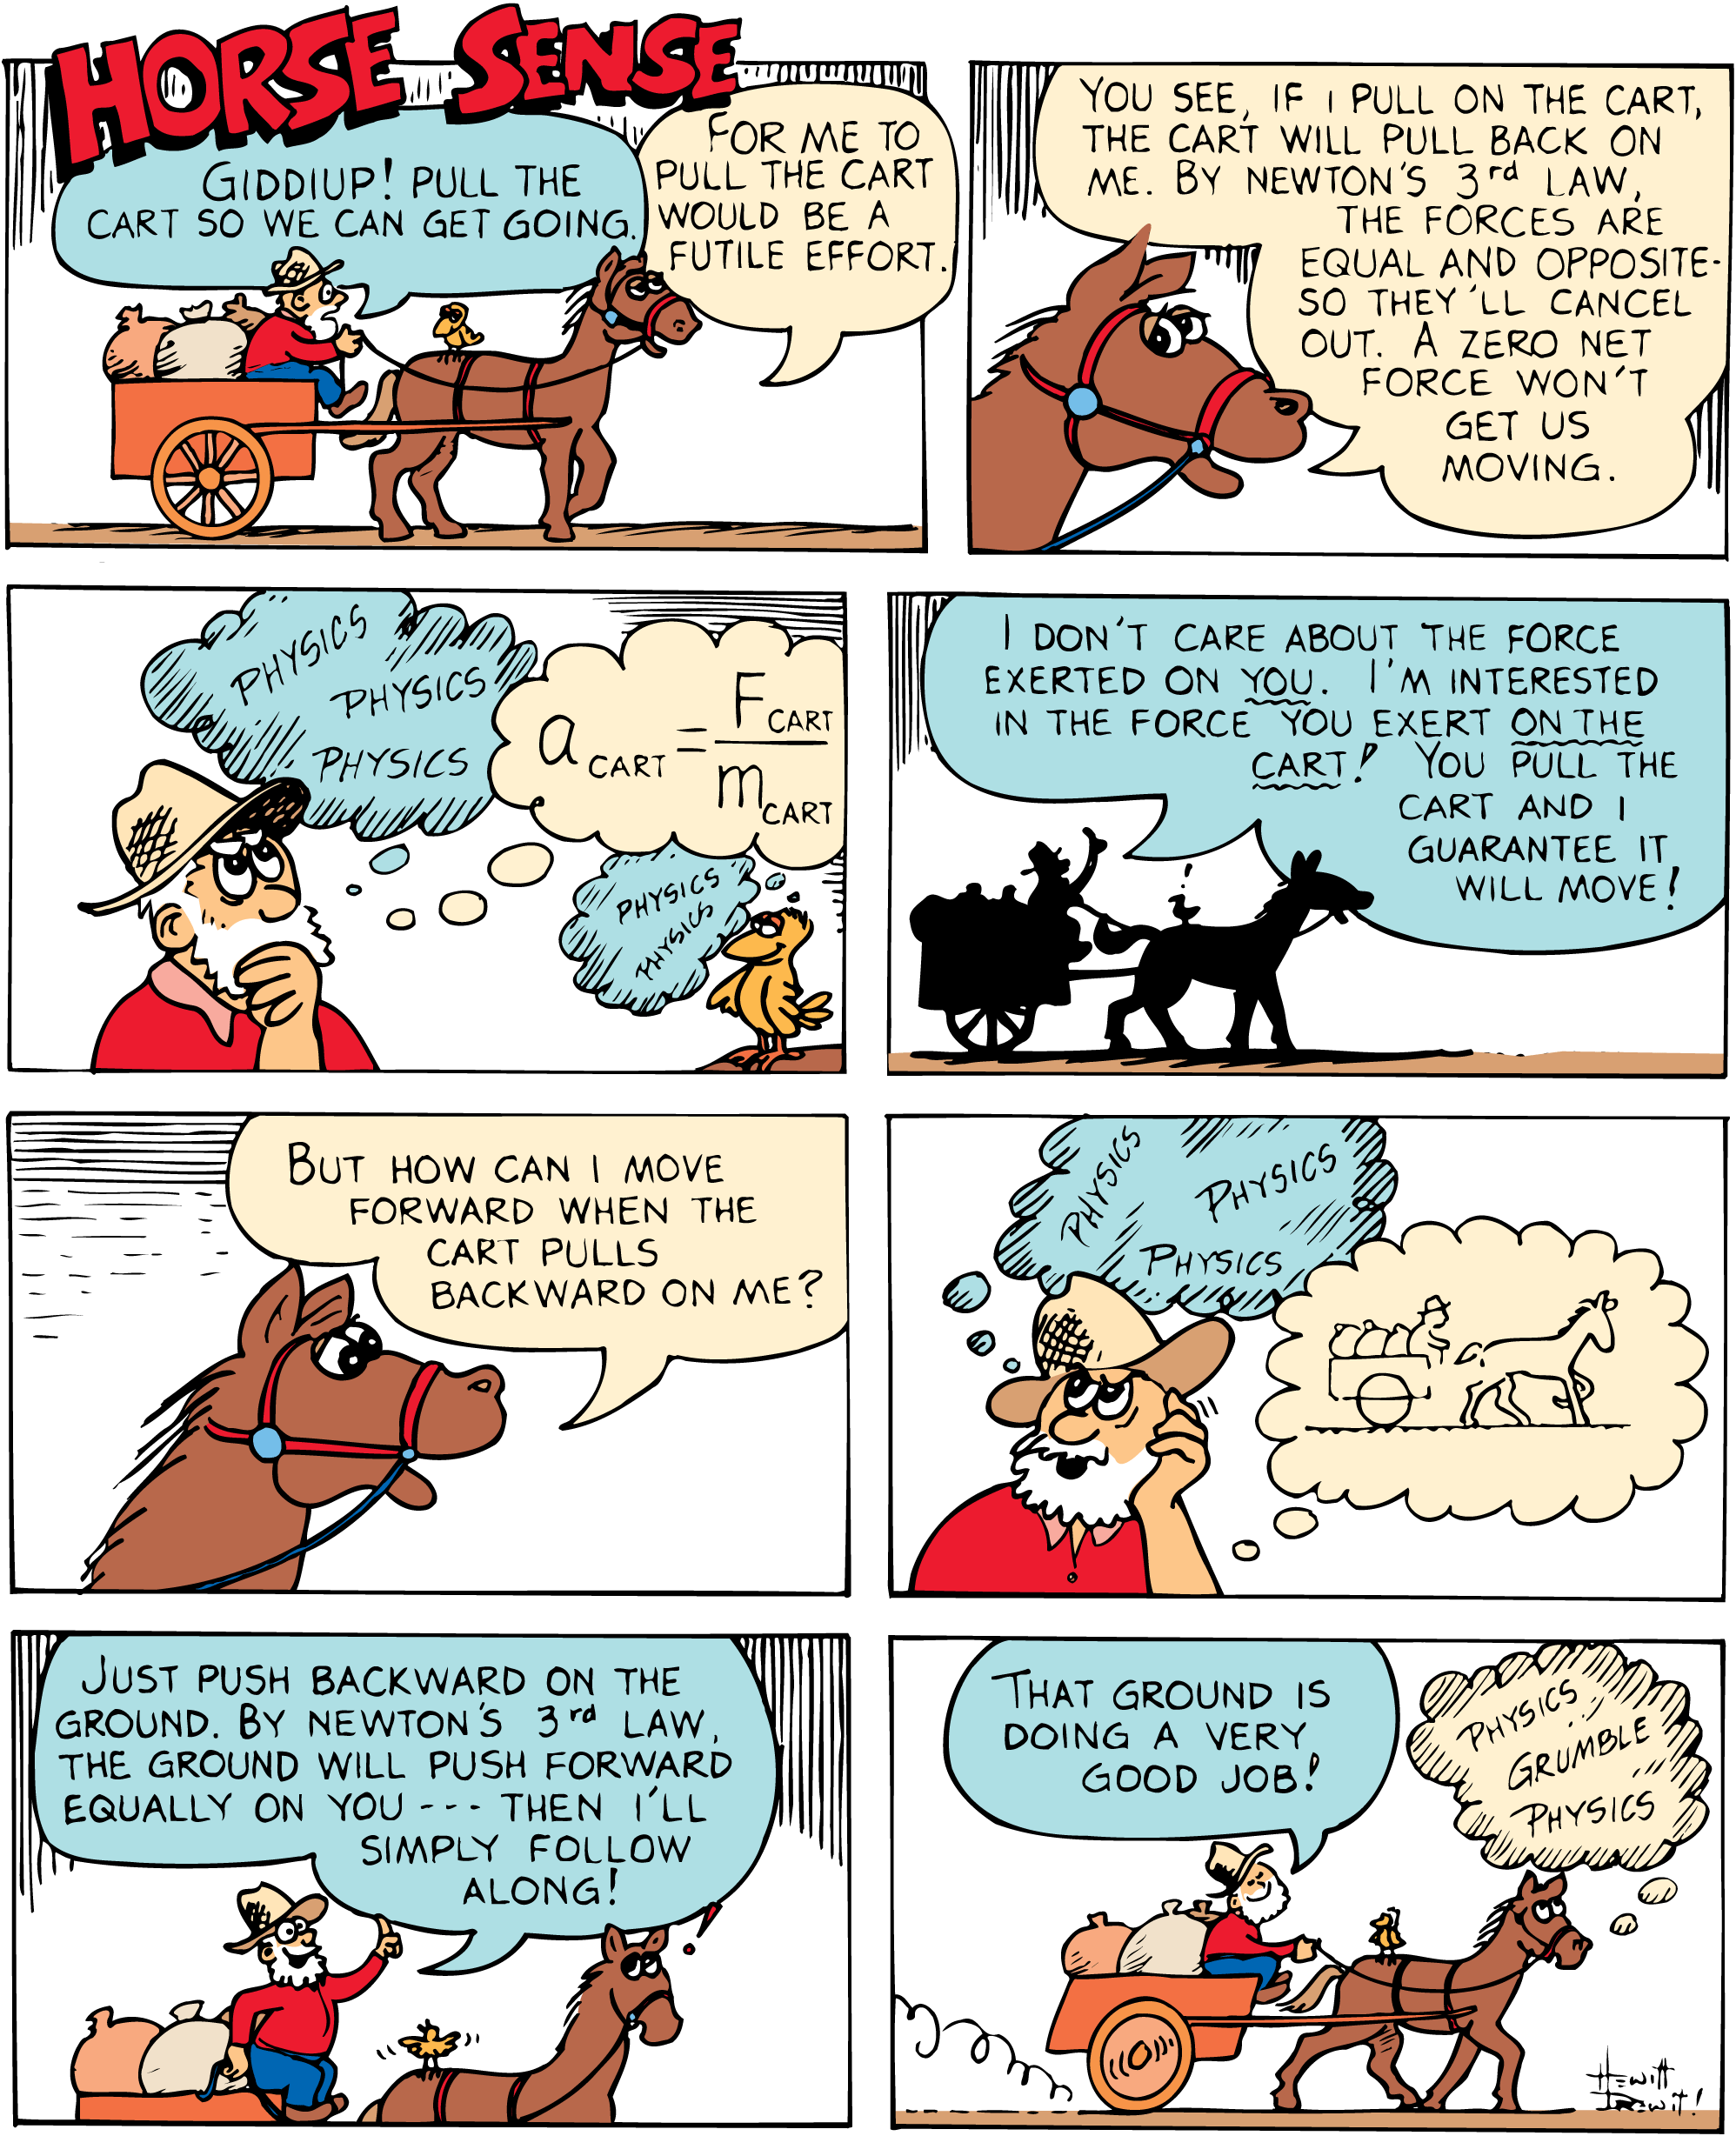
7.6 The Horse-Cart Problem

Slide 66
7.6 The Horse-Cart Problem
think!
What is the net force that acts on the cart? On the horse? On the ground?

Slide 67
7.6 The Horse-Cart Problem
think!
What is the net force that acts on the cart? On the horse? On the ground?
Answer: The net force on the cart is P–f; on the horse, F–P; on the ground F–f.

Slide 68
7.6 The Horse-Cart Problem
How does a horse-cart system accelerate?

Slide 69
7.7 Action Equals Reaction
For every interaction between things, there is always a pair of oppositely directed forces that are equal in strength.

Slide 70
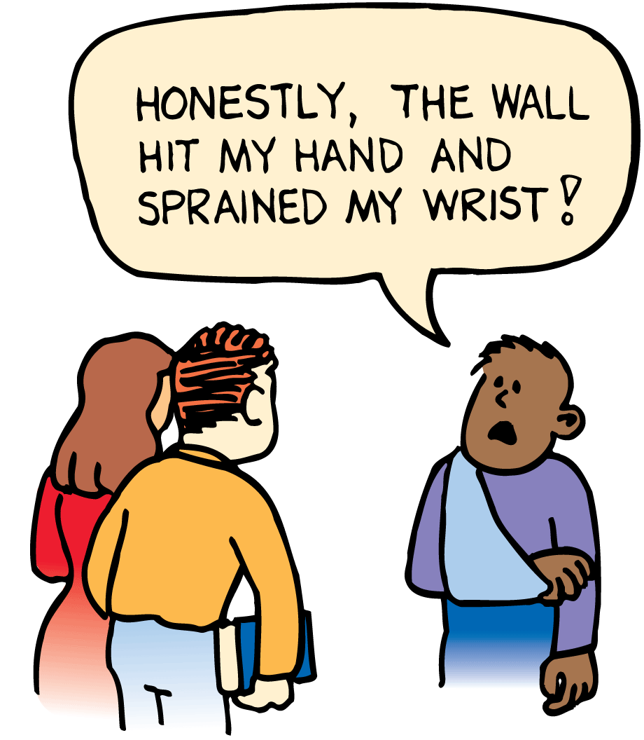
7.7 Action Equals Reaction
If you hit the wall, it will hit you equally hard.

Slide 71
7.7 Action Equals Reaction
If a sheet of paper is held in midair, the heavyweight champion of the world could not strike the paper with a force of 200 N (45 pounds).
The paper is not capable of exerting a reaction force of 200 N, and you cannot have an action force without a reaction force.
If the paper is against the wall, then the wall will easily assist the paper in providing 200 N of reaction force, and more if needed!

Slide 72
7.7 Action Equals Reaction
If you push hard on the world, for example, the world pushes hard on you.
If you touch the world gently, the world will touch you gently in return.

Slide 73
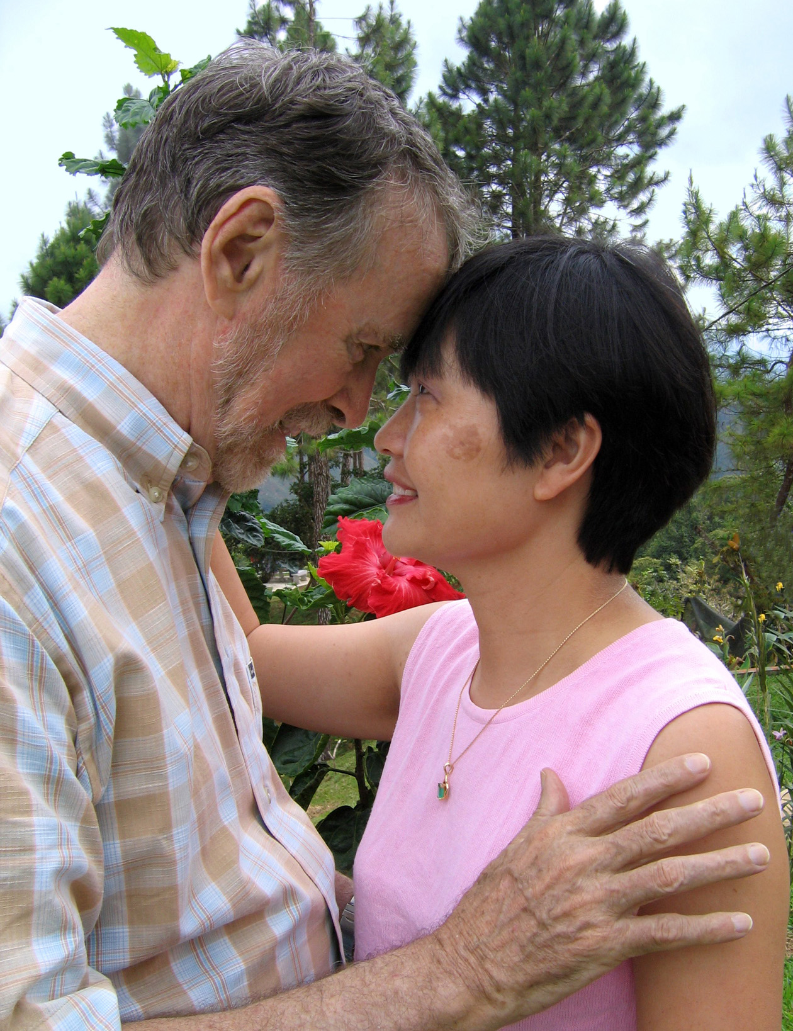
7.7 Action Equals Reaction
You cannot touch without being touched—Newton’s third law.

Slide 74
7.7 Action Equals Reaction
What must occur in every interaction between things?

Slide 75
Assessment Questions
A force interaction requires at least a(n)
single force.
pair of forces.
action force.
reaction force.

Slide 76
Assessment Questions
A force interaction requires at least a(n)
single force.
pair of forces.
action force.
reaction force.
Answer: B

Slide 77
Assessment Questions
Whenever one object exerts a force on a second object, the second object exerts a force on the first that is
opposite in direction and equal in magnitude at the same time.
in the same direction and equal in magnitude a moment later.
opposite in direction and greater in magnitude at the same time.
in the same direction and weaker in magnitude a moment later.

Slide 78
Assessment Questions
Whenever one object exerts a force on a second object, the second object exerts a force on the first that is
opposite in direction and equal in magnitude at the same time.
in the same direction and equal in magnitude a moment later.
opposite in direction and greater in magnitude at the same time.
in the same direction and weaker in magnitude a moment later.
Answer: A

Slide 79
Assessment Questions
The force that directly propels a motor scooter along a highway is that provided by the
engine.
fuel.
tires.
road.

Slide 80
Assessment Questions
The force that directly propels a motor scooter along a highway is that provided by the
engine.
fuel.
tires.
road.
Answer: D

Slide 81
Assessment Questions
When you jump vertically upward, strictly speaking, you cause Earth to
move downward.
also move upward with you.
remain stationary.
move sideways a bit.

Slide 82
Assessment Questions
When you jump vertically upward, strictly speaking, you cause Earth to
move downward.
also move upward with you.
remain stationary.
move sideways a bit.
Answer: A

Slide 83
Assessment Questions
A system undergoes acceleration only when acted on by a(n)
net force.
pair of forces.
action and reaction forces.
internal interactions.

Slide 84
Assessment Questions
A system undergoes acceleration only when acted on by a(n)
net force.
pair of forces.
action and reaction forces.
internal interactions.
Answer: A

Slide 85
Assessment Questions
If a net force acts on a horse while it is pulling a wagon, the horse
accelerates.
is restrained.
is pulled backward by an equal and opposite net force.
cannot move.

Slide 86
Assessment Questions
If a net force acts on a horse while it is pulling a wagon, the horse
accelerates.
is restrained.
is pulled backward by an equal and opposite net force.
cannot move.
Answer: A

Slide 87
Assessment Questions
At a pizza shop, the cook throws the pizza dough in the air. The amount of force the cook exerts on the dough depends on the
mass of the dough.
strength of the cook.
weight of the dough.
height of the cook.

Slide 88
Assessment Questions
At a pizza shop, the cook throws the pizza dough in the air. The amount of force the cook exerts on the dough depends on the
mass of the dough.
strength of the cook.
weight of the dough.
height of the cook.
Answer: A

