Slide 1
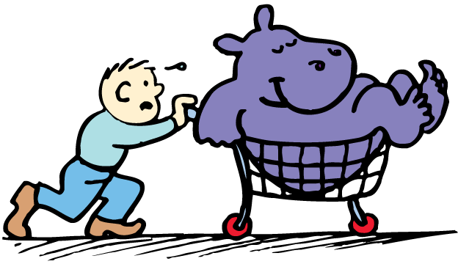
An object accelerates when a net force acts on it.

Slide 2
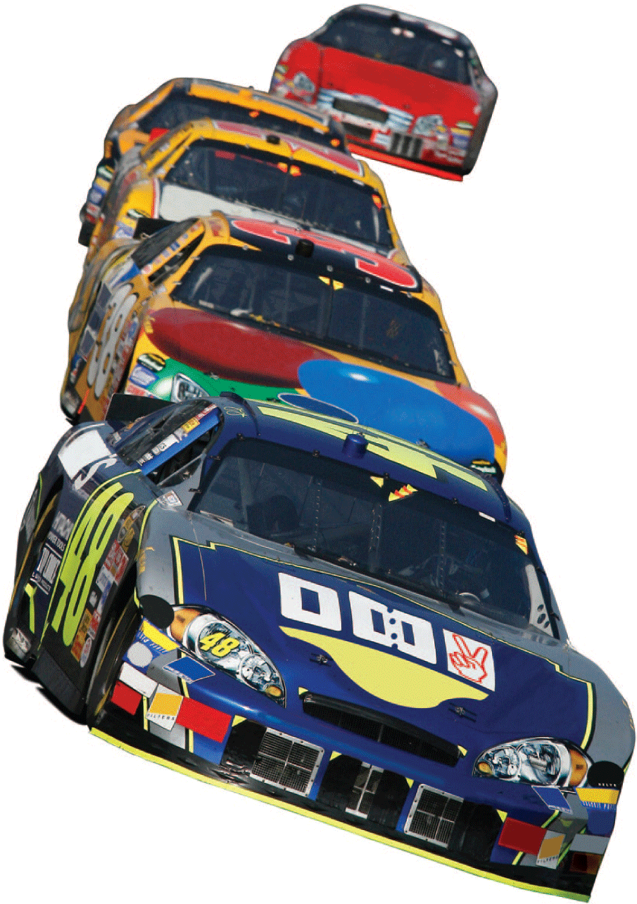
Recall the definition of acceleration:
The cause of acceleration is force.

Slide 3
6.1 Force Causes Acceleration
Unbalanced forces acting on an object cause the object to accelerate.

Slide 4
6.1 Force Causes Acceleration
When a hockey puck is at rest, the net force on it (gravity and the support force) is balanced, so the puck is in equilibrium.
Hit the puck (that is, apply an unbalanced force to it) and the puck experiences a change in motion—it accelerates.
Apply another force by striking the puck again, and the puck’s motion changes again.

Slide 5
6.1 Force Causes Acceleration
Recall from the previous chapter that the combination of forces acting on an object is the net force.
Acceleration depends on the net force.
To increase the acceleration of an object, you must increase the net force acting on it.
An object’s acceleration is directly proportional to the net force acting on it:
acceleration ~ net force
(The symbol ~ stands for “is directly proportional to.”)

Slide 6
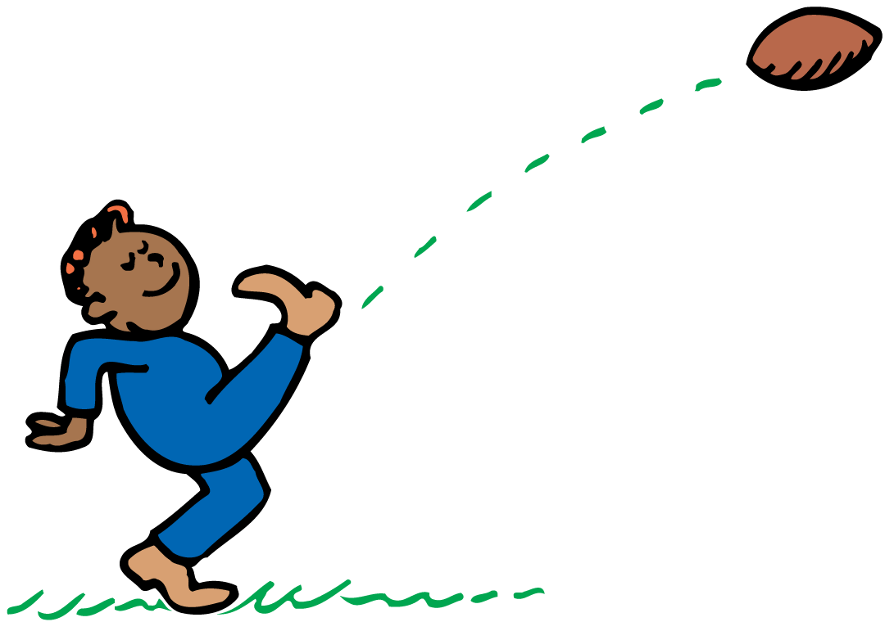
6.1 Force Causes Acceleration
Kick a football and it neither remains at rest nor moves in a straight line.

Slide 7
6.1 Force Causes Acceleration
What causes an object to accelerate?

Slide 8
6.2 Mass Resists Acceleration
For a constant force, an increase in the mass will result in a decrease in the acceleration.

Slide 9
6.2 Mass Resists Acceleration
Push on an empty shopping cart. Then push equally hard on a heavily loaded shopping cart.
The loaded shopping cart will accelerate much less than the empty cart.
Acceleration depends on the mass being pushed.

Slide 10
6.2 Mass Resists Acceleration
The same force applied to twice as much mass results in only half the acceleration.
The acceleration is inversely proportional to the mass.
Inversely means that the two values change in opposite directions. As the denominator increases, the whole quantity decreases by the same factor.

Slide 11
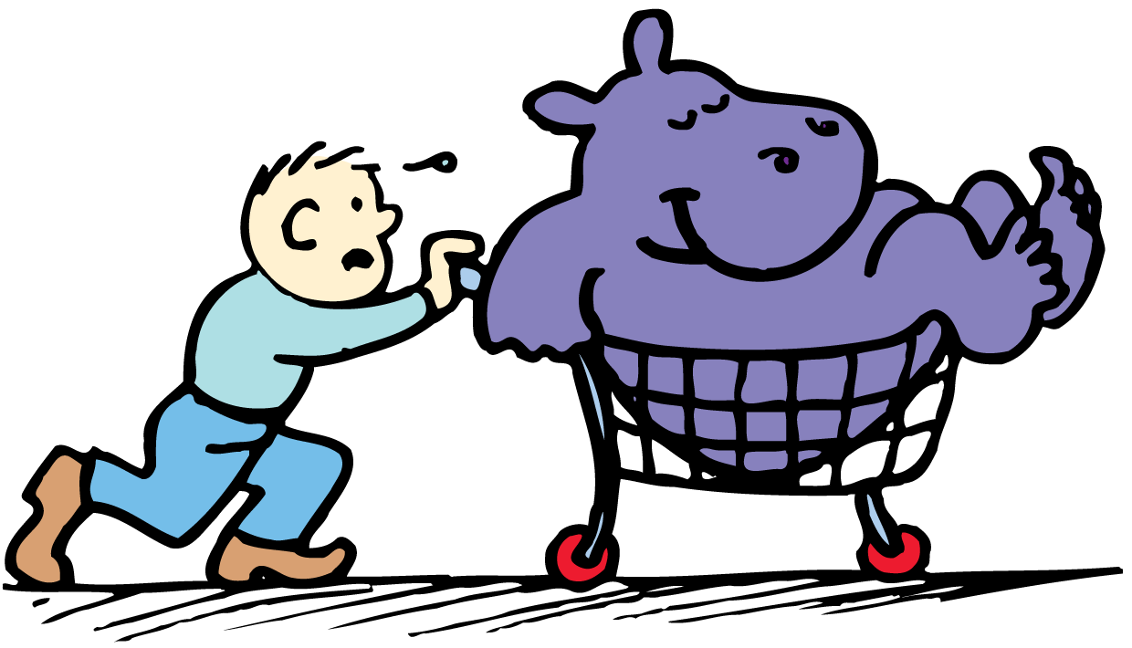
6.2 Mass Resists Acceleration
The acceleration produced depends on the mass that is pushed.

Slide 12
6.2 Mass Resists Acceleration
How does an increase in mass affect acceleration?

Slide 13
6.3 Newton’s Second Law
Newton’s second law states that the acceleration produced by a net force on an object is directly proportional to the magnitude of the net force, is in the same direction as the net force, and is inversely proportional to the mass of the object.

Slide 14
6.3 Newton’s Second Law
Newton’s second law describes the relationship among an object's mass, an object's acceleration, and the net force on an object.

Slide 15
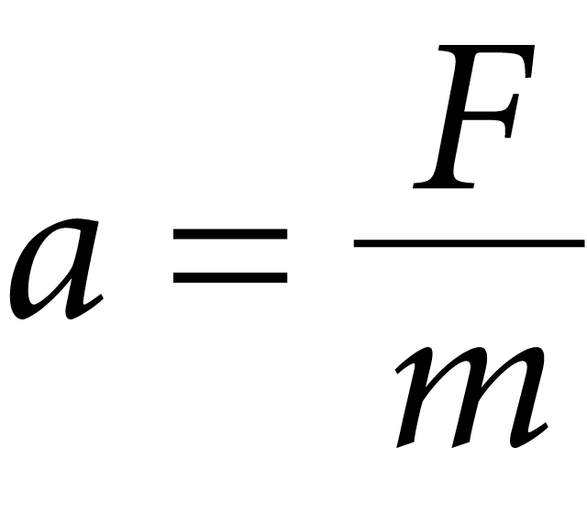
6.3 Newton’s Second Law
By using consistent units, such as newtons (N) for force, kilograms (kg) for mass, and meters per second squared (m/s²) for acceleration, we get the exact equation:
If a is acceleration, F is net force, and m is mass,

Slide 16
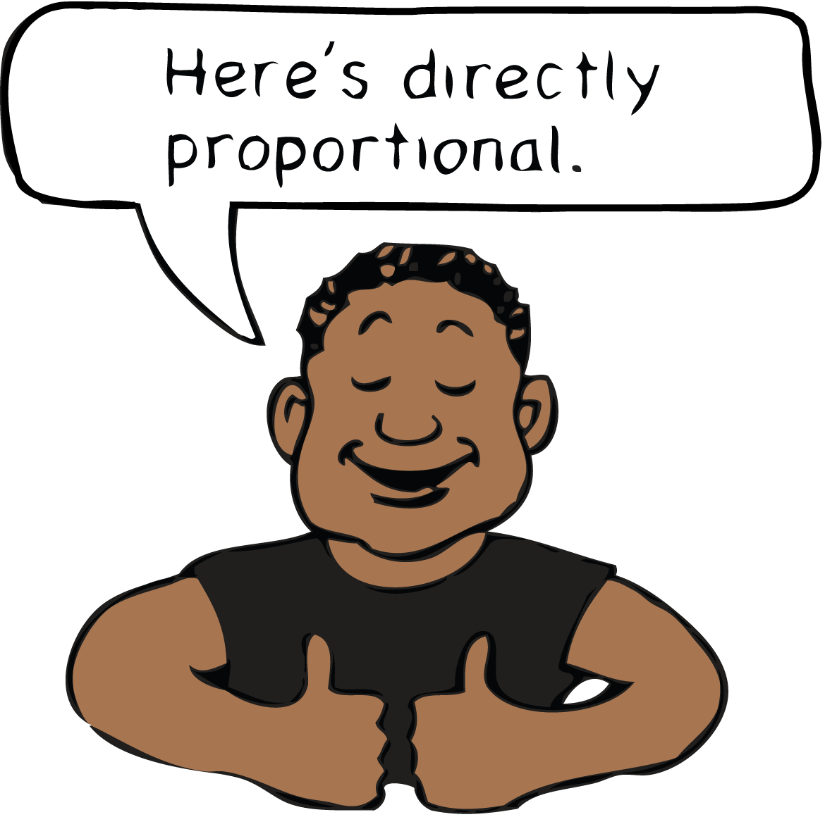
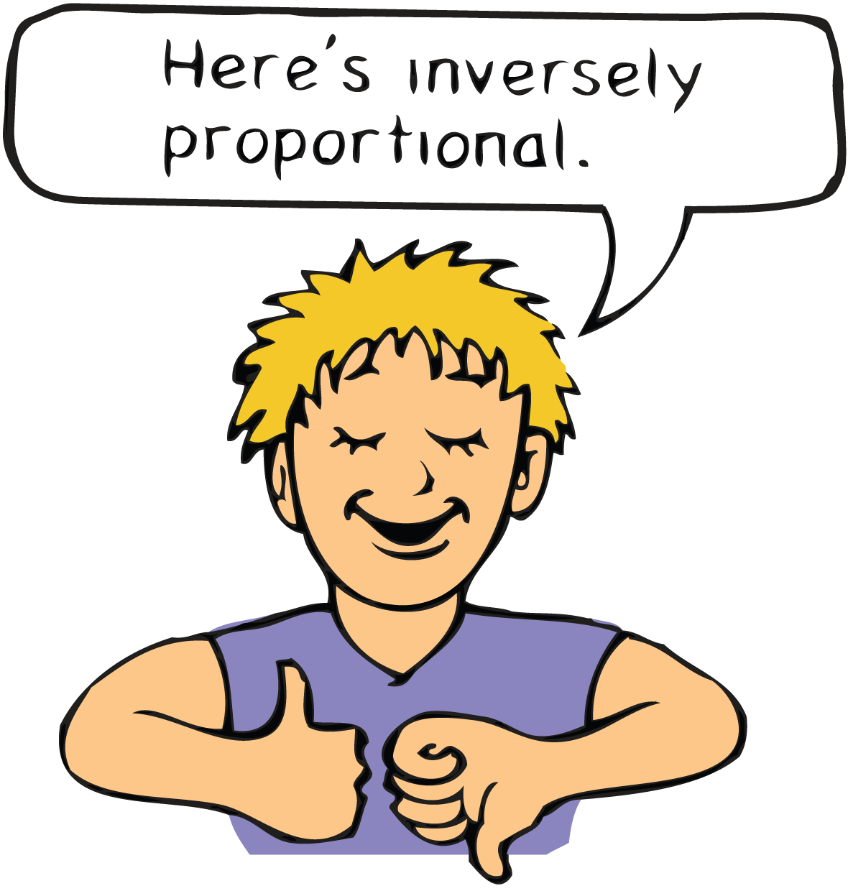
6.3 Newton’s Second Law
The acceleration is equal to the net force divided by the mass.
If the net force acting on an object doubles, its acceleration is doubled.
If the mass is doubled, then acceleration will be halved.
If both the net force and the mass are doubled, the acceleration will be unchanged.

Slide 17
6.3 Newton’s Second Law
think!
If a car can accelerate at 2 m/s², what acceleration can it attain if it is towing another car of equal mass?

Slide 18
6.3 Newton’s Second Law
think!
If a car can accelerate at 2 m/s², what acceleration can it attain if it is towing another car of equal mass?
Answer: The same force on twice the mass produces half the acceleration, or 1 m/s².

Slide 19
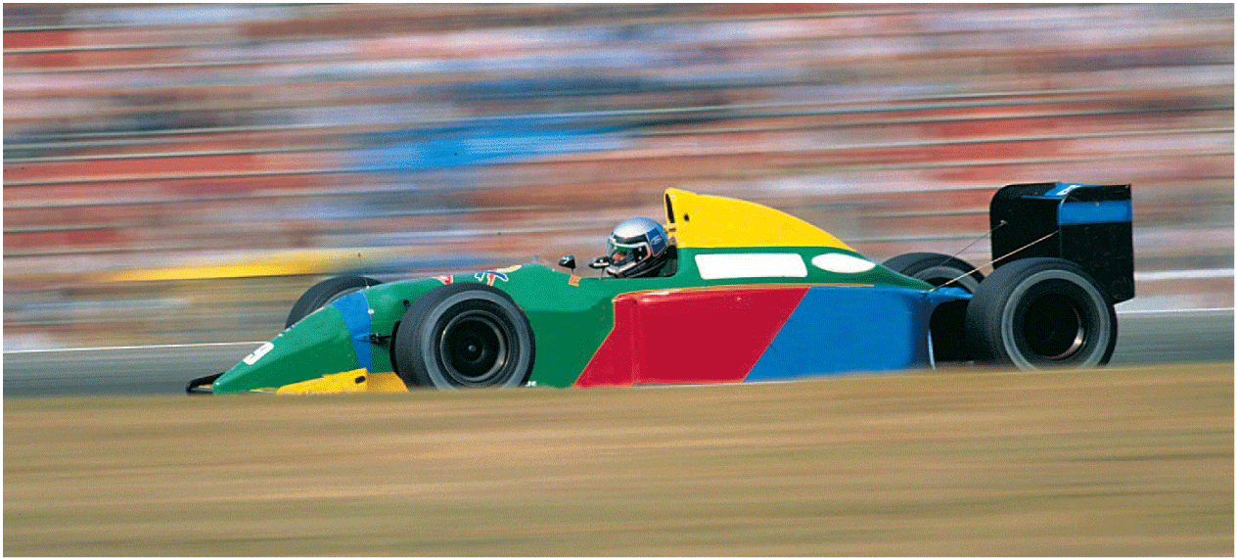
6.3 Newton’s Second Law
do the math!
A car has a mass of 1000 kg. What is the acceleration produced by a force of 2000 N?

Slide 20
6.3 Newton’s Second Law
do the math!
A car has a mass of 1000 kg. What is the acceleration produced by a force of 2000 N?

Slide 21
6.3 Newton’s Second Law
do the math!
If the force is 4000 N, what is the acceleration?

Slide 22
6.3 Newton’s Second Law
do the math!
If the force is 4000 N, what is the acceleration?
Doubling the force on the same mass simply doubles the acceleration.

Slide 23
6.3 Newton’s Second Law
do the math!
How much force, or thrust, must a 30,000-kg jet plane develop to achieve an acceleration of 1.5 m/s²?

Slide 24
6.3 Newton’s Second Law
do the math!
How much force, or thrust, must a 30,000-kg jet plane develop to achieve an acceleration of 1.5 m/s²?
Arrange Newton’s second law to read:
force = mass × acceleration
F = ma
= (30,000 kg)(1.5 m/s²)
= 45,000 kg•m/s²
= 45,000 N

Slide 25
6.3 Newton’s Second Law
What is the relationship among an object’s mass, an object’s acceleration, and the net force on an object?

Slide 26
6.4 Friction
The force of friction between the surfaces depends on the kinds of material in contact and how much the surfaces are pressed together.

Slide 27
6.4 Friction
Friction is a force and affects motion:
Friction acts on materials that are in contact with each other.
It always acts in a direction to oppose relative motion.
When two solid objects come into contact, the friction is mainly due to irregularities in the two surfaces.

Slide 28
6.4 Friction
Rubber against concrete produces more friction than steel against steel, so concrete road dividers have replaced steel rails.
The friction produced by a tire rubbing against the concrete is more effective in slowing the car than the friction produced by a steel car body sliding against a steel rail.

Slide 29
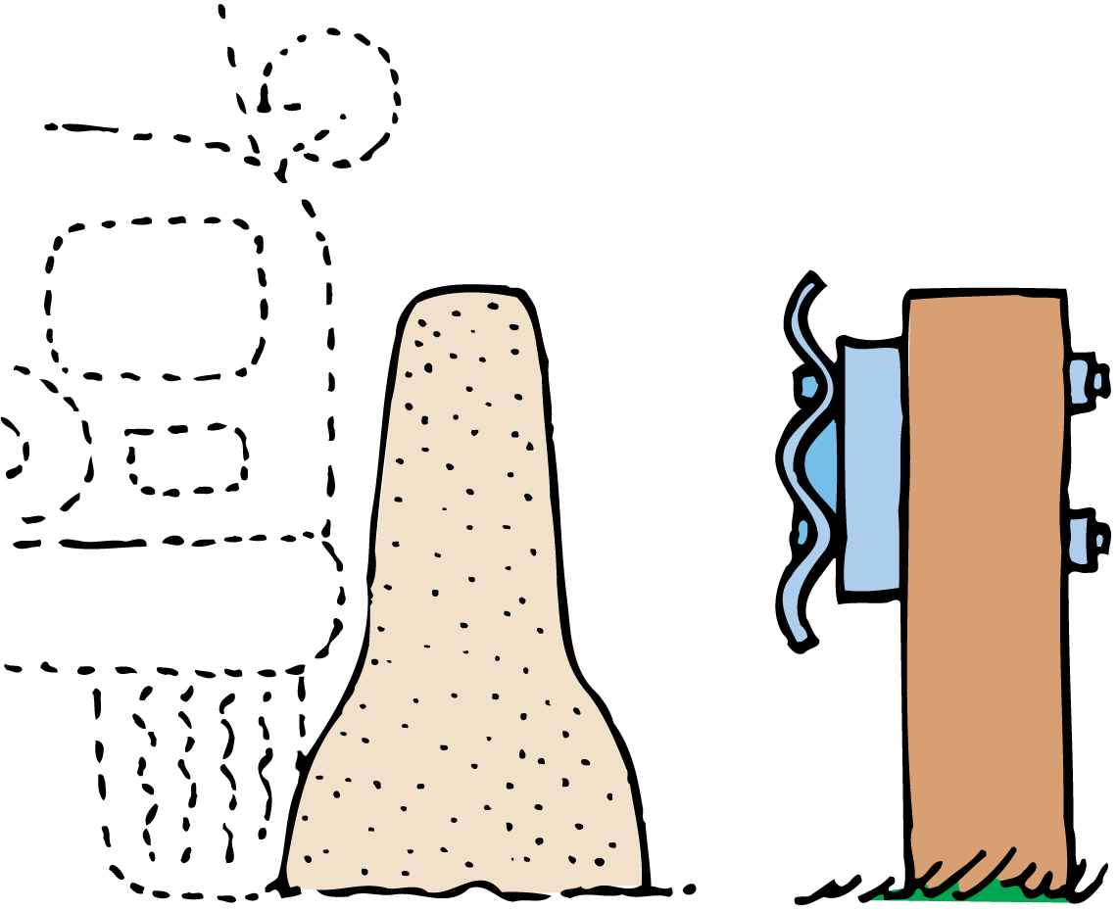
6.4 Friction
A concrete road divider has a better design than a steel road divider for slowing an out-of-control, sideswiping car.
The concrete divider is wider at the bottom to ensure that the tire will make contact with the divider before the steel car body does.

Slide 30
6.4 Friction
Both liquids and gases are called fluids because they flow.
Fluid friction occurs as an object pushes aside the fluid it is moving through.
The friction of liquids is appreciable, even at low speeds.
Air resistance is the friction acting on something moving through air.

Slide 31
6.4 Friction
When friction is present, an object may move with a constant velocity even when an outside force is applied to it. In such a case, the friction force just balances the applied force. The net force is zero, so there is no acceleration.
A diagram showing all the forces acting on an object is called a free-body diagram.

Slide 32
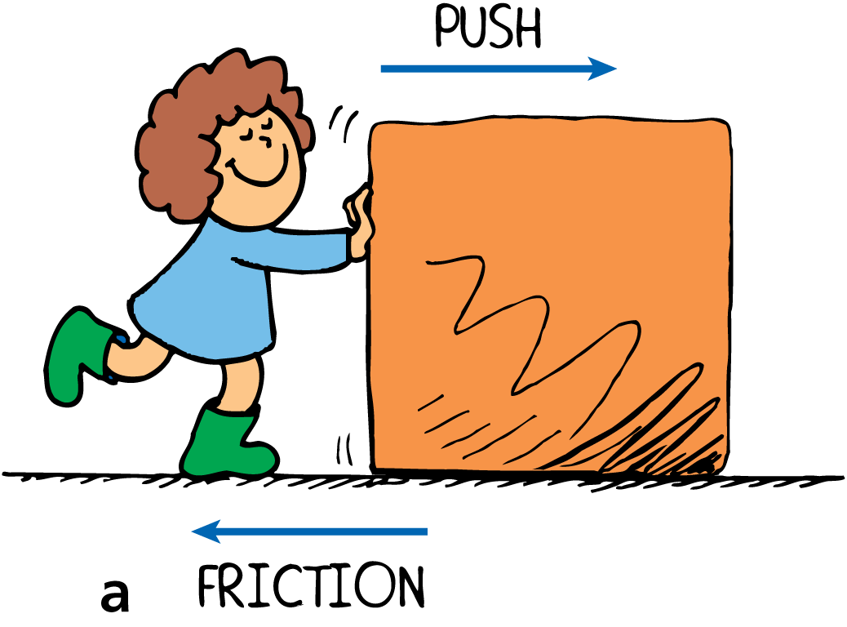
6.4 Friction
The direction of the force of friction always opposes the direction of motion.
a. Push the crate to the right and friction acts toward the left.

Slide 33
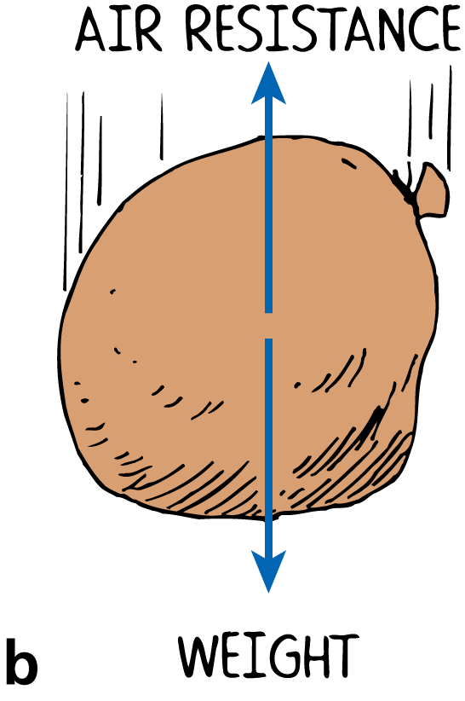
6.4 Friction
The direction of the force of friction always opposes the direction of motion.
a. Push the crate to the right and friction acts toward the left.
b. The sack falls downward and air friction acts upward.

Slide 34
6.4 Friction
think!
Two forces act on a book resting on a table: its weight and the support force from the table. Does a force of friction act as well?

Slide 35
6.4 Friction
think!
Two forces act on a book resting on a table: its weight and the support force from the table. Does a force of friction act as well?
Answer: No, not unless the book tends to slide or does slide across the table. Friction forces occur only when an object tends to slide or is sliding.

Slide 36
6.4 Friction
What factors affect the force of friction between surfaces?

Slide 37
6.5 Applying Force-Pressure
For a constant force, an increase in the area of contact will result in a decrease in the pressure.

Slide 38
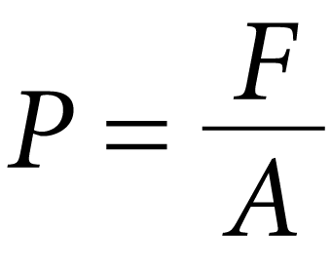
6.5 Applying Force-Pressure
The amount of force per unit of area is called pressure.
When the force is perpendicular to the surface area,
P is the pressure and A is the area over which the force acts.
Pressure is measured in newtons per square meter, or pascals (Pa). One newton per square meter is equal to one pascal.

Slide 39
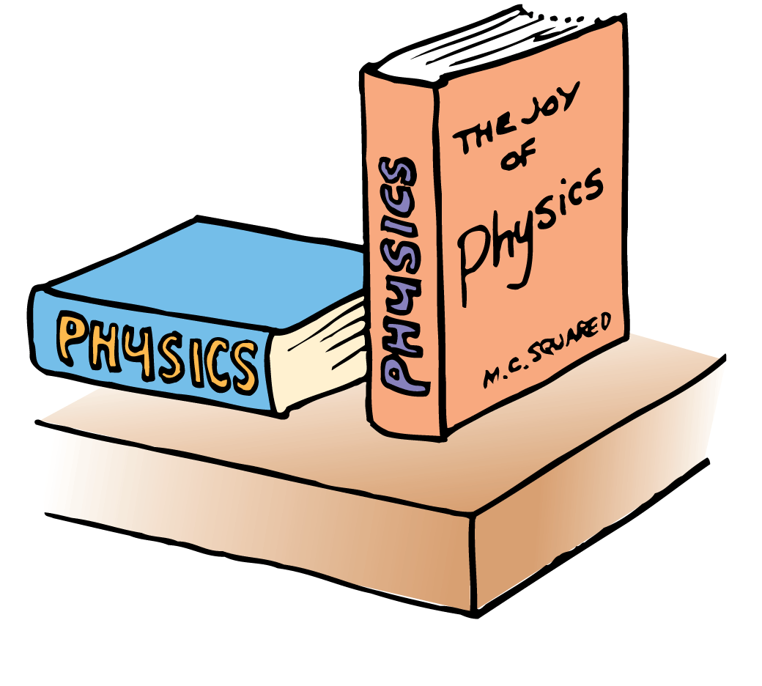
6.5 Applying Force-Pressure
The force of the book on the table is the same.
The upright book exerts the same force, but greater pressure, against the supporting surface.

Slide 40
6.5 Applying Force-Pressure
You exert more pressure against the ground when you stand on one foot than when you stand on both feet due to the decreased area of contact.
The smaller the area supporting a given force, the greater the pressure on that surface.

Slide 41
6.5 Applying Force-Pressure
The driving force per nail is not enough to puncture the skin.
CAUTION: Do not attempt this on your own!

Slide 42
6.5 Applying Force-Pressure
think!
In attempting to do the bed-of-nails demonstration, would it be wise to begin with a few nails and work upward to more nails?

Slide 43
6.5 Applying Force-Pressure
think!
In attempting to do the bed-of-nails demonstration, would it be wise to begin with a few nails and work upward to more nails?
Answer: No, no, no! There would be one less physics teacher if the demonstration were performed with fewer nails. The resulting greater pressure would cause harm.

Slide 44
6.5 Applying Force-Pressure
How does the area of contact affect the pressure a force exerts on an object?

Slide 45
6.6 Free Fall Explained
All freely falling objects fall with the same acceleration because the net force on an object is only its weight, and the ratio of weight to mass is the same for all objects.

Slide 46
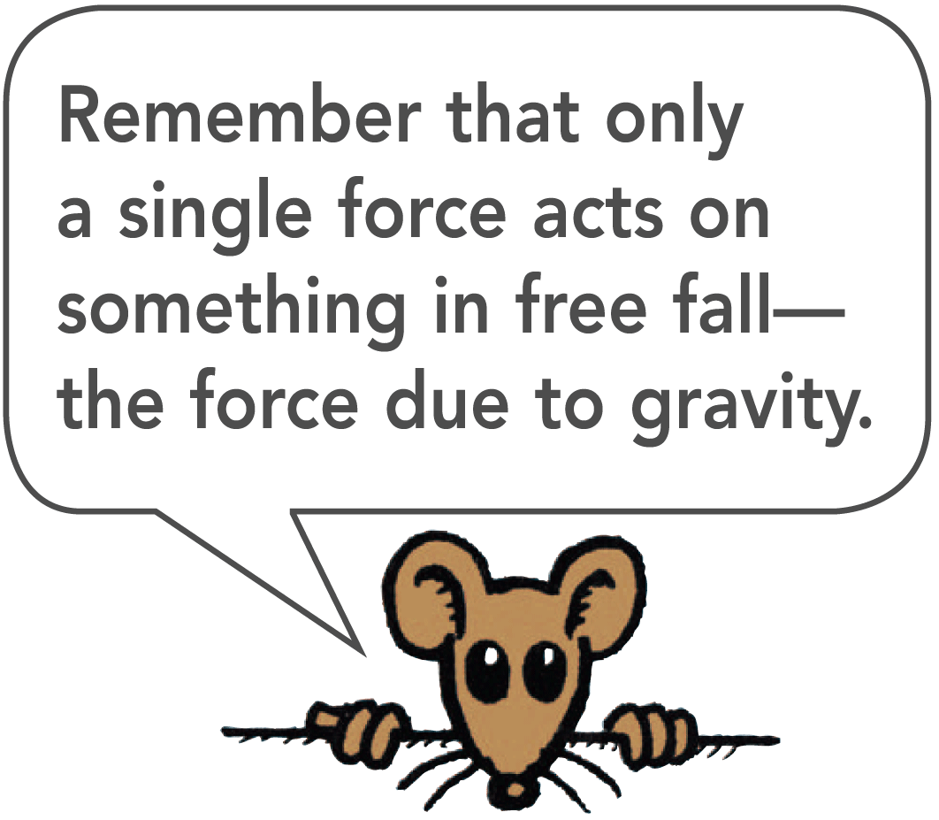
6.6 Free Fall Explained
Galileo showed that falling objects accelerate equally, regardless of their masses.
This is strictly true if air resistance is negligible, that is, if the objects are in free fall.
It is approximately true when air resistance is very small compared with the mass of the falling object.

Slide 47
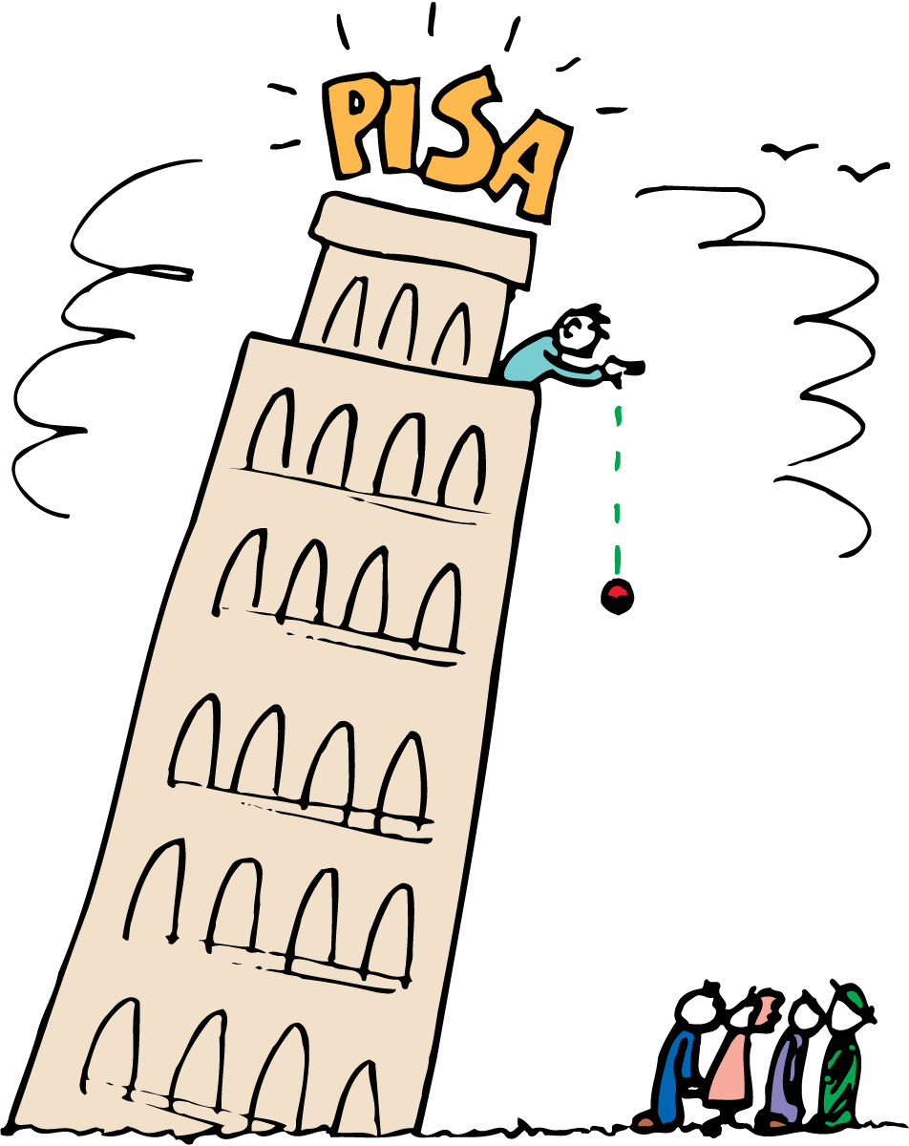
6.6 Free Fall Explained
In Galileo’s famous demonstration, a 10-kg cannonball and a 1-kg stone strike the ground at practically the same time.
This experiment demolished the Aristotelian idea that an object that weighs ten times as much as another should fall ten times faster than the lighter object.

Slide 48
6.6 Free Fall Explained
Recall that mass (a quantity of matter) and weight (the force due to gravity) are proportional.
A 10-kg cannonball experiences 10 times as much gravitational force (weight) as a 1-kg stone.
Newton’s second law tells us to consider the mass as well.
Ten times as much force acting on ten times as much mass produces the same acceleration.

Slide 49
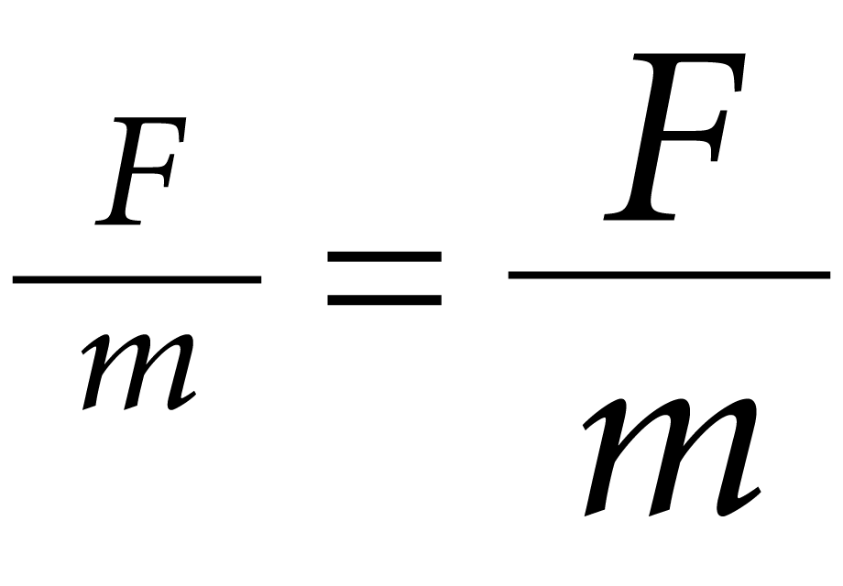
6.6 Free Fall Explained
F stands for the force (weight) acting on the cannonball, and m stands for the correspondingly large mass of the cannonball. The small F and m stand for the weight and mass of the stone.
The ratio of weight to mass is the same for these or any objects.
All freely falling objects undergo the same acceleration at the same place on Earth.

Slide 50
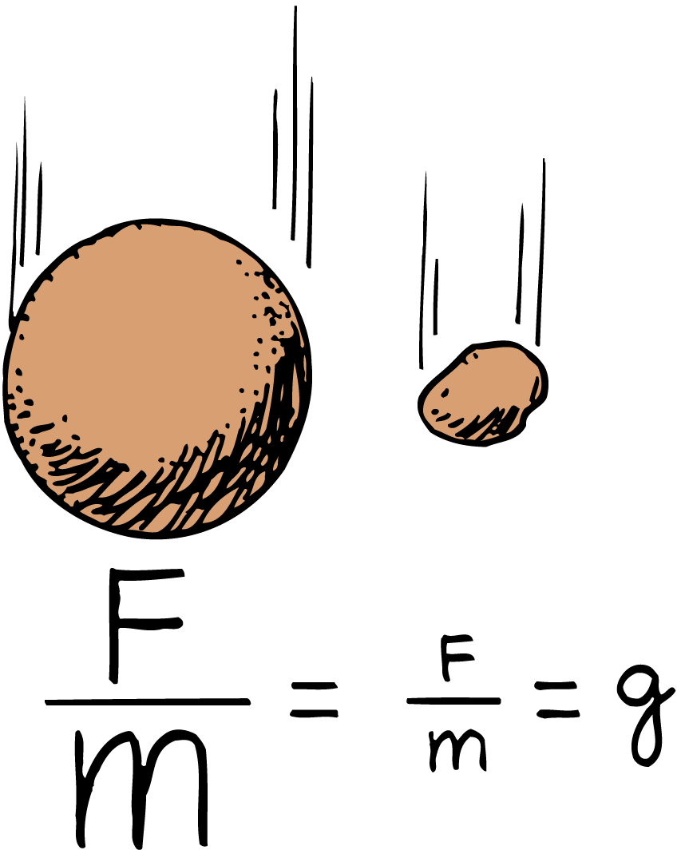
6.6 Free Fall Explained
The ratio of weight (F) to mass (m) is the same for the 10-kg cannonball and the 1-kg stone.

Slide 51
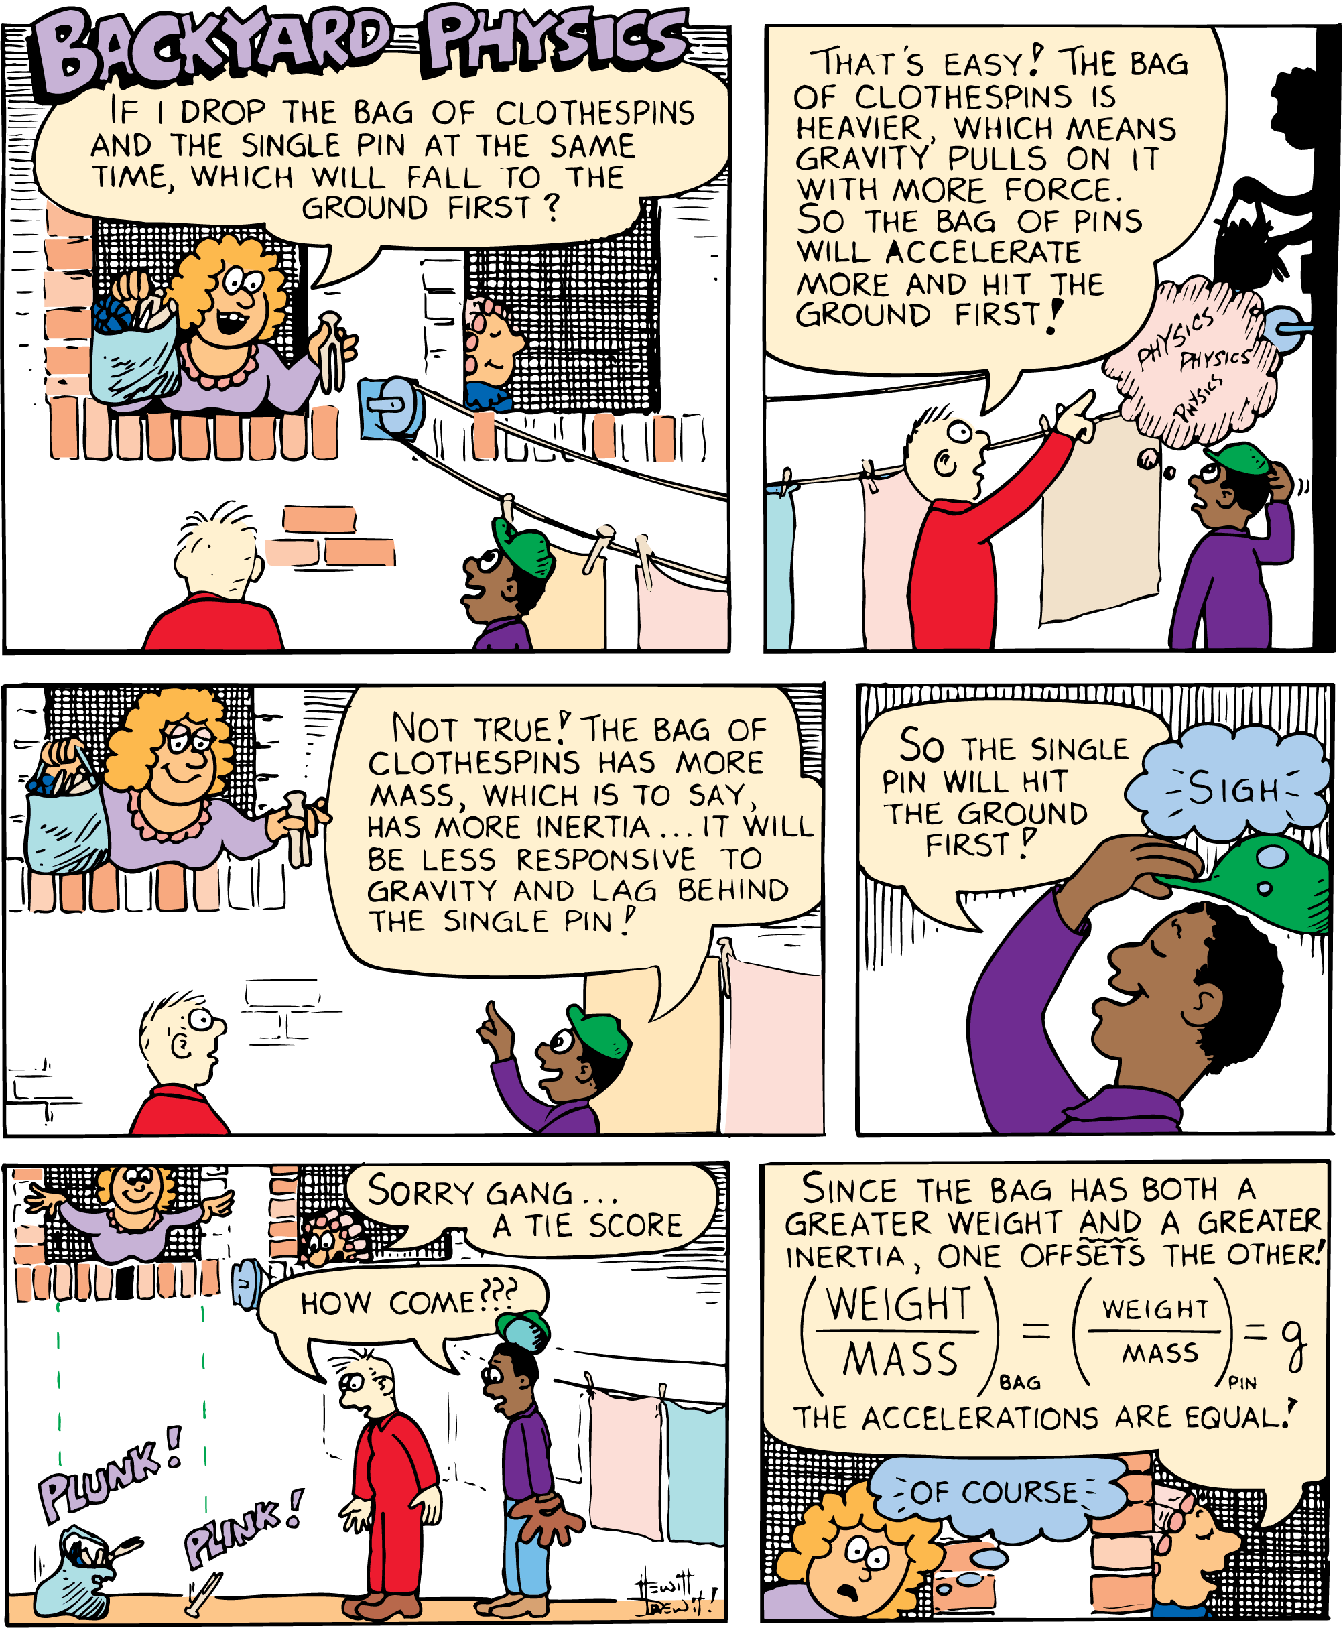
6.6 Free Fall Explained

Slide 52
6.6 Free Fall Explained
The weight of a 1-kg stone is 10 N at Earth’s surface. Using Newton’s second law, the acceleration of the stone is
The weight of a 10-kg cannonball is 100 N at Earth’s surface and the acceleration of the cannonball is

Slide 53
6.6 Free Fall Explained
Why do all freely falling objects fall with the same acceleration?

Slide 54
6.7 Falling and Air Resistance
The air resistance force an object experiences depends on the object’s speed and area.

Slide 55
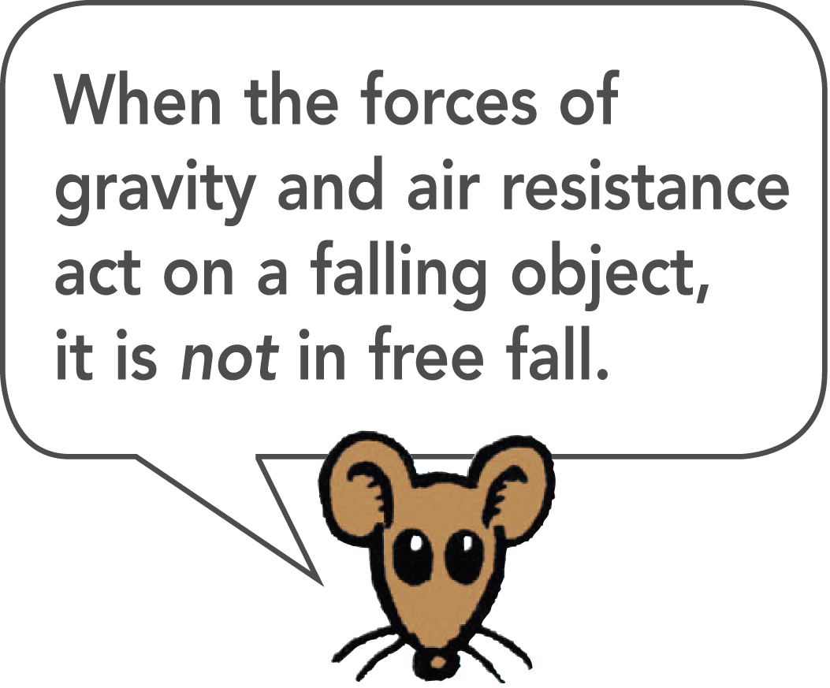
6.7 Falling and Air Resistance
A feather and a coin fall with equal accelerations in a vacuum, but very unequally in the presence of air.
When falling in air, the coin falls quickly while the feather flutters to the ground.
The force due to air resistance diminishes the net force acting on the falling objects.

Slide 56
6.7 Falling and Air Resistance
Speed and Area
You experience the force due to air resistance when you stick your hand out of the window of a moving car.
If the car moves faster, the force on your hand increases.
If instead of just your hand, you hold your physics book out the window with the large side facing forward, the air resistance force is much larger than on your hand at the same speed.

Slide 57
6.7 Falling and Air Resistance
Air resistance force ~ speed × frontal area
The expression shows that the air resistance force is directly proportional to the speed and frontal area of an object.

Slide 58
6.7 Falling and Air Resistance
Terminal Speed
Terminal speed is the speed at which the acceleration of a falling object is zero because friction balances the weight.
Terminal velocity is terminal speed together with the direction of motion.

Slide 59
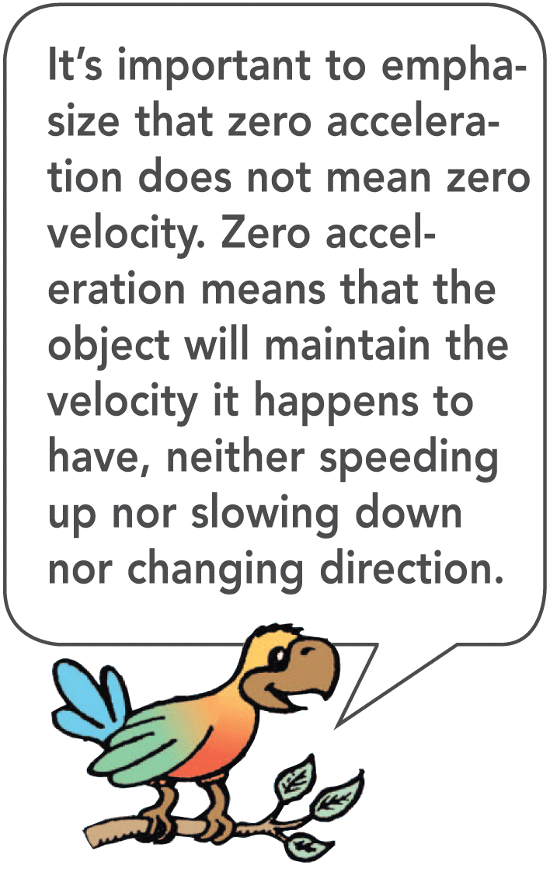
6.7 Falling and Air Resistance

Slide 60
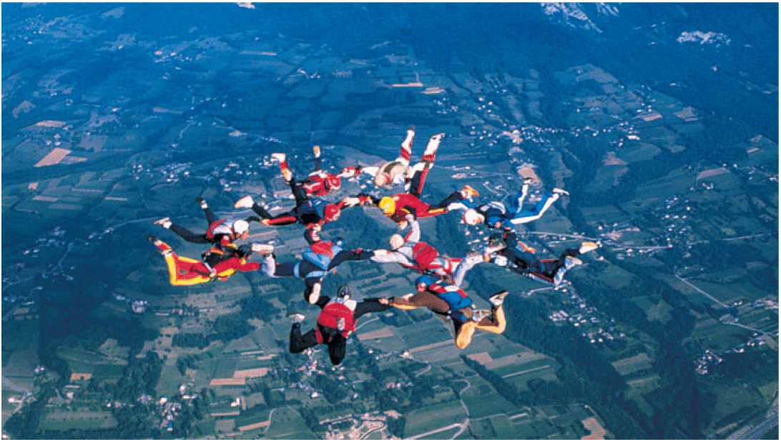
6.7 Falling and Air Resistance
Sky divers reach terminal speed when air resistance equals weight.

Slide 61
6.7 Falling and Air Resistance
A falling feather reaches its terminal speed quite quickly. Its area is large relative to its very small weight so air resistance has a large effect on the feather’s motion.
A coin has a relatively small area compared to its weight, so the coin will have to fall faster to reach its terminal speed.

Slide 62
6.7 Falling and Air Resistance
The terminal speed for a sky diver varies from about 150 to 200 km/h, depending on the weight and orientation of the body.
A heavier person will attain a greater terminal speed than a lighter person.
Body orientation also makes a difference. More air is encountered when the body is spread out and surface area is increased.

Slide 63
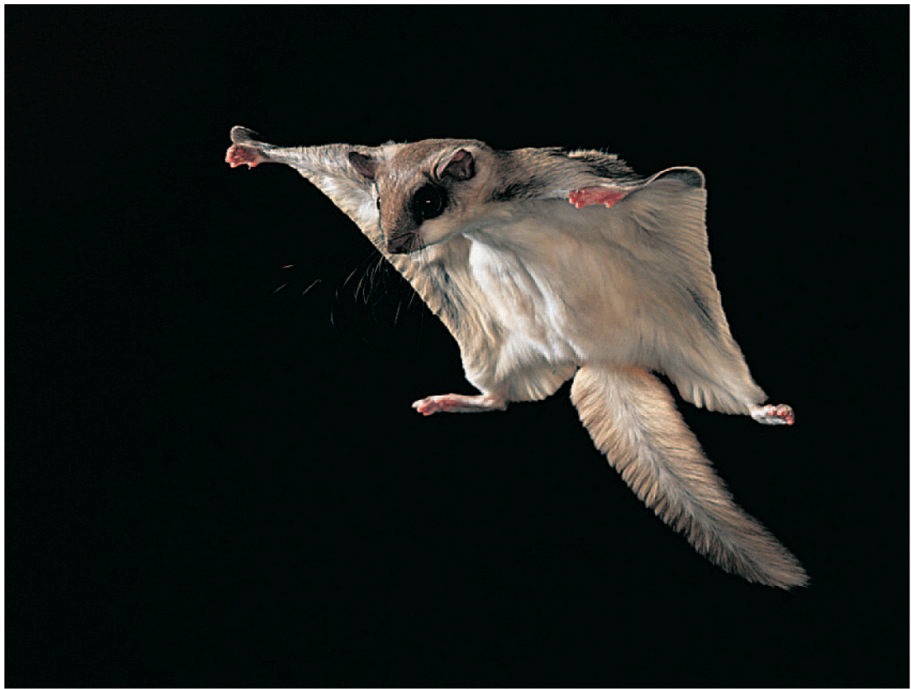
6.7 Falling and Air Resistance
The flying squirrel increases its area by spreading out. This increases air resistance and decreases the speed of its fall.

Slide 64
6.7 Falling and Air Resistance
Terminal speed can be controlled by variations in body orientation.
A heavy sky diver and a light sky diver can remain in close proximity to each other if the heavy person spreads out like a flying squirrel while the light person falls head or feet first.
A parachute greatly increases air resistance, and cuts the terminal speed down to 15 to 25 km/h, slow enough for a safe landing.

Slide 65
6.7 Falling and Air Resistance
At low speeds, air resistance is often negligible, but at high speeds, it can make quite a difference.
If you hold a baseball and tennis ball at arm’s length and release them at the same time, you’ll see them strike the floor at the same time. But if you drop them from the top of a building, you’ll notice the heavier baseball strikes the ground first.

Slide 66
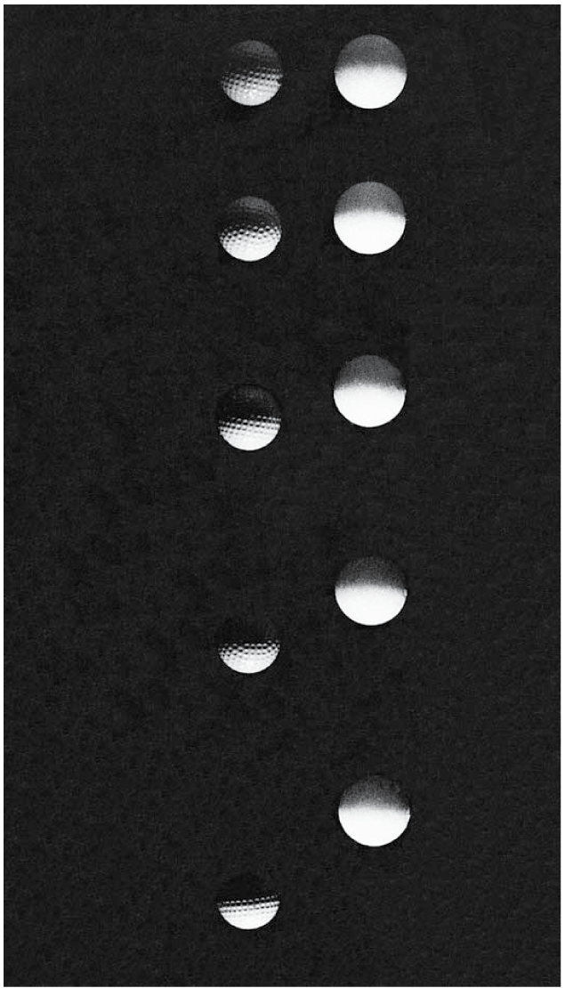
6.7 Falling and Air Resistance
This stroboscopic photo shows a golf ball and a foam ball falling in air.
The heavier golf ball is more effective in overcoming air resistance, so its acceleration is greater.

Slide 67
6.7 Falling and Air Resistance
think!
Which experiences a greater air resistance force, a falling piece of paper or a falling elephant?

Slide 68
6.7 Falling and Air Resistance
think!
Which experiences a greater air resistance force, a falling piece of paper or a falling elephant?
Answer: The elephant! It has a greater frontal area and falls faster than a piece of paper—both of which mean the elephant pushes more air molecules out of the way. The effect of the air resistance force on each, however, is another story!

Slide 69
6.7 Falling and Air Resistance
think!
If a heavy person and a light person open their parachutes together at the same altitude and each wears the same size parachute, who will reach the ground first?

Slide 70
6.7 Falling and Air Resistance
think!
If a heavy person and a light person open their parachutes together at the same altitude and each wears the same size parachute, who will reach the ground first?
Answer: The heavy person will reach the ground first. Like a feather, the light person reaches terminal speed sooner, while the heavy person continues to accelerate until a greater terminal speed is reached.

Slide 71
6.7 Falling and Air Resistance
What factors determine the air resistance force on an object?

Slide 72
Assessment Questions
An object will accelerate when
SF = 0.
it is unbalanced.
it is pushed or pulled with a net force.
its mass increases.

Slide 73
Assessment Questions
An object will accelerate when
SF = 0.
it is unbalanced.
it is pushed or pulled with a net force.
its mass increases.
Answer: C

Slide 74
Assessment Questions
When a net force acts on an object, its acceleration depends on the object’s
initial speed.
mass.
volume.
weight.

Slide 75
Assessment Questions
When a net force acts on an object, its acceleration depends on the object’s
initial speed.
mass.
volume.
weight.
Answer: B

Slide 76
Assessment Questions
A cart is pushed and undergoes a certain acceleration. Consider how the acceleration would compare if it were pushed with twice the net force while its mass increased by four. Then its acceleration would be
one quarter.
half.
twice.
the same.

Slide 77
Assessment Questions
A cart is pushed and undergoes a certain acceleration. Consider how the acceleration would compare if it were pushed with twice the net force while its mass increased by four. Then its acceleration would be
one quarter.
half.
twice.
the same.
Answer: B

Slide 78
Assessment Questions
Friction is a force like any other force and affects motion. Friction occurs in
solids sliding over one another.
fluids.
air.
all of these

Slide 79
Assessment Questions
Friction is a force like any other force and affects motion. Friction occurs in
solids sliding over one another.
fluids.
air.
all of these
Answer: D

Slide 80
Assessment Questions
When you stand on one foot instead of two, the pressure you exert on the ground is
half.
the same.
twice.
quadruple.

Slide 81
Assessment Questions
When you stand on one foot instead of two, the pressure you exert on the ground is
half.
the same.
twice.
quadruple.
Answer: C

Slide 82
Assessment Questions
The reason a 20-kg rock falls no faster than a 10-kg rock in free fall is that
air resistance is negligible.
the force of gravity on both is the same.
their speeds are the same.
the force/mass ratio is the same.

Slide 83
Assessment Questions
The reason a 20-kg rock falls no faster than a 10-kg rock in free fall is that
air resistance is negligible.
the force of gravity on both is the same.
their speeds are the same.
the force/mass ratio is the same.
Answer: D

Slide 84
Assessment Questions
Kevin and Suzanne go sky diving. Kevin is heavier than Suzanne, but both use the same size parachute. Kevin has a greater terminal speed compared with Suzanne because
he has to fall faster for air resistance to match his weight.
gravity acts on him more.
he has greater air resistance.
he has weaker terminal velocity.

Slide 85
Assessment Questions
Kevin and Suzanne go sky diving. Kevin is heavier than Suzanne, but both use the same size parachute. Kevin has a greater terminal speed compared with Suzanne because
he has to fall faster for air resistance to match his weight.
gravity acts on him more.
he has greater air resistance.
he has weaker terminal velocity.
Answer: A

