Slide 1
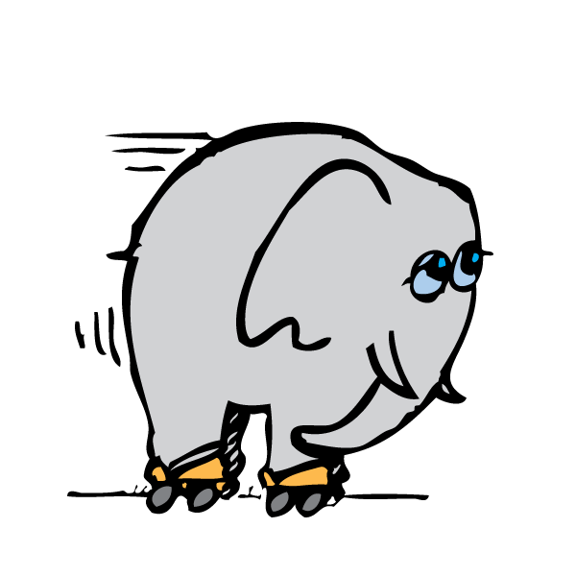
Forces cause changes in motion.

Slide 2
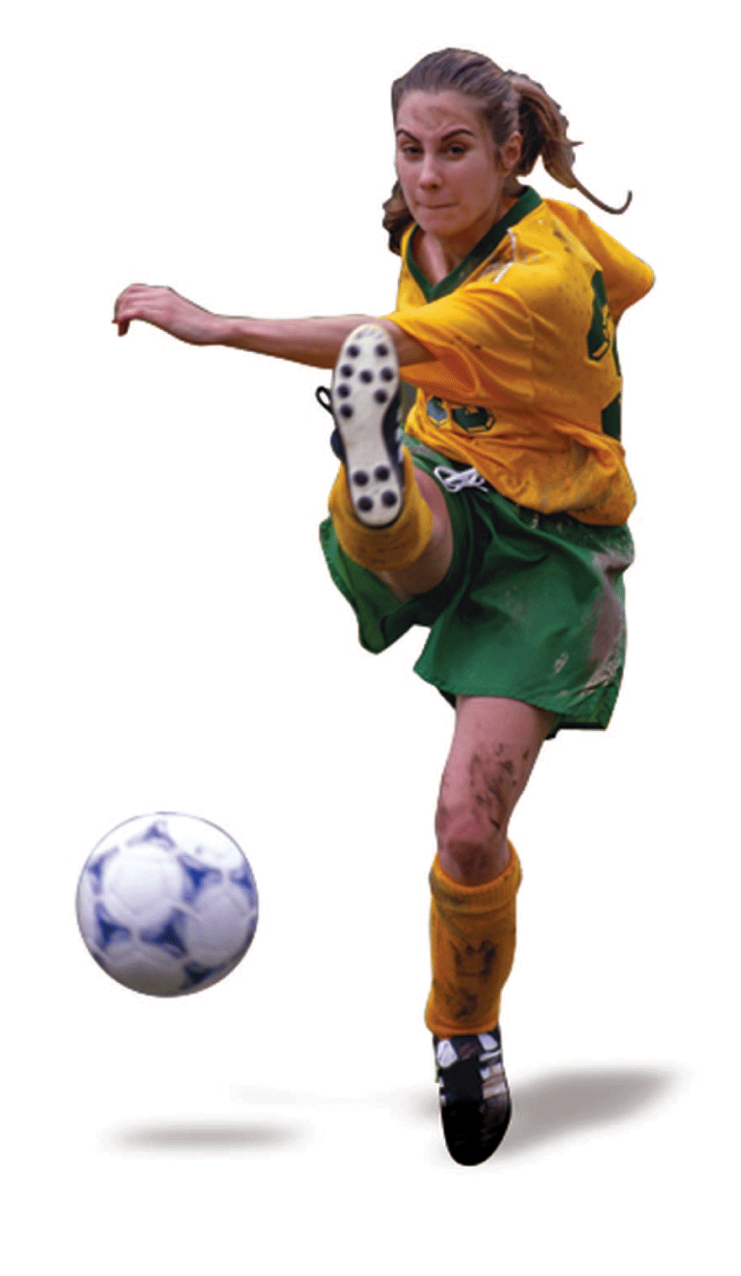
A ball at rest in the middle of a flat field is in equilibrium. No net force acts on it.
If you saw it begin to move across the ground, you’d look for forces that don’t balance to zero.
We don’t believe that changes in motion occur without cause.

Slide 3
3.1 Aristotle on Motion
Aristotle, the foremost Greek scientist, studied motion and divided it into two types: natural motion and violent motion.

Slide 4
3.1 Aristotle on Motion
Natural motion on Earth was thought to be either straight up or straight down.
Objects seek their natural resting places: boulders on the ground and smoke high in the air like the clouds.
Heavy things fall and very light things rise.
Circular motion was natural for the heavens.
These motions were considered natural–not caused by forces.

Slide 5
3.1 Aristotle on Motion
Violent motion, on the other hand, was imposed motion.
It was the result of forces that pushed or pulled.
The important thing about defining violent motion was that it had an external cause.
Violent motion was imparted to objects.
Objects in their natural resting places could not move by themselves.

Slide 6
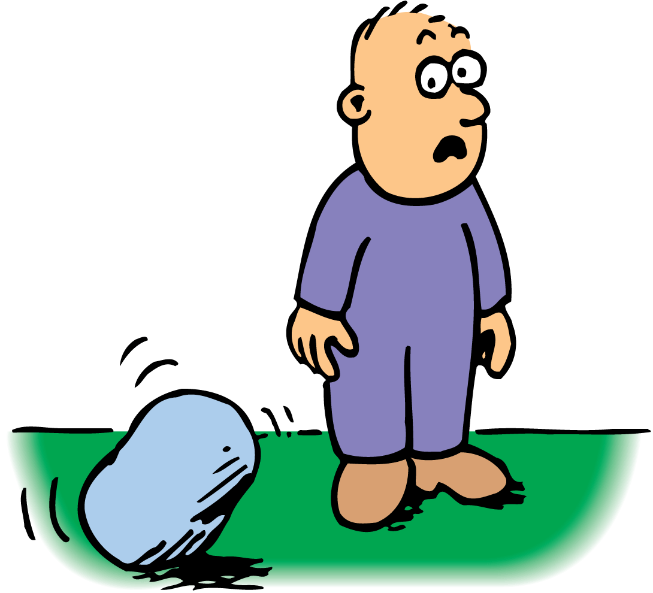
3.1 Aristotle on Motion
Boulders do not move without cause.

Slide 7
3.1 Aristotle on Motion
It was commonly thought for nearly 2000 years that a force was responsible for an object moving “against its nature.”
The state of objects was one of rest unless they were being pushed or pulled or moving toward their natural resting place.
Most thinkers before the 1500s considered it obvious that Earth must be in its natural resting place.
A force large enough to move it was unthinkable.
Earth did not move.

Slide 8
3.1 Aristotle on Motion
According to Aristotle, what were the two types of motion?

Slide 9
3.2 Copernicus and the Moving Earth
Copernicus reasoned that the simplest way to interpret astronomical observations was to assume that Earth and the other planets move around the sun.

Slide 10
3.2 Copernicus and the Moving Earth
The astronomer Nicolaus Copernicus (1473–1543) formulated a theory of the moving Earth.
This idea was extremely controversial at the time. People preferred to believe that Earth was at the center of the universe.
Copernicus worked on his ideas in secret. The first copy of his work, De Revolutionibus, reached him on the day of his death, May 24, 1543.

Slide 11
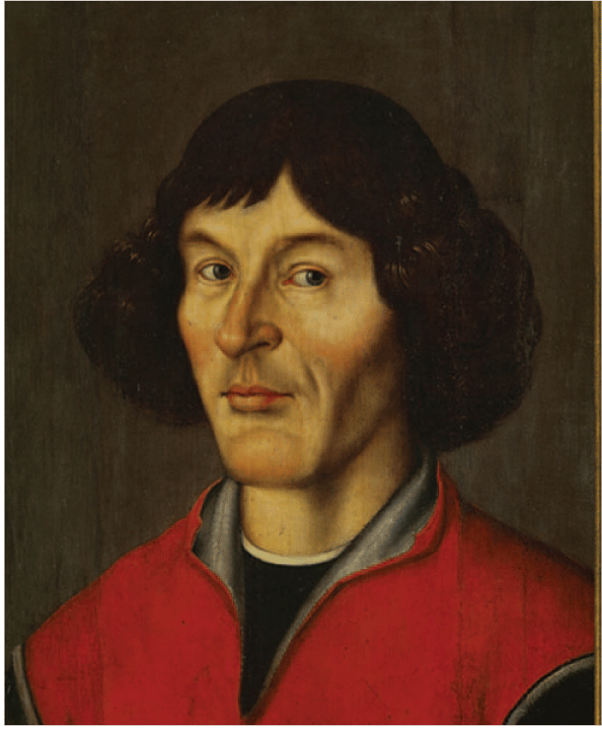
3.2 Copernicus and the Moving Earth
Nicolaus Copernicus proposed that Earth moved around the sun.

Slide 12
3.2 Copernicus and the Moving Earth
What did Copernicus state about Earth’s motion?

Slide 13
3.3 Galileo on Motion
Galileo argued that only when friction is present—as it usually is—is a force needed to keep an object moving.

Slide 14
3.3 Galileo on Motion
Galileo, the foremost scientist of late-Renaissance Italy, was outspoken in his support of Copernicus.
One of Galileo’s great contributions to physics was demolishing the notion that a force is necessary to keep an object moving.

Slide 15
3.3 Galileo on Motion
Friction is the name given to the force that acts between materials that touch as they move past each other.
Friction is caused by the irregularities in the surfaces of objects that are touching.
Even very smooth surfaces have microscopic irregularities that obstruct motion.
If friction were absent, a moving object would need no force whatever to remain in motion.

Slide 16
3.3 Galileo on Motion
Galileo tested his idea by rolling balls along plane surfaces tilted at different angles.
A ball rolling down an inclined plane speeds up.
A ball rolling up an inclined plane—in a direction opposed by gravity—slows down.
A ball rolling on a smooth horizontal plane has almost constant velocity.

Slide 17
3.3 Galileo on Motion
Downward, the ball moves with Earth’s gravity.

Slide 18
3.3 Galileo on Motion
Downward, the ball moves with Earth’s gravity.
Upward, the ball moves against gravity.

Slide 19
3.3 Galileo on Motion
Downward, the ball moves with Earth’s gravity.
Upward, the ball moves against gravity.
On a level plane, it does not move with or against gravity.

Slide 20
3.3 Galileo on Motion
Galileo stated that if friction were entirely absent, a ball moving horizontally would move forever.
No push or pull would be required to keep it moving once it is set in motion.

Slide 21
3.3 Galileo on Motion
Galileo’s conclusion was supported by another line of reasoning.
He described two inclined planes facing each other.
A ball released to roll down one plane would roll up the other to reach nearly the same height.
The ball tended to attain the same height, even when the second plane was longer and inclined at a smaller angle than the first plane.

Slide 22
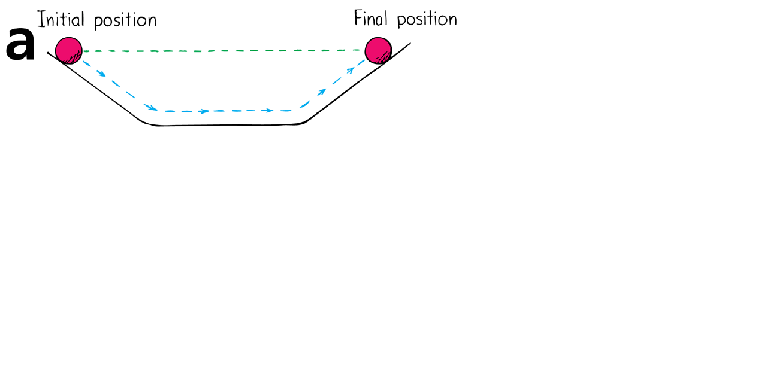
3.3 Galileo on Motion
The ball rolling down the incline rolls up the opposite incline and reaches its initial height.

Slide 23
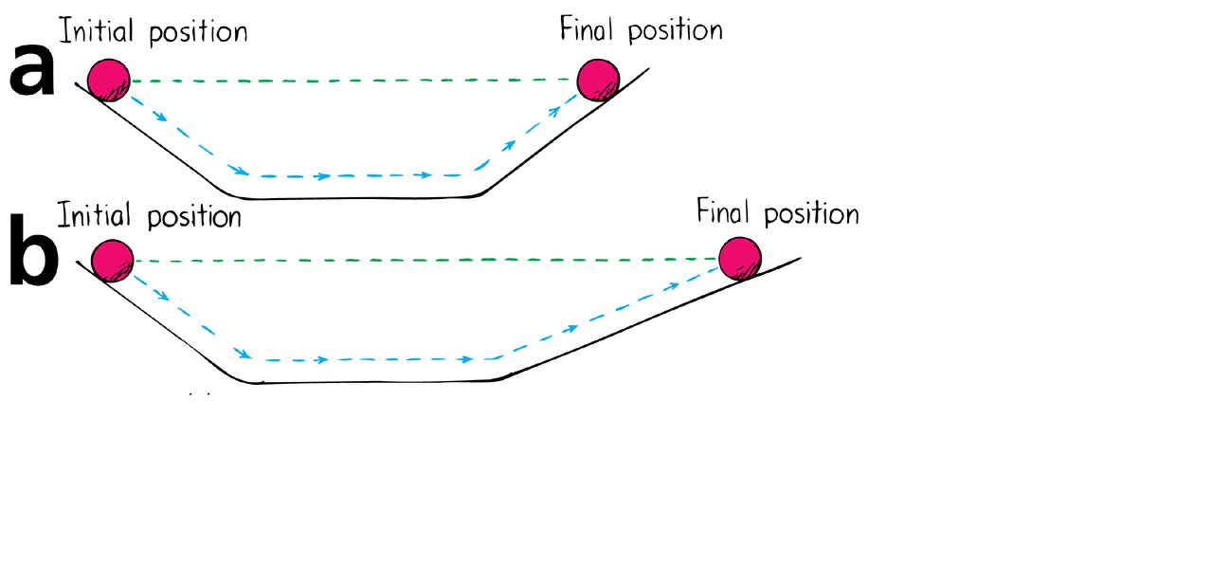
3.3 Galileo on Motion
The ball rolling down the incline rolls up the opposite incline and reaches its initial height.
The ball rolls a greater distance to reach its initial height.

Slide 24
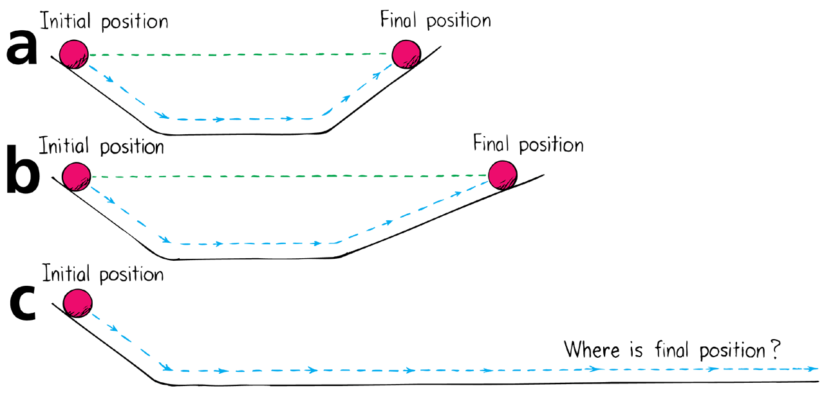
3.3 Galileo on Motion
The ball rolling down the incline rolls up the opposite incline and reaches its initial height.
The ball rolls a greater distance to reach its initial height.
If there is no friction, the ball will never stop.

Slide 25
3.3 Galileo on Motion
If the angle of incline of the second plane were reduced to zero so that the plane was perfectly horizontal, only friction would keep it from rolling forever.
It was not the nature of the ball to come to rest as Aristotle had claimed.

Slide 26
3.3 Galileo on Motion
Galileo stated that this tendency of a moving body to keep moving is natural and that every material object resists changes to its state of motion.
The property of a body to resist changes to its state of motion is called inertia.

Slide 27
3.3 Galileo on Motion
think!
A ball is rolled across a counter top and rolls slowly to a stop. How would Aristotle interpret this behavior? How would Galileo interpret it? How would you interpret it?

Slide 28
3.3 Galileo on Motion
think!
A ball is rolled across a counter top and rolls slowly to a stop. How would Aristotle interpret this behavior? How would Galileo interpret it? How would you interpret it?
Answer: Aristotle would probably say that the ball stops because it seeks its natural state of rest. Galileo would probably say that the friction between the ball and the table overcomes the ball’s natural tendency to continue rolling—overcomes the ball’s inertia—and brings it to a stop. Only you can answer the last question!

Slide 29
3.3 Galileo on Motion
According to Galileo, when is a force needed to keep an object moving?

Slide 30
3.4 Newton’s Law of Inertia
Newton’s first law states that every object continues in a state of rest, or of uniform speed in a straight line, unless acted on by a nonzero net force.

Slide 31
3.4 Newton’s Law of Inertia
Newton’s first law, usually called the law of inertia, is a restatement of Galileo’s idea that a force is not needed to keep an object moving.

Slide 32
3.4 Newton’s Law of Inertia
Objects at Rest
Simply put, things tend to keep on doing what they’re already doing.
Objects in a state of rest tend to remain at rest.
Only a force will change that state.

Slide 33
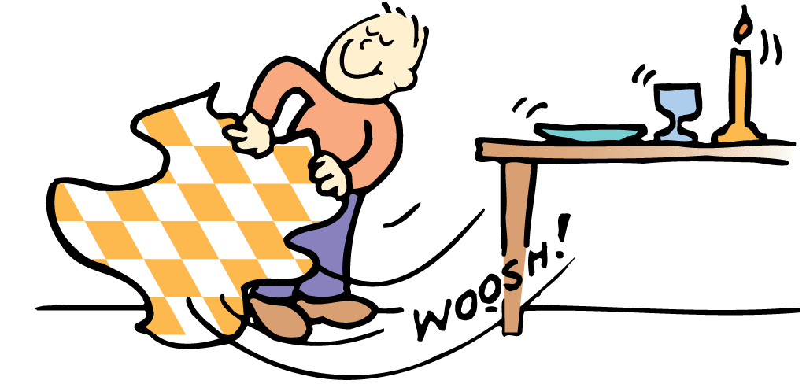
3.4 Newton’s Law of Inertia
Objects at rest tend to remain at rest.

Slide 34
3.4 Newton’s Law of Inertia
Objects in Motion
Now consider an object in motion.
In the absence of forces, a moving object tends to move in a straight line indefinitely.
Toss an object from a space station located in the vacuum of outer space, and the object will move forever due to inertia.

Slide 35
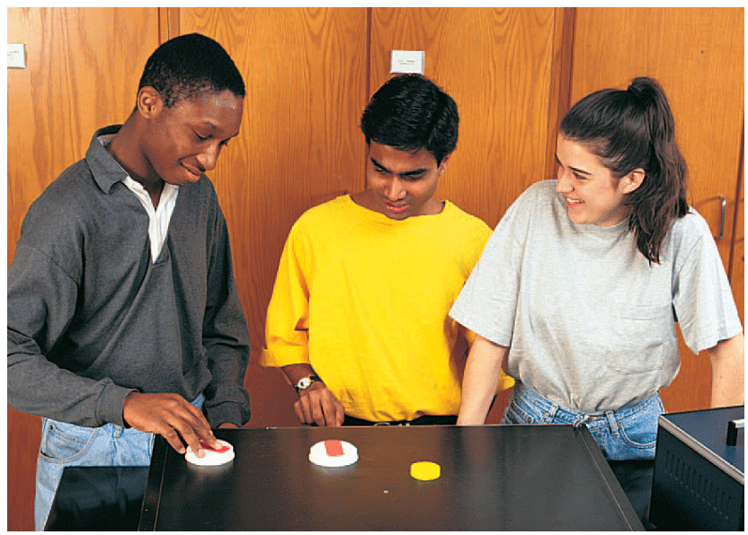
3.4 Newton’s Law of Inertia
Blasts of air from many tiny holes provide a nearly friction-free surface on the air table. If you slide a hockey puck along the surface of a city street, the puck soon comes to rest. If you slide it along an air table where friction is practically absent, it slides with no apparent loss in speed.

Slide 36
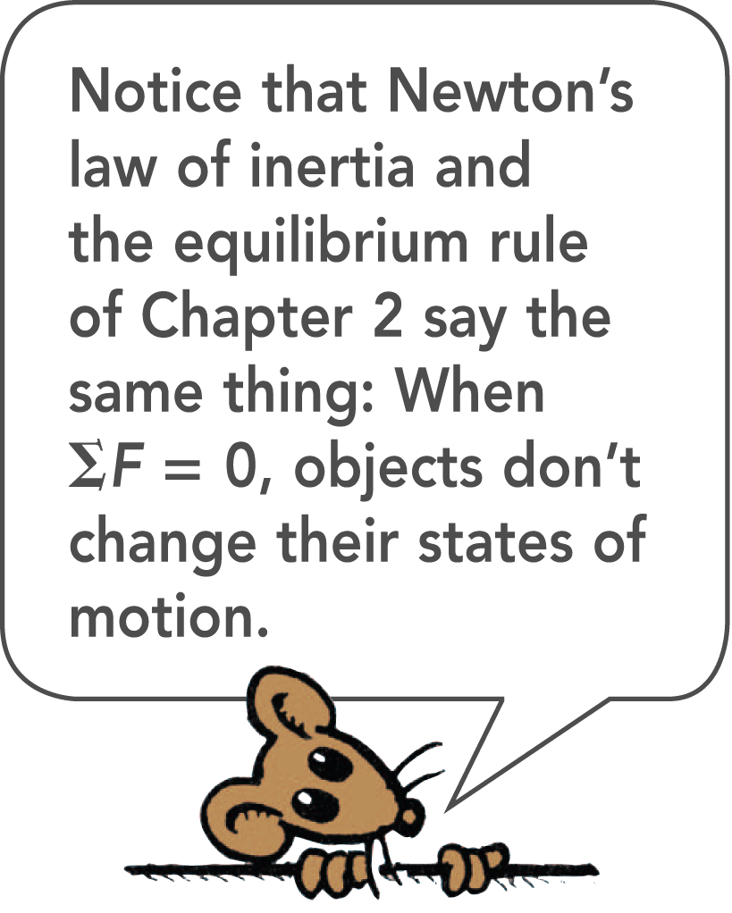
3.4 Newton’s Law of Inertia
The law of inertia provides a completely different way of viewing motion from the ancients.
Objects continue to move by themselves.
Forces are needed to overcome any friction that may be present and to set objects in motion initially.
Once the object is moving in a force-free environment, it will move in a straight line indefinitely.

Slide 37
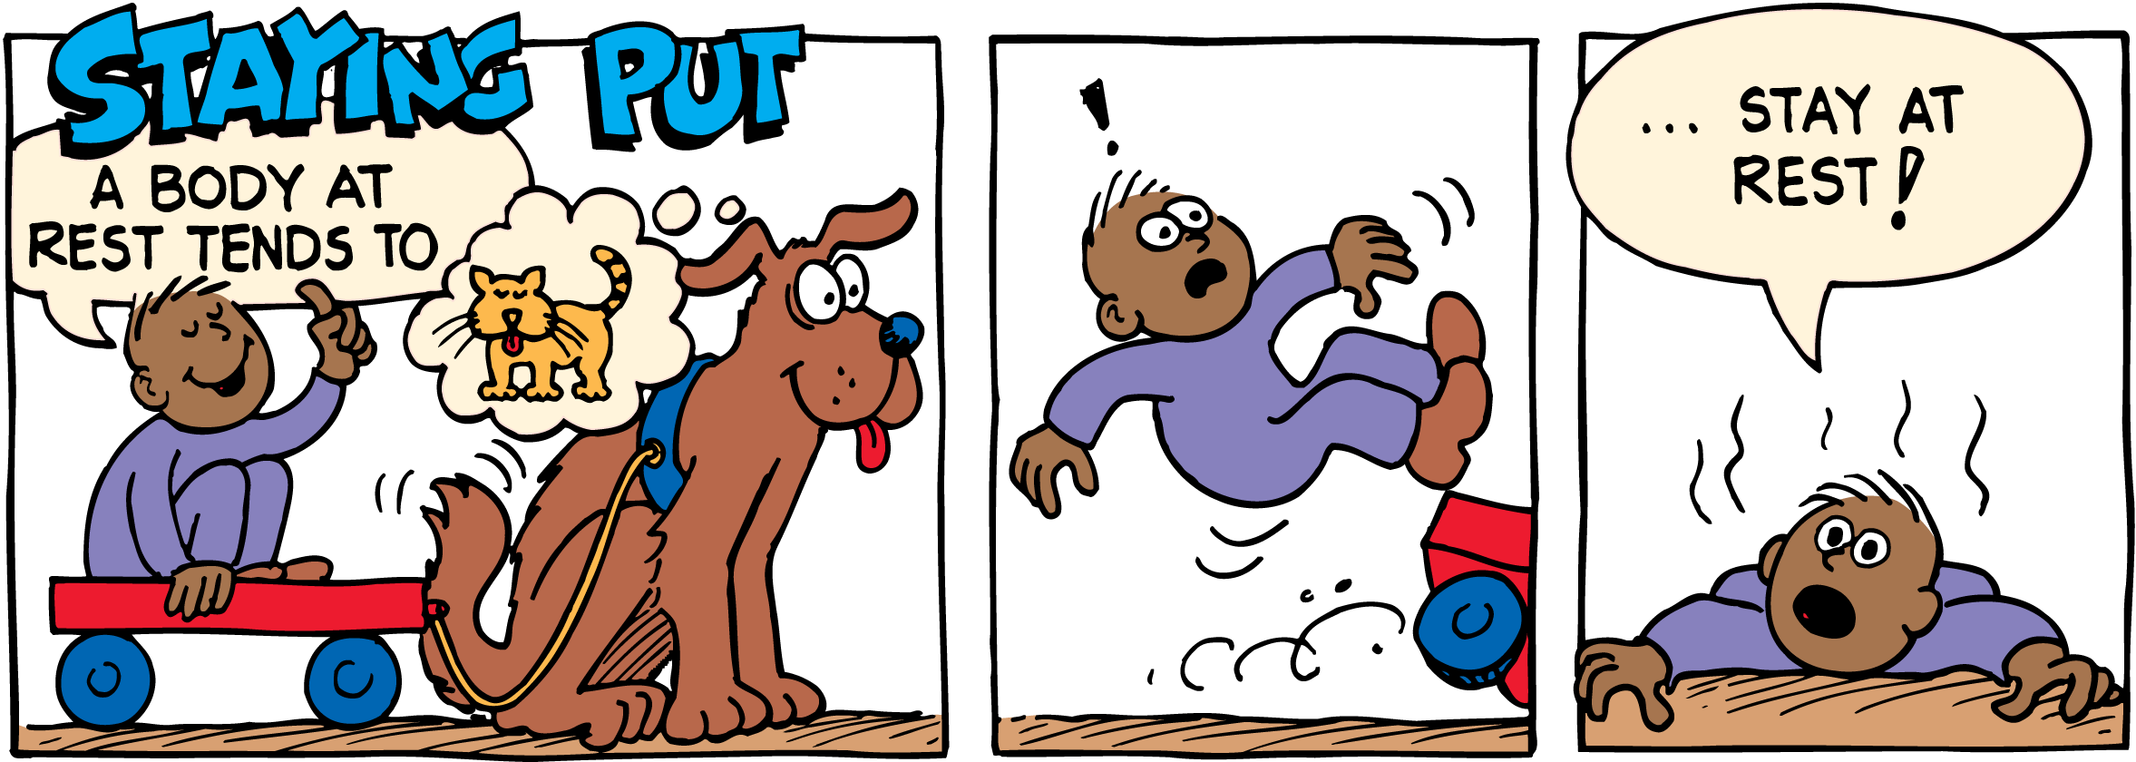
3.4 Newton’s Law of Inertia

Slide 38
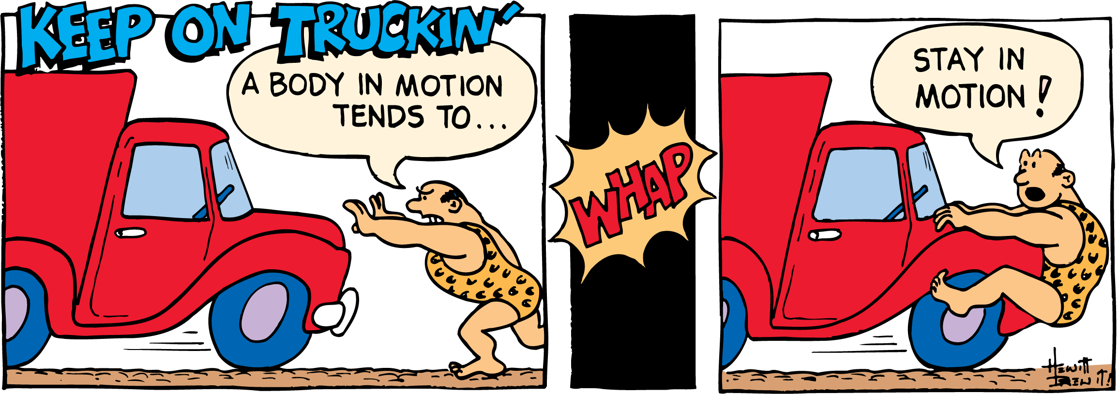
3.4 Newton’s Law of Inertia

Slide 39
3.4 Newton’s Law of Inertia
think!
A force of gravity between the sun and its planets holds the planets in orbit around the sun. If that force of gravity suddenly disappeared, in what kind of path would the planets move?

Slide 40
3.4 Newton’s Law of Inertia
think!
A force of gravity between the sun and its planets holds the planets in orbit around the sun. If that force of gravity suddenly disappeared, in what kind of path would the planets move?
Answer: Each planet would move in a straight line at constant speed.

Slide 41
3.4 Newton’s Law of Inertia
think!
Is it correct to say that the reason an object resists change and persists in its state of motion is that it has inertia?

Slide 42
3.4 Newton’s Law of Inertia
think!
Is it correct to say that the reason an object resists change and persists in its state of motion is that it has inertia?
Answer: We don’t know the reason why objects persist in their motion when nothing acts on them, but we know that they do, and we call this property inertia.

Slide 43
3.4 Newton’s Law of Inertia
What is Newton’s first law of motion?

Slide 44
3.5 Mass—A Measure of Inertia
The more mass an object has, the greater its inertia and the more force it takes to change its state of motion.

Slide 45
3.5 Mass—A Measure of Inertia
The amount of inertia an object has depends on its mass—which is roughly the amount of material present in the object.
Mass is a measure of the inertia of an object.

Slide 46
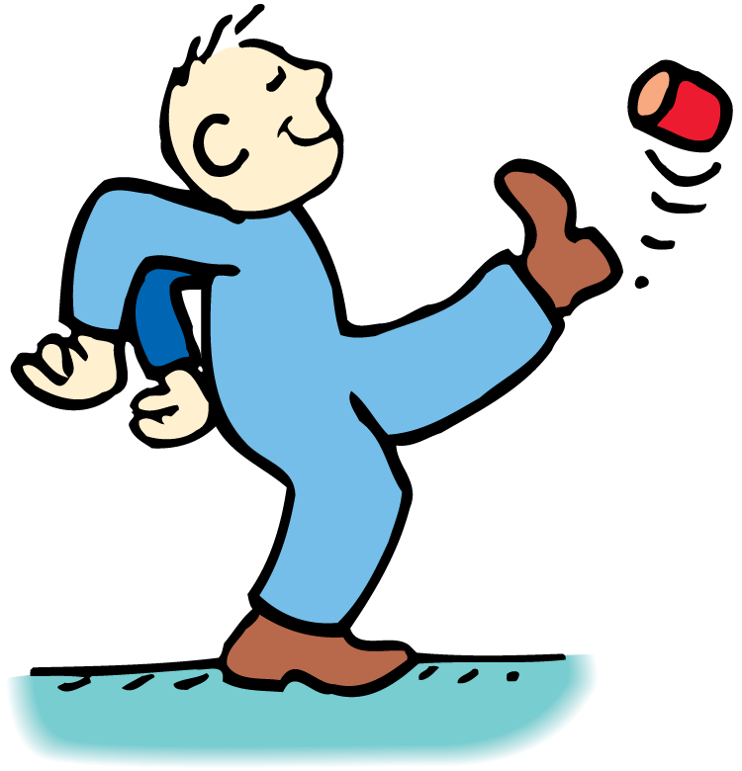
3.5 Mass—A Measure of Inertia
You can tell how much matter is in a can when you kick it. Kick an empty can and it moves. Kick a can filled with sand and it doesn’t move as much.

Slide 47
3.5 Mass—A Measure of Inertia
Mass Is Not Volume
Do not confuse mass and volume.
Volume is a measure of space and is measured in units such as cubic centimeters, cubic meters, and liters.
Mass is measured in the fundamental unit of kilograms.

Slide 48
3.5 Mass—A Measure of Inertia
Which has more mass, a feather pillow or a common automobile battery?
Clearly an automobile battery is more difficult to set into motion. This is evidence of the battery’s greater inertia and hence its greater mass.

Slide 49
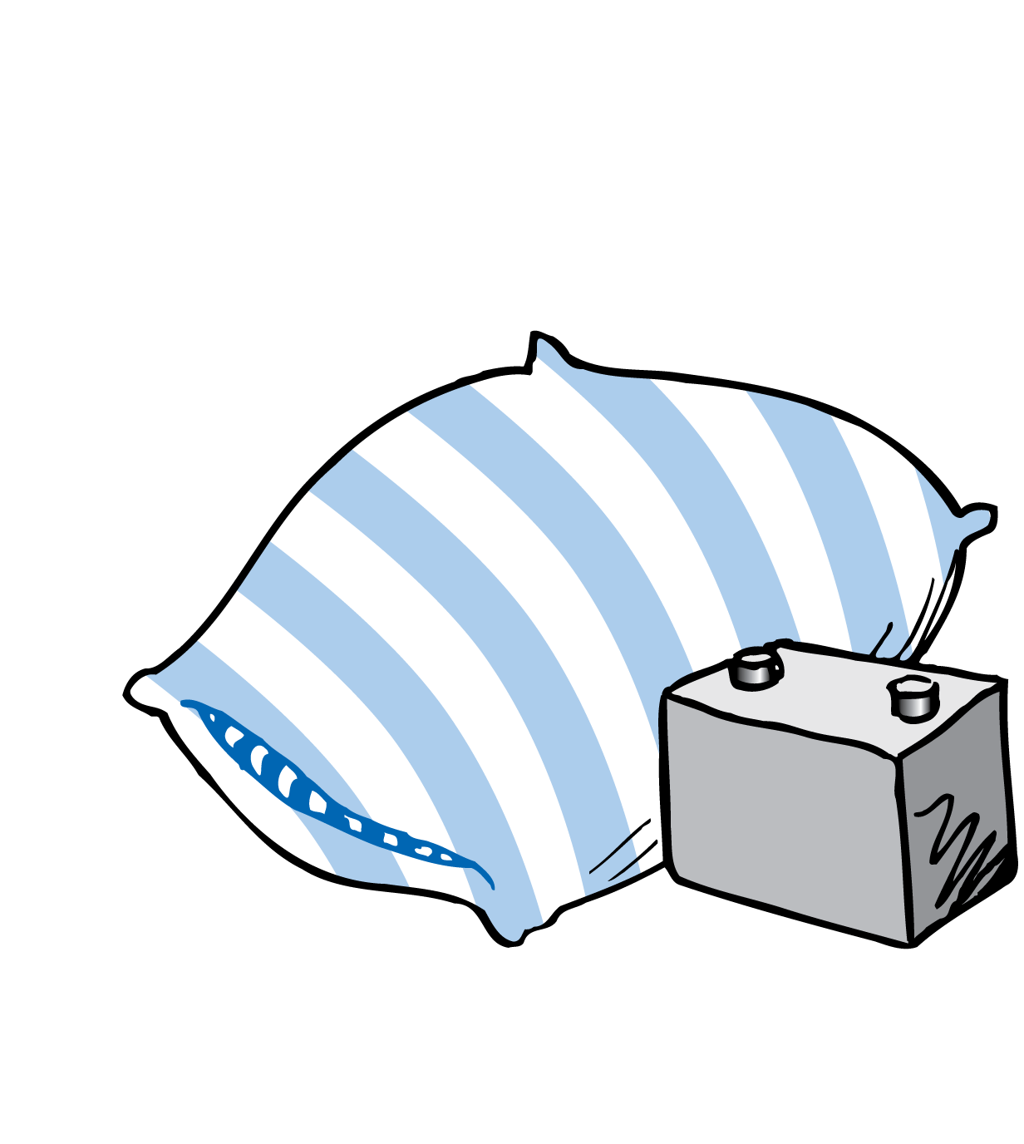
3.5 Mass—A Measure of Inertia
The pillow has a larger size (volume) but a smaller mass than the battery.

Slide 50
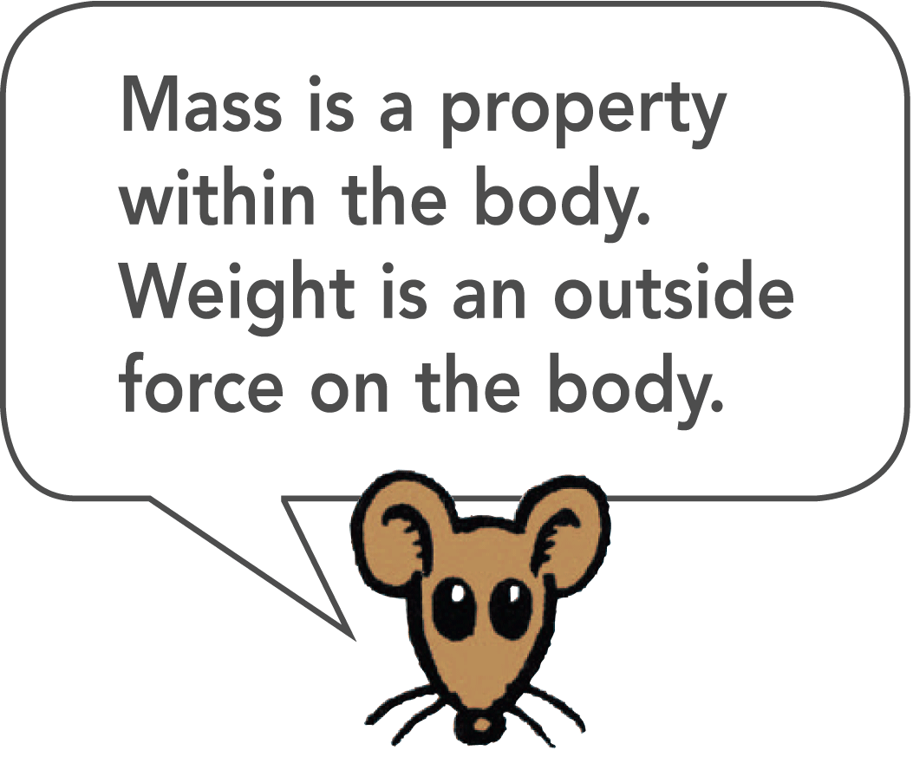
3.5 Mass—A Measure of Inertia
Mass Is Not Weight
Mass is often confused with weight.
We often determine the amount of matter in an object by measuring its gravitational attraction to Earth. However, mass is more fundamental than weight.
Mass is a measure of the amount of material in an object. Weight, on the other hand, is a measure of the gravitational force acting on the object.

Slide 51
3.5 Mass—A Measure of Inertia
Mass Is Inertia
The amount of material in a particular stone is the same whether the stone is located on Earth, on the moon, or in outer space.
The mass of the stone is the same in all of these locations.
The weight of the stone would be very different on Earth and on the moon, and still different in outer space.

Slide 52
3.5 Mass—A Measure of Inertia
The stone’s inertia, or mass, is a property of the stone and not its location.
The same force would be required to shake the stone with the same rhythm whether the stone was on Earth, on the moon, or in a force-free region of outer space.

Slide 53
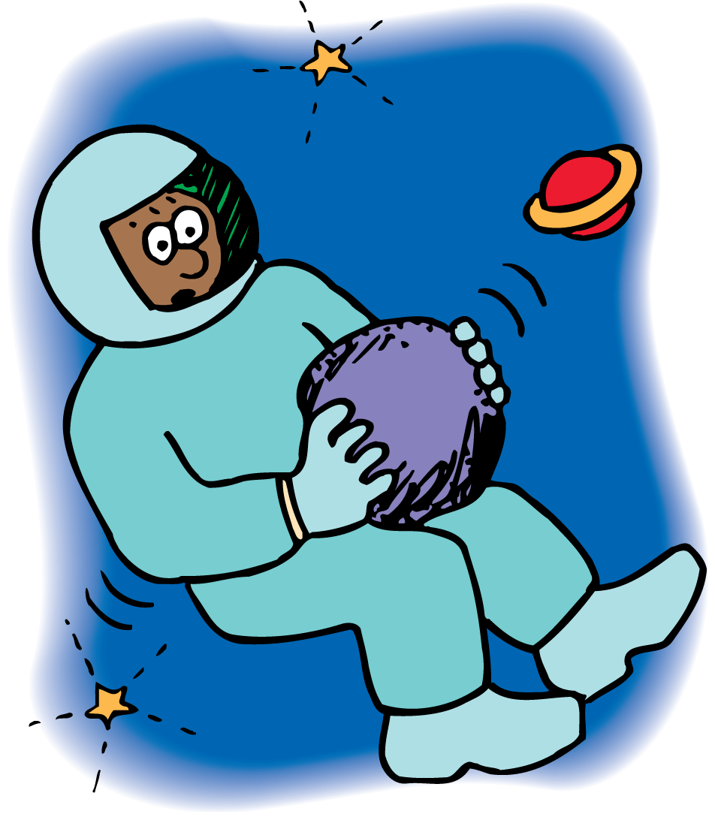
3.5 Mass—A Measure of Inertia
It’s just as difficult to shake a stone in its weightless state in space as it is in its weighted state on Earth.

Slide 54
3.5 Mass—A Measure of Inertia
We can define mass and weight as follows:
Mass is the quantity of matter in an object. More specifically, mass is a measure of the inertia, or “laziness,” that an object exhibits in response to any effort made to start it, stop it, or otherwise change its state of motion.
Weight is the force of gravity on an object.

Slide 55
3.5 Mass—A Measure of Inertia
Mass and weight are proportional to each other in a given place:
In the same location, twice the mass weighs twice as much.
Mass and weight are proportional to each other, but they are not equal to each other.

Slide 56
3.5 Mass—A Measure of Inertia
One Kilogram Weighs 10 Newtons
It is common to describe the amount of matter in an object by its gravitational pull to Earth, that is, by its weight.
In the United States, the traditional unit of weight is the pound. In most parts of the world, however, the measure of matter is commonly expressed in units of mass, the kilogram (kg).
At Earth’s surface, 1 kilogram has a weight of 2.2 pounds.

Slide 57
3.5 Mass—A Measure of Inertia
The SI unit of force is the newton. The SI symbol for the newton is N.
One newton is equal to slightly less than a quarter pound.
If you know the mass of something in kilograms and want its weight in newtons at Earth’s surface, multiply the number of kilograms by 10.

Slide 58
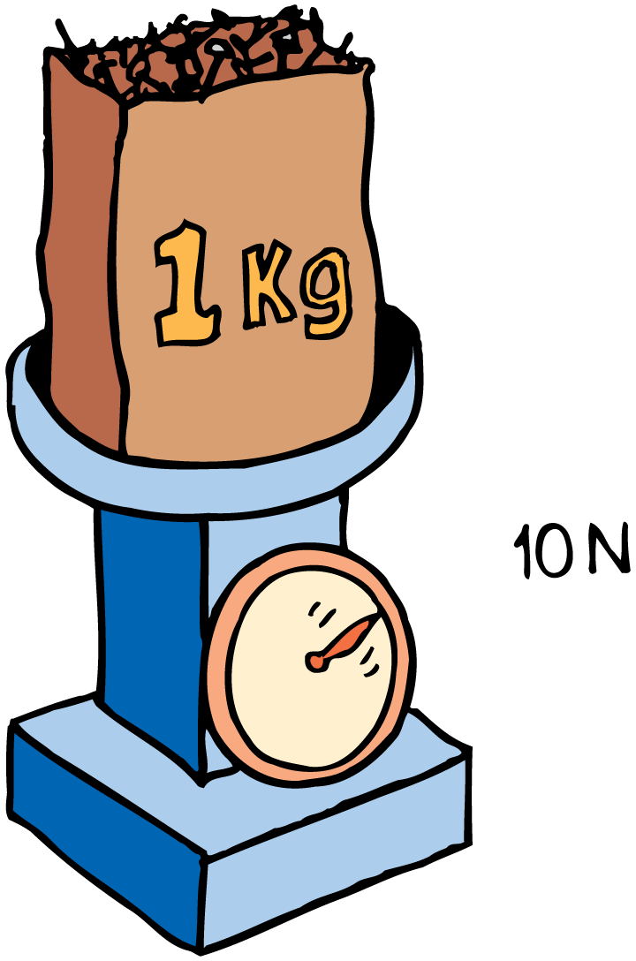
3.5 Mass—A Measure of Inertia
One kilogram of nails weighs 10 newtons, which is equal to 2.2 pounds. Away from Earth’s surface, where the force of gravity is less, the bag of nails weighs less.

Slide 59
3.5 Mass—A Measure of Inertia
think!
Does a 2-kilogram bunch of bananas have twice as much inertia as a 1-kilogram loaf of bread? Twice as much mass? Twice as much volume? Twice as much weight, when weighed in the same location?

Slide 60
3.5 Mass—A Measure of Inertia
think!
Does a 2-kilogram bunch of bananas have twice as much inertia as a 1-kilogram loaf of bread? Twice as much mass? Twice as much volume? Twice as much weight, when weighed in the same location?
Answer: Two kilograms of anything has twice the inertia and twice the mass of one kilogram of anything else. In the same location, where mass and weight are proportional, two kilograms of anything will weigh twice as much as one kilogram of anything. Except for volume, the answer to all the questions is yes. Bananas are much more dense than bread, so two kilograms of bananas must occupy less volume than one kilogram of bread.

Slide 61
3.5 Mass—A Measure of Inertia
What is the relationship between mass and inertia?

Slide 62
3.6 The Moving Earth Again
The law of inertia states that objects in motion remain in motion if no unbalanced forces act on them.

Slide 63
3.6 The Moving Earth Again
Copernicus announced the idea of a moving Earth in the sixteenth century. One of the arguments against a moving Earth was:
Consider a bird sitting at rest in the top of a tall tree.
The bird sees a worm, drops down vertically, and catches it.
It was argued that this would not be possible if Earth moved as Copernicus suggested.
The fact that birds do catch worms from high tree branches seemed to be clear evidence that Earth must be at rest.

Slide 64
3.6 The Moving Earth Again
Objects Move With Earth
You can refute this argument using the idea of inertia.
Earth moves at 30 km/s, but so do the tree, the worm below, and even the air in between.
Objects on Earth move with Earth as Earth moves around the sun.

Slide 65
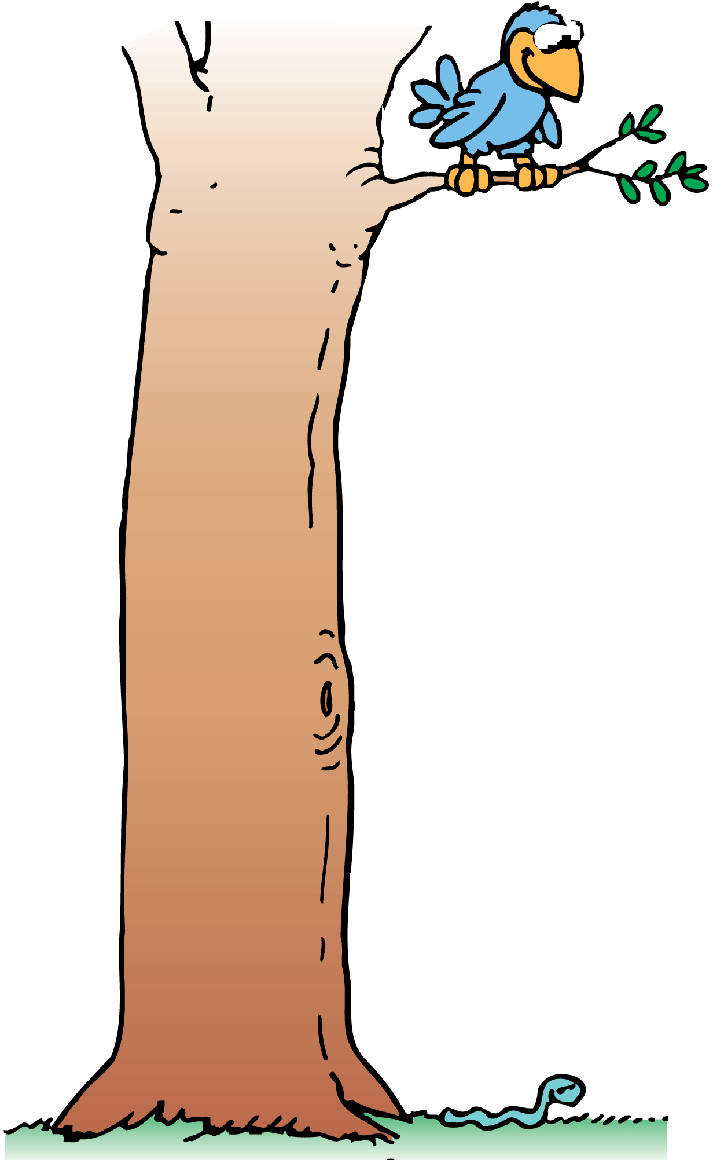
3.6 The Moving Earth Again
Earth does not need to be at rest for the bird to catch the worm.

Slide 66
3.6 The Moving Earth Again
Objects Move With Vehicles
If we flip a coin in a high-speed car, bus, or plane, we can catch the vertically moving coin as we would if the vehicle were at rest.
We see evidence for the law of inertia when the horizontal motion of the coin before, during, and after the catch is the same.
The vertical force of gravity affects only the vertical motion of the coin.

Slide 67
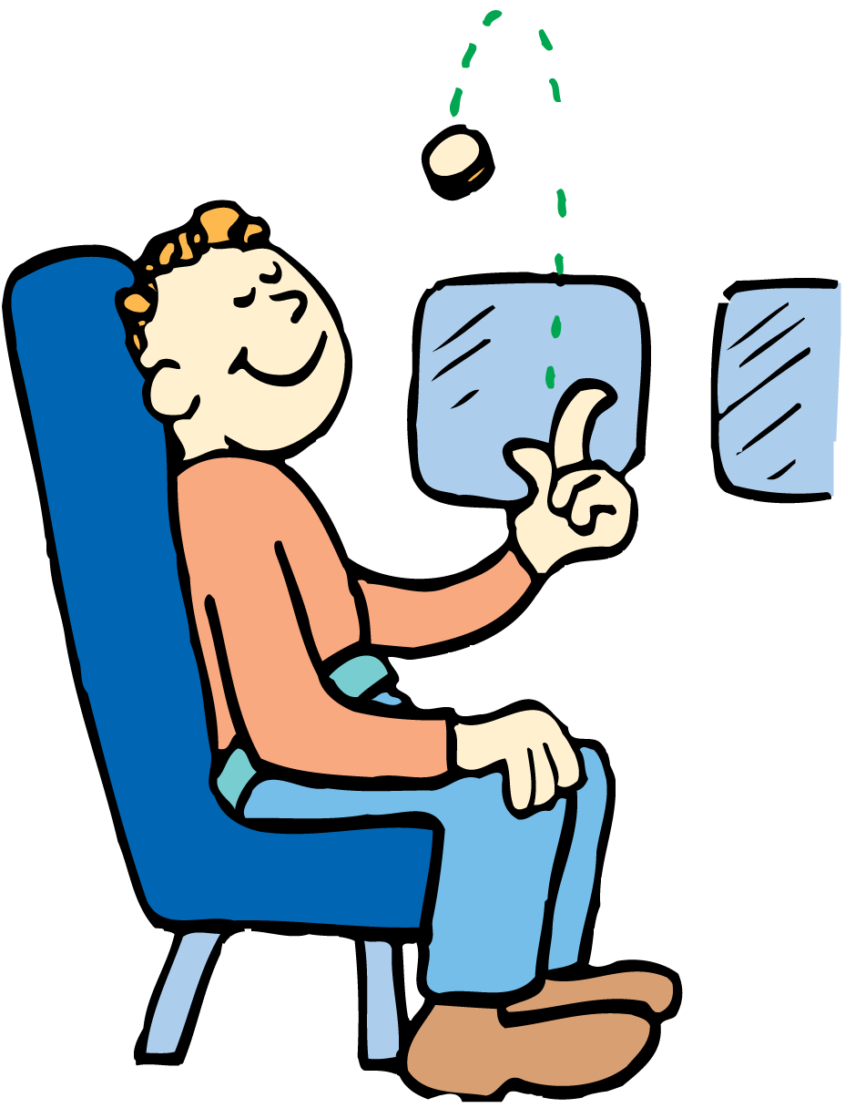
3.6 The Moving Earth Again
Flip a coin in an airplane, and it behaves as if the plane were at rest. The coin keeps up with you—inertia in action!

Slide 68
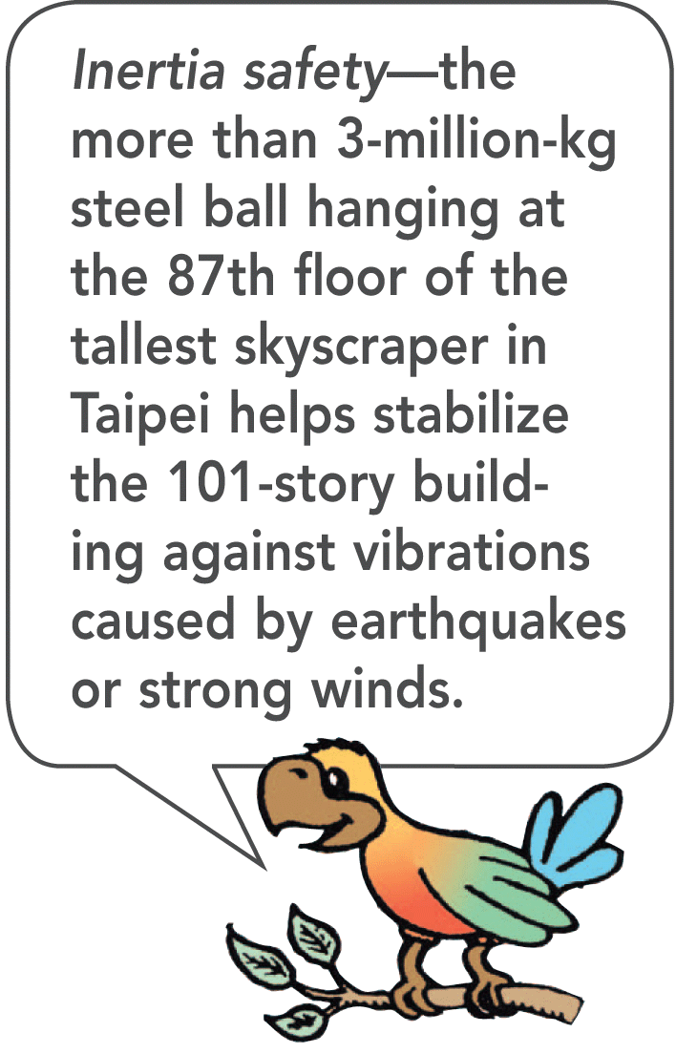
3.6 The Moving Earth Again

Slide 69
3.6 The Moving Earth Again
How does the law of inertia apply to objects in motion?

Slide 70
Assessment Questions
Two thousand years ago, people thought that Earth did not move. One major reason for thinking this was that
no force was large enough to move the Earth.
Earth’s motion would be unnatural.
Earth was near the center of the universe.
Earth moved in a perfect circle.

Slide 71
Assessment Questions
Two thousand years ago, people thought that Earth did not move. One major reason for thinking this was that
no force was large enough to move the Earth.
Earth’s motion would be unnatural.
Earth was near the center of the universe.
Earth moved in a perfect circle.
Answer: A

Slide 72
Assessment Questions
According to Aristotle and his followers over centuries, Earth was at the center of the universe. The first European to effectively challenge that notion was
Copernicus.
Galileo.
Newton.
Einstein.

Slide 73
Assessment Questions
According to Aristotle and his followers over centuries, Earth was at the center of the universe. The first European to effectively challenge that notion was
Copernicus.
Galileo.
Newton.
Einstein.
Answer: A

Slide 74
Assessment Questions
Galileo’s conclusions about motion helped advance science because they were based on
experiments rather than philosophical discussions.
philosophical discussions rather than experiments.
nonmathematical thinking.
Aristotle’s theories of motion.

Slide 75
Assessment Questions
Galileo’s conclusions about motion helped advance science because they were based on
experiments rather than philosophical discussions.
philosophical discussions rather than experiments.
nonmathematical thinking.
Aristotle’s theories of motion.
Answer: A

Slide 76
Assessment Questions
If gravity between the sun and Earth suddenly vanished, Earth would continue moving in a(n)
curved path.
straight-line path.
outward spiral path.
inward spiral path.

Slide 77
Assessment Questions
If gravity between the sun and Earth suddenly vanished, Earth would continue moving in a(n)
curved path.
straight-line path.
outward spiral path.
inward spiral path.
Answer: B

Slide 78
Assessment Questions
To say that 1 kg of matter weighs 10 N is to say that 1 kg of matter
will weigh 10 N everywhere.
has ten times less volume than 10 kg of matter.
has ten times more inertia than 10 kg of matter.
is attracted to Earth with 10 N of force.

Slide 79
Assessment Questions
To say that 1 kg of matter weighs 10 N is to say that 1 kg of matter
will weigh 10 N everywhere.
has ten times less volume than 10 kg of matter.
has ten times more inertia than 10 kg of matter.
is attracted to Earth with 10 N of force.
Answer: D

Slide 80
Assessment Questions
The Earth moves about 30 km/s relative to the sun. But when you jump upward in front of a wall, the wall doesn’t slam into you at 30 km/s. A good explanation for why it doesn’t is that
the sun’s influence on you is negligible.
the air in the room is also moving.
both you and the wall are moving at the same speed, before, during, and after your jump.
the inertia of you and the wall is negligible compared with that of the sun.

Slide 81
Assessment Questions
The Earth moves about 30 km/s relative to the sun. But when you jump upward in front of a wall, the wall doesn’t slam into you at 30 km/s. A good explanation for why it doesn’t is that
the sun’s influence on you is negligible.
the air in the room is also moving.
both you and the wall are moving at the same speed, before, during, and after your jump.
the inertia of you and the wall is negligible compared with that of the sun.
Answer: C

