Slide 1
Momentum is conserved for all collisions as long as external forces don’t interfere.

Slide 2
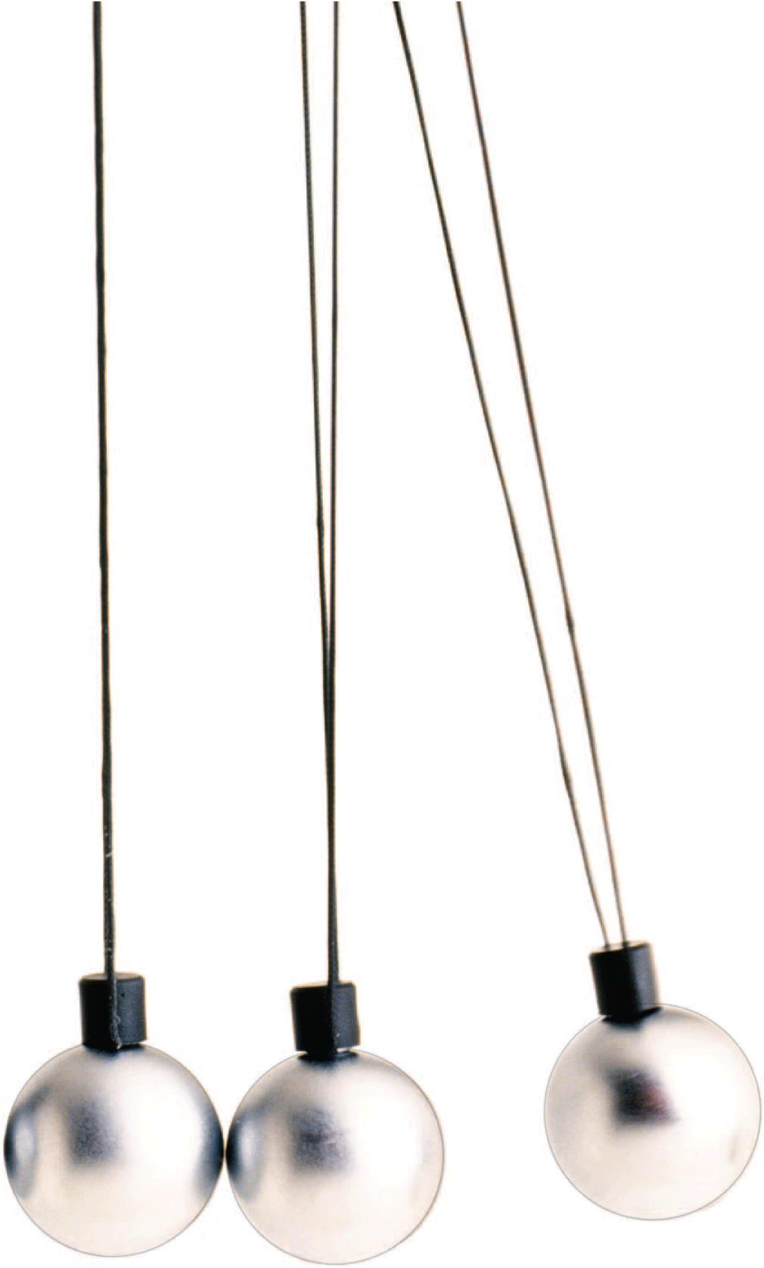
The concept of inertia was introduced and developed both in terms of objects at rest and objects in motion. In this chapter we are concerned only with the concept of inertia in motion—momentum.

Slide 3
8.1 Momentum
A moving object can have a large momentum if it has a large mass, a high speed, or both.

Slide 4
8.1 Momentum
It is harder to stop a large truck than a small car when both are moving at the same speed.
The truck has more momentum than the car. By momentum, we mean inertia in motion.

Slide 5
8.1 Momentum
Momentum is the mass of an object multiplied by its velocity.
momentum = mass × velocity
momentum = mv
When direction is not an important factor,
momentum = mass × speed

Slide 6
8.1 Momentum
A moving truck has more momentum than a car moving at the same speed because the truck has more mass.
A fast car can have more momentum than a slow truck.
A truck at rest has no momentum at all.

Slide 7
8.1 Momentum
A truck rolling down a hill has more momentum than a roller skate with the same speed. But if the truck is at rest and the roller skate moves, then the skate has more momentum.

Slide 8
8.1 Momentum
think!
Can you think of a case where a roller skate and a truck would have the same momentum?

Slide 9
8.1 Momentum
think!
Can you think of a case where a roller skate and a truck would have the same momentum?
Answer: The roller skate and truck can have the same momentum if the speed of the roller skate is much greater than the speed of the truck. For example, a 1000-kg truck backing out of a driveway at 0.01 m/s has the same momentum as a 1-kg skate going 10 m/s. Both have momentum = 10 kg•m/s.

Slide 10
8.1 Momentum
What factors affect an object’s momentum?

Slide 11
8.2 Impulse Changes Momentum
The change in momentum depends on the force that acts and the length of time it acts.

Slide 12
8.2 Impulse Changes Momentum
If the momentum of an object changes, either the mass or the velocity or both change.
The greater the force acting on an object, the greater its change in velocity and the greater its change in momentum.

Slide 13
8.2 Impulse Changes Momentum
Impulse
A force sustained for a long time produces more change in momentum than does the same force applied briefly.
Both force and time are important in changing an object’s momentum.

Slide 14
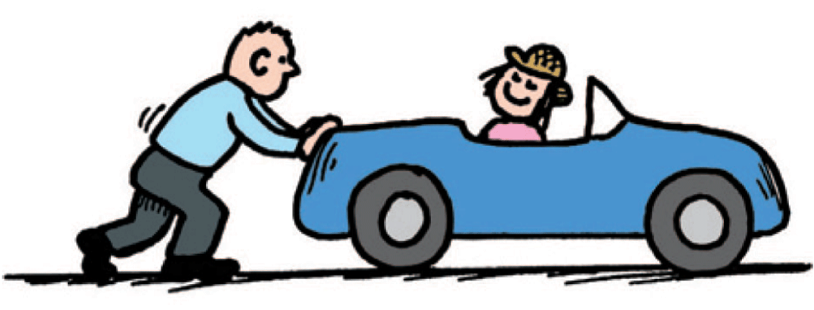
8.2 Impulse Changes Momentum
When you push with the same force for twice the time, you impart twice the impulse and produce twice the change in momentum.

Slide 15
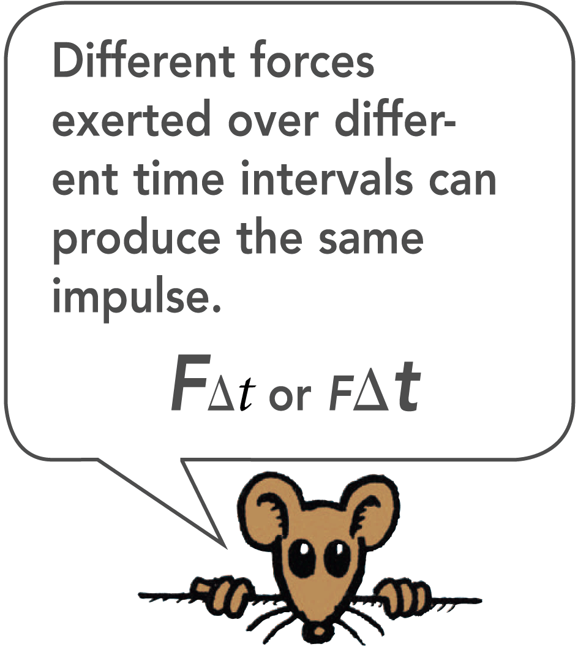
8.2 Impulse Changes Momentum
The quantity force × time interval is called impulse.
impulse = F × t
The greater the impulse exerted on something, the greater will be the change in momentum.
impulse = change in momentum
Ft = ∆(mv)

Slide 16
8.2 Impulse Changes Momentum
Increasing Momentum
To increase the momentum of an object, apply the greatest force possible for as long as possible.
A golfer teeing off and a baseball player trying for a home run do both of these things when they swing as hard as possible and follow through with their swing.

Slide 17
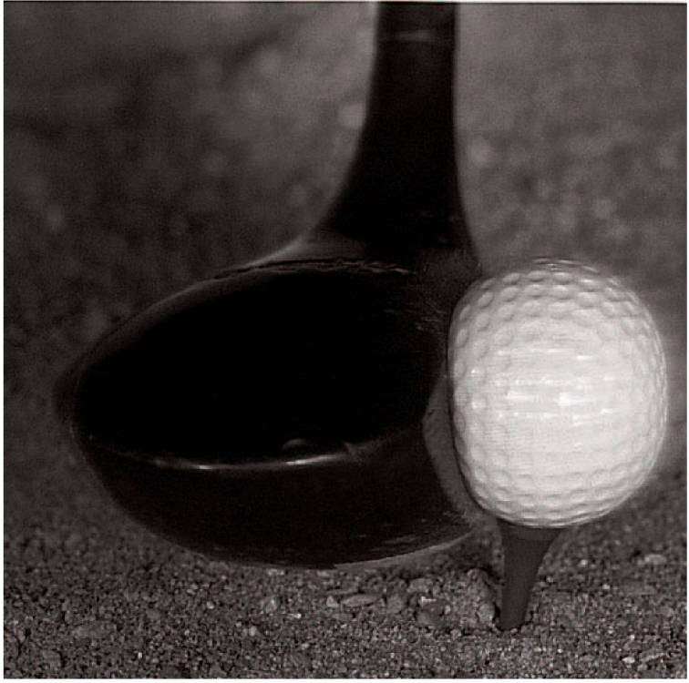
8.2 Impulse Changes Momentum
The force of impact on a golf ball varies throughout the duration of impact.

Slide 18
8.2 Impulse Changes Momentum
The forces involved in impulses usually vary from instant to instant.
A golf club that strikes a golf ball exerts zero force on the ball until it comes in contact with it.
The force increases rapidly as the ball becomes distorted.
The force diminishes as the ball comes up to speed and returns to its original shape.
We can use the average force to solve for the impulse on an object.

Slide 19
8.2 Impulse Changes Momentum
Decreasing Momentum
If you were in a car that was out of control and had to choose between hitting a haystack or a concrete wall, you would choose the haystack.
Physics helps you to understand why hitting a soft object is entirely different from hitting a hard one.

Slide 20
8.2 Impulse Changes Momentum
If the change in momentum occurs over a long time, the force of impact is small.

Slide 21
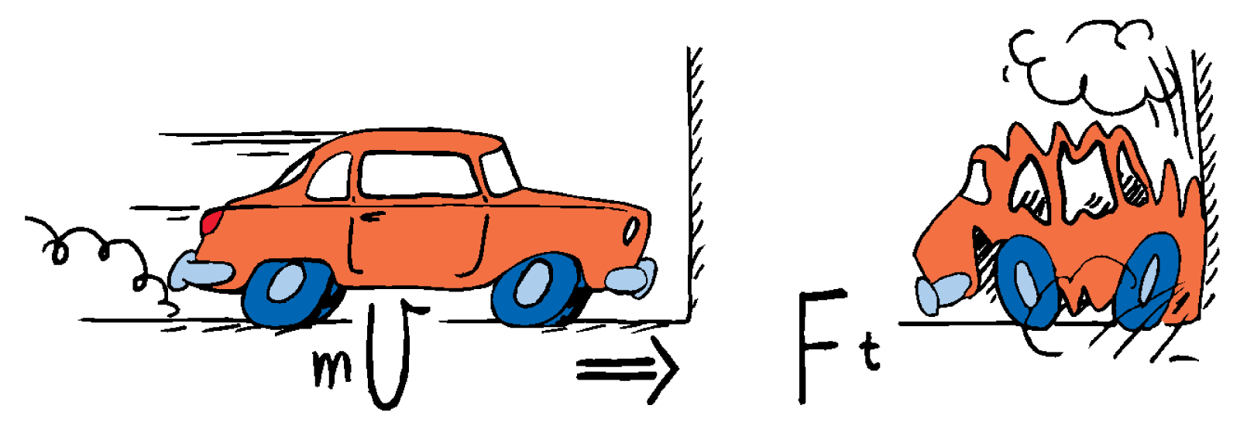
8.2 Impulse Changes Momentum
If the change in momentum occurs over a short time, the force of impact is large.

Slide 22
8.2 Impulse Changes Momentum
When hitting either the wall or the haystack and coming to a stop, the momentum is decreased by the same impulse.
The same impulse does not mean the same amount of force or the same amount of time.
It means the same product of force and time.
To keep the force small, we extend the time.

Slide 23
8.2 Impulse Changes Momentum
When you extend the time, you reduce the force.
A padded dashboard in a car is safer than a rigid metal one.
Airbags save lives.
To catch a fast-moving ball, extend your hand forward and move it backward after making contact with the ball.

Slide 24
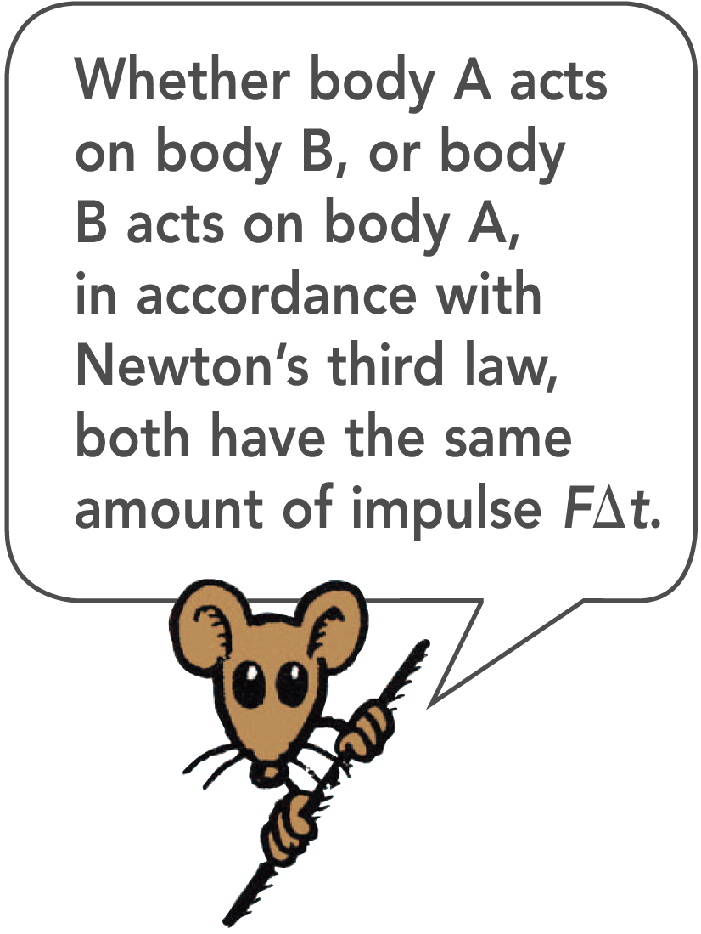
8.2 Impulse Changes Momentum
When you jump down to the ground, bend your knees when your feet make contact with the ground to extend the time during which your momentum decreases.
A wrestler thrown to the floor extends his time of hitting the mat, spreading the impulse into a series of smaller ones as his foot, knee, hip, ribs, and shoulder successively hit the mat.

Slide 25
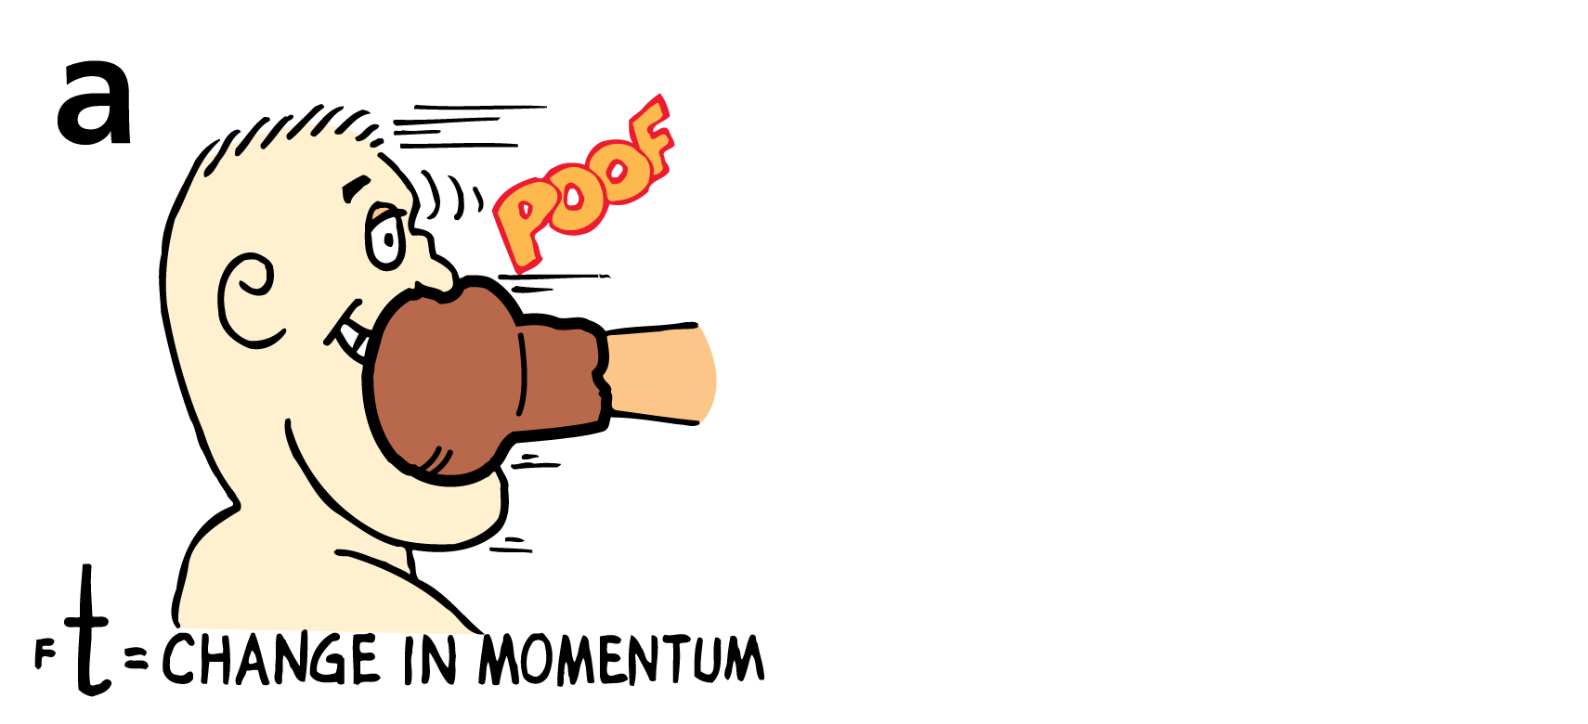
8.2 Impulse Changes Momentum
The impulse provided by a boxer’s jaw counteracts the momentum of the punch.
a. The boxer moves away from the punch.

Slide 26
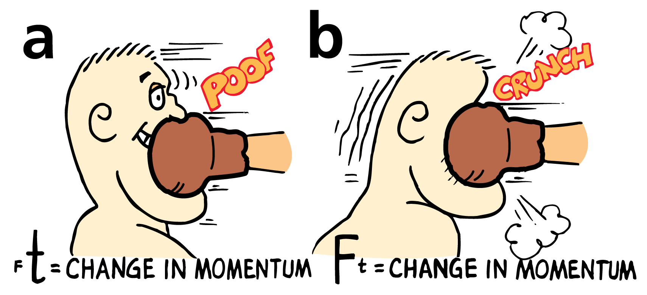
8.2 Impulse Changes Momentum
The impulse provided by a boxer’s jaw counteracts the momentum of the punch.
a. The boxer moves away from the punch.
b. The boxer moves toward the punch. Ouch!

Slide 27
8.2 Impulse Changes Momentum
A glass dish is more likely to survive if it is dropped on a carpet rather than a sidewalk. The carpet has more “give.”
Since time is longer hitting the carpet than hitting the sidewalk, a smaller force results.
The shorter time hitting the sidewalk results in a greater stopping force.

Slide 28
8.2 Impulse Changes Momentum
The safety net used by circus acrobats is a good example of how to achieve the impulse needed for a safe landing.
The safety net reduces the stopping force on a fallen acrobat by substantially increasing the time interval of the contact.

Slide 29
8.2 Impulse Changes Momentum
think!
When a dish falls, will the impulse be less if it lands on a carpet than if it lands on a hard floor?

Slide 30
8.2 Impulse Changes Momentum
think!
When a dish falls, will the impulse be less if it lands on a carpet than if it lands on a hard floor?
Answer: No. The impulse would be the same for either surface because the same momentum change occurs for each. It is the force that is less for the impulse on the carpet because of the greater time of momentum change.

Slide 31
8.2 Impulse Changes Momentum
think!
If a boxer is able to make the contact time five times longer by “riding” with the punch, how much will the force of the punch impact be reduced?

Slide 32
8.2 Impulse Changes Momentum
think!
If a boxer is able to make the contact time five times longer by “riding” with the punch, how much will the force of the punch impact be reduced?
Answer: Since the time of impact increases five times, the force of impact will be reduced five times.

Slide 33
8.2 Impulse Changes Momentum
What factors affect how much an object’s momentum changes?

Slide 34
8.3 Bouncing
The impulse required to bring an object to a stop and then to “throw it back again” is greater than the impulse required merely to bring the object to a stop.

Slide 35
8.3 Bouncing
Suppose you catch a falling pot with your hands.
You provide an impulse to reduce its momentum to zero.
If you throw the pot upward again, you have to provide additional impulse.

Slide 36
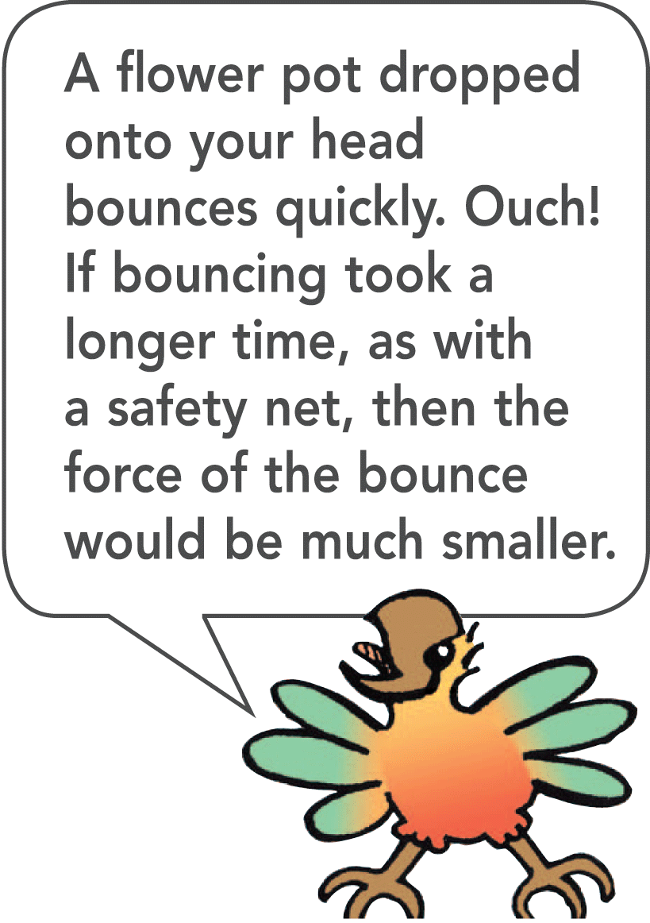
8.3 Bouncing
If the flower pot falls from a shelf onto your head, you may be in trouble.
If it bounces from your head, you may be in more serious trouble because impulses are greater when an object bounces. The increased impulse is supplied by your head if the pot bounces.

Slide 37
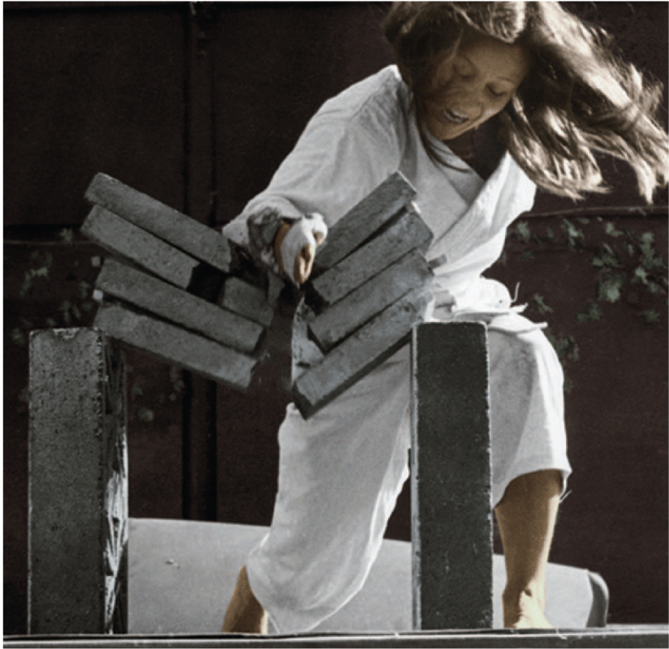
8.3 Bouncing
Cassy imparts a large impulse to the bricks in a short time and produces considerable force. Her hand bounces back, yielding as much as twice the impulse to the bricks.

Slide 38
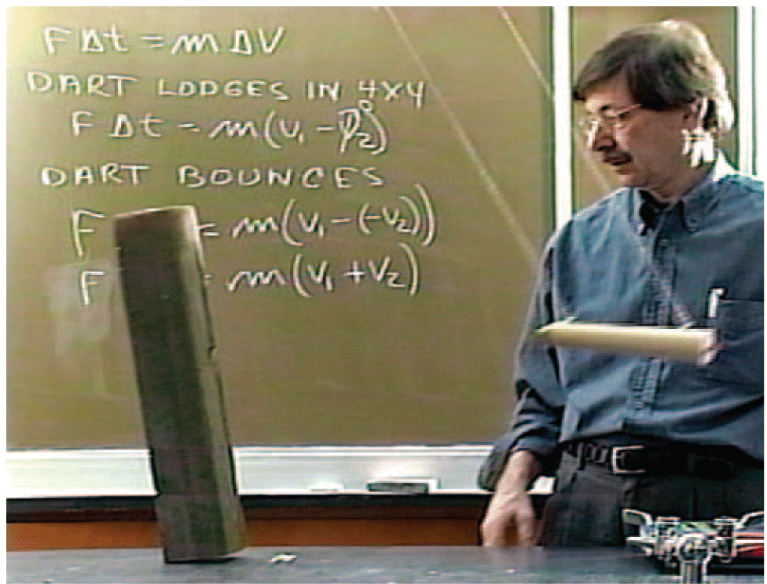
8.3 Bouncing
The block topples when the swinging dart bounces from it. Without the rubber head of the dart, it doesn’t bounce when it hits the block and no toppling occurs.

Slide 39
8.3 Bouncing
The waterwheels used in gold mining operations during the California Gold Rush were not very effective.
Lester A. Pelton designed a curve-shaped paddle that caused the incoming water to make a U-turn upon impact. The water “bounced,” increasing the impulse exerted on the waterwheel.

Slide 40
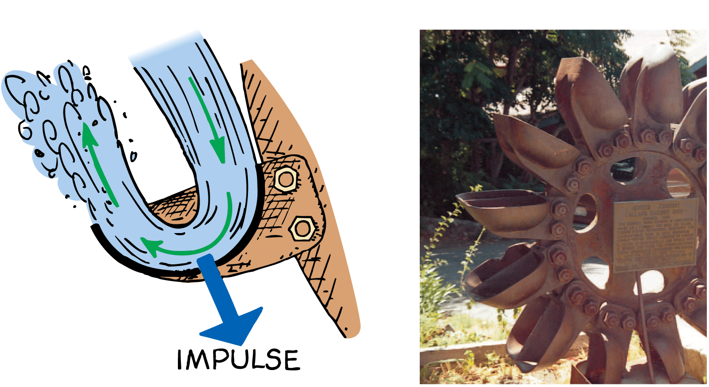
8.3 Bouncing
The curved blades of the Pelton Wheel cause water to bounce and make a U-turn, producing a large impulse that turns the wheel.

Slide 41
8.3 Bouncing
How does the impulse of a bounce compare to stopping only?

Slide 42
8.4 Conservation of Momentum
The law of conservation of momentum states that, in the absence of an external force, the momentum of a system remains unchanged.

Slide 43
8.4 Conservation of Momentum
The force or impulse that changes momentum must be exerted on the object by something outside the object.
Molecular forces within a basketball have no effect on the momentum of the basketball.
A push against the dashboard from inside does not affect the momentum of a car.
These are internal forces. They come in balanced pairs that cancel within the object.

Slide 44
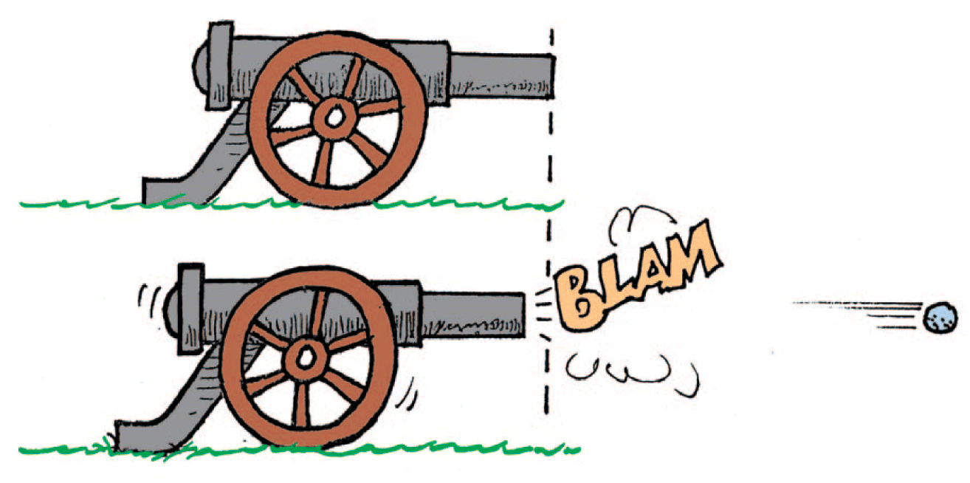
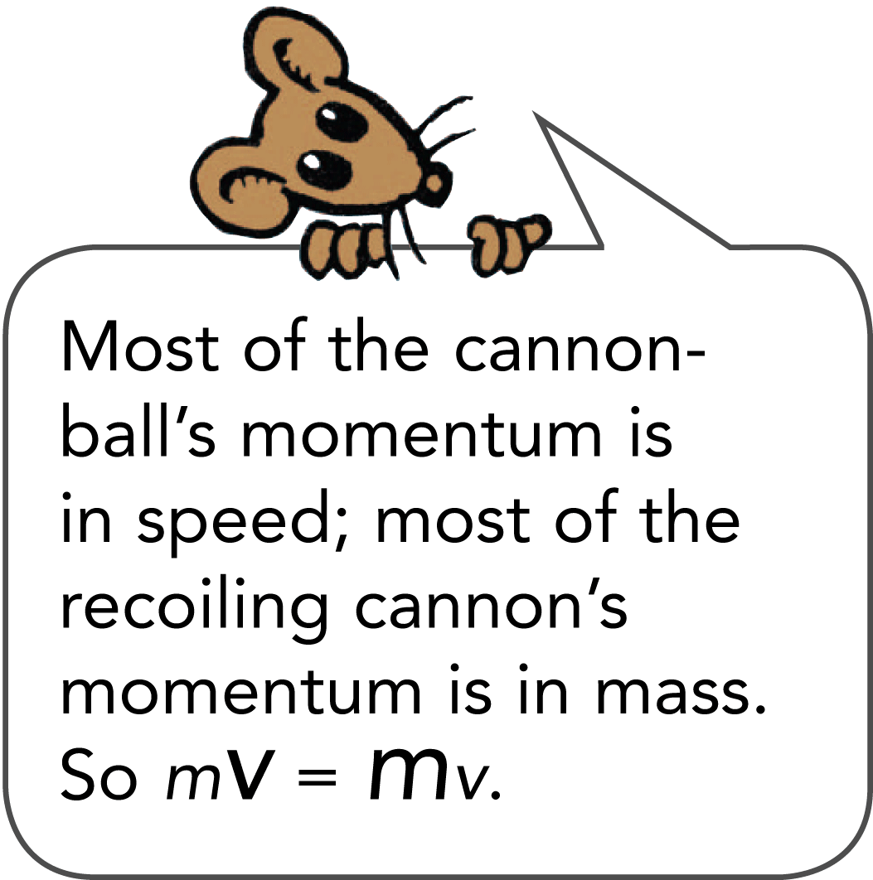
8.4 Conservation of Momentum
The momentum before firing is zero. After firing, the net momentum is still zero because the momentum of the cannon is equal and opposite to the momentum of the cannonball.

Slide 45
8.4 Conservation of Momentum
The force on the cannonball inside the cannon barrel is equal and opposite to the force causing the cannon to recoil. The action and reaction forces are internal to the system so they don’t change the momentum of the cannon-cannonball system.
Before the firing, the momentum is zero.
After the firing, the net momentum is still zero.
Net momentum is neither gained nor lost.

Slide 46
8.4 Conservation of Momentum
Momentum has both direction and magnitude. It is a vector quantity.
The cannonball gains momentum and the recoiling cannon gains momentum in the opposite direction.
The cannon-cannonball system gains none.
The momenta of the cannonball and the cannon are equal in magnitude and opposite in direction.
No net force acts on the system so there is no net impulse on the system and there is no net change in the momentum.

Slide 47
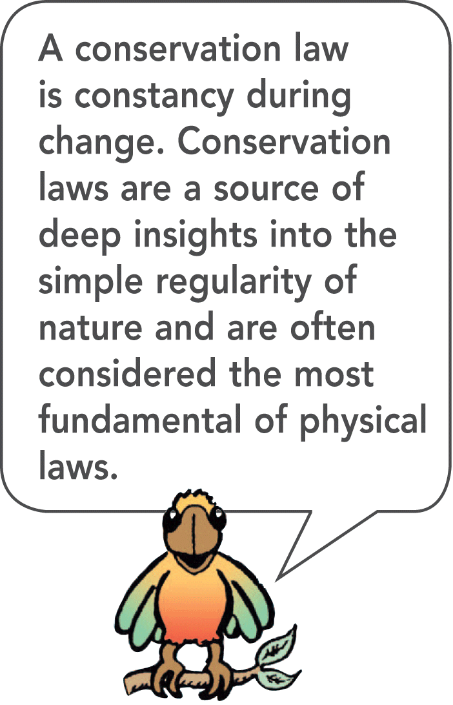
8.4 Conservation of Momentum
In every case, the momentum of a system cannot change unless it is acted on by external forces.
When any quantity in physics does not change, we say it is conserved.

Slide 48
8.4 Conservation of Momentum
The law of conservation of momentum describes the momentum of a system:
If a system undergoes changes wherein all forces are internal, the net momentum of the system before and after the event is the same. Examples are:
atomic nuclei undergoing radioactive decay,
cars colliding, and
stars exploding.

Slide 49
8.4 Conservation of Momentum
think!
Newton’s second law states that if no net force is exerted on a system, no acceleration occurs. Does it follow that no change in momentum occurs?

Slide 50
8.4 Conservation of Momentum
think!
Newton’s second law states that if no net force is exerted on a system, no acceleration occurs. Does it follow that no change in momentum occurs?
Answer: Yes, because no acceleration means that no change occurs in velocity or in momentum (mass × velocity). Another line of reasoning is simply that no net force means there is no net impulse and thus no change in momentum.

Slide 51
8.4 Conservation of Momentum
What does the law of conservation of momentum state?

Slide 52
8.5 Collisions
Whenever objects collide in the absence of external forces, the net momentum of the objects before the collision equals the net momentum of the objects after the collision.

Slide 53
8.5 Collisions
The collision of objects clearly shows the conservation of momentum.

Slide 54
8.5 Collisions
Elastic Collisions
When a moving billiard ball collides head-on with a ball at rest, the first ball comes to rest and the second ball moves away with a velocity equal to the initial velocity of the first ball.
Momentum is transferred from the first ball to the second ball.

Slide 55
8.5 Collisions
When objects collide without being permanently deformed and without generating heat, the collision is an elastic collision.
Colliding objects bounce perfectly in perfect elastic collisions.
The sum of the momentum vectors is the same before and after each collision.

Slide 56
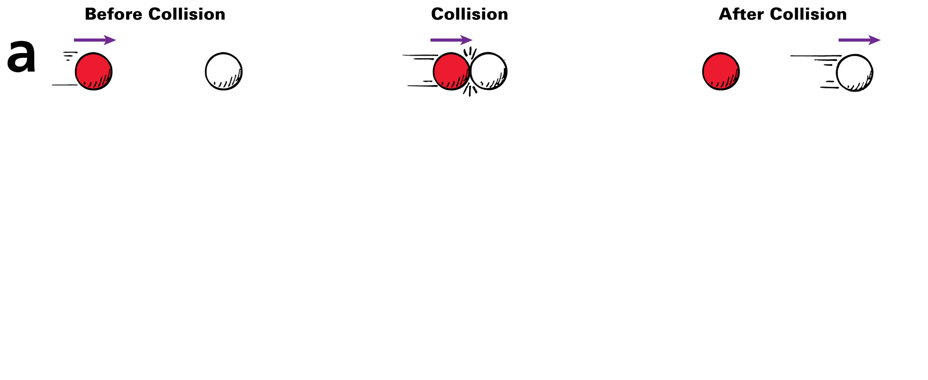
8.5 Collisions
A moving ball strikes a ball at rest.

Slide 57
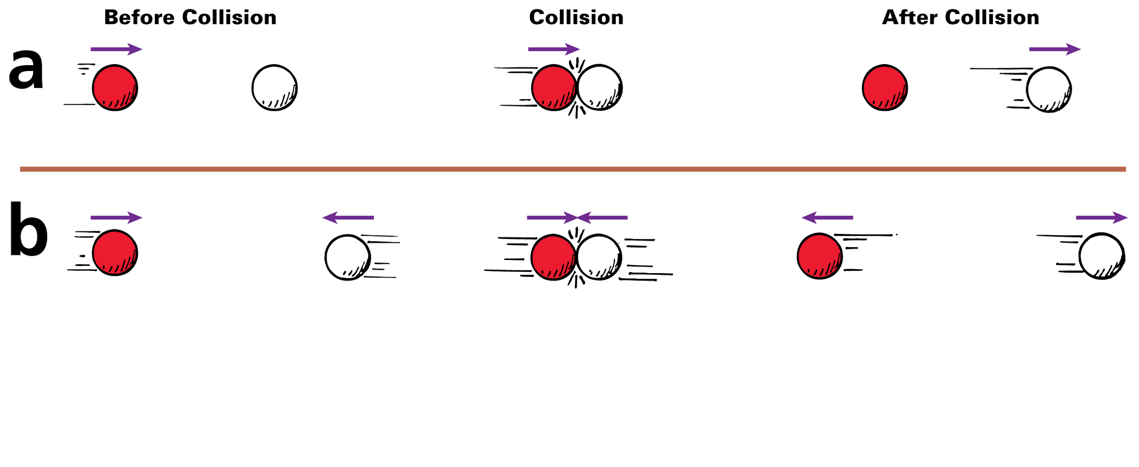
8.5 Collisions
A moving ball strikes a ball at rest.
Two moving balls collide head-on.

Slide 58
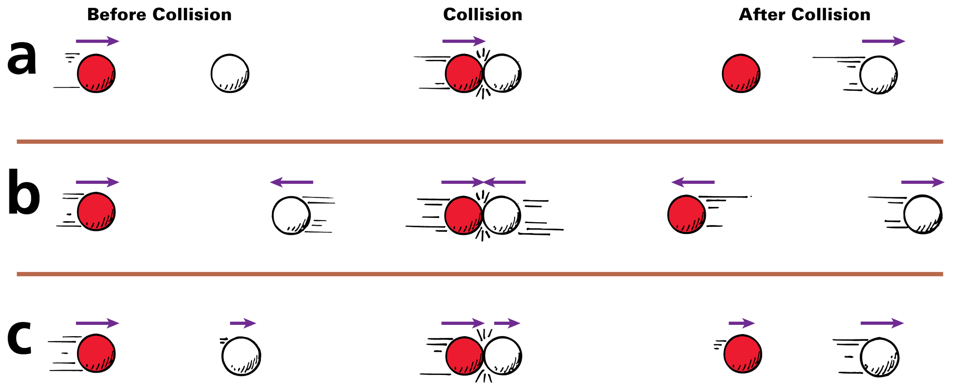
8.5 Collisions
A moving ball strikes a ball at rest.
Two moving balls collide head-on.
Two balls moving in the same direction collide.

Slide 59
8.5 Collisions
Inelastic Collisions
A collision in which the colliding objects become distorted and generate heat during the collision is an inelastic collision.
Momentum conservation holds true even in inelastic collisions.
Whenever colliding objects become tangled or couple together, a totally inelastic collision occurs.

Slide 60
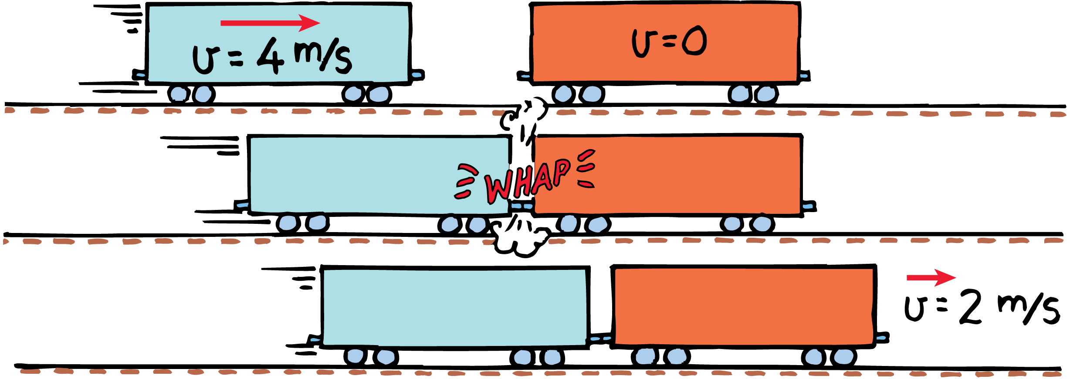
8.5 Collisions
In an inelastic collision between two freight cars, the momentum of the freight car on the left is shared with the freight car on the right.

Slide 61
8.5 Collisions
The freight cars are of equal mass m, and one car moves at 4 m/s toward the other car that is at rest.
net momentum _{before collision} = net momentum _{after collision}
(net mv)_{before} = (net mv)_{after}
(m)(4 m/s) + (m)(0 m/s) = (2m)(v_{after})

Slide 62
8.5 Collisions
Twice as much mass is moving after the collision, so the velocity, v_{after}, must be one half of 4 m/s.
v_{after} = 2 m/s in the same direction as the velocity before the collision, v_{before}.

Slide 63
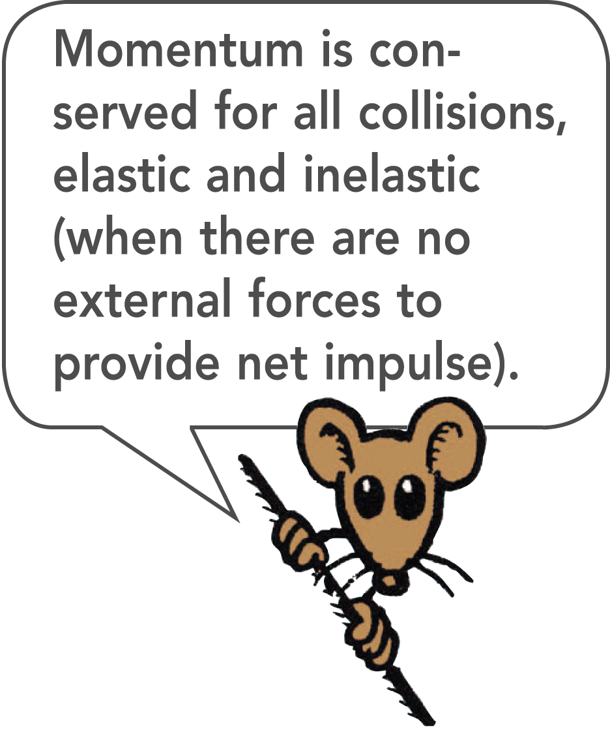
8.5 Collisions
The initial momentum is shared by both cars without loss or gain.
Momentum is conserved.
External forces are usually negligible during the collision, so the net momentum does not change during collision.

Slide 64
8.5 Collisions
External forces may have an effect after the collision:
Billiard balls encounter friction with the table and the air.
After a collision of two trucks, the combined wreck slides along the pavement and friction decreases its momentum.
Two space vehicles docking in orbit have the same net momentum just before and just after contact. Since there is no air resistance in space, the combined momentum is then changed only by gravity.

Slide 65
8.5 Collisions
Perfectly elastic collisions are not common in the everyday world. Drop a ball and after it bounces from the floor, both the ball and the floor are a bit warmer.
At the microscopic level, however, perfectly elastic collisions are commonplace. For example, electrically charged particles bounce off one another without generating heat; they don’t even touch in the classic sense of the word.

Slide 66
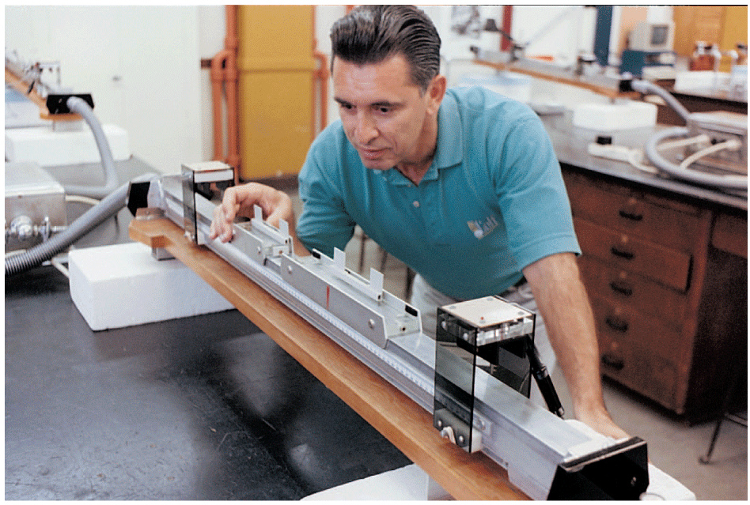
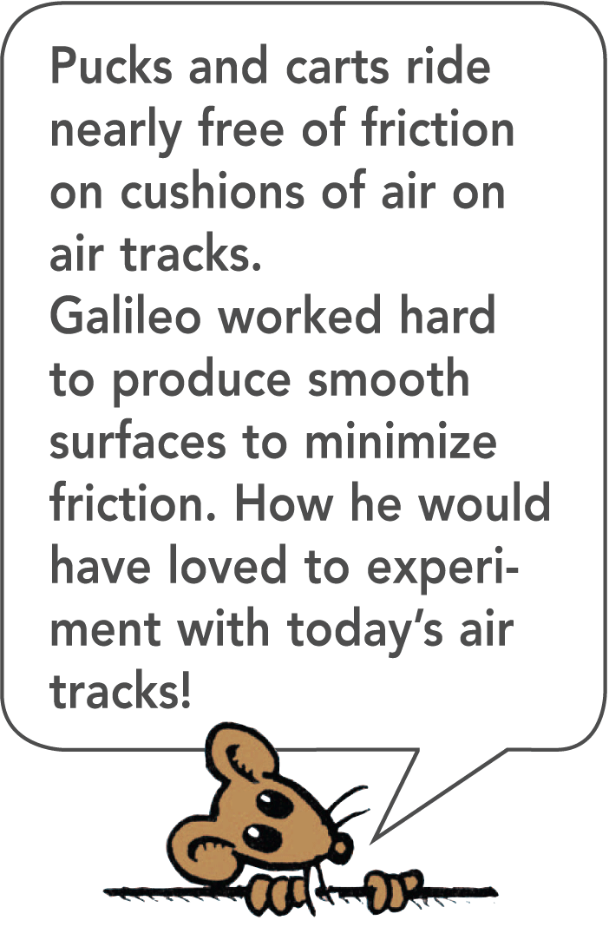
8.5 Collisions
An air track nicely demonstrates conservation of momentum. Many small air jets provide a nearly frictionless cushion of air for the gliders to slide on.

Slide 67
8.5 Collisions
think!
One glider is loaded so it has three times the mass of another glider. The loaded glider is initially at rest. The unloaded glider collides with the loaded glider and the two gliders stick together. Describe the motion of the gliders after the collision.

Slide 68
8.5 Collisions
think!
One glider is loaded so it has three times the mass of another glider. The loaded glider is initially at rest. The unloaded glider collides with the loaded glider and the two gliders stick together. Describe the motion of the gliders after the collision.
Answer: The mass of the stuck-together gliders is four times that of the unloaded glider. The velocity of the stuck-together gliders is one fourth of the unloaded glider’s velocity before collision. This velocity is in the same direction as before, since the direction as well as the amount of momentum is conserved.

Slide 69
8.5 Collisions
do the math!
Consider a 6-kg fish that swims toward and swallows a 2-kg fish that is at rest. If the larger fish swims at 1 m/s, what is its velocity immediately after lunch?

Slide 70
8.5 Collisions
do the math!
Consider a 6-kg fish that swims toward and swallows a 2-kg fish that is at rest. If the larger fish swims at 1 m/s, what is its velocity immediately after lunch?
Momentum is conserved from the instant before lunch until the instant after (in so brief an interval, water resistance does not have time to change the momentum).

Slide 71
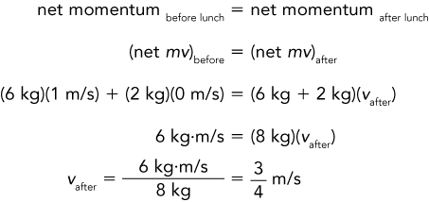
8.5 Collisions
do the math!

Slide 72
8.5 Collisions
do the math!
Suppose the small fish is not at rest but is swimming toward the large fish at 2 m/s.

Slide 73
8.5 Collisions
do the math!
Suppose the small fish is not at rest but is swimming toward the large fish at 2 m/s.
If we consider the direction of the large fish as positive, then the velocity of the small fish is –2 m/s.

Slide 74
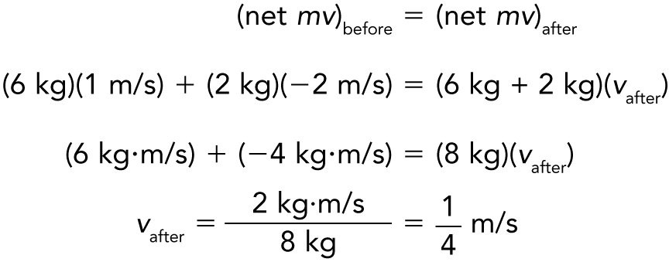
8.5 Collisions
do the math!
The negative momentum of the small fish slows the large fish.

Slide 75
8.5 Collisions
do the math!
If the small fish were swimming at –3 m/s, then both fish would have equal and opposite momenta.
Zero momentum before lunch would equal zero momentum after lunch, and both fish would come to a halt.

Slide 76
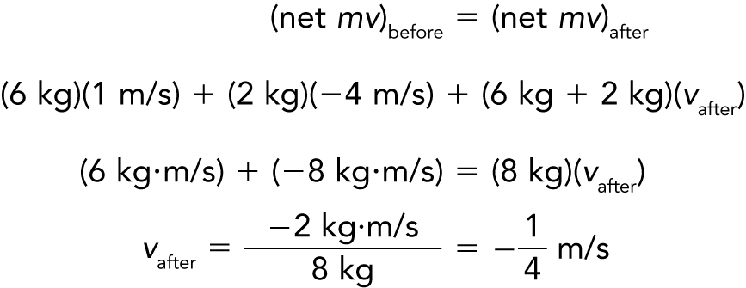
8.5 Collisions
do the math!
Suppose the small fish swims at –4 m/s.
The minus sign tells us that after lunch the two-fish system moves in a direction opposite to the large fish’s direction before lunch.

Slide 77
8.5 Collisions
How does conservation of momentum apply to collisions?

Slide 78
8.6 Momentum Vectors
The vector sum of the momenta is the same before and after a collision.

Slide 79
8.6 Momentum Vectors
Momentum is conserved even when interacting objects don’t move along the same straight line. To analyze momentum in any direction, we use the vector techniques we’ve previously learned.
We’ll look at momentum conservation involving angles by considering three examples.

Slide 80
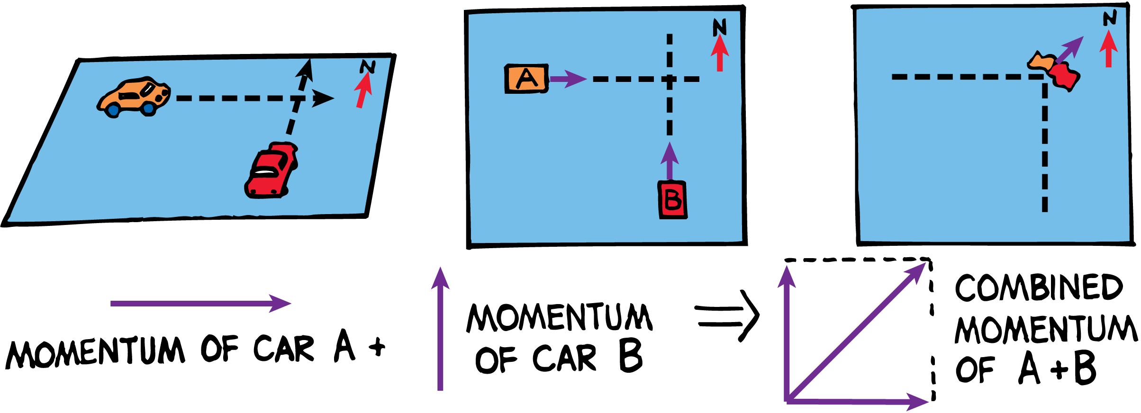
8.6 Momentum Vectors
Momentum is a vector quantity. The momentum of the wreck is equal to the vector sum of the momenta of car A and car B before the collision.

Slide 81
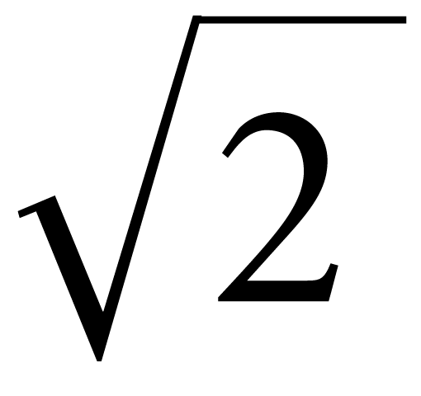
8.6 Momentum Vectors
The momentum of car A is directed due east and that of car B is directed due north.
If their momenta are equal in magnitude, after colliding their combined momentum will be in a northeast direction with a magnitude times the momentum either vehicle had before the collision.

Slide 82
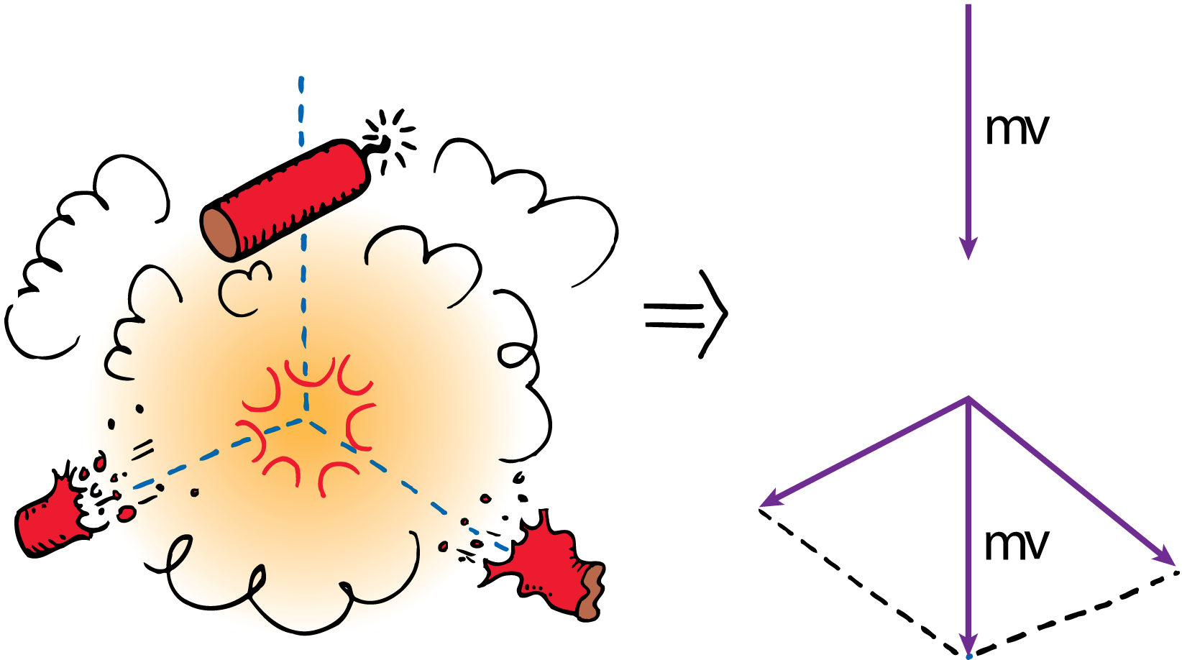
8.6 Momentum Vectors
When the firecracker bursts, the vector sum of the momenta of its fragments add up to the firecracker’s momentum just before bursting.

Slide 83
8.6 Momentum Vectors
A falling firecracker explodes into two pieces.
The momenta of the fragments combine by vector rules to equal the original momentum of the falling firecracker.

Slide 84
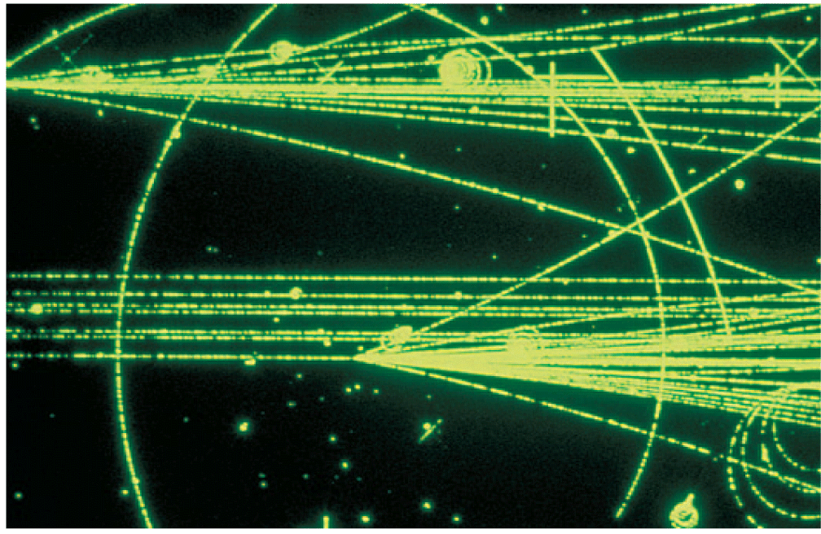
8.6 Momentum Vectors
Momentum is conserved for the high-speed elementary particles, as shown by the tracks they leave in a bubble chamber.

Slide 85
8.6 Momentum Vectors
Subatomic particles make tracks in a bubble chamber.
The mass of these particles can be computed by applying both the conservation of momentum and conservation of energy laws.
The conservation laws are extremely useful to experimenters in the atomic and subatomic realms.

Slide 86
8.6 Momentum Vectors
What is true about the vector sum of momenta in a collision?

Slide 87
Assessment Questions
When the speed of an object is doubled, its momentum
remains unchanged in accord with the conservation of momentum.
doubles.
quadruples.
decreases.

Slide 88
Assessment Questions
When the speed of an object is doubled, its momentum
remains unchanged in accord with the conservation of momentum.
doubles.
quadruples.
decreases.
Answer: B

Slide 89
Assessment Questions
The impulse-momentum relationship is a direct result of Newton’s
first law.
second law.
third law.
law of gravity.

Slide 90
Assessment Questions
The impulse-momentum relationship is a direct result of Newton’s
first law.
second law.
third law.
law of gravity.
Answer: B

Slide 91
Assessment Questions
When a falling object bounces, as it hits the ground its change in momentum and the impulse on it is
less than for stopping.
greater than for stopping.
the same as it is for stopping.
the same as it was when dropped.

Slide 92
Assessment Questions
When a falling object bounces, as it hits the ground its change in momentum and the impulse on it is
less than for stopping.
greater than for stopping.
the same as it is for stopping.
the same as it was when dropped.
Answer: B

Slide 93
Assessment Questions
On roller blades you horizontally toss a ball away from you. The mass of the ball is one tenth your mass. Compared with the speed you give to the ball, your recoil speed will ideally be
one tenth as much.
the same.
ten times as much.
100 times as much.

Slide 94
Assessment Questions
On roller blades you horizontally toss a ball away from you. The mass of the ball is one tenth your mass. Compared with the speed you give to the ball, your recoil speed will ideally be
one tenth as much.
the same.
ten times as much.
100 times as much.
Answer: A

Slide 95
Assessment Questions
A big fish swims upon and swallows a small fish at rest. After lunch, the big fish has less
speed.
momentum.
both of these
none of these

Slide 96
Assessment Questions
A big fish swims upon and swallows a small fish at rest. After lunch, the big fish has less
speed.
momentum.
both of these
none of these
Answer: A

Slide 97
Assessment Questions
A falling firecracker bursts into two pieces. Compared with the momentum of the firecracker when it bursts, the two pieces
combined have the same momentum.
each have half as much momentum.
have more momentum.
may or may not have more momentum.

Slide 98
Assessment Questions
A falling firecracker bursts into two pieces. Compared with the momentum of the firecracker when it bursts, the two pieces
combined have the same momentum.
each have half as much momentum.
have more momentum.
may or may not have more momentum.
Answer: A

