Slide 1
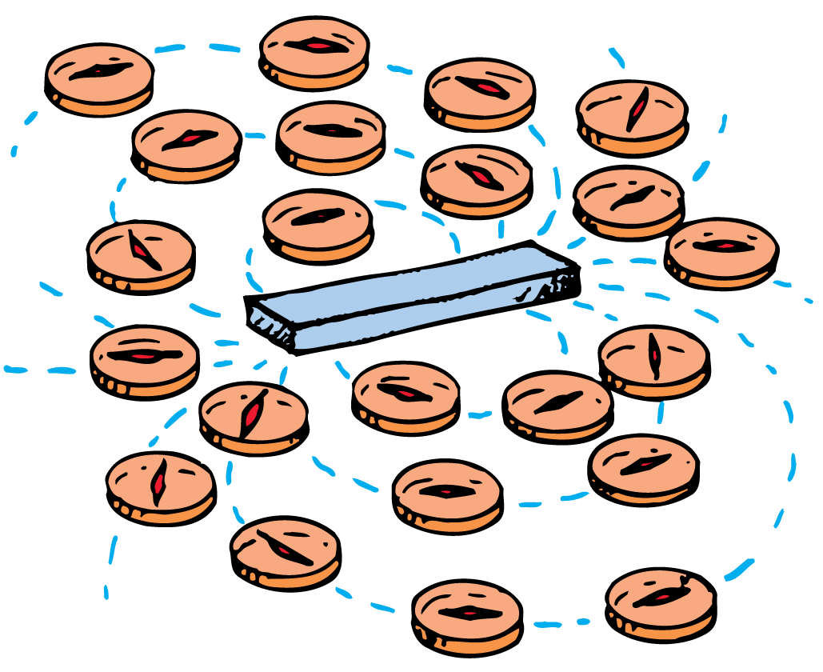
A moving electric charge is surrounded by a magnetic field.

Slide 2
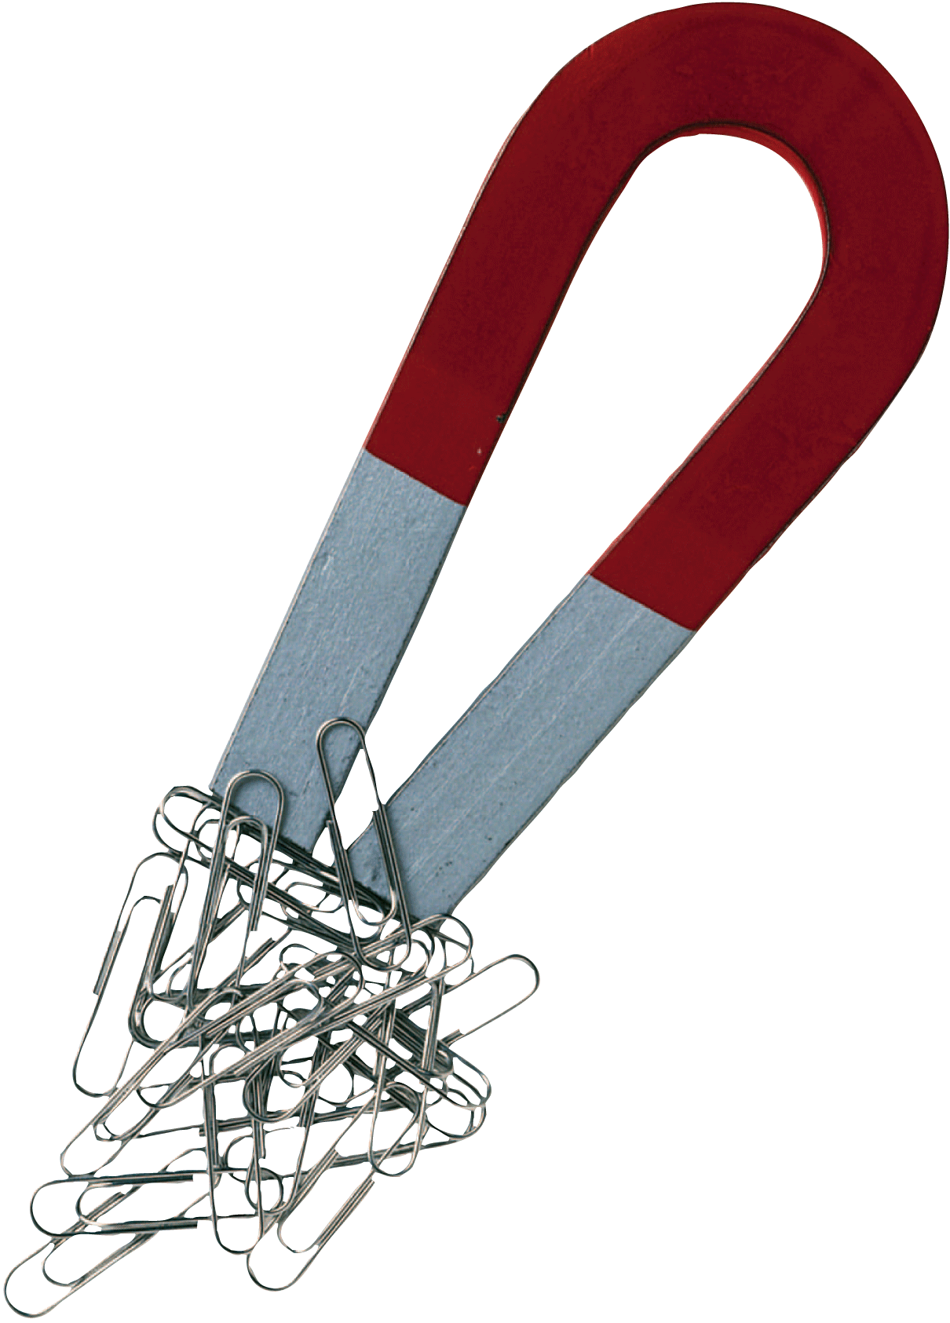
Electricity and magnetism were regarded as unrelated phenomena until it was noticed that an electric current caused the deflection of the compass needle. Then, magnets were found to exert forces on current-carrying wires. The stage was set for a whole new technology, which would eventually bring electric power, radio, and television.

Slide 3
36.1 Magnetic Poles
Like poles repel; opposite poles attract.

Slide 4
36.1 Magnetic Poles
Magnets exert forces on one another.
They are similar to electric charges, for they can both attract and repel without touching.
Like electric charges, the strength of their interaction depends on the distance of separation of the two magnets.
Electric charges produce electrical forces and regions called magnetic poles produce magnetic forces.

Slide 5
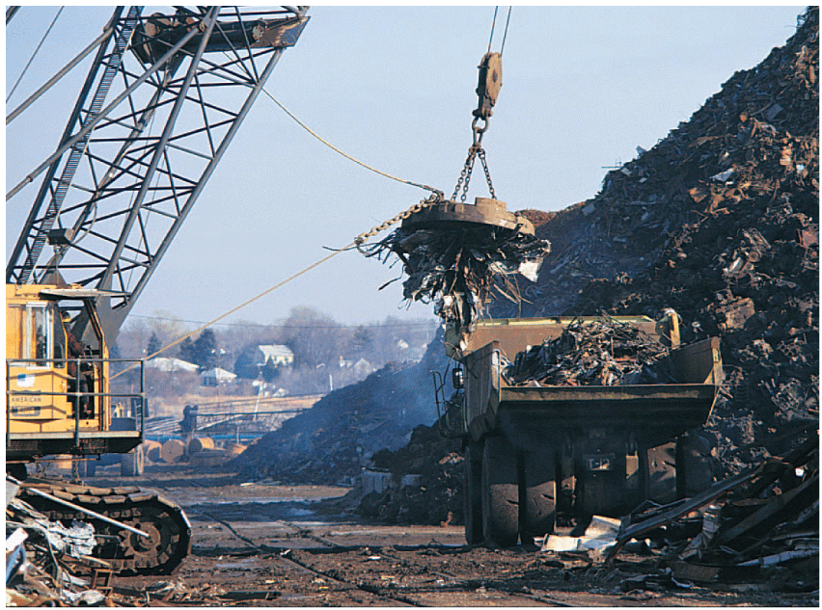
36.1 Magnetic Poles
Which interaction has the greater strength—the gravitational attraction between the scrap iron and Earth, or the magnetic attraction between the magnet and the scrap iron?

Slide 6
36.1 Magnetic Poles
If you suspend a bar magnet from its center by a piece of string, it will act as a compass.
The end that points northward is called the north-seeking pole.
The end that points southward is called the south-seeking pole.
More simply, these are called the north and south poles.
All magnets have both a north and a south pole. For a simple bar magnet the poles are located at the two ends.

Slide 7
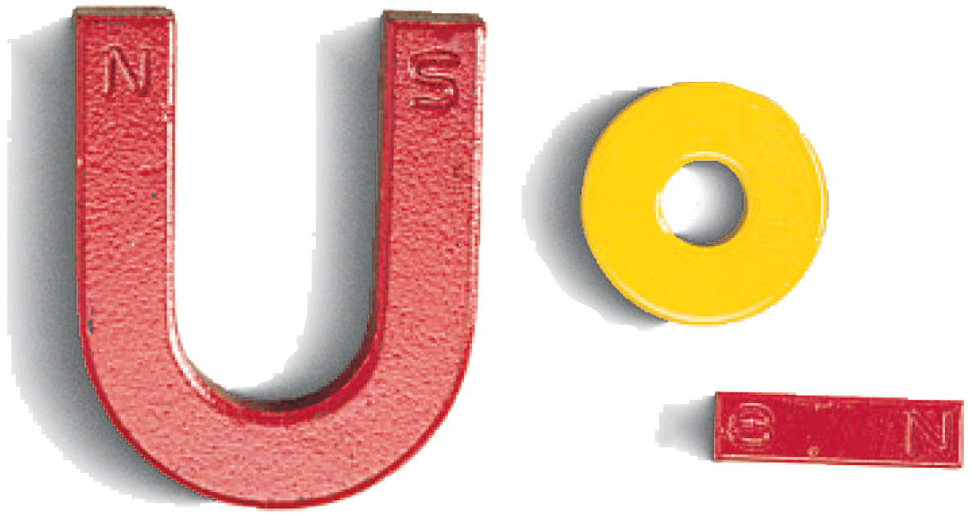
36.1 Magnetic Poles
If the north pole of one magnet is brought near the north pole of another magnet, they repel.
The same is true of a south pole near a south pole.
If opposite poles are brought together, however, attraction occurs.

Slide 8
36.1 Magnetic Poles
Magnetic poles behave similarly to electric charges in some ways, but there is a very important difference.
Electric charges can be isolated, but magnetic poles cannot.
A north magnetic pole never exists without the presence of a south pole, and vice versa.
The north and south poles of a magnet are like the head and tail of the same coin.

Slide 9
36.1 Magnetic Poles
If you break a bar magnet in half, each half still behaves as a complete magnet.
Break the pieces in half again, and you have four complete magnets.
Even when your piece is one atom thick, there are two poles. This suggests that atoms themselves are magnets.

Slide 10
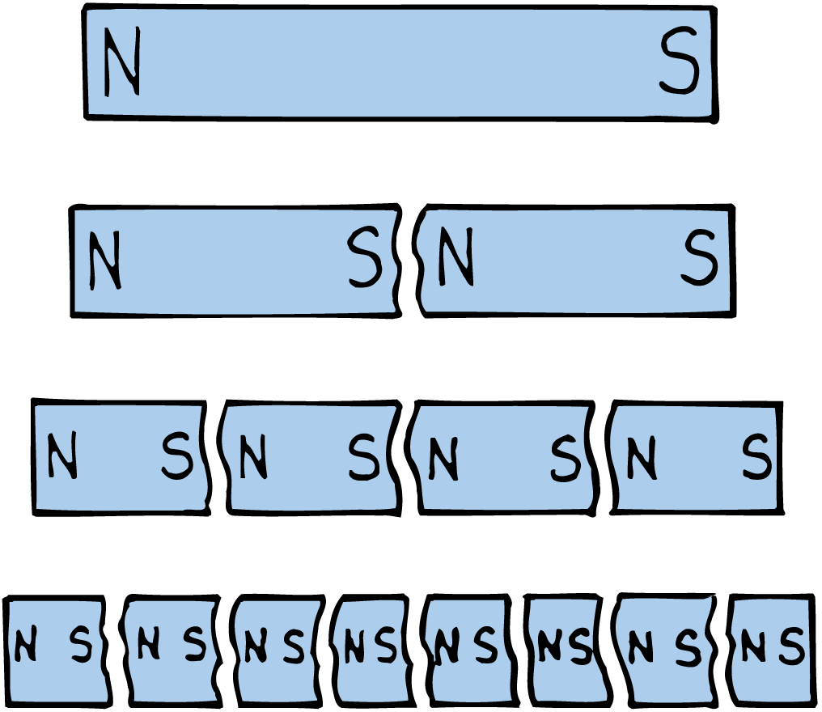
36.1 Magnetic Poles

Slide 11
36.1 Magnetic Poles
think!
Does every magnet necessarily have a north and a south pole?

Slide 12
36.1 Magnetic Poles
think!
Does every magnet necessarily have a north and a south pole?
Answer:
Yes, just as every coin has two sides, a “head” and a “tail.” (Some “trick” magnets have more than two poles.)

Slide 13
36.1 Magnetic Poles
How do magnetic poles affect each other?

Slide 14
36.2 Magnetic Fields
The direction of the magnetic field outside a magnet is from the north to the south pole.

Slide 15
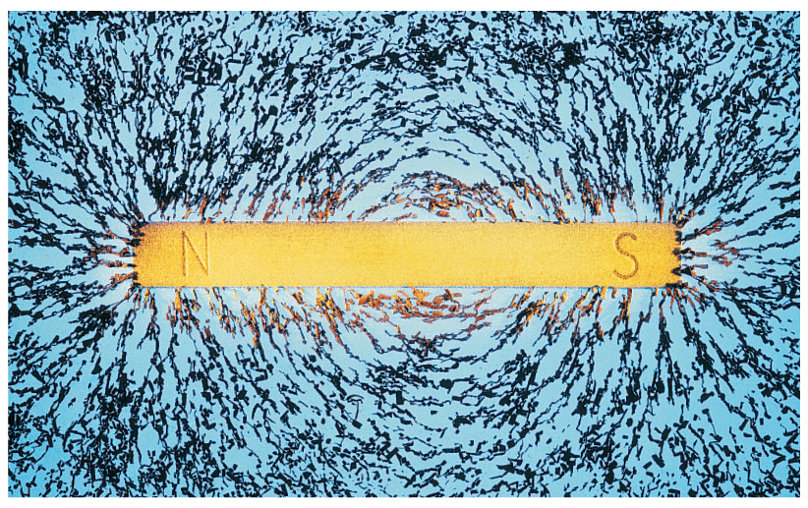
36.2 Magnetic Fields
Iron filings sprinkled on a sheet of paper over a bar magnet will tend to trace out a pattern of lines that surround the magnet.
The space around a magnet, in which a magnetic force is exerted, is filled with a magnetic field.
The shape of the field is revealed by magnetic field lines.

Slide 16
36.2 Magnetic Fields
Magnetic field lines spread out from one pole, curve around the magnet, and return to the other pole.

Slide 17
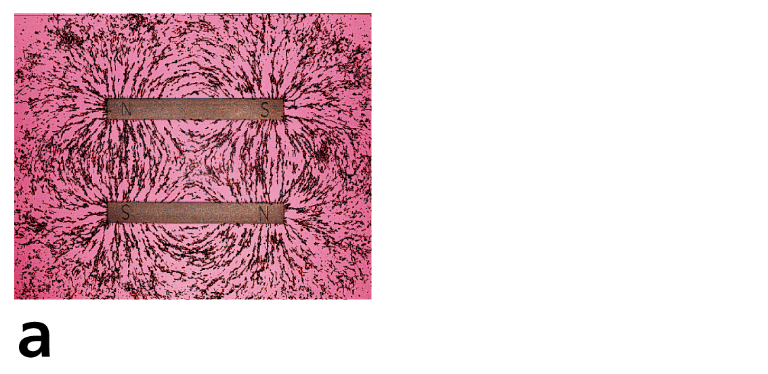
36.2 Magnetic Fields
Magnetic field patterns for a pair of magnets when
opposite poles are near each other

Slide 18
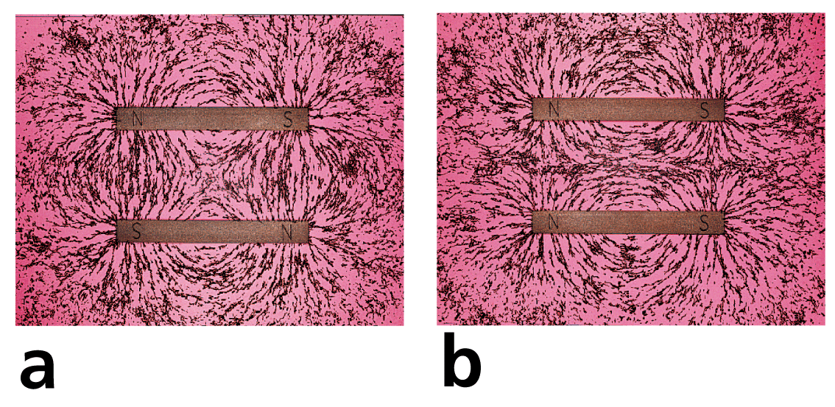
36.2 Magnetic Fields
Magnetic field patterns for a pair of magnets when
opposite poles are near each other
like poles are near each other

Slide 19
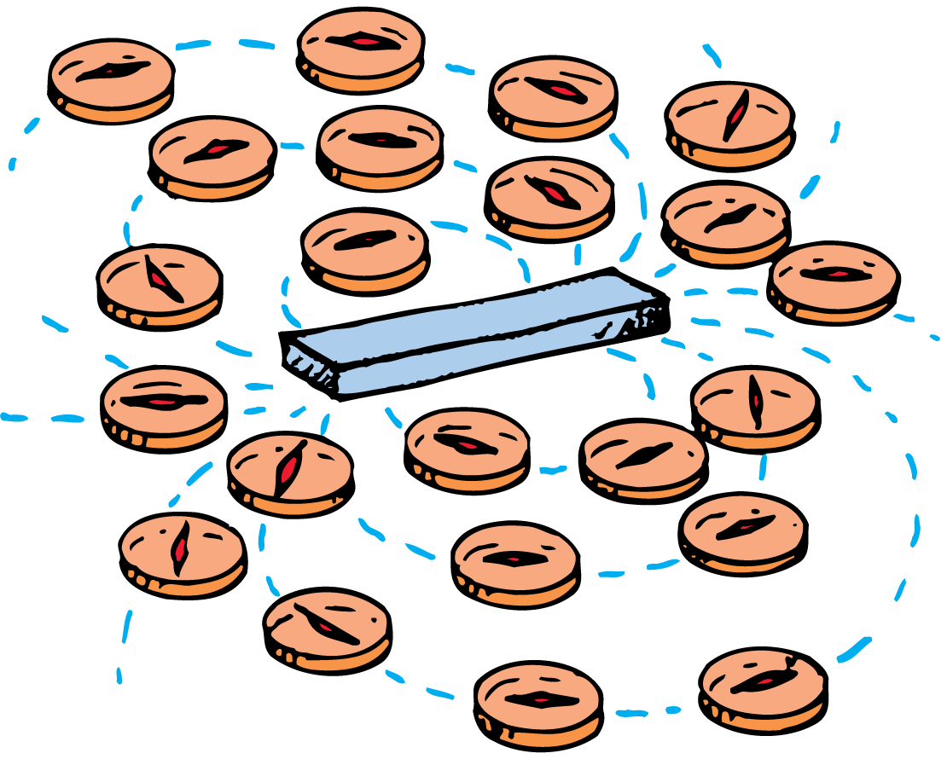
36.2 Magnetic Fields
The direction of the magnetic field outside a magnet is from the north to the south pole.
Where the lines are closer together, the field strength is greater.
The magnetic field strength is greater at the poles.
If we place another magnet or a small compass anywhere in the field, its poles will tend to line up with the magnetic field.

Slide 20
36.2 Magnetic Fields
What is the direction of the magnetic field outside a magnet?

Slide 21
36.3 The Nature of a Magnetic Field
A magnetic field is produced by the motion of electric charge.

Slide 22
36.3 The Nature of a Magnetic Field
Magnetism is very much related to electricity.
Just as an electric charge is surrounded by an electric field, a moving electric charge is also surrounded by a magnetic field.
Charges in motion have associated with them both an electric and a magnetic field.

Slide 23
36.3 The Nature of a Magnetic Field
Electrons in Motion
Where is the motion of electric charges in a common bar magnet?
The magnet as a whole may be stationary, but it is composed of atoms whose electrons are in constant motion about atomic nuclei.
This moving charge constitutes a tiny current and produces a magnetic field.

Slide 24
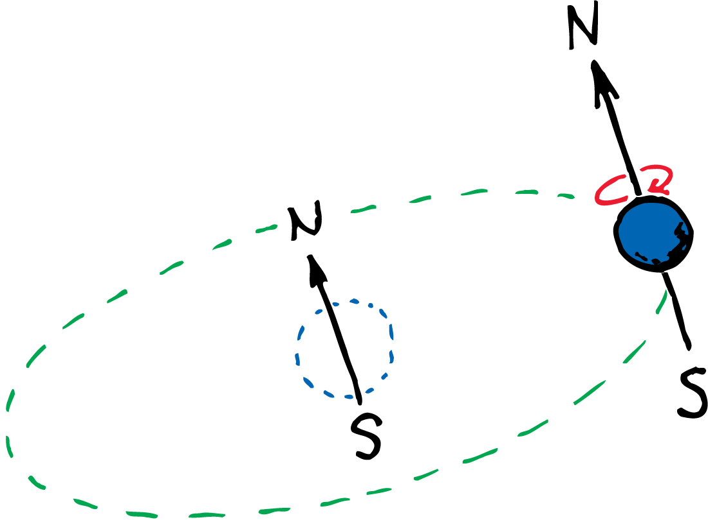
36.3 The Nature of a Magnetic Field
More important, electrons can be thought of as spinning about their own axes like tops.
A spinning electron creates another magnetic field.
In most materials, the field due to spinning predominates over the field due to orbital motion.

Slide 25
36.3 The Nature of a Magnetic Field
Spin Magnetism
Every spinning electron is a tiny magnet.
A pair of electrons spinning in the same direction makes up a stronger magnet.
Electrons spinning in opposite directions work against one another.
Their magnetic fields cancel.

Slide 26
36.3 The Nature of a Magnetic Field
Most substances are not magnets because the various fields cancel one another due to electrons spinning in opposite directions.
In materials such as iron, nickel, and cobalt, however, the fields do not cancel one another entirely.
An iron atom has four electrons whose spin magnetism is not canceled.
Each iron atom, then, is a tiny magnet. The same is true to a lesser degree for the atoms of nickel and cobalt.

Slide 27
36.3 The Nature of a Magnetic Field
How is a magnetic field produced?

Slide 28
36.4 Magnetic Domains
Permanent magnets are made by simply placing pieces of iron or certain iron alloys in strong magnetic fields.

Slide 29
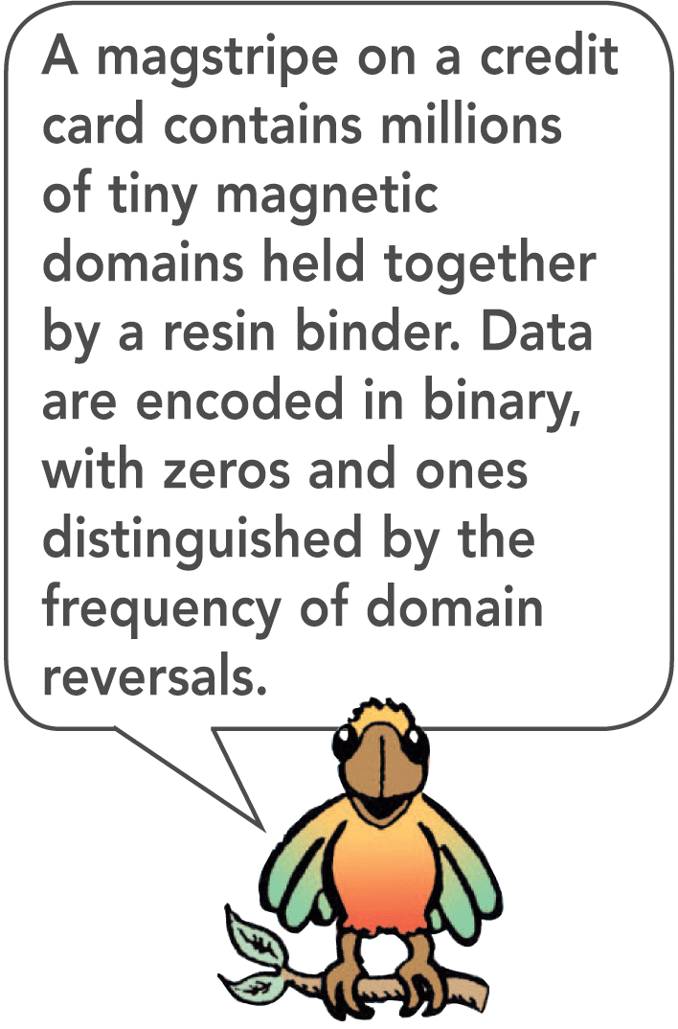
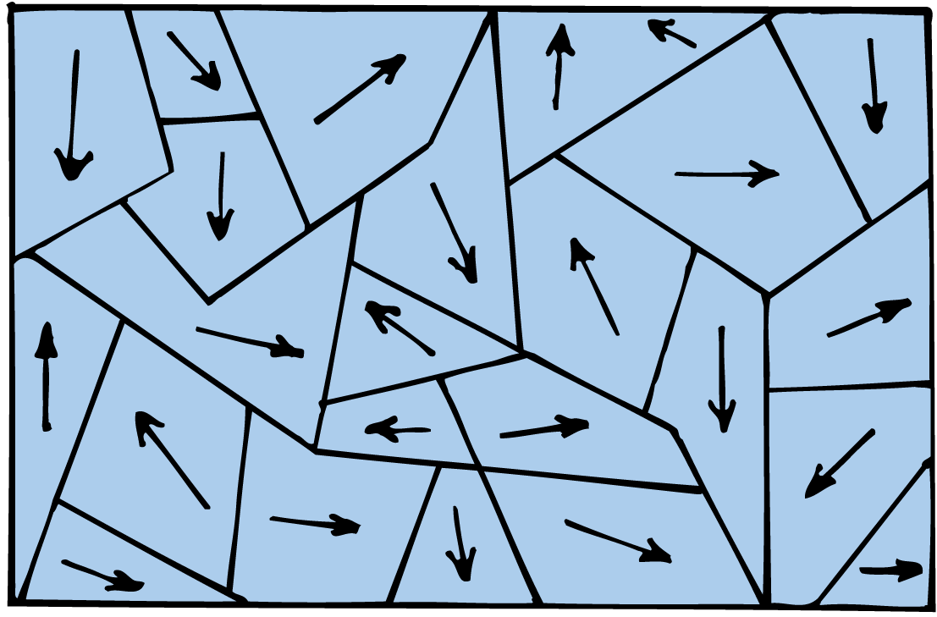
36.4 Magnetic Domains
The magnetic fields of individual iron atoms are strong.
Interactions among adjacent iron atoms cause large clusters of them to line up with one another.
These clusters of aligned atoms are called magnetic domains.
Each domain is perfectly magnetized, and is made up of billions of aligned atoms.
The domains are microscopic, and there are many of them in a crystal of iron.

Slide 30
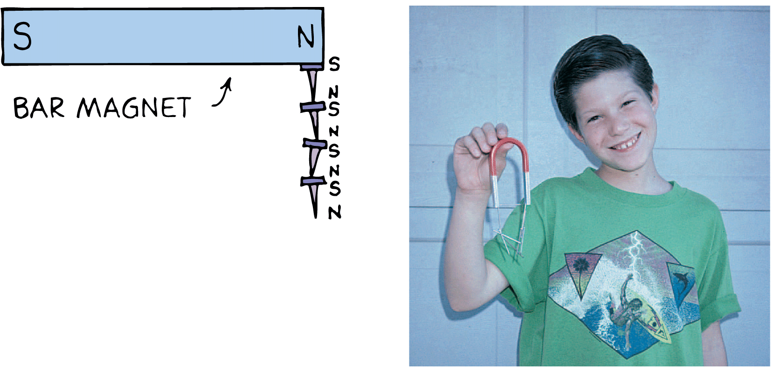
36.4 Magnetic Domains
The difference between a piece of ordinary iron and an iron magnet is the alignment of domains.
In a common iron nail, the domains are randomly oriented.
When a strong magnet is brought nearby, there is a growth in size of domains oriented in the direction of the magnetic field.
The domains also become aligned much as electric dipoles are aligned in the presence of a charged rod.
When you remove the nail from the magnet, thermal motion causes most of the domains to return to a random arrangement.

Slide 31
36.4 Magnetic Domains
Permanent magnets are made by simply placing pieces of iron or certain iron alloys in strong magnetic fields.
Another way of making a permanent magnet is to stroke a piece of iron with a magnet.
The stroking motion aligns the domains in the iron.
If a permanent magnet is dropped or heated, some of the domains are jostled out of alignment and the magnet becomes weaker.

Slide 32
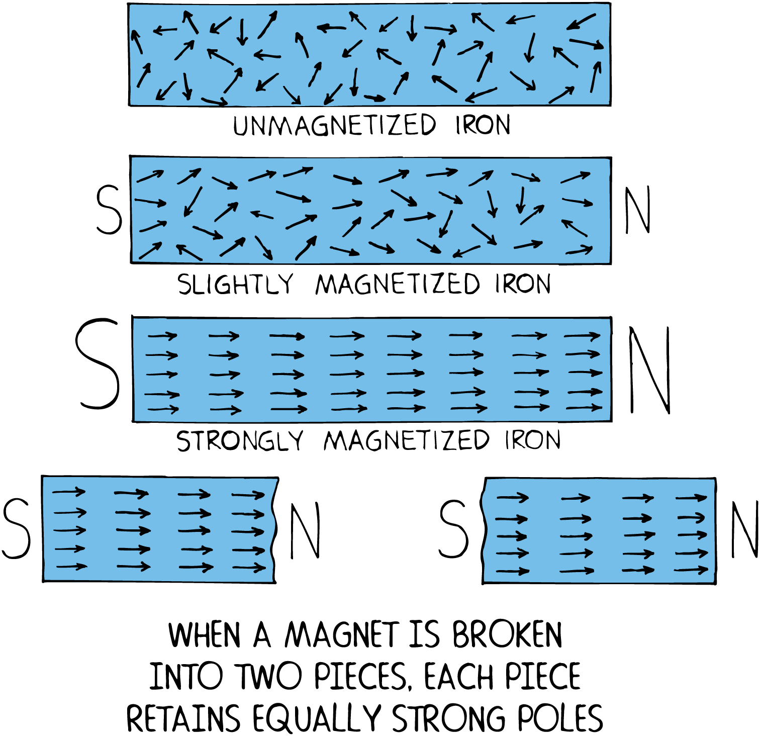
36.4 Magnetic Domains
The arrows represent domains, where the head is a north pole and the tail a south pole. Poles of neighboring domains neutralize one another’s effects, except at the ends.

Slide 33
36.4 Magnetic Domains
think!
Iron filings sprinkled on paper that covers a magnet were not initially magnetized. Why, then, do they line up with the magnetic field of the magnet?

Slide 34
36.4 Magnetic Domains
think!
Iron filings sprinkled on paper that covers a magnet were not initially magnetized. Why, then, do they line up with the magnetic field of the magnet?
Answer:
Domains align in the individual filings, causing them to act like tiny compasses. The poles of each “compass” are pulled in opposite directions, producing a torque that twists each filing into alignment with the external magnetic field.

Slide 35
36.4 Magnetic Domains
How can you make a permanent magnet?

Slide 36
36.5 Electric Currents and Magnetic Fields
An electric current produces a magnetic field.

Slide 37
36.5 Electric Currents and Magnetic Fields
A moving charge produces a magnetic field.
An electric current passing through a conductor produces a magnetic field because it has many charges in motion.

Slide 38
36.5 Electric Currents and Magnetic Fields
The magnetic field surrounding a current-carrying conductor can be shown by arranging magnetic compasses around the wire.
The compasses line up with the magnetic field produced by the current, a pattern of concentric circles about the wire.
When the current reverses direction, the compasses turn around, showing that the direction of the magnetic field changes also.

Slide 39
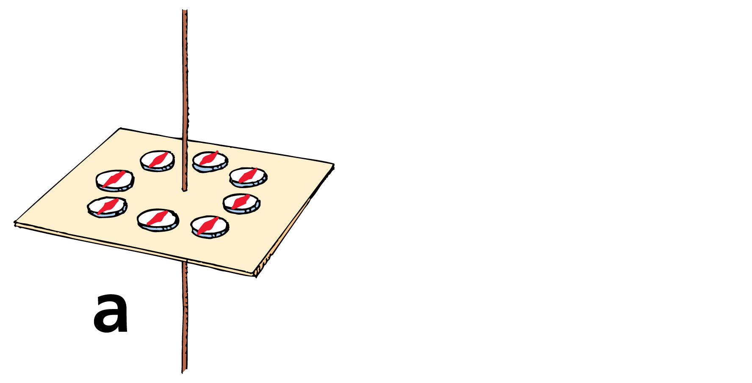
36.5 Electric Currents and Magnetic Fields
When there is no current in the wire, the compasses align with Earth’s magnetic field.

Slide 40
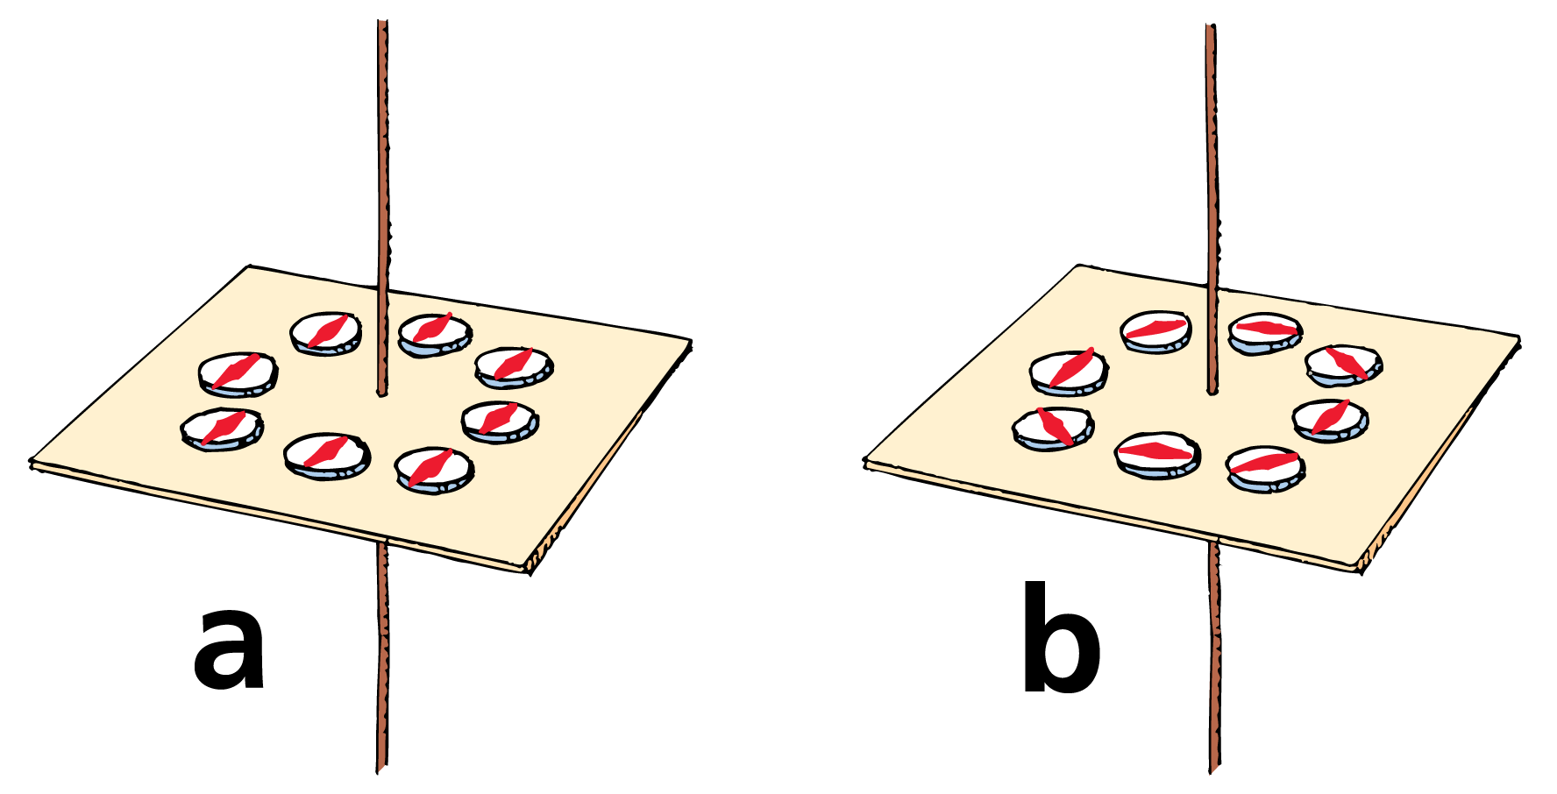
36.5 Electric Currents and Magnetic Fields
When there is no current in the wire, the compasses align with Earth’s magnetic field.
When there is a current in the wire, the compasses align with the stronger magnetic field near the wire.

Slide 41
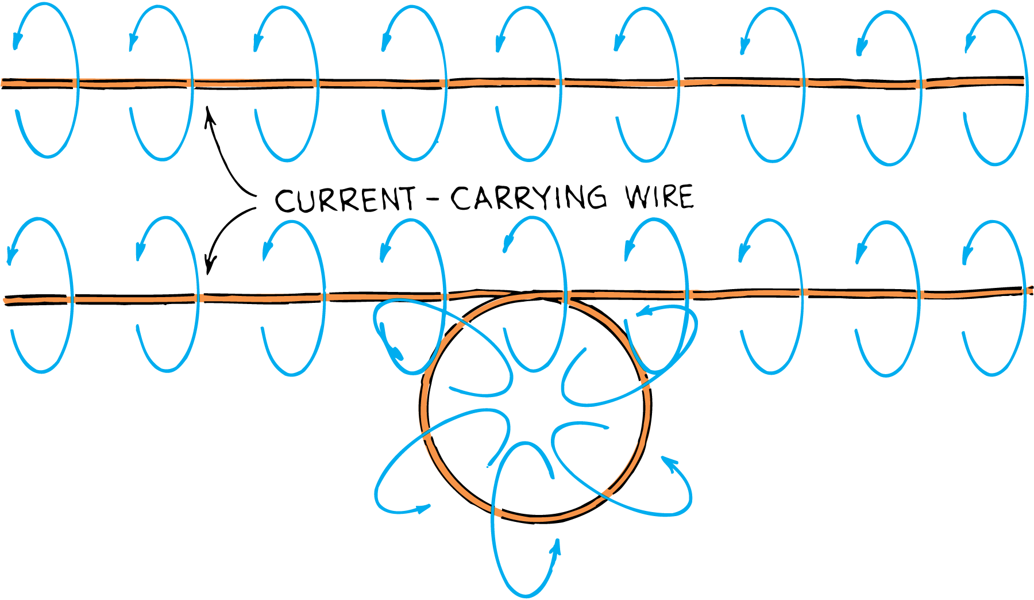
36.5 Electric Currents and Magnetic Fields
If the wire is bent into a loop, the magnetic field lines become bunched up inside the loop.
If the wire is bent into another loop, the concentration of magnetic field lines inside the double loop is twice that of the single loop.
The magnetic field intensity increases as the number of loops is increased.

Slide 42
36.5 Electric Currents and Magnetic Fields
A current-carrying coil of wire is an electromagnet.

Slide 43
36.5 Electric Currents and Magnetic Fields
Iron filings sprinkled on paper reveal the magnetic field configurations about
a current-carrying wire

Slide 44
36.5 Electric Currents and Magnetic Fields
Iron filings sprinkled on paper reveal the magnetic field configurations about
a current-carrying wire
a current-carrying loop

Slide 45
36.5 Electric Currents and Magnetic Fields
Iron filings sprinkled on paper reveal the magnetic field configurations about
a current-carrying wire
a current-carrying loop
a coil of loops

Slide 46
36.5 Electric Currents and Magnetic Fields
Sometimes a piece of iron is placed inside the coil of an electromagnet.
The magnetic domains in the iron are induced into alignment, increasing the magnetic field intensity.
Beyond a certain limit, the magnetic field in iron “saturates,” so iron is not used in the cores of the strongest electromagnets.

Slide 47
36.5 Electric Currents and Magnetic Fields
A superconducting electromagnet can generate a powerful magnetic field indefinitely without using any power.
At Fermilab near Chicago, superconducting electromagnets guide high-energy particles around the four-mile-circumference accelerator.
Superconducting magnets can also be found in magnetic resonance imaging (MRI) devices in hospitals.

Slide 48
36.5 Electric Currents and Magnetic Fields
Why does a current-carrying wire deflect a magnetic compass?

Slide 49
36.6 Magnetic Forces on Moving Charged Particles
A moving charge is deflected when it crosses magnetic field lines but not when it travels parallel to the field lines.

Slide 50
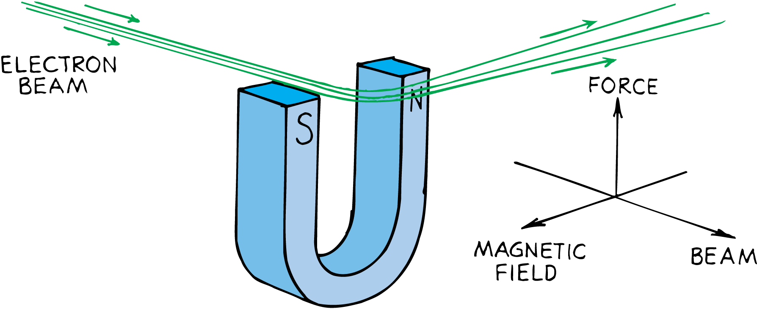
36.6 Magnetic Forces on Moving Charged Particles
If the charged particle moves in a magnetic field, the charged particle experiences a deflecting force.
This force is greatest when the particle moves in a direction perpendicular to the magnetic field lines.
At other angles, the force is less.
The force becomes zero when the particle moves parallel to the field lines.
The direction of the force is always perpendicular to both the magnetic field lines and the velocity of the charged particle.

Slide 51
36.6 Magnetic Forces on Moving Charged Particles
The deflecting force is different from other forces, such as the force of gravitation between masses, the electrostatic force between charges, and the force between magnetic poles.
The force that acts on a moving charged particle acts perpendicular to both the magnetic field and the electron velocity.

Slide 52
36.6 Magnetic Forces on Moving Charged Particles
The deflection of charged particles by magnetic fields provides a TV picture.
Charged particles from outer space are deflected by Earth’s magnetic field, which reduces the intensity of cosmic radiation.
A much greater reduction in intensity results from the absorption of cosmic rays in the atmosphere.

Slide 53
36.6 Magnetic Forces on Moving Charged Particles
What happens when a charged particle moves in a magnetic field?

Slide 54
36.7 Magnetic Forces on Current-Carrying Wires
Since a charged particle moving through a magnetic field experiences a deflecting force, a current of charged particles moving through a magnetic field also experiences a deflecting force.

Slide 55
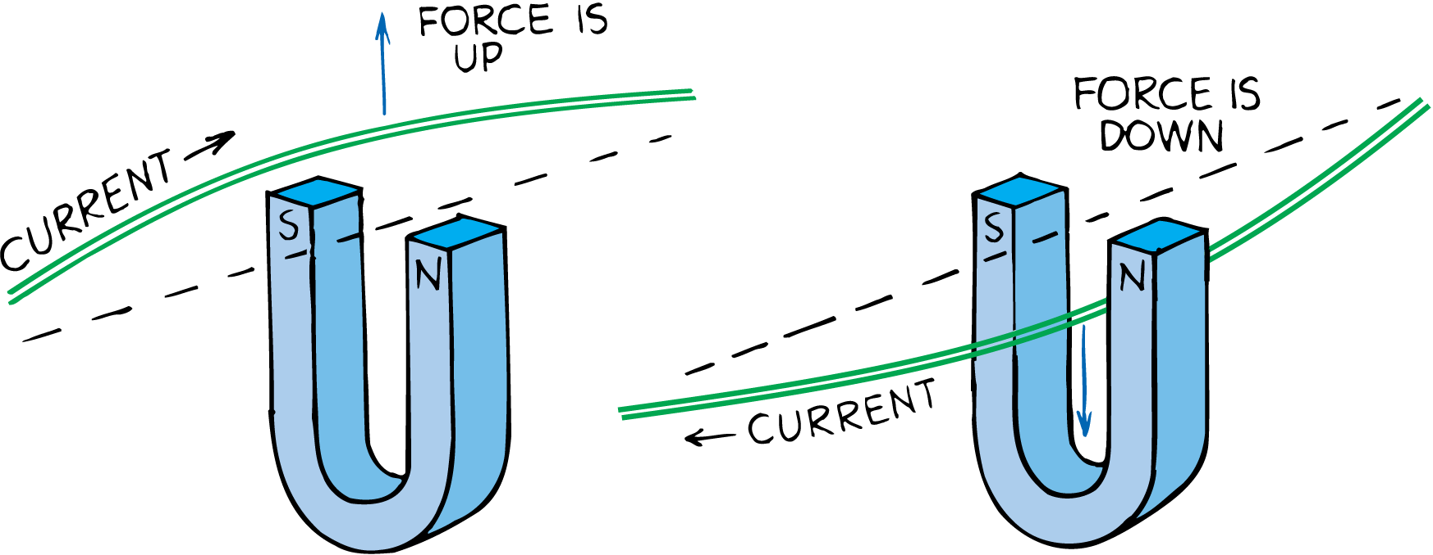
36.7 Magnetic Forces on Current-Carrying Wires
If the particles are inside a wire, the wire will also move.
If the direction of current in the wire is reversed, the deflecting force acts in the opposite direction.
The force is maximum when the current is perpendicular to the magnetic field lines.
The direction of force is along neither the magnetic field lines nor the direction of current.
The force is perpendicular to both field lines and current, and it is a sideways force.

Slide 56
36.7 Magnetic Forces on Current-Carrying Wires
Just as a current-carrying wire will deflect a magnetic compass, a magnet will deflect a current-carrying wire.
Both cases show different effects of the same phenomenon.
The discovery that a magnet exerts a force on a current-carrying wire created much excitement.
People began harnessing this force for useful purposes—electric meters and electric motors.

Slide 57
36.7 Magnetic Forces on Current-Carrying Wires
think!
What law of physics tells you that if a current-carrying wire produces a force on a magnet, a magnet must produce a force on a current-carrying wire?

Slide 58
36.7 Magnetic Forces on Current-Carrying Wires
think!
What law of physics tells you that if a current-carrying wire produces a force on a magnet, a magnet must produce a force on a current-carrying wire?
Answer:
Newton’s third law, which applies to all forces in nature.

Slide 59
36.7 Magnetic Forces on Current-Carrying Wires
How is current affected by a magnetic field?

Slide 60
36.8 Meters to Motors
The principal difference between a galvanometer and an electric motor is that in an electric motor, the current is made to change direction every time the coil makes a half revolution.

Slide 61
36.8 Meters to Motors
The simplest meter to detect electric current consists of a magnetic needle on a pivot at the center of loops of insulated wire.
When an electric current passes through the coil, each loop produces its own effect on the needle.
A very small current can be detected. A sensitive current-indicating instrument is called a galvanometer.

Slide 62
36.8 Meters to Motors
Common Galvanometers
A more common design employs more loops of wire and is therefore more sensitive.
The coil is mounted for movement and the magnet is held stationary.
The coil turns against a spring, so the greater the current in its loops, the greater its deflection.

Slide 63
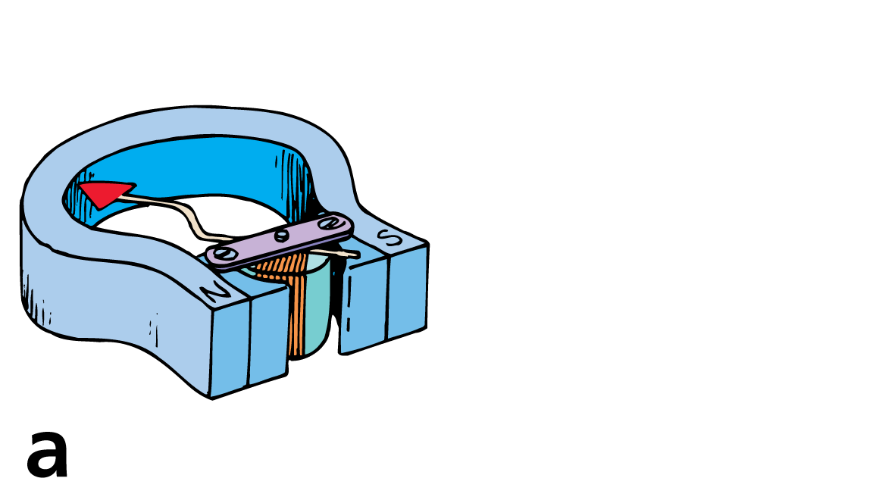
36.8 Meters to Motors
A common galvanometer consists of a stationary magnet and a movable coil of wire.

Slide 64
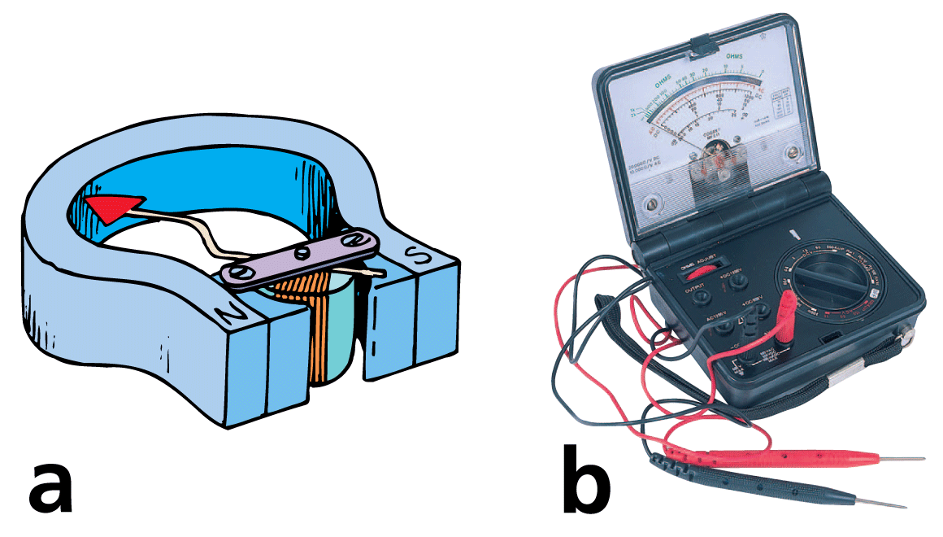
36.8 Meters to Motors
A common galvanometer consists of a stationary magnet and a movable coil of wire.
A multimeter can function as both an ammeter and a voltmeter.

Slide 65
36.8 Meters to Motors
A galvanometer may be calibrated to measure current (amperes), in which case it is called an ammeter.
Or it may be calibrated to measure electric potential (volts), in which case it is called a voltmeter.

Slide 66
36.8 Meters to Motors
Electric Motors
If the design of the galvanometer is slightly modified, you have an electric motor.
The principal difference is that in an electric motor, the current changes direction every time the coil makes a half revolution.
After it has been forced to rotate one half revolution, it overshoots just in time for the current to reverse.
The coil is forced to continue another half revolution, and so on in cyclic fashion to produce continuous rotation.

Slide 67
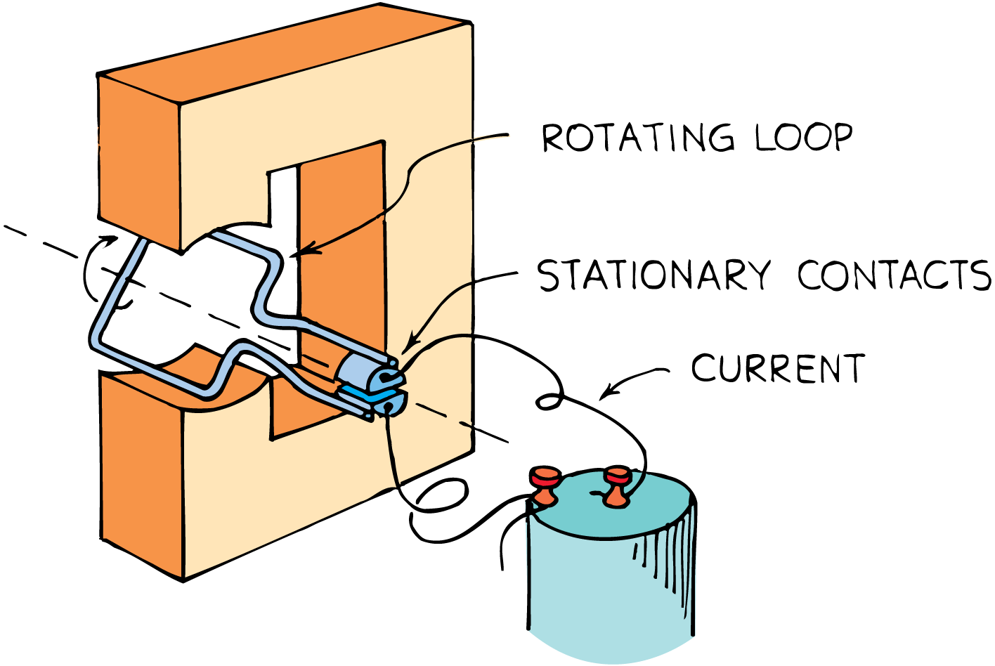
36.8 Meters to Motors
In a simple DC motor, a permanent magnet produces a magnetic field in a region where a rectangular loop of wire is mounted.
The loop can turn about an axis.
When a current passes through the loop, it flows in opposite directions in the upper and lower sides of the loop.
The loop is forced to move as if it were a galvanometer.

Slide 68
36.8 Meters to Motors
The current is reversed during each half revolution by means of stationary contacts on the shaft.
The parts of the wire that brush against these contacts are called brushes.
The current in the loop alternates so that the forces in the upper and lower regions do not change directions as the loop rotates.
The rotation is continuous as long as current is supplied.

Slide 69
36.8 Meters to Motors
Larger motors, DC or AC, are made by replacing the permanent magnet with an electromagnet, energized by the power source.
Many loops of wire are wound about an iron cylinder, called an armature, which then rotates when energized with electric current.

Slide 70
36.8 Meters to Motors
think!
How is a galvanometer similar to a simple electric motor? How do they fundamentally differ?

Slide 71
36.8 Meters to Motors
think!
How is a galvanometer similar to a simple electric motor? How do they fundamentally differ?
Answer:
A galvanometer and a motor are similar in that they both employ coils positioned in magnetic fields. When current passes through the coils, forces on the wires rotate the coils. The fundamental difference is that the maximum rotation of the coil in a galvanometer is one half turn, whereas in a motor the coil (armature) rotates through many complete turns. In the armature of a motor, the current is made to change direction with each half turn of the armature.

Slide 72
36.8 Meters to Motors
What is the main difference between a galvanometer and an electric motor?

Slide 73
36.9 Earth’s Magnetic Field
A compass points northward because Earth itself is a huge magnet.

Slide 74
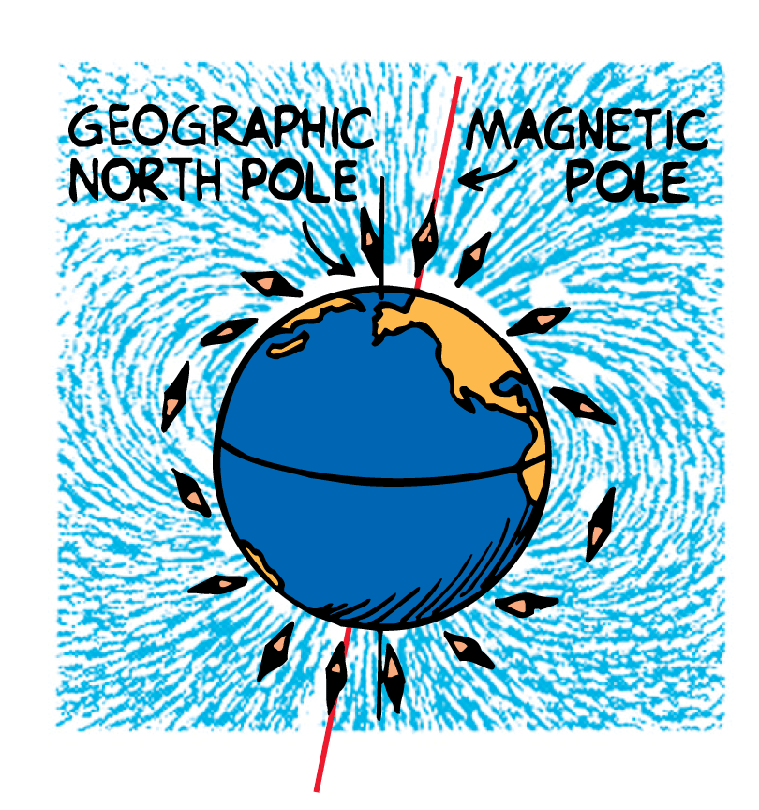
36.9 Earth’s Magnetic Field
The compass aligns with the magnetic field of Earth, but the magnetic poles of Earth do not coincide with the geographic poles.
The magnetic pole in the Northern Hemisphere, for example, is located some 800 kilometers from the geographic North Pole.
This means that compasses do not generally point to true north.
The discrepancy is known as the magnetic declination.

Slide 75
36.9 Earth’s Magnetic Field
Moving Changes Within Earth
The configuration of Earth’s magnetic field is like that of a strong bar magnet placed near the center of Earth.
Earth is not a magnetized chunk of iron like a bar magnet. It is simply too hot for individual atoms to remain aligned.

Slide 76
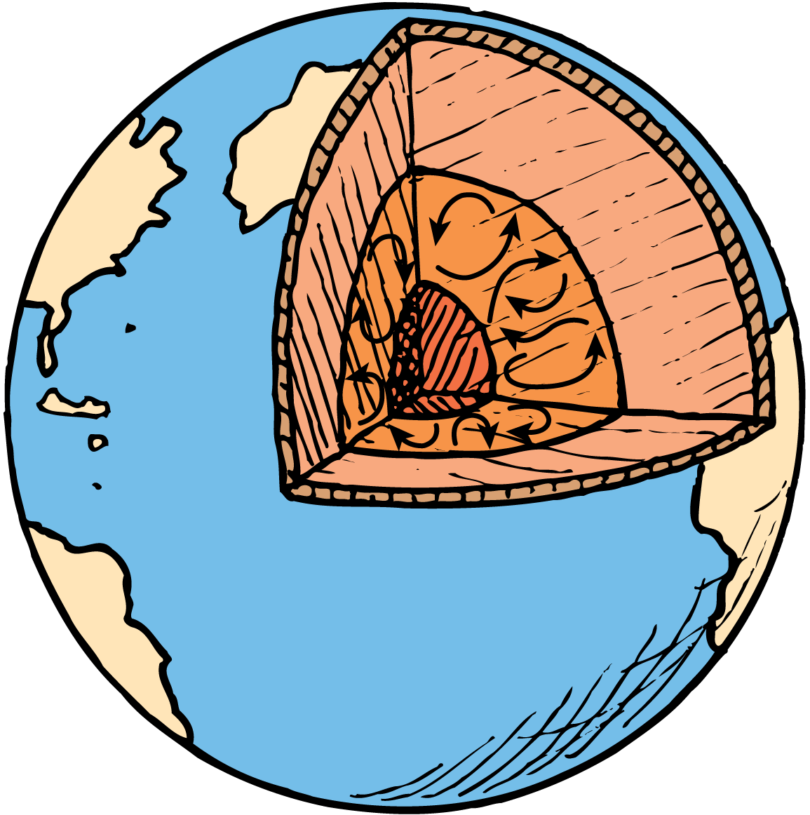
36.9 Earth’s Magnetic Field
Currents in the molten part of Earth beneath the crust provide a better explanation for Earth’s magnetic field.
Most geologists think that moving charges looping around within Earth create its magnetic field. Because of Earth’s great size, the speed of charges would have to be less than one millimeter per second to account for the field.
Another possible cause for Earth’s magnetic field is convection currents from the rising heat of Earth’s core. Perhaps such convection currents combined with the rotational effects of Earth produce Earth’s magnetic field.

Slide 77
36.9 Earth’s Magnetic Field
Magnetic Field Reversals
The magnetic field of Earth is not stable. Magnetic rock strata show that it has flip-flopped throughout geologic time.
Iron atoms in a molten state align with Earth’s magnetic field.
When the iron solidifies, the direction of Earth’s field is recorded by the orientation of the domains in the rock.

Slide 78
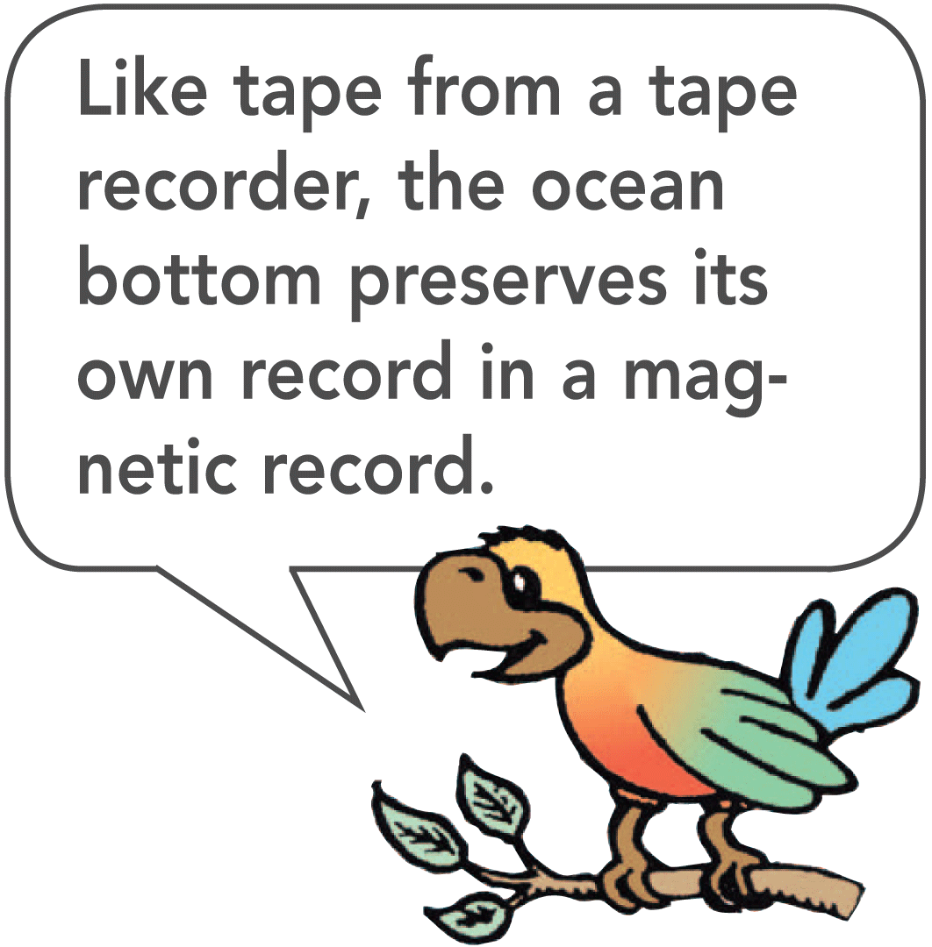
36.9 Earth’s Magnetic Field
On the ocean floor at mid-ocean ridges, continuous eruption of lava produces new seafloor.
This new rock is magnetized by the existing magnetic field.
Alternating magnetic stripes show that there have been times when the Earth’s magnetic field has dropped to zero and then reversed.

Slide 79
36.9 Earth’s Magnetic Field
More than 20 reversals have taken place in the past 5 million years. The most recent occurred 780,000 years ago.
We cannot predict when the next reversal will occur because the reversal sequence is not regular.
Recent measurements show a decrease of over 5% of Earth’s magnetic field strength in the last 100 years. If this change is maintained, there may be another field reversal within 2000 years.

Slide 80
36.9 Earth’s Magnetic Field
Why does a magnetic compass point northward?

Slide 81
Assessment Questions
For magnets, like poles repel each other and unlike poles
also repel each other.
attract each other.
can disappear into nothingness.
can carry a lot of energy.

Slide 82
Assessment Questions
For magnets, like poles repel each other and unlike poles
also repel each other.
attract each other.
can disappear into nothingness.
can carry a lot of energy.
Answer: B

Slide 83
Assessment Questions
The space surrounding a magnet is known as a(n)
electric field.
magnetic field.
magnetic pole.
electric pole.

Slide 84
Assessment Questions
The space surrounding a magnet is known as a(n)
electric field.
magnetic field.
magnetic pole.
electric pole.
Answer: B

Slide 85
Assessment Questions
Moving electric charges are surrounded by
only electric fields.
only magnetic fields.
both magnetic and electric fields.
nothing.

Slide 86
Assessment Questions
Moving electric charges are surrounded by
only electric fields.
only magnetic fields.
both magnetic and electric fields.
nothing.
Answer: C

Slide 87
Assessment Questions
The magnetic domains in a magnet produce a weaker magnet when the
magnet is heated.
magnet is brought in contact with steel.
magnet is brought in contact with another strong magnet.
magnetic domains are all in alignment.

Slide 88
Assessment Questions
The magnetic domains in a magnet produce a weaker magnet when the
magnet is heated.
magnet is brought in contact with steel.
magnet is brought in contact with another strong magnet.
magnetic domains are all in alignment.
Answer: A

Slide 89
Assessment Questions
The magnetic field lines about a current-carrying wire form
circles.
radial lines.
eddy currents.
spirals.

Slide 90
Assessment Questions
The magnetic field lines about a current-carrying wire form
circles.
radial lines.
eddy currents.
spirals.
Answer: A

Slide 91
Assessment Questions
A magnetic force cannot act on an electron when it moves
perpendicular to the magnetic field lines.
at an angle between 90° and 180° to the magnetic field lines.
at an angle between 45° and 90° to the magnetic field lines.
parallel to the magnetic field lines.

Slide 92
Assessment Questions
A magnetic force cannot act on an electron when it moves
perpendicular to the magnetic field lines.
at an angle between 90° and 180° to the magnetic field lines.
at an angle between 45° and 90° to the magnetic field lines.
parallel to the magnetic field lines.
Answer: D

Slide 93
Assessment Questions
A magnetic force acts most strongly on a current-carrying wire when it is
parallel to the magnetic field.
perpendicular to the magnetic field.
at an angle to the magnetic field that is less than 90°.
at an angle to the magnetic field that is more than 90°.

Slide 94
Assessment Questions
A magnetic force acts most strongly on a current-carrying wire when it is
parallel to the magnetic field.
perpendicular to the magnetic field.
at an angle to the magnetic field that is less than 90°.
at an angle to the magnetic field that is more than 90°.
Answer: B

Slide 95
Assessment Questions
Your teacher gives you two electrical machines and asks you to identify which is a galvanometer and which is an electric motor. How can you tell the difference between the two?
In a galvanometer, the current changes direction every time the coil makes a half revolution.
In an electric motor, the current changes direction every time the coil makes a half revolution.
In a galvanometer, the current changes direction every time the coil makes a whole revolution.
In an electric motor, the current changes direction every time the coil makes a whole revolution.

Slide 96
Assessment Questions
Your teacher gives you two electrical machines and asks you to identify which is a galvanometer and which is an electric motor. How can you tell the difference between the two?
In a galvanometer, the current changes direction every time the coil makes a half revolution.
In an electric motor, the current changes direction every time the coil makes a half revolution.
In a galvanometer, the current changes direction every time the coil makes a whole revolution.
In an electric motor, the current changes direction every time the coil makes a whole revolution.
Answer: B

Slide 97
Assessment Questions
The magnetic field surrounding Earth
is caused by magnetized chunks of iron in Earth’s crust.
is likely caused by magnetic declination.
never changes.
is likely caused by electric currents in its interior.

Slide 98
Assessment Questions
The magnetic field surrounding Earth
is caused by magnetized chunks of iron in Earth’s crust.
is likely caused by magnetic declination.
never changes.
is likely caused by electric currents in its interior.
Answer: D

