Slide 1
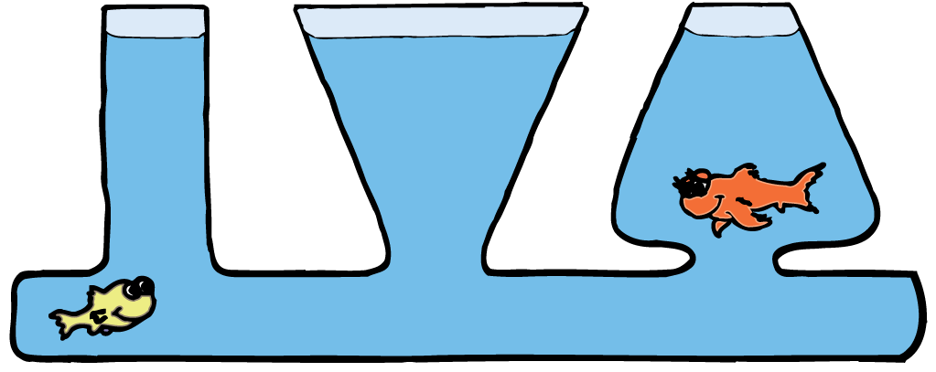
In the liquid phase, molecules can flow freely from position to position by sliding over one another. A liquid takes the shape of its container.

Slide 2
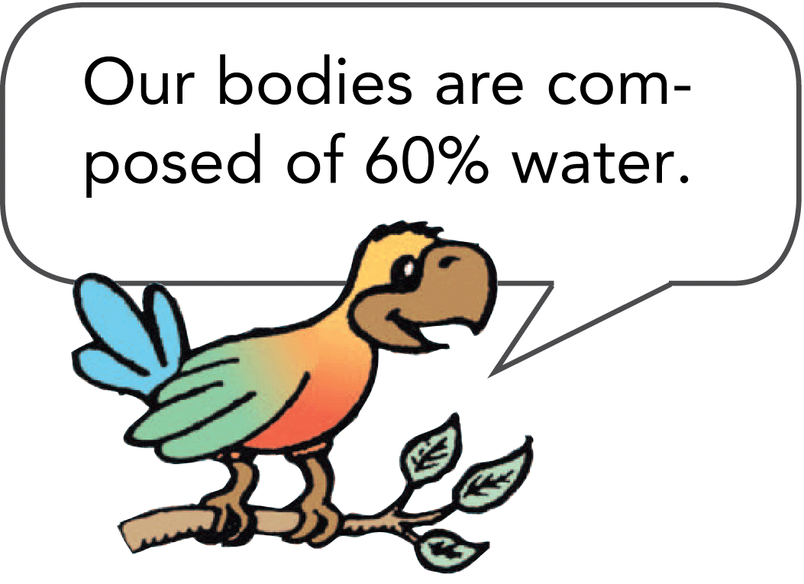
In the liquid phase, molecules can flow freely from position to position by sliding over one another. A liquid takes the shape of its container.

Slide 3
19.1 Liquid Pressure
The pressure of a liquid at rest depends only on gravity and the density and depth of the liquid.

Slide 4
19.1 Liquid Pressure
A liquid in a container exerts forces on the walls and bottom of the container.
Recall that pressure is defined as the force per unit area on which the force acts.

Slide 5
19.1 Liquid Pressure
Depth
For any given liquid, the pressure on the bottom of the container will be greater if the liquid is deeper.

Slide 6
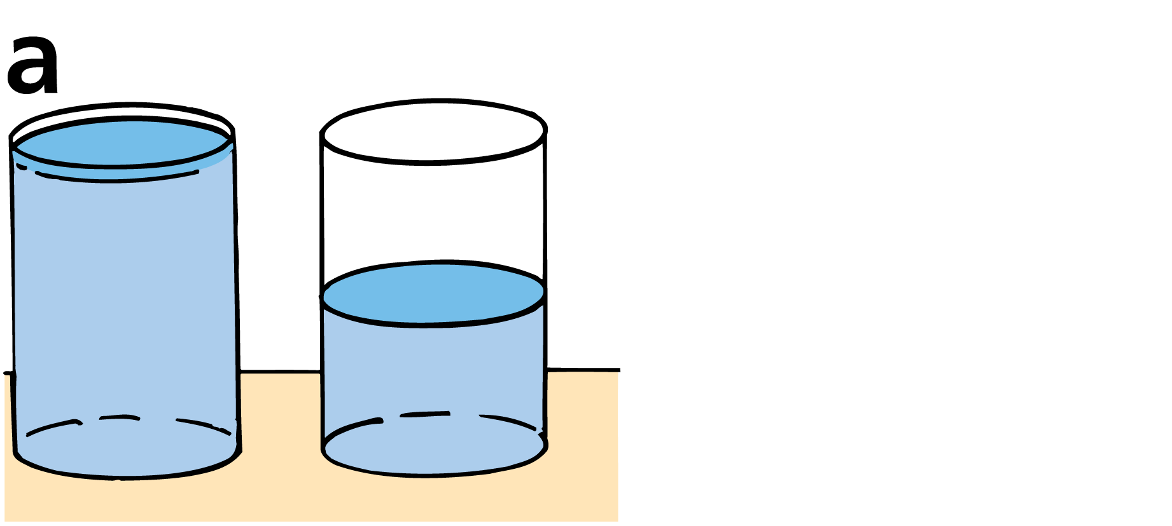
19.1 Liquid Pressure
The liquid in the first container is twice as deep, so the pressure on the bottom is twice that in the second container.

Slide 7
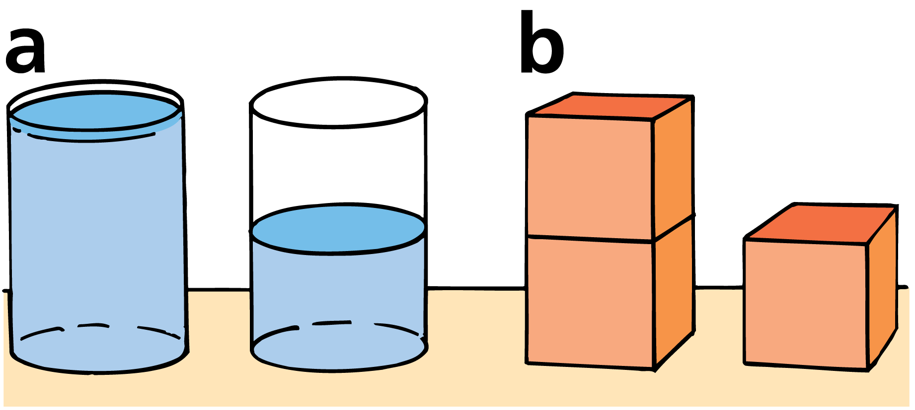
19.1 Liquid Pressure
The liquid in the first container is twice as deep, so the pressure on the bottom is twice that in the second container.
Two blocks exert twice as much pressure on the table.

Slide 8
19.1 Liquid Pressure
Volume
The pressure of a liquid does not depend on the amount of liquid.
Neither the volume nor even the total weight of liquid matters.

Slide 9
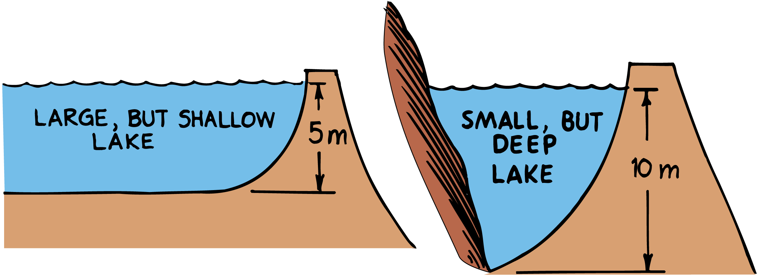
19.1 Liquid Pressure
The water pressure is greater at the bottom of the deeper lake. The dam holding back water twice as deep must withstand greater average water pressure, regardless of the total volume of water.

Slide 10
19.1 Liquid Pressure
The pressure of the liquid is the same at any given depth below the surface, regardless of the shape of the container.

Slide 11
19.1 Liquid Pressure
The “Pascal’s vases” illustrate that water pressure depends on depth and not on volume.
The water’s surface in each of the connected vases is at the same level. The pressures at equal depths are the same.
At the bottom of all four vases, for example, the pressures are equal.

Slide 12
19.1 Liquid Pressure
At any point within a liquid, the forces that produce pressure are exerted equally in all directions.
When you are swimming underwater, no matter which way you tilt your head, your ears feel the same amount of water pressure.

Slide 13
19.1 Liquid Pressure
When the liquid is pressing against a surface, there is a force from the liquid directed perpendicular to the surface.
If there is a hole in the surface, the liquid initially will move perpendicular to the surface.
Gravity causes the path of the liquid to curve downward.
At greater depths, the net force is greater, and the velocity of the escaping liquid is greater.

Slide 14
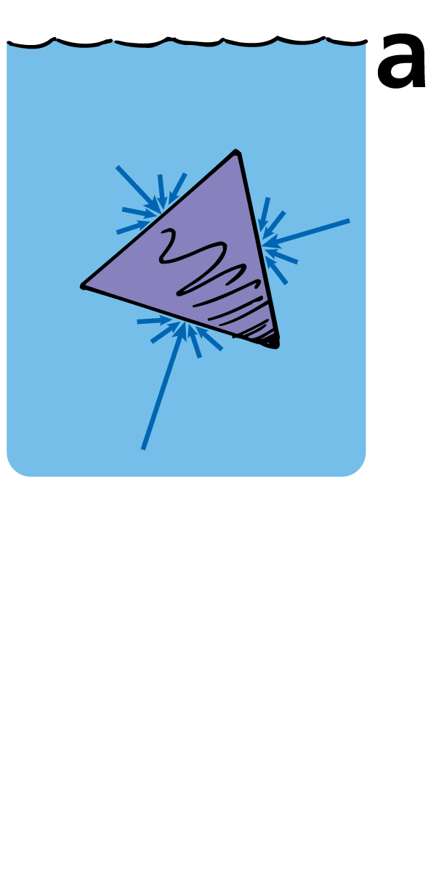
19.1 Liquid Pressure
The forces against a surface add up to a net force that is perpendicular to the surface.

Slide 15
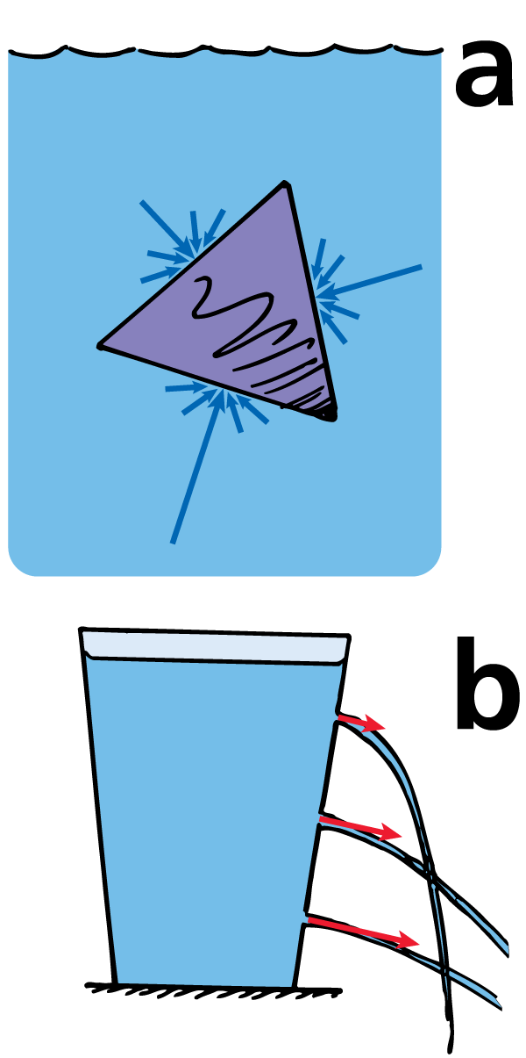
19.1 Liquid Pressure
The forces against a surface add up to a net force that is perpendicular to the surface.
Liquid escaping through a hole initially moves perpendicular to the surface.

Slide 16
19.1 Liquid Pressure
What determines the pressure of a liquid?

Slide 17
19.2 Buoyancy
When the weight of a submerged object is greater than the buoyant force, the object will sink. When the weight is less than the buoyant force, the object will rise to the surface and float.

Slide 18
19.2 Buoyancy
Buoyancy is the apparent loss of weight of objects when submerged in a liquid.
It is easier to lift a boulder submerged on the bottom of a riverbed than to lift it above the water’s surface.
When the boulder is submerged, the water exerts an upward force that is opposite in direction to gravity. This upward force is called the buoyant force.
The buoyant force is the net upward force exerted by a fluid on a submerged or immersed object.

Slide 19
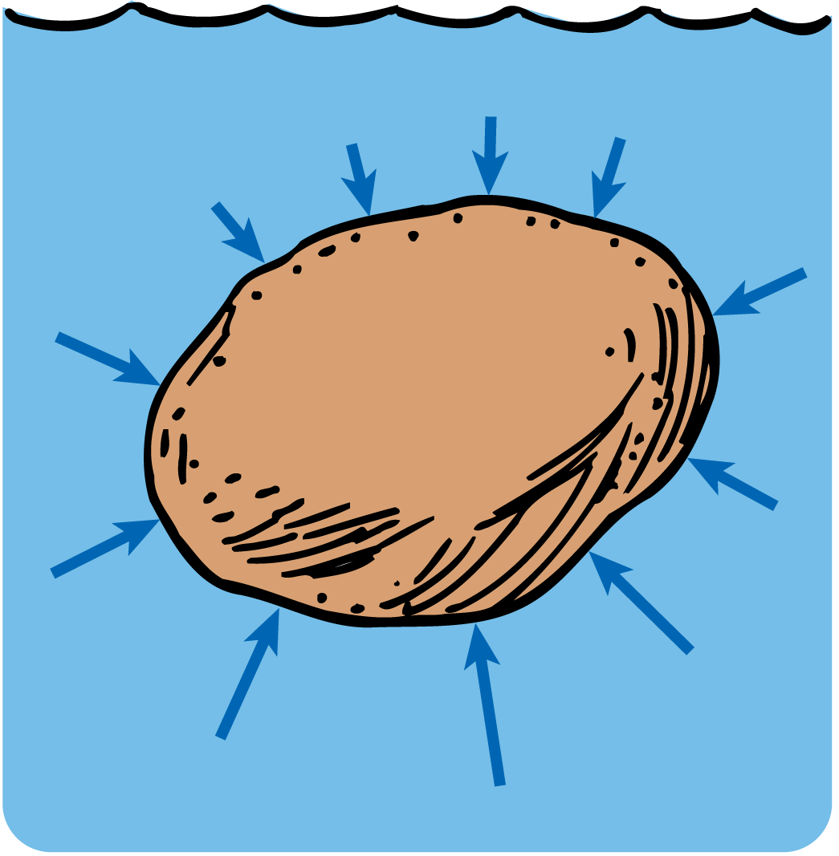
19.2 Buoyancy
The upward forces against the bottom of a submerged object are greater than the downward forces against the top. There is a net upward force, the buoyant force.

Slide 20
19.2 Buoyancy
Arrows represent the forces within the liquid that produce pressure against the submerged boulder.
The forces are greater at greater depth.
The forces acting horizontally against the sides cancel each other, so the boulder is not pushed sideways.
Forces acting upward against the bottom are greater than those acting downward against the top.
The difference in upward and downward forces is the buoyant force.

Slide 21
19.2 Buoyancy
When the weight is equal to the buoyant force, the submerged object will remain at any level, like a fish.

Slide 22
19.2 Buoyancy
If a stone is placed in a container of water, the water level will rise.
Water is said to be displaced, or pushed aside, by the stone.
The volume of water displaced is equal to the volume of the stone.
A completely submerged object always displaces a volume of liquid equal to its own volume.

Slide 23
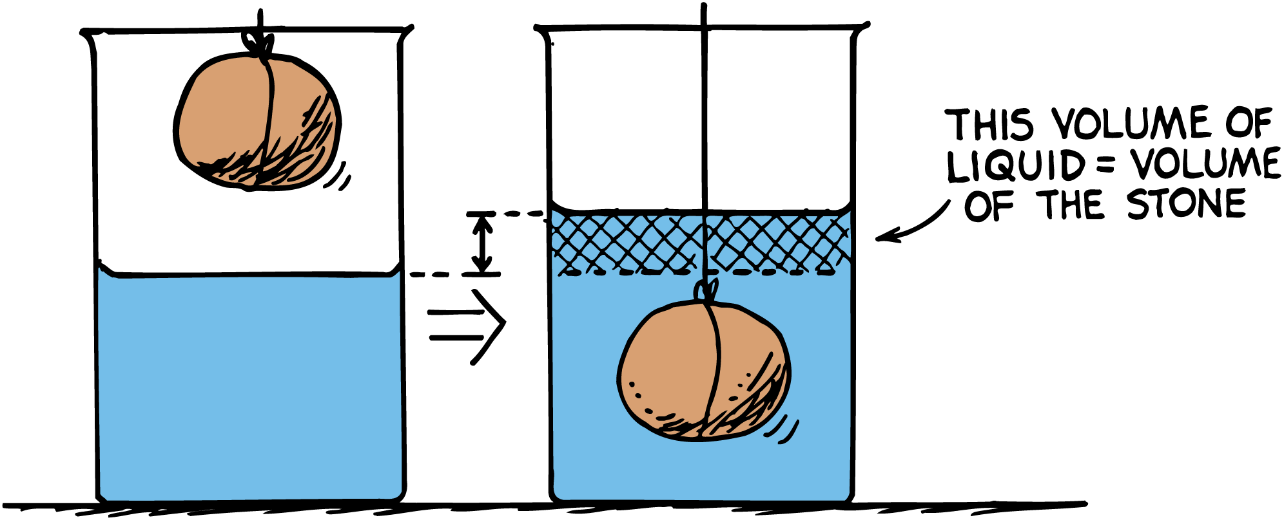
19.2 Buoyancy
When an object is submerged, it displaces a volume of water equal to the volume of the object itself.

Slide 24
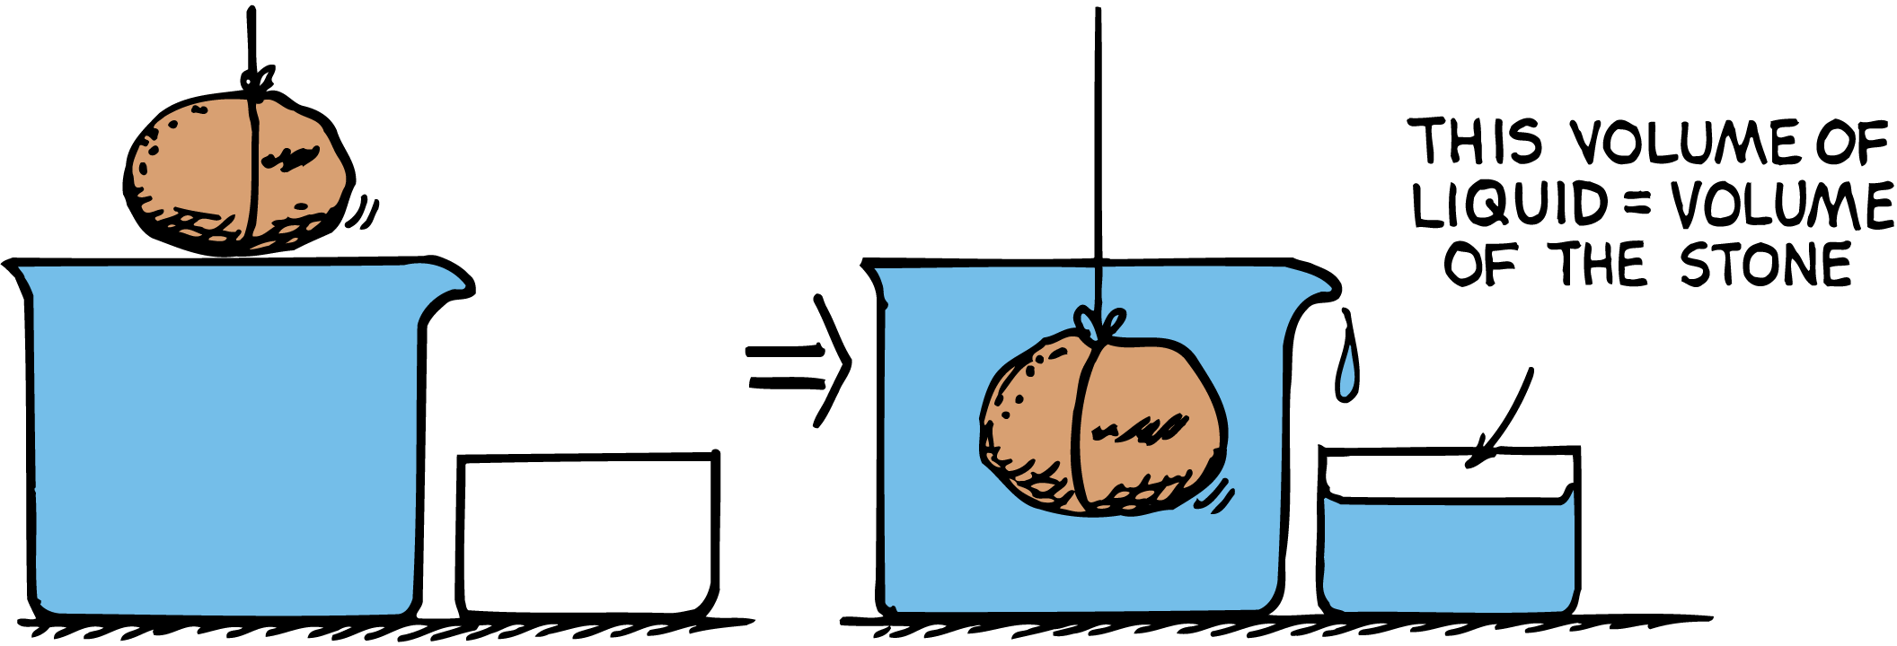
19.2 Buoyancy
When an object is submerged in a container that is initially full, the volume of water overflowing is equal to the volume of the object.

Slide 25
19.2 Buoyancy
What determines if an object will sink or float?

Slide 26
19.3 Archimedes’ Principle
Archimedes’ principle states that the buoyant force on an immersed object is equal to the weight of the fluid it displaces.

Slide 27
19.3 Archimedes’ Principle
Archimedes’ principle describes the relationship between buoyancy and displaced liquid.
It was discovered in ancient times by the Greek philosopher Archimedes (third century B.C.).
Archimedes’ principle is true for liquids and gases, which are both fluids.

Slide 28
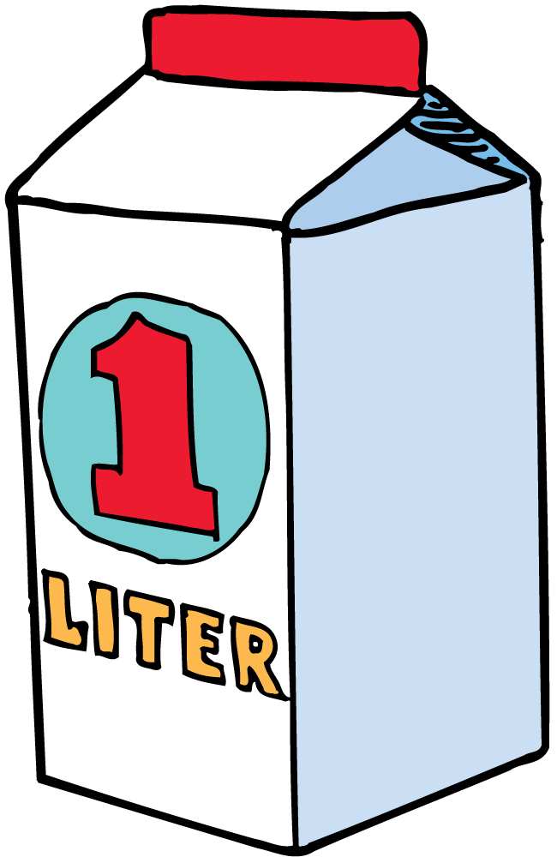
19.3 Archimedes’ Principle
A liter of water occupies 1000 cubic centimeters, has a mass of 1 kilogram, and weighs 10 N. Any object with a volume of 1 liter will experience a buoyant force of 10 N when fully submerged in water.

Slide 29
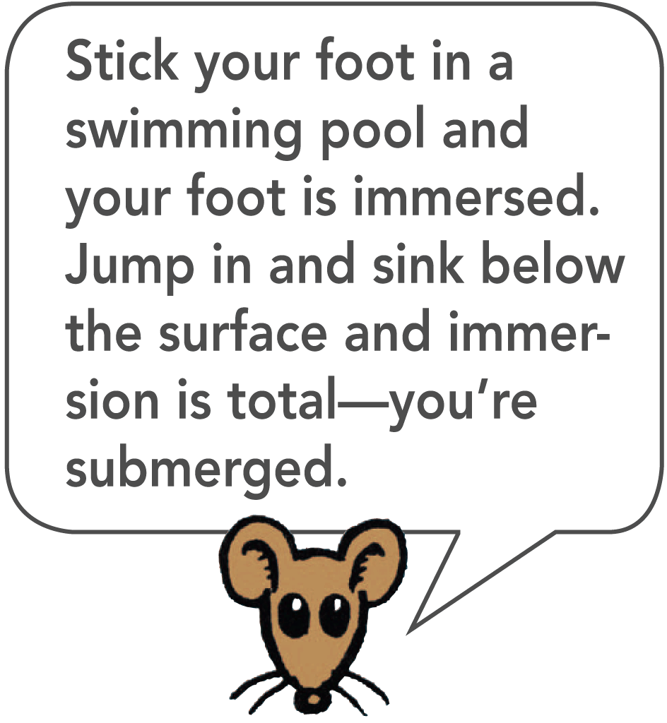
19.3 Archimedes’ Principle
Immersed means “either completely or partially submerged.”
If we immerse a sealed 1-liter container halfway into water, it will displace half a liter of water and be buoyed up by the weight of half a liter of water.
If we immerse it all the way (submerge it), it will be buoyed up by the weight of a full liter of water (10 newtons).

Slide 30
19.3 Archimedes’ Principle
Unless the completely submerged container becomes compressed, the buoyant force will equal the weight of 1 liter of water at any depth.
The container will displace the same volume of water, and hence the same weight of water, at any depth.
The weight of this displaced water (not the weight of the submerged object!) is the buoyant force.

Slide 31
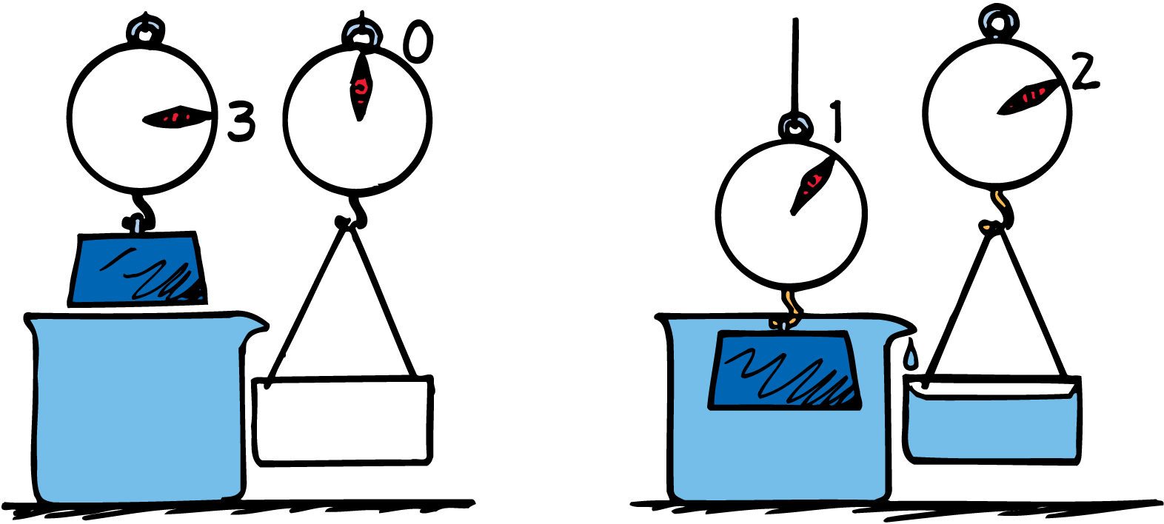
19.3 Archimedes’ Principle
A brick weighs less in water than in air. The buoyant force on the submerged brick is equal to the weight of the water displaced.

Slide 32
19.3 Archimedes’ Principle
A 300-gram brick weighs about 3 N in air.
If the brick displaces 2 N of water when it is submerged, the buoyant force on the submerged brick will also equal 2 N.
The brick will seem to weigh less under water than above water.
The apparent weight of a submerged object is its weight in air minus the buoyant force.

Slide 33
19.3 Archimedes’ Principle
For any submerged block, the upward force due to water pressure on the bottom of the block, minus the downward force due to water pressure on the top, equals the weight of liquid displaced.
As long as the block is submerged, depth makes no difference.
There is more pressure at greater depths but the difference in pressures on the bottom and top of the block is the same at any depth.

Slide 34
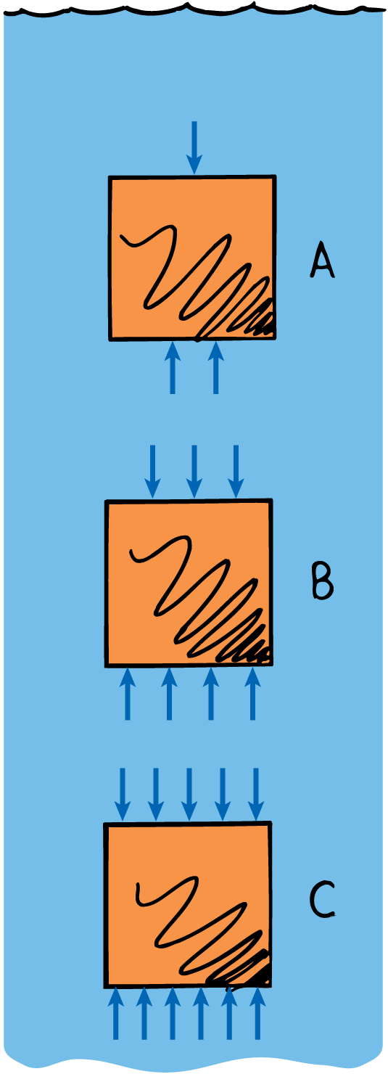
19.3 Archimedes’ Principle
The difference in the upward force and the downward force acting on the submerged block is the same at any depth.

Slide 35
19.3 Archimedes’ Principle
think!
A block is held suspended beneath the water in the three positions, A, B, and C. In which position is the buoyant force on it greatest?

Slide 36
19.3 Archimedes’ Principle
think!
A block is held suspended beneath the water in the three positions, A, B, and C. In which position is the buoyant force on it greatest?
Answer:
The buoyant force is the same at all three positions, because the amount of water displaced is the same in A, B, and C.

Slide 37
19.3 Archimedes’ Principle
think!
A stone is thrown into a deep lake. As it sinks deeper and deeper into the water, does the buoyant force on it increase, decrease, or remain unchanged?

Slide 38
19.3 Archimedes’ Principle
think!
A stone is thrown into a deep lake. As it sinks deeper and deeper into the water, does the buoyant force on it increase, decrease, or remain unchanged?
Answer:
The volume of displaced water is the same at any depth. Water is practically incompressible, so its density is the same at any depth, and equal volumes of water weigh the same. The buoyant force on the stone remains unchanged as it sinks deeper and deeper.

Slide 39
19.3 Archimedes’ Principle
What does Archimedes’ principle state?

Slide 40
19.4 Does It Sink, or Does It Float?
Sinking and floating can be summed up in three simple rules.
1. An object more dense than the fluid in which it is immersed sinks.
2. An object less dense than the fluid in which it is immersed floats.
3. An object with density equal to the density of the fluid in which it is immersed neither sinks nor floats.

Slide 41
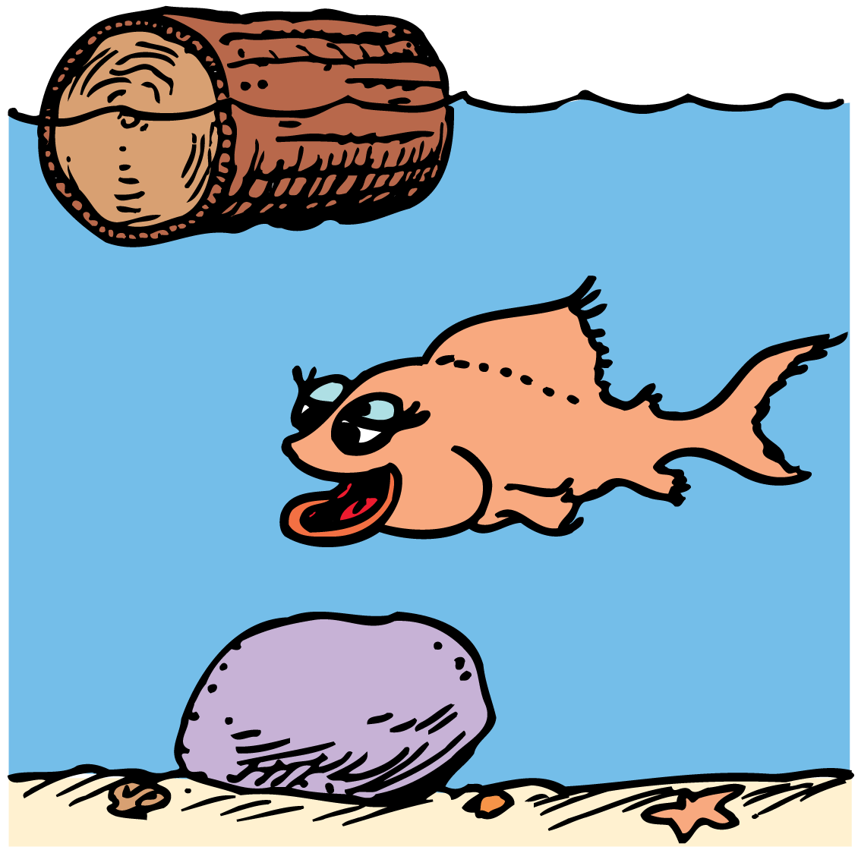
19.4 Does It Sink, or Does It Float?
The wood floats because it is less dense than water. The rock sinks because it is denser than water. The fish neither rises nor sinks because it has the same density as water.

Slide 42
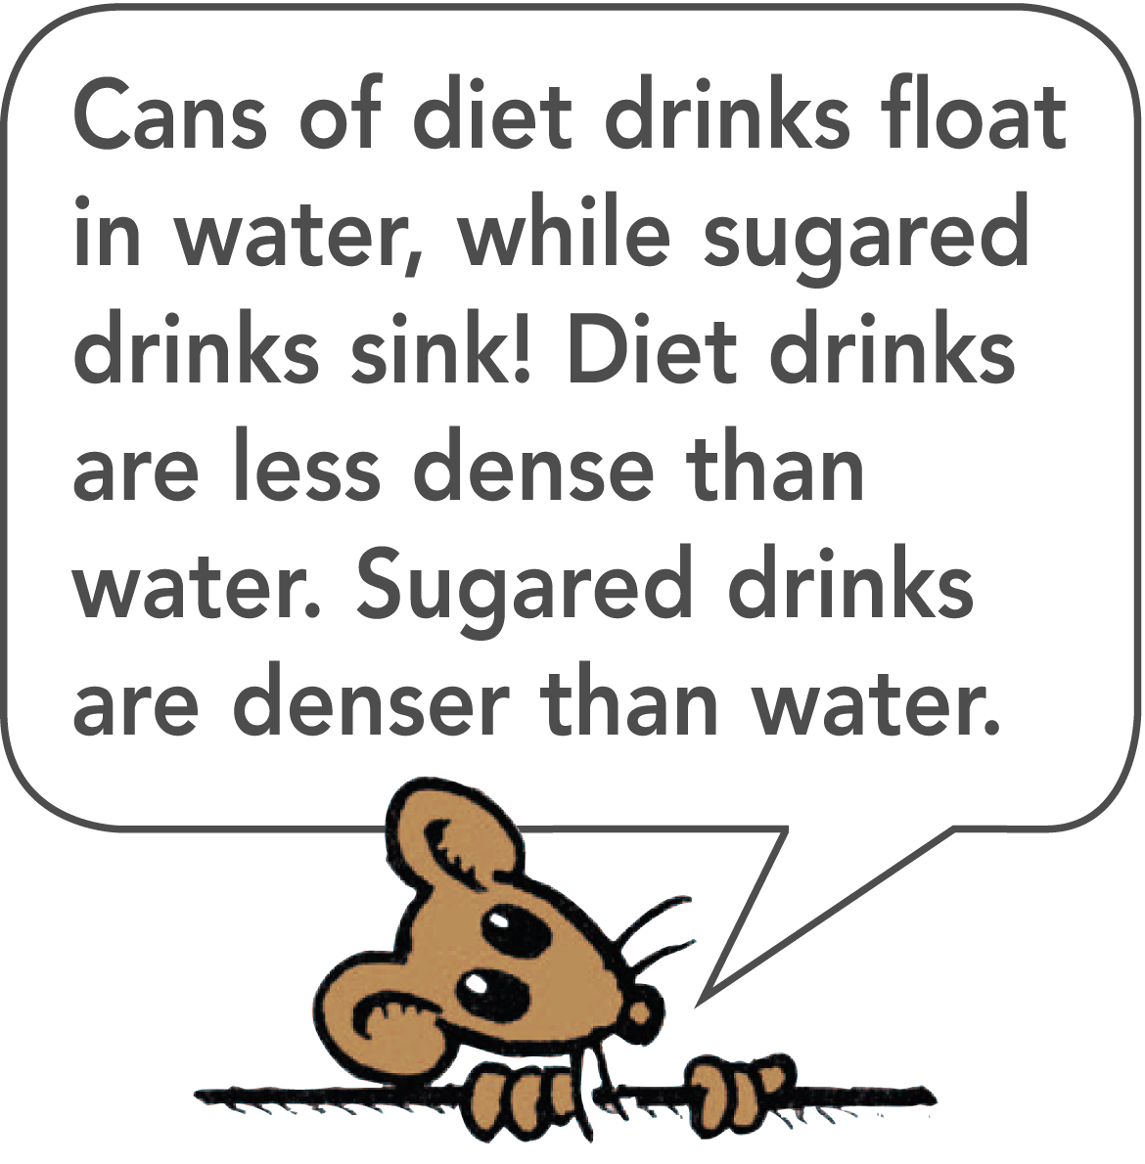
19.4 Does It Sink, or Does It Float?
The fish is “at one” with the water—it doesn’t sink or float.
The density of the fish equals the density of water.
If the fish were somehow bloated up, it would be less dense than water, and would float to the top.
If the fish swallowed a stone and became more dense than water, it would sink to the bottom.

Slide 43
19.4 Does It Sink, or Does It Float?
The density of a submarine is controlled by the flow of water into and out of its ballast tanks to achieve the desired average density.
A fish regulates its density by expanding or contracting an air sac that changes its volume. It moves upward by increasing its volume and downward by contracting its volume.
A crocodile increases its density when it swallows stones to swim lower in the water and expose less of itself to its prey.

Slide 44
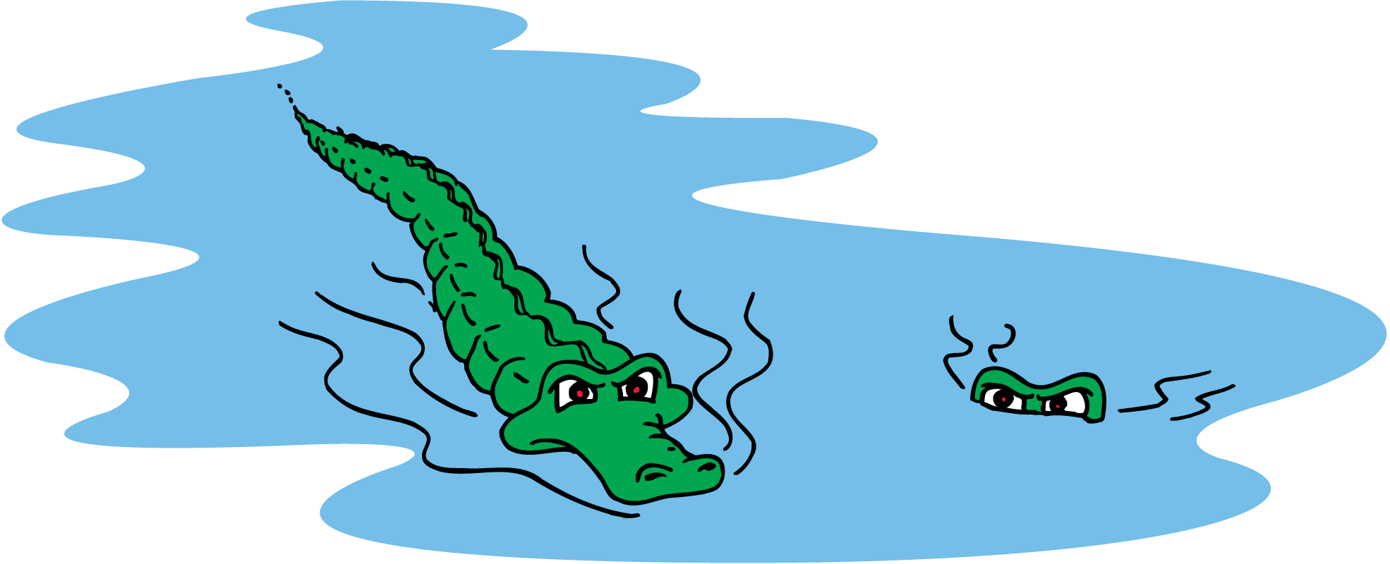
19.4 Does It Sink, or Does It Float?
The crocodile on the left is less dense than the crocodile on the right because its belly is not full of stones.

Slide 45
19.4 Does It Sink, or Does It Float?
think!
If a fish makes itself more dense, it will sink; if it makes itself less dense, it will rise. In terms of buoyant force, why is this so?

Slide 46
19.4 Does It Sink, or Does It Float?
think!
If a fish makes itself more dense, it will sink; if it makes itself less dense, it will rise. In terms of buoyant force, why is this so?
Answer:
When the fish increases its density by decreasing its volume, it displaces less water, so the buoyant force decreases. When the fish decreases its density by expanding, it displaces more water, and the buoyant force increases.

Slide 47
19.4 Does It Sink, or Does It Float?
What are the three rules of sinking and floating?

Slide 48
19.5 Flotation
The principle of flotation states that a floating object displaces a weight of fluid equal to its own weight.

Slide 49
19.5 Flotation
How does a ship made of iron float? This is an example of the principle of flotation.
Iron is nearly eight times as dense as water. When it is submerged, a solid 1-ton block of iron will displace only 1/8 ton of water.
The buoyant force will be far from enough to keep it from sinking.

Slide 50
19.5 Flotation
Reshape the same iron block into a bowl shape.
The iron bowl still weighs 1 ton but if you lower the bowl into a body of water, it displaces a greater volume of water.
The deeper the bowl is immersed, the more water is displaced and the greater is the buoyant force exerted on the bowl.
When the weight of the displaced water equals the weight of the bowl, it will sink no farther.
The buoyant force now equals the weight of the bowl.

Slide 51
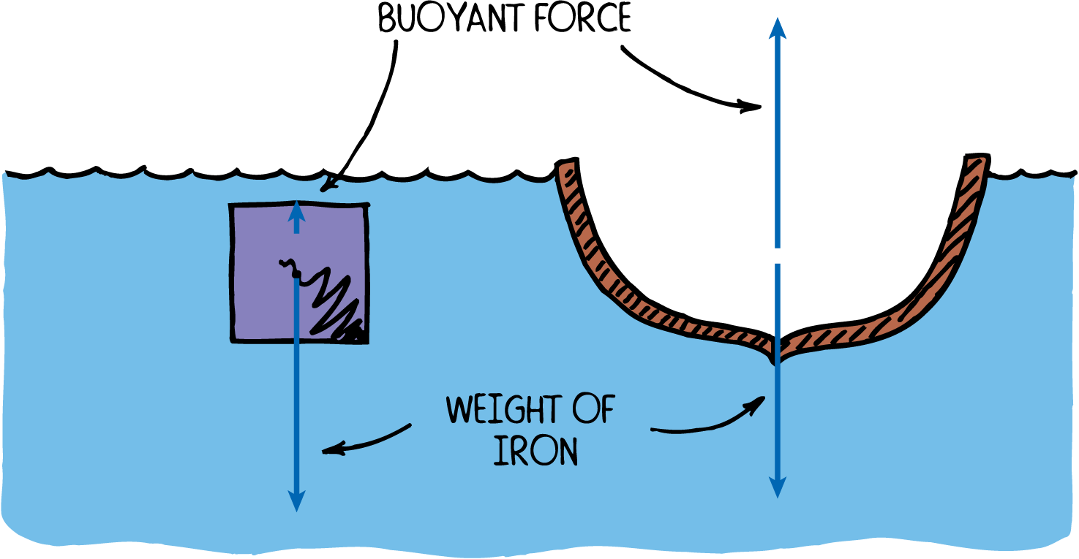
19.5 Flotation
A solid iron block sinks, while the same block shaped to occupy at least eight times as much volume floats.

Slide 52
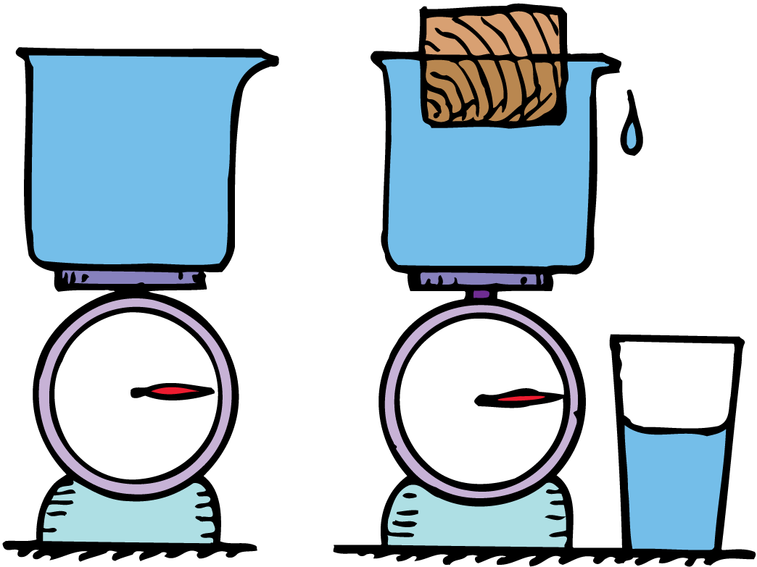
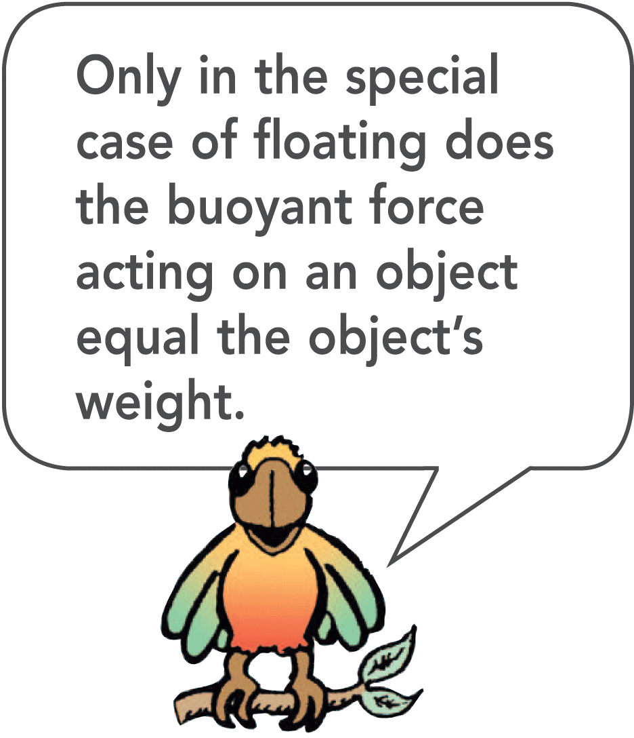
19.5 Flotation
A floating object displaces a weight of liquid equal to its own weight.

Slide 53
19.5 Flotation
Every ship must be designed to displace a weight of water equal to its own weight.
A 10,000-ton ship must be built wide enough to displace 10,000 tons of water before it sinks too deep below the surface.

Slide 54
19.5 Flotation
The weight of the floating canoe equals the weight of the water displaced by the submerged part of the canoe. It floats lower in the water when loaded.

Slide 55
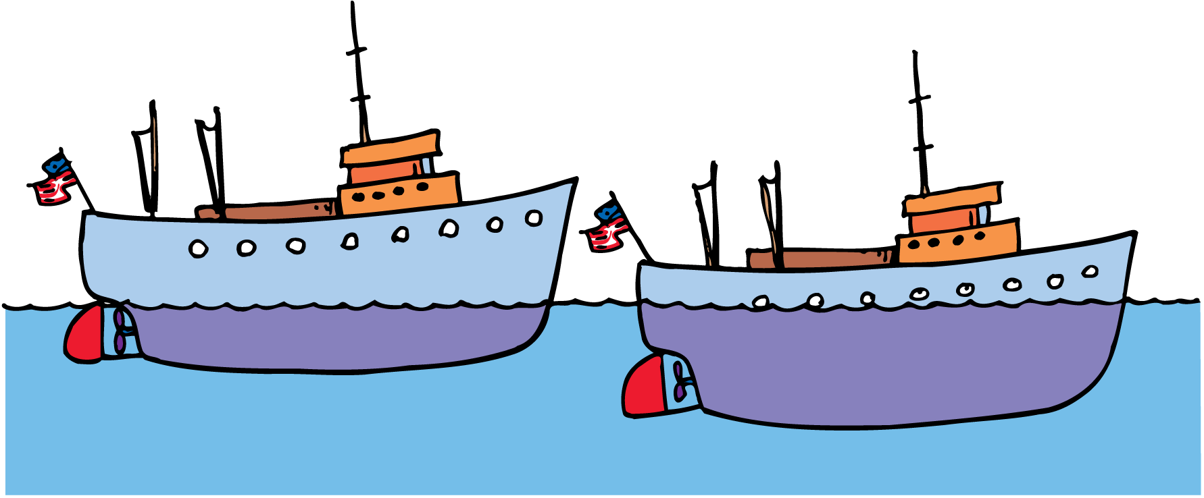
19.5 Flotation
The same ship is shown empty and loaded. The weight of the ship’s load equals the weight of extra water displaced.

Slide 56
19.5 Flotation
If a submarine beneath the surface displaces a weight of water greater than its own weight, it will rise.
If it displaces less, it will go down.
If it displaces exactly its weight, it will remain at constant depth.
Water has slightly different densities at different temperatures, so a submarine must make periodic adjustments.

Slide 57
19.5 Flotation
What does the principle of flotation state?

Slide 58
19.6 Pascal’s Principle
Pascal’s principle states that changes in pressure at any point in an enclosed fluid at rest are transmitted undiminished to all points in the fluid and act in all directions.

Slide 59
19.6 Pascal’s Principle
A change in the pressure in one part of a fluid is transmitted to other parts.
If the pressure of city water is increased at the pumping station by 10 units of pressure, the pressure everywhere in the pipes of the connected system will be increased by 10 units of pressure.
Pascal’s principle describes how changes in a pressure are transmitted in a fluid.

Slide 60
19.6 Pascal’s Principle
Pascal’s principle is employed in a hydraulic press.
Fill a U-shaped tube with water and place pistons at each end.
Pressure exerted against the left piston will be transmitted throughout the liquid and against the bottom of the right piston.
The pressure the left piston exerts against the water will be exactly equal to the pressure the water exerts against the right piston if the levels are the same.

Slide 61
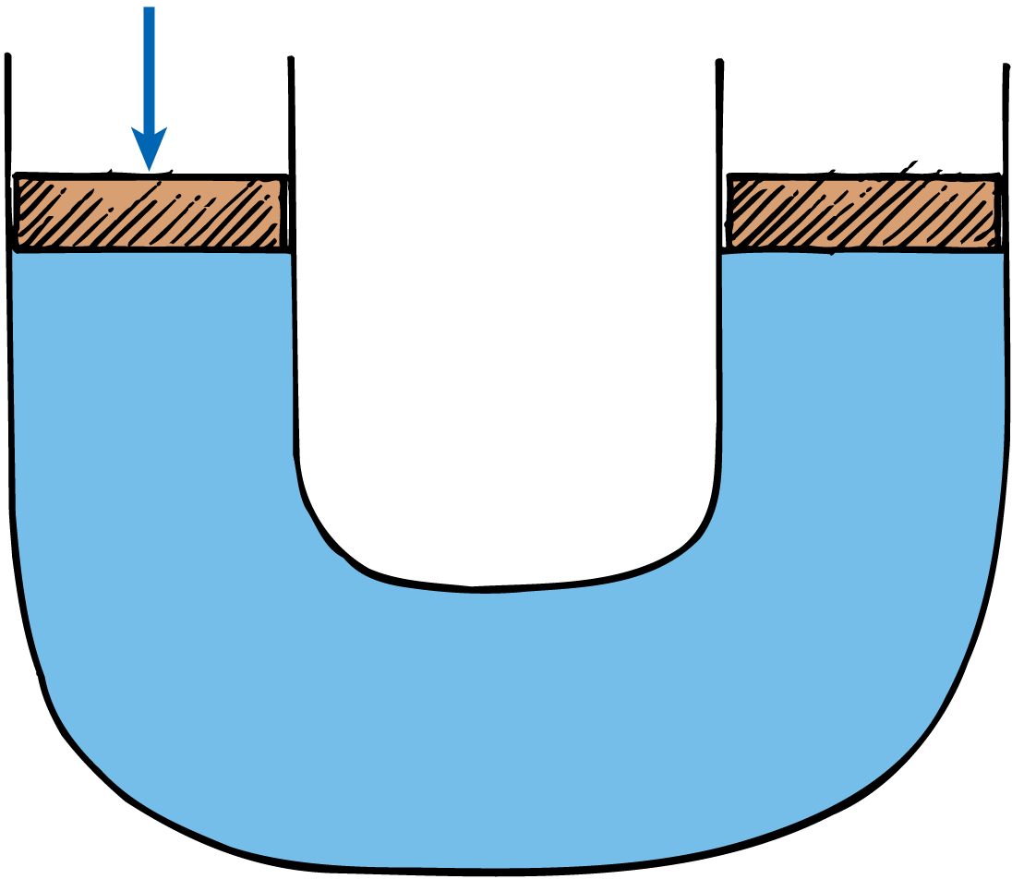
19.6 Pascal’s Principle
The force exerted on the left piston increases the pressure in the liquid and is transmitted to the right piston.

Slide 62
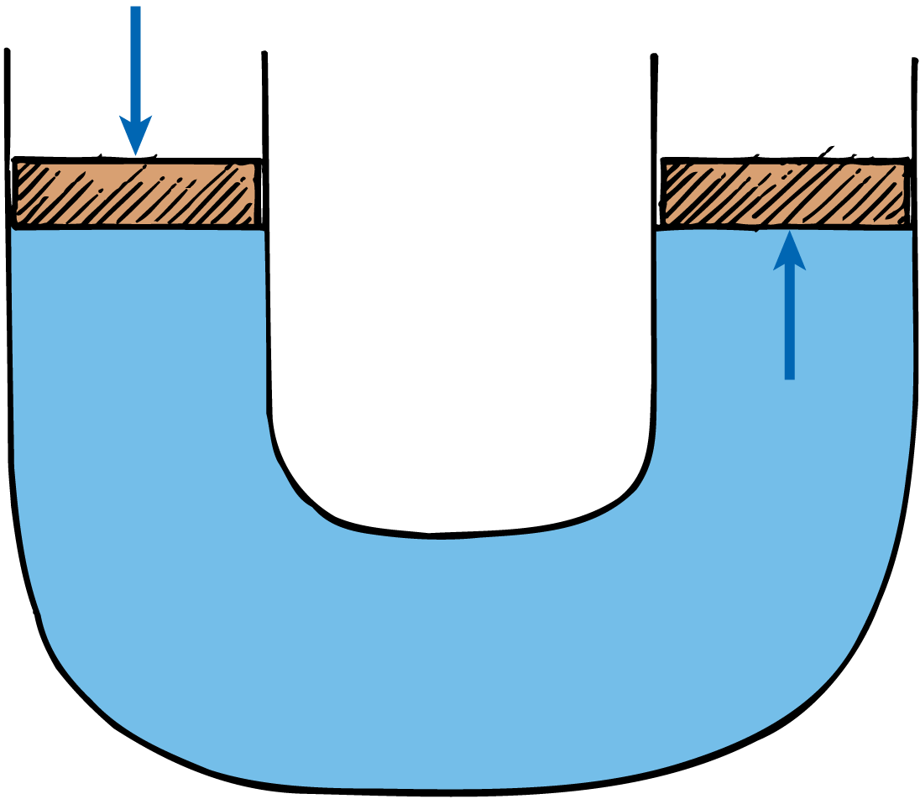
19.6 Pascal’s Principle
The force exerted on the left piston increases the pressure in the liquid and is transmitted to the right piston.

Slide 63
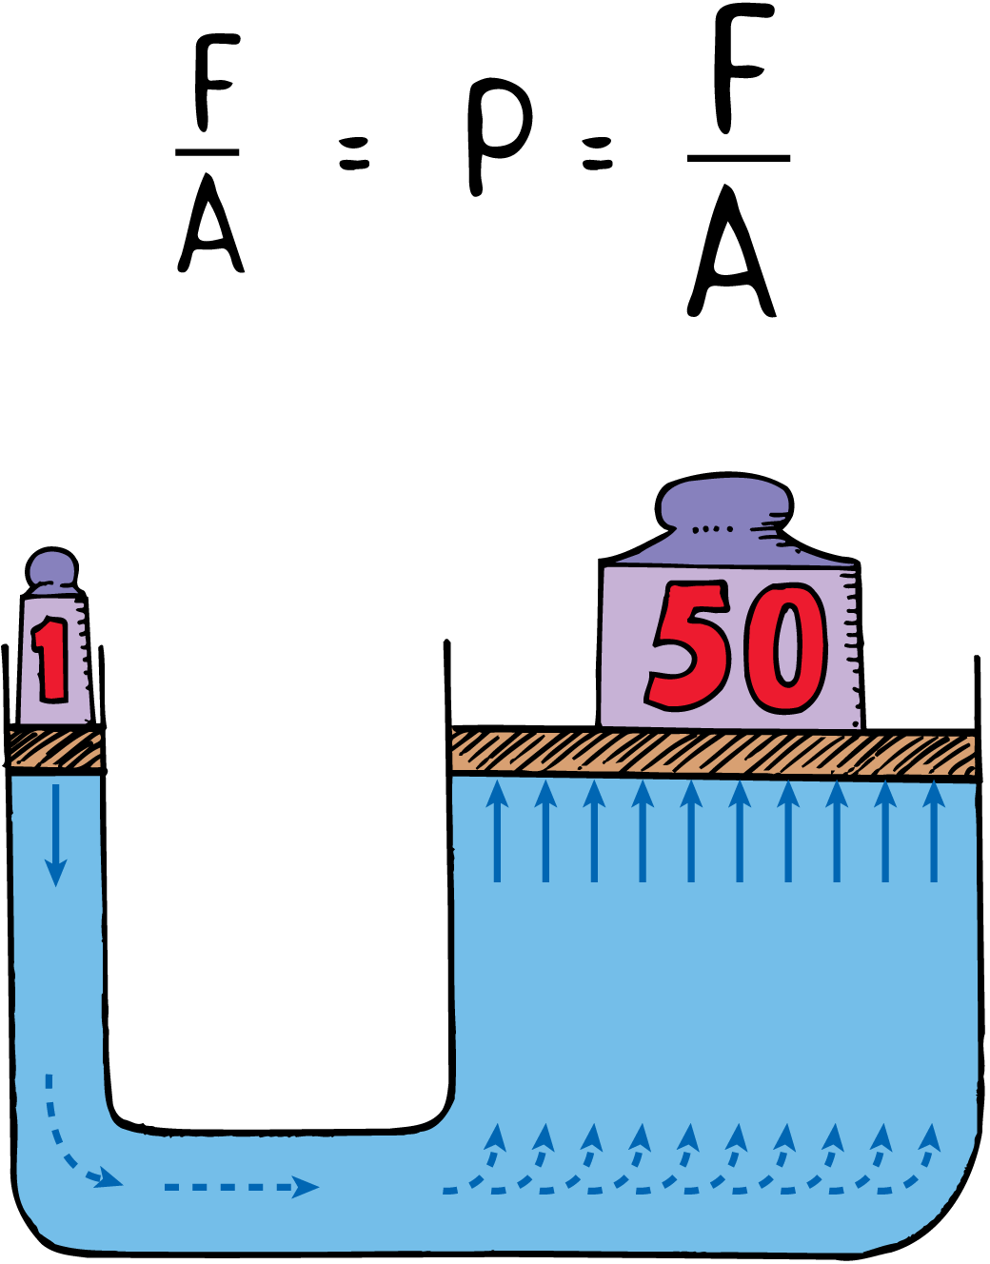
19.6 Pascal’s Principle
A 1-N load on the left piston will support 50 N on the right piston.

Slide 64
19.6 Pascal’s Principle
The piston on the left has an area of 1 cm², and the piston on the right has an area 50 times as great, 50 cm².
A 1-newton load on the left piston causes an additional pressure of 1 newton per square centimeter (1 N/cm²).
The pressure is transmitted throughout the liquid and up against the larger piston.

Slide 65
19.6 Pascal’s Principle
The additional pressure of 1 N/cm² is exerted against every square centimeter of the larger piston.
The total extra force exerted on the larger piston is 50 newtons.
The larger piston will support a 50-newton load. This is 50 times the load on the smaller piston!

Slide 66
19.6 Pascal’s Principle
We can multiply forces with such a device—1 newton input, 50 newtons output.
By further increasing the area of the larger piston, we can multiply forces to any amount.

Slide 67
19.6 Pascal’s Principle
The increase in force is compensated for by a decrease in distance.
When the small piston is moved downward 10 cm, the large piston will be raised only one fiftieth of this, or 0.2 cm.
The input force multiplied by the distance it moves is equal to the output force multiplied by the distance it moves.

Slide 68
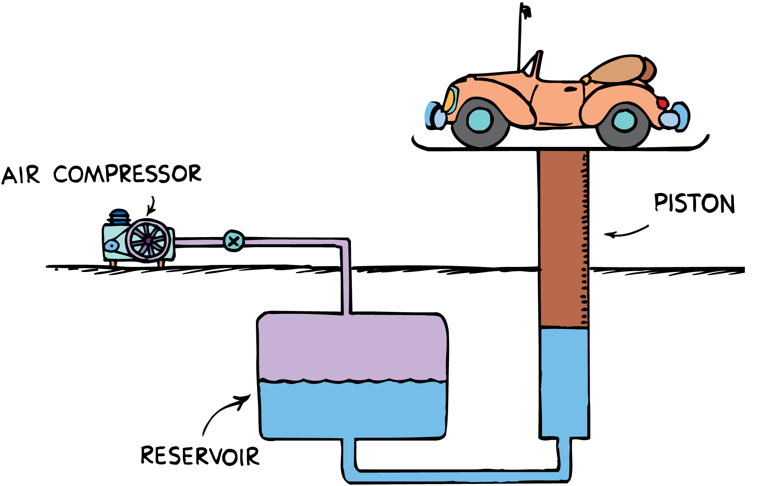
19.6 Pascal’s Principle
The automobile lift in a service station is an application of Pascal’s principle. A low pressure exerted over a relatively large area produces a large force.

Slide 69
19.6 Pascal’s Principle
Pascal’s principle applies to all fluids (gases and liquids).
The automobile lift is in many service stations.
Compressed air exerts pressure on the oil in an underground reservoir.
The oil transmits the pressure to a cylinder, which lifts the automobile.
Whatever air pressure the compressor supplies to the reservoir, is transmitted through the oil to the piston that raises the car.

Slide 70
19.6 Pascal’s Principle
think!
As the automobile is being lifted, how does the change in oil level in the reservoir compare with the distance the automobile moves?

Slide 71
19.6 Pascal’s Principle
think!
As the automobile is being lifted, how does the change in oil level in the reservoir compare with the distance the automobile moves?
Answer:
The car moves up a greater distance than the oil level drops, since the area of the piston is smaller than the surface area of the oil in the reservoir. (Note: The surface area of the reservoir doesn’t matter—it contains no piston.)

Slide 72
19.6 Pascal’s Principle
What does Pascal’s principle state?

Slide 73
Assessment Questions
Water pressure at the bottom of a lake depends on the
weight of water in the lake.
surface area of the lake.
depth of the lake.
density of the water.

Slide 74
Assessment Questions
Water pressure at the bottom of a lake depends on the
weight of water in the lake.
surface area of the lake.
depth of the lake.
density of the water.
Answer: C

Slide 75
Assessment Questions
The buoyant force that acts on an object submerged in water is due to
equal water pressures on all sides.
greater water pressure on the bottom than on the top.
the greater volume of the submerged object compared with the volume of an equal weight of water.
whether or not the object is denser than water.

Slide 76
Assessment Questions
The buoyant force that acts on an object submerged in water is due to
equal water pressures on all sides.
greater water pressure on the bottom than on the top.
the greater volume of the submerged object compared with the volume of an equal weight of water.
whether or not the object is denser than water.
Answer: B

Slide 77
Assessment Questions
If an object submerged in water displaces 20 kg of water, then the buoyant force that acts on the object is
20 kg.
20 N.
200 N.
400 N.

Slide 78
Assessment Questions
If an object submerged in water displaces 20 kg of water, then the buoyant force that acts on the object is
20 kg.
20 N.
200 N.
400 N.
Answer: C

Slide 79
Assessment Questions
The buoyant force that normally acts on a 1-kg fish is
less than 10 N.
10 N.
more than 10 N.
dependent on whether it is in salt water or fresh water.

Slide 80
Assessment Questions
The buoyant force that normally acts on a 1-kg fish is
less than 10 N.
10 N.
more than 10 N.
dependent on whether it is in salt water or fresh water.
Answer: B

Slide 81
Assessment Questions
The buoyant force that acts on a 20,000-N ship is
somewhat less than 20,000 N.
20,000 N.
more than 20,000 N.
dependent on whether it is in fresh water or salt water.

Slide 82
Assessment Questions
The buoyant force that acts on a 20,000-N ship is
somewhat less than 20,000 N.
20,000 N.
more than 20,000 N.
dependent on whether it is in fresh water or salt water.
Answer: B

Slide 83
Assessment Questions
Consider a U-shaped tube filled with water with pistons at each end. When pressure is increased at one end of the tube, pressure at the other side will
increase by the same amount.
increase more if the piston at the output end has a greater area.
decrease if the piston at the output end has a smaller area.
decrease in accord with the conservation of energy, regardless of piston area.

Slide 84
Assessment Questions
Consider a U-shaped tube filled with water with pistons at each end. When pressure is increased at one end of the tube, pressure at the other side will
increase by the same amount.
increase more if the piston at the output end has a greater area.
decrease if the piston at the output end has a smaller area.
decrease in accord with the conservation of energy, regardless of piston area.
Answer: A

