Slide 1
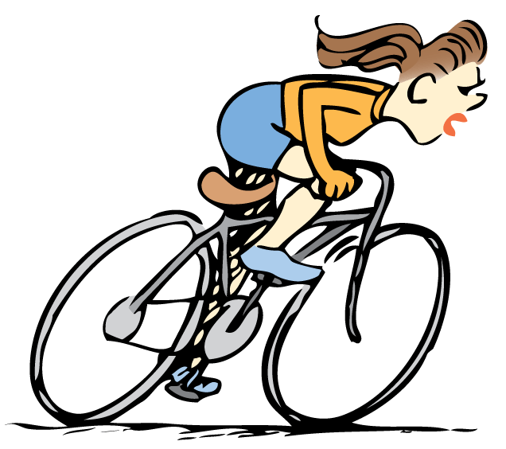
You can describe the motion of an object by its position, speed, direction, and acceleration.

Slide 2
4.1 Motion Is Relative
An object is moving if its position relative to a fixed point is changing.
Notes:
2

Slide 3
4.1 Motion Is Relative
Even things that appear to be at rest move.
When we describe the motion of one object with respect to another, we say that the object is moving relative to the other object.
A book that is at rest, relative to the table it lies on, is moving at about 30 kilometers per second relative to the sun.
The book moves even faster relative to the center of our galaxy.

Slide 4
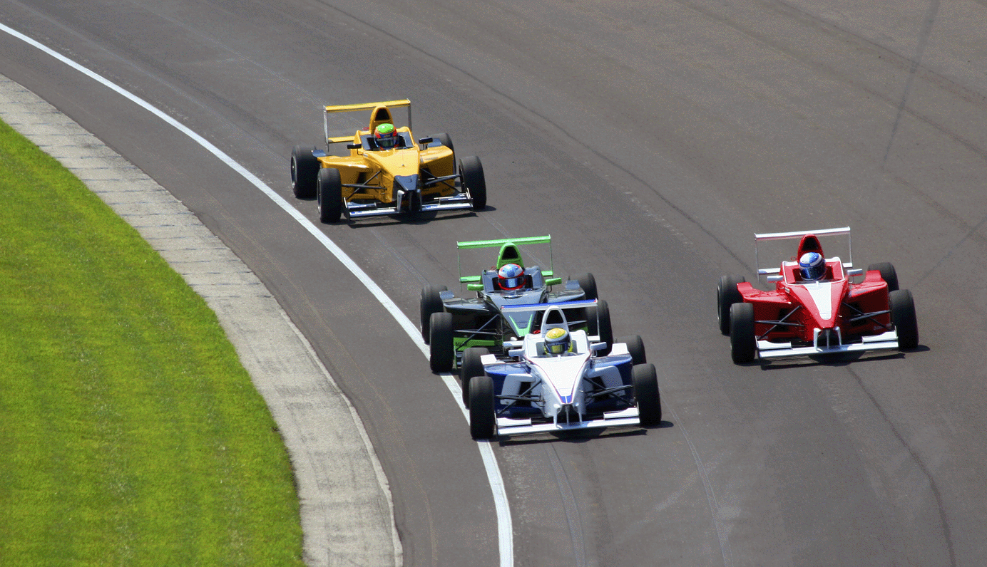
4.1 Motion Is Relative
The racing cars in the Indy 500 move relative to the track.

Slide 5
4.1 Motion Is Relative
When we discuss the motion of something, we describe its motion relative to something else.
The space shuttle moves at 8 kilometers per second relative to Earth below.
A racing car in the Indy 500 reaches a speed of 300 kilometers per hour relative to the track.
Unless stated otherwise, the speeds of things in our environment are measured relative to the surface of Earth.

Slide 6
4.1 Motion Is Relative
Although you may be at rest relative to Earth’s surface, you’re moving about 100,000 km/h relative to the sun.

Slide 7
4.1 Motion Is Relative
think!
A hungry mosquito sees you resting in a hammock in a 3-meters-per-second breeze. How fast and in what direction should the mosquito fly in order to hover above you for lunch?

Slide 8
4.1 Motion Is Relative
think!
A hungry mosquito sees you resting in a hammock in a 3-meters-per-second breeze. How fast and in what direction should the mosquito fly in order to hover above you for lunch?
Answer: The mosquito should fly toward you into the breeze. When above you it should fly at 3 meters per second in order to hover at rest above you.

Slide 9
4.1 Motion Is Relative
How can you tell if an object is moving?

Slide 10
4.2 Speed
You can calculate the speed of an object by dividing the distance covered by time.

Slide 11
4.2 Speed
Before the time of Galileo, people described moving things as simply “slow” or “fast.” Such descriptions were vague.
Galileo is credited as being the first to measure speed by considering the distance covered and the time it takes.
Speed is how fast an object is moving.

Slide 12
4.2 Speed
Any combination of units for distance and time that are useful and convenient are legitimate for describing speed:
miles per hour (mi/h)
kilometers per hour (km/h)
centimeters per day
light-years per century

Slide 13
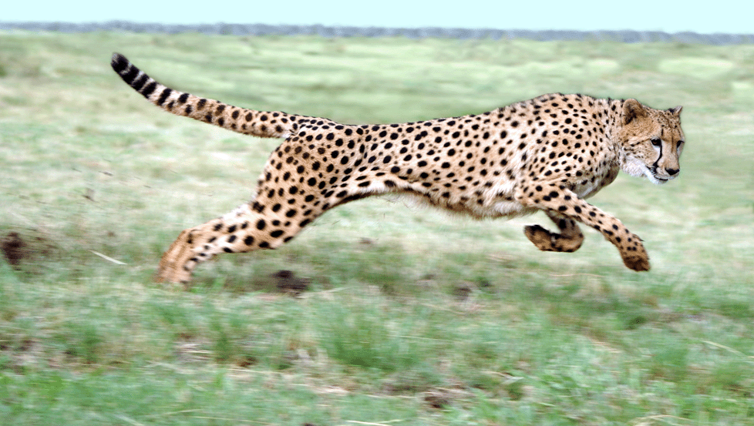
4.2 Speed
A cheetah is the fastest land animal over distances less than 500 meters and can achieve peak speeds of 100 km/h.

Slide 14
4.2 Speed
We will primarily use the unit meters per second (m/s) for speed.
If a cheetah covers 50 meters in a time of 2 seconds, its speed is 25 m/s.

Slide 15
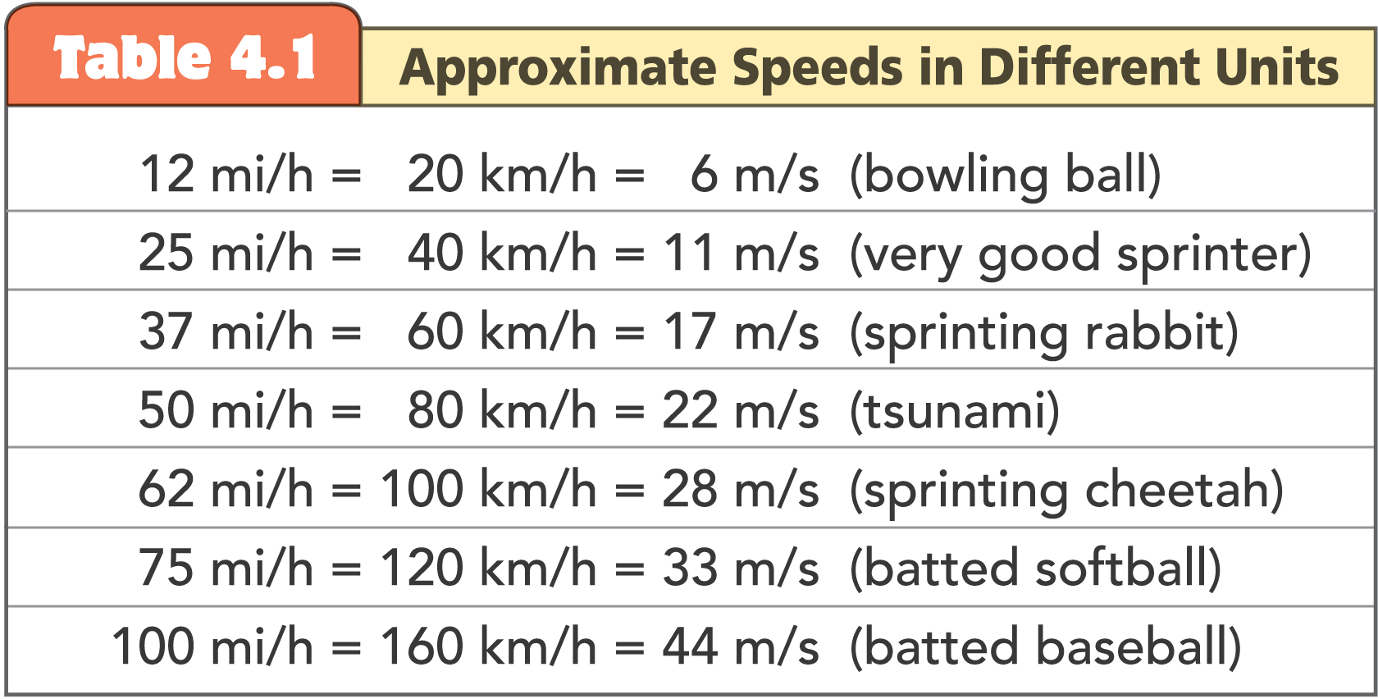
4.2 Speed

Slide 16
4.2 Speed
Instantaneous Speed
A car does not always move at the same speed.
You can tell the speed of the car at any instant by looking at the car’s speedometer.
The speed at any instant is called the instantaneous speed.

Slide 17
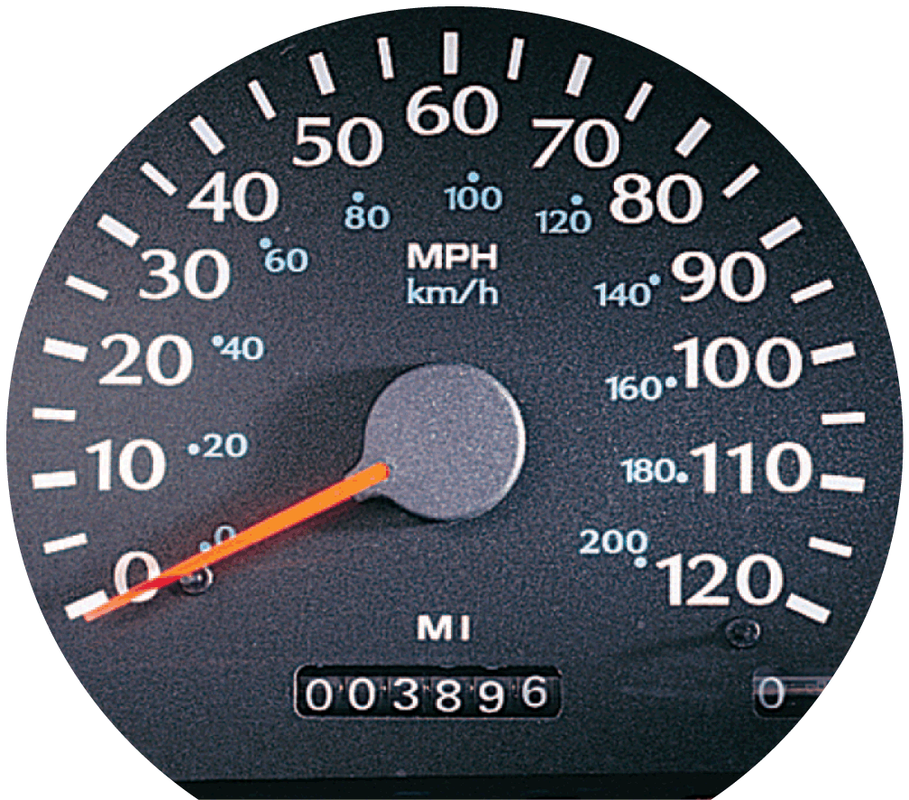
4.2 Speed
The speedometer gives readings of instantaneous speed in both mi/h and km/h.

Slide 18
4.2 Speed
Average Speed
In a trip by car, the car will certainly not travel at the same speed all during the trip.
The driver cares about the average speed for the trip as a whole.
The average speed is the total distance covered divided by the time.

Slide 19
4.2 Speed
Average speed can be calculated easily:
For example, a distance of 240 kilometers during a time of 4 hours is an average speed of 60 km/h:

Slide 20
4.2 Speed
The average speed is often quite different from the instantaneous speed.
Whether we talk about average speed or instantaneous speed, we are talking about the rates at which distance is traveled.

Slide 21
4.2 Speed
If we know average speed and travel time, the distance traveled is easy to find.
total distance covered = average speed × travel time
For example, if your average speed is 80 kilometers per hour on a 4-hour trip, then you cover a total distance of 320 kilometers.

Slide 22
4.2 Speed
think!
If a cheetah can maintain a constant speed of 25 m/s, it will cover 25 meters every second. At this rate, how far will it travel in 10 seconds? In 1 minute?

Slide 23
4.2 Speed
think!
If a cheetah can maintain a constant speed of 25 m/s, it will cover 25 meters every second. At this rate, how far will it travel in 10 seconds? In 1 minute?
Answer: In 10 s the cheetah will cover 250 m, and in 1 min (or 60 s) it will cover 1500 m.

Slide 24
4.2 Speed
think!
The speedometer in every car also has an odometer that records the distance traveled. If the odometer reads zero at the beginning of a trip and 35 km a half hour later, what is the average speed?

Slide 25
4.2 Speed
think!
The speedometer in every car also has an odometer that records the distance traveled. If the odometer reads zero at the beginning of a trip and 35 km a half hour later, what is the average speed?
Answer:

Slide 26
4.2 Speed
How can you calculate speed?

Slide 27
4.3 Velocity
Speed is a description of how fast an object moves; velocity is how fast and in what direction it moves.

Slide 28
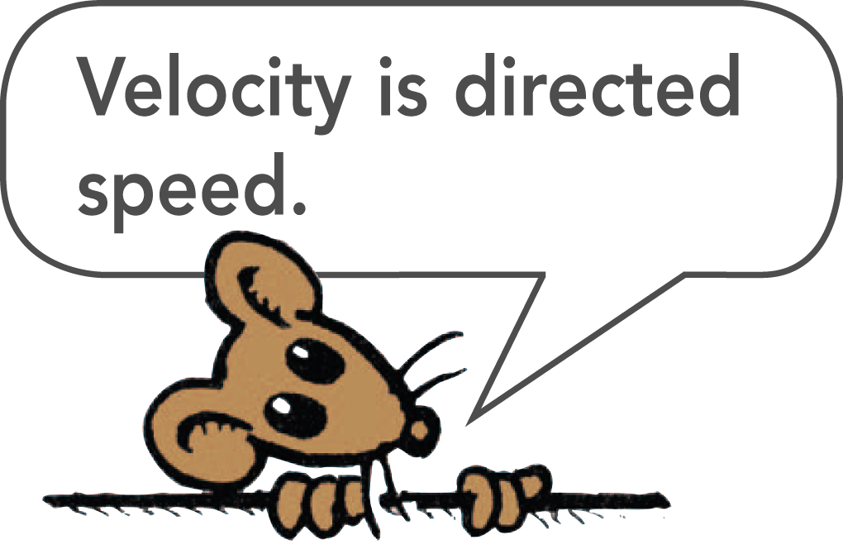
4.3 Velocity
In physics, velocity is speed in a given direction.
When we say a car travels at 60 km/h, we are specifying its speed.
When we say a car moves at 60 km/h to the north, we are specifying its velocity.

Slide 29
4.3 Velocity
A quantity such as velocity that specifies direction as well as magnitude is called a vector quantity.
Speed is a scalar quantity.
Velocity, like force, is a vector quantity.

Slide 30
4.3 Velocity
Constant Velocity
Constant speed means steady speed. Something with constant speed doesn’t speed up or slow down.
Constant velocity means both constant speed and constant direction.
Constant direction is a straight line, so constant velocity means motion in a straight line at constant speed.

Slide 31
4.3 Velocity
Changing Velocity
If either the speed or the direction (or both) is changing, then the velocity is changing.
Constant speed and constant velocity are not the same.
A body may move at constant speed along a curved path but it does not move with constant velocity, because its direction is changing every instant.

Slide 32
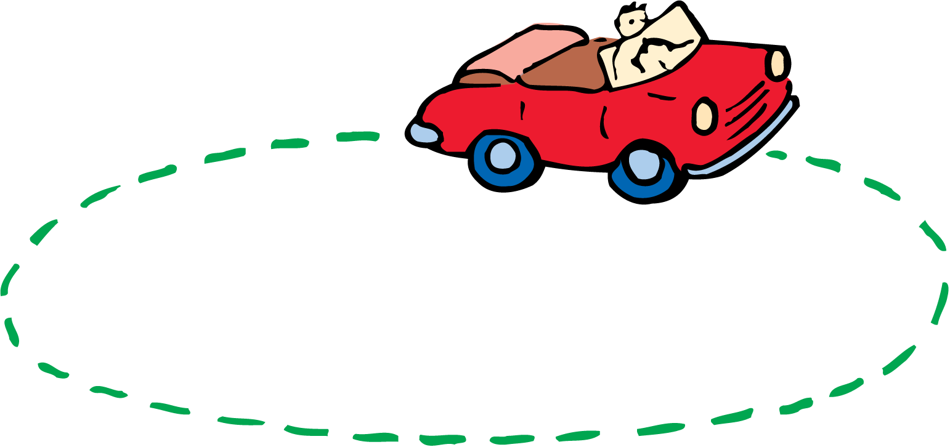
4.3 Velocity
The car on the circular track may have a constant speed but not a constant velocity, because its direction of motion is changing every instant.

Slide 33
4.3 Velocity
think!
The speedometer of a car moving northward reads 60 km/h. It passes another car that travels southward at 60 km/h. Do both cars have the same speed? Do they have the same velocity?

Slide 34
4.3 Velocity
think!
The speedometer of a car moving northward reads 60 km/h. It passes another car that travels southward at 60 km/h. Do both cars have the same speed? Do they have the same velocity?
Answer: Both cars have the same speed, but they have opposite velocities because they are moving in opposite directions.

Slide 35
4.3 Velocity
How is velocity different from speed?

Slide 36
4.4 Acceleration
You can calculate the acceleration of an object by dividing the change in its velocity by time.

Slide 37
4.4 Acceleration
We can change the state of motion of an object by changing its speed, its direction of motion, or both.
Acceleration is the rate at which the velocity is changing.

Slide 38
4.4 Acceleration
In physics, the term acceleration applies to decreases as well as increases in speed.
The brakes of a car can produce large retarding accelerations, that is, they can produce a large decrease per second in the speed. This is often called deceleration.

Slide 39
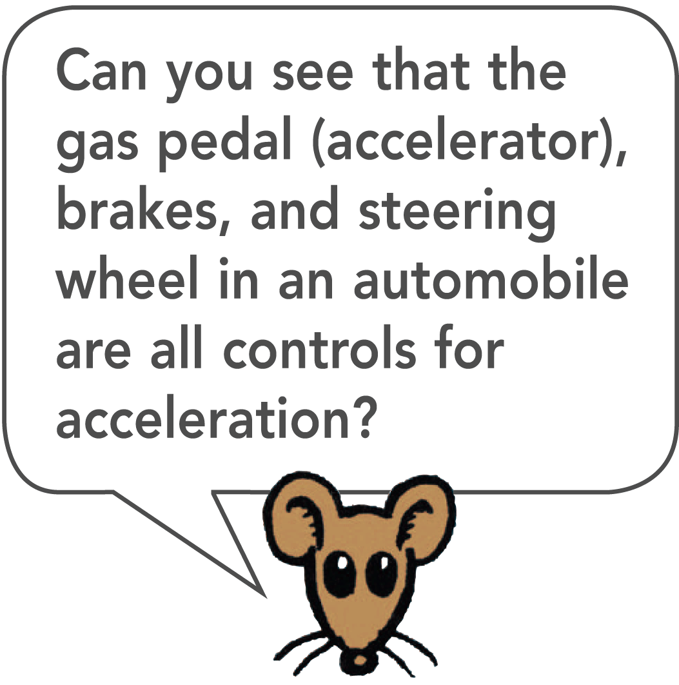
4.4 Acceleration
A car is accelerating whenever there is a change in its state of motion.

Slide 40
4.4 Acceleration
A car is accelerating whenever there is a change in its state of motion.

Slide 41
4.4 Acceleration
A car is accelerating whenever there is a change in its state of motion.

Slide 42
4.4 Acceleration
Change in Direction
Acceleration also applies to changes in direction.
It is important to distinguish between speed and velocity.
Acceleration is defined as the rate of change in velocity, rather than speed.
Acceleration, like velocity, is a vector quantity because it is directional.

Slide 43
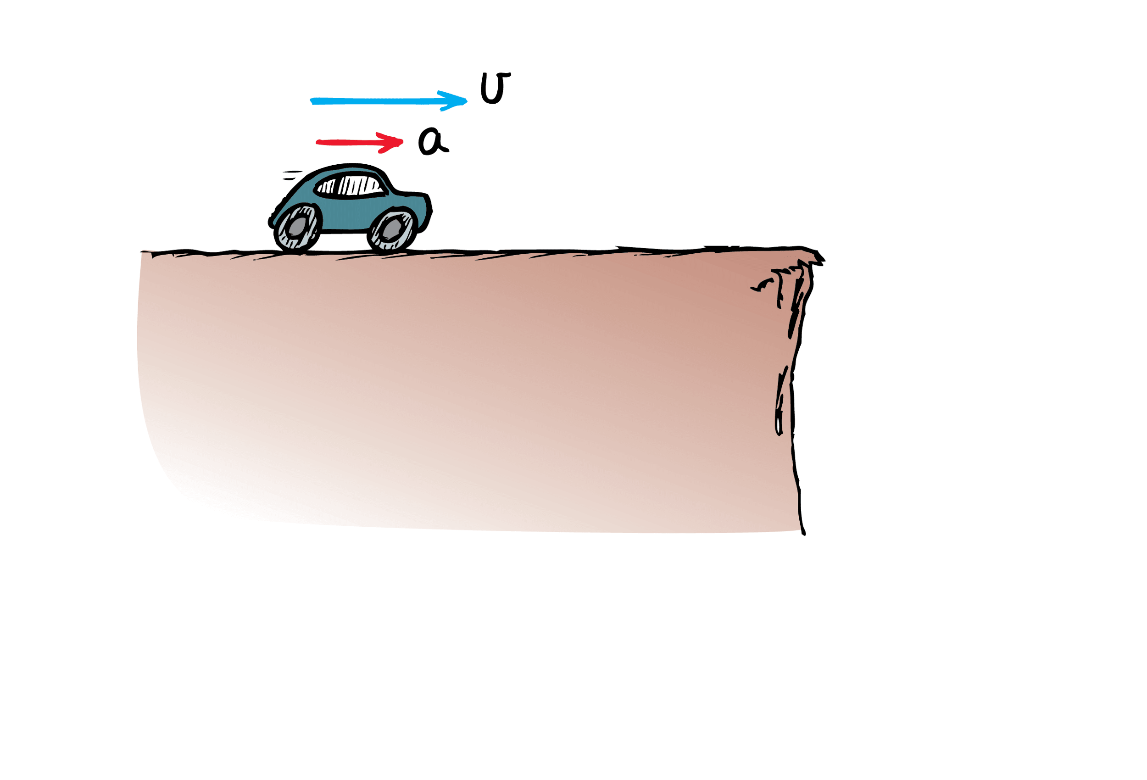
4.4 Acceleration
Accelerate in the direction of velocity–speed up

Slide 44
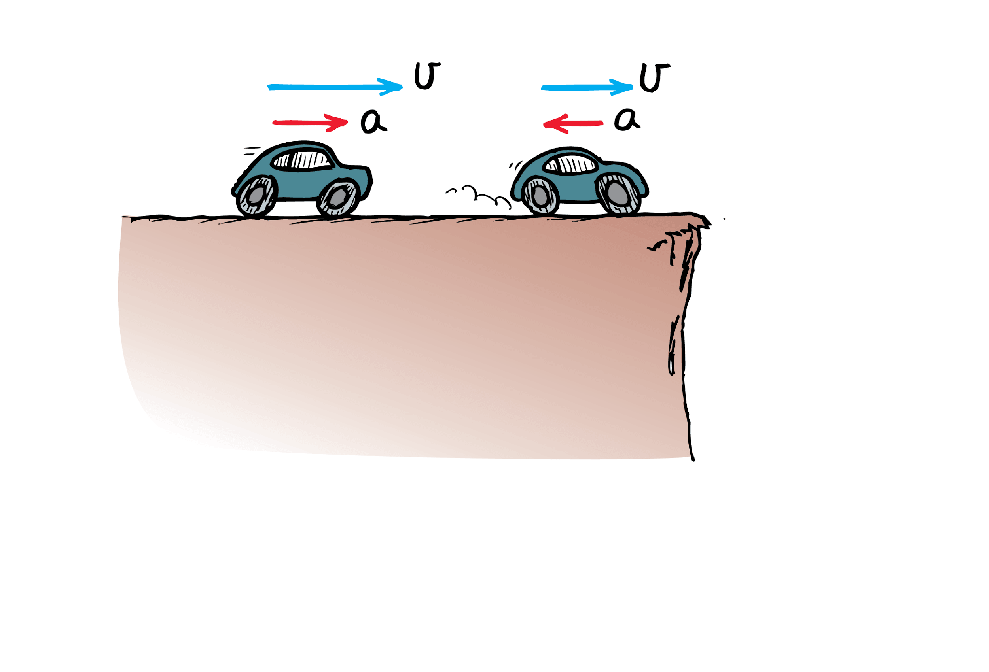
4.4 Acceleration
Accelerate in the direction of velocity–speed up
Accelerate against velocity–slow down

Slide 45
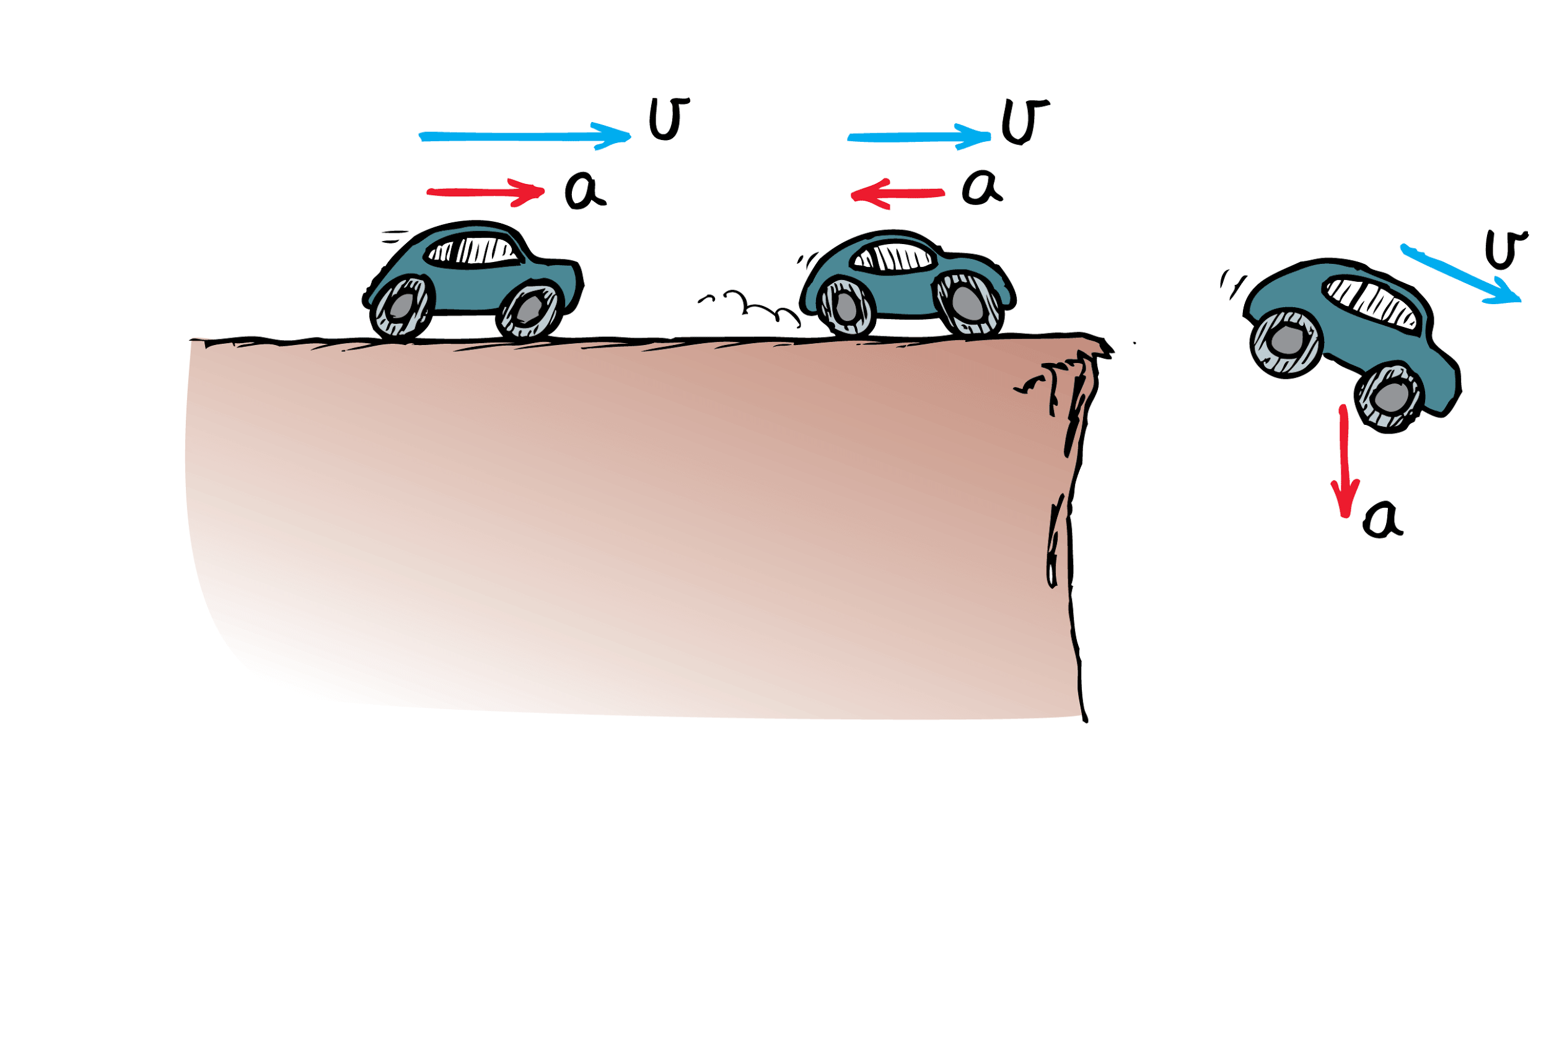
4.4 Acceleration
Accelerate in the direction of velocity–speed up
Accelerate against velocity–slow down
Accelerate at an angle to velocity–change direction

Slide 46
4.4 Acceleration
Change in Speed
When straight-line motion is considered, it is common to use speed and velocity interchangeably.
When the direction is not changing, acceleration may be expressed as the rate at which speed changes.

Slide 47
4.4 Acceleration
Speed and velocity are measured in units of distance per time.
Acceleration is the change in velocity (or speed) per time interval.
Acceleration units are speed per time.
Changing speed, without changing direction, from 0 km/h to 10 km/h in 1 second, acceleration along a straight line is

Slide 48
4.4 Acceleration
The acceleration is 10 km/h•s, which is read as “10 kilometers per hour-second.”
Note that a unit for time appears twice: once for the unit of speed and again for the interval of time in which the speed is changing.

Slide 49
4.4 Acceleration
think!
Suppose a car moving in a straight line steadily increases its speed each second, first from 35 to 40 km/h, then from 40 to 45 km/h, then from 45 to 50 km/h. What is its acceleration?

Slide 50
4.4 Acceleration
think!
Suppose a car moving in a straight line steadily increases its speed each second, first from 35 to 40 km/h, then from 40 to 45 km/h, then from 45 to 50 km/h. What is its acceleration?
Answer: The speed increases by 5 km/h during each 1-s interval in a straight line. The acceleration is therefore 5 km/h•s during each interval.

Slide 51
4.4 Acceleration
think!
In 5 seconds a car moving in a straight line increases its speed from 50 km/h to 65 km/h, while a truck goes from rest to 15 km/h in a straight line. Which undergoes greater acceleration? What is the acceleration of each vehicle?

Slide 52
4.4 Acceleration
think!
In 5 seconds a car moving in a straight line increases its speed from 50 km/h to 65 km/h, while a truck goes from rest to 15 km/h in a straight line. Which undergoes greater acceleration? What is the acceleration of each vehicle?
Answer: The car and truck both increase their speed by 15 km/h during the same time interval, so their acceleration is the same.

Slide 53
4.4 Acceleration
How do you calculate acceleration?

Slide 54
4.5 Free Fall: How Fast
The acceleration of an object in free fall is about 10 meters per second squared (10 m/s²).

Slide 55
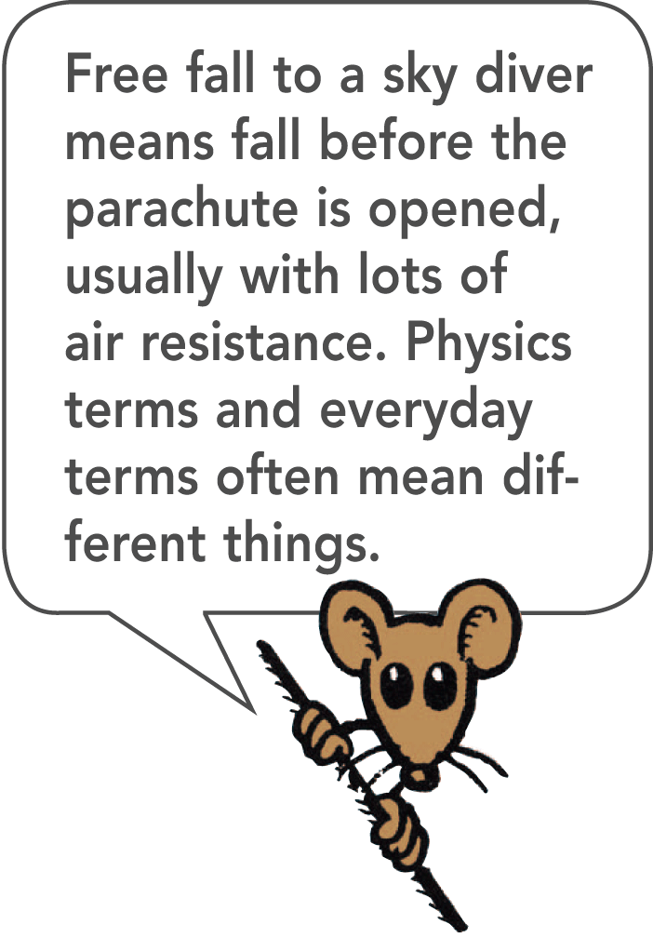
4.5 Free Fall: How Fast
Falling Objects
Imagine there is no air resistance and that gravity is the only thing affecting a falling object.
An object moving under the influence of the gravitational force only is said to be in free fall.
The elapsed time is the time that has elapsed, or passed, since the beginning of any motion, in this case the fall.

Slide 56
4.5 Free Fall: How Fast
During each second of fall the instantaneous speed of the object increases by an additional 10 meters per second.
This gain in speed per second is the acceleration.

Slide 57
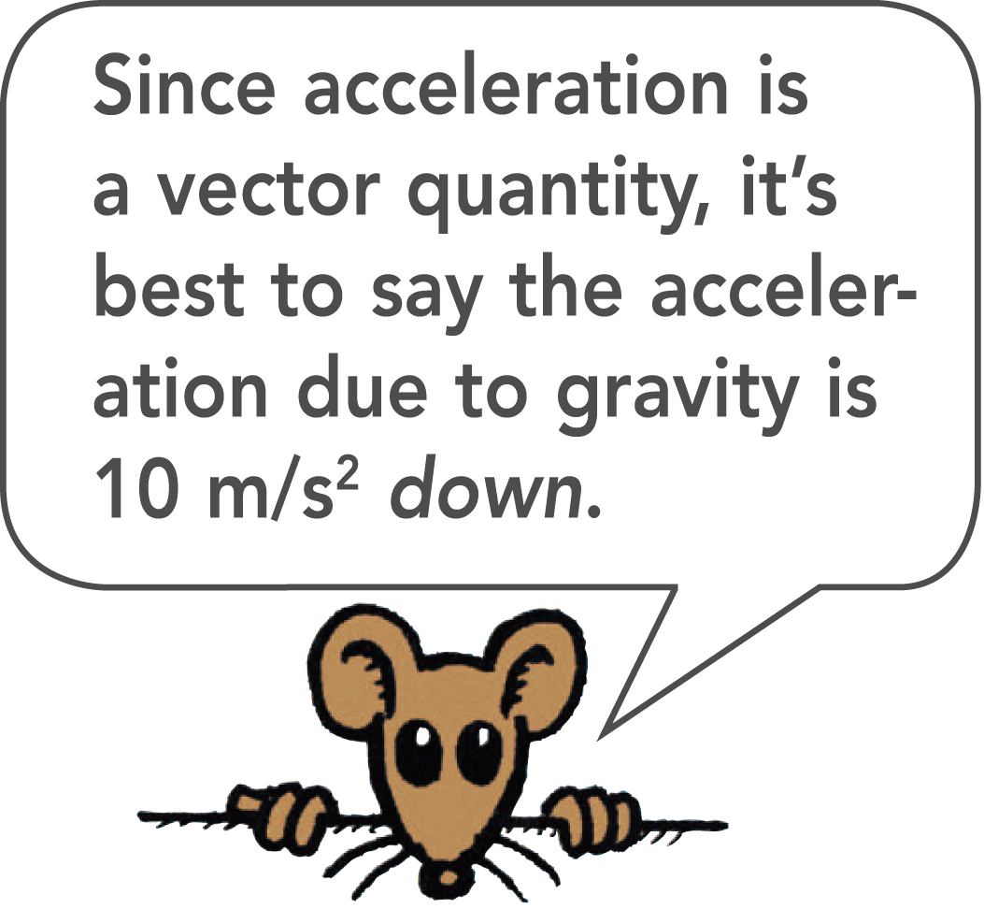
4.5 Free Fall: How Fast
When the change in speed is in m/s and the time interval is in s, the acceleration is in m/s², which is read as “meters per second squared.”
The unit of time, the second, occurs twice—once for the unit of speed and again for the time interval during which the speed changes.

Slide 58
4.5 Free Fall: How Fast
For free fall, it is customary to use the letter g to represent the acceleration because the acceleration is due to gravity.
Although g varies slightly in different parts of the world, its average value is nearly 10 m/s².
Where accuracy is important, the value of 9.8 m/s² should be used for the acceleration during free fall.

Slide 59
4.5 Free Fall: How Fast
The instantaneous speed of an object falling from rest is equal to the acceleration multiplied by the elapsed time.
v = gt
The letter v represents both speed and velocity. When the acceleration g = 10 m/s² is multiplied by the elapsed time in seconds, the result is the instantaneous speed in meters per second.

Slide 60
4.5 Free Fall: How Fast
If a falling rock were somehow equipped with a speedometer, in each succeeding second of fall its reading would increase by the same amount, 10 m/s.

Slide 61
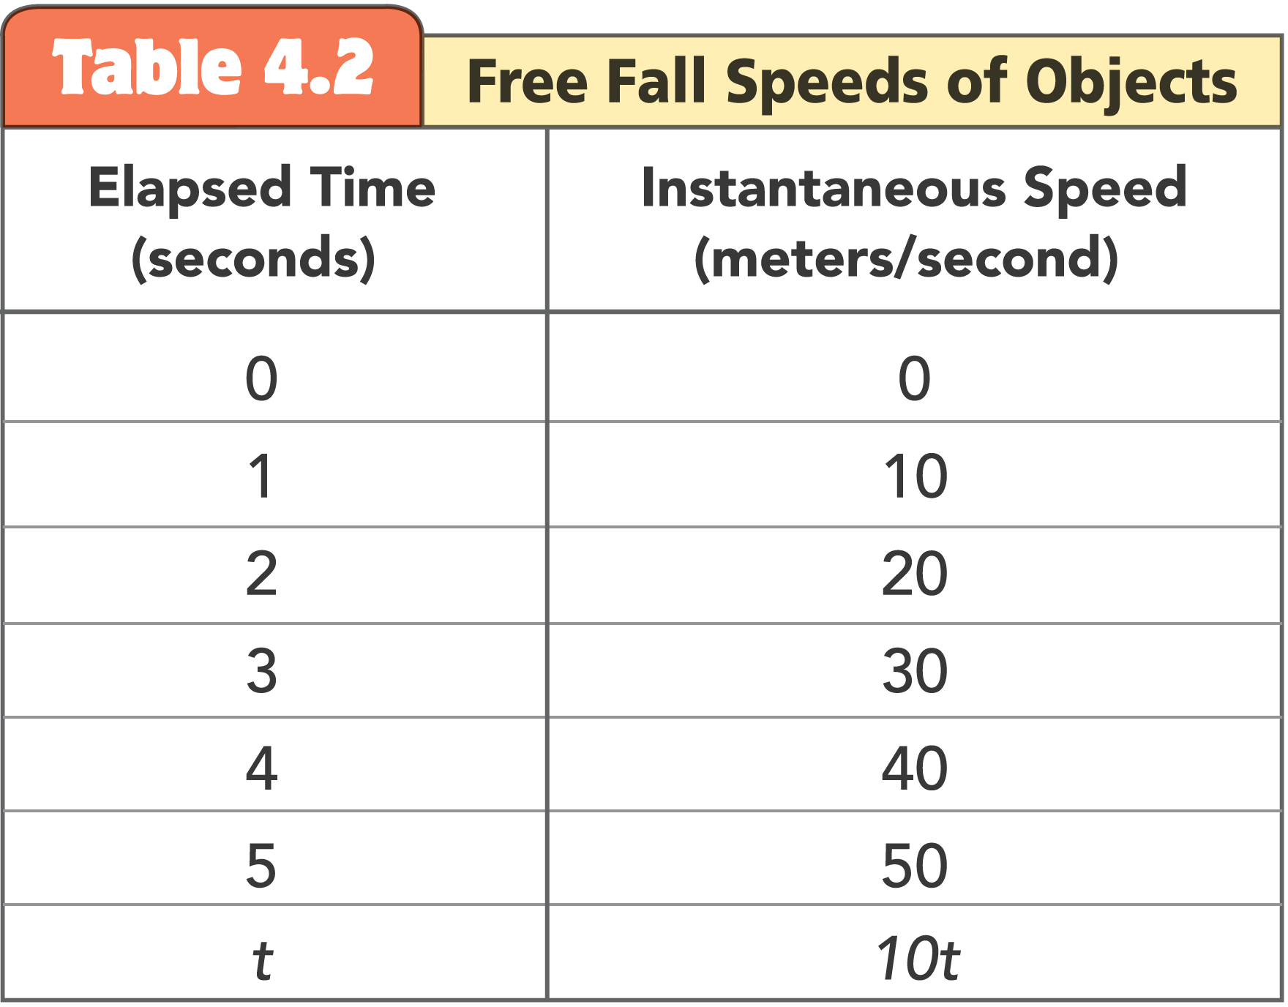
4.5 Free Fall: How Fast

Slide 62
4.5 Free Fall: How Fast
The average speed of any object moving in a straight line with constant acceleration is the average of the initial speed and the final speed.
The average speed of a freely falling object in its first second of fall is the sum of the initial speed of zero and the final speed of 10 m/s, divided by 2, or 5 m/s.

Slide 63
4.5 Free Fall: How Fast
Rising Objects
Now consider an object thrown straight up:
It moves upward for a while.
At the highest point, when the object is changing its direction from upward to downward, its instantaneous speed is zero.
It then falls downward as if it had been dropped from rest at that height.

Slide 64
4.5 Free Fall: How Fast
During the upward part of this motion, the object slows from its initial upward velocity to zero velocity.
The object is accelerating because its velocity is changing.
How much does its speed decrease each second?

Slide 65
4.5 Free Fall: How Fast
The speed decreases at the same rate it increases when moving downward—at 10 meters per second each second.
The instantaneous speed at points of equal elevation in the path is the same whether the object is moving upward or downward.
The velocities are different because they are in opposite directions.
During each second, the speed or the velocity changes by 10 m/s downward.

Slide 66
4.5 Free Fall: How Fast
The change in speed each second is the same whether the ball is going upward or downward.

Slide 67
4.5 Free Fall: How Fast
think!
During the span of the second time interval in Table 4.2, the object begins at 10 m/s and ends at 20 m/s. What is the average speed of the object during this 1-second interval? What is its acceleration?

Slide 68
4.5 Free Fall: How Fast
think!
During the span of the second time interval in Table 4.2, the object begins at 10 m/s and ends at 20 m/s. What is the average speed of the object during this 1-second interval? What is its acceleration?
Answer: The average speed is 15 m/s. The acceleration is 10 m/s².

Slide 69
4.5 Free Fall: How Fast
think!
What would the speedometer reading on the falling rock be 4.5 seconds after it drops from rest?
How about 8 seconds after it is dropped?

Slide 70
4.5 Free Fall: How Fast
think!
What would the speedometer reading on the falling rock be 4.5 seconds after it drops from rest?
How about 8 seconds after it is dropped?
Answer: The speedometer readings would be 45 m/s and 80 m/s, respectively.

Slide 71
4.5 Free Fall: How Fast
What is the acceleration of an object in free fall?

Slide 72
4.6 Free Fall: How Far
For each second of free fall, an object falls a greater distance than it did in the previous second.

Slide 73
4.6 Free Fall: How Far
How far does an object in free fall travel in the first second?
At the end of the first second, the falling object has an instantaneous speed of 10 m/s.
The initial speed is 0 m/s.
The average speed is 5 m/s.
During the first second, the object has an average speed of 5 m/s, so it falls a distance of 5 m.

Slide 74
4.6 Free Fall: How Far
Pretend that a falling rock is somehow equipped with an odometer. The readings of distance fallen increase with time.

Slide 75
4.6 Free Fall: How Far
At the end of one second, the rock has fallen 5 meters.
At the end of 2 seconds, it has dropped a total distance of 20 meters.
At the end of 3 seconds, it has dropped 45 meters altogether.

Slide 76
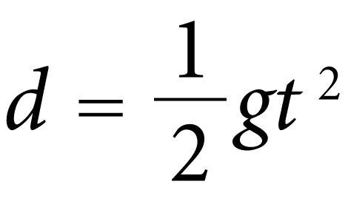
4.6 Free Fall: How Far
These distances form a mathematical pattern: at the end of time t, the object starting from rest falls a distance d.

Slide 77
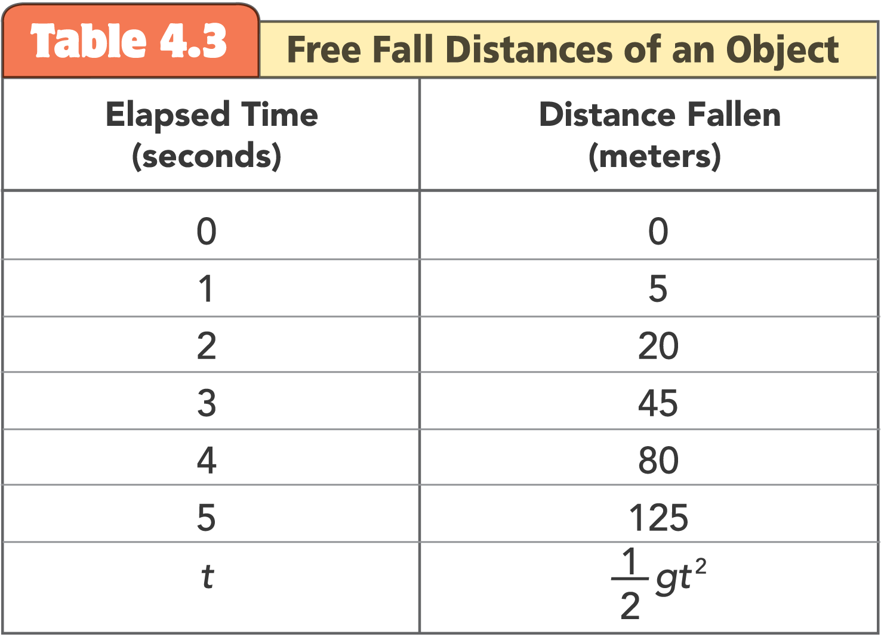
4.6 Free Fall: How Far

Slide 78
4.6 Free Fall: How Far
We used freely falling objects to describe the relationship between distance traveled, acceleration, and velocity acquired.
The same principles apply to any accelerating object. Whenever an object’s initial speed is zero and the acceleration a is constant, velocity and distance traveled are:

Slide 79
4.6 Free Fall: How Far
think!
An apple drops from a tree and hits the ground in one second. What is its speed upon striking the ground? What is its average speed during the one second? How high above ground was the apple when it first dropped?

Slide 80
4.6 Free Fall: How Far
think!
An apple drops from a tree and hits the ground in one second. What is its speed upon striking the ground? What is its average speed during the one second? How high above ground was the apple when it first dropped?
Answer: The speed when it strikes the ground is 10 m/s. The average speed was 5 m/s and the apple dropped from a height of 5 meters.

Slide 81
4.6 Free Fall: How Far
For a falling object, how does the distance per second change?

Slide 82
4.7 Graphs of Motion
On a speed-versus-time graph the slope represents speed per time, or acceleration.

Slide 83
4.7 Graphs of Motion
Equations and tables are not the only way to describe relationships such as velocity and acceleration.
Graphs can visually describe relationships.

Slide 84
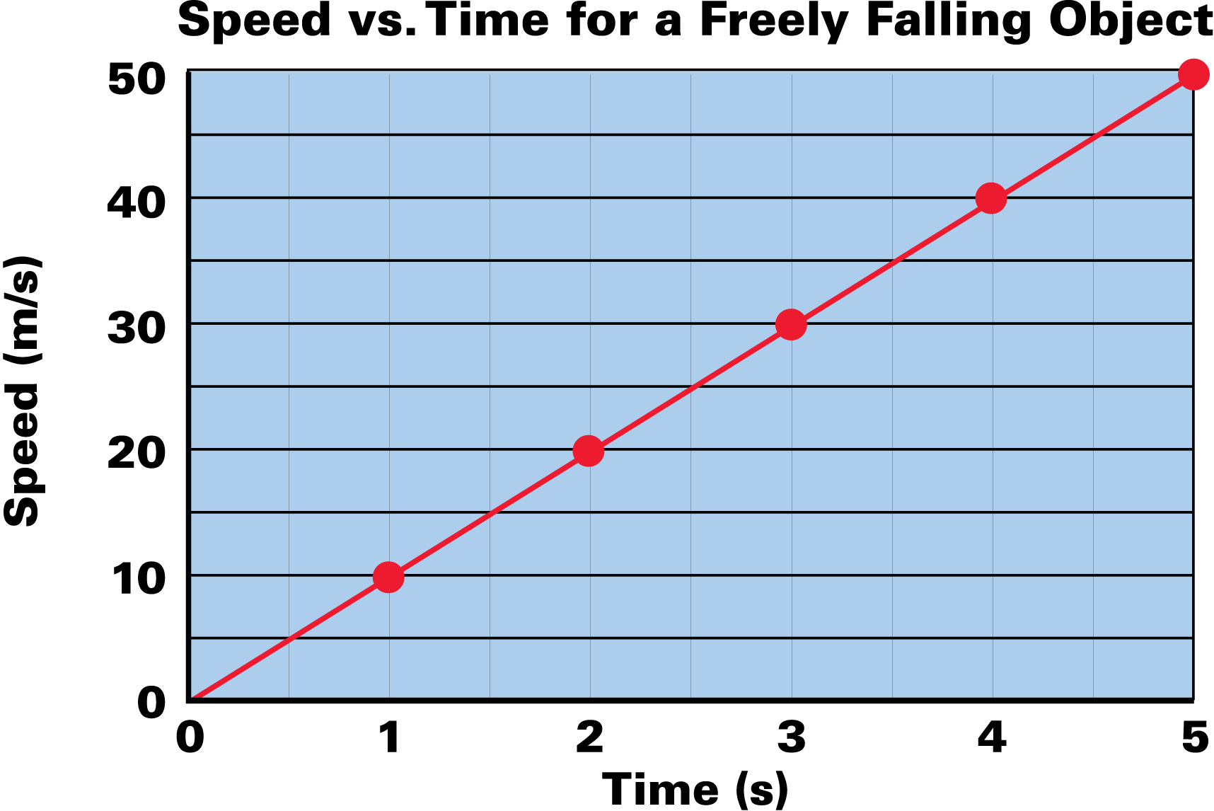
4.7 Graphs of Motion
Speed-Versus-Time
On a speed-versus-time graph, the speed v of a freely falling object can be plotted on the vertical axis and time t on the horizontal axis.

Slide 85
4.7 Graphs of Motion
The “curve” that best fits the points forms a straight line.
For every increase of 1 s, there is the same 10 m/s increase in speed.
Mathematicians call this linearity.
Since the object is dropped from rest, the line starts at the origin, where both v and t are zero.
If we double t, we double v; if we triple t, we triple v; and so on.

Slide 86
4.7 Graphs of Motion
This particular linearity is called a direct proportion, and we say that time and speed are directly proportional to each other.

Slide 87
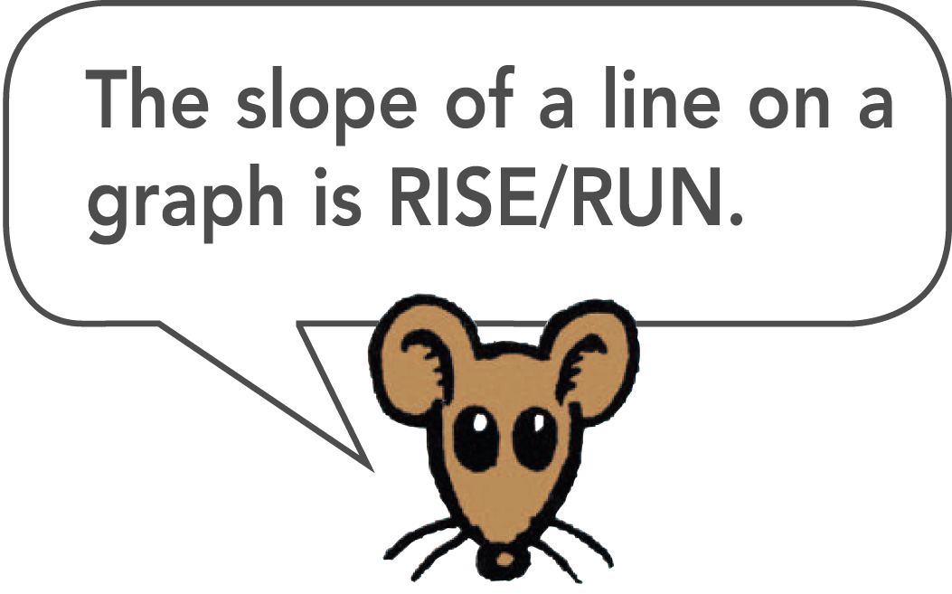
4.7 Graphs of Motion
The curve is a straight line, so its slope is constant.
Slope is the vertical change divided by the horizontal change for any part of the line.

Slide 88
4.7 Graphs of Motion
For 10 m/s of vertical change there is a horizontal change of 1 s.
The slope is 10 m/s divided by 1 s, or 10 m/s².
The straight line shows the acceleration is constant.
If the acceleration were greater, the slope of the graph would be steeper.

Slide 89
4.7 Graphs of Motion
Distance-Versus-Time
When the distance d traveled by a freely falling object is plotted on the vertical axis and time t on the horizontal axis, the result is a curved line.

Slide 90
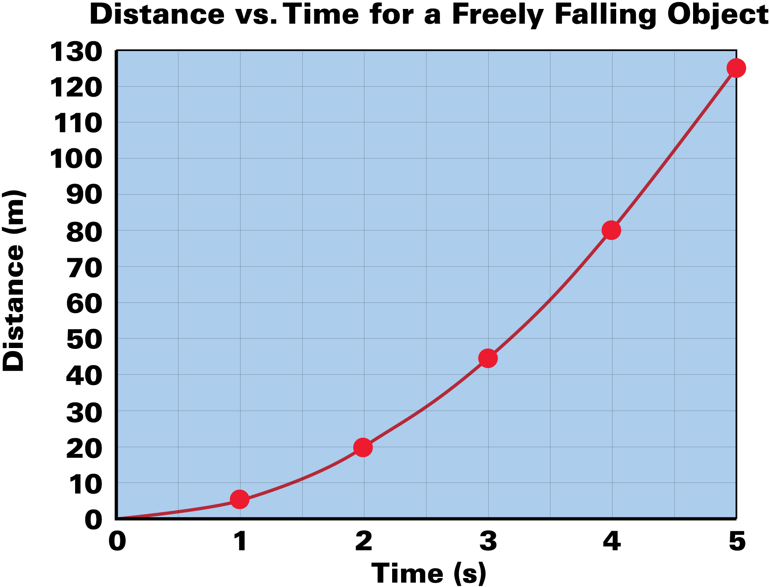
4.7 Graphs of Motion
This distance-versus-time graph is parabolic.

Slide 91
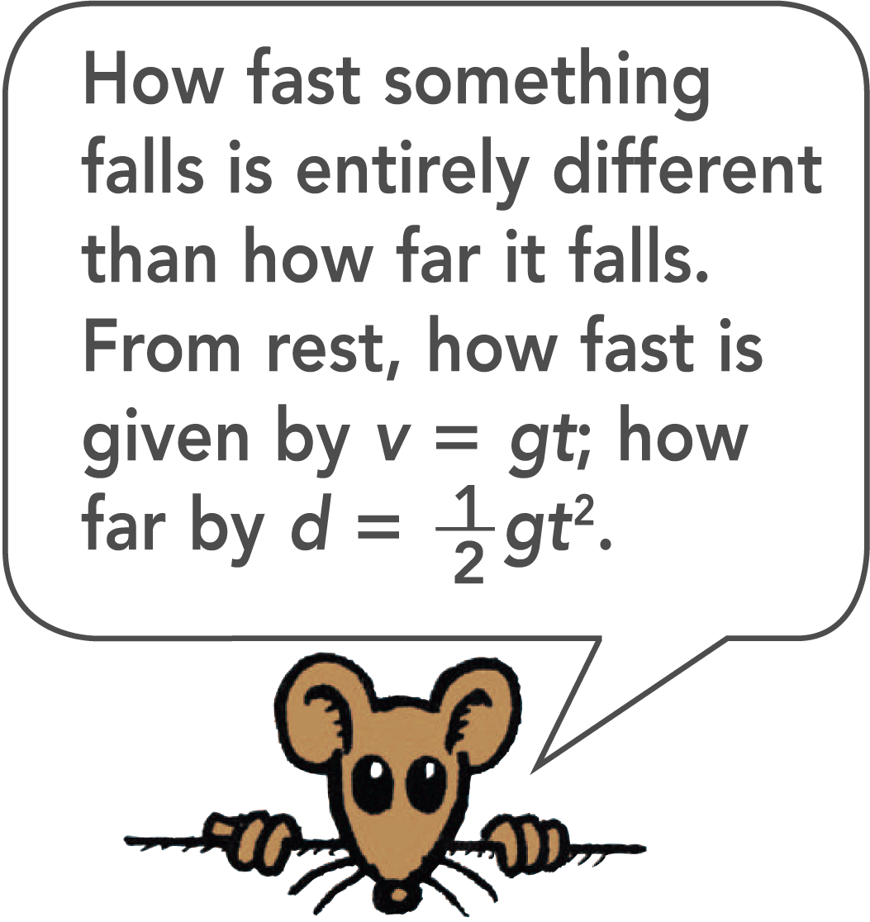
4.7 Graphs of Motion
The relationship between distance and time is nonlinear.
The relationship is quadratic and the curve is parabolic—when we double t, we do not double d; we quadruple it. Distance depends on time squared!

Slide 92
4.7 Graphs of Motion
A curved line also has a slope—different at different points.
The slope of a curve changes from one point to the next.
The slope of the curve on a distance-versus-time graph is speed, the rate at which distance is covered per unit of time.
The slope steepens (becomes greater) as time passes, which shows that speed increases as time passes.

Slide 93
4.7 Graphs of Motion
What does a slope of a speed-versus-time graph represent?

Slide 94
4.8 Air Resistance and Falling Objects
Air resistance noticeably slows the motion of things with large surface areas like falling feathers or pieces of paper. But air resistance less noticeably affects the motion of more compact objects like stones and baseballs.

Slide 95
4.8 Air Resistance and Falling Objects
Drop a feather and a coin and the coin reaches the floor far ahead of the feather.
Air resistance is responsible for these different accelerations.
In a vacuum, the feather and coin fall side by side with the same acceleration, g.

Slide 96
4.8 Air Resistance and Falling Objects
A feather and a coin accelerate equally when there is no air around them.

Slide 97
4.8 Air Resistance and Falling Objects
In many cases the effect of air resistance is small enough to be neglected.
With negligible air resistance, falling objects can be considered to be falling freely.

Slide 98
4.8 Air Resistance and Falling Objects
How does air resistance affect falling objects?

Slide 99
4.9 How Fast, How Far, How Quickly How Fast Changes
Acceleration is the rate at which velocity itself changes.

Slide 100
4.9 How Fast, How Far, How Quickly How Fast Changes
Don’t mix up “how fast” with “how far.”
How fast something freely falls from rest after a certain elapsed time is speed or velocity. The appropriate equation is v = gt.
How far that object has fallen is distance. The appropriate equation is d = 1/2gt².

Slide 101
4.9 How Fast, How Far, How Quickly How Fast Changes
One of the most confusing concepts encountered in this book is acceleration, or “how quickly does speed or velocity change.”
What makes acceleration so complex is that it is a rate of a rate. It is often confused with velocity, which is itself a rate (the rate at which distance is covered).
Acceleration is not velocity, nor is it even a change in velocity.

Slide 102
4.9 How Fast, How Far, How Quickly How Fast Changes
What is the relationship between velocity and acceleration?

Slide 103
Assessment Questions
Jake walks east through a passenger car on a train that moves 10 m/s in the same direction. Jake’s speed relative to the car is 2 m/s. Jake’s speed relative to an observer at rest outside the train is
2 m/s.
5 m/s.
8 m/s.
12 m/s.

Slide 104
Assessment Questions
Jake walks east through a passenger car on a train that moves 10 m/s in the same direction. Jake’s speed relative to the car is 2 m/s. Jake’s speed relative to an observer at rest outside the train is
2 m/s.
5 m/s.
8 m/s.
12 m/s.
Answer: D

Slide 105
Assessment Questions
A gazelle travels 2 km in a half hour. The gazelle’s average speed is
1/2 km/h.
1 km/h.
2 km/h.
4 km/h.

Slide 106
Assessment Questions
A gazelle travels 2 km in a half hour. The gazelle’s average speed is
1/2 km/h.
1 km/h.
2 km/h.
4 km/h.
Answer: D

Slide 107
Assessment Questions
Constant speed in a constant direction is
constant velocity.
constant acceleration.
instantaneous speed.
average velocity.

Slide 108
Assessment Questions
Constant speed in a constant direction is
constant velocity.
constant acceleration.
instantaneous speed.
average velocity.
Answer: A

Slide 109
Assessment Questions
A vehicle undergoes acceleration when it
gains speed.
decreases speed.
changes direction.
all of the above

Slide 110
Assessment Questions
A vehicle undergoes acceleration when it
gains speed.
decreases speed.
changes direction.
all of the above
Answer: D

Slide 111
Assessment Questions
If a falling object gains 10 m/s each second it falls, its acceleration can be expressed as
10 m/s/s.
10 m/s².
v = gt.
both A and B.

Slide 112
Assessment Questions
If a falling object gains 10 m/s each second it falls, its acceleration can be expressed as
10 m/s/s.
10 m/s².
v = gt.
both A and B.
Answer: D

Slide 113
Assessment Questions
A rock falls 180 m from a cliff into the ocean. How long is it in free fall?
6 s
10 s
18 s
180 s

Slide 114
Assessment Questions
A rock falls 180 m from a cliff into the ocean. How long is it in free fall?
6 s
10 s
18 s
180 s
Answer: A

Slide 115
Assessment Questions
The slope of a speed-versus-time graph represents
distance traveled.
velocity.
acceleration.
air resistance.

Slide 116
Assessment Questions
The slope of a speed-versus-time graph represents
distance traveled.
velocity.
acceleration.
air resistance.
Answer: C

Slide 117
Assessment Questions
In a vacuum tube, a feather is seen to fall as fast as a coin. This is because
gravity doesn’t act in a vacuum.
air resistance doesn’t act in a vacuum.
greater air resistance acts on the coin.
gravity is greater in a vacuum.

Slide 118
Assessment Questions
In a vacuum tube, a feather is seen to fall as fast as a coin. This is because
gravity doesn’t act in a vacuum.
air resistance doesn’t act in a vacuum.
greater air resistance acts on the coin.
gravity is greater in a vacuum.
Answer: B

Slide 119
Assessment Questions
Speed and acceleration are actually
one and the same concept, but expressed differently.
rates of one another.
entirely different concepts.
expressions of distance traveled.

Slide 120
Assessment Questions
Speed and acceleration are actually
one and the same concept, but expressed differently.
rates of one another.
entirely different concepts.
expressions of distance traveled.
Answer: C

