Slide 1
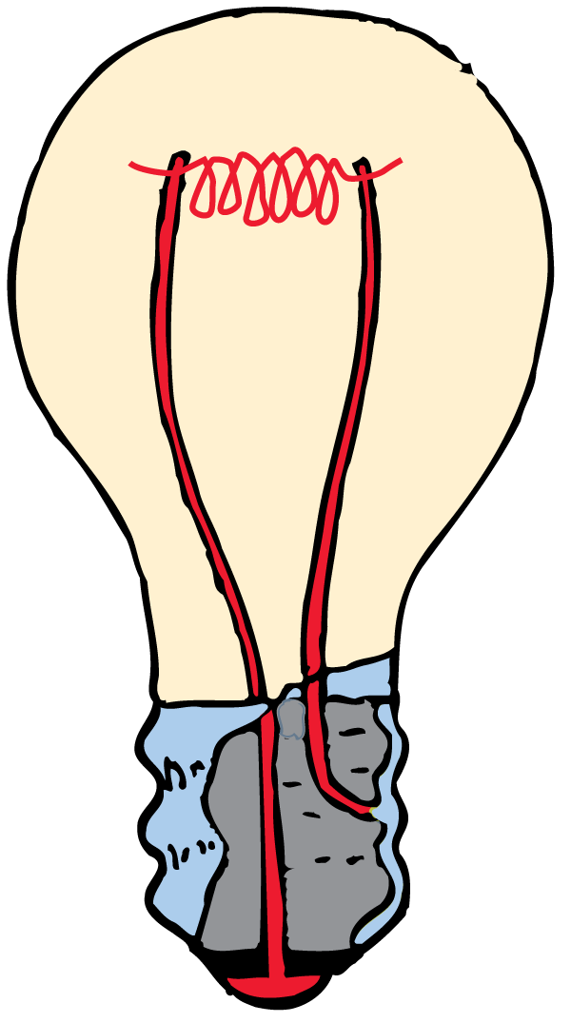
Light is the ONLY thing you see! All visible objects either emit or reflect light.

Slide 2
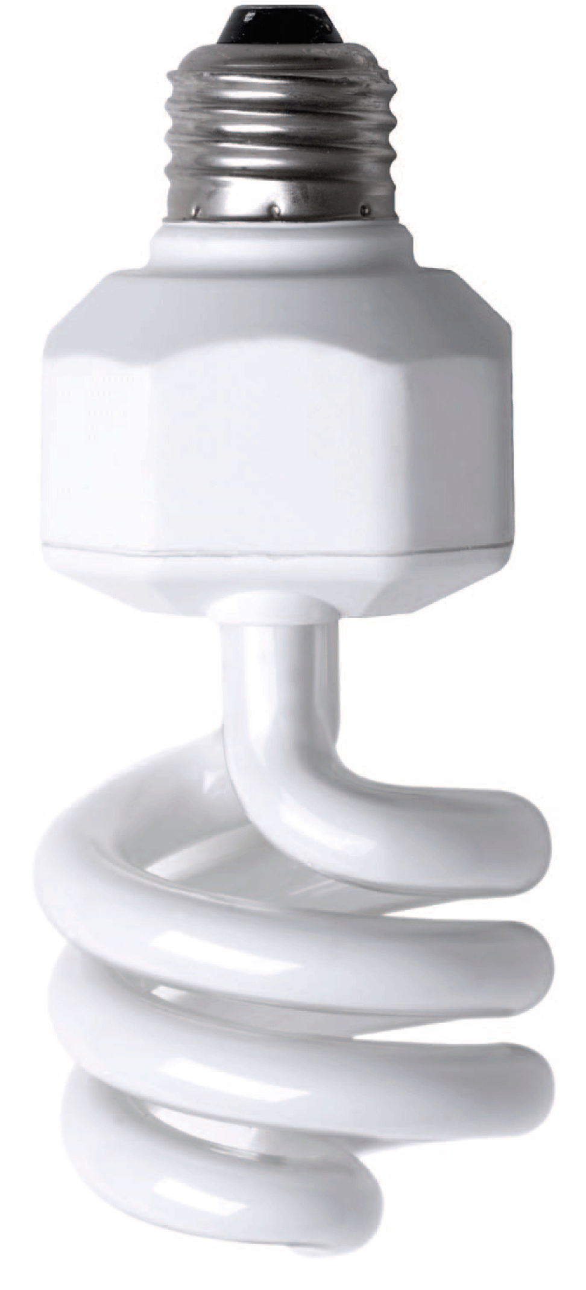
Almost everything we see is made visible by the light it reflects. Some materials, such as air, water, or window glass, allow light to pass through. Other materials, such as thin paper or frosted glass, allow the passage of light in diffused directions so that we can’t see objects through them.

Slide 3
27.1 Early Concepts of Light
Scientists now agree that light has a dual nature, part particle and part wave.

Slide 4
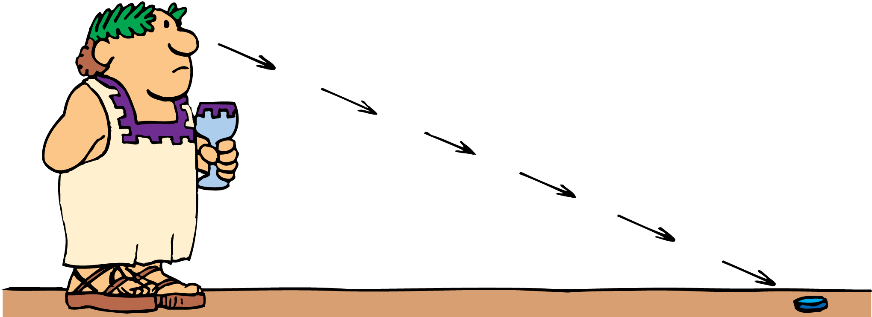
27.1 Early Concepts of Light
Light has been studied for thousands of years.
Some ancient Greek philosophers thought that light consists of tiny particles, which enter the eye to create the sensation of vision.
Others thought that vision resulted from streamers or filaments emitted by the eye making contact with an object.

Slide 5
27.1 Early Concepts of Light
Up until the time of Newton and beyond, most philosophers and scientists thought that light consisted of particles.
However, one Greek, Empedocles, thought that light traveled in waves.
One of Newton’s contemporaries, the Dutch scientist Christian Huygens, also argued that light was a wave.

Slide 6
27.1 Early Concepts of Light
The particle theory was supported by the fact that light seemed to move in straight lines instead of spreading out as waves do.
Huygens showed that under some circumstances light does spread out and other scientists found evidence to support the wave theory.
The wave theory became the accepted theory in the nineteenth century.

Slide 7
27.1 Early Concepts of Light
In 1905, Einstein published a theory explaining the photoelectric effect.
According to this theory, light consists of particles called photons, massless bundles of concentrated electromagnetic energy.
Scientists now agree that light has a dual nature, part particle and part wave.

Slide 8
27.1 Early Concepts of Light
What is the nature of light?

Slide 9
27.2 The Speed of Light
Michelson’s experimental value for the speed of light was 299,920 km/s, which is usually rounded to 300,000 km/s.

Slide 10
27.2 The Speed of Light
It was not known whether light travels instantaneously or with finite speed until the late 1600s.
Galileo tried to measure the time a light beam takes to travel to a distant mirror, but it was so short he couldn’t begin to measure it.
Others tried the experiment at longer distances with lanterns they flashed on and off between distant mountaintops. All they succeeded in doing was measuring their own reaction times.

Slide 11
27.2 The Speed of Light
Olaus Roemer
The first demonstration that light travels at a finite speed was supplied by the Danish astronomer Olaus Roemer about 1675.
Roemer carefully measured the periods of Jupiter’s moons.
The innermost moon, Io, revolves around Jupiter in 42.5 hours.
The Io disappears periodically into Jupiter’s shadow, so this period could be measured with great accuracy.

Slide 12
27.2 The Speed of Light
Roemer found that while Earth was moving away from Jupiter, the periods of Io were all somewhat longer than average.
When Earth was moving toward Jupiter, the measured periods were shorter than average.
Roemer estimated that the cumulative discrepancy amounted to about 22 minutes.

Slide 13
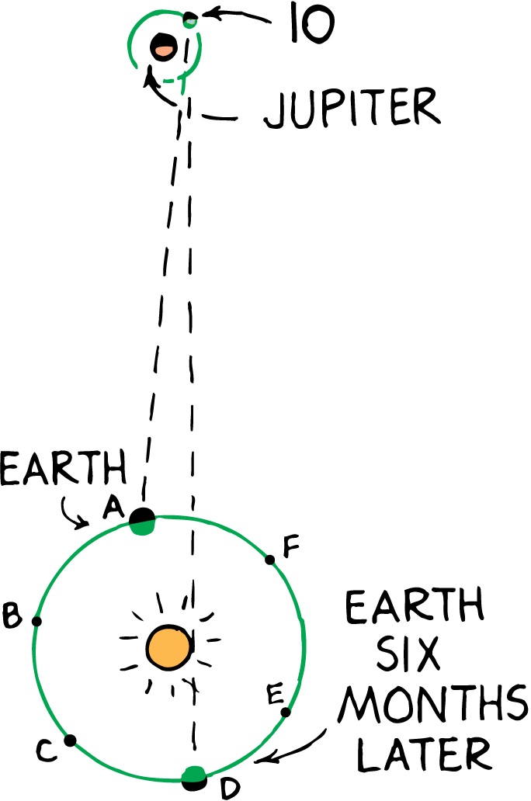
27.2 The Speed of Light
Light coming from Io takes longer to reach Earth at position D than at position A. The extra distance that the light travels divided by the extra time it takes gives the speed of light.

Slide 14
27.2 The Speed of Light
Christian Huygens
Christian Huygens correctly interpreted this discrepancy.
The Io passed into Jupiter’s shadow at the predicted time.
The light did not arrive until it had traveled the extra distance across the diameter of Earth’s orbit.
This distance is now known to be 300,000,000 km.

Slide 15
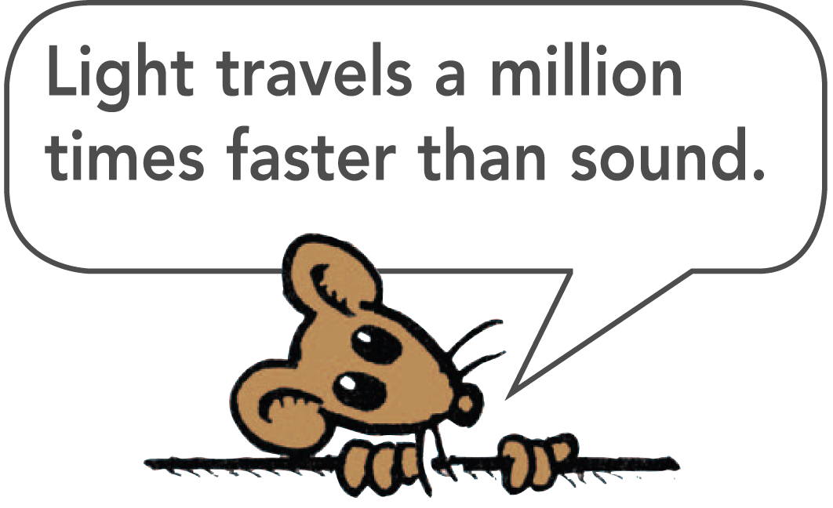
27.2 The Speed of Light
Using the travel time of 1000 s for light to move across Earth’s orbit makes the calculation of the speed of light quite simple:
The speed of light is 300,000 km/s.

Slide 16
27.2 The Speed of Light
Albert Michelson
The most famous experiment measuring the speed of light was performed by the American physicist Albert Michelson in 1880.
Light was directed by a lens to an octagonal mirror.
A beam of light was reflected to a stationary mirror on a mountain 35 km away and then reflected back.
The distance was known, so Michelson had to find only the time it took to make a round trip.

Slide 17
27.2 The Speed of Light
When the mirror was spun, short bursts of light reached the stationary mirror and were reflected back to the spinning octagonal mirror.
If the rotating mirror made one-eighth rotation while the light made the trip, the mirror reflected light to the observer.
If the mirror was rotated too slowly or too quickly, it would not be in a position to reflect light.

Slide 18
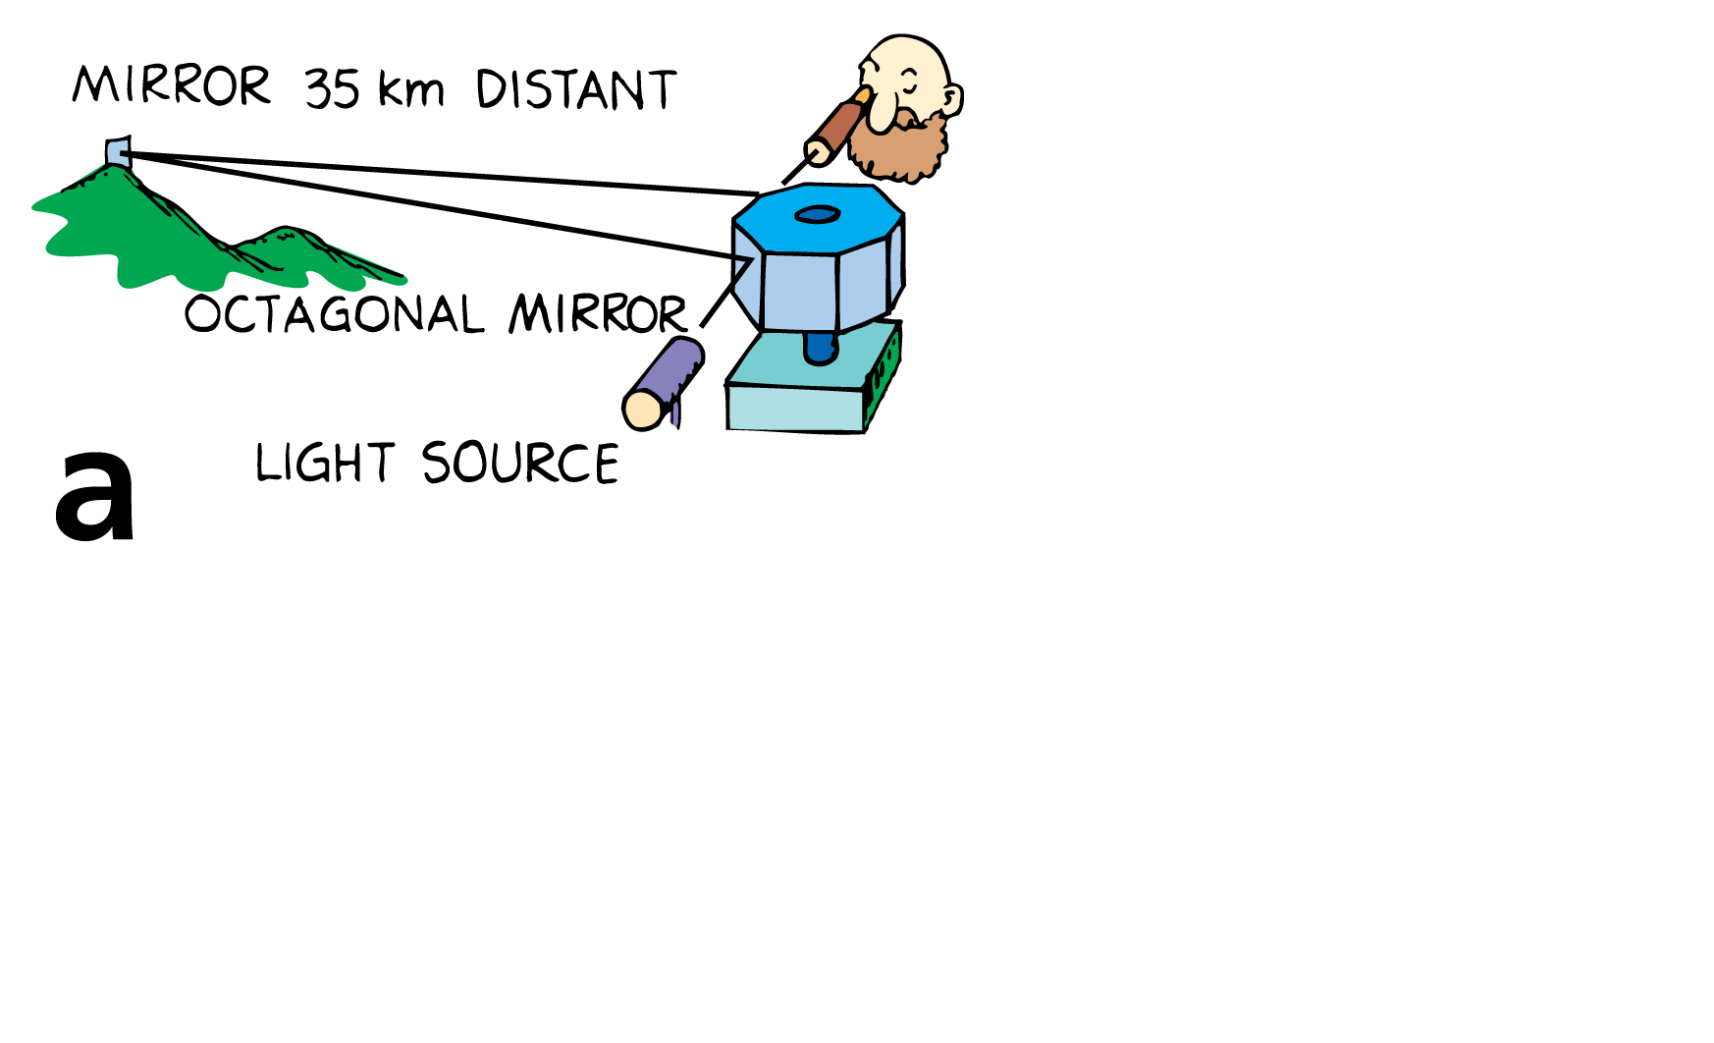
27.2 The Speed of Light
Light is reflected back to the eyepiece when the mirror is at rest.

Slide 19
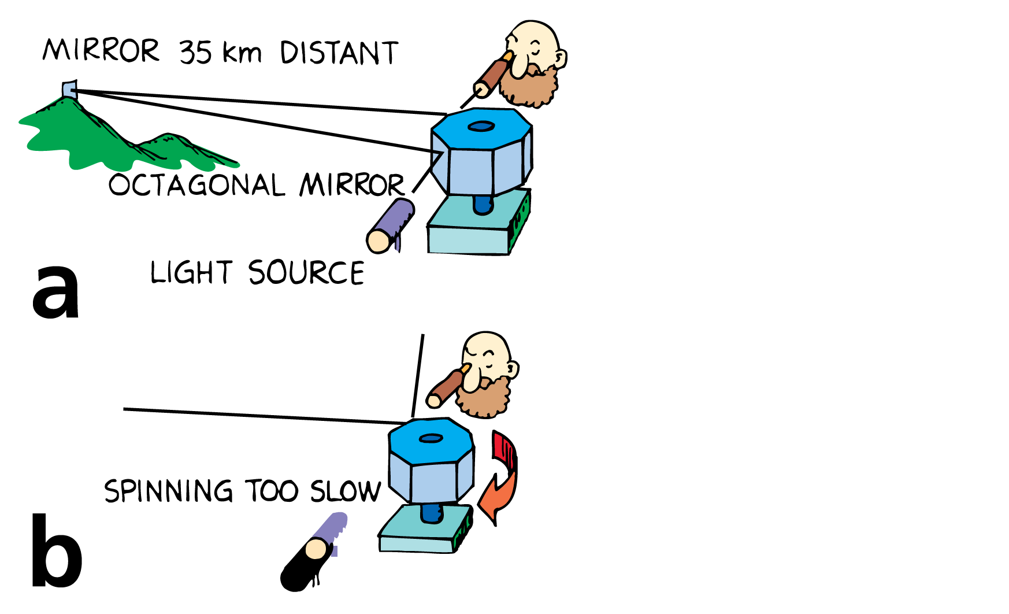
27.2 The Speed of Light
Light is reflected back to the eyepiece when the mirror is at rest.
Reflected light fails to enter the eyepiece when the mirror spins too slowly . . .

Slide 20
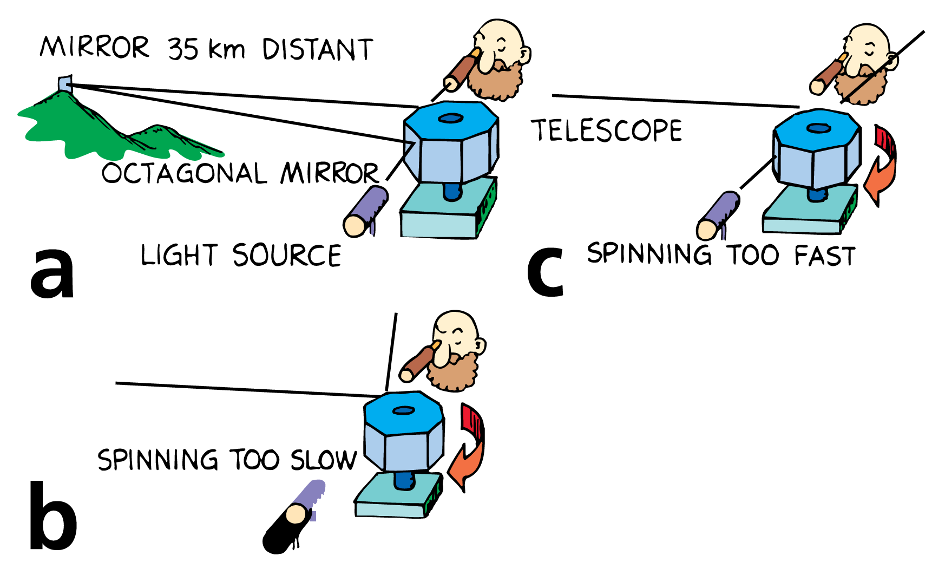
27.2 The Speed of Light
Light is reflected back to the eyepiece when the mirror is at rest.
Reflected light fails to enter the eyepiece when the mirror spins too slowly . . .
. . . or too fast.

Slide 21
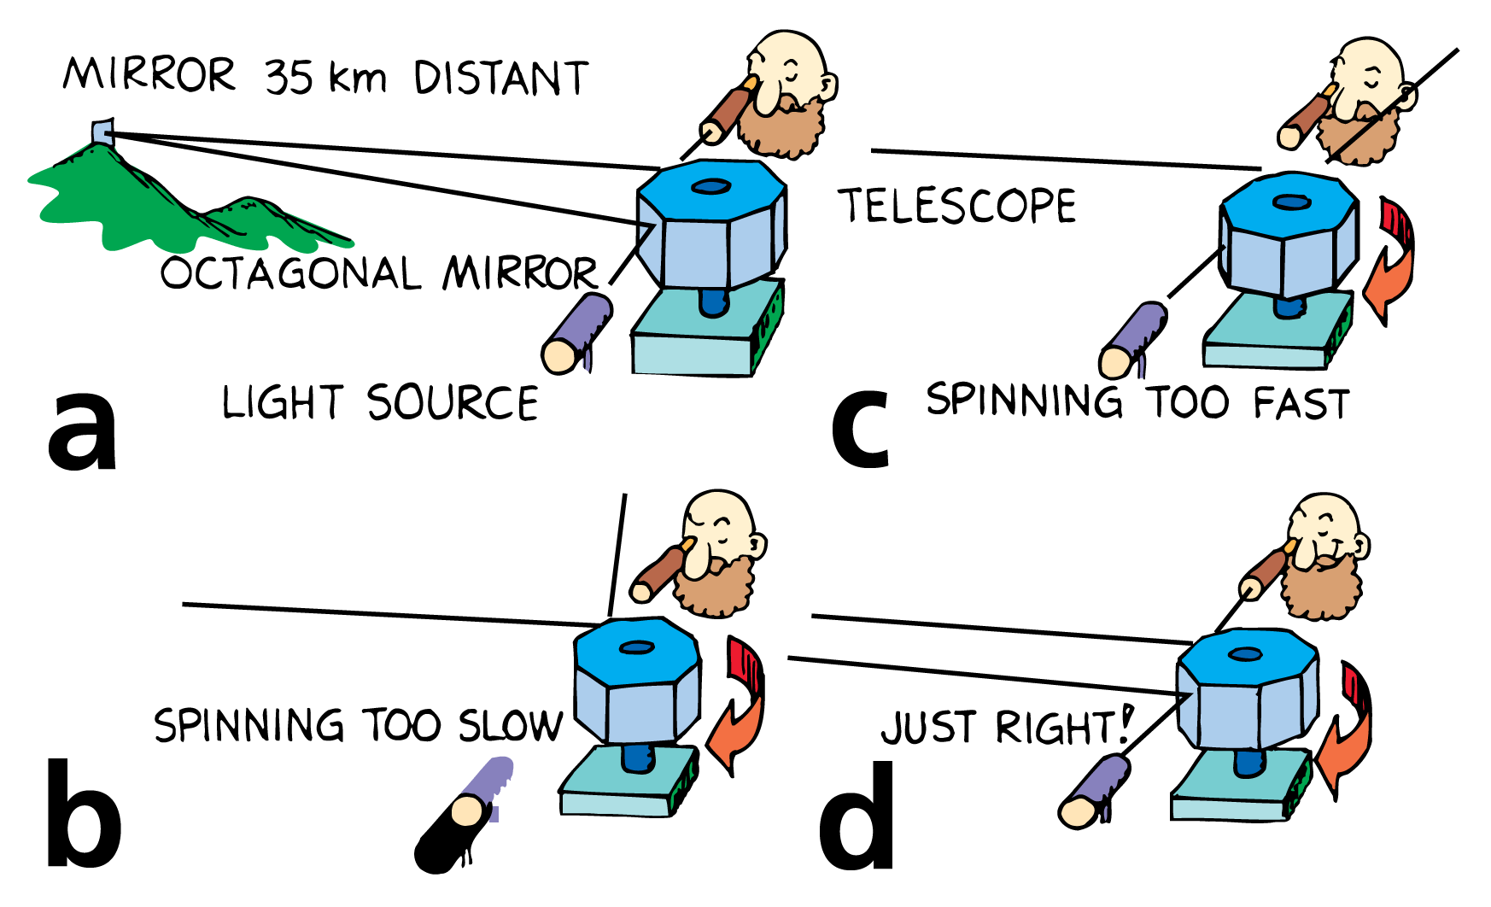
27.2 The Speed of Light
Light is reflected back to the eyepiece when the mirror is at rest.
Reflected light fails to enter the eyepiece when the mirror spins too slowly . . .
. . . or too fast.
When the mirror rotates at the correct speed, light reaches the eyepiece.

Slide 22
27.2 The Speed of Light
When the light entered the eyepiece, the time for the light to make the trip and the time for the mirror to make one eighth of a rotation were the same.
Michelson divided the 70-km round trip distance by this time and found the speed of light was 299,920 km/s, which is usually rounded to 300,000 km/s.
Michelson received the 1907 Nobel Prize in physics for this experiment.

Slide 23
27.2 The Speed of Light
The speed of light in a vacuum is a universal constant.
Light is so fast that if a beam of light could travel around Earth, it would make 7.5 trips in one second.
Light takes 8 minutes to travel from the sun to Earth and 4 years from the next nearest star, Alpha Centauri.
The distance light travels in one year is called a light-year.

Slide 24
27.2 The Speed of Light
think!
Light entered the eyepiece when Michelson’s octagonal mirror made exactly one eighth of a rotation during the time light traveled to the distant mountain and back. Would light enter the eyepiece if the mirror turned one quarter of a rotation in this time?

Slide 25
27.2 The Speed of Light
think!
Light entered the eyepiece when Michelson’s octagonal mirror made exactly one eighth of a rotation during the time light traveled to the distant mountain and back. Would light enter the eyepiece if the mirror turned one quarter of a rotation in this time?
Answer:
Yes, light would enter the eyepiece whenever the octagonal mirror turned in multiples of 1/8 rotation— ¼, ½, 1, etc.—in the time the light made its round trip.

Slide 26
27.2 The Speed of Light
What was Michelson’s experimental value for the speed of light?

Slide 27
27.3 Electromagnetic Waves
The electromagnetic spectrum consists of radio waves, microwaves, infrared, light, ultraviolet rays, X-rays, and gamma rays.

Slide 28
27.3 Electromagnetic Waves
Light is energy that is emitted by accelerating electric charges—often electrons in atoms.
This energy travels in a wave that is partly electric and partly magnetic. Such a wave is an electromagnetic wave.

Slide 29
27.3 Electromagnetic Waves
Light is a portion of the family of electromagnetic waves that includes radio waves, microwaves, and X-rays.
The range of electromagnetic waves is called the electromagnetic spectrum.

Slide 30
27.3 Electromagnetic Waves
The lowest frequency of light we can see appears red. The highest visible light, violet, has nearly twice the frequency of red light.
Electromagnetic waves of frequencies lower than the red of visible light are called infrared. Heat lamps give off infrared waves.
Electromagnetic waves of frequencies higher than those of violet are called ultraviolet. They are responsible for sunburns.

Slide 31
27.3 Electromagnetic Waves
What are the waves of the electromagnetic spectrum?

Slide 32
27.4 Light and Transparent Materials
Light passes through materials whose atoms absorb the energy and immediately reemit it as light.

Slide 33
27.4 Light and Transparent Materials
Light is energy carried in an electromagnetic wave, generated by vibrating electric charges.
When light strikes matter, electrons in the matter are forced into vibration.

Slide 34
27.4 Light and Transparent Materials
Just as a sound wave can force a sound receiver into vibration, a light wave can force charged particles in materials into vibration.

Slide 35
27.4 Light and Transparent Materials
Exactly how a material responds to light depends on the frequency of light and the natural frequency of electrons in the material.
Visible light vibrates at a very high rate, more than 100 trillion times per second (10¹⁴ hertz).
To respond to these ultrafast vibrations, a particle must have very little inertia. Electrons, with their small mass, can vibrate this fast.

Slide 36
27.4 Light and Transparent Materials
Materials that transmit light are transparent. Glass and water are transparent.
Materials that are springy (elastic) respond more to vibrations at some frequencies than at others.
The natural vibration frequencies of an electron depend on how strongly it is attached to a nearby nucleus.

Slide 37
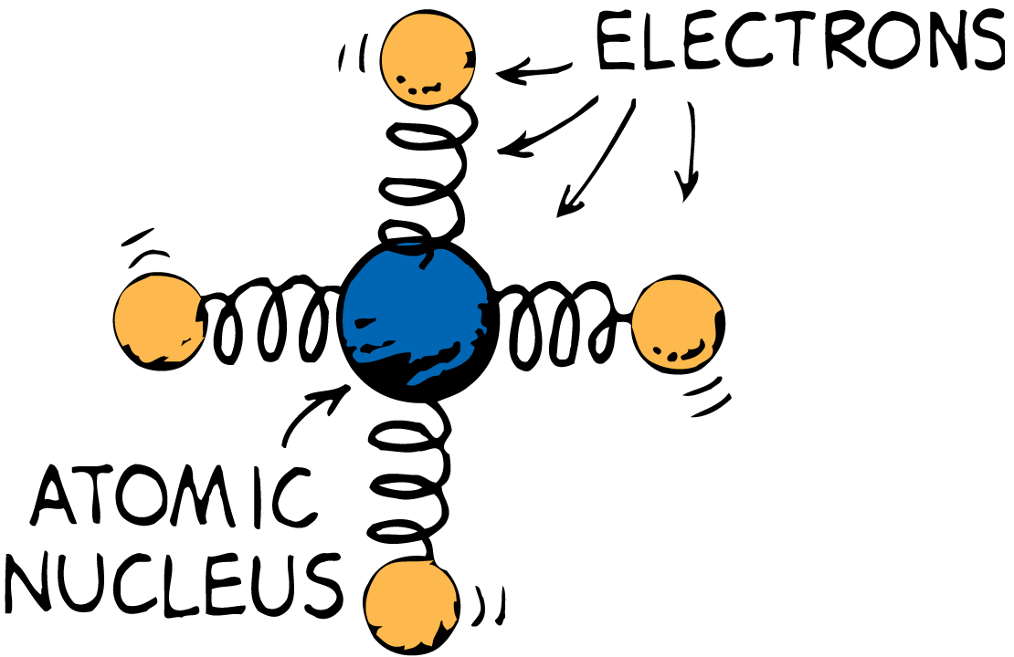
27.4 Light and Transparent Materials
The electrons of atoms in glass can be imagined to be bound to the atomic nucleus as if connected by springs.

Slide 38
27.4 Light and Transparent Materials
Electrons in glass have a natural vibration frequency in the ultraviolet range.
In ultraviolet light, resonance occurs as the wave builds a large vibration between the electron and the nucleus.
The energy received by the atom can be either passed on to neighboring atoms by collisions or reemitted as light.
If ultraviolet light interacts with an atom that has the same natural frequency, the vibration amplitude is unusually large.

Slide 39
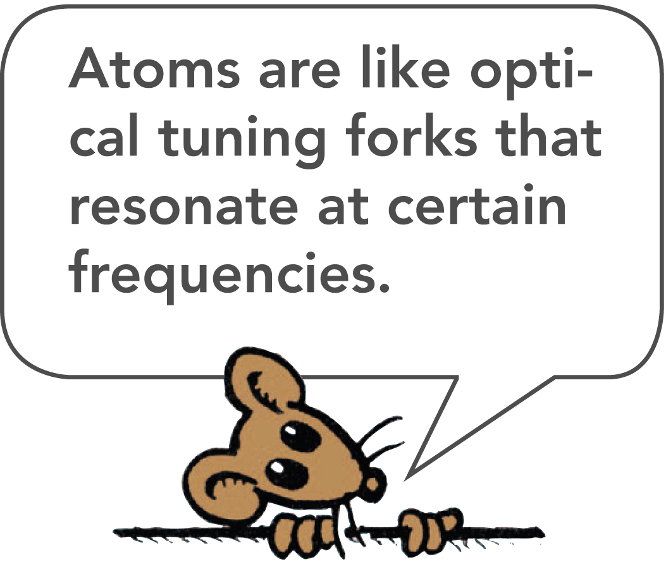
27.4 Light and Transparent Materials
The atom typically holds on to this energy for about 1 million vibrations or 100 millionths of a second.
During this time, the atom makes many collisions with other atoms and gives up its energy in the form of heat.
That’s why glass is not transparent to ultraviolet.

Slide 40
27.4 Light and Transparent Materials
When the electromagnetic wave has a lower frequency than ultraviolet, as visible light does, the electrons are forced into vibration with smaller amplitudes.
The atom holds the energy for less time, with less chance of collision with neighboring atoms.
Less energy is transferred as heat.
The energy of the vibrating electrons is reemitted as transmitted light.

Slide 41
27.4 Light and Transparent Materials
Glass is transparent to all the frequencies of visible light.
The frequency of the reemitted light is identical to that of the light that produced the vibration to begin with.
The main difference is a slight time delay between absorption and reemission.
This time delay results in a lower average speed of light through a transparent material.

Slide 42
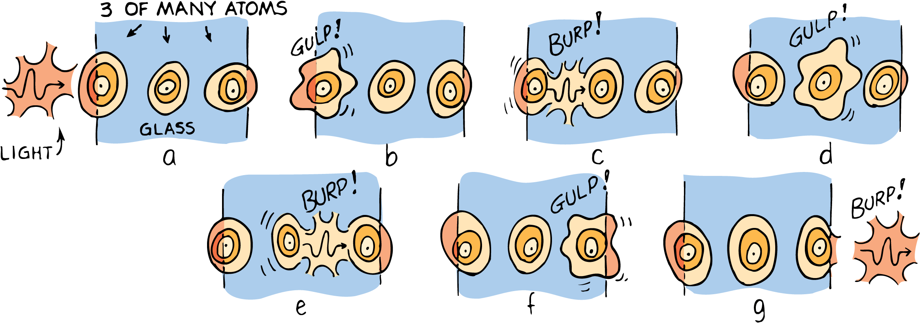
27.4 Light and Transparent Materials
A light wave incident upon a pane of glass sets up vibrations in the atoms. Because of the time delay between absorptions and reemissions, the average speed of light in glass is less than c.

Slide 43
27.4 Light and Transparent Materials
In a vacuum, the speed of light is a constant 300,000 km/s; we call this speed of light c.
Light travels slightly less than c in the atmosphere, but the speed is usually rounded to c.
In water, light travels at 75% of its speed in a vacuum, 0.75c.
In glass, light travels at about 0.67c, depending on glass type.
In a diamond, light travels at only 0.40c.
When light emerges from these materials into the air, it travels at its original speed, c.

Slide 44
27.4 Light and Transparent Materials
Infrared waves, with frequencies lower than visible light, vibrate not only the electrons, but also the entire structure of the glass.
This vibration of the structure increases the internal energy of the glass and makes it warmer.
Glass is transparent to visible light, but not to ultraviolet and infrared light.

Slide 45
27.4 Light and Transparent Materials
What kind of materials does light pass through?

Slide 46
27.5 Opaque Materials
In opaque materials, any coordinated vibrations given by light to the atoms and molecules are turned into random kinetic energy—that is, into internal energy.

Slide 47
27.5 Opaque Materials
Materials that absorb light without reemission and thus allow no light through them are opaque.
Wood, stone, and people are opaque.
In opaque materials, any vibrations from light are turned into random kinetic energy—that is, into internal energy.
The materials become slightly warmer.

Slide 48
27.5 Opaque Materials
Metals are also opaque.
In metals, the outer electrons of atoms are not bound to any particular atom.
When light shines on metal and sets these free electrons into vibration, their energy does not “spring” from atom to atom.
It is reemitted as visible light. This reemitted light is seen as a reflection. That’s why metals are shiny.

Slide 49
27.5 Opaque Materials
Our atmosphere is transparent to visible light and some infrared, but almost opaque to high-frequency ultraviolet waves.
The ultraviolet that gets through is responsible for sunburns.
Clouds are semitransparent to ultraviolet, so you can get a sunburn on a cloudy day.
Ultraviolet also reflects from sand and water, so you can sometimes get a sunburn while in the shade of a beach umbrella.

Slide 50
27.5 Opaque Materials
think!
Why is glass transparent to visible light but opaque to ultraviolet and infrared?

Slide 51
27.5 Opaque Materials
think!
Why is glass transparent to visible light but opaque to ultraviolet and infrared?
Answer:
The natural frequency of vibration for electrons in glass matches the frequency of ultraviolet light, so resonance in the glass occurs when ultraviolet waves shine on it. These vibrations generate heat instead of wave reemission, so the glass is opaque to ultraviolet. In the range of visible light, the forced vibrations of electrons in the glass result in reemission of light, so the glass is transparent. Lower-frequency infrared causes entire atomic structures to resonate so heat is generated, and the glass is opaque.

Slide 52
27.5 Opaque Materials
Why does light not pass through opaque materials?

Slide 53
27.6 Shadows
When light shines on an object, some of the rays may be stopped while others pass on in a straight-line path.

Slide 54
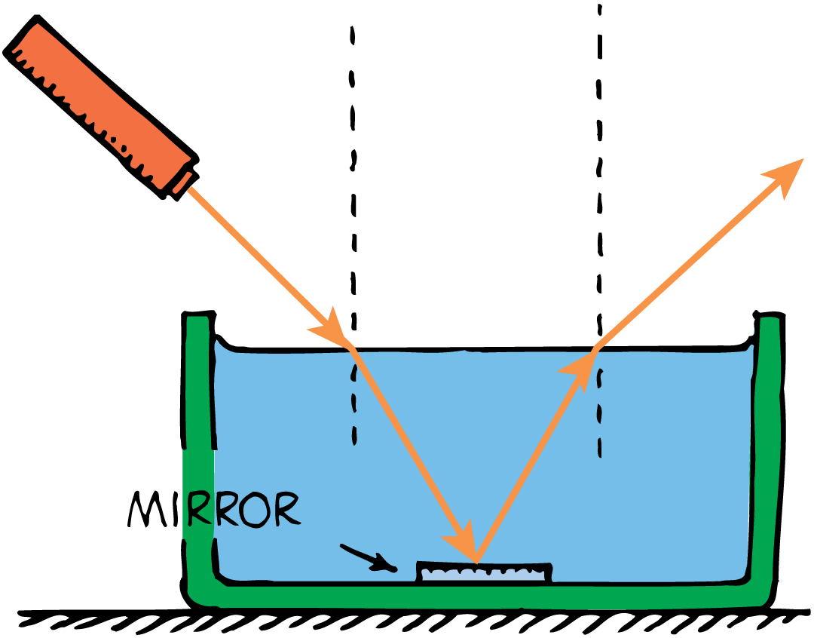
27.6 Shadows
A thin beam of light is often called a ray.
Any beam of light—no matter how wide—can be thought of as made of a bundle of rays.
A shadow is formed where light rays cannot reach.

Slide 55
27.6 Shadows
Sharp shadows are produced by a small light source nearby or by a larger source farther away.
However, most shadows are somewhat blurry, with a dark part on the inside and a lighter part around the edges.
A total shadow is called an umbra.
A partial shadow is called a penumbra. A penumbra appears where some of the light is blocked but where other light fills in.

Slide 56
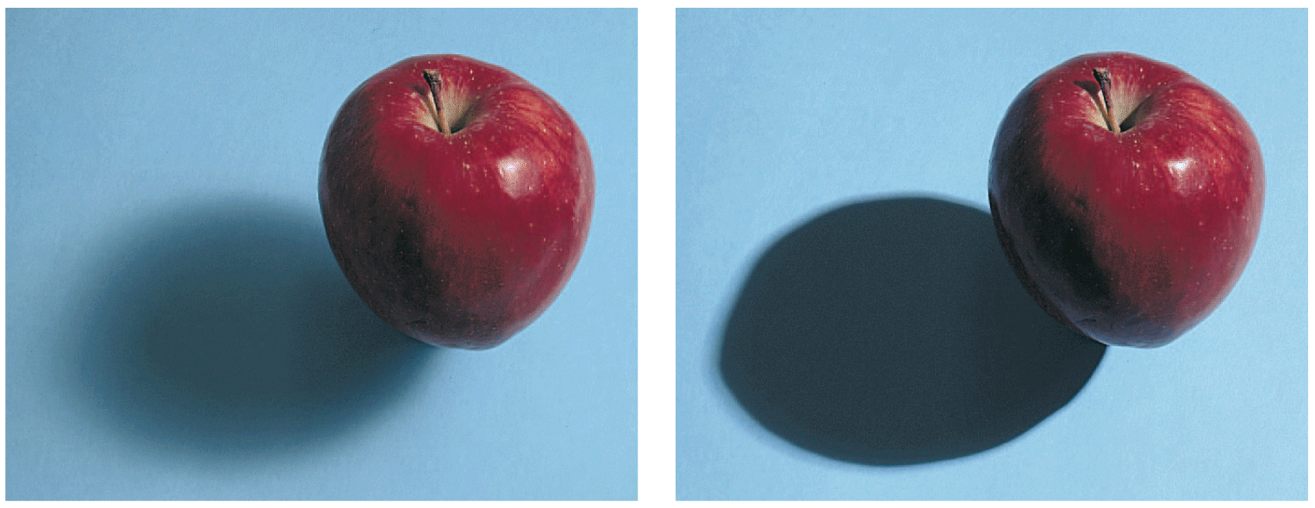
27.6 Shadows
A large light source produces a softer shadow than a smaller source.

Slide 57
27.6 Shadows
An object held close to a wall casts a sharp shadow.

Slide 58
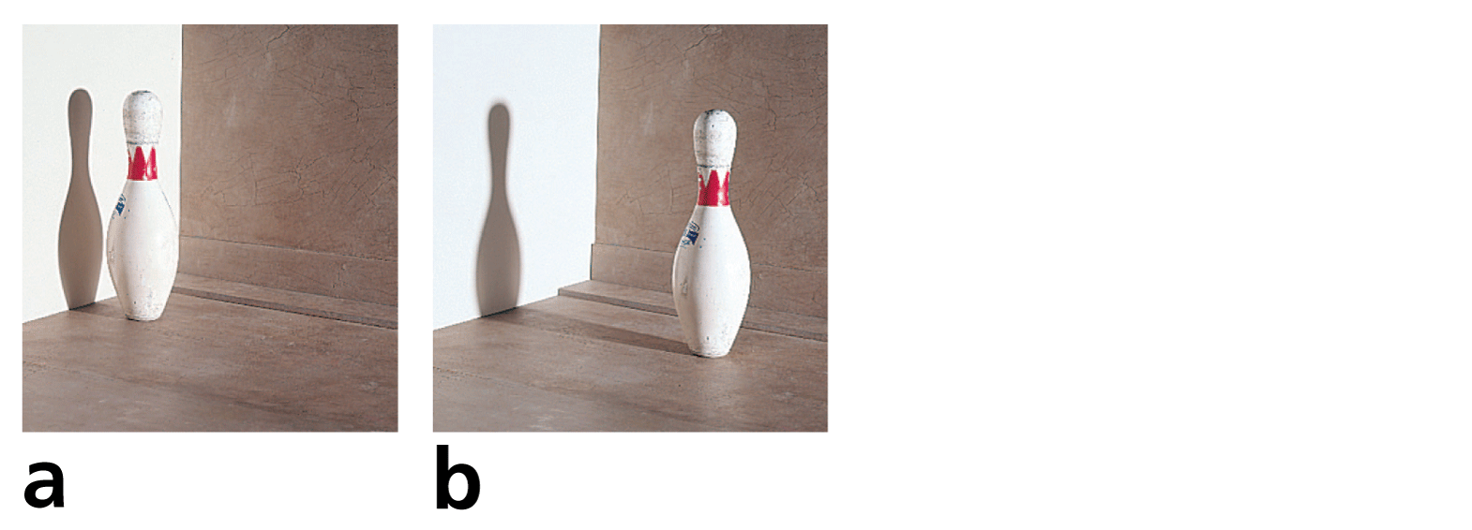
27.6 Shadows
An object held close to a wall casts a sharp shadow.
As the object is moved farther away, penumbras are formed and cut down on the umbra.

Slide 59
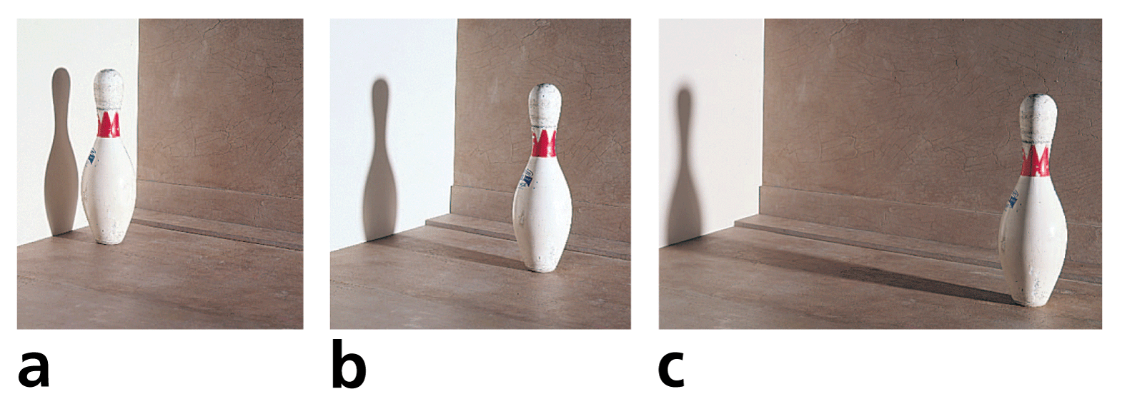
27.6 Shadows
An object held close to a wall casts a sharp shadow.
As the object is moved farther away, penumbras are formed and cut down on the umbra.
When it is very far away, all the penumbras mix together into a big blur.

Slide 60
27.6 Shadows
A penumbra occurs when the moon passes between Earth and the sun—during a solar eclipse.
The moon’s shadow barely reaches Earth.
If you stand in the umbra shadow, you experience brief darkness during the day.
If you stand in the penumbra, you experience a partial eclipse. The sunlight is dimmed, and the sun appears as a crescent.

Slide 61
27.6 Shadows
Earth, like most objects in sunlight, casts a shadow.
This shadow extends into space, and sometimes the moon passes into it. When this happens, we have a lunar eclipse.
A lunar eclipse can be seen by all observers on the nighttime half of Earth.

Slide 62
27.6 Shadows
Shadows also occur when light is bent in passing through a transparent material such as water.
Light travels at slightly different speeds in warm and in cold water.
The change in speed causes light to bend, just as layers of warm and cool air in the night sky bend starlight and cause twinkling.
Some light gets deflected a bit and leaves darker places on the wall. The shapes of the shadows depend on how the light is bent.

Slide 63
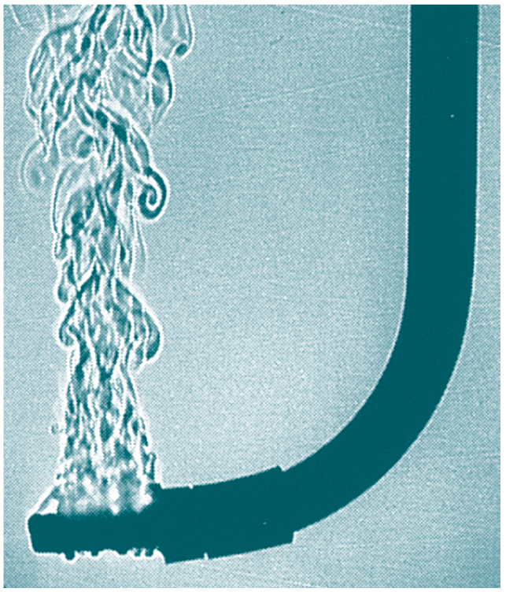
27.6 Shadows
A heater at the tip of this submerged J-tube produces convection currents in the water. They are revealed by shadows cast by light that is deflected differently by the water of different temperatures.

Slide 64
27.6 Shadows
think!
Why are lunar eclipses more commonly seen than solar eclipses?

Slide 65
27.6 Shadows
think!
Why are lunar eclipses more commonly seen than solar eclipses?
Answer:
There are usually two of each every year. However, the shadow of the moon on Earth is very small compared with the shadow of Earth on the moon. Only a relatively few people are in the shadow of the moon (solar eclipse), while everybody who views the nighttime sky can see the shadow of Earth on the moon (lunar eclipse).

Slide 66
27.6 Shadows
What causes the formation of shadows?

Slide 67
27.7 Polarization
Light that reflects at glancing angles from nonmetallic surfaces, such as glass, water, or roads, vibrates mainly in the plane of the reflecting surface.

Slide 68
27.7 Polarization
Light travels in waves. The fact that the waves are transverse—and not longitudinal—is demonstrated by the phenomenon of polarization.
If you shake the end of a horizontal rope, a transverse wave travels along the rope.
The vibrations are back and forth in one direction.
The wave is said to be polarized.

Slide 69
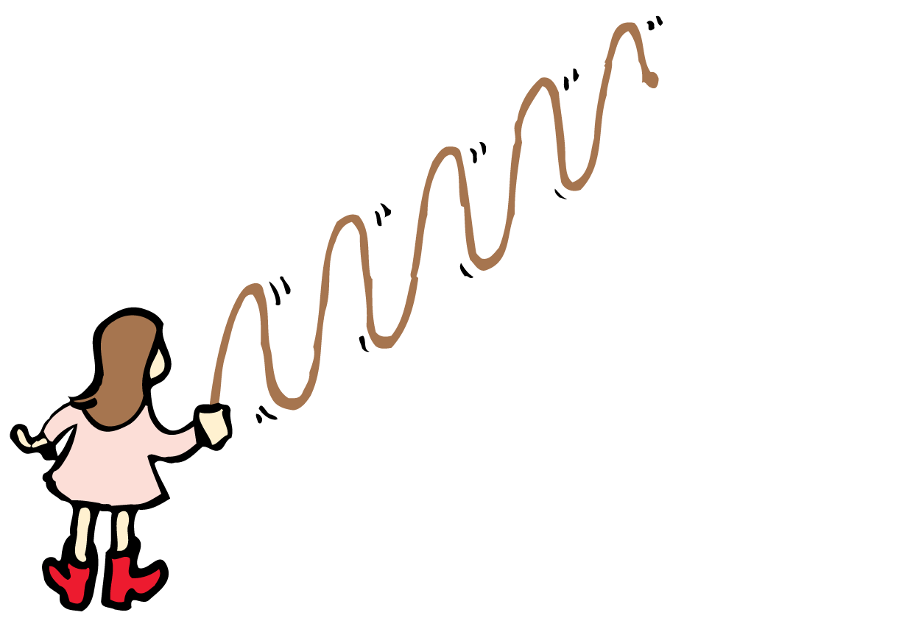
27.7 Polarization
If the rope is shaken up and down, a vertically polarized wave is produced.
The waves traveling along the rope are confined to a vertical plane.

Slide 70
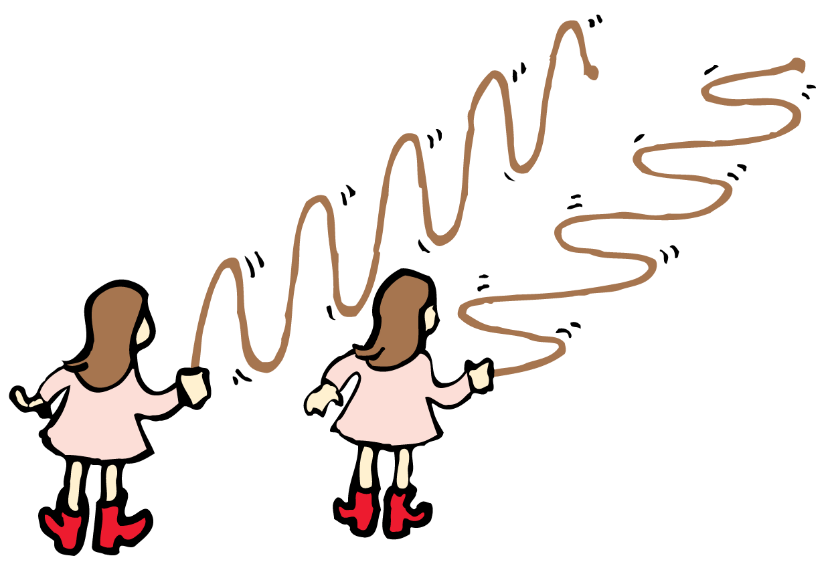
27.7 Polarization
If the rope is shaken up and down, a vertically polarized wave is produced.
The waves traveling along the rope are confined to a vertical plane.
If the rope is shaken from side to side, a horizontally polarized wave is produced.

Slide 71
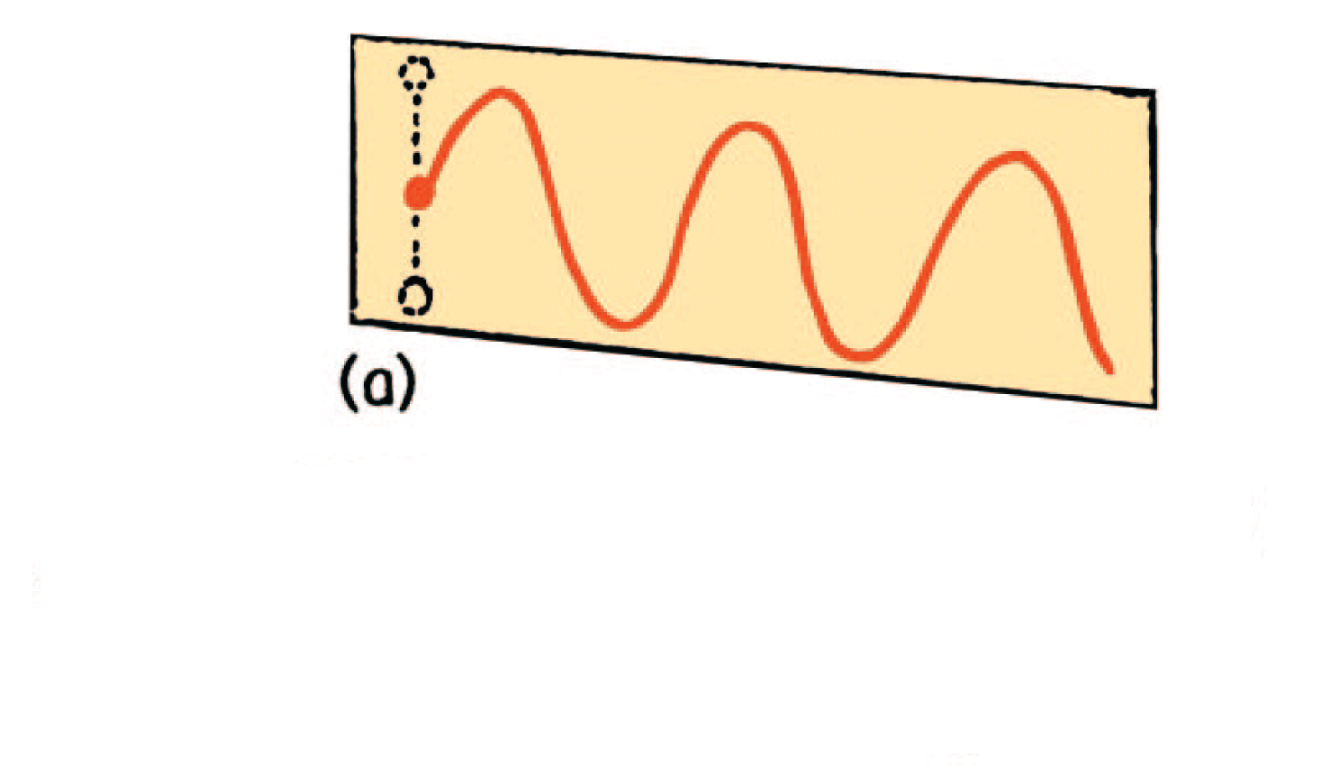
27.7 Polarization
A vibrating electron emits a polarized electromagnetic wave.
A vertically vibrating electron emits vertically polarized light.

Slide 72
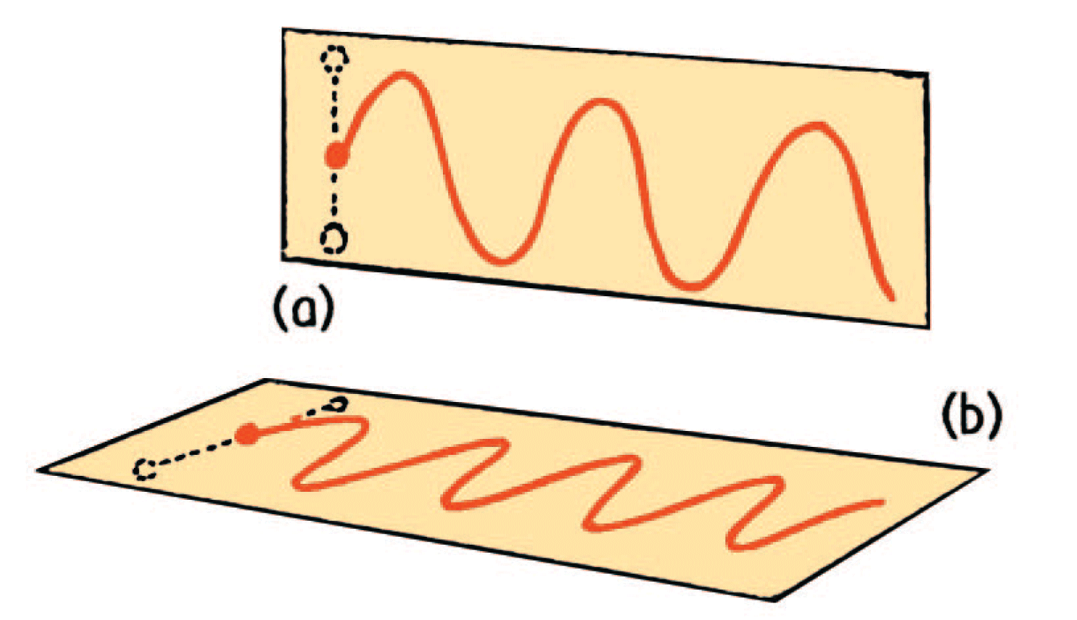
27.7 Polarization
A vibrating electron emits a polarized electromagnetic wave.
A vertically vibrating electron emits vertically polarized light.
A horizontally vibrating electron emits horizontally polarized light.

Slide 73
27.7 Polarization
An incandescent or fluorescent lamp, a candle flame, or the sun all emit light that is not polarized.
The electrons that produce the light vibrate in random directions.

Slide 74
27.7 Polarization
When light shines on a polarizing filter, the light that is transmitted is polarized.
The filter is said to have a polarization axis that is in the direction of the vibrations of the polarized light wave.
Light passes through two polarizing filters when the polarization axes are aligned but not when they are crossed at right angles.

Slide 75
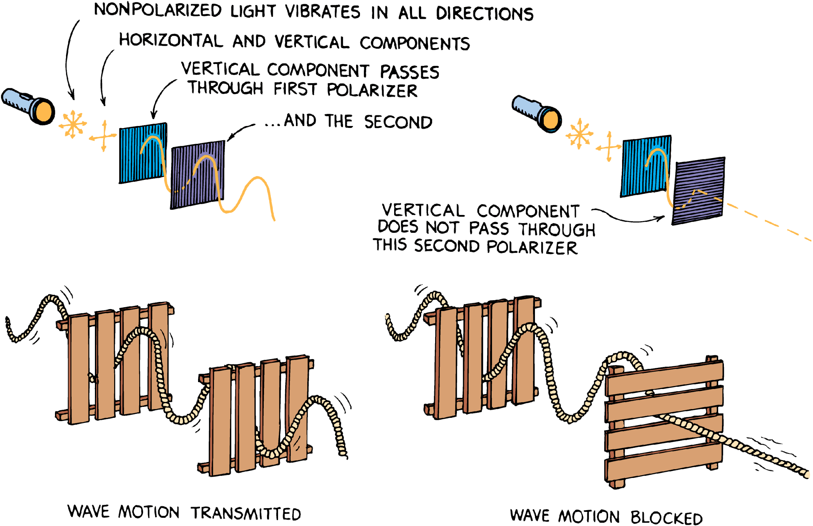
27.7 Polarization
A rope analogy illustrates the effect of crossed sheets of polarizing material.

Slide 76
27.7 Polarization
Try skipping flat stones across the surface of a pond.
Stones with flat sides parallel to the water bounce (“reflect”).
Stones with flat sides at right angles to the surface penetrate the water (“refract”).
Light behaves similarly. The flat side of a stone is like the plane of vibration of polarized light.
Light reflecting from nonmetallic surfaces, such as glass, water, or roads, vibrates mainly in the plane of the reflecting surface.

Slide 77
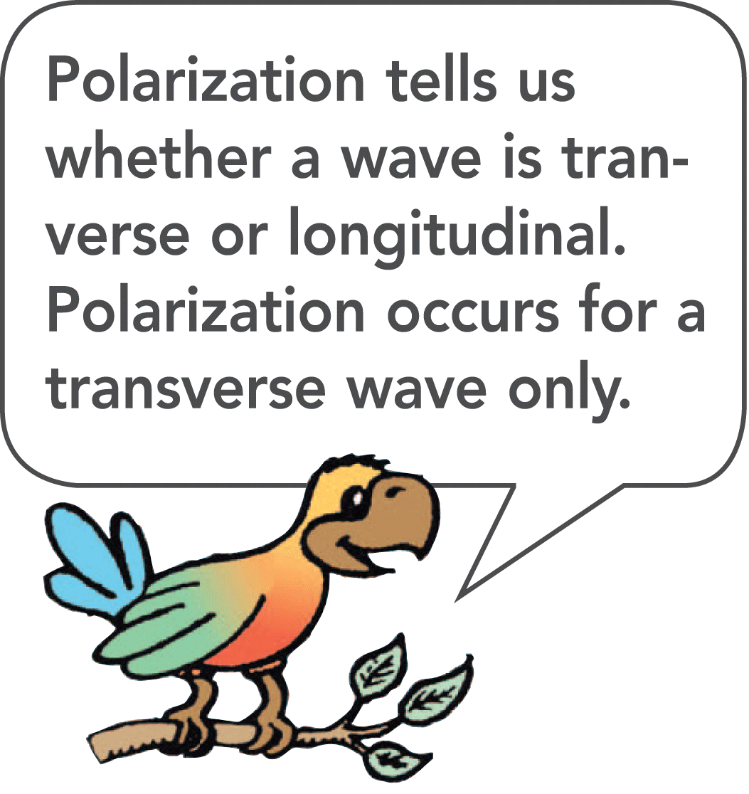
27.7 Polarization
So glare from a horizontal surface is horizontally polarized.
The axes of polarized sunglasses are vertical so that glare from horizontal surfaces is eliminated.

Slide 78
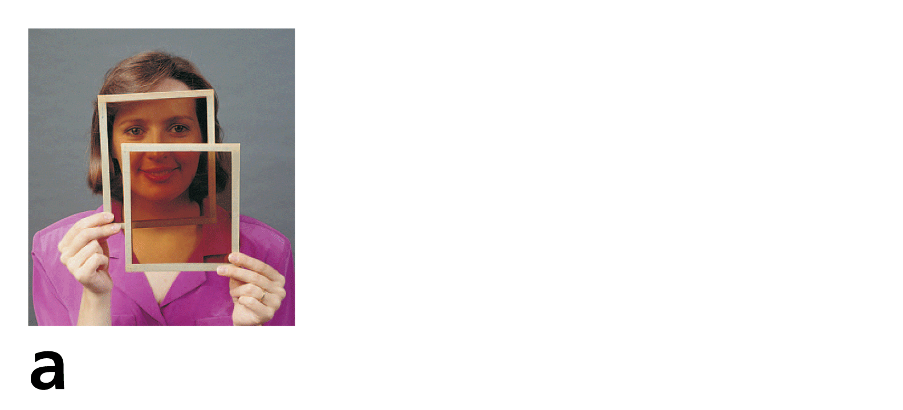
27.7 Polarization
Light is transmitted when the axes of the polarizing filters are aligned.

Slide 79
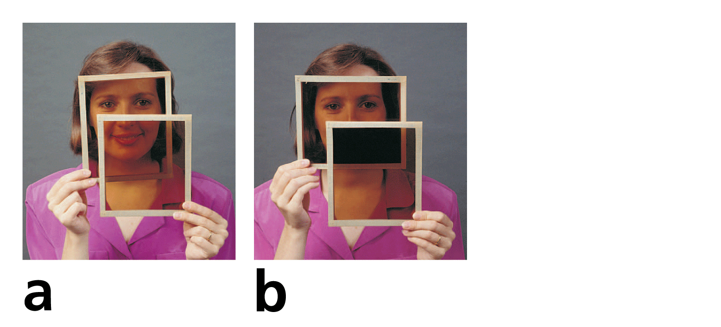
27.7 Polarization
Light is transmitted when the axes of the polarizing filters are aligned.
Light is absorbed when they are at right angles to each other.

Slide 80
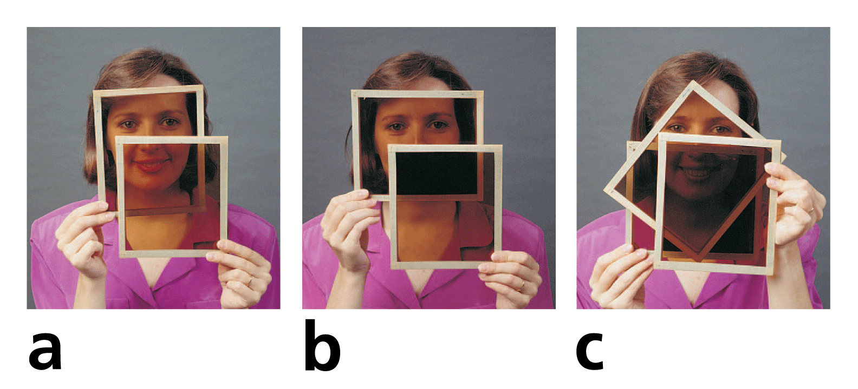
27.7 Polarization
Light is transmitted when the axes of the polarizing filters are aligned.
Light is absorbed when they are at right angles to each other.
Surprisingly, when a third filter is sandwiched between the two crossed ones, light is transmitted. (The explanation involves vectors!)

Slide 81
27.7 Polarization
Why is glare from a horizontal surface horizontally polarized?

Slide 82
27.8 Polarized Light and 3-D Viewing
A pair of photographs or movie frames, taken a short distance apart (about average eye spacing), can be seen in 3-D when the left eye sees only the left view and the right eye sees only the right view.

Slide 83
27.8 Polarized Light and 3-D Viewing
Vision in three dimensions depends on both eyes giving impressions simultaneously from slightly different angles.
The combination of views in the eye-brain system gives depth.
A pair of photographs taken a short distance apart is seen in 3-D when the left eye sees only the left view and the right eye sees only the right view.

Slide 84
27.8 Polarized Light and 3-D Viewing
Slide shows or movies can project a pair of views through polarization filters onto a screen with their polarization axes at right angles to each other.
The overlapping pictures look blurry to the naked eye.
To see in 3-D, the viewer wears polarizing eyeglasses with the lens axes also at right angles.
Each eye sees a separate picture. The brain interprets the two pictures as a single picture with a feeling of depth.

Slide 85
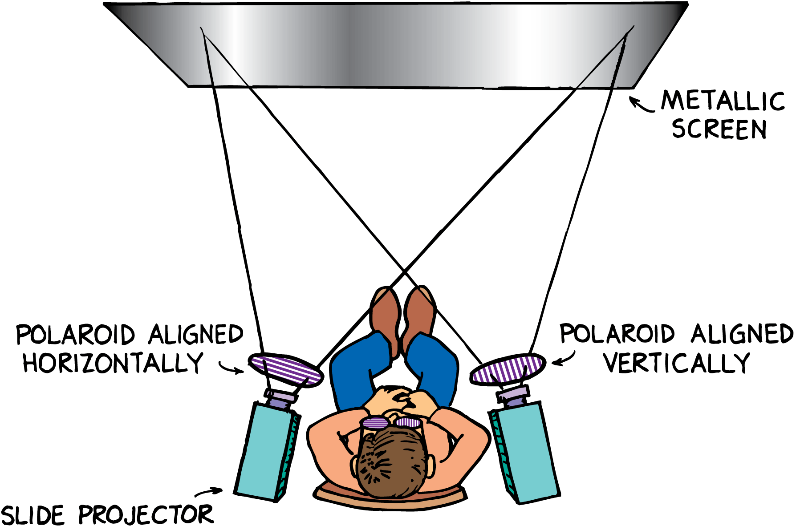
27.8 Polarized Light and 3-D Viewing
A 3-D slide show uses polarizing filters. The left eye sees only polarized light from the left projector; the right eye sees only polarized light from the right projector.

Slide 86
27.8 Polarized Light and 3-D Viewing
Depth is also seen in computer-generated stereograms.
In computer-generated stereograms, the slightly different patterns are hidden from a casual view. In your book, you can view the message of Figure 27.20 with the procedure for viewing Figure 27.18. Once you’ve mastered the viewing technique, head for the local mall and check the variety of stereograms in posters and books.

Slide 87
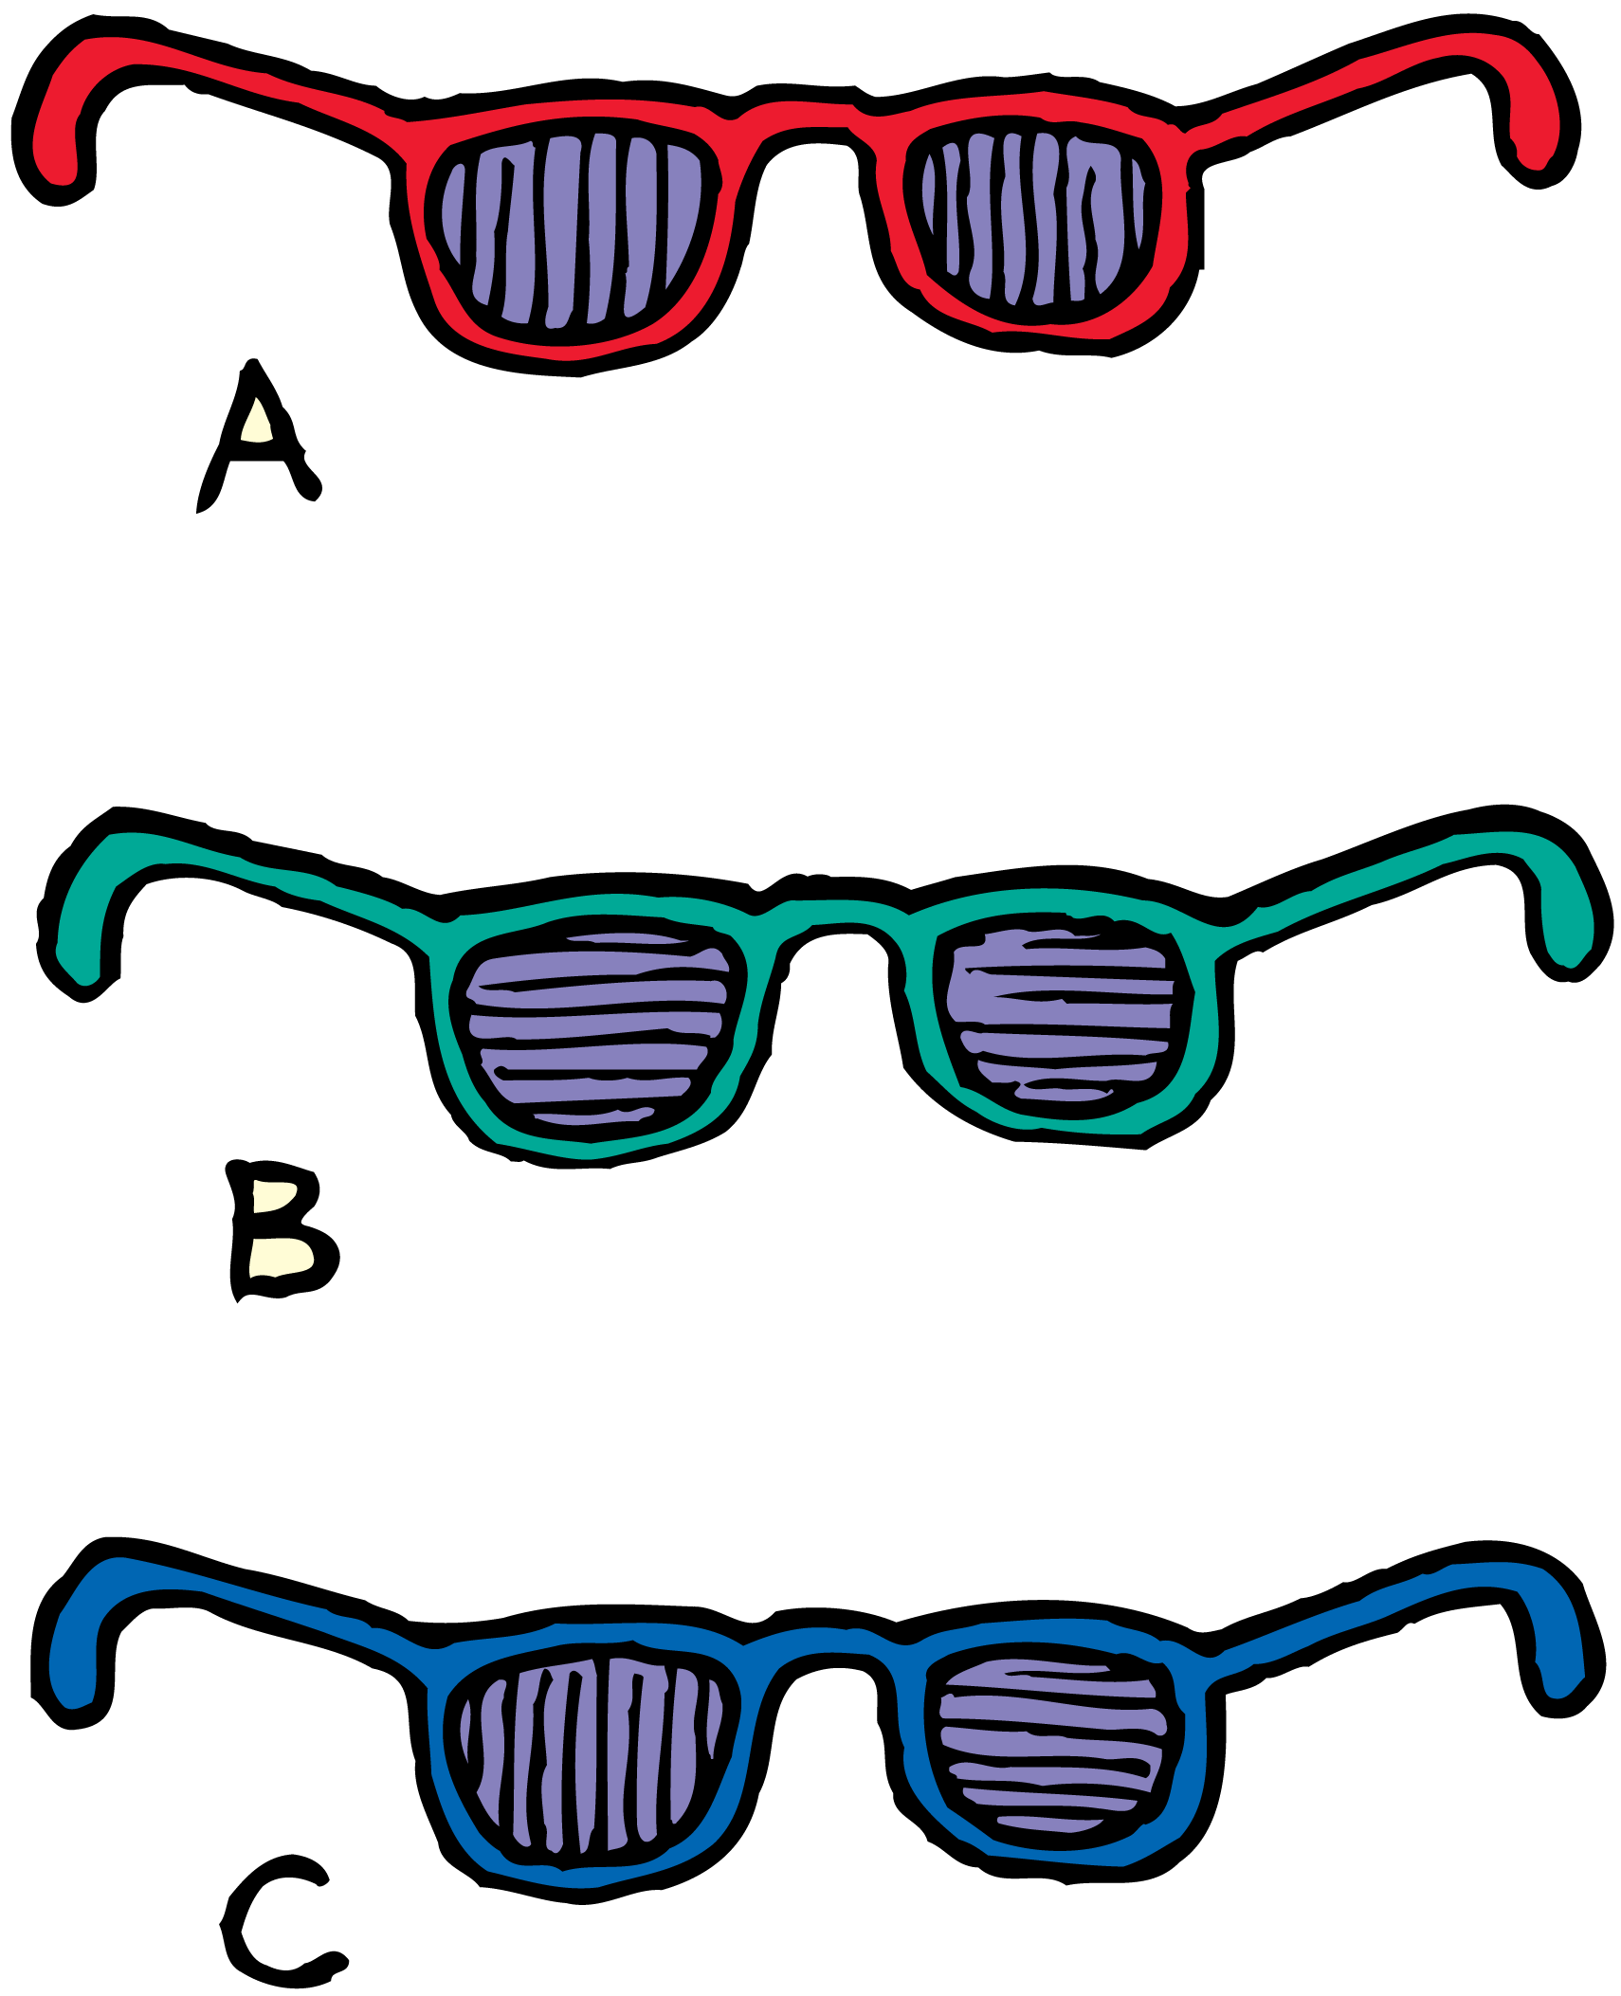
27.8 Polarized Light and 3-D Viewing
think!
Which pair of glasses is best suited for automobile drivers? (The polarization axes are shown by the straight lines.)

Slide 88
27.8 Polarized Light and 3-D Viewing
think!
Which pair of glasses is best suited for automobile drivers? (The polarization axes are shown by the straight lines.)
Answer:
Pair A is best suited because the vertical axes block horizontally polarized light that composes much of the glare from horizontal surfaces. (Pair C is suited for viewing 3-D movies.)

Slide 89
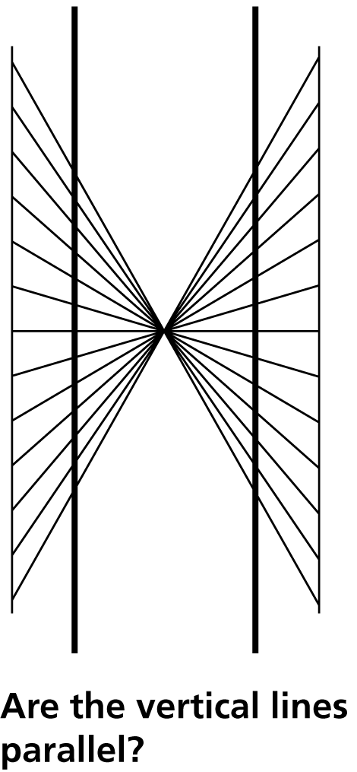
27.8 Polarized Light and 3-D Viewing
Try these optical illusions.

Slide 90
27.8 Polarized Light and 3-D Viewing

Slide 91
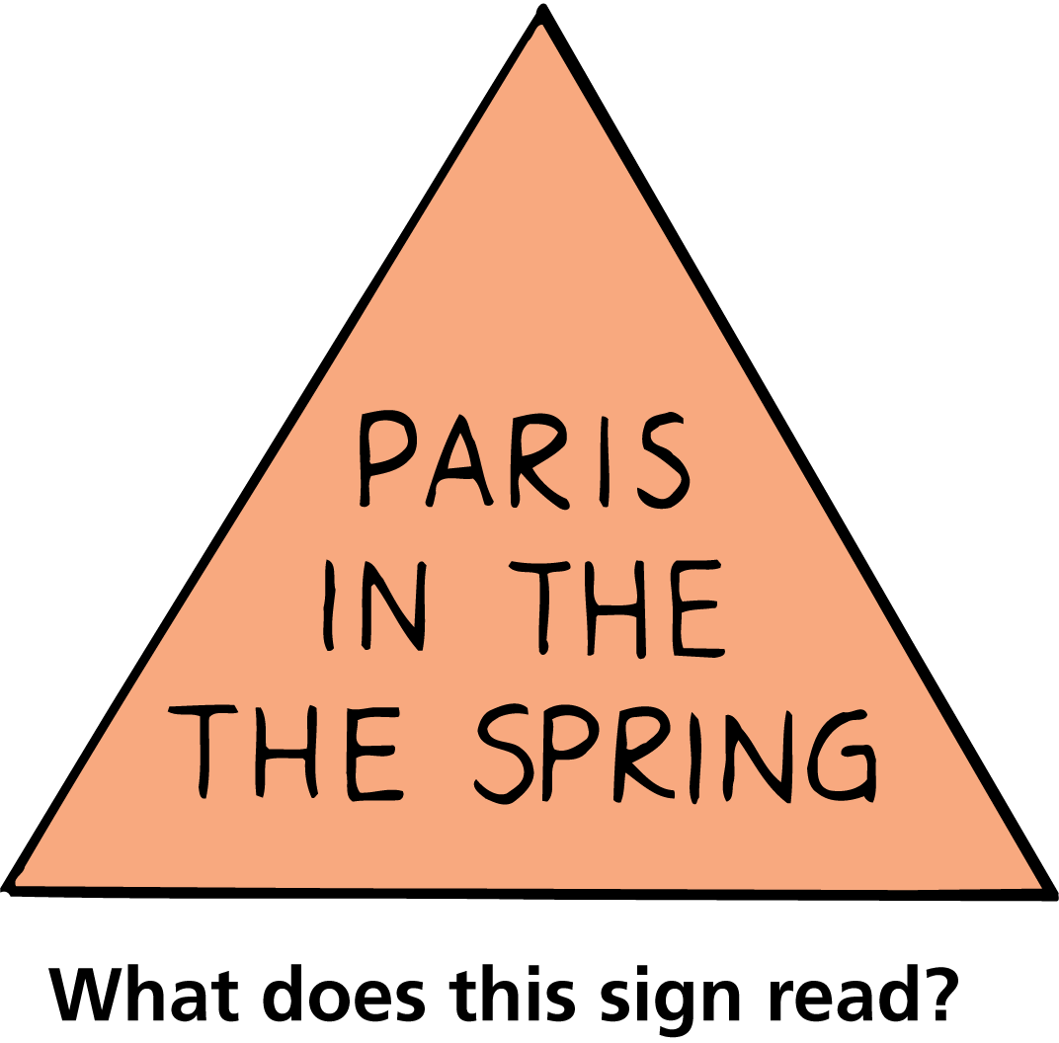
27.8 Polarized Light and 3-D Viewing

Slide 92
27.8 Polarized Light and 3-D Viewing
How can you see photographs or movies in 3-D?

Slide 93
Assessment Questions
Scientists now agree that light is composed of
only electromagnetic waves.
only photons.
electromagnetic waves and particles called photons.
an unknown source.

Slide 94
Assessment Questions
Scientists now agree that light is composed of
only electromagnetic waves.
only photons.
electromagnetic waves and particles called photons.
an unknown source.
Answer: C

Slide 95
Assessment Questions
The time it takes light to travel across the orbit of Earth is about
less than a second.
8 minutes.
22 minutes.
4 years.

Slide 96
Assessment Questions
The time it takes light to travel across the orbit of Earth is about
less than a second.
8 minutes.
22 minutes.
4 years.
Answer: C

Slide 97
Assessment Questions
All of the following are part of the electromagnetic spectrum EXCEPT
light.
sound.
radio waves.
X-rays.

Slide 98
Assessment Questions
All of the following are part of the electromagnetic spectrum EXCEPT
light.
sound.
radio waves.
X-rays.
Answer: B

Slide 99
Assessment Questions
Strictly speaking, the photons of light that shine on glass are
the ones that travel through and exit the other side.
not the ones that travel through and exit the other side.
absorbed and transformed to thermal energy.
reflected.

Slide 100
Assessment Questions
Strictly speaking, the photons of light that shine on glass are
the ones that travel through and exit the other side.
not the ones that travel through and exit the other side.
absorbed and transformed to thermal energy.
reflected.
Answer: B

Slide 101
Assessment Questions
Light that is not transmitted by opaque materials is
converted to internal energy in the material.
mainly reflected.
mainly refracted.
transmitted at a lower frequency.

Slide 102
Assessment Questions
Light that is not transmitted by opaque materials is
converted to internal energy in the material.
mainly reflected.
mainly refracted.
transmitted at a lower frequency.
Answer: A

Slide 103
Assessment Questions
When the shadow of the moon falls on Earth we have a
lunar eclipse.
solar eclipse.
solar eclipse if it’s daytime and lunar eclipse if it’s nighttime.
very dangerous event.

Slide 104
Assessment Questions
When the shadow of the moon falls on Earth we have a
lunar eclipse.
solar eclipse.
solar eclipse if it’s daytime and lunar eclipse if it’s nighttime.
very dangerous event.
Answer: B

Slide 105
Assessment Questions
Polarization occurs when waves of light are
undergoing interference.
longitudinal.
aligned.
in harmony.

Slide 106
Assessment Questions
Polarization occurs when waves of light are
undergoing interference.
longitudinal.
aligned.
in harmony.
Answer: C

Slide 107
Assessment Questions
The best way to view something in 3-D is to
have keen eyesight.
use two eyes.
use only one eye.
be slightly cross-eyed.

Slide 108
Assessment Questions
The best way to view something in 3-D is to
have keen eyesight.
use two eyes.
use only one eye.
be slightly cross-eyed.
Answer: B

