Slide 1
Energy can change from one form to another without a net loss or gain.

Slide 2
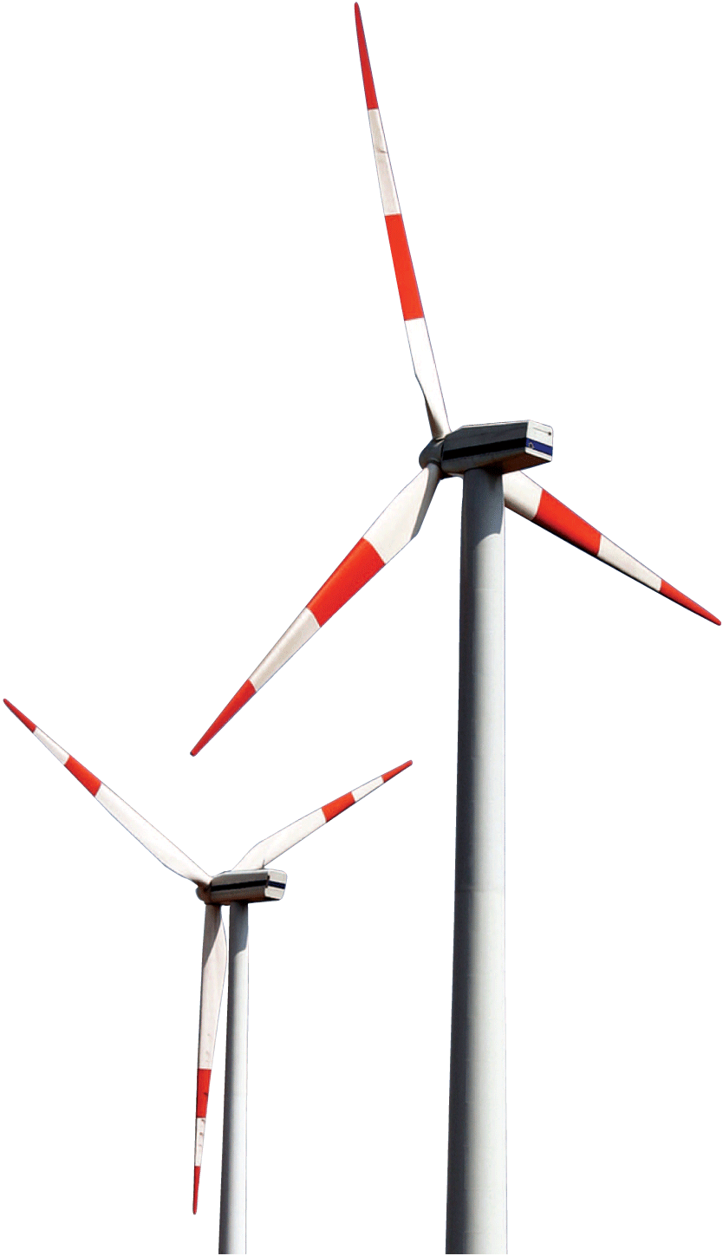
Energy may be the most familiar concept in science, yet it is one of the most difficult to define. We observe the effects of energy when something is happening—only when energy is being transferred from one place to another or transformed from one form to another.

Slide 3
9.1 Work
Work is done when a net force acts on an object and the object moves in the direction of the net force.

Slide 4
9.1 Work
Work is the product of the force on an object and the distance through which the object is moved: the quantity force × distance
We do work when we lift a load against Earth’s gravity. The heavier the load or the higher we lift it, the more work we do.

Slide 5
9.1 Work
If the force is constant and the motion takes place in a straight line in the direction of the force, the work done on an object by a net force is the product of the force and the distance through which the object is moved.
work = net force × distance
W = Fd

Slide 6
9.1 Work
If we lift two loads, we do twice as much work as lifting one load the same distance, because the force needed is twice as great.
If we lift one load twice as far, we do twice as much work because the distance is twice as great.

Slide 7
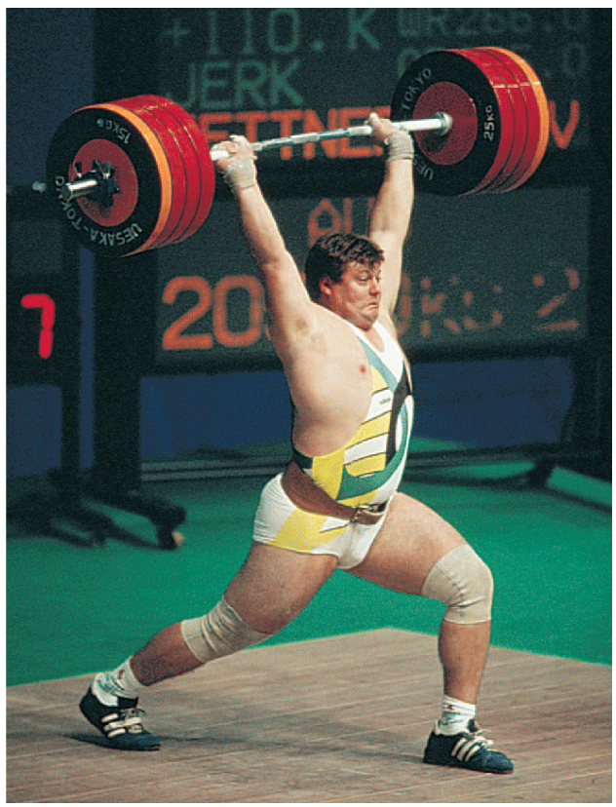
9.1 Work
Work is done in lifting the barbell. If the barbell could be lifted twice as high, the weight lifter would have to do twice as much work.

Slide 8
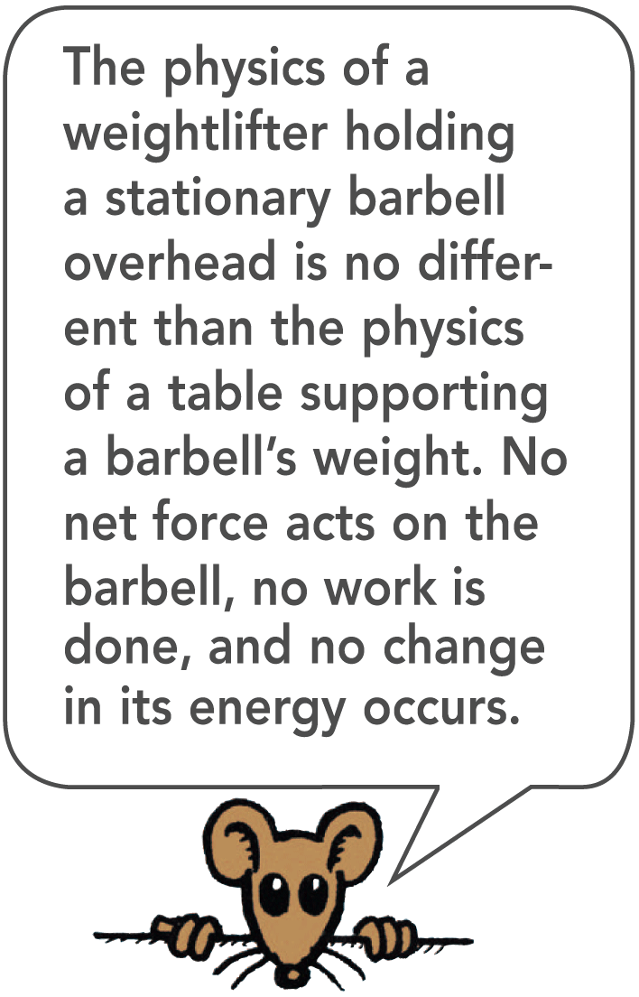
9.1 Work
While the weight lifter is holding a barbell over his head, he may get really tired, but he does no work on the barbell.
Work may be done on the muscles by stretching and squeezing them, but this work is not done on the barbell.
When the weight lifter raises the barbell, he is doing work on it.

Slide 9
9.1 Work
Some work is done against another force.
An archer stretches her bowstring, doing work against the elastic forces of the bow.
When the ram of a pile driver is raised, work is required to raise the ram against the force of gravity.
When you do push-ups, you do work against your own weight.

Slide 10
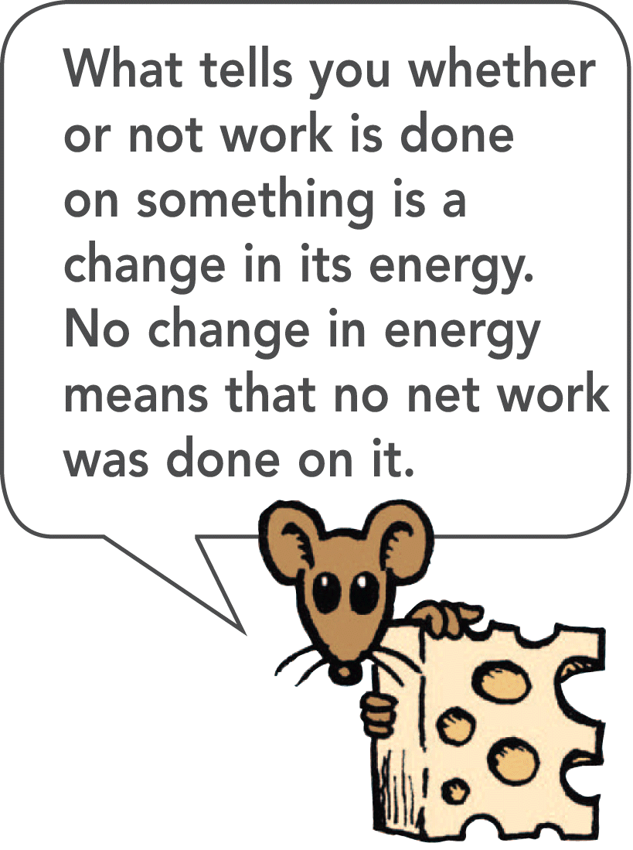
9.1 Work
Some work is done to change the speed of an object.
Bringing an automobile up to speed or in slowing it down involves work.
In both categories, work involves a transfer of energy between something and its surroundings.

Slide 11
9.1 Work
The unit of measurement for work combines a unit of force, N, with a unit of distance, m.
The unit of work is the newton-meter (N•m), also called the joule.
One joule (J) of work is done when a force of 1 N is exerted over a distance of 1 m (lifting an apple over your head).

Slide 12
9.1 Work
Larger units are required to describe greater work.
Kilojoules (kJ) are thousands of joules. The weight lifter does work on the order of kilojoules.
Megajoules (MJ) are millions of joules. To stop a loaded truck going at 100 km/h takes megajoules of work.

Slide 13
9.1 Work
think!
Suppose that you apply a 60-N horizontal force to a 32-kg package, which pushes it 4 meters across a mailroom floor. How much work do you do on the package?

Slide 14
9.1 Work
think!
Suppose that you apply a 60-N horizontal force to a 32-kg package, which pushes it 4 meters across a mailroom floor. How much work do you do on the package?
Answer:
W = Fd = 60 N × 4 m = 240 J

Slide 15
9.1 Work
When is work done on an object?

Slide 16
9.2 Power
Power equals the amount of work done divided by the time interval during which the work is done.

Slide 17
9.2 Power
When carrying a load up some stairs, you do the same amount of work whether you walk or run up the stairs.
Power is the rate at which work is done.

Slide 18
9.2 Power
A high-power engine does work rapidly.
An engine that delivers twice the power of another engine does not necessarily produce twice as much work or go twice as fast.
Twice the power means the engine can do twice the work in the same amount of time or the same amount of work in half the time.
A powerful engine can get an automobile up to a given speed in less time than a less powerful engine can.

Slide 19
9.2 Power
The unit of power is the joule per second, also known as the watt.
One watt (W) of power is expended when one joule of work is done in one second.
One kilowatt (kW) equals 1000 watts.
One megawatt (MW) equals one million watts.

Slide 20
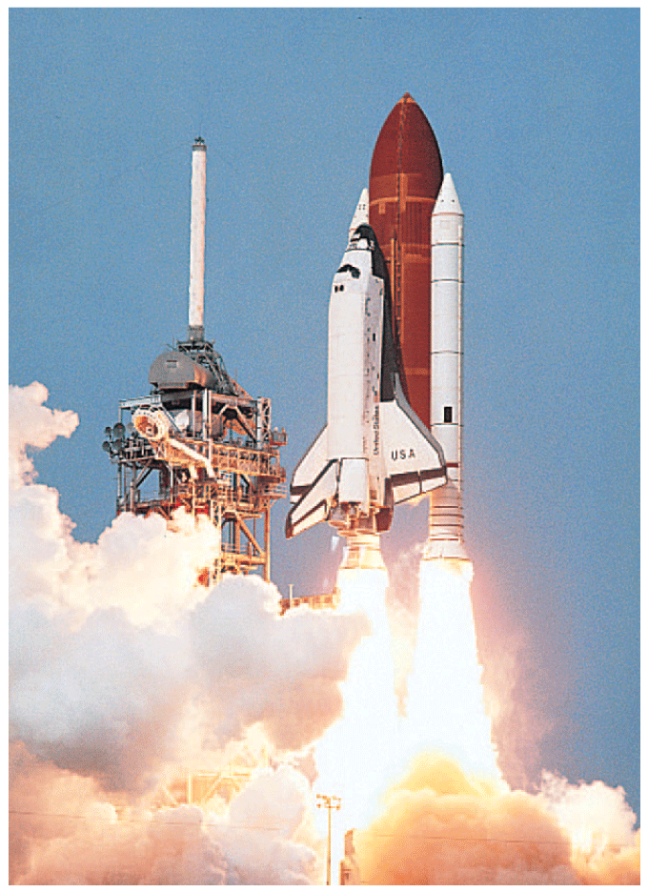
9.2 Power
The three main engines of the space shuttle can develop 33,000 MW of power when fuel is burned at the enormous rate of 3400 kg/s.

Slide 21
9.2 Power
In the United States, we customarily rate engines in units of horsepower and electricity in kilowatts, but either may be used.
In the metric system of units, automobiles are rated in kilowatts. One horsepower (hp) is the same as 0.75 kW, so an engine rated at 134 hp is a 100-kW engine.

Slide 22
9.2 Power
think!
If a forklift is replaced with a new forklift that has twice the power, how much greater a load can it lift in the same amount of time? If it lifts the same load, how much faster can it operate?

Slide 23
9.2 Power
think!
If a forklift is replaced with a new forklift that has twice the power, how much greater a load can it lift in the same amount of time? If it lifts the same load, how much faster can it operate?
Answer:
The forklift that delivers twice the power will lift twice the load in the same time, or the same load in half the time.

Slide 24
9.2 Power
How can you calculate power?

Slide 25
9.3 Mechanical Energy
The two forms of mechanical energy are kinetic energy and potential energy.

Slide 26
9.3 Mechanical Energy
When work is done by an archer in drawing back a bowstring, the bent bow acquires the ability to do work on the arrow.
When work is done to raise the heavy ram of a pile driver, the ram acquires the ability to do work on the object it hits when it falls.
When work is done to wind a spring mechanism, the spring acquires the ability to do work on various gears to run a clock, ring a bell, or sound an alarm.

Slide 27
9.3 Mechanical Energy
Something has been acquired that enables the object to do work.
It may be in the form of a compression of atoms in the material of an object; a physical separation of attracting bodies; or a rearrangement of electric charges in the molecules of a substance.

Slide 28
9.3 Mechanical Energy
The property of an object or system that enables it to do work is energy. Like work, energy is measured in joules.
Mechanical energy is the energy due to the position of something or the movement of something.

Slide 29
9.3 Mechanical Energy
What are the two forms of mechanical energy?

Slide 30
9.4 Potential Energy
Three examples of potential energy are elastic potential energy, chemical energy, and gravitational potential energy.

Slide 31
9.4 Potential Energy
An object may store energy by virtue of its position.
Energy that is stored and held in readiness is called potential energy (PE) because in the stored state it has the potential for doing work.

Slide 32
9.4 Potential Energy
Elastic Potential Energy
A stretched or compressed spring has a potential for doing work.
When a bow is drawn back, energy is stored in the bow. The bow can do work on the arrow.
A stretched rubber band has potential energy because of its position.
These types of potential energy are elastic potential energy.

Slide 33
9.4 Potential Energy
Chemical Energy
The chemical energy in fuels is also potential energy.
It is energy of position at the submicroscopic level. This energy is available when the positions of electric charges within and between molecules are altered and a chemical change takes place.

Slide 34
9.4 Potential Energy
Gravitational Potential Energy
Work is required to elevate objects against Earth’s gravity.
The potential energy due to elevated positions is gravitational potential energy.
Water in an elevated reservoir and the raised ram of a pile driver have gravitational potential energy.

Slide 35
9.4 Potential Energy
The amount of gravitational potential energy possessed by an elevated object is equal to the work done against gravity to lift it.
The upward force required while moving at constant velocity is equal to the weight, mg, of the object, so the work done in lifting it through a height h is the product mgh.
gravitational potential energy = weight × height
PE = mgh

Slide 36
9.4 Potential Energy
Note that the height is the distance above some chosen reference level, such as the ground or the floor of a building.
The gravitational potential energy, mgh, is relative to that level and depends only on mg and h.

Slide 37
9.4 Potential Energy
The potential energy of the 100-N boulder with respect to the ground below is 200 J in each case.
The boulder is lifted with 100 N of force.

Slide 38
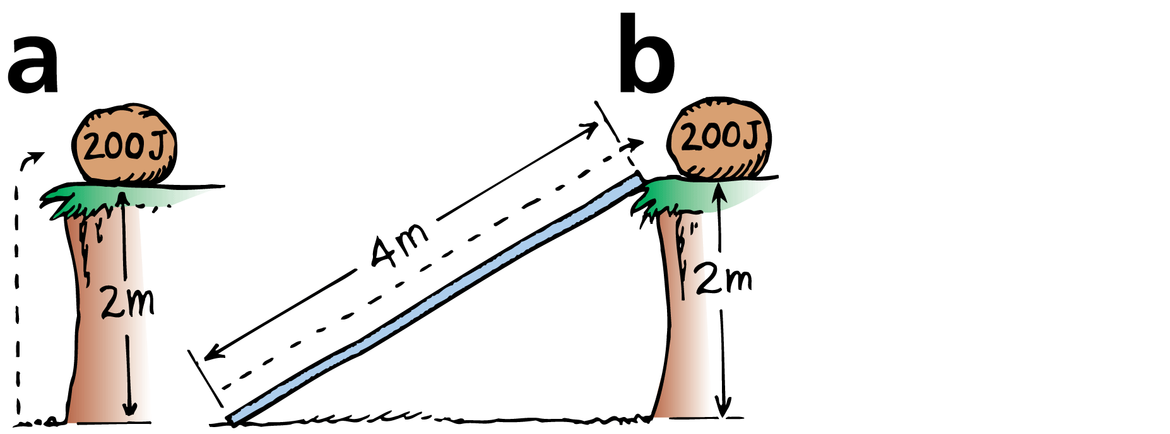
9.4 Potential Energy
The potential energy of the 100-N boulder with respect to the ground below is 200 J in each case.
The boulder is lifted with 100 N of force.
The boulder is pushed up the 4-m incline with 50 N of force.

Slide 39
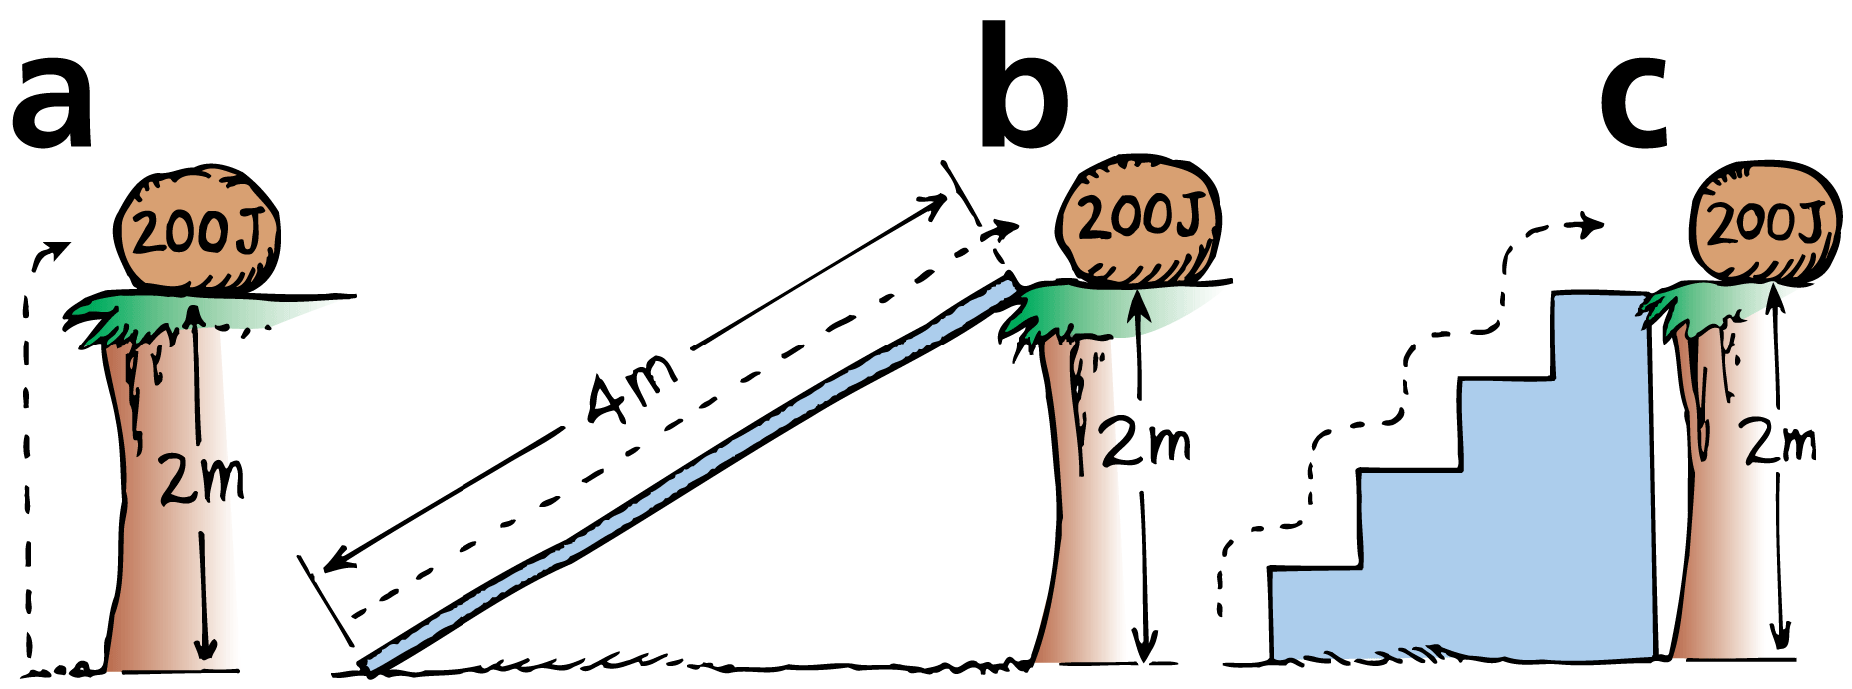
9.4 Potential Energy
The potential energy of the 100-N boulder with respect to the ground below is 200 J in each case.
The boulder is lifted with 100 N of force.
The boulder is pushed up the 4-m incline with 50 N of force.
The boulder is lifted with 100 N of force up each 0.5-m stair.

Slide 40
9.4 Potential Energy
Hydroelectric power stations use gravitational potential energy.
Water from an upper reservoir flows through a long tunnel to an electric generator.
Gravitational potential energy of the water is converted to electrical energy.
Power stations buy electricity at night, when there is much less demand, and pump water from a lower reservoir back up to the upper reservoir. This process is called pumped storage.
The pumped storage system helps to smooth out differences between energy demand and supply.

Slide 41
9.4 Potential Energy
think!
You lift a 100-N boulder 1 m.
a. How much work is done on the boulder?
b. What power is expended if you lift the boulder in a time of 2 s?
c. What is the gravitational potential energy of the boulder in the lifted position?

Slide 42
9.4 Potential Energy
think!
You lift a 100-N boulder 1 m.
a. How much work is done on the boulder?
b. What power is expended if you lift the boulder in a time of 2 s?
c. What is the gravitational potential energy of the boulder in the lifted position?
Answer:
a. W = Fd = 100 N·m = 100 J
b. Power = 100 J / 2 s = 50 W
c. Relative to its starting position, the boulder’s PE is 100 J. Relative to some other reference level, its PE would be some other value.

Slide 43
9.4 Potential Energy
Name three examples of potential energy.

Slide 44
9.5 Kinetic Energy
The kinetic energy of a moving object is equal to the work required to bring it to its speed from rest, or the work the object can do while being brought to rest.

Slide 45
9.5 Kinetic Energy
If an object is moving, then it is capable of doing work. It has energy of motion, or kinetic energy (KE).
The kinetic energy of an object depends on the mass of the object as well as its speed.
It is equal to half the mass multiplied by the square of the speed.

Slide 46
9.5 Kinetic Energy
When you throw a ball, you do work on it to give it speed as it leaves your hand. The moving ball can then hit something and push it, doing work on what it hits.

Slide 47
9.5 Kinetic Energy
Note that the speed is squared, so if the speed of an object is doubled, its kinetic energy is quadrupled (2² = 4).
It takes four times the work to double the speed.
An object moving twice as fast takes four times as much work to stop.

Slide 48
9.5 Kinetic Energy
How are work and the kinetic energy of a moving object related?

Slide 49
9.6 Work-Energy Theorem
The work-energy theorem states that whenever work is done, energy changes.

Slide 50
9.6 Work-Energy Theorem
To increase the kinetic energy of an object, work must be done on the object.
If an object is moving, work is required to bring it to rest.
The change in kinetic energy is equal to the net work done.
The work-energy theorem describes the relationship between work and energy.

Slide 51
9.6 Work-Energy Theorem
We abbreviate “change in” with the delta symbol, ∆
Work = ∆KE
Work equals the change in kinetic energy.
The work in this equation is the net work—that is, the work based on the net force.

Slide 52
9.6 Work-Energy Theorem
If there is no change in an object’s kinetic energy, then no net work was done on it.
Push against a box on a floor.
If it doesn’t slide, then you are not doing work on the box.
On a very slippery floor, if there is no friction at all, the work of your push times the distance of your push appears as kinetic energy of the box.

Slide 53
9.6 Work-Energy Theorem
If there is some friction, it is the net force of your push minus the frictional force that is multiplied by distance to give the gain in kinetic energy.
If the box moves at a constant speed, you are pushing just hard enough to overcome friction. The net force and net work are zero, and, according to the work-energy theorem, ∆KE = 0. The kinetic energy doesn’t change.

Slide 54
9.6 Work-Energy Theorem
The work-energy theorem applies to decreasing speed as well.
The more kinetic energy something has, the more work is required to stop it.
Twice as much kinetic energy means twice as much work.

Slide 55
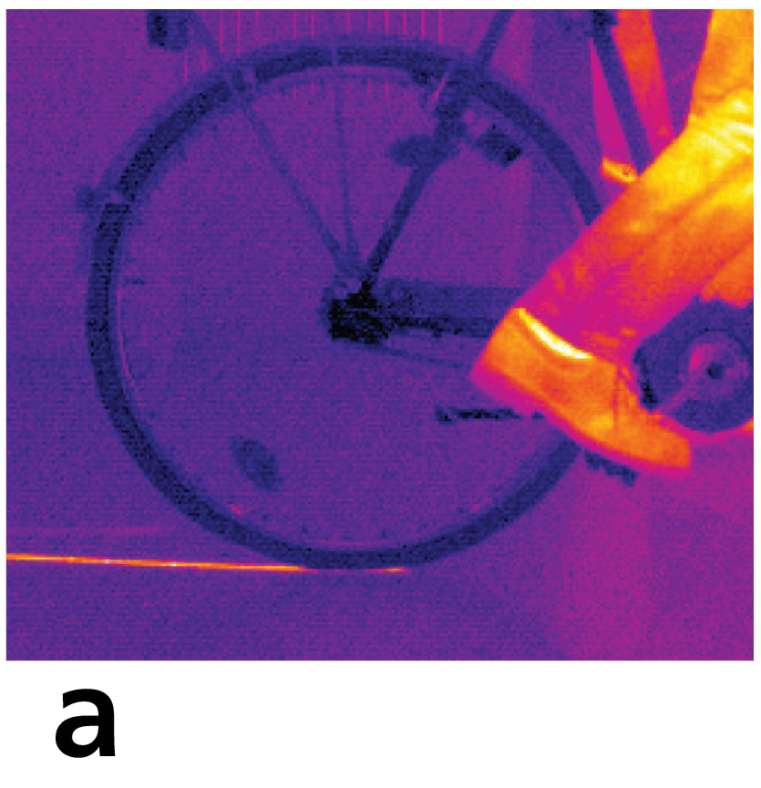
9.6 Work-Energy Theorem
Due to friction, energy is transferred both into the floor and into the tire when the bicycle skids to a stop.
An infrared camera reveals the heated tire track on the floor.

Slide 56
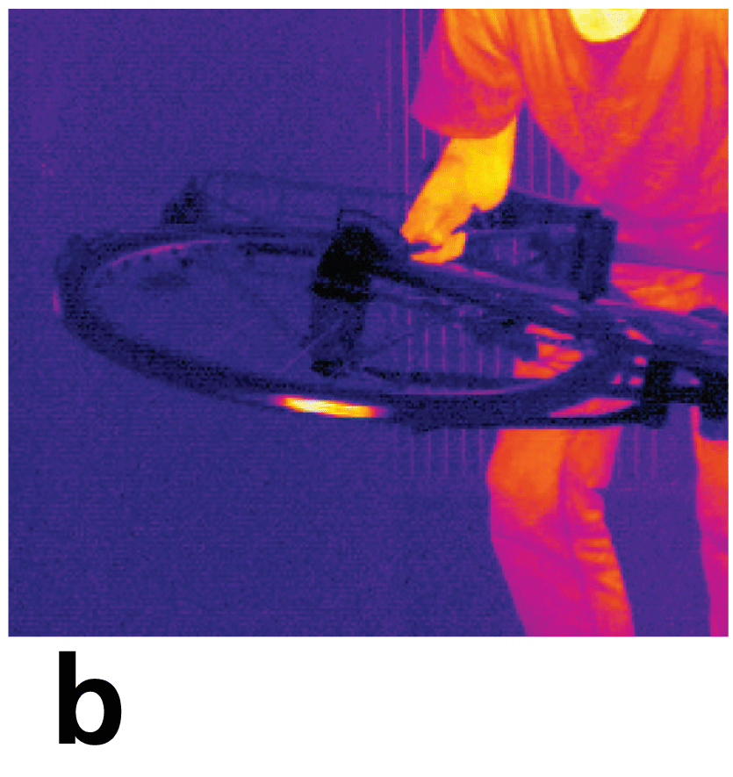
9.6 Work-Energy Theorem
Due to friction, energy is transferred both into the floor and into the tire when the bicycle skids to a stop.
An infrared camera reveals the heated tire track on the floor.
The warmth of the tire is also revealed.

Slide 57
9.6 Work-Energy Theorem
When a car brakes, the work is the friction force supplied by the brakes multiplied by the distance over which the friction force acts.
A car moving at twice the speed of another has four times as much kinetic energy, and will require four times as much work to stop.
The frictional force is nearly the same for both cars, so the faster one takes four times as much distance to stop.
Kinetic energy depends on speed squared.

Slide 58
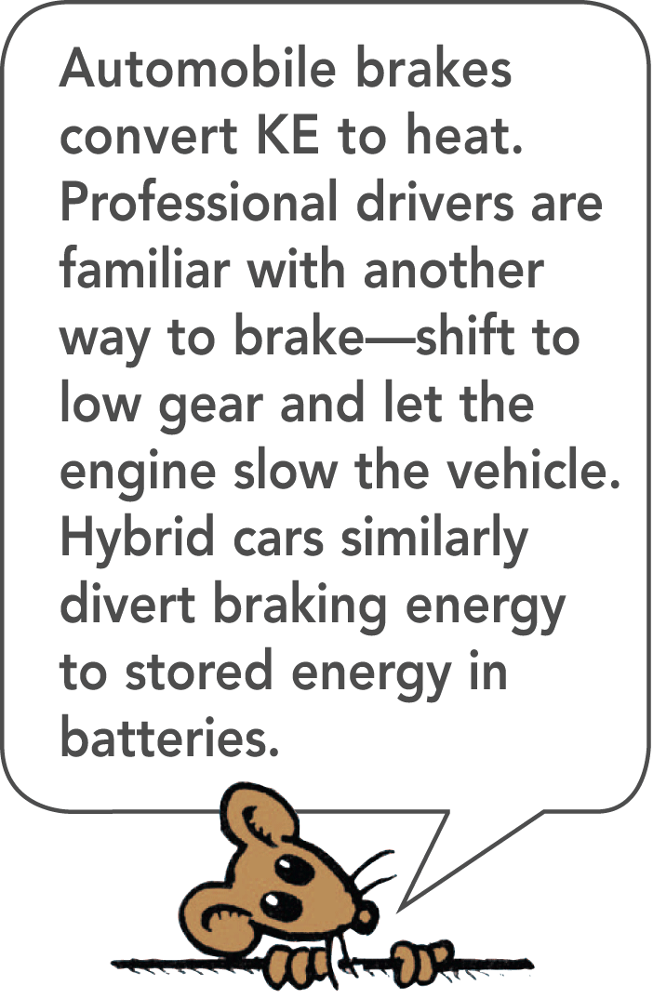
9.6 Work-Energy Theorem
Typical stopping distances for cars equipped with antilock brakes traveling at various speeds. The work done to stop the car is friction force × distance of slide.

Slide 59
9.6 Work-Energy Theorem
Typical stopping distances for cars equipped with antilock brakes traveling at various speeds. The work done to stop the car is friction force × distance of slide.

Slide 60
9.6 Work-Energy Theorem
Typical stopping distances for cars equipped with antilock brakes traveling at various speeds. The work done to stop the car is friction force × distance of slide.

Slide 61
9.6 Work-Energy Theorem
Kinetic energy often appears hidden in different forms of energy, such as heat, sound, light, and electricity.
Random molecular motion is sensed as heat.
Sound consists of molecules vibrating in rhythmic patterns.
Light energy originates in the motion of electrons within atoms.
Electrons in motion make electric currents.

Slide 62
9.6 Work-Energy Theorem
think!
A friend says that if you do 100 J of work on a moving cart, the cart will gain 100 J of KE. Another friend says this depends on whether or not there is friction. What is your opinion of these statements?

Slide 63
9.6 Work-Energy Theorem
think!
A friend says that if you do 100 J of work on a moving cart, the cart will gain 100 J of KE. Another friend says this depends on whether or not there is friction. What is your opinion of these statements?
Answer:
Careful. Although you do 100 J of work on the cart, this may not mean the cart gains 100 J of KE. How much KE the cart gains depends on the net work done on it.

Slide 64
9.6 Work-Energy Theorem
think!
When the brakes of a car are locked, the car skids to a stop. How much farther will the car skid if it’s moving 3 times as fast?

Slide 65
9.6 Work-Energy Theorem
think!
When the brakes of a car are locked, the car skids to a stop. How much farther will the car skid if it’s moving 3 times as fast?
Answer:
Nine times farther. The car has nine times as much kinetic energy when it travels three times as fast:

Slide 66
9.6 Work-Energy Theorem
What is the work-energy theorem?

Slide 67
9.7 Conservation of Energy
The law of conservation of energy states that energy cannot be created or destroyed. It can be transformed from one form into another, but the total amount of energy never changes.

Slide 68
9.7 Conservation of Energy
More important than knowing what energy is, is understanding how it behaves—how it transforms.
We can understand nearly every process that occurs in nature if we analyze it in terms of a transformation of energy from one form to another.

Slide 69
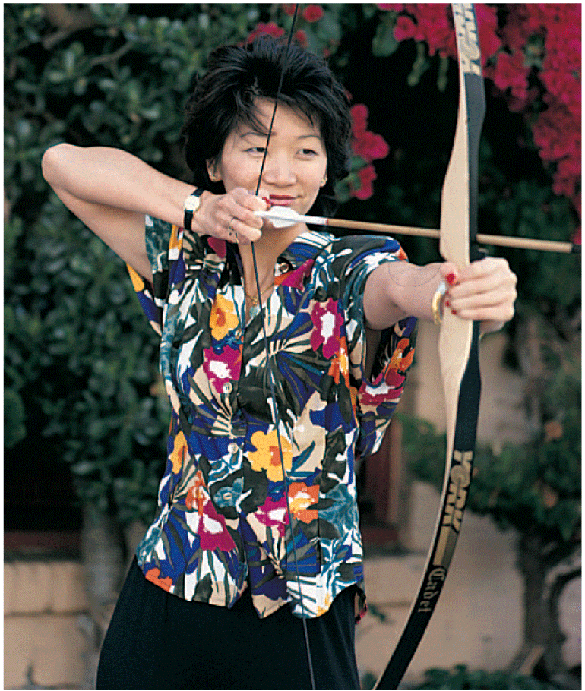
9.7 Conservation of Energy
Potential energy will become the kinetic energy of the arrow.

Slide 70
9.7 Conservation of Energy
As you draw back the arrow in a bow, you do work stretching the bow.
The bow then has potential energy.
When released, the arrow has kinetic energy equal to this potential energy.
It delivers this energy to its target.

Slide 71
9.7 Conservation of Energy
The small distance the arrow moves multiplied by the average force of impact doesn’t quite match the kinetic energy of the target.
However, the arrow and target are a bit warmer by the energy difference.
Energy changes from one form to another without a net loss or a net gain.

Slide 72
9.7 Conservation of Energy
The study of the forms of energy and the transformations from one form into another is the law of conservation of energy.
For any system in its entirety—as simple as a swinging pendulum or as complex as an exploding galaxy—there is one quantity that does not change: energy.
Energy may change form, but the total energy stays the same.

Slide 73
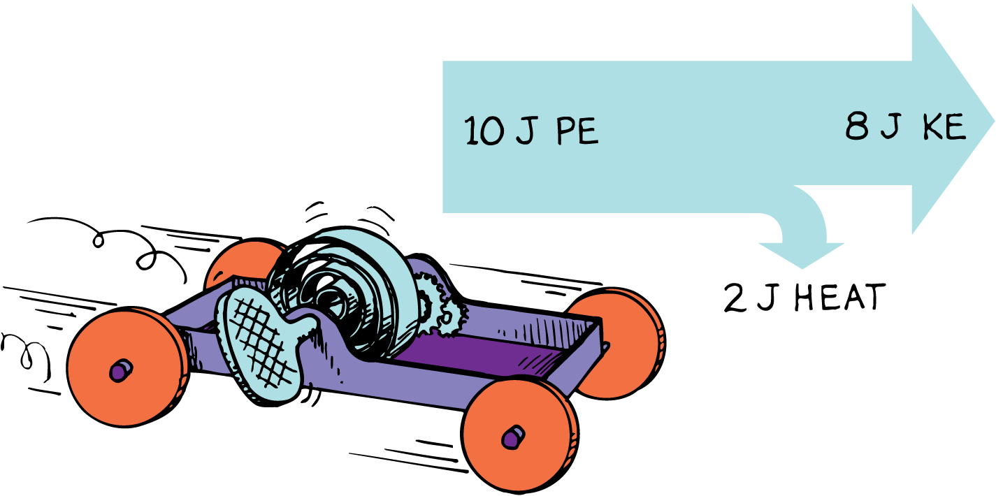
9.7 Conservation of Energy
Part of the PE of the wound spring changes into KE. The remaining PE goes into heating the machinery and the surroundings due to friction. No energy is lost.

Slide 74
9.7 Conservation of Energy
Everywhere along the path of the pendulum bob, the sum of PE and KE is the same. Because of the work done against friction, this energy will eventually be transformed into heat.

Slide 75
9.7 Conservation of Energy
When the woman leaps from the burning building, the sum of her PE and KE remains constant at each successive position all the way down to the ground.

Slide 76
9.7 Conservation of Energy
Each atom that makes up matter is a concentrated bundle of energy.
When the nuclei of atoms rearrange themselves, enormous amounts of energy can be released.
The sun shines because some of its nuclear energy is transformed into radiant energy.
In nuclear reactors, nuclear energy is transformed into heat.

Slide 77
9.7 Conservation of Energy
Enormous compression due to gravity in the deep, hot interior of the sun causes hydrogen nuclei to fuse and become helium nuclei.
This high-temperature welding of atomic nuclei is called thermonuclear fusion.
This process releases radiant energy, some of which reaches Earth.
Part of this energy falls on plants, and some of the plants later become coal.

Slide 78
9.7 Conservation of Energy
Another part supports life in the food chain that begins with microscopic marine animals and plants, and later gets stored in oil.
Part of the sun’s energy is used to evaporate water from the ocean.
Some water returns to Earth as rain that is trapped behind a dam.

Slide 79
9.7 Conservation of Energy
The water behind a dam has potential energy that is used to power a generating plant below the dam.
The generating plant transforms the energy of falling water into electrical energy.
Electrical energy travels through wires to homes where it is used for lighting, heating, cooking, and operating electric toothbrushes.

Slide 80
9.7 Conservation of Energy
What does the law of conservation of energy state?

Slide 81
9.8 Machines
A machine transfers energy from one place to another or transforms it from one form to another.

Slide 82
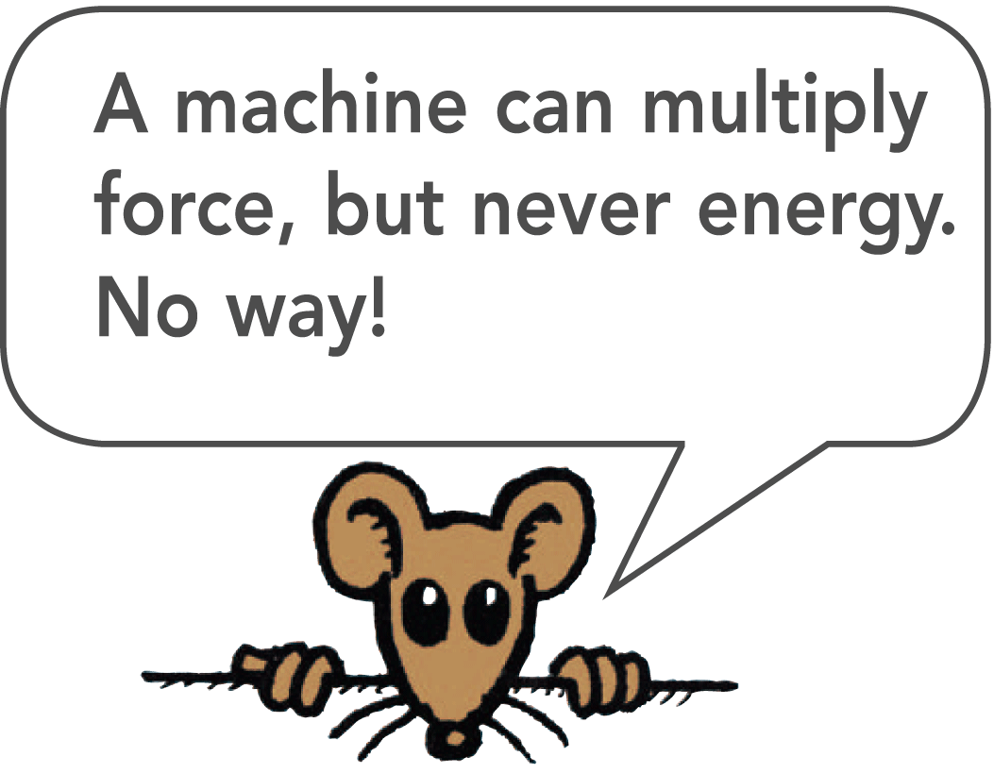
9.8 Machines
A machine is a device used to multiply forces or simply to change the direction of forces.
The concept that underlies every machine is the conservation of energy. A machine cannot put out more energy than is put into it.

Slide 83
9.8 Machines
Levers
A lever is a simple machine made of a bar that turns about a fixed point. If the heat from friction is small enough to neglect, the work input will be equal to the work output.
work input = work output
Since work equals force times distance, we can say
(force × distance)_{input} = (force × distance)_{output}

Slide 84
9.8 Machines
The pivot point, or fulcrum, of the lever can be relatively close to the load.
Then a small input force exerted through a large distance will produce a large output force over a short distance.
In this way, a lever can multiply forces.
However, no machine can multiply work or energy.

Slide 85
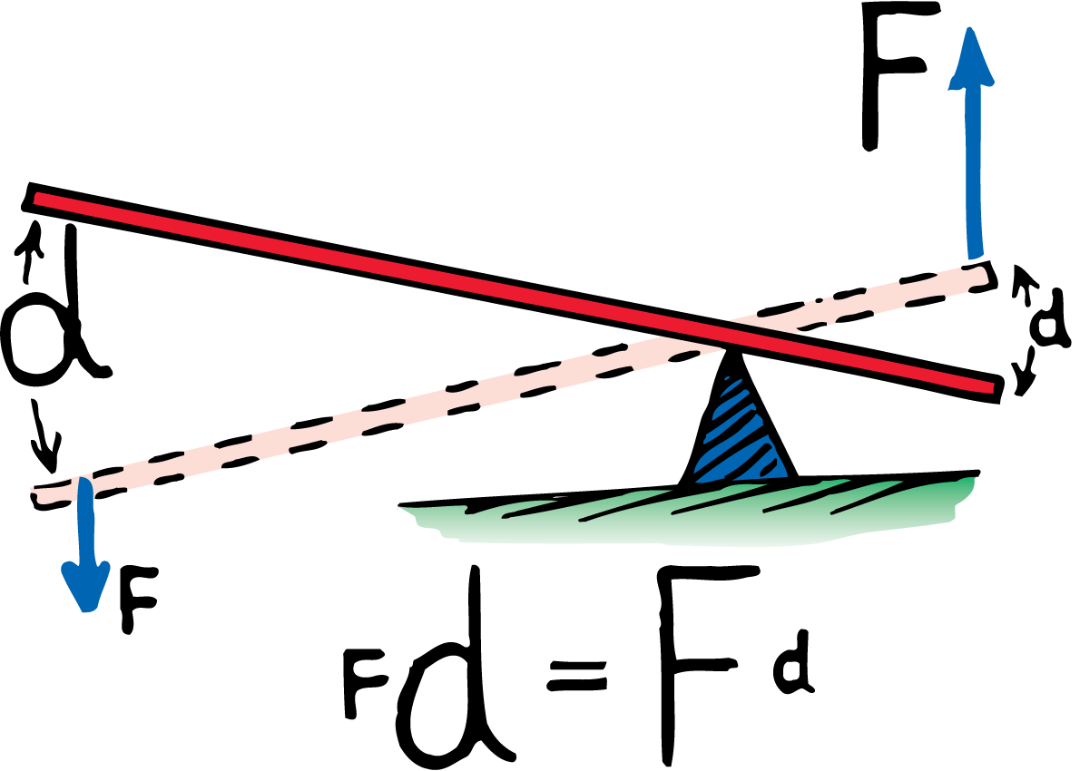
9.8 Machines
In the lever, the work (force × distance) done at one end is equal to the work done on the load at the other end.

Slide 86
9.8 Machines
The output force is eight times the input force.
The output distance is one eighth of the input distance.

Slide 87
9.8 Machines
The child pushes down 10 N and lifts an 80-N load.
The ratio of output force to input force for a machine is called the mechanical advantage.
The mechanical advantage is (80 N)/(10 N), or 8.
Neglecting friction, the mechanical advantage can also be determined by the ratio of input distance to output distance.

Slide 88
9.8 Machines
There are three common ways to set up a lever:
A type 1 lever has the fulcrum between the force and the load, or between input and output.
A type 2 lever has the load between the fulcrum and the input force.
A type 3 lever has the fulcrum at one end and the load at the other.

Slide 89
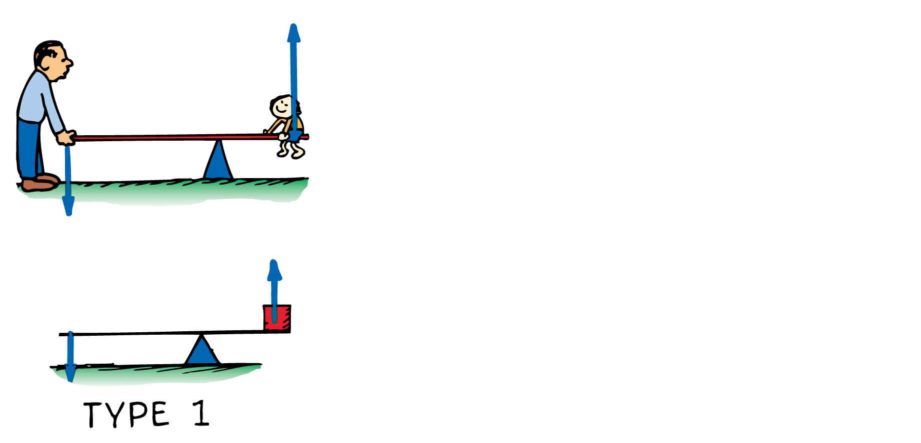
9.8 Machines
The three basic types of levers are shown here.

Slide 90
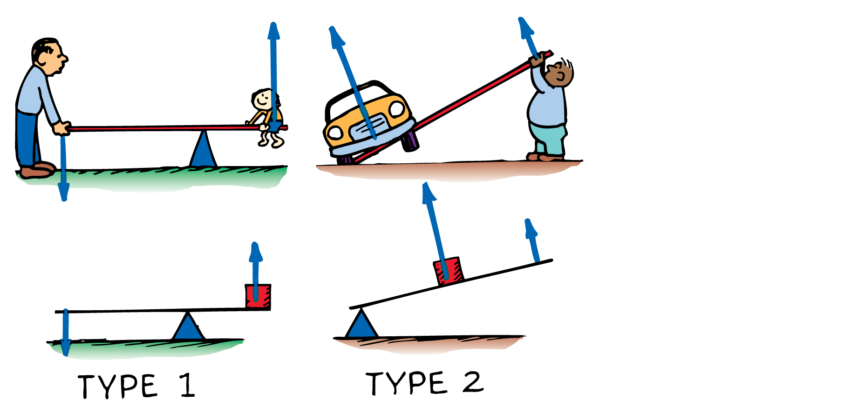
9.8 Machines
The three basic types of levers are shown here.

Slide 91
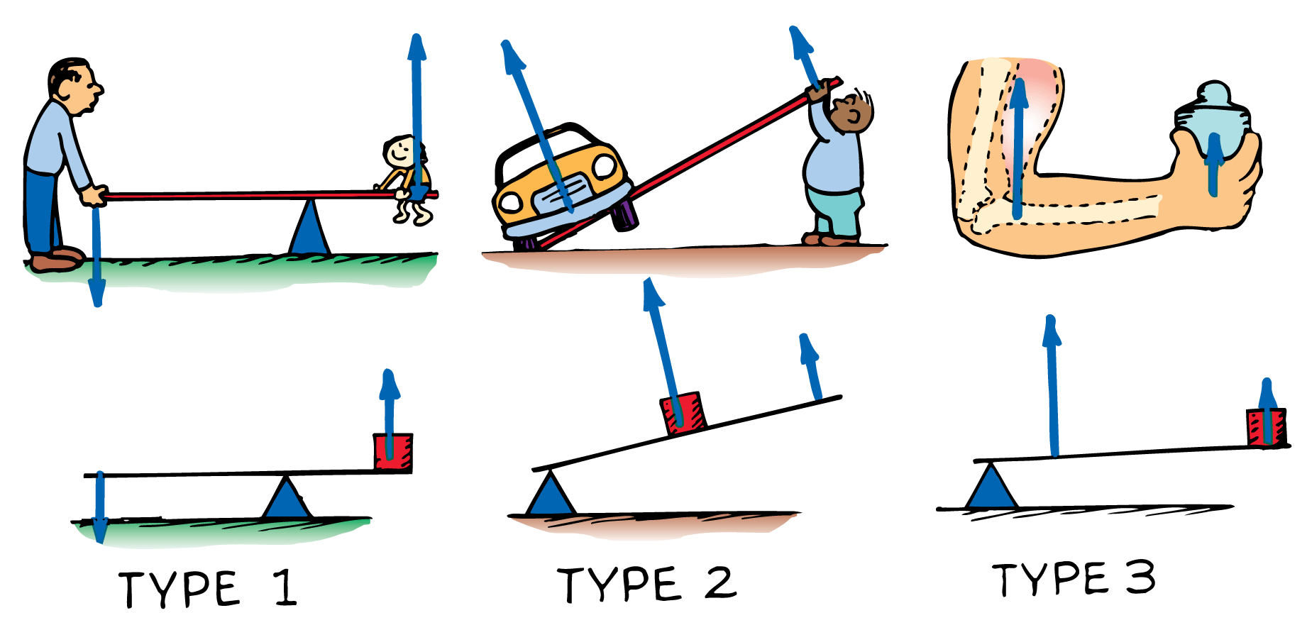
9.8 Machines
The three basic types of levers are shown here.

Slide 92
9.8 Machines
For a type 1 lever, push down on one end and you lift a load at the other. The directions of input and output are opposite.
For a type 2 lever, you lift the end of the lever. Since the input and output forces are on the same side of the fulcrum, the forces have the same direction.
For a type 3 lever, the input force is applied between the fulcrum and the load. The input and output forces are on the same side of the fulcrum and have the same direction.

Slide 93
9.8 Machines
Pulleys
A pulley is basically a kind of lever that can be used to change the direction of a force.
Properly used, a pulley or system of pulleys can multiply forces.

Slide 94
9.8 Machines
A pulley can change the direction of a force.

Slide 95
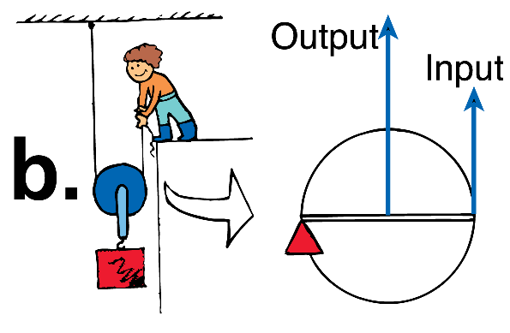
9.8 Machines
A pulley can change the direction of a force.
A pulley multiplies force.

Slide 96
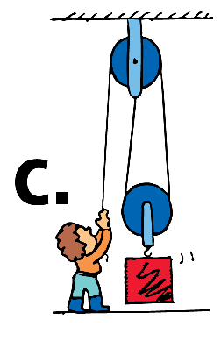
9.8 Machines
A pulley can change the direction of a force.
A pulley multiplies force.
Two pulleys can change the direction and multiply force.

Slide 97
9.8 Machines
This single pulley behaves like a type 1 lever.
The axis of the pulley acts as the fulcrum.
Both lever distances (the radius of the pulley) are equal so the pulley does not multiply force.
It changes the direction of the applied force.
The mechanical advantage equals 1.

Slide 98
9.8 Machines
This single pulley acts as a type 2 lever.
The fulcrum is at the left end of the “lever” where the supporting rope makes contact with the pulley.
The load is halfway between the fulcrum and the input.
1 N of input will support a 2-N load, so the mechanical advantage is 2.
The load is now supported by two strands of rope, each supporting half the load.

Slide 99
9.8 Machines
The mechanical advantage for simple pulley systems is the same as the number of strands of rope that actually support the load.
The mechanical advantage of this simple system is 2.
Although three strands of rope are shown, only two strands actually support the load.
The upper pulley serves only to change the direction of the force.

Slide 100
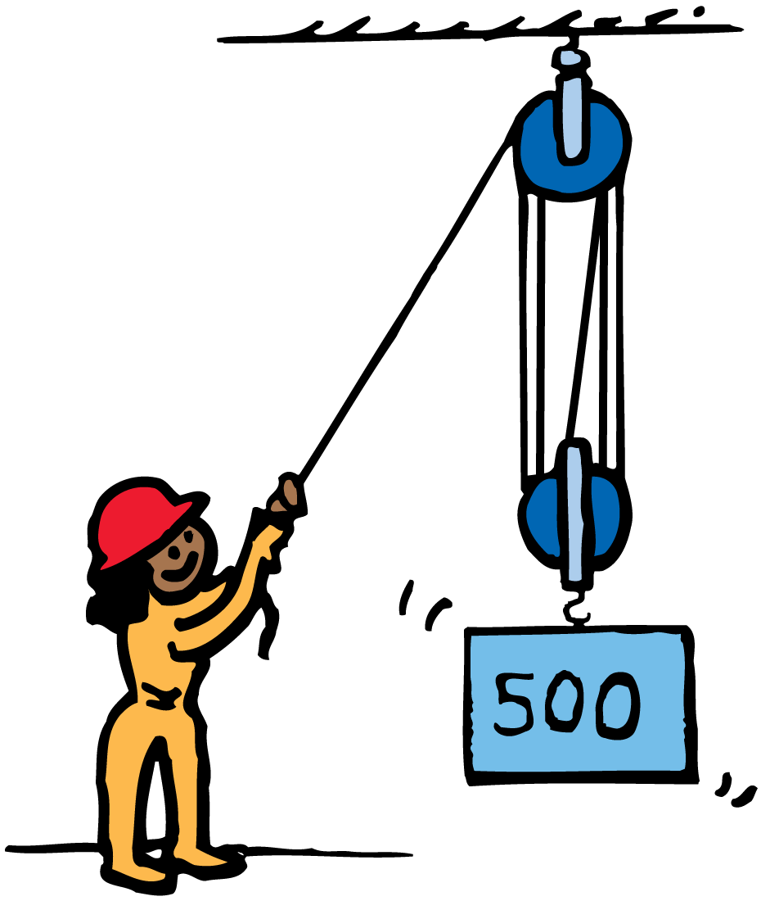
9.8 Machines
When the rope is pulled 5 m with a force of 100 N, a 500-N load is lifted 1 m.
The mechanical advantage is (500 N)/(100 N), or 5.
Force is multiplied at the expense of distance.

Slide 101
9.8 Machines
How does a machine use energy?

Slide 102
9.9 Efficiency
In any machine, some energy is transformed into atomic or molecular kinetic energy—making the machine warmer.

Slide 103
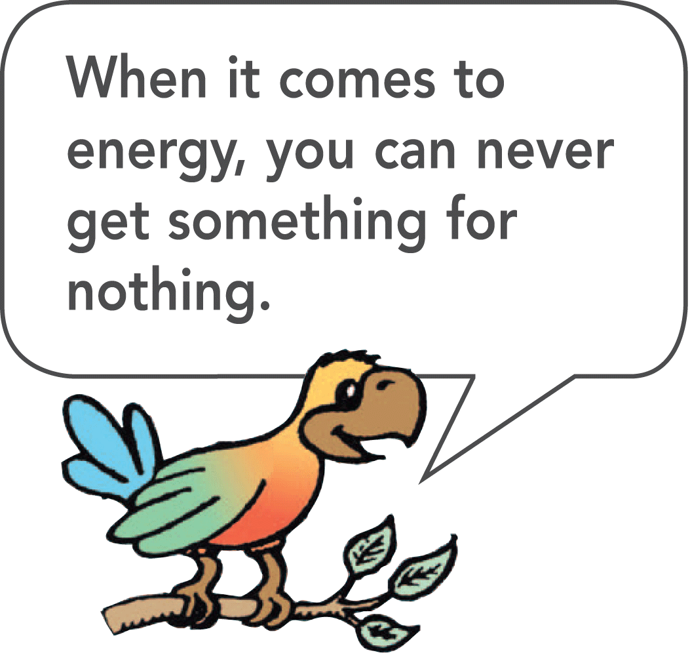
9.9 Efficiency
The previous examples of machines were considered to be ideal because all the work input was transferred to work output.
In a real machine, when a simple lever rocks about its fulcrum, or a pulley turns about its axis, a small fraction of input energy is converted into thermal energy.

Slide 104
9.9 Efficiency
The efficiency of a machine is the ratio of useful energy output to total energy input—the percentage of the work input that is converted to work output.
To convert efficiency to percent, you multiply by 100%. An ideal machine would have 100% efficiency. No real machine can be 100% efficient. Wasted energy is dissipated as heat.

Slide 105
9.9 Efficiency
If we put in 100 J of work on a lever and get out 98 J of work, the lever is 98% efficient. We lose 2 J of work input as heat.
In a pulley system, a larger fraction of input energy is lost as heat. For example, if we do 100 J of work, the friction on the pulleys as they turn and rub on their axle can dissipate 40 J of heat energy. This pulley system has an efficiency of 60%.

Slide 106
9.9 Efficiency
Inclined Planes
An inclined plane is a machine.
Sliding a load up an incline requires less force than lifting it vertically.

Slide 107
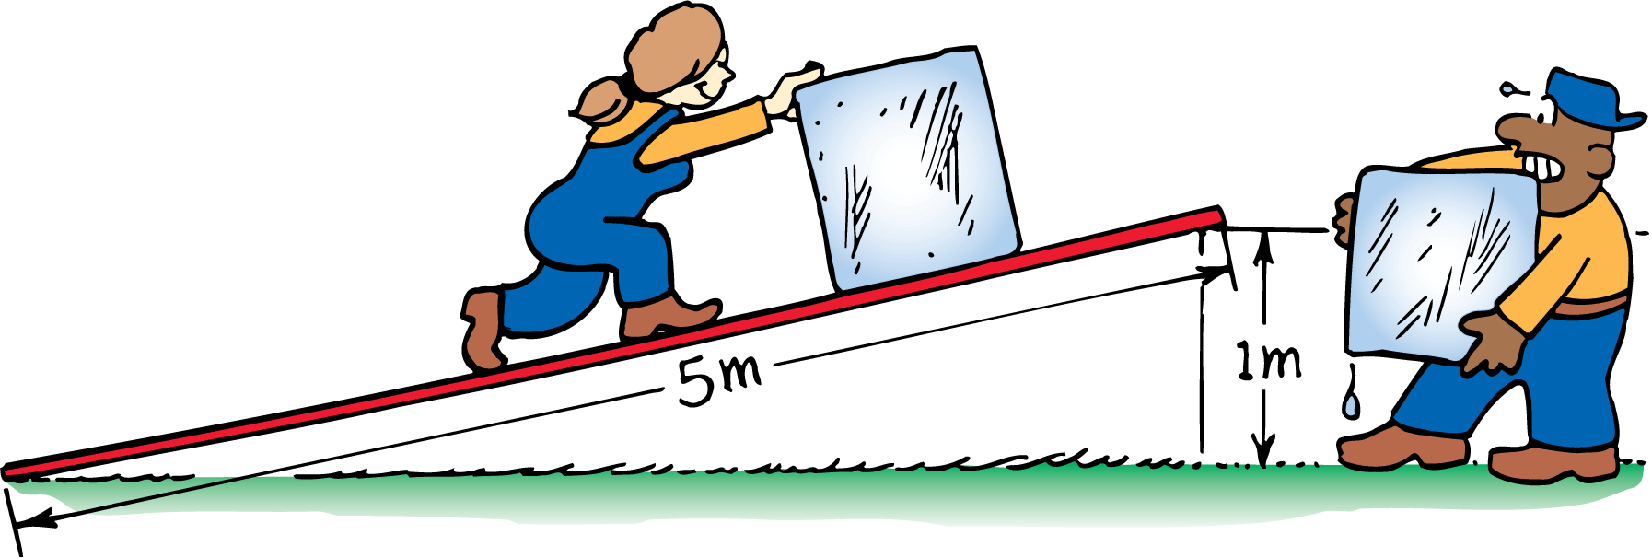
9.9 Efficiency
Pushing the block of ice 5 times farther up the incline than the vertical distance it’s lifted requires a force of only one fifth its weight. If friction is negligible, we need apply only one fifth of the force. The inclined plane shown has a theoretical mechanical advantage of 5.

Slide 108
9.9 Efficiency
An icy plank used to slide a block of ice up to some height might have an efficiency of almost 100%.
When the load is a wooden crate sliding on a wooden plank, both the actual mechanical advantage and the efficiency will be considerably less.
Friction will require you to exert more force (a greater work input) without any increase in work output.

Slide 109
9.9 Efficiency
Efficiency can be expressed as the ratio of actual mechanical advantage to theoretical mechanical advantage.
Efficiency will always be a fraction less than 1.

Slide 110
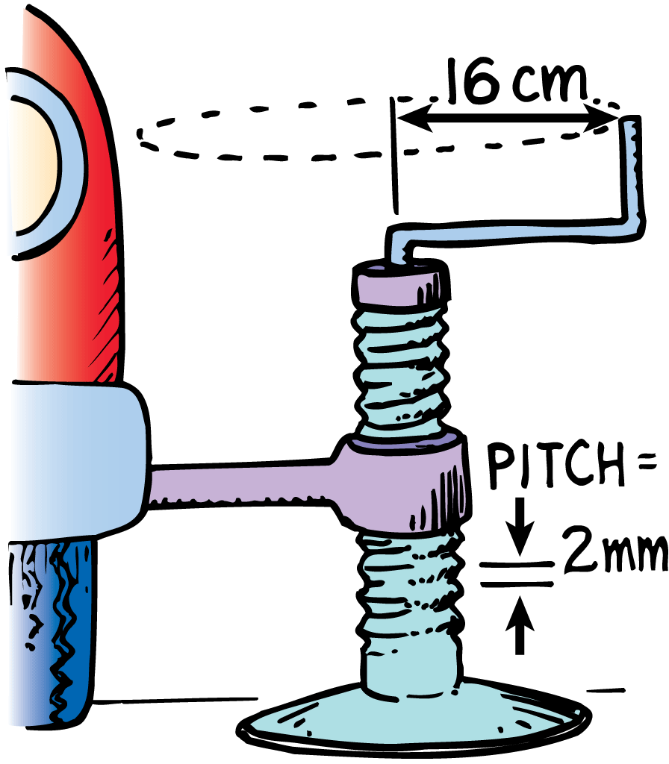
9.9 Efficiency
Complex Machines
This auto jack shown is an inclined plane wrapped around a cylinder.
A single turn of the handle raises the load a relatively small distance.

Slide 111
9.9 Efficiency
If the circular distance the handle is moved is 500 times greater than the distance between ridges, then the theoretical mechanical advantage of the jack is 500.
There is a great deal of friction in the jack, so the efficiency might be about 20%.
This means the jack actually multiplies force by about 100 times, so the actual mechanical advantage is about 100.

Slide 112
9.9 Efficiency
An automobile engine is a machine that transforms chemical energy stored in fuel into mechanical energy.
The molecules of the gasoline break up as the fuel burns.
Carbon atoms from the gasoline combine with oxygen atoms to form carbon dioxide. Hydrogen atoms combine with oxygen, and energy is released.
The converted energy is used to run the engine.

Slide 113
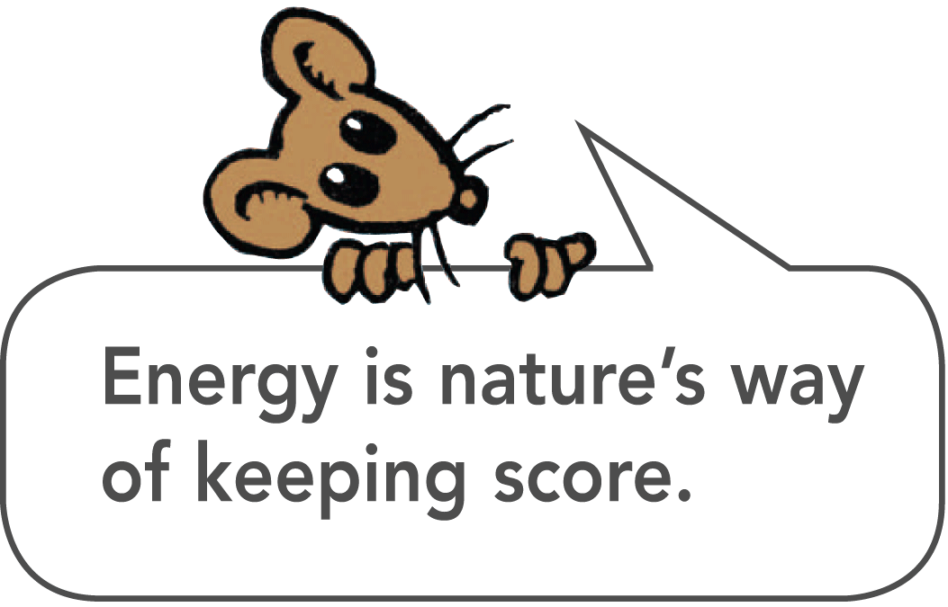
9.9 Efficiency
Transforming 100% of thermal energy into mechanical energy is not possible.
Some heat must flow from the engine.
Friction adds more to the energy loss.
Even the best-designed gasoline-powered automobile engines are unlikely to be more than 35% efficient.

Slide 114
9.9 Efficiency
think!
A child on a sled (total weight 500 N) is pulled up a 10-m slope that elevates her a vertical distance of 1 m. What is the theoretical mechanical advantage of the slope?

Slide 115
9.9 Efficiency
think!
A child on a sled (total weight 500 N) is pulled up a 10-m slope that elevates her a vertical distance of 1 m. What is the theoretical mechanical advantage of the slope?
Answer: The ideal, or theoretical, mechanical advantage is
input distance / output distance = 10 m / 1 m = 10

Slide 116
9.9 Efficiency
Why can’t a machine be 100% efficient?

Slide 117
9.10 Energy for Life
There is more energy stored in the molecules in food than there is in the reaction products after the food is metabolized. This energy difference sustains life.

Slide 118
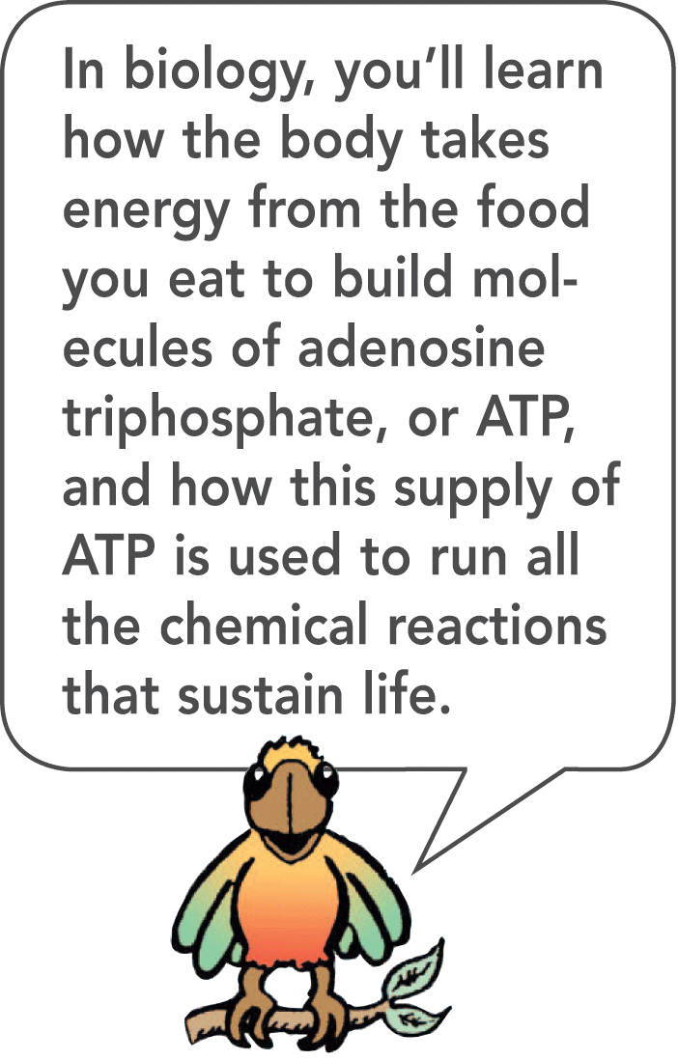
9.10 Energy for Life
Every living cell in every organism is a machine. Like any machine, living cells need an energy supply.
In metabolism, carbon combines with oxygen to form carbon dioxide.
During metabolism, the reaction rate is much slower than combustion and energy is released as it is needed by the body.

Slide 119
9.10 Energy for Life
Only green plants and certain one-celled organisms can make carbon dioxide combine with water to produce hydrocarbon compounds such as sugar.
This process—photosynthesis—requires an energy input, which normally comes from sunlight.
Green plants are able to use the energy of sunlight to make food that gives us and all other organisms energy.

Slide 120
9.10 Energy for Life
What role does energy play in sustaining life?

Slide 121
9.11 Sources of Energy
The sun is the source of practically all our energy on Earth.

Slide 122
9.11 Sources of Energy
Solar Power
Sunlight is directly transformed into electricity by photovoltaic cells.
We use the energy in sunlight to generate electricity indirectly as well: sunlight evaporates water, which later falls as rain; rainwater flows into rivers and into generator turbines as it returns to the sea.

Slide 123
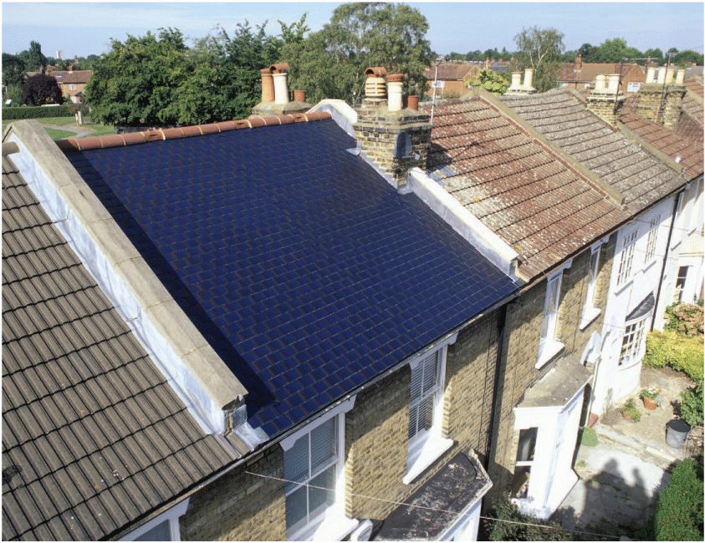
9.11 Sources of Energy
Solar shingles look like traditional asphalt shingles but they are hooked into a home’s electrical system.

Slide 124
9.11 Sources of Energy
Wind, caused by unequal warming of Earth’s surface, is another form of solar power.
The energy of wind can be used to turn generator turbines within specially equipped windmills.
Harnessing the wind is very practical when the energy it produces is stored for future use, such as in the form of hydrogen.

Slide 125
9.11 Sources of Energy
Fuel Cells
Hydrogen is the least polluting of all fuels.
Because it takes energy to make hydrogen—to extract it from water and carbon compounds—it is not a source of energy.

Slide 126
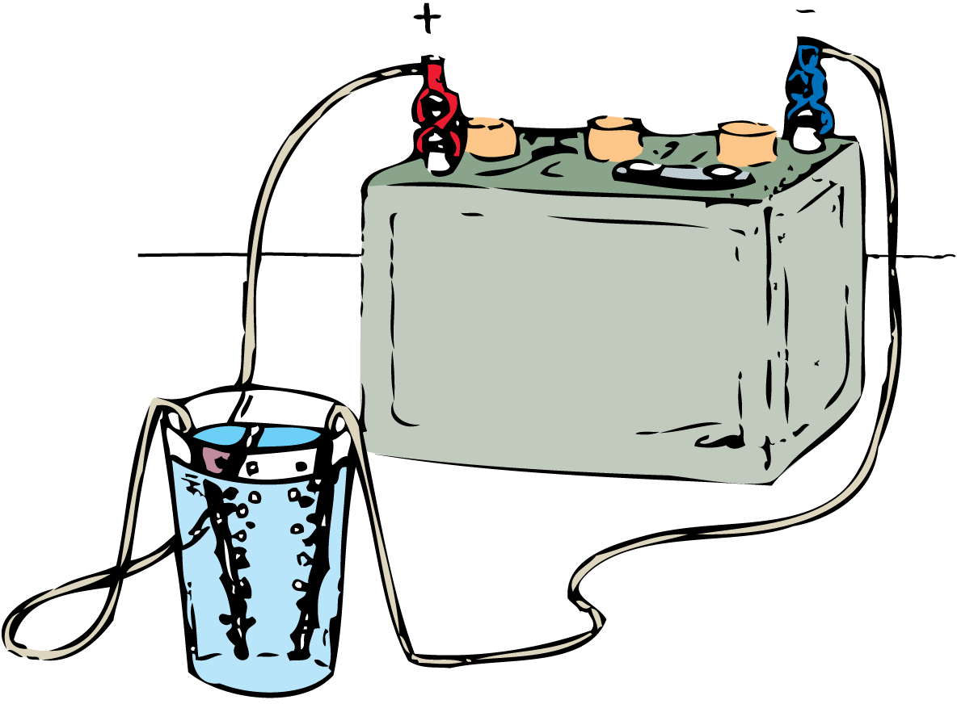
9.11 Sources of Energy
An electric current can break water down into hydrogen and oxygen, a process called electrolysis.

Slide 127
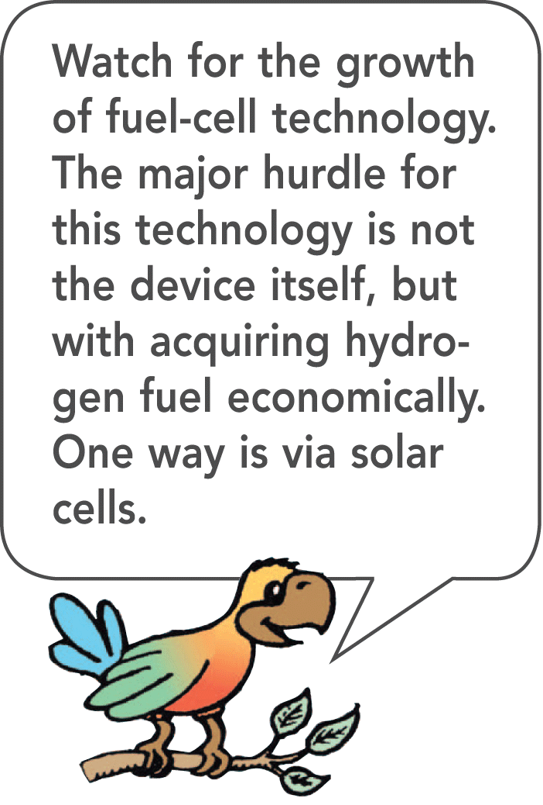
9.11 Sources of Energy
If you make the electrolysis process run backward, you have a fuel cell.
In a fuel cell, hydrogen and oxygen gas are compressed at electrodes to produce water and electric current.

Slide 128
9.11 Sources of Energy
Nuclear and Geothermal Energy
The most concentrated form of usable energy is stored in uranium and plutonium, which are nuclear fuels.
Earth’s interior is kept hot by producing a form of nuclear power, radioactivity, which has been with us since the Earth was formed.

Slide 129
9.11 Sources of Energy
A byproduct of radioactivity in Earth’s interior is geothermal energy.
Geothermal energy is held in underground reservoirs of hot water.
In these places, heated water near Earth’s surface is tapped to provide steam for running turbogenerators.

Slide 130
9.11 Sources of Energy
What is the source of practically all of our energy on Earth?

Slide 131
Assessment Questions
Raising an auto in a service station requires work. Raising it twice as high requires
half as much work.
the same work.
twice the work.
four times the work.

Slide 132
Assessment Questions
Raising an auto in a service station requires work. Raising it twice as high requires
half as much work.
the same work.
twice the work.
four times the work.
Answer: C

Slide 133
Assessment Questions
Raising an auto in a service station requires work. Raising it in half the time requires
half the power.
the same power.
twice the power.
four times the power.

Slide 134
Assessment Questions
Raising an auto in a service station requires work. Raising it in half the time requires
half the power.
the same power.
twice the power.
four times the power.
Answer: C

Slide 135
Assessment Questions
The energy due to the position of something or the energy due to motion is called
potential energy.
kinetic energy.
mechanical energy.
conservation of energy.

Slide 136
Assessment Questions
The energy due to the position of something or the energy due to motion is called
potential energy.
kinetic energy.
mechanical energy.
conservation of energy.
Answer: C

Slide 137
Assessment Questions
After you place a book on a high shelf, we say the book has increased
elastic potential energy.
chemical energy.
kinetic energy.
gravitational potential energy.

Slide 138
Assessment Questions
After you place a book on a high shelf, we say the book has increased
elastic potential energy.
chemical energy.
kinetic energy.
gravitational potential energy.
Answer: D

Slide 139
Assessment Questions
An empty truck traveling at 10 km/h has kinetic energy. How much kinetic energy does it have when it is loaded so its mass is twice, and its speed is increased to twice?
the same KE
twice the KE
four times the KE
more than four times the KE

Slide 140
Assessment Questions
An empty truck traveling at 10 km/h has kinetic energy. How much kinetic energy does it have when it is loaded so its mass is twice, and its speed is increased to twice?
the same KE
twice the KE
four times the KE
more than four times the KE
Answer: D

Slide 141
Assessment Questions
Which of the following equations is most useful for solving a problem that asks for the distance a fast-moving crate slides across a factory floor in coming to a stop?
F = ma
Ft = ∆mv
KE = 1/2mv²
Fd = ∆1/2mv²

Slide 142
Assessment Questions
Which of the following equations is most useful for solving a problem that asks for the distance a fast-moving crate slides across a factory floor in coming to a stop?
F = ma
Ft = ∆mv
KE = 1/2mv²
Fd = ∆1/2mv²
Answer: D

Slide 143
Assessment Questions
A boulder at the top of a vertical cliff has a potential energy of 100 MJ relative to the ground below. It rolls off the cliff. When it is halfway to the ground its kinetic energy is
the same as its potential energy at that point.
negligible.
about 60 MJ.
more than 60 MJ.

Slide 144
Assessment Questions
A boulder at the top of a vertical cliff has a potential energy of 100 MJ relative to the ground below. It rolls off the cliff. When it is halfway to the ground its kinetic energy is
the same as its potential energy at that point.
negligible.
about 60 MJ.
more than 60 MJ.
Answer: A

Slide 145
Assessment Questions
In an ideal pulley system, a woman lifts a 100-N crate by pulling a rope downward with a force of 25 N. For every 1-meter length of rope she pulls downward, the crate rises
25 centimeters.
45 centimeters.
50 centimeters.
100 centimeters.

Slide 146
Assessment Questions
In an ideal pulley system, a woman lifts a 100-N crate by pulling a rope downward with a force of 25 N. For every 1-meter length of rope she pulls downward, the crate rises
25 centimeters.
45 centimeters.
50 centimeters.
100 centimeters.
Answer: A

Slide 147
Assessment Questions
When 100 J are put into a device that puts out 40 J, the efficiency of the device is
40%.
50%.
60%.
140%.

Slide 148
Assessment Questions
When 100 J are put into a device that puts out 40 J, the efficiency of the device is
40%.
50%.
60%.
140%.
Answer: A

Slide 149
Assessment Questions
An energy supply is needed for the operation of a(n)
automobile.
living cell.
machine.
all of these

Slide 150
Assessment Questions
An energy supply is needed for the operation of a(n)
automobile.
living cell.
machine.
all of these
Answer: D

Slide 151
Assessment Questions
The main sources of energy on Earth are
solar and nuclear.
gasoline and fuel cells.
wind and tidal.
potential energy and kinetic energy.

Slide 152
Assessment Questions
The main sources of energy on Earth are
solar and nuclear.
gasoline and fuel cells.
wind and tidal.
potential energy and kinetic energy.
Answer: A

