Slide 1
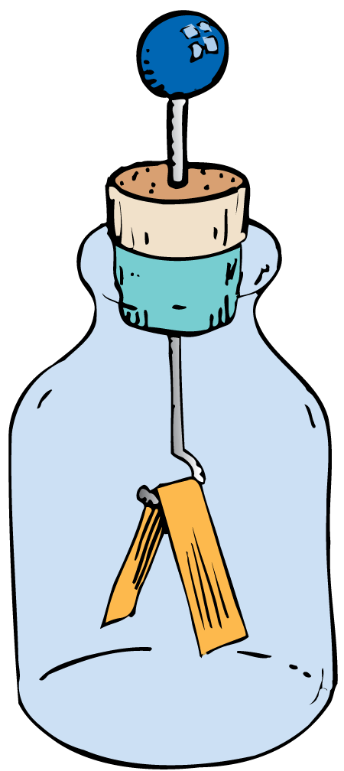
Electrostatics involves electric charges, the forces between them, and their behavior in materials.

Slide 2
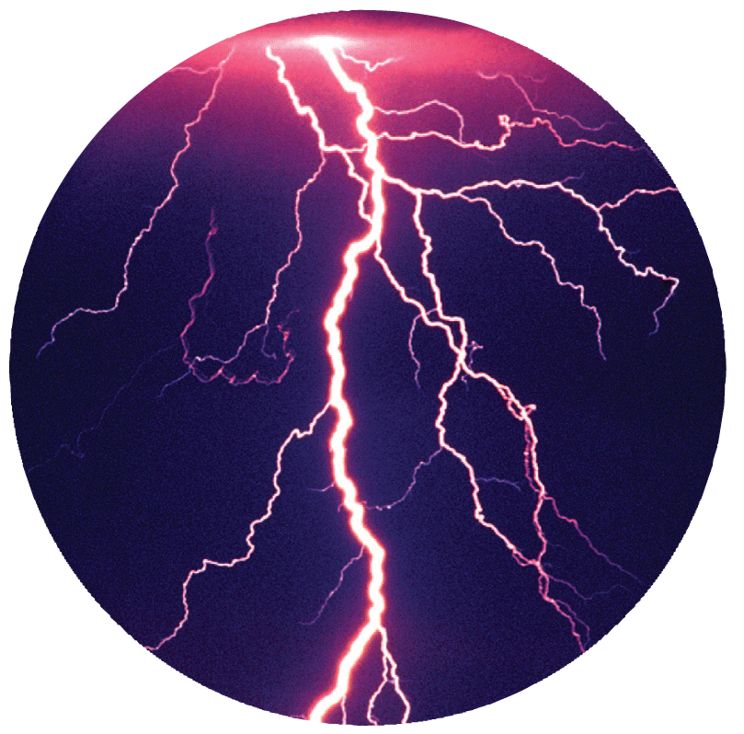
Electrostatics, or electricity at rest, involves electric charges, the forces between them, and their behavior in materials. An understanding of electricity requires a step-by-step approach, for one concept is the building block for the next.
Notes:
‹#›

Slide 3
32.1 Electrical Forces and Charges
The fundamental rule at the base of all electrical phenomena is that like charges repel and opposite charges attract.

Slide 4
32.1 Electrical Forces and Charges
Consider a force acting on you that is billions upon billions of times stronger than gravity.
Suppose that in addition to this enormous force there is a repelling force, also billions upon billions of times stronger than gravity.
The two forces acting on you would balance each other and have no noticeable effect at all.
A pair of such forces acts on you all the time—electrical forces.

Slide 5
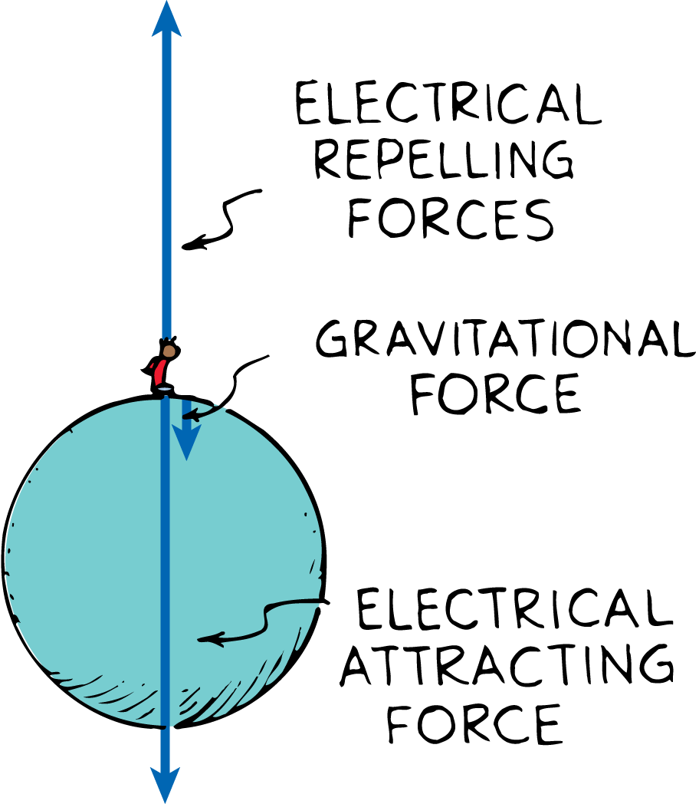
32.1 Electrical Forces and Charges
The enormous attractive and repulsive electrical forces between the charges in Earth and the charges in your body balance out, leaving the relatively weaker force of gravity, which only attracts.

Slide 6
32.1 Electrical Forces and Charges
The Atom
Electrical forces arise from particles in atoms.
The protons in the nucleus attract the electrons and hold them in orbit. Electrons are attracted to protons, but electrons repel other electrons.

Slide 7
32.1 Electrical Forces and Charges
The fundamental electrical property to which the mutual attractions or repulsions between electrons or protons is attributed is called charge.
By convention, electrons are negatively charged and protons positively charged.
Neutrons have no charge, and are neither attracted nor repelled by charged particles.

Slide 8
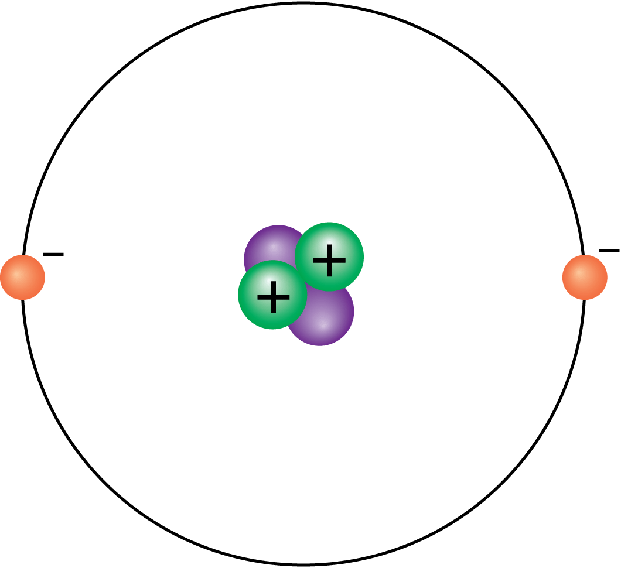
32.1 Electrical Forces and Charges
The helium nucleus is composed of two protons and two neutrons. The positively charged protons attract two negative electrons.

Slide 9
32.1 Electrical Forces and Charges
Here are some important facts about atoms:
Every atom has a positively charged nucleus surrounded by negatively charged electrons.
All electrons are identical.
The nucleus is composed of protons and neutrons. All protons are identical; similarly, all neutrons are identical.
Atoms usually have as many electrons as protons, so the atom has zero net charge.
A proton has nearly 2000 times the mass of an electron, but its positive charge is equal in magnitude to the negative charge of the electron.

Slide 10
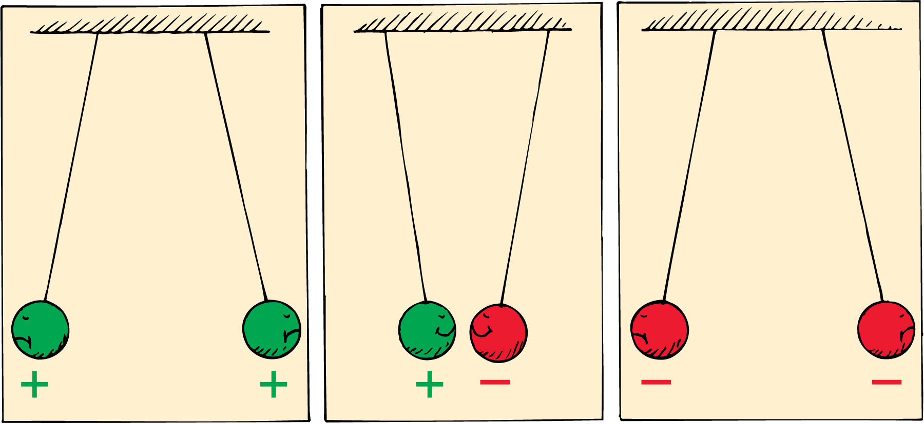
32.1 Electrical Forces and Charges
Attraction and Repulsion

Slide 11
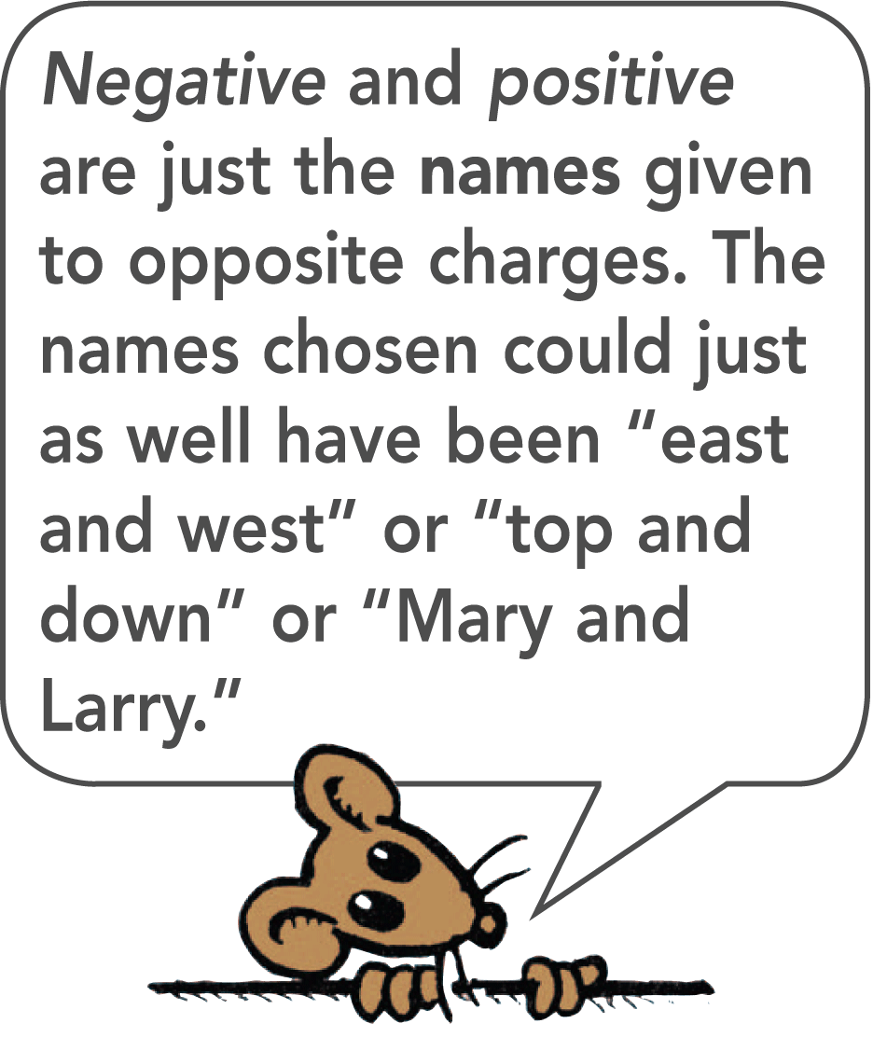
32.1 Electrical Forces and Charges
The fundamental rule of all electrical phenomena is that like charges repel and opposite charges attract.

Slide 12
32.1 Electrical Forces and Charges
What is the fundamental rule at the base of all electrical phenomena?

Slide 13
32.2 Conservation of Charge
An object that has unequal numbers of electrons and protons is electrically charged.

Slide 14
32.2 Conservation of Charge
Electrons and protons have electric charge.
In a neutral atom, there are as many electrons as protons, so there is no net charge.

Slide 15
32.2 Conservation of Charge
If an electron is removed from an atom, the atom is no longer neutral. It has one more positive charge than negative charge.
A charged atom is called an ion.
A positive ion has a net positive charge; it has lost one or more electrons.
A negative ion has a net negative charge; it has gained one or more extra electrons.

Slide 16
32.2 Conservation of Charge
Electrically Charged Objects
Matter is made of atoms, and atoms are made of electrons and protons.
An object that has equal numbers of electrons and protons has no net electric charge.
But if there is an imbalance in the numbers, the object is then electrically charged.
An imbalance comes about by adding or removing electrons.

Slide 17
32.2 Conservation of Charge
The innermost electrons in an atom are bound very tightly to the oppositely charged atomic nucleus.
The outermost electrons of many atoms are bound very loosely and can be easily dislodged.
How much energy is required to tear an electron away from an atom varies for different substances.

Slide 18
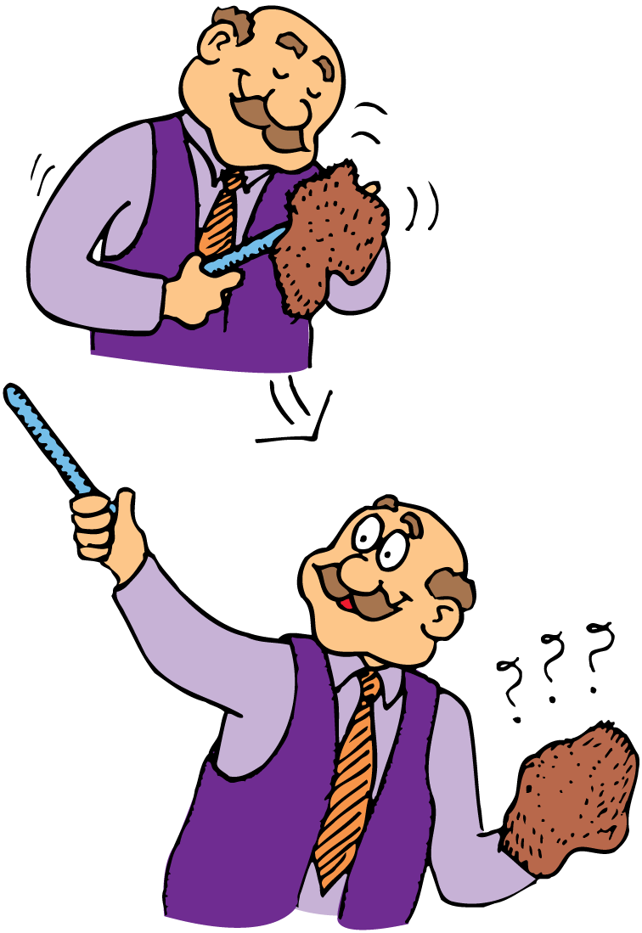
32.2 Conservation of Charge
When electrons are transferred from the fur to the rod, the rod becomes negatively charged.

Slide 19
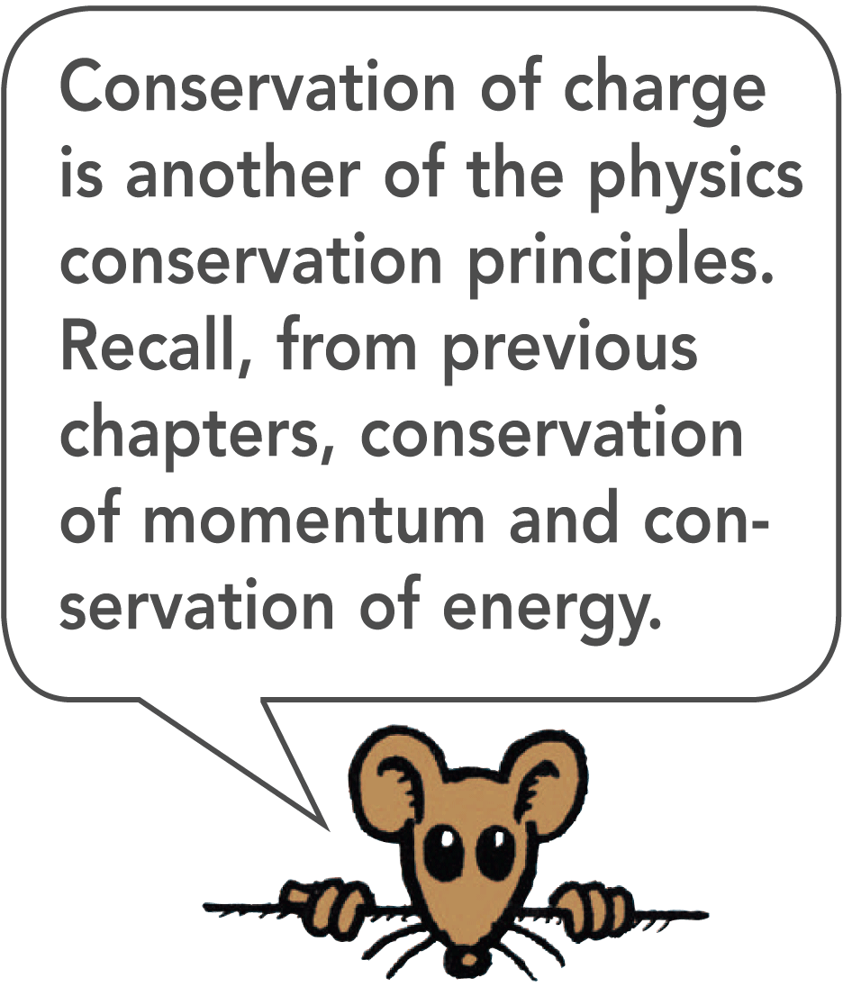
32.2 Conservation of Charge
Principle of Conservation of Charge
Electrons are neither created nor destroyed but are simply transferred from one material to another. This principle is known as conservation of charge.
In every event, whether large-scale or at the atomic and nuclear level, the principle of conservation of charge applies.

Slide 20
32.2 Conservation of Charge
Any object that is electrically charged has an excess or deficiency of some whole number of electrons—electrons cannot be divided into fractions of electrons.
This means that the charge of the object is a whole-number multiple of the charge of an electron.

Slide 21
32.2 Conservation of Charge
think!
If you scuff electrons onto your shoes while walking across a rug, are you negatively or positively charged?

Slide 22
32.2 Conservation of Charge
think!
If you scuff electrons onto your shoes while walking across a rug, are you negatively or positively charged?
Answer:
When your rubber- or plastic-soled shoes drag across the rug, they pick up electrons from the rug in the same way you charge a rubber or plastic rod by rubbing it with a cloth. You have more electrons after you scuff your shoes, so you are negatively charged (and the rug is positively charged).

Slide 23
32.2 Conservation of Charge
What causes an object to become electrically charged?

Slide 24
32.3 Coulomb’s Law
Coulomb’s law states that for charged particles or objects that are small compared with the distance between them, the force between the charges varies directly as the product of the charges and inversely as the square of the distance between them.

Slide 25
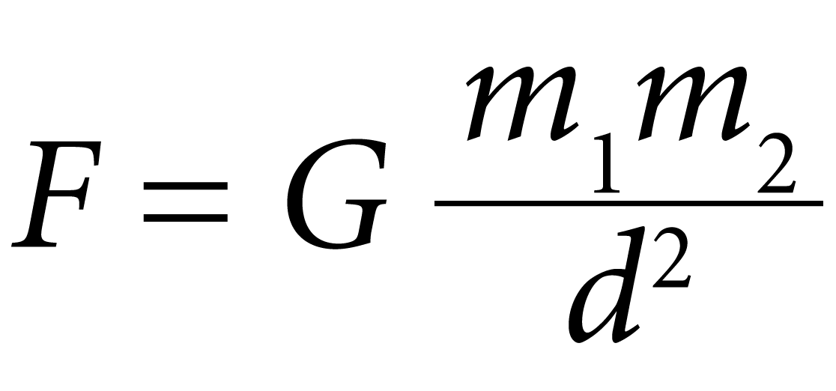
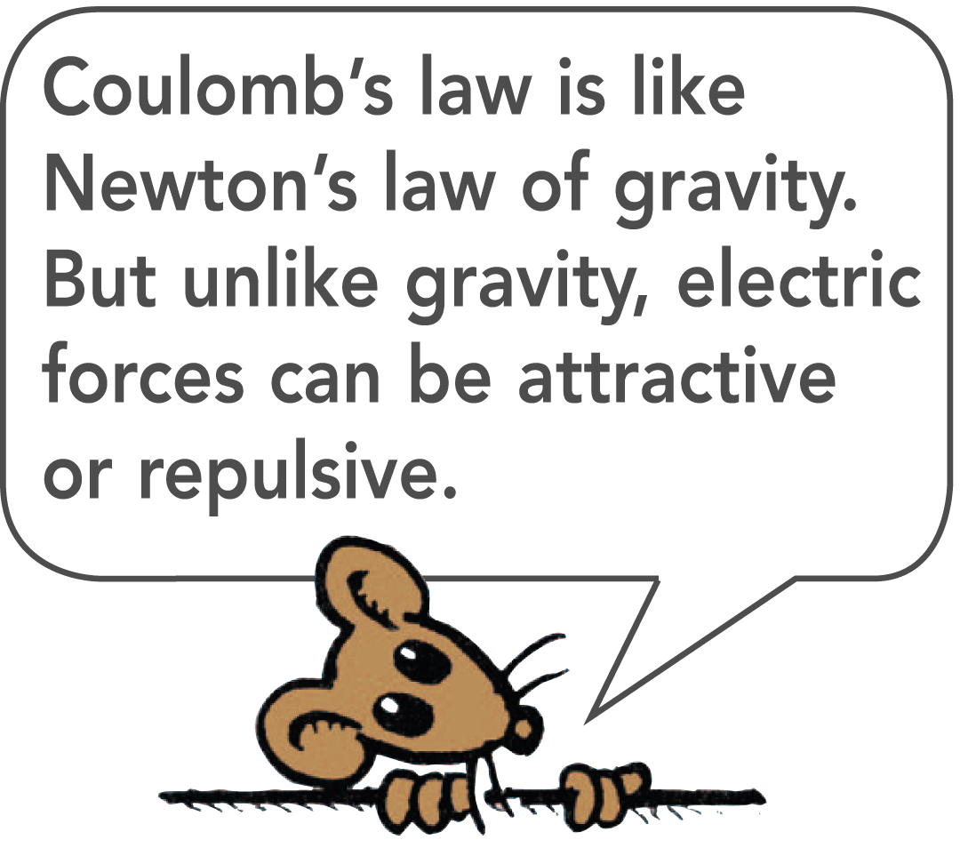
32.3 Coulomb’s Law
Recall from Newton’s law of gravitation that the gravitational force between two objects of mass m₁ and mass m₂ is proportional to the product of the masses and inversely proportional to the square of the distance d between them:

Slide 26
32.3 Coulomb’s Law
Force, Charges, and Distance
The electrical force between any two objects obeys a similar inverse-square relationship with distance.
The relationship among electrical force, charges, and distance—Coulomb’s law—was discovered by the French physicist Charles Coulomb in the eighteenth century.

Slide 27
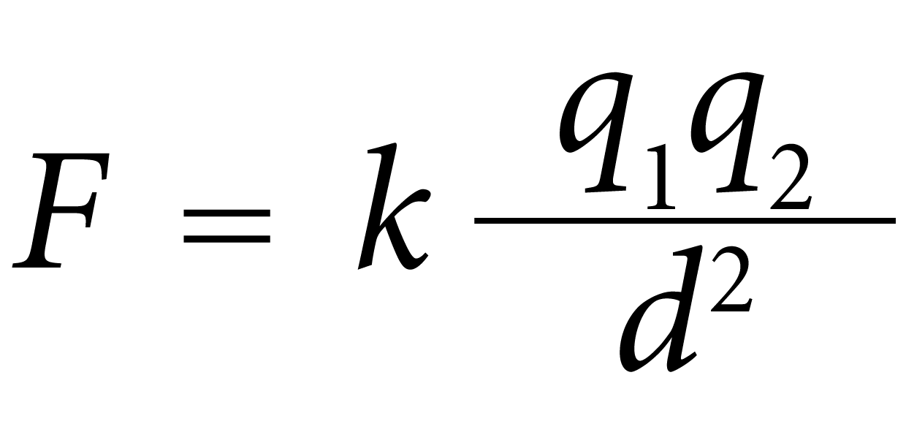
32.3 Coulomb’s Law
For charged objects, the force between the charges varies directly as the product of the charges and inversely as the square of the distance between them.
Where:
d is the distance between the charged particles.
q₁ represents the quantity of charge of one particle.
q₂ is the quantity of charge of the other particle.
k is the proportionality constant.

Slide 28
32.3 Coulomb’s Law
The SI unit of charge is the coulomb, abbreviated C.
A charge of 1 C is the charge of 6.24 × 10¹⁸ electrons.
A coulomb represents the amount of charge that passes through a common 100-W light bulb in about one second.

Slide 29
32.3 Coulomb’s Law
The Electrical Proportionality Constant
The proportionality constant k in Coulomb’s law is similar to G in Newton’s law of gravitation.
k = 9,000,000,000 N·m²/C² or 9.0 × 10⁹ N·m²/C²
If a pair of charges of 1 C each were 1 m apart, the force of repulsion between the two charges would be 9 billion newtons.
That would be more than 10 times the weight of a battleship!

Slide 30
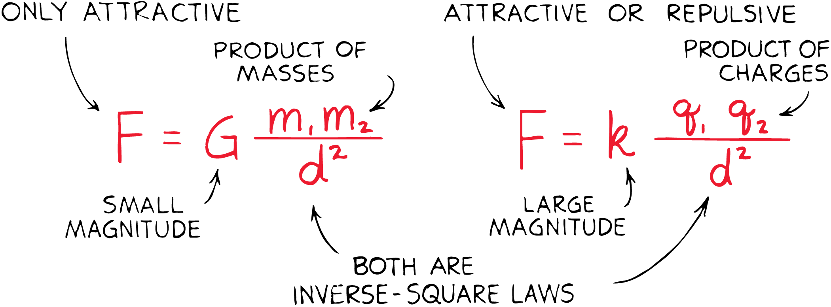
32.3 Coulomb’s Law
Newton’s law of gravitation for masses is similar to Coulomb’s law for electric charges.
Whereas the gravitational force of attraction between a pair of one-kilogram masses is extremely small, the electrical force between a pair of one-coulomb charges is extremely large.
The greatest difference between gravitation and electrical forces is that gravity only attracts but electrical forces may attract or repel.

Slide 31
32.3 Coulomb’s Law
Electrical Forces in Atoms
Because most objects have almost exactly equal numbers of electrons and protons, electrical forces usually balance out.
Between Earth and the moon, for example, there is no measurable electrical force.
In general, the weak gravitational force, which only attracts, is the predominant force between astronomical bodies.

Slide 32
32.3 Coulomb’s Law
Although electrical forces balance out for astronomical and everyday objects, at the atomic level this is not always true.
Often two or more atoms, when close together, share electrons.
Bonding results when the attractive force between the electrons of one atom and the positive nucleus of another atom is greater than the repulsive force between the electrons of both atoms. Bonding leads to the formation of molecules.

Slide 33
32.3 Coulomb’s Law
think!
What is the chief significance of the fact that G in Newton’s law of gravitation is a small number and k in Coulomb’s law is a large number when both are expressed in SI units?

Slide 34
32.3 Coulomb’s Law
think!
What is the chief significance of the fact that G in Newton’s law of gravitation is a small number and k in Coulomb’s law is a large number when both are expressed in SI units?
Answer:
The small value of G indicates that gravity is a weak force; the large value of k indicates that the electrical force is enormous in comparison.

Slide 35
32.3 Coulomb’s Law
think!
a. If an electron at a certain distance from a charged particle is attracted with a certain force, how will the force compare at twice this distance?

Slide 36
32.3 Coulomb’s Law
think!
a. If an electron at a certain distance from a charged particle is attracted with a certain force, how will the force compare at twice this distance?
Answer:
a. In accord with the inverse-square law, at twice the distance the force will be one fourth as much.

Slide 37
32.3 Coulomb’s Law
think!
a. If an electron at a certain distance from a charged particle is attracted with a certain force, how will the force compare at twice this distance?
b. Is the charged particle in this case positive or negative?
Answer:
a. In accord with the inverse-square law, at twice the distance the force will be one fourth as much.

Slide 38
32.3 Coulomb’s Law
think!
a. If an electron at a certain distance from a charged particle is attracted with a certain force, how will the force compare at twice this distance?
b. Is the charged particle in this case positive or negative?
Answer:
a. In accord with the inverse-square law, at twice the distance the force will be one fourth as much. b. Since there is a force of attraction, the charges must be opposite in sign, so the charged particle is positive.

Slide 39
32.3 Coulomb’s Law
What does Coulomb’s law state?

Slide 40
32.4 Conductors and Insulators
Electrons move easily in good conductors and poorly in good insulators.

Slide 41
32.4 Conductors and Insulators
Outer electrons of the atoms in a metal are not anchored to the nuclei of particular atoms, but are free to roam in the material.
Materials through which electric charge can flow are called conductors.
Metals are good conductors for the motion of electric charges because their electrons are “loose.”

Slide 42
32.4 Conductors and Insulators
Electrons in other materials—rubber and glass, for example—are tightly bound and remain with particular atoms.
They are not free to wander about to other atoms in the material.
These materials, known as insulators, are poor conductors of electricity.

Slide 43
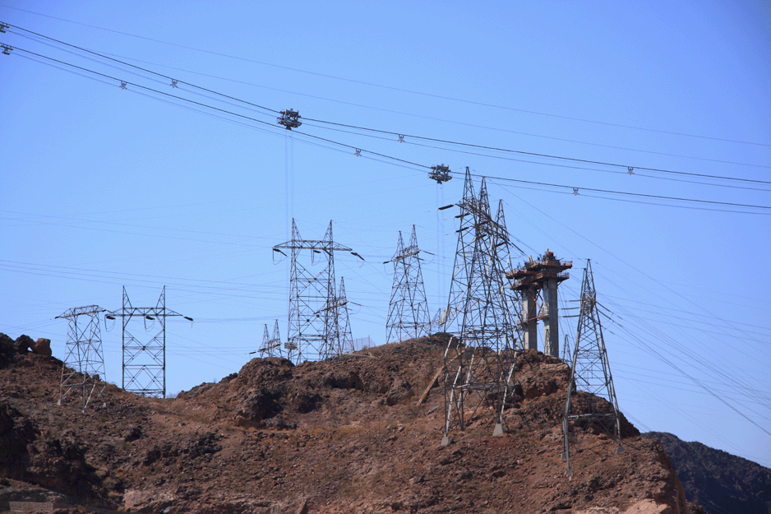
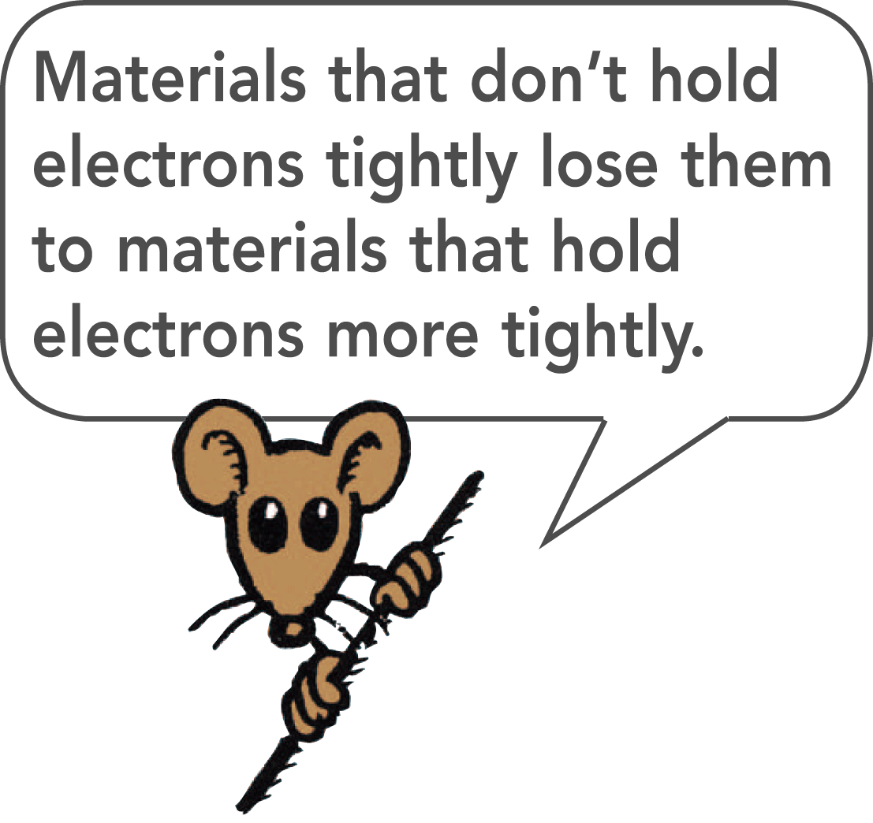
32.4 Conductors and Insulators
A substance is classified as a conductor or an insulator based on how tightly the atoms of the substance hold their electrons.
The conductivity of a metal can be more than a million trillion times greater than the conductivity of an insulator such as glass.
In power lines, charge flows much more easily through hundreds of kilometers of metal wire than through the few centimeters of insulating material that separates the wire from the supporting tower.

Slide 44
32.4 Conductors and Insulators
Semiconductors are materials that can be made to behave sometimes as insulators and sometimes as conductors.
Atoms in a semiconductor hold their electrons until given small energy boosts.
This occurs in photovoltaic cells that convert solar energy into electrical energy.
Thin layers of semiconducting materials sandwiched together make up transistors.

Slide 45
32.4 Conductors and Insulators
What is the difference between a good conductor and a good insulator?

Slide 46
32.5 Charging by Friction and Contact
Two ways electric charge can be transferred are by friction and by contact.

Slide 47
32.5 Charging by Friction and Contact
We can stroke a cat’s fur and hear the crackle of sparks that are produced.
We can comb our hair in front of a mirror in a dark room and see as well as hear the sparks of electricity.
We can scuff our shoes across a rug and feel the tingle as we reach for the doorknob.
Electrons are being transferred by friction when one material rubs against another.

Slide 48
32.5 Charging by Friction and Contact
If you slide across a seat in an automobile, you are in danger of being charged by friction.

Slide 49
32.5 Charging by Friction and Contact
Electrons can also be transferred from one material to another by simply touching.
When a charged rod is placed in contact with a neutral object, some charge will transfer to the neutral object.
This method of charging is called charging by contact.
If the object is a good conductor, the charge will spread to all parts of its surface because the like charges repel each other.

Slide 50
32.5 Charging by Friction and Contact
What are two ways electric charge can be transferred?

Slide 51
32.6 Charging by Induction
If a charged object is brought near a conducting surface, even without physical contact, electrons will move in the conducting surface.

Slide 52
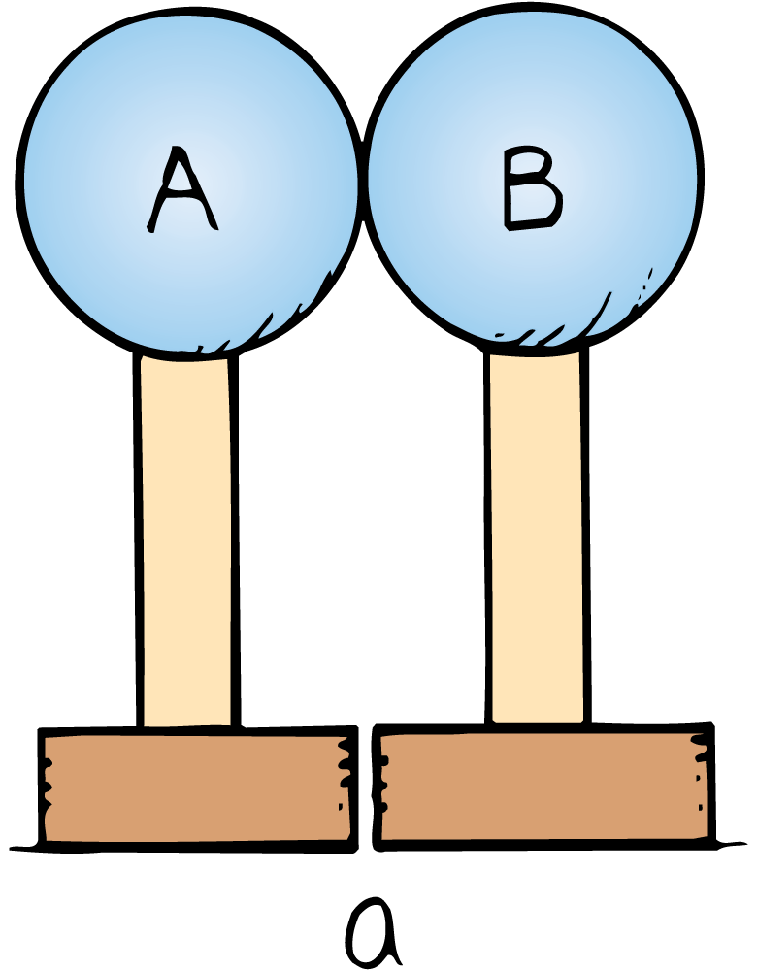
32.6 Charging by Induction
Charging by induction can be illustrated using two insulated metal spheres.
Uncharged insulated metal spheres touching each other, in effect, form a single noncharged conductor.

Slide 53
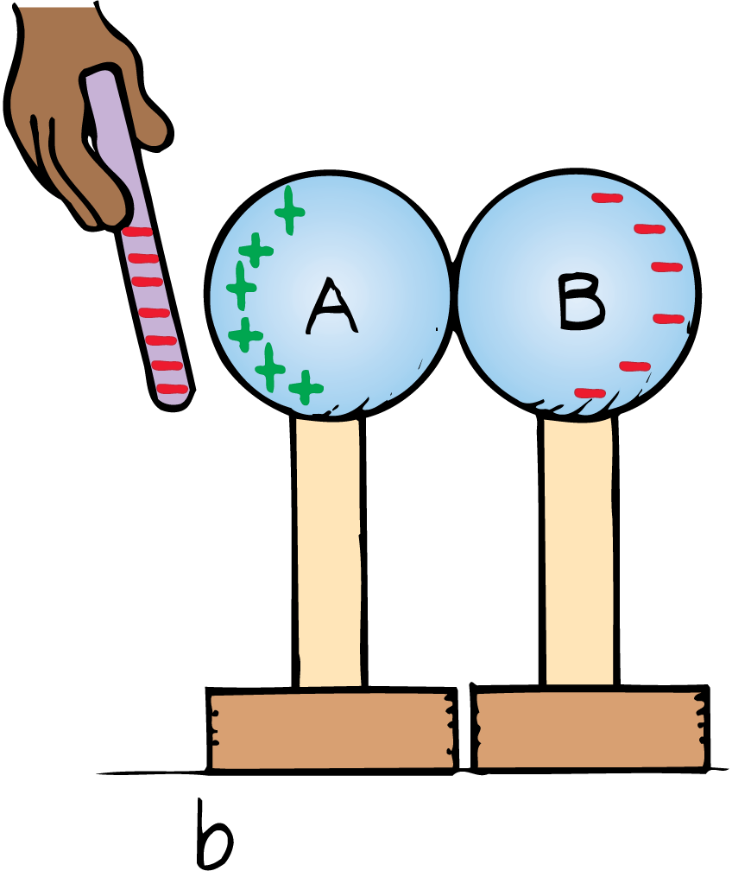
32.6 Charging by Induction
When a negatively charged rod is held near one sphere, electrons in the metal are repelled by the rod.
Excess negative charge has moved to the other sphere, leaving the first sphere with an excess positive charge.
The charge on the spheres has been redistributed, or induced.

Slide 54
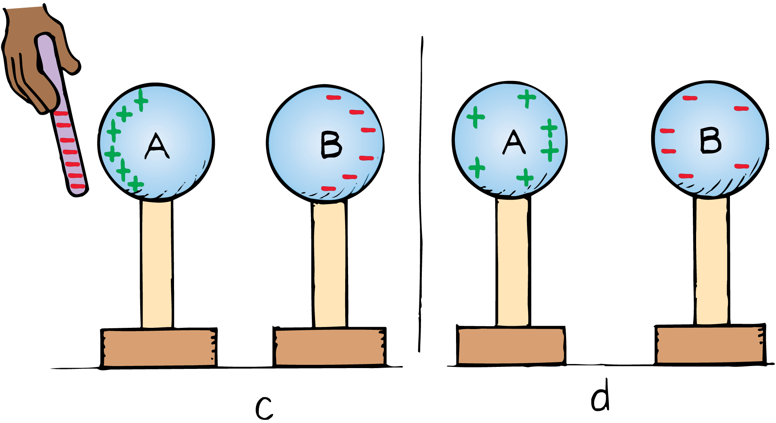
32.6 Charging by Induction
When the spheres are separated and the rod removed, the spheres are charged equally and oppositely.
They have been charged by induction, which is the charging of an object without direct contact.

Slide 55
32.6 Charging by Induction
Charge induction by grounding can be illustrated using a metal sphere hanging from a nonconducting string.

Slide 56
32.6 Charging by Induction
Charge induction by grounding can be illustrated using a metal sphere hanging from a nonconducting string.
A charge redistribution is induced by the presence of the charged rod. The net charge on the sphere is still zero.

Slide 57
32.6 Charging by Induction
Charge induction by grounding can be illustrated using a metal sphere hanging from a nonconducting string.
A charge redistribution is induced by the presence of the charged rod. The net charge on the sphere is still zero.
Touching the sphere removes electrons by contact and the sphere is left positively charged.

Slide 58
32.6 Charging by Induction
Charge induction by grounding can be illustrated using a metal sphere hanging from a nonconducting string.
A charge redistribution is induced by the presence of the charged rod. The net charge on the sphere is still zero.
Touching the sphere removes electrons by contact and the sphere is left positively charged.
The positively charged sphere is attracted to a negative rod.

Slide 59
32.6 Charging by Induction
Charge induction by grounding can be illustrated using a metal sphere hanging from a nonconducting string.
A charge redistribution is induced by the presence of the charged rod. The net charge on the sphere is still zero.
Touching the sphere removes electrons by contact and the sphere is left positively charged.
The positively charged sphere is attracted to a negative rod.
When electrons move onto the sphere from the rod, it becomes negatively charged by contact.

Slide 60
32.6 Charging by Induction
When we touch the metal surface with a finger, charges that repel each other have a conducting path to a practically infinite reservoir for electric charge—the ground.
When we allow charges to move off (or onto) a conductor by touching it, we are grounding it.

Slide 61
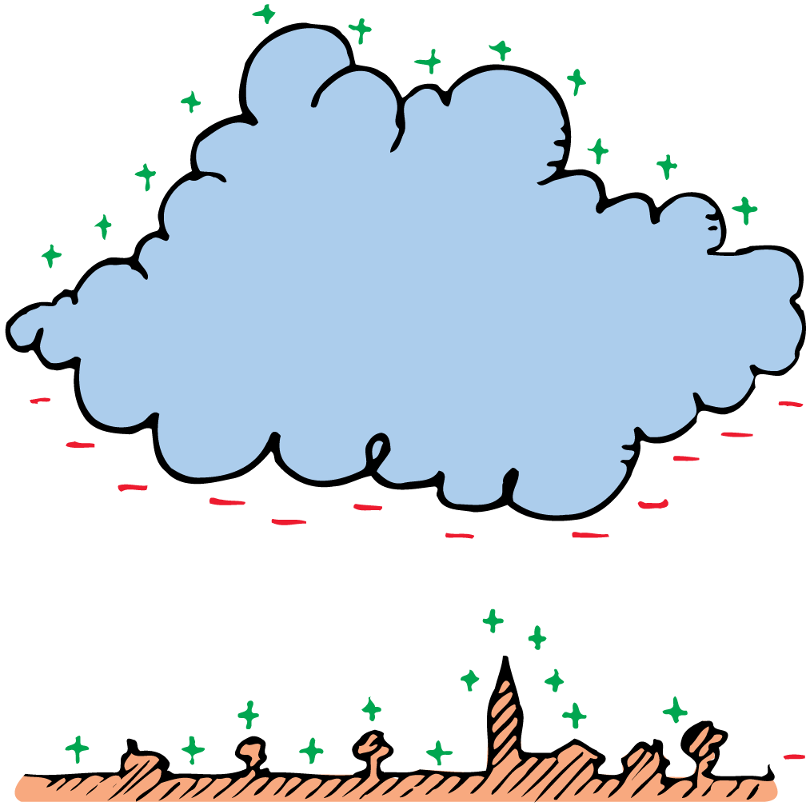
32.6 Charging by Induction
Charging by induction occurs during thunderstorms.
The negatively charged bottoms of clouds induce a positive charge on the surface of Earth below.
Most lightning is an electrical discharge between oppositely charged parts of clouds.
The kind of lightning we are most familiar with is the electrical discharge between clouds and oppositely charged ground below.

Slide 62
32.6 Charging by Induction
If a rod is placed above a building and connected to the ground, the point of the rod collects electrons from the air.
This prevents a buildup of positive charge by induction.
The primary purpose of the lightning rod is to prevent a lightning discharge from occurring.
If lightning does strike, it may be attracted to the rod and short-circuited to the ground, sparing the building.

Slide 63
32.6 Charging by Induction
think!
Why does the negative rod in the two-sphere example have the same charge before and after the spheres are charged, but not when charging takes place in the single-sphere example?

Slide 64
32.6 Charging by Induction
think!
Why does the negative rod in the two-sphere example have the same charge before and after the spheres are charged, but not when charging takes place in the single-sphere example?
Answer:
In the first charging process, no contact was made between the negative rod and either of the spheres. In the second charging process, however, the rod touched the sphere when it was positively charged. A transfer of charge by contact reduced the negative charge on the rod.

Slide 65
32.6 Charging by Induction
What happens when a charged object is placed near a conducting surface?

Slide 66
32.7 Charge Polarization
Charge polarization can occur in insulators that are near a charged object.

Slide 67
32.7 Charge Polarization
Charging by induction is not restricted to conductors. Charge polarization can occur in insulators that are near a charged object.
When a charged rod is brought near an insulator, there are no free electrons to migrate throughout the insulating material.
Instead, there is a rearrangement of the positions of charges within the atoms and molecules themselves.

Slide 68
32.7 Charge Polarization
One side of the atom or molecule is induced to be slightly more positive (or negative) than the opposite side.
The atom or molecule is said to be electrically polarized.

Slide 69
32.7 Charge Polarization
When an external negative charge is brought closer from the left, the charges within a neutral atom or molecule rearrange.

Slide 70
32.7 Charge Polarization
When an external negative charge is brought closer from the left, the charges within a neutral atom or molecule rearrange.
All the atoms or molecules near the surface of the insulator become electrically polarized.

Slide 71
32.7 Charge Polarization
Examples of Charge Polarization
Polarization explains why electrically neutral bits of paper are attracted to a charged object, such as a charged comb.
Molecules are polarized in the paper, with the oppositely charged sides of molecules closest to the charged object.

Slide 72
32.7 Charge Polarization
The bits of paper experience a net attraction.
Sometimes they will cling to the charged object and suddenly fly off.
Charging by contact has occurred; the paper bits have acquired the same sign of charge as the charged object and are then repelled.

Slide 73
32.7 Charge Polarization
A charged comb attracts an uncharged piece of paper because the force of attraction for the closer charge is greater than the force of repulsion for the farther charge.

Slide 74
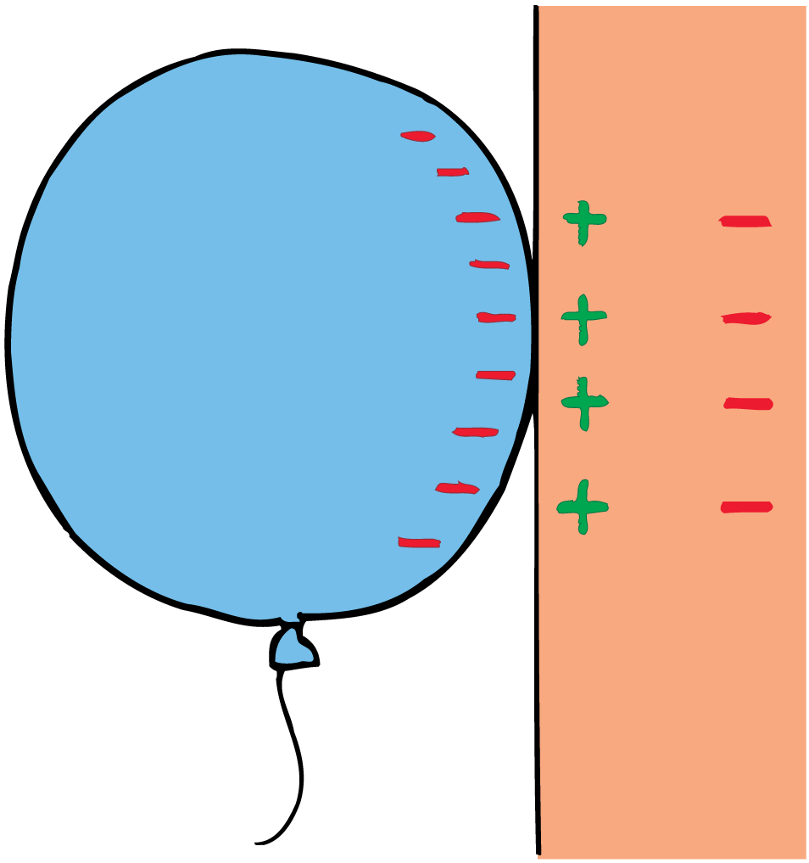
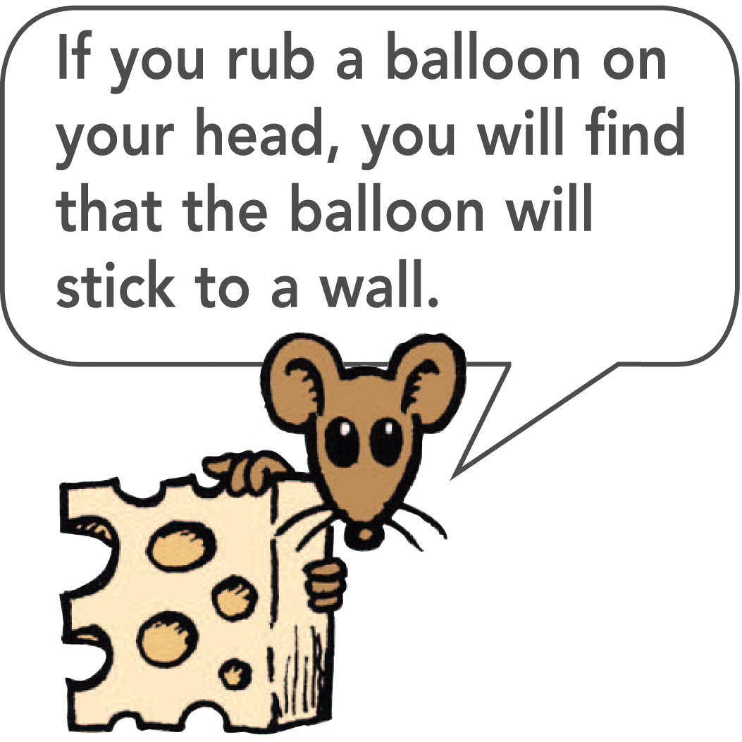
32.7 Charge Polarization
Rub an inflated balloon on your hair and it becomes charged.
Place the balloon against the wall and it sticks.
The charge on the balloon induces an opposite surface charge on the wall. The charge on the balloon is slightly closer to the opposite induced charge than to the charge of the same sign.

Slide 75
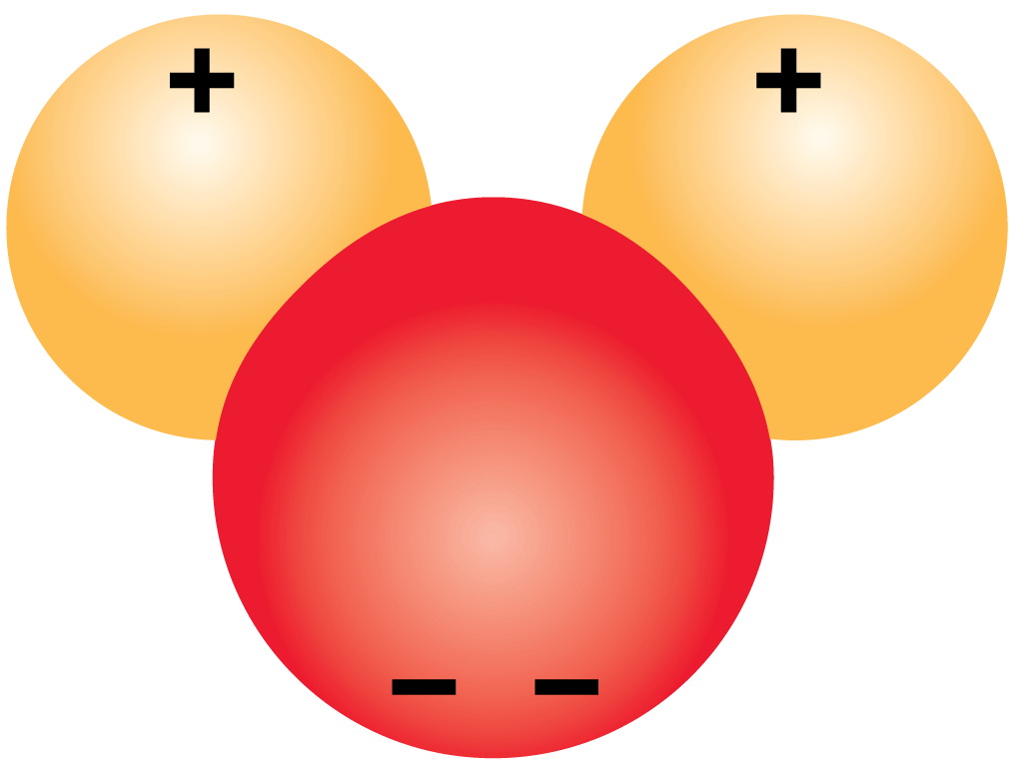
32.7 Charge Polarization
Electric Dipoles
Many molecules—H₂O, for example—are electrically polarized in their normal states.
The distribution of electric charge is not perfectly even.
There is a little more negative charge on one side of the molecule than on the other.
Such molecules are said to be electric dipoles.

Slide 76
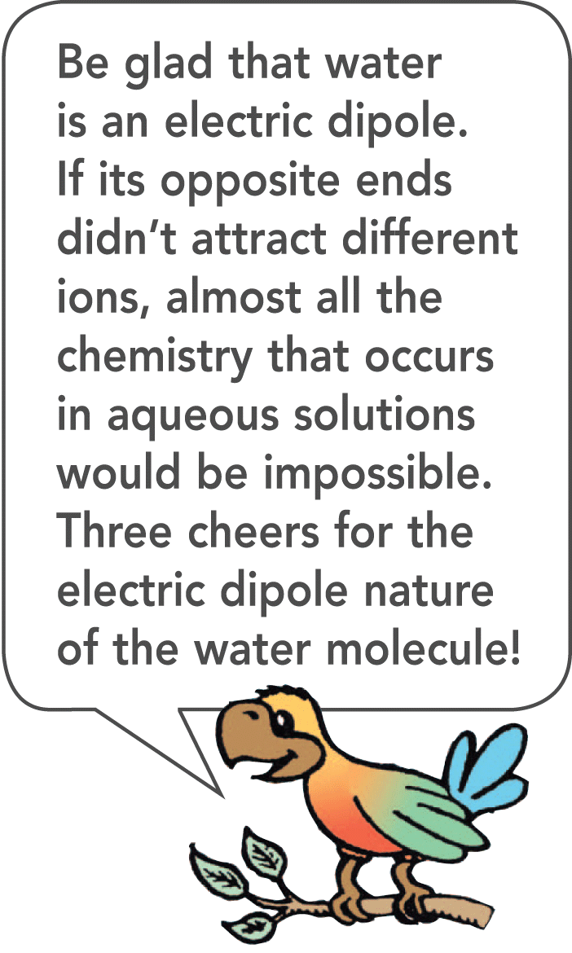
32.7 Charge Polarization

Slide 77
32.7 Charge Polarization
In summary, objects are electrically charged in three ways.
By friction, when electrons are transferred by friction from one object to another.
By contact, when electrons are transferred from one object to another by direct contact without rubbing.
By induction, when electrons are caused to gather or disperse by the presence of nearby charge without physical contact.

Slide 78
32.7 Charge Polarization
If the object is an insulator, on the other hand, then a realignment of charge rather than a migration of charge occurs.
This is charge polarization, in which the surface near the charged object becomes oppositely charged.

Slide 79
32.7 Charge Polarization
What happens when an insulator is in the presence of a charged object?

Slide 80
Assessment Questions
If a neutral atom has 22 protons in its nucleus, the number of surrounding electrons is
less than 22.
22.
more than 22.
unknown.

Slide 81
Assessment Questions
If a neutral atom has 22 protons in its nucleus, the number of surrounding electrons is
less than 22.
22.
more than 22.
unknown.
Answer: B

Slide 82
Assessment Questions
When we say charge is conserved, we mean that charge can
be saved, like money in a bank.
only be transferred from one place to another.
take equivalent forms.
be created or destroyed, as in nuclear reactions.

Slide 83
Assessment Questions
When we say charge is conserved, we mean that charge can
be saved, like money in a bank.
only be transferred from one place to another.
take equivalent forms.
be created or destroyed, as in nuclear reactions.
Answer: B

Slide 84
Assessment Questions
A difference between Newton’s law of gravity and Coulomb’s law is that only one of these
is a fundamental physical law.
uses a proportionality constant.
invokes the inverse-square law.
involves repulsive as well as attractive forces.

Slide 85
Assessment Questions
A difference between Newton’s law of gravity and Coulomb’s law is that only one of these
is a fundamental physical law.
uses a proportionality constant.
invokes the inverse-square law.
involves repulsive as well as attractive forces.
Answer: D

Slide 86
Assessment Questions
Which is the predominant carrier of charge in copper wire?
protons
electrons
ions
neutrons

Slide 87
Assessment Questions
Which is the predominant carrier of charge in copper wire?
protons
electrons
ions
neutrons
Answer: B

Slide 88
Assessment Questions
When you scuff electrons off a rug with your shoes, your shoes are then
negatively charged.
positively charged.
ionic.
electrically neutral.

Slide 89
Assessment Questions
When you scuff electrons off a rug with your shoes, your shoes are then
negatively charged.
positively charged.
ionic.
electrically neutral.
Answer: A

Slide 90
Assessment Questions
When a cloud that is negatively charged on its bottom and positively charged on its top moves over the ground below, the ground acquires
a negative charge.
a positive charge.
no charge since the cloud is electrically neutral.
an electrically grounded state.

Slide 91
Assessment Questions
When a cloud that is negatively charged on its bottom and positively charged on its top moves over the ground below, the ground acquires
a negative charge.
a positive charge.
no charge since the cloud is electrically neutral.
an electrically grounded state.
Answer: B

Slide 92
Assessment Questions
When a negatively charged balloon is placed against a non-conducting wall, positive charges in the wall are
attracted to the balloon.
repelled from the balloon.
too bound to negative charges in the wall to have any effect.
neutralized.

Slide 93
Assessment Questions
When a negatively charged balloon is placed against a non-conducting wall, positive charges in the wall are
attracted to the balloon.
repelled from the balloon.
too bound to negative charges in the wall to have any effect.
neutralized.
Answer: A

