Slide 1
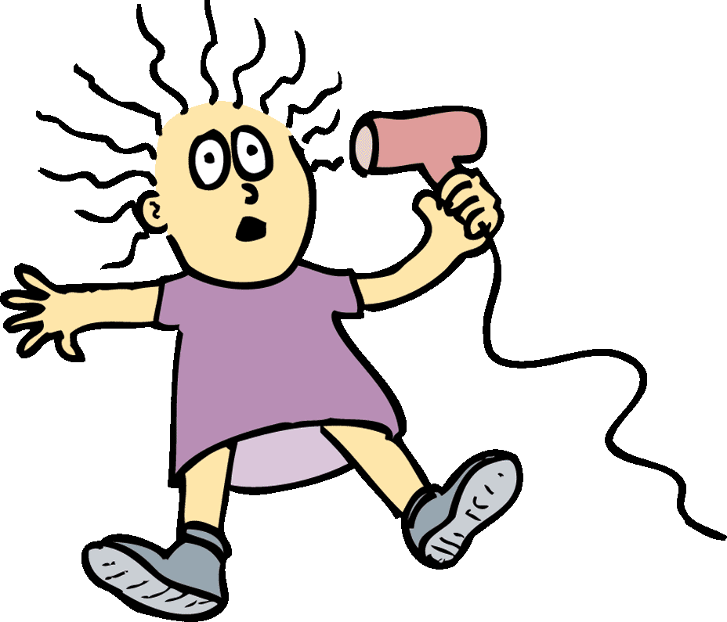
Electric current is related to the voltage that produces it, and the resistance that opposes it.

Slide 2
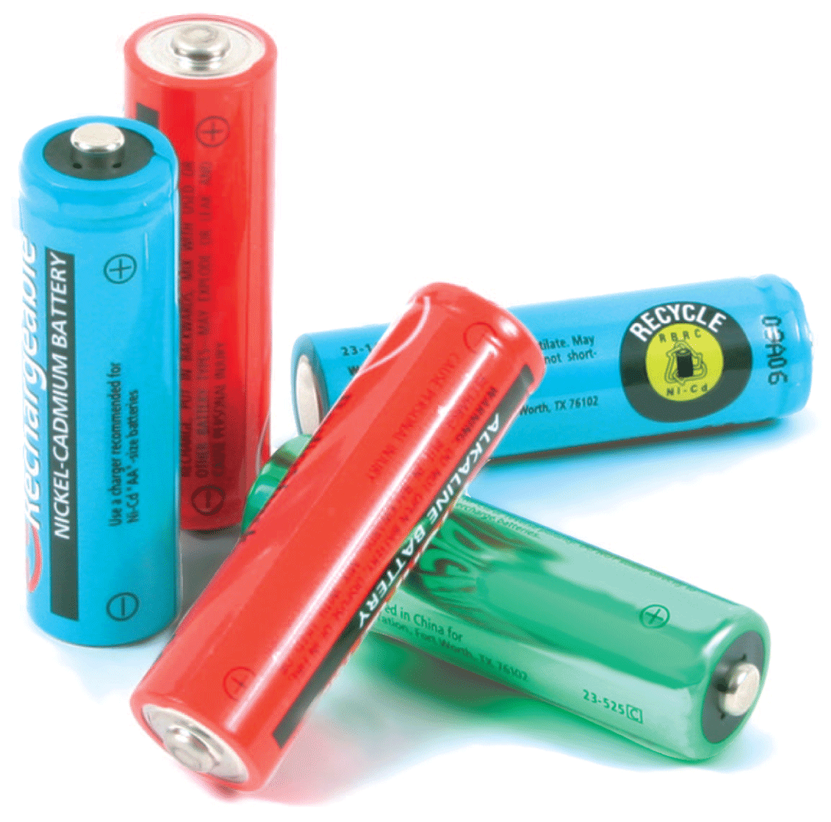
Voltage produces a flow of charge, or current, within a conductor. The flow is restrained by the resistance it encounters. The rate at which energy is transferred by electric current is power.

Slide 3
34.1 Flow of Charge
When the ends of an electric conductor are at different electric potentials, charge flows from one end to the other.

Slide 4
34.1 Flow of Charge
Heat flows through a conductor when a temperature difference exists. Heat flows from higher temperature to lower temperature.
When temperature is at equilibrium, the flow of heat ceases.

Slide 5
34.1 Flow of Charge
Charge flows in a similar way. Charge flows when there is a potential difference, or difference in potential (voltage), between the ends of a conductor. The flow continues until both ends reach the same potential.
When there is no potential difference, there is no longer a flow of charge through the conductor.
To attain a sustained flow of charge in a conductor, one end must remain at a higher potential than the other.
The situation is analogous to the flow of water.

Slide 6
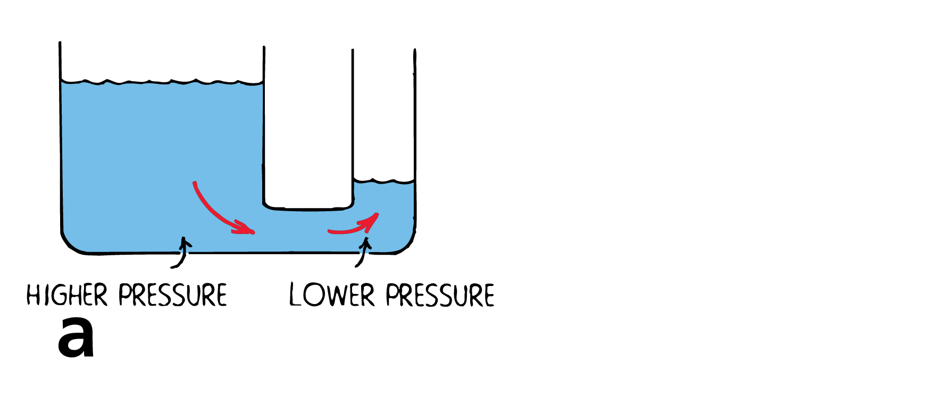
34.1 Flow of Charge
Water flows from higher pressure to lower pressure. The flow will cease when the difference in pressure ceases.

Slide 7
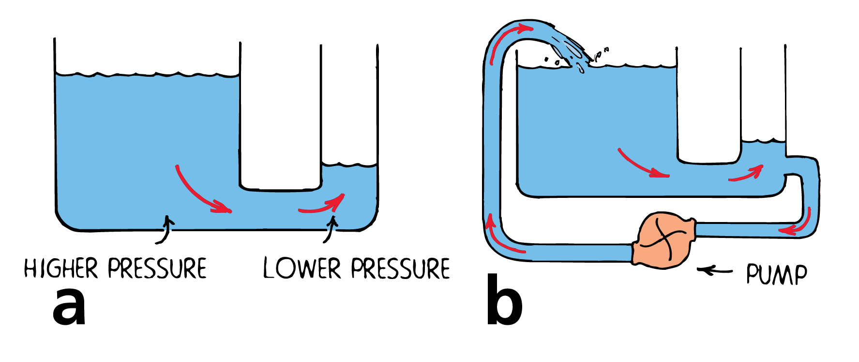
34.1 Flow of Charge
Water flows from higher pressure to lower pressure. The flow will cease when the difference in pressure ceases.
Water continues to flow because a difference in pressure is maintained with the pump. The same is true of electric current.

Slide 8
34.1 Flow of Charge
What happens when the ends of a conductor are at different electrical potentials?

Slide 9
34.2 Electric Current
A current-carrying wire has a net electric charge of zero.

Slide 10
34.2 Electric Current
Electric current is the flow of electric charge.
In solid conductors, electrons carry the charge through the circuit because they are free to move throughout the atomic network.
These electrons are called conduction electrons.
Protons are bound inside atomic nuclei, locked in fixed positions.
In fluids, such as the electrolyte in a car battery, positive and negative ions as well as electrons may flow.

Slide 11
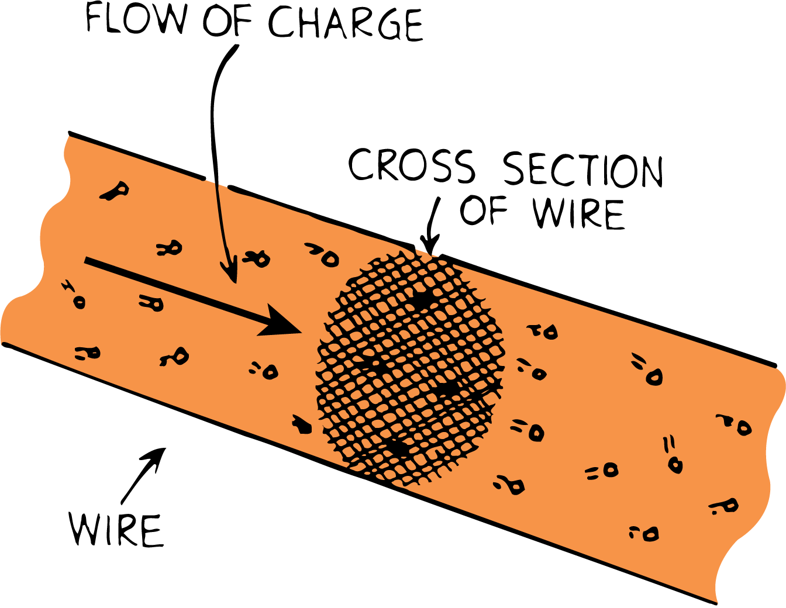
34.2 Electric Current
Measuring Current
Electric current is measured in amperes, symbol A.
An ampere is the flow of 1 coulomb of charge per second.
When the flow of charge past any cross section is 1 coulomb (6.24 billion billion electrons) per second, the current is 1 ampere.

Slide 12
34.2 Electric Current
Net Charge of a Wire
While the current is flowing, negative electrons swarm through the atomic network of positively charged atomic nuclei.
Under ordinary conditions, the number of electrons in the wire is equal to the number of positive protons in the atomic nuclei.
As electrons flow, the number entering is the same as the number leaving, so the net charge is normally zero at every moment.

Slide 13
34.2 Electric Current
What is the net flow of electric charge in a current-carrying wire?

Slide 14
34.3 Voltage Sources
Voltage sources such as batteries and generators supply energy that allows charges to move steadily.

Slide 15
34.3 Voltage Sources
Charges do not flow unless there is a potential difference.
Something that provides a potential difference is known as a voltage source.
Batteries and generators are capable of maintaining a continuous flow of electrons.

Slide 16
34.3 Voltage Sources
Steady Voltage Sources
In a battery, a chemical reaction releases electrical energy.
Generators—such as the alternators in automobiles—convert mechanical energy to electrical energy.
The electrical potential energy produced is available at the terminals of the battery or generator.

Slide 17
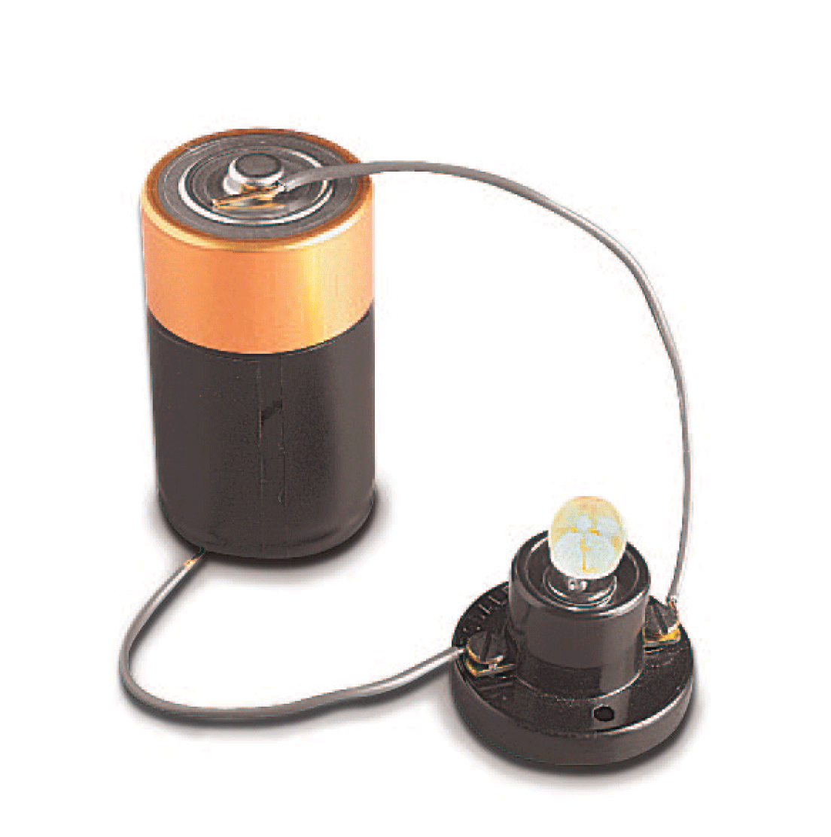
34.3 Voltage Sources
The potential energy per coulomb of charge available to electrons moving between terminals is the voltage.
The voltage provides the “electric pressure” to move electrons between the terminals in a circuit.

Slide 18
34.3 Voltage Sources
Power utilities use electric generators to provide the 120 volts delivered to home outlets.
The alternating potential difference between the two holes in the outlet averages 120 volts.
When the prongs of a plug are inserted into the outlet, an average electric “pressure” of 120 volts is placed across the circuit.
This means that 120 joules of energy is supplied to each coulomb of charge that is made to flow in the circuit.

Slide 19
34.3 Voltage Sources
Distinguishing Between Current and Voltage
There is often some confusion between charge flowing through a circuit and voltage being impressed across a circuit.

Slide 20
34.3 Voltage Sources
Consider a long pipe filled with water.
Water will flow through the pipe if there is a difference in pressure across the pipe or between its ends.
Water flows from high pressure to low pressure.
Similarly, charges flow through a circuit because of an applied voltage across the circuit.
You don’t say that voltage flows through a circuit.
Voltage doesn’t go anywhere, for it is the charges that move.
Voltage causes current.

Slide 21
34.3 Voltage Sources
What are two voltage sources used to provide the energy that allows charges to move steadily?

Slide 22
34.4 Electric Resistance
The resistance of a wire depends on the conductivity of the material used in the wire (that is, how well it conducts) and also on the thickness and length of the wire.

Slide 23
34.4 Electric Resistance
The amount of charge that flows in a circuit depends on the voltage provided by the voltage source.
The current also depends on the resistance that the conductor offers to the flow of charge—the electric resistance.
This is similar to the rate of water flow in a pipe, which depends on the pressure difference and on the resistance of the pipe.

Slide 24
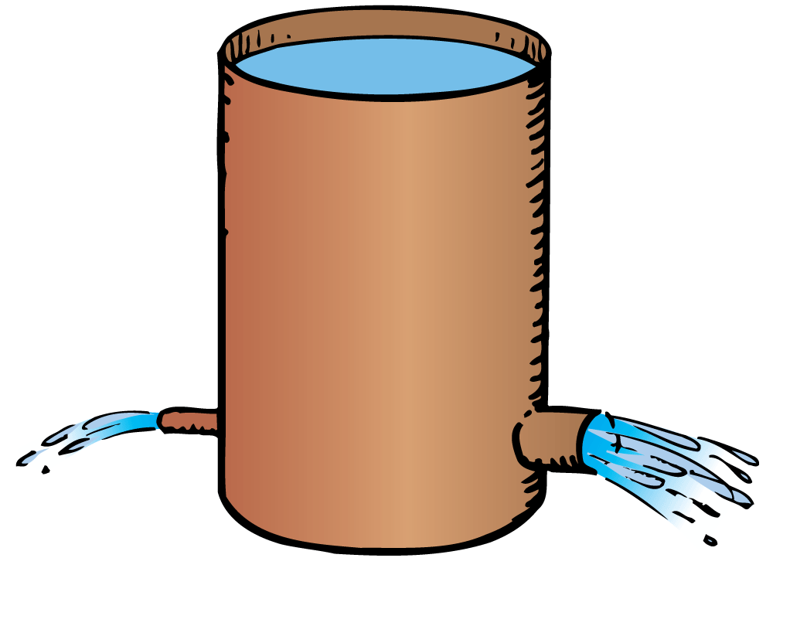
34.4 Electric Resistance
For a given pressure, more water passes through a large pipe than a small one. Similarly, for a given voltage, more electric current passes through a large-diameter wire than a small-diameter one.

Slide 25
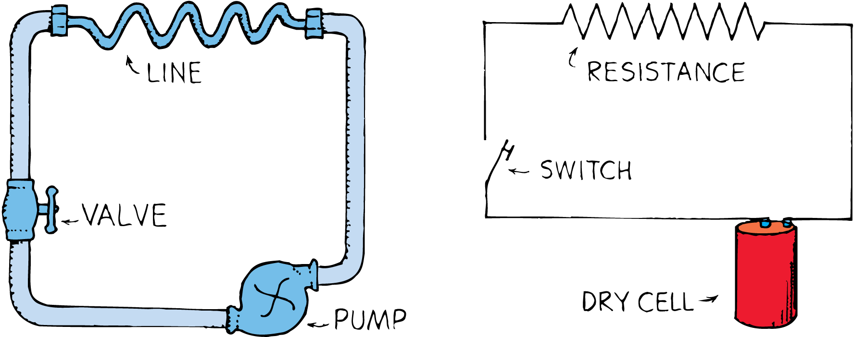
34.4 Electric Resistance
A simple hydraulic circuit is analogous to an electric circuit.

Slide 26
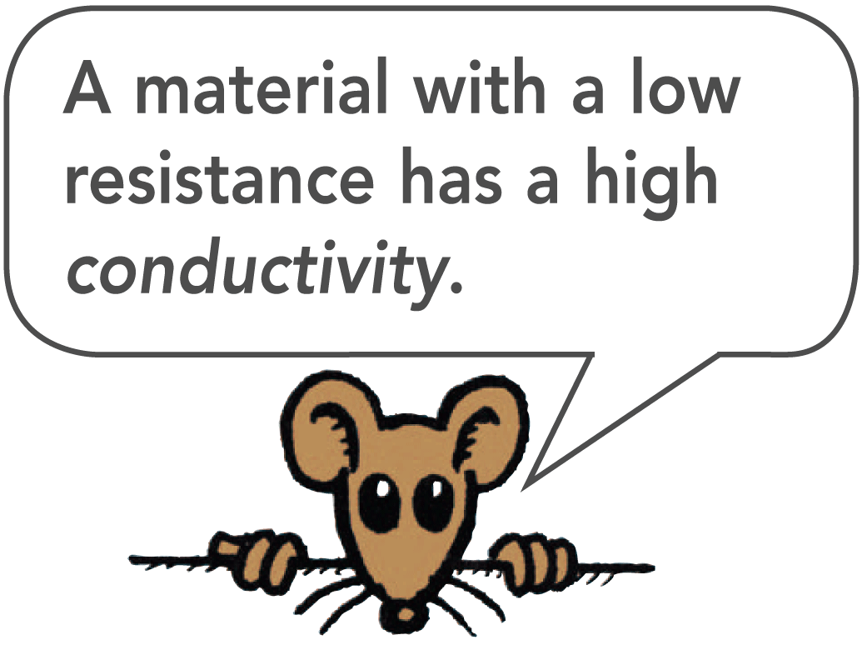
34.4 Electric Resistance
The resistance of a wire depends on the conductivity of the material in the wire and on the thickness and length of the wire.
Thick wires have less resistance than thin wires.
Longer wires have more resistance than short wires.
Electric resistance also depends on temperature. For most conductors, increased temperature means increased resistance.

Slide 27
34.4 Electric Resistance
The resistance of some materials becomes zero at very low temperatures, a phenomenon known as superconductivity.
Certain metals acquire superconductivity (zero resistance to the flow of charge) at temperatures near absolute zero.
Superconductivity at “high” temperatures (above 100 K) has been found in a variety of nonmetallic compounds.
In a superconductor, the electrons flow indefinitely.

Slide 28
34.4 Electric Resistance
What factors affect the resistance of a wire?

Slide 29
34.5 Ohm’s Law
Ohm’s law states that the current in a circuit is directly proportional to the voltage impressed across the circuit, and is inversely proportional to the resistance of the circuit.

Slide 30
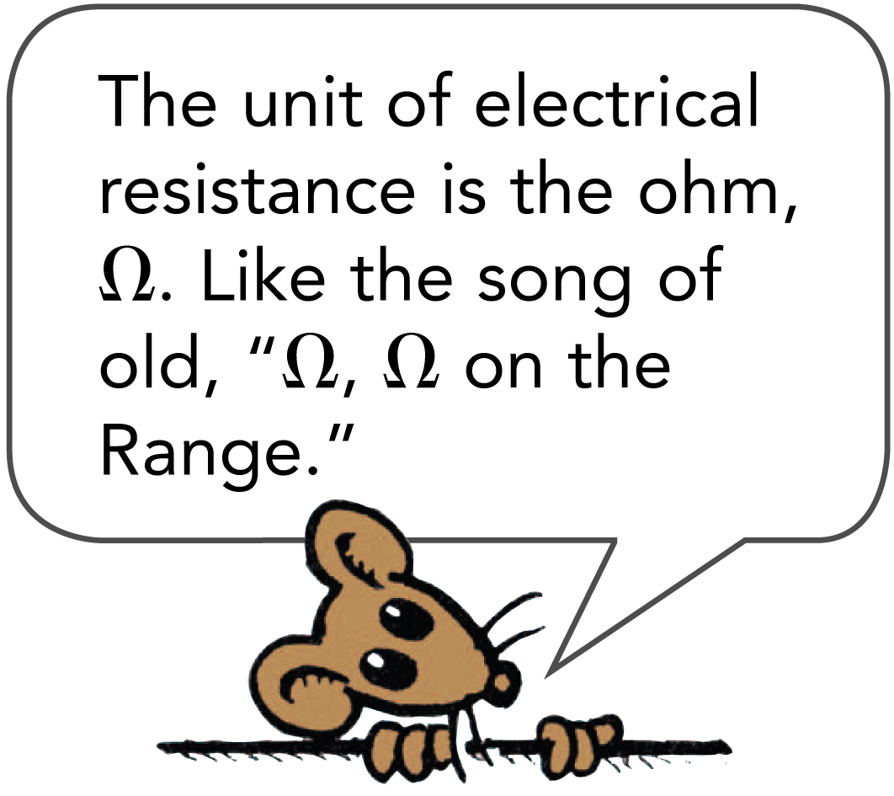
34.5 Ohm’s Law
Electric resistance is measured in units called ohms.
Georg Simon Ohm, a German physicist, tested wires in circuits to see what effect the resistance of the wire had on the current.
The relationship among voltage, current, and resistance is called Ohm’s law.

Slide 31
34.5 Ohm’s Law
For a given circuit of constant resistance, current and voltage are proportional.
Twice the current flows through a circuit for twice the voltage across the circuit. The greater the voltage, the greater the current.
If the resistance is doubled for a circuit, the current will be half what it would be otherwise.

Slide 32
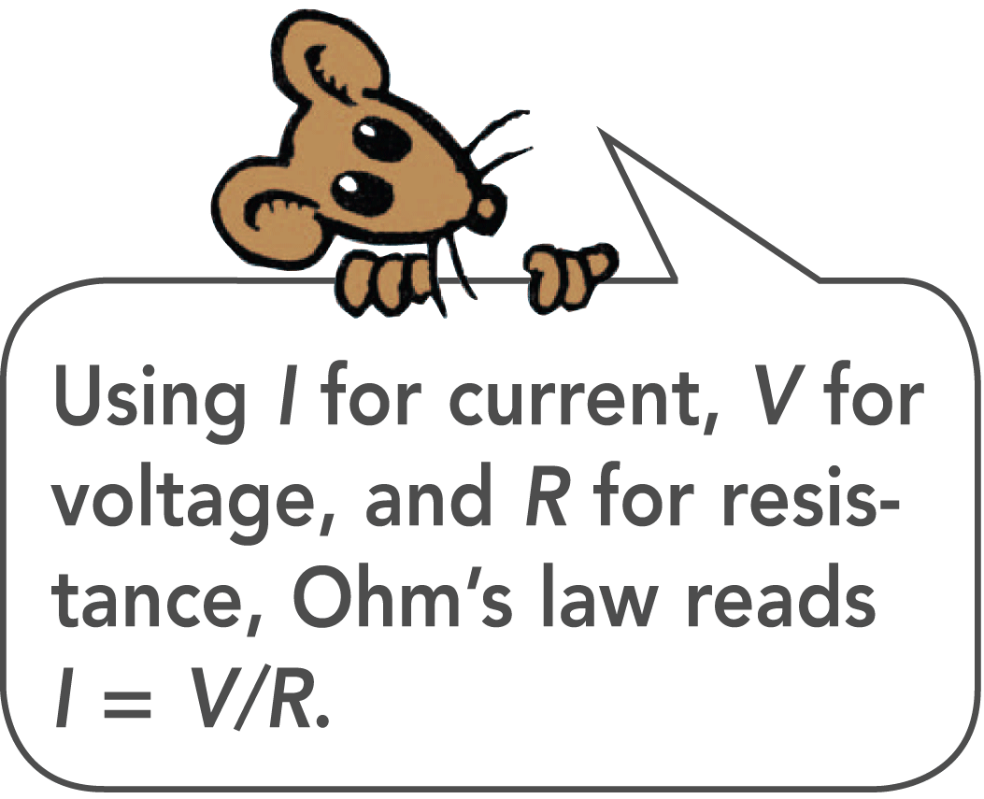
34.5 Ohm’s Law
The relationship among the units of measurement is:
A potential difference of 1 volt impressed across a circuit that has a resistance of 1 ohm will produce a current of 1 ampere.
If a voltage of 12 volts is impressed across the same circuit, the current will be 12 amperes.

Slide 33
34.5 Ohm’s Law
The resistance of a typical lamp cord is much less than 1 ohm, while a typical light bulb has a resistance of about 100 ohms.
An iron or electric toaster has a resistance of 15 to 20 ohms.
The low resistance permits a large current, which produces considerable heat.

Slide 34
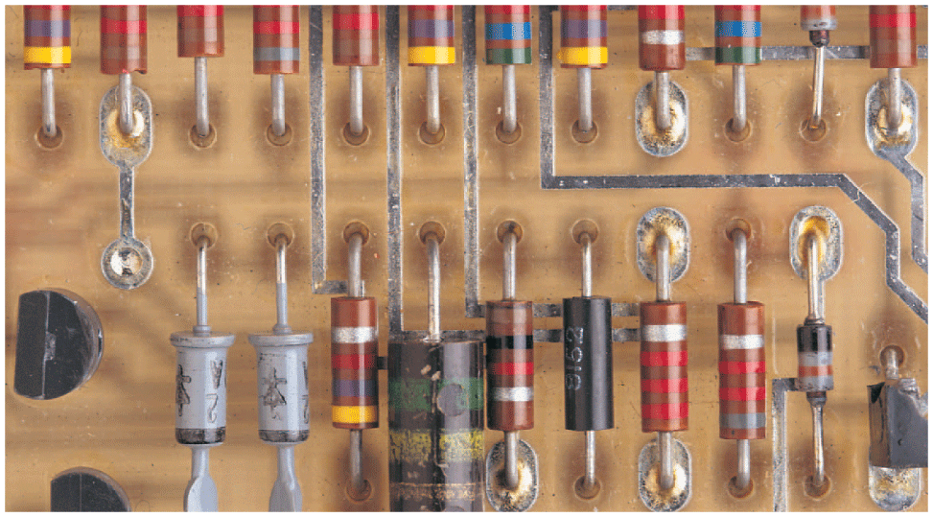
34.5 Ohm’s Law
Current inside electric devices is regulated by circuit elements called resistors.
The stripes on these resistors are color coded to indicate the resistance in ohms.

Slide 35
34.5 Ohm’s Law
think!
How much current is drawn by a lamp that has a resistance of 100 ohms when a voltage of 50 volts is impressed across it?

Slide 36
34.5 Ohm’s Law
think!
How much current is drawn by a lamp that has a resistance of 100 ohms when a voltage of 50 volts is impressed across it?
Answer:

Slide 37
34.5 Ohm’s Law
What does Ohm’s law state?

Slide 38
34.6 Ohm’s Law and Electric Shock
The damaging effects of electric shock are the result of current passing through the body.

Slide 39
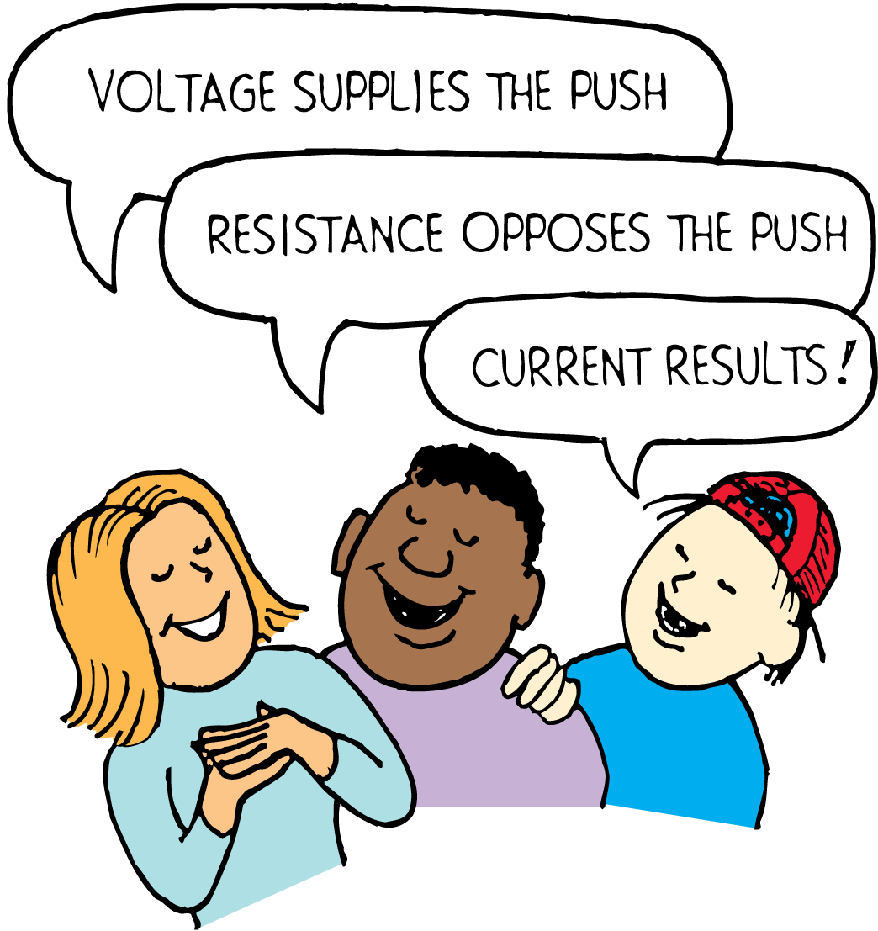
34.6 Ohm’s Law and Electric Shock
From Ohm’s law, we can see that current depends on the voltage applied, and also on the electric resistance of the human body.

Slide 40
34.6 Ohm’s Law and Electric Shock
The Body’s Resistance
Your body’s resistance ranges from about 100 ohms if soaked with salt water to about 500,000 ohms if your skin is very dry.
Touch the electrodes of a battery with dry fingers and your resistance to the flow of charge would be about 100,000 ohms.
You would not feel 12 volts, and 24 volts would just barely tingle.
With moist skin, however, 24 volts could be quite uncomfortable.

Slide 41
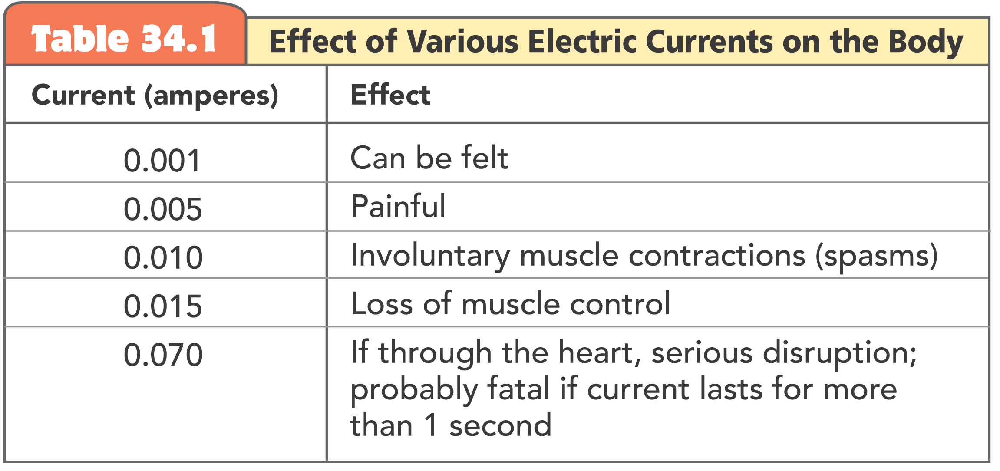
34.6 Ohm’s Law and Electric Shock

Slide 42
34.6 Ohm’s Law and Electric Shock
Many people are killed each year by current from common 120-volt electric circuits.
Touch a faulty 120-volt light fixture while standing on the ground and there is a 120-volt “pressure” between you and the ground.
The soles of your shoes normally provide a very large resistance, so the current would probably not be enough to do serious harm.

Slide 43
34.6 Ohm’s Law and Electric Shock
If you are standing barefoot in a wet bathtub, the resistance between you and the ground is very small.
Your overall resistance is so low that the 120-volt potential difference may produce a harmful current through your body.
Drops of water that collect around the on/off switches of devices such as a hair dryer can conduct current to the user.

Slide 44
34.6 Ohm’s Law and Electric Shock
Although distilled water is a good insulator, the ions in ordinary water greatly reduce the electric resistance.
There is also usually a layer of salt on your skin, which when wet lowers your skin resistance to a few hundred ohms or less.
Handling electric devices while taking a bath is extremely dangerous.

Slide 45
34.6 Ohm’s Law and Electric Shock
Handling a wet hair dryer can be like sticking your fingers into a live socket.

Slide 46
34.6 Ohm’s Law and Electric Shock
High-Voltage Wires
You probably have seen birds perched on high-voltage wires.
Every part of the bird’s body is at the same high potential as the wire, and it feels no ill effects.
For the bird to receive a shock, there must be a difference in potential between one part of its body and another part.
Most of the current will then pass along the path of least electric resistance connecting these two points.

Slide 47
34.6 Ohm’s Law and Electric Shock
Suppose you fall from a bridge and manage to grab onto a high-voltage power line, halting your fall.
If you touch nothing else of different potential, you will receive no shock, even if the wire is thousands of volts above ground potential.
No charge will flow from one hand to the other because there is no appreciable difference in electric potential between your hands.

Slide 48
34.6 Ohm’s Law and Electric Shock
Ground Wires
Mild shocks occur when the surfaces of appliances are at an electric potential different from other nearby devices.
If you touch surfaces of different potentials, you become a pathway for current.
To prevent this, electric appliances are connected to a ground wire, through the round third prong of a three-wire electric plug.

Slide 49
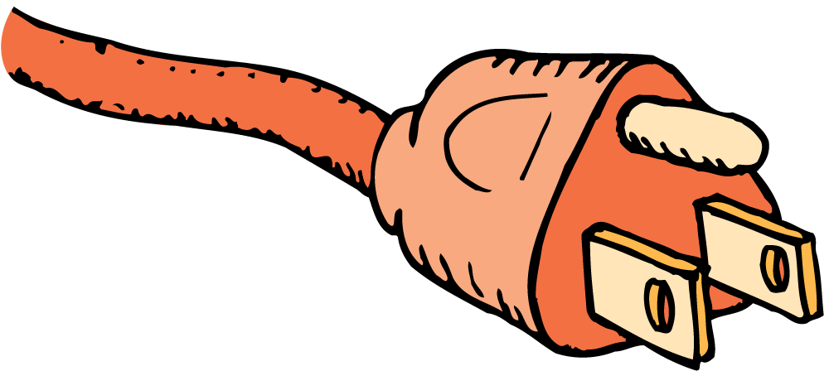
34.6 Ohm’s Law and Electric Shock
All ground wires in all plugs are connected together through the wiring system of the house.
The two flat prongs are for the current-carrying double wire.
If the live wire accidentally comes in contact with the metal surface of an appliance, the current will be directed to ground rather than shocking you if you handle it.

Slide 50
34.6 Ohm’s Law and Electric Shock
Health Effects
One effect of electric shock is to overheat tissues in the body or to disrupt normal nerve functions.
It can upset the nerve center that controls breathing.

Slide 51
34.6 Ohm’s Law and Electric Shock
think!
If the resistance of your body were 100,000 ohms, what would be the current in your body when you touched the terminals of a 12-volt battery?

Slide 52
34.6 Ohm’s Law and Electric Shock
think!
If the resistance of your body were 100,000 ohms, what would be the current in your body when you touched the terminals of a 12-volt battery?
Answer:

Slide 53
34.6 Ohm’s Law and Electric Shock
think!
If your skin were very moist, so that your resistance was only 1000 ohms, and you touched the terminals of a 24-volt battery, how much current would you draw?

Slide 54
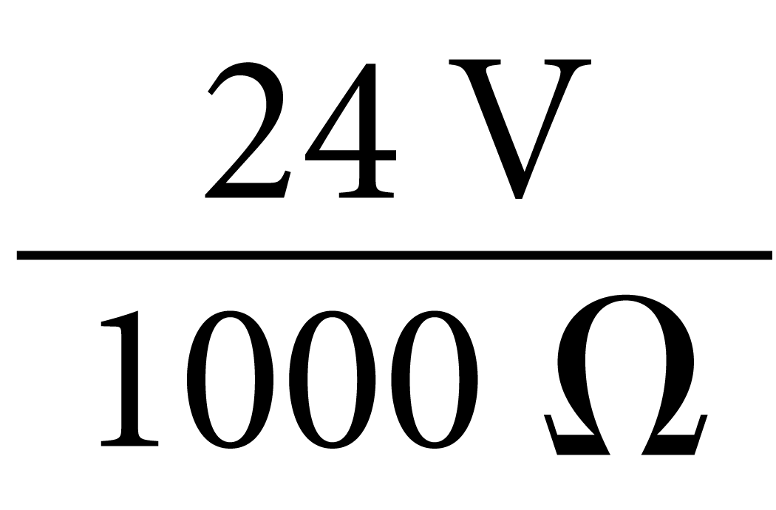
34.6 Ohm’s Law and Electric Shock
think!
If your skin were very moist, so that your resistance was only 1000 ohms, and you touched the terminals of a 24-volt battery, how much current would you draw?
Answer: You would draw or 0.024 A, a dangerous amount of current!

Slide 55
34.6 Ohm’s Law and Electric Shock
What causes the damaging effects of electric shock?

Slide 56
34.7 Direct Current and Alternating Current
Electric current may be DC or AC.

Slide 57
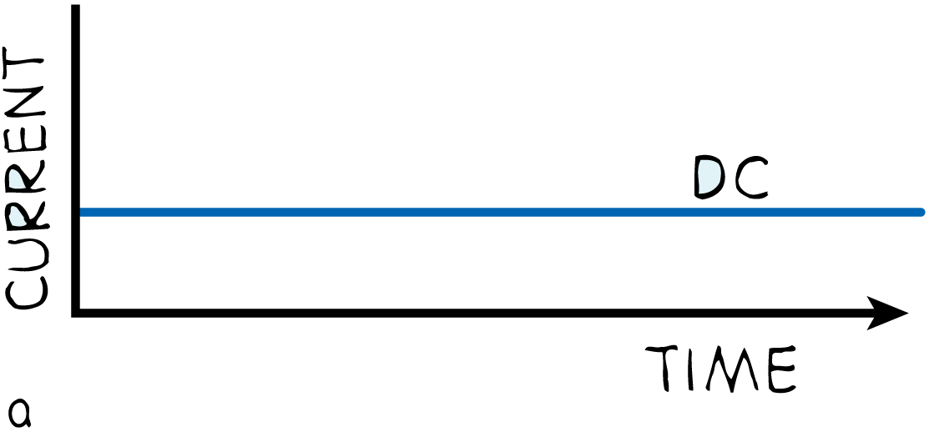
34.7 Direct Current and Alternating Current
By DC, we mean direct current, which refers to a flow of charge that always flows in one direction.
A battery produces direct current in a circuit because the terminals of the battery always have the same sign of charge.
Electrons always move through the circuit from the negative terminal toward the positive terminal.
Even if the current moves in unsteady pulses, so long as it moves in one direction only, it is DC.

Slide 58
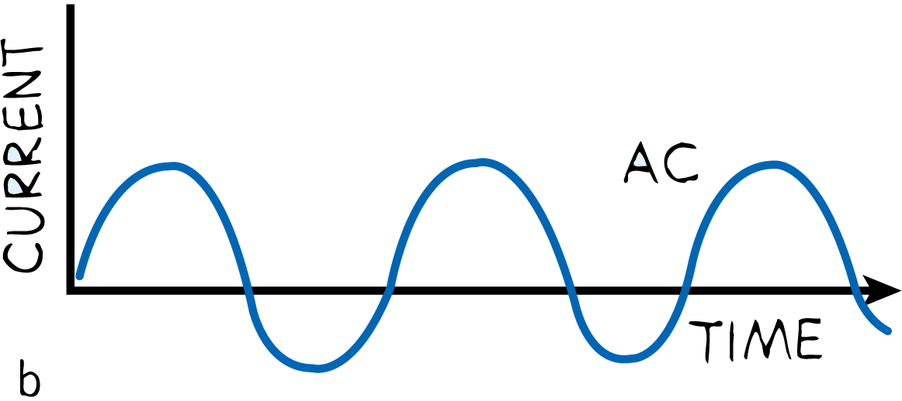
34.7 Direct Current and Alternating Current
Alternating current (AC), as the name implies, is electric current that repeatedly reverses direction.
Electrons in the circuit move first in one direction and then in the opposite direction.
They alternate back and forth about relatively fixed positions.
This is accomplished by alternating the polarity of voltage at the generator or other voltage source.

Slide 59
34.7 Direct Current and Alternating Current
Voltage Standards
Voltage of AC in North America is normally 120 volts.
In the early days of electricity, higher voltages burned out the filaments of electric light bulbs.
Power plants in the United States prior to 1900 adopted 110 volts (or 115 or 120 volts) as standard.

Slide 60
34.7 Direct Current and Alternating Current
By the time electricity became popular in Europe, light bulbs were available that would not burn out so fast at higher voltages.
Power transmission is more efficient at higher voltages, so Europe adopted 220 volts as their standard.
The United States stayed with 110 volts (today, officially 120 volts) because of the installed base of 110-volt equipment.

Slide 61
34.7 Direct Current and Alternating Current
Three-Wire Service
Although lamps in an American home operate on 110–120 volts, electric stoves and other appliances operate on 220–240 volts.
Most electric service in the United States is three-wire:
one wire at 120 volts positive
one wire at zero volts (neutral)
one wire at a negative 120 volts

Slide 62
34.7 Direct Current and Alternating Current
In AC, the positive and negative alternate at 60 hertz. A wire that is positive at one instant is negative 1/120 of a second later.
Most home appliances are connected between the neutral wire and either of the other two wires, producing 120 volts.
When the plus-120 is connected to the minus-120, it produces a 240-volt difference—just right for electric stoves, air conditioners, and clothes dryers.

Slide 63
34.7 Direct Current and Alternating Current
The popularity of AC arises from the fact that electrical energy in the form of AC can be transmitted great distances.
Easy voltage step-ups result in lower heat losses in the wires.
The primary use of electric current, whether DC or AC, is to transfer energy from one place to another.

Slide 64
34.7 Direct Current and Alternating Current
What are the two types of electric current?

Slide 65
34.8 Converting AC to DC
With an AC-DC converter, you can operate a battery-run device on AC instead of batteries.

Slide 66
34.8 Converting AC to DC
The current in your home is AC. The current in a battery-operated device, such as a laptop computer or cell phone, is DC.
With an AC-DC converter, you can operate a battery-run device on AC instead of batteries.

Slide 67
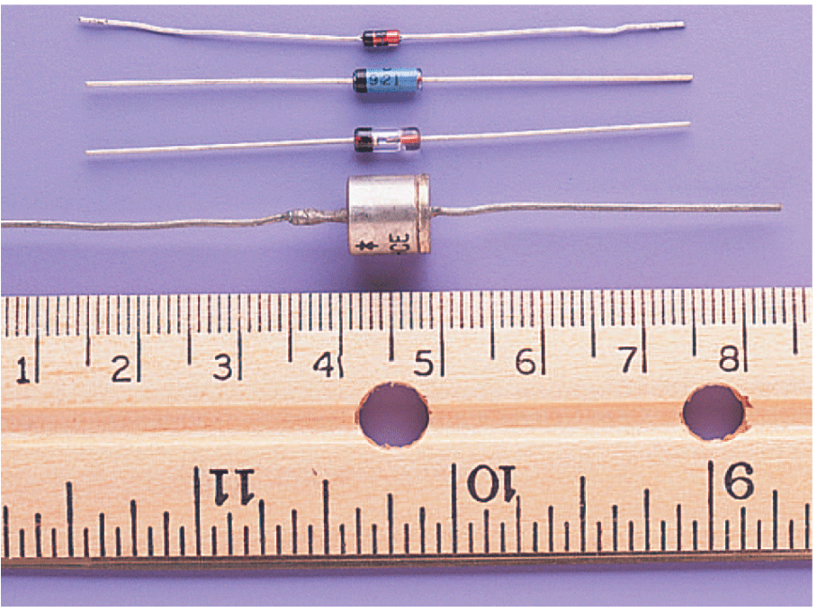
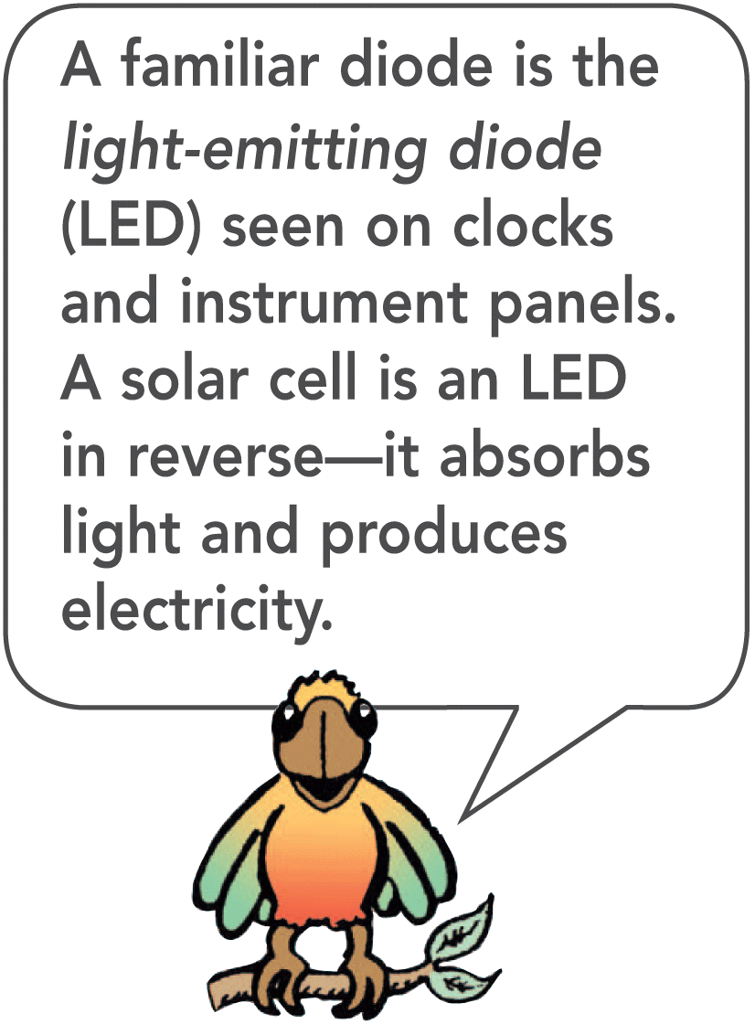
34.8 Converting AC to DC
A converter uses a transformer to lower the voltage and a diode, an electronic device that allows electron flow in only one direction.
Since alternating current vibrates in two directions, only half of each cycle will pass through a diode.
The output is a rough DC, off half the time.
To maintain continuous current while smoothing the bumps, a capacitor is used.

Slide 68
34.8 Converting AC to DC
Recall that a capacitor acts as a storage reservoir for charge.
Just as it takes time to raise or lower the water level in a reservoir, it takes time to add or remove electrons from the capacitor.
A capacitor therefore produces a retarding effect on changes in current flow and smoothes the pulsed output.

Slide 69
34.8 Converting AC to DC
When input to a diode is AC,

Slide 70
34.8 Converting AC to DC
When input to a diode is AC,
output is pulsating DC.

Slide 71
34.8 Converting AC to DC
When input to a diode is AC,
output is pulsating DC.
Charging and discharging of a capacitor provides continuous and smoother current.

Slide 72
34.8 Converting AC to DC
When input to a diode is AC,
output is pulsating DC.
Charging and discharging of a capacitor provides continuous and smoother current.
In practice, a pair of diodes is used so there are no gaps in current output.

Slide 73
34.8 Converting AC to DC
How can you operate a battery-run device on AC?

Slide 74
34.9 The Speed of Electrons in a Circuit
In a current-carrying wire, collisions interrupt the motion of the electrons so that their actual drift speed, or net speed through the wire due to the field, is extremely low.

Slide 75
34.9 The Speed of Electrons in a Circuit
When you flip on the light switch on your wall and the circuit is completed, the light bulb appears to glow immediately.
Energy is transported through the connecting wires at nearly the speed of light.
The electrons that make up the current, however, do not move at this high speed.

Slide 76
34.9 The Speed of Electrons in a Circuit
The electrons inside a metal wire have an average speed of a few million kilometers per hour due to their thermal motion.
This does not produce a current because the motion is random. There is no net flow in any one direction.
When a battery or generator is connected, an electric field is established inside the wire.

Slide 77
34.9 The Speed of Electrons in a Circuit
A pulsating electric field can travel through a circuit at nearly the speed of light.
The electrons continue their random motions in all directions while simultaneously being nudged along the wire by the electric field.
The conducting wire acts as a “pipe” for electric field lines. Inside the wire, the electric field is directed along the wire.

Slide 78
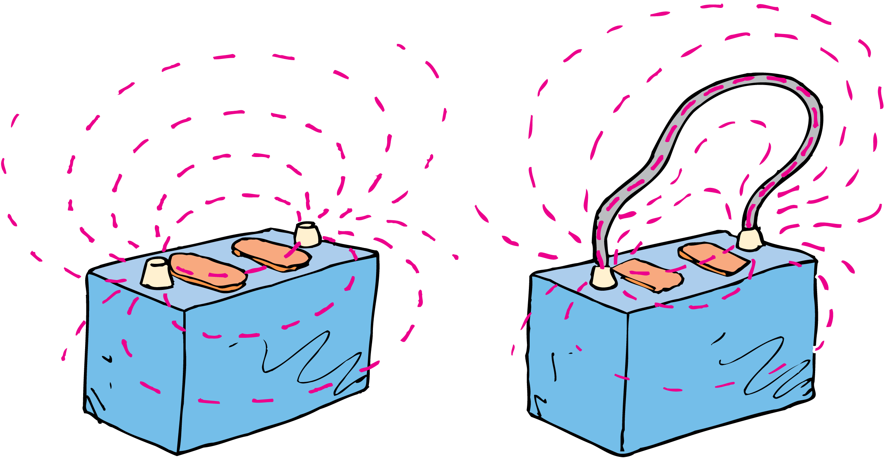
34.9 The Speed of Electrons in a Circuit
The electric field lines between the terminals of a battery are directed through a conductor, which joins the terminals.

Slide 79
34.9 The Speed of Electrons in a Circuit
Conduction electrons are accelerated by the field.
Before the electrons gain appreciable speed, they “bump into” metallic ions and transfer some of their kinetic energy.
Collisions interrupt the motion of the electrons. Their actual drift speed, or net speed through the wire, is extremely low.
In the electric system of an automobile, electrons have a net average drift speed of about 0.01 cm/s.

Slide 80
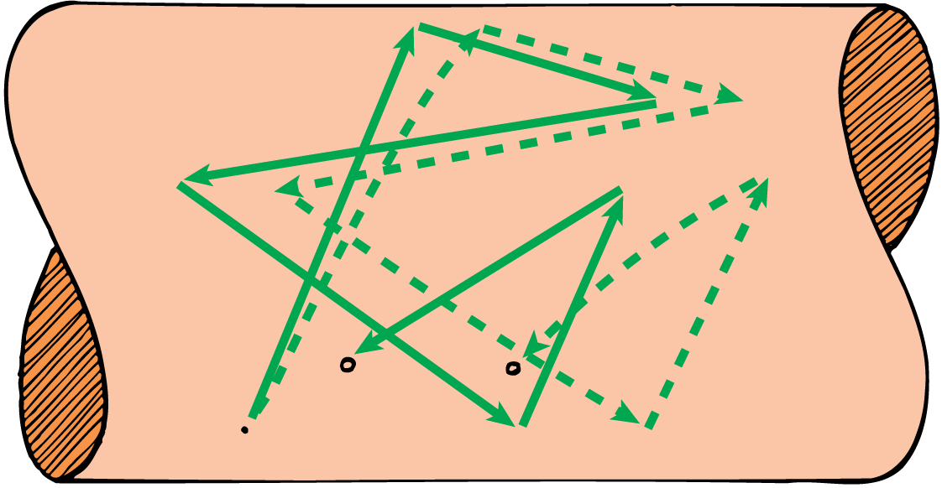
34.9 The Speed of Electrons in a Circuit
The solid lines depict a random path of an electron bouncing off atoms in a conductor. The dashed lines show an exaggerated view of how this path changes when an electric field is applied. The electron drifts toward the right with an average speed less than a snail’s pace.

Slide 81
34.9 The Speed of Electrons in a Circuit
In an AC circuit, the conduction electrons don’t make any net progress in any direction.
In a single cycle they drift a tiny fraction of a centimeter in one direction, and then the same distance in the opposite direction.
They oscillate rhythmically about relatively fixed positions.
On a conventional telephone, it is the pattern of oscillating motion that is carried at nearly the speed of light.
The electrons in the wires vibrate to the rhythm of the traveling pattern.

Slide 82
34.9 The Speed of Electrons in a Circuit
Why is the drift speed of electrons in a current-carrying wire extremely low?

Slide 83
34.10 The Source of Electrons in a Circuit
The source of electrons in a circuit is the conducting circuit material itself.

Slide 84
34.10 The Source of Electrons in a Circuit
You can buy a water hose that is empty of water, but you can’t buy a piece of wire, an “electron pipe,” that is empty of electrons.
The source of electrons in a circuit is the conducting circuit material itself.
Electrons do not travel appreciable distances through a wire in an AC circuit. They vibrate to and fro about relatively fixed positions.

Slide 85
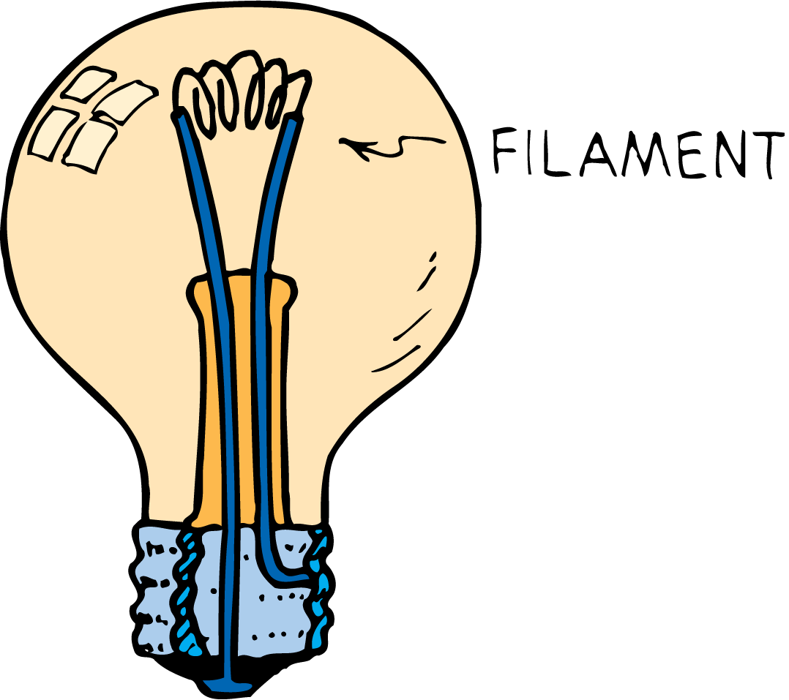
34.10 The Source of Electrons in a Circuit
When you plug a lamp into an AC outlet, energy flows from the outlet into the lamp, not electrons.
Energy is carried by the electric field and causes a vibratory motion of the electrons that already exist in the lamp filament.
Most of this electrical energy appears as heat, while some of it takes the form of light.
Power utilities do not sell electrons. They sell energy. You supply the electrons.

Slide 86
34.10 The Source of Electrons in a Circuit
When you are jolted by an AC electric shock, the electrons making up the current in your body originate in your body.
Electrons do not come out of the wire and through your body and into the ground; energy does.
The energy simply causes free electrons in your body to vibrate in unison.
Small vibrations tingle; large vibrations can be fatal.

Slide 87
34.10 The Source of Electrons in a Circuit
What is the source of electrons in a circuit?

Slide 88
34.11 Electric Power
Electric power is equal to the product of current and voltage.

Slide 89
34.11 Electric Power
Unless it is in a superconductor, a charge moving in a circuit expends energy.
This may result in heating the circuit or in turning a motor.
Electric power is the rate at which electrical energy is converted into another form such as mechanical energy, heat, or light.

Slide 90
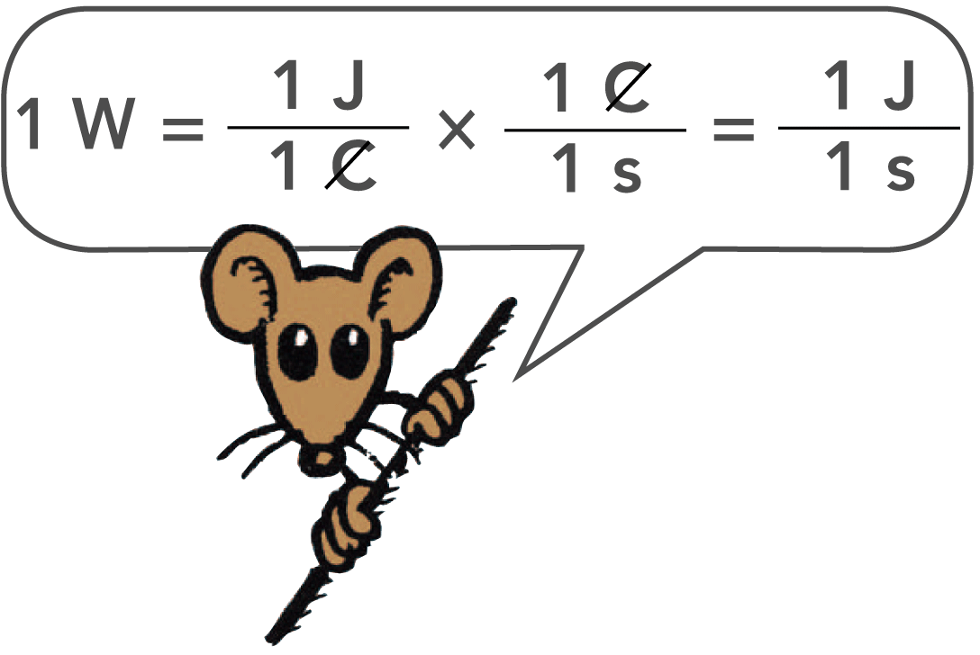
34.11 Electric Power
Electric power is equal to the product of current and voltage.
electric power = current × voltage
If the voltage is expressed in volts and the current in amperes, then the power is expressed in watts.
1 watt = (1 ampere) × (1 volt)

Slide 91
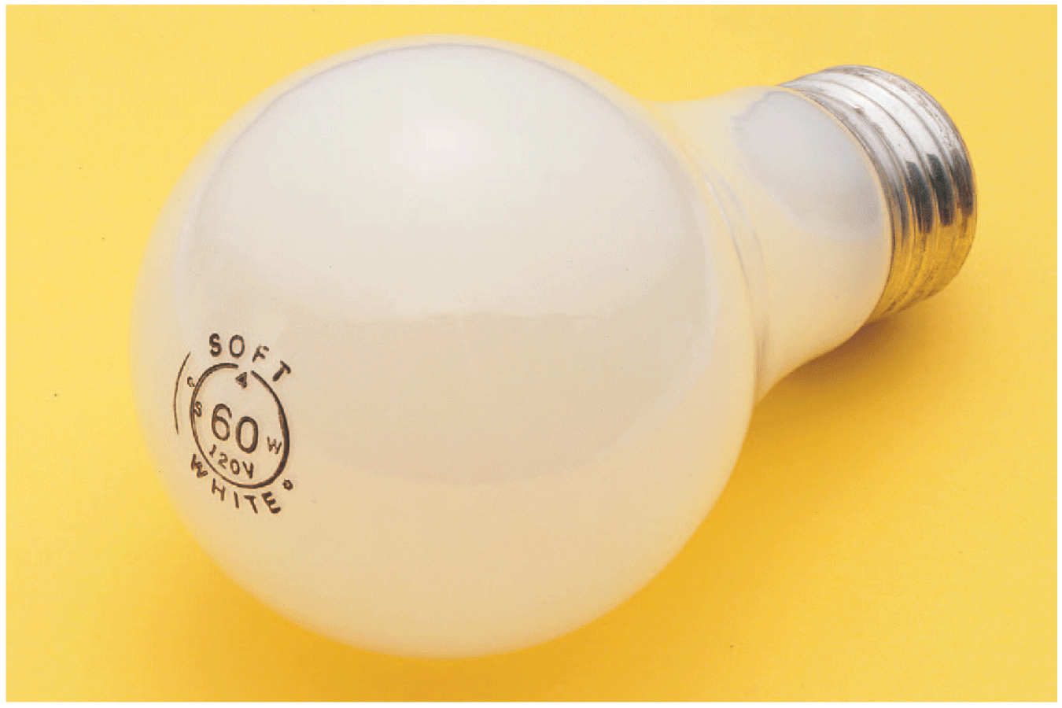
34.11 Electric Power
The power and voltage on the light bulb read “60 W 120 V.”
The current that would flow through the bulb is:
I = P/V = (60 W)/(120 V) = 0.5 A.

Slide 92
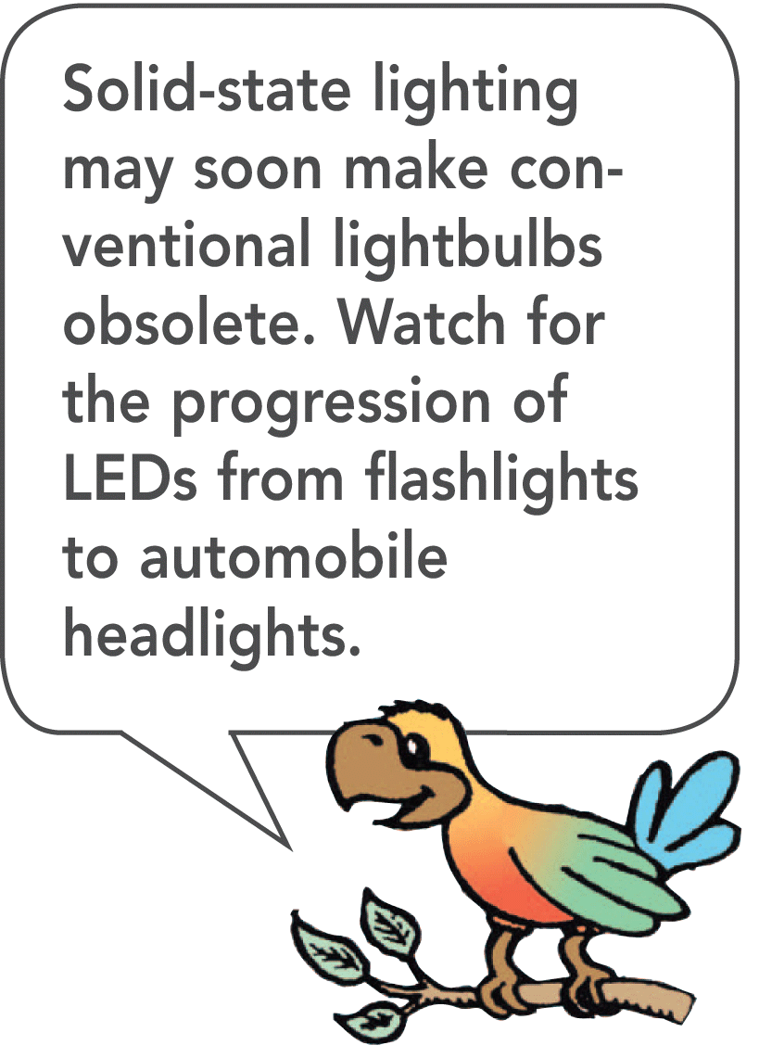
34.11 Electric Power
A lamp rated at 120 watts operated on a 120-volt line will draw a current of 1 ampere: 120 watts = (1 ampere) × (120 volts).
A 60-watt lamp draws 0.5 ampere on a 120-volt line.

Slide 93
34.11 Electric Power
A kilowatt is 1000 watts, and a kilowatt-hour represents the amount of energy consumed in 1 hour at the rate of 1 kilowatt.
Where electrical energy costs 10 cents per kilowatt-hour, a 100-watt light bulb burns for 10 hours for 10 cents.
A toaster or iron, which draws more current and therefore more power, costs several times as much to operate for the same time.

Slide 94
34.11 Electric Power
think!
How much power is used by a calculator that operates on 8 volts and 0.1 ampere? If it is used for one hour, how much energy does it use?

Slide 95
34.11 Electric Power
think!
How much power is used by a calculator that operates on 8 volts and 0.1 ampere? If it is used for one hour, how much energy does it use?
Answer: Power = current × voltage = (0.1 A) × (8 V) = 0.8 W. Energy = power × time = (0.8 W) × (1 h) = 0.8 watt-hour, or 0.0008 kilowatt-hour.

Slide 96
34.11 Electric Power
think!
Will a 1200-watt hair dryer operate on a 120-volt line if the current is limited to 15 amperes by a safety fuse? Can two hair dryers operate on this line?

Slide 97
34.11 Electric Power
think!
Will a 1200-watt hair dryer operate on a 120-volt line if the current is limited to 15 amperes by a safety fuse? Can two hair dryers operate on this line?
Answer: One 1200-W hair dryer can be operated because the circuit can provide (15 A) × (120 V) = 1800 W. But there is inadequate power to operate two hair dryers of combined power 2400 W. In terms of current, (1200 W)/(120 V) = 10 A; so the hair dryer will operate when connected to the circuit. But two hair dryers will require 20 A and will blow the 15-A fuse.

Slide 98
34.11 Electric Power
How can you express electric power in terms of current and voltage?

Slide 99
Assessment Questions
Electric charge will flow in an electric circuit when
electrical resistance is low enough.
a potential difference exists.
the circuit is grounded.
electrical devices in the circuit are not defective.

Slide 100
Assessment Questions
Electric charge will flow in an electric circuit when
electrical resistance is low enough.
a potential difference exists.
the circuit is grounded.
electrical devices in the circuit are not defective.
Answer: B

Slide 101
Assessment Questions
The electric current in a copper wire is normally composed of
electrons.
protons.
ions.
amperes.

Slide 102
Assessment Questions
The electric current in a copper wire is normally composed of
electrons.
protons.
ions.
amperes.
Answer: A

Slide 103
Assessment Questions
Which statement is correct?
Voltage flows in a circuit.
Charge flows in a circuit.
A battery is the source of electrons in a circuit.
A generator is the source of electrons in a circuit.

Slide 104
Assessment Questions
Which statement is correct?
Voltage flows in a circuit.
Charge flows in a circuit.
A battery is the source of electrons in a circuit.
A generator is the source of electrons in a circuit.
Answer: B

Slide 105
Assessment Questions
Which of the following type of copper wire would you expect to have the least electric resistance?
a thick long wire
a thick short wire
a thin long wire
a thin short wire

Slide 106
Assessment Questions
Which of the following type of copper wire would you expect to have the least electric resistance?
a thick long wire
a thick short wire
a thin long wire
a thin short wire
Answer: D

Slide 107
Assessment Questions
When you double the voltage in a simple electric circuit, you double the
current.
resistance.
ohms.
resistors.

Slide 108
Assessment Questions
When you double the voltage in a simple electric circuit, you double the
current.
resistance.
ohms.
resistors.
Answer: A

Slide 109
Assessment Questions
To receive an electric shock there must be
current in one direction.
moisture in an electrical device being used.
high voltage and low body resistance.
a difference in potential across part or all of your body.

Slide 110
Assessment Questions
To receive an electric shock there must be
current in one direction.
moisture in an electrical device being used.
high voltage and low body resistance.
a difference in potential across part or all of your body.
Answer: D

Slide 111
Assessment Questions
The difference between DC and AC in electrical circuits is that in DC
charges flow steadily in one direction only.
charges flow in one direction.
charges steadily flow to and fro.
charges flow to and fro.

Slide 112
Assessment Questions
The difference between DC and AC in electrical circuits is that in DC
charges flow steadily in one direction only.
charges flow in one direction.
charges steadily flow to and fro.
charges flow to and fro.
Answer: B

Slide 113
Assessment Questions
To convert AC to a fairly steady DC, which devices are used?
diodes and batteries
capacitors and diodes
capacitors and batteries
resistors and batteries

Slide 114
Assessment Questions
To convert AC to a fairly steady DC, which devices are used?
diodes and batteries
capacitors and diodes
capacitors and batteries
resistors and batteries
Answer: B

Slide 115
Assessment Questions
What is it that travels at about the speed of light in an electric circuit?
charges
current
electric field
voltage

Slide 116
Assessment Questions
What is it that travels at about the speed of light in an electric circuit?
charges
current
electric field
voltage
Answer: C

Slide 117
Assessment Questions
When you buy a water pipe in a hardware store, the water isn’t included. When you buy copper wire, electrons
must be supplied by you, just as water must be supplied for a water pipe.
are already in the wire.
may fall out, which is why wires are insulated.
enter it from the electric outlet.

Slide 118
Assessment Questions
When you buy a water pipe in a hardware store, the water isn’t included. When you buy copper wire, electrons
must be supplied by you, just as water must be supplied for a water pipe.
are already in the wire.
may fall out, which is why wires are insulated.
enter it from the electric outlet.
Answer: B

Slide 119
Assessment Questions
If you double both the current and the voltage in a circuit, the power
remains unchanged if resistance remains constant.
halves.
doubles.
quadruples.

Slide 120
Assessment Questions
If you double both the current and the voltage in a circuit, the power
remains unchanged if resistance remains constant.
halves.
doubles.
quadruples.
Answer: D

