Slide 1
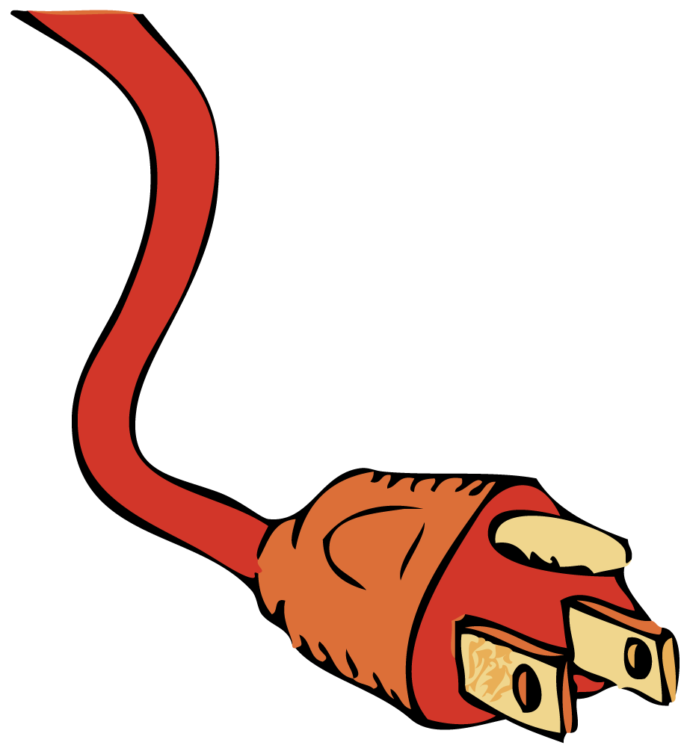
Any path along which electrons can flow is a circuit.

Slide 2
Mechanical things seem to be easier to figure out for most people than electrical things. Maybe this is because most people have had experience playing with blocks and mechanical toys. Hands-on laboratory experience aids your understanding of electric circuits. The experience can be a lot of fun, too!

Slide 3
35.1 A Battery and a Bulb
In a flashlight, when the switch is turned on to complete an electric circuit, the mobile conduction electrons already in the wires and the filament begin to drift through the circuit.

Slide 4
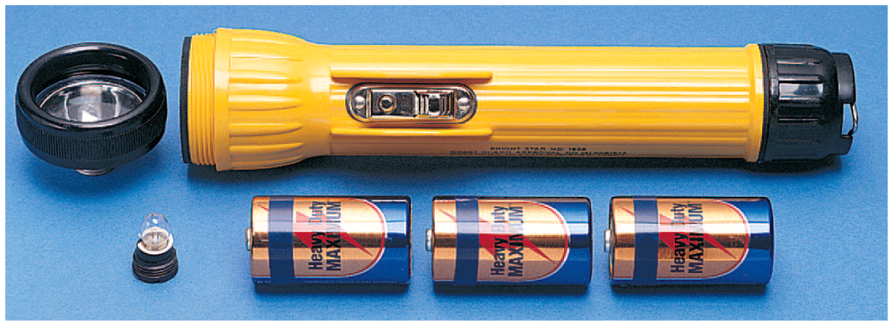
35.1 A Battery and a Bulb
A flashlight consists of a reflector cap, a light bulb, batteries, and a barrel-shaped housing with a switch.

Slide 5
35.1 A Battery and a Bulb
There are several ways to connect the battery and bulb from a flashlight so that the bulb lights up.
The important thing is that there must be a complete path, or circuit, that
includes the bulb filament
runs from the positive terminal at the top of the battery
runs to the negative terminal at the bottom of the battery

Slide 6
35.1 A Battery and a Bulb
Electrons flow
from the negative part of the battery through the wire
to the side (or bottom) of the bulb
through the filament inside the bulb
out the bottom (or side)
through the wire to the positive part of the battery
The current then passes through the battery to complete the circuit.

Slide 7
35.1 A Battery and a Bulb
Unsuccessful ways to light a bulb.

Slide 8
35.1 A Battery and a Bulb
Unsuccessful ways to light a bulb.
Successful ways to light a bulb.

Slide 9
35.1 A Battery and a Bulb
The flow of charge in a circuit is very much like the flow of water in a closed system of pipes.
In a flashlight, the battery is analogous to a pump, the wires are analogous to the pipes, and the bulb is analogous to any device that operates when the water is flowing.
When a valve in the line is opened and the pump is operating, water already in the pipes starts to flow.

Slide 10
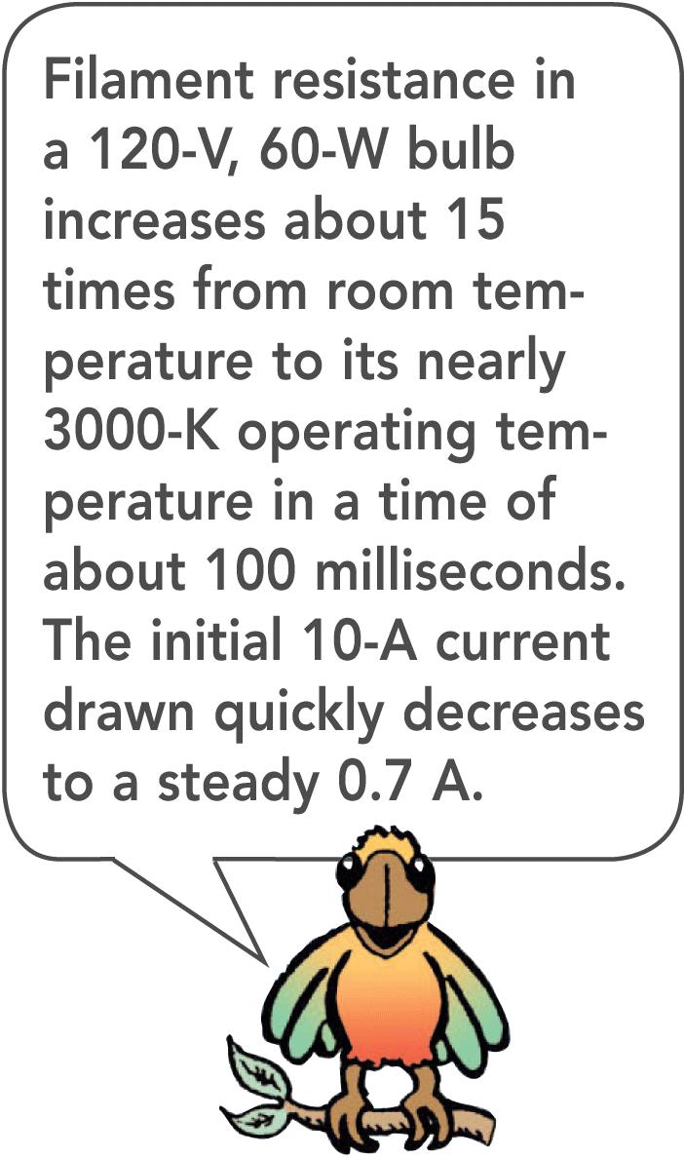
35.1 A Battery and a Bulb
Neither the water nor the electrons concentrate in certain places.
They flow continuously around a loop, or circuit.
When the switch is turned on, the mobile conduction electrons in the wires and the filament begin to drift through the circuit.

Slide 11
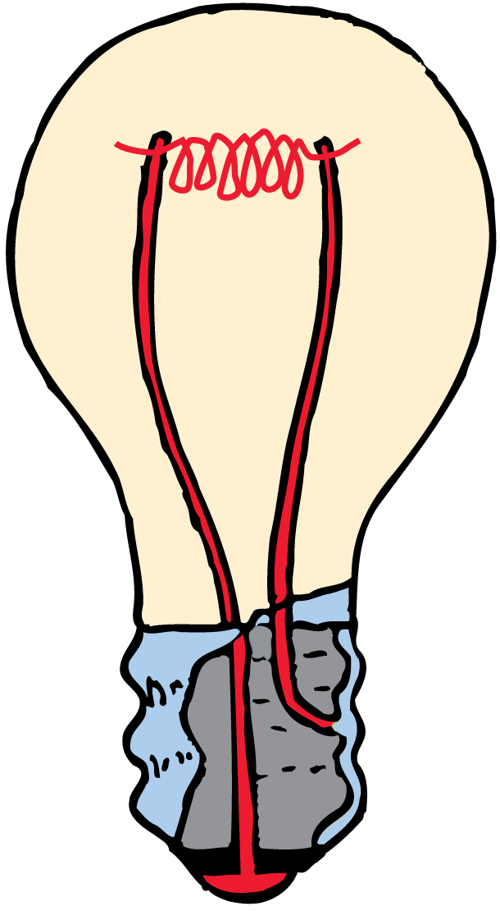
35.1 A Battery and a Bulb
Electrons do not pile up inside a bulb, but instead flow through its filament.

Slide 12
35.1 A Battery and a Bulb
What happens to the mobile conduction electrons when you turn on a flashlight?

Slide 13
35.2 Electric Circuits
For a continuous flow of electrons, there must be a complete circuit with no gaps.

Slide 14
35.2 Electric Circuits
Any path along which electrons can flow is a circuit.
A gap is usually provided by an electric switch that can be opened or closed to either cut off or allow electron flow.

Slide 15
35.2 Electric Circuits
The water analogy is useful but has some limitations.
A break in a water pipe results in a leak, but a break in an electric circuit results in a complete stop in the flow.
Opening a switch stops the flow of electricity. An electric circuit must be closed for electricity to flow. Opening a water faucet, on the other hand, starts the flow of water.

Slide 16
35.2 Electric Circuits
Most circuits have more than one device that receives electrical energy.
These devices are commonly connected in a circuit in one of two ways, series or parallel.
When connected in series, the devices in a circuit form a single pathway for electron flow.
When connected in parallel, the devices in a circuit form branches, each of which is a separate path for electron flow.

Slide 17
35.2 Electric Circuits
How can a circuit achieve a continuous flow of electrons?

Slide 18
35.3 Series Circuits
If one device fails in a series circuit, current in the whole circuit ceases and none of the devices will work.

Slide 19
35.3 Series Circuits
If three lamps are connected in series with a battery, they form a series circuit. Charge flows through each in turn.
When the switch is closed, a current exists almost immediately in all three lamps.
The current does not “pile up” in any lamp but flows through each lamp. Electrons in all parts of the circuit begin to move at once.

Slide 20
35.3 Series Circuits
Eventually the electrons move all the way around the circuit.
A break anywhere in the path results in an open circuit, and the flow of electrons ceases.
Burning out of one of the lamp filaments or simply opening the switch could cause such a break.

Slide 21
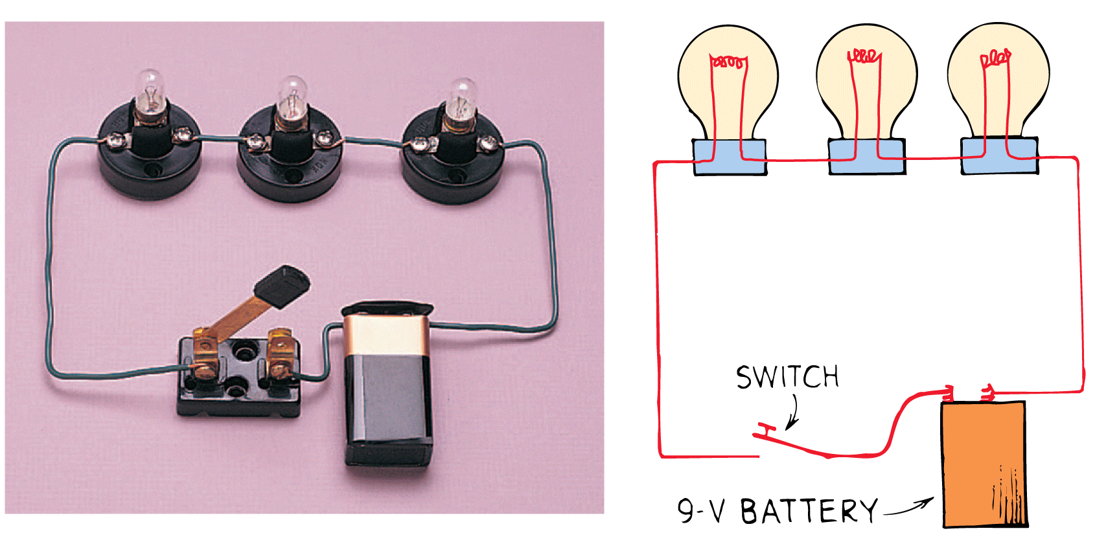
35.3 Series Circuits
In this simple series circuit, a 9-volt battery provides 3 volts across each lamp.

Slide 22
35.3 Series Circuits
For series connections:
Electric current has a single pathway through the circuit.
The total resistance to current in the circuit is the sum of the individual resistances along the circuit path.
The current is equal to the voltage supplied by the source divided by the total resistance of the circuit. This is Ohm’s law.
The voltage drop, or potential difference, across each device depends directly on its resistance.
The sum of the voltage drops across the individual devices is equal to the total voltage supplied by the source.

Slide 23
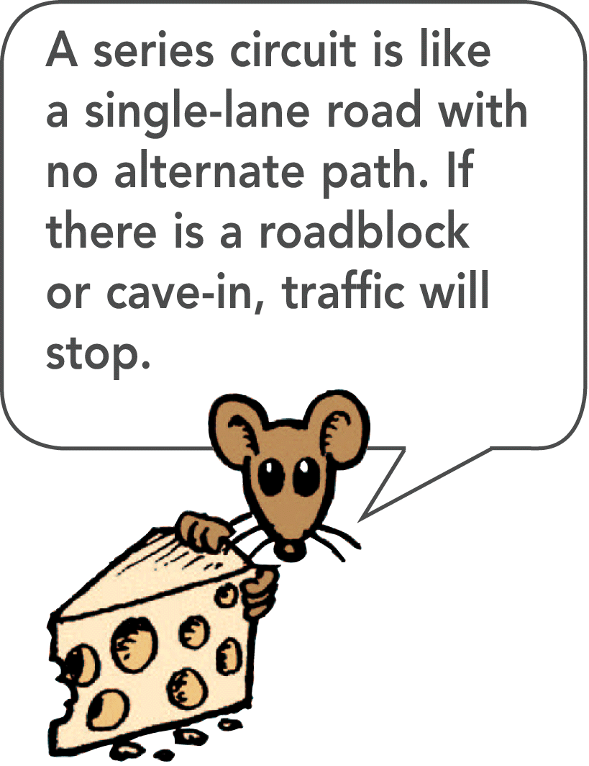
35.3 Series Circuits
The main disadvantage of a series circuit is that when one device fails, the current in the whole circuit stops.
Some cheap light strings are connected in series. When one lamp burns out, you have to replace it or no lights work.

Slide 24
35.3 Series Circuits
think!
What happens to the light intensity of each lamp in a series circuit when more lamps are added to the circuit?

Slide 25
35.3 Series Circuits
think!
What happens to the light intensity of each lamp in a series circuit when more lamps are added to the circuit?
Answer:
The addition of more lamps results in a greater circuit resistance. This decreases the current in the circuit (and in each lamp), which causes dimming of the lamps.

Slide 26
35.3 Series Circuits
think!
A series circuit has three bulbs. If the current through one of the bulbs is 1 A, can you tell what the current is through each of the other two bulbs? If the voltage across bulb 1 is 2 V, and across bulb 2 is 4 V, what is the voltage across bulb 3?

Slide 27
35.3 Series Circuits
think!
A series circuit has three bulbs. If the current through one of the bulbs is 1 A, can you tell what the current is through each of the other two bulbs? If the voltage across bulb 1 is 2 V, and across bulb 2 is 4 V, what is the voltage across bulb 3?
Answer:
The same current, 1 A, passes through every part of a series circuit. Each coulomb of charge has 9 J of electrical potential energy (9 V = 9 J/C). If it spends 2 J in one bulb and 4 in another, it must spend 3 J in the last bulb. 3 J/C = 3 V

Slide 28
35.3 Series Circuits
What happens to current in other lamps if one lamp in a series circuit burns out?

Slide 29
35.4 Parallel Circuits
In a parallel circuit, each device operates independent of the other devices. A break in any one path does not interrupt the flow of charge in the other paths.

Slide 30
35.4 Parallel Circuits
In a parallel circuit having three lamps, each electric device has its own path from one terminal of the battery to the other.
There are separate pathways for current, one through each lamp.
In contrast to a series circuit, the parallel circuit is completed whether all, two, or only one lamp is lit.
A break in any one path does not interrupt the flow of charge in the other paths.

Slide 31
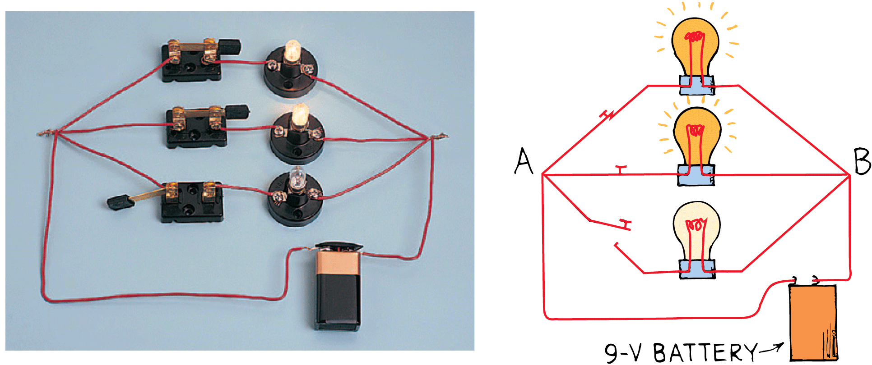
35.4 Parallel Circuits
In this parallel circuit, a 9-volt battery provides 9 volts across each activated lamp. (Note the open switch in the lower branch.)

Slide 32
35.4 Parallel Circuits
Major characteristics of parallel connections:
Each device connects the same two points A and B of the circuit. The voltage is therefore the same across each device.
The total current divides among the parallel branches.
The amount of current in each branch is inversely proportional to the resistance of the branch.
The total current is the sum of the currents in its branches.
As the number of parallel branches is increased, the total current through the battery increases.

Slide 33
35.4 Parallel Circuits
From the battery’s perspective, the overall resistance of the circuit is decreased.
This means the overall resistance of the circuit is less than the resistance of any one of the branches.

Slide 34
35.4 Parallel Circuits
think!
What happens to the light intensity of each lamp in a parallel circuit when more lamps are added in parallel to the circuit?

Slide 35
35.4 Parallel Circuits
think!
What happens to the light intensity of each lamp in a parallel circuit when more lamps are added in parallel to the circuit?
Answer:
The light intensity for each lamp is unchanged as other lamps are introduced (or removed). Although changes of resistance and current occur for the circuit as a whole, no changes occur in any individual branch in the circuit.

Slide 36
35.4 Parallel Circuits
What happens if one device in a parallel circuit fails?

Slide 37
35.5 Schematic Diagrams
In a schematic diagram, resistance is shown by a zigzag line, and ideal resistance-free wires are shown with solid straight lines. A battery is represented with a set of short and long parallel lines.

Slide 38
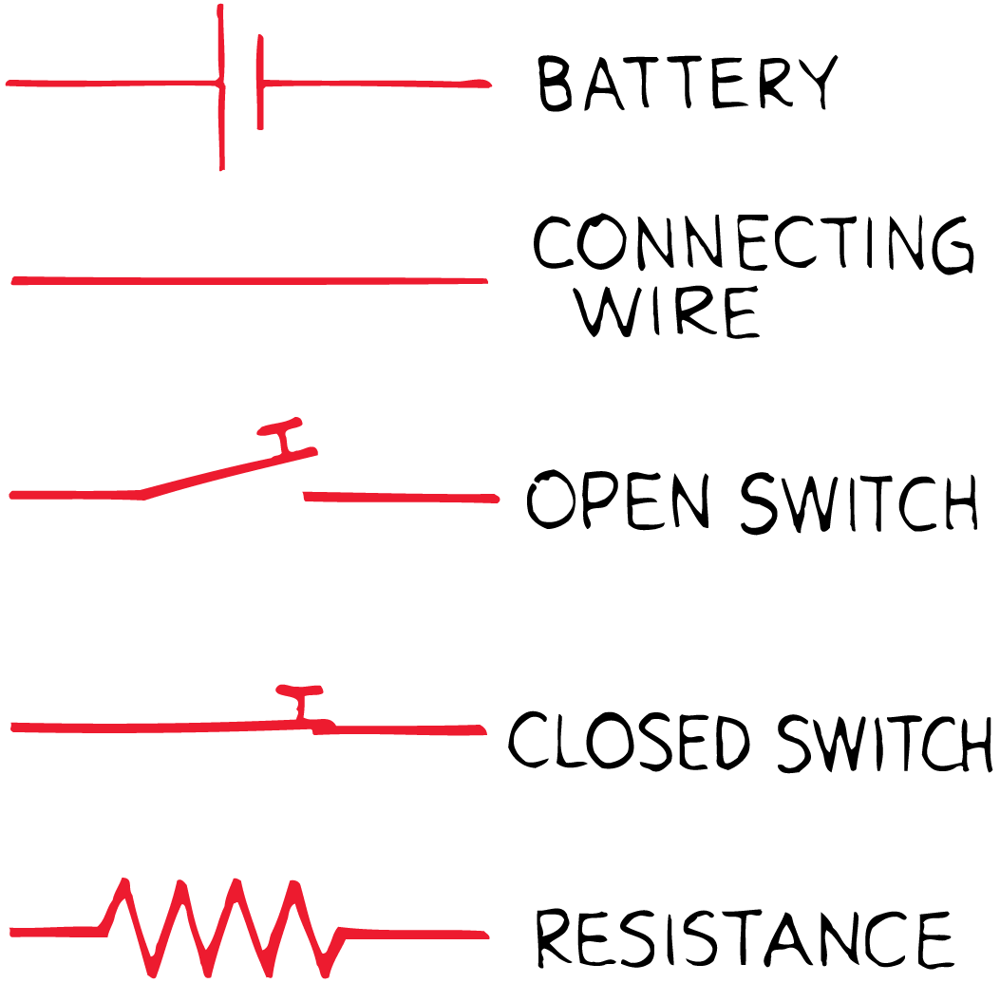
35.5 Schematic Diagrams
Electric circuits are frequently described by simple diagrams, called schematic diagrams.
Resistance is shown by a zigzag line, and ideal resistance-free wires are shown with solid straight lines.
A battery is shown by a set of short and long parallel lines, the positive terminal with a long line and the negative terminal with a short line.

Slide 39
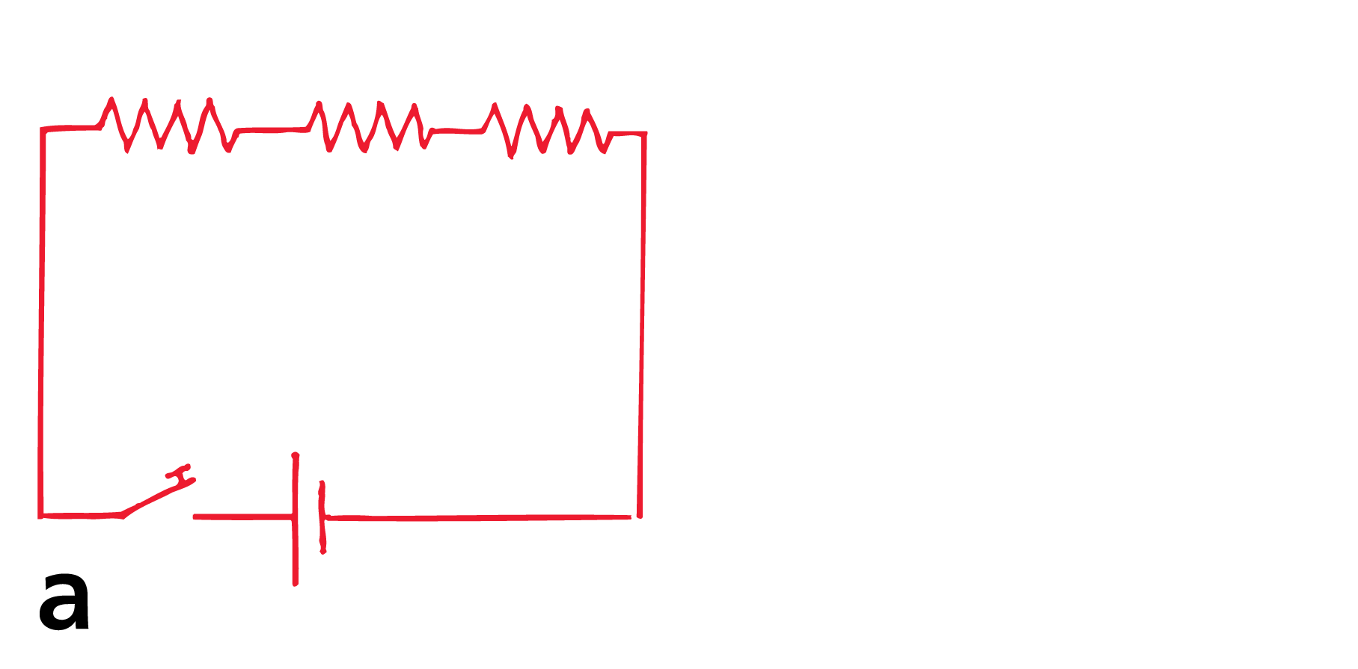
35.5 Schematic Diagrams
These schematic diagrams represent
a circuit with three lamps in series, and

Slide 40
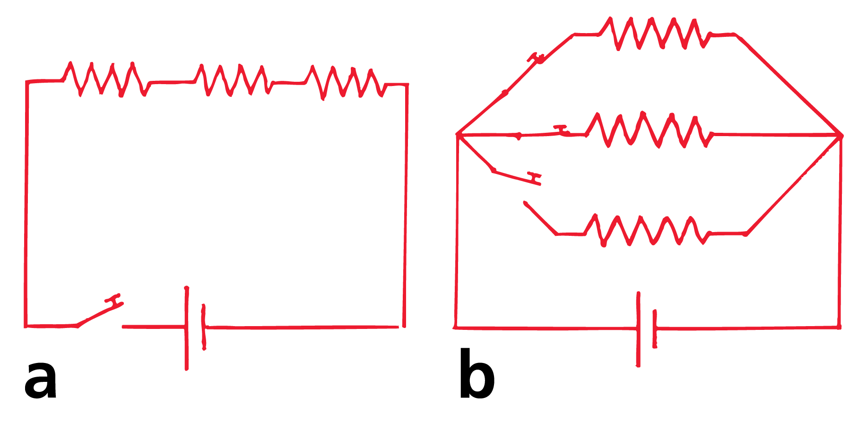
35.5 Schematic Diagrams
These schematic diagrams represent
a circuit with three lamps in series, and
a circuit with three lamps in parallel.

Slide 41
35.5 Schematic Diagrams
What symbols are used to represent resistance, wires, and batteries in schematic diagrams?

Slide 42
35.6 Combining Resistors in a Compound Circuit
The equivalent resistance of resistors connected in series is the sum of their values. The equivalent resistance for a pair of equal resistors in parallel is half the value of either resistor.

Slide 43
35.6 Combining Resistors in a Compound Circuit
Sometimes it is useful to know the equivalent resistance of a circuit that has several resistors in its network.
The equivalent resistance is the value of the single resistor that would comprise the same load to the battery or power source.
The equivalent resistance of resistors connected in series is the sum of their values. For example, the equivalent resistance for a pair of 1-ohm resistors in series is simply 2 ohms.

Slide 44
35.6 Combining Resistors in a Compound Circuit
The equivalent resistance for a pair of equal resistors in parallel is half the value of either resistor.
The equivalent resistance for a pair of 1-ohm resistors in parallel is 0.5 ohm.
The equivalent resistance is less because the current has “twice the path width” when it takes the parallel path.

Slide 45
35.6 Combining Resistors in a Compound Circuit
The equivalent resistance of two 8-ohm resistors in series is 16 ohms.

Slide 46
35.6 Combining Resistors in a Compound Circuit
The equivalent resistance of two 8-ohm resistors in series is 16 ohms.
The equivalent resistance of two 8-ohm resistors in parallel is 4 ohms.

Slide 47
35.6 Combining Resistors in a Compound Circuit
For the combination of three 8-ohm resistors, the two resistors in parallel are equivalent to a single 4-ohm resistor.
They are in series with an 8-ohm resistor, adding to produce an equivalent resistance of 12 ohms.
If a 12-volt battery were connected to these resistors, the current through the battery would be 1 ampere.
(In practice it would be less, for there is resistance inside the battery as well, called the battery’s internal resistance.)

Slide 48
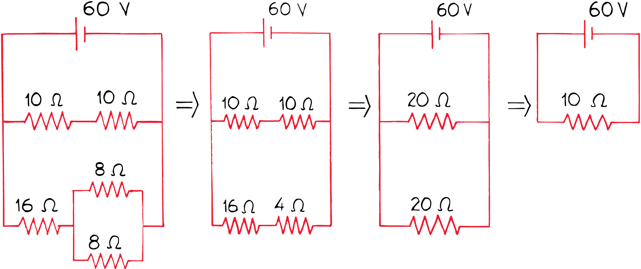
35.6 Combining Resistors in a Compound Circuit
Schematic diagrams for an arrangement of various electric devices. The equivalent resistance of the circuit is 10 ohms.

Slide 49
35.6 Combining Resistors in a Compound Circuit
think!
In the circuit shown below, what is the current in amperes through the pair of 10-ohm resistors? Through each of the 8-ohm resistors?

Slide 50
35.6 Combining Resistors in a Compound Circuit
think!
In the circuit shown below, what is the current in amperes through the pair of 10-ohm resistors? Through each of the 8-ohm resistors?
Answer:
The total resistance of the middle branch is 20 Ω. Since the voltage is 60 V, the current = (voltage)/(resistance) = (60V)/(2 Ω) = 3 A. The current through the pair of 8-Ω resistors is 3 A, and the current through each is therefore 1.5 A.

Slide 51
35.6 Combining Resistors in a Compound Circuit
What is the equivalent resistance of resistors in series? Of equal resistors in parallel?

Slide 52
35.7 Parallel Circuits and Overloading
To prevent overloading in circuits, fuses or circuit breakers are connected in series along the supply line.

Slide 53
35.7 Parallel Circuits and Overloading
Electric current is fed into a home by two wires called lines. About 110 to 120 volts are impressed on these lines at the power utility.
These lines are very low in resistance and are connected to wall outlets in each room.
The voltage is applied to appliances and other devices that are connected in parallel by plugs to these lines.

Slide 54
35.7 Parallel Circuits and Overloading
As more devices are connected to the lines, more pathways are provided for current.
The additional pathways lower the combined resistance of the circuit. Therefore, a greater amount of current occurs in the lines.
Lines that carry more than a safe amount of current are said to be overloaded, and may heat sufficiently to melt the insulation and start a fire.

Slide 55
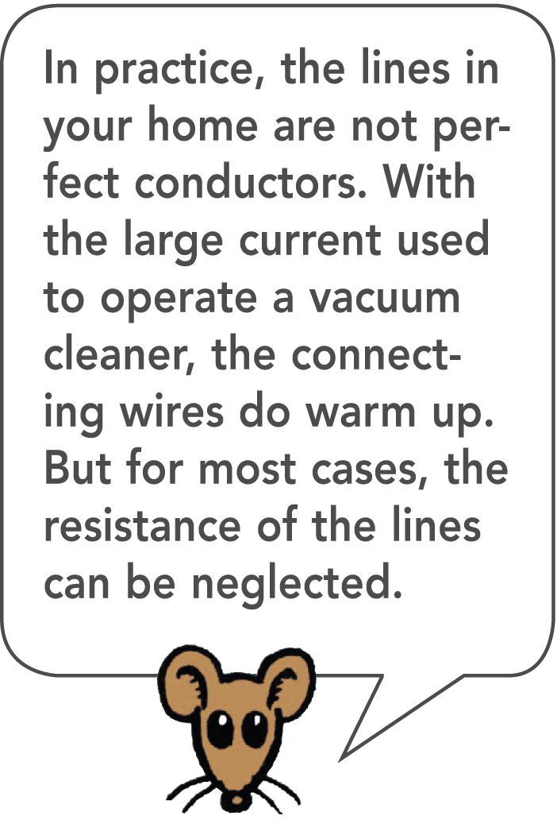
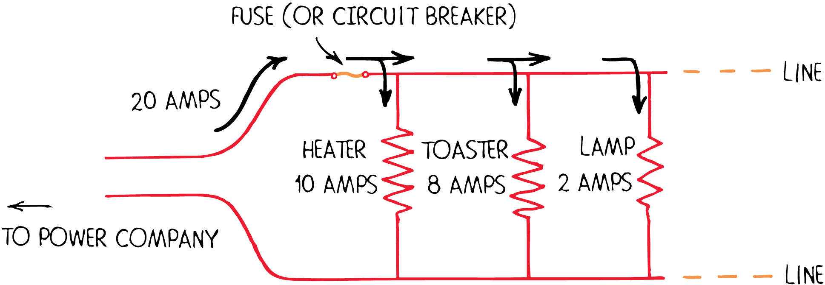
35.7 Parallel Circuits and Overloading
Consider a line connected to a toaster that draws 8 amps, a heater that draws 10 amps, and a lamp that draws 2 amps.
If the toaster is operating, the total line current is 8 amperes.
When the heater is also operating, the total line current increases to 18 amperes.
If you turn on the lamp, the line current increases to 20 amperes.

Slide 56
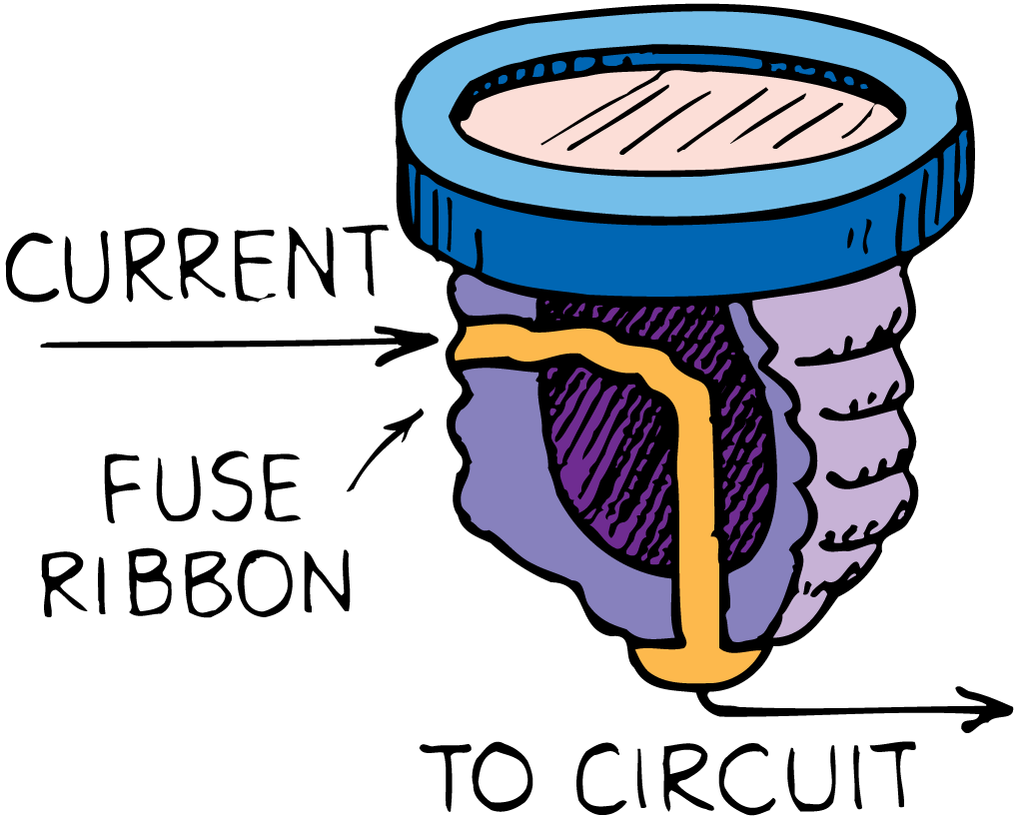
35.7 Parallel Circuits and Overloading
To prevent overloading in circuits, fuses or circuit breakers are connected in series along the supply line.
The entire line current must pass through the fuse.
If the fuse is rated at 20 amperes, it will pass up to 20 amperes.
A current above 20 amperes will melt the fuse ribbon, which “blows out” and breaks the circuit.

Slide 57
35.7 Parallel Circuits and Overloading
Before a blown fuse is replaced, the cause of overloading should be determined and remedied.
Insulation that separates the wires in a circuit can wear away and allow the wires to touch.
This effectively shortens the path of the circuit, and is called a short circuit.
A short circuit draws a dangerously large current because it bypasses the normal circuit resistance.

Slide 58
35.7 Parallel Circuits and Overloading
Circuits may also be protected by circuit breakers, which use magnets or bimetallic strips to open the switch.
Utility companies use circuit breakers to protect their lines all the way back to the generators.
Circuit breakers are used in modern buildings because they do not have to be replaced each time the circuit is opened.

Slide 59
35.7 Parallel Circuits and Overloading
How can you prevent overloading in circuits?

Slide 60
Assessment Questions
In a light bulb, the amount of current in the filament is
slightly less than the current in the connecting wires.
the same as the current in the connecting wires.
slightly greater than the current in the connecting wires.
twice as great as the current that is in the connecting wires.

Slide 61
Assessment Questions
In a light bulb, the amount of current in the filament is
slightly less than the current in the connecting wires.
the same as the current in the connecting wires.
slightly greater than the current in the connecting wires.
twice as great as the current that is in the connecting wires.
Answer: B

Slide 62
Assessment Questions
The flow of charge in an electric circuit is
much like the flow of water in a system of pipes.
very different from water flow in pipes.
like an electric valve.
like an electric pump.

Slide 63
Assessment Questions
The flow of charge in an electric circuit is
much like the flow of water in a system of pipes.
very different from water flow in pipes.
like an electric valve.
like an electric pump.
Answer: A

Slide 64
Assessment Questions
In a series circuit, if the current in one lamp is 2 amperes, the current in the battery is
half, 1 A.
2 A.
not necessarily 2 A, depending on internal battery resistance.
more than 2 A.

Slide 65
Assessment Questions
In a series circuit, if the current in one lamp is 2 amperes, the current in the battery is
half, 1 A.
2 A.
not necessarily 2 A, depending on internal battery resistance.
more than 2 A.
Answer: B

Slide 66
Assessment Questions
In a circuit with two lamps in parallel, if the current in one lamp is 2 amperes, the current in the battery is
half, 1 A.
2 A.
more than 2 A.
cannot be calculated from the information given

Slide 67
Assessment Questions
In a circuit with two lamps in parallel, if the current in one lamp is 2 amperes, the current in the battery is
half, 1 A.
2 A.
more than 2 A.
cannot be calculated from the information given
Answer: C

Slide 68
Assessment Questions
In a circuit diagram there may be
no switches.
at most, one switch.
two switches.
any number of switches.

Slide 69
Assessment Questions
In a circuit diagram there may be
no switches.
at most, one switch.
two switches.
any number of switches.
Answer: D

Slide 70
Assessment Questions
Consider a compound circuit consisting of a pair of 6-ohm resistors in parallel, which are in series with two 6-ohm resistors in series. The equivalent resistance of the circuit is
9 ohms.
12 ohms.
15 ohms.
24 ohms.

Slide 71
Assessment Questions
Consider a compound circuit consisting of a pair of 6-ohm resistors in parallel, which are in series with two 6-ohm resistors in series. The equivalent resistance of the circuit is
9 ohms.
12 ohms.
15 ohms.
24 ohms.
Answer: C

Slide 72
Assessment Questions
One way to prevent overloading in your home circuit is to
operate fewer devices at the same time.
change the wiring from parallel to series for troublesome devices.
find a way to bypass the fuse.
find a way to bypass the circuit breaker.

Slide 73
Assessment Questions
One way to prevent overloading in your home circuit is to
operate fewer devices at the same time.
change the wiring from parallel to series for troublesome devices.
find a way to bypass the fuse.
find a way to bypass the circuit breaker.
Answer: A

