Slide 1
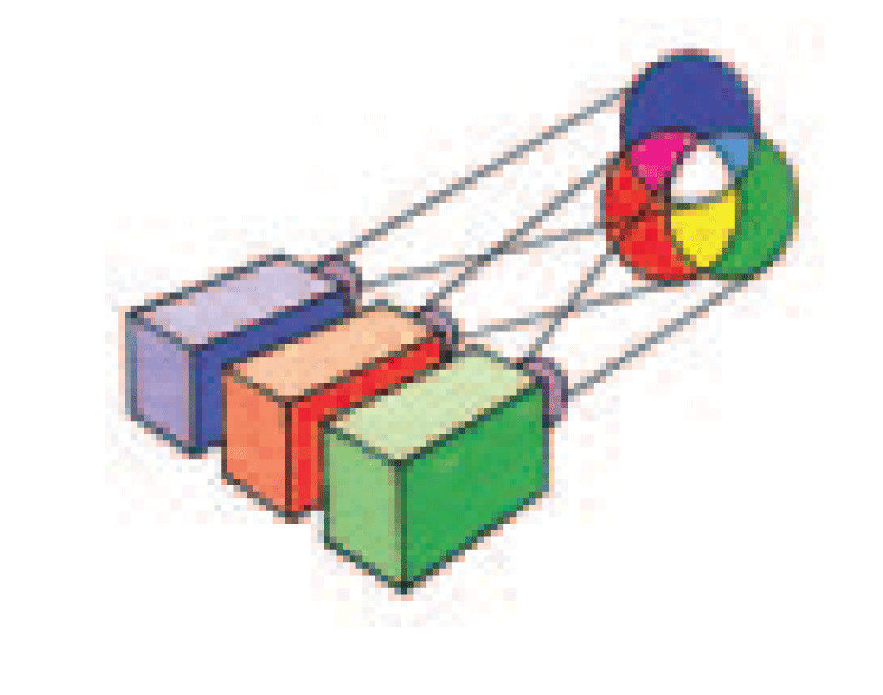
The colors of the objects depend on the color of the light that illuminates them.

Slide 2
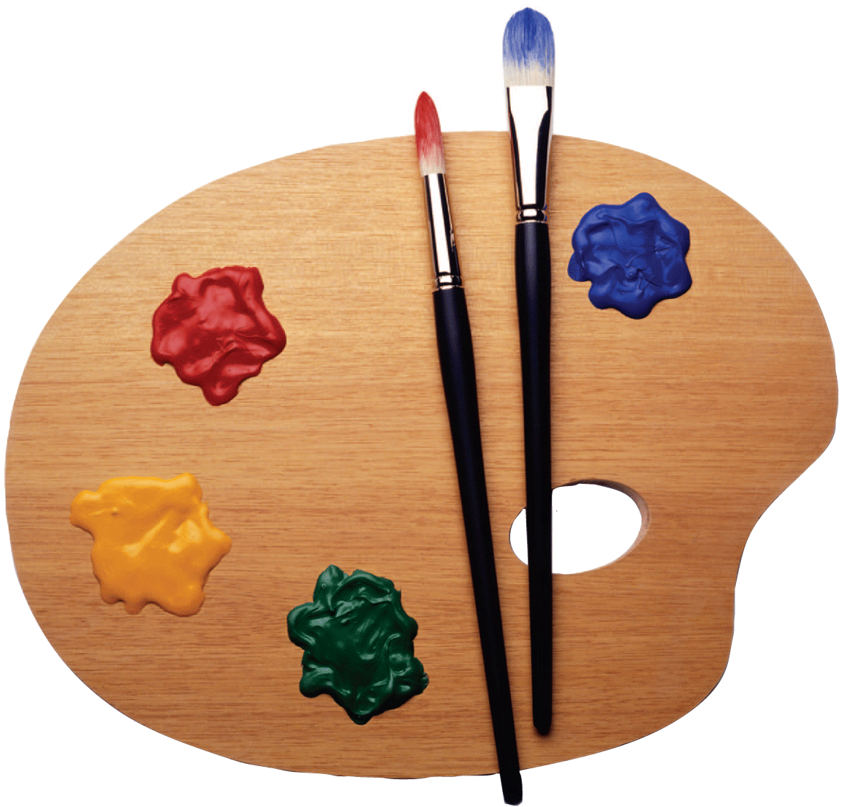
Color is in the eye of the beholder and is provoked by the frequencies of light emitted or reflected by things. We see red in a rose when light of certain frequencies reaches our eyes. Many organisms, including people with defective color vision, see no red in a rose.
Notes:
‹#›

Slide 3
28.1 The Color Spectrum
By passing a narrow beam of sunlight through a triangular-shaped glass prism, Newton showed that sunlight is composed of a mixture of all the colors of the rainbow.

Slide 4
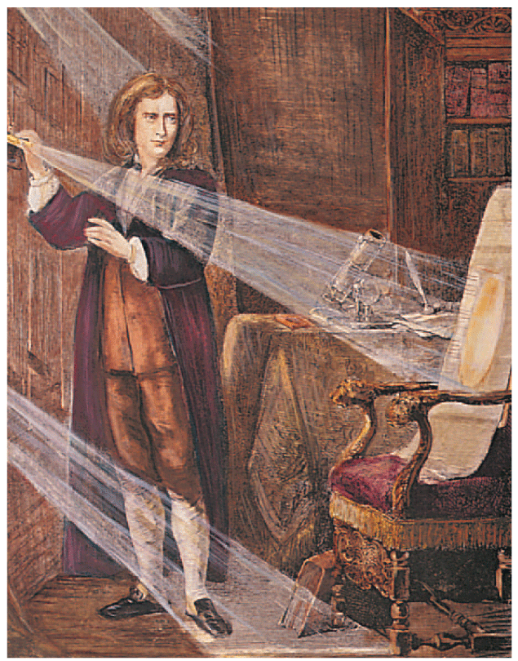
28.1 The Color Spectrum
Isaac Newton was the first to make a systematic study of color.
Passing sunlight through a glass prism, Newton showed that sunlight is composed of a mixture of all the colors of the rainbow.
Newton called this spread of colors a spectrum, and noted that the colors were formed in the order red, orange, yellow, green, blue, and violet.

Slide 5
28.1 The Color Spectrum
Sunlight is an example of what is called white light. White light is a combination of all the colors.
Under white light, white objects appear white and colored objects appear in their individual colors.

Slide 6
28.1 The Color Spectrum
Newton showed that the colors in the spectrum were a property not of the prism but of white light itself.
He recombined the colors with a second prism to produce white light again.
In other words, all the colors, one atop the other, combine to produce white light.
White is not a color but a combination of all colors.

Slide 7
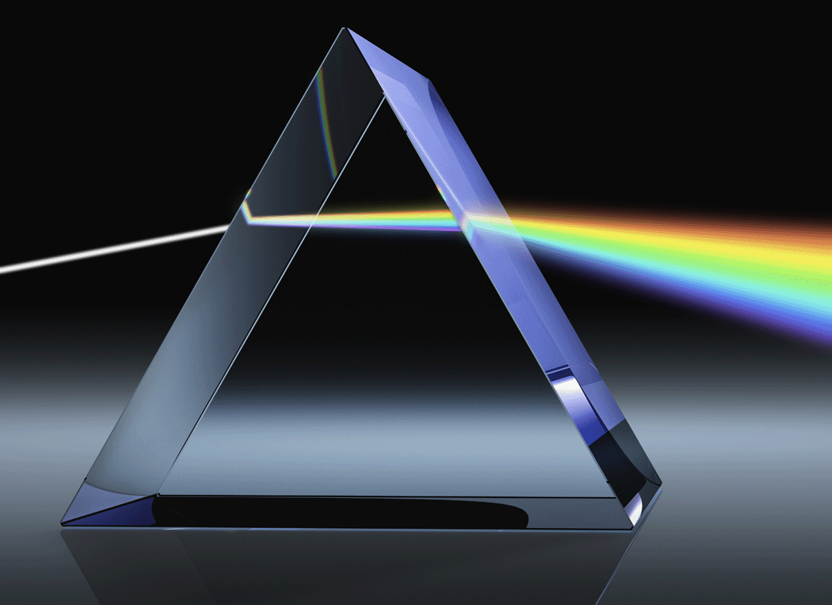
28.1 The Color Spectrum
When sunlight passes through a prism, it separates into a spectrum of all the colors of the rainbow.

Slide 8
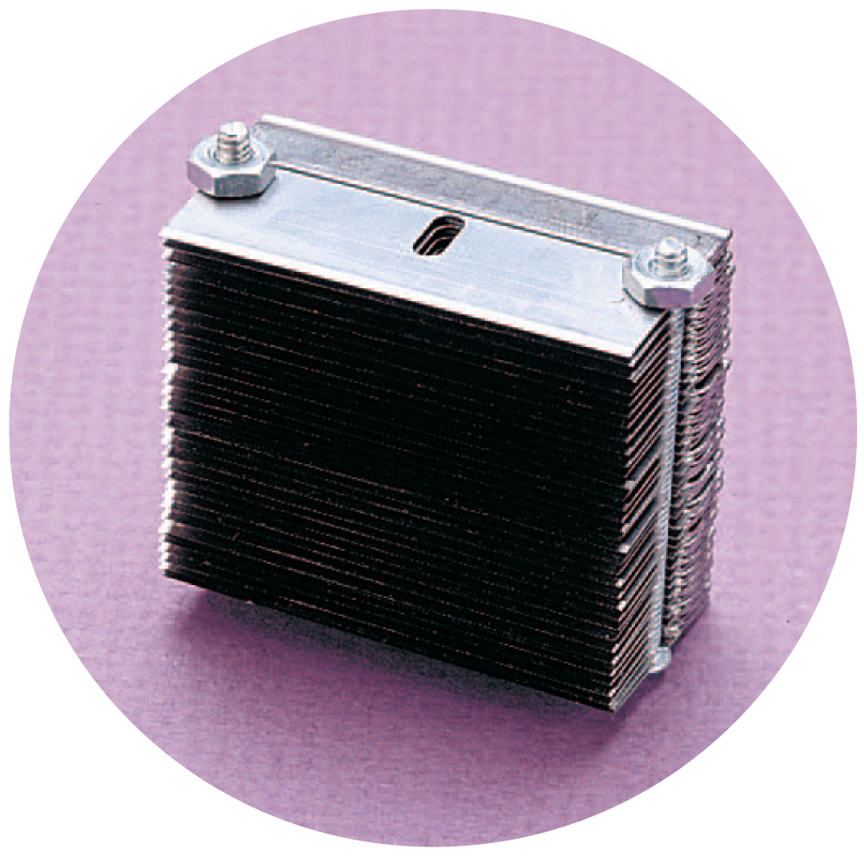
28.1 The Color Spectrum
Black is similarly not a color, but is the absence of light. Objects appear black when they absorb light of all visible frequencies.
Even a polished surface may look black under some conditions.
Highly polished razor blades stacked together and viewed end on appear black.
Light that gets between the closely spaced edges of the blades gets trapped and is absorbed after being reflected many times.

Slide 9
28.1 The Color Spectrum
Black objects that you can see do not absorb all light that falls on them, for there is always some reflection at the surface.
If not, you wouldn’t be able to see them.

Slide 10
28.1 The Color Spectrum
How did Isaac Newton show that sunlight is composed of a mixture of all colors of the rainbow?

Slide 11
28.2 Color by Reflection
The color of an opaque object is the color of the light it reflects.

Slide 12
28.2 Color by Reflection
The colors of most objects around you are due to the way the objects reflect light.
The color of an opaque object is the color of the light it reflects.
Light reflects from objects similar to the way sound “reflects” from a tuning fork when another sets it into vibration.

Slide 13
28.2 Color by Reflection
We can think of atoms and molecules as three-dimensional tuning forks.
Electrons behave as tiny oscillators in orbits around the nuclei.
Electrons can be forced temporarily into larger orbits by the vibrations of electromagnetic waves.
Like tuning forks, once excited to more vigorous motion, electrons send out their own energy waves in all directions.

Slide 14
28.2 Color by Reflection
Differences Among Materials
Different materials have different natural frequencies for absorbing and emitting radiation.
At the resonant frequencies where the amplitudes of oscillation are large, light is absorbed.
At frequencies below and above the resonant frequencies, light is reemitted.

Slide 15
28.2 Color by Reflection
If the material is transparent, the reemitted light passes through it.
If the material is opaque, the light passes back into the medium from which it came. This is reflection.
Most materials absorb light of some frequencies and reflect the rest.
If a material absorbs light of most visible frequencies and reflects red, for example, the material appears red.

Slide 16
28.2 Color by Reflection
This square reflects all the colors illuminating it. In sunlight, it is white. When illuminated with blue light, it is blue.

Slide 17
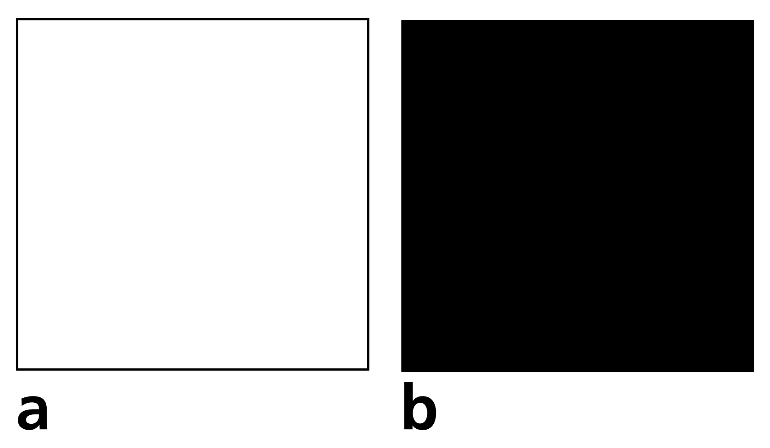
28.2 Color by Reflection
This square reflects all the colors illuminating it. In sunlight, it is white. When illuminated with blue light, it is blue.
This square absorbs all the colors illuminating it. In sunlight it is warmer than the white square.

Slide 18
28.2 Color by Reflection
When white light falls on a flower, light of some frequencies is absorbed by the cells in the flower and some light is reflected.
Cells that contain chlorophyll absorb light of most frequencies and reflect the green part, so they appear green.
The petals of a red rose, on the other hand, reflect primarily red light, with a lesser amount of blue.

Slide 19
28.2 Color by Reflection
Petals of most yellow flowers, such as daffodils, reflect red and green as well as yellow.
Yellow daffodils reflect light of a broad band of frequencies.
The reflected colors of most objects are not pure single-frequency colors, but a spread of frequencies.
So something yellow, for example, may simply be a mixture of colors without blue and violet—or it can be red and green together.

Slide 20
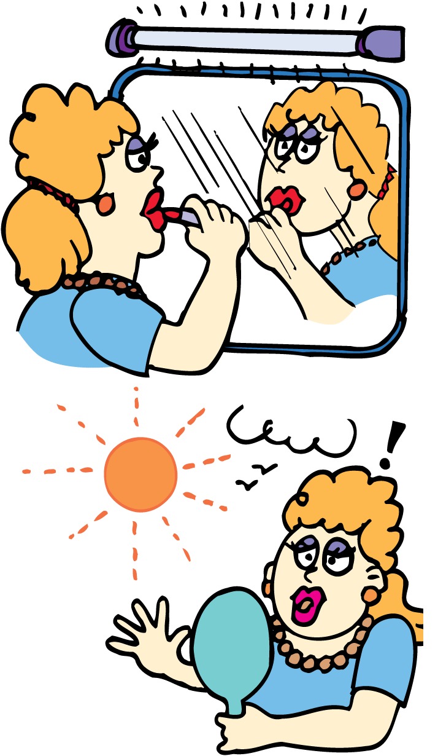
28.2 Color by Reflection
Light Sources
The color of an object depends on the kind of light used.
A candle flame is deficient in higher frequencies; it emits a yellowish light. Things look yellowish in candlelight.
An incandescent lamp emits light of all the visible frequencies, but is richer toward the lower frequencies, enhancing the reds.
A fluorescent lamp is richer in the higher frequencies, so blues are enhanced when illuminated with fluorescent lamps.

Slide 21
28.2 Color by Reflection
think!
When red light shines on a red rose, why do the leaves become warmer than the petals?

Slide 22
28.2 Color by Reflection
think!
When red light shines on a red rose, why do the leaves become warmer than the petals?
Answer:
The leaves absorb rather than reflect red light, so the leaves become warmer.

Slide 23
28.2 Color by Reflection
think!
When green light shines on a red rose, why do the petals look black?

Slide 24
28.2 Color by Reflection
think!
When green light shines on a red rose, why do the petals look black?
Answer:
The petals absorb rather than reflect the green light. So, the rose appears to have no color at all—black.

Slide 25
28.2 Color by Reflection
What determines the color of an opaque object?

Slide 26
28.3 Color by Transmission
The color of a transparent object is the color of the light it transmits.

Slide 27
28.3 Color by Transmission
A red piece of glass appears red because it absorbs all the colors that compose white light, except red, which it transmits.
A blue piece of glass appears blue because it transmits primarily blue and absorbs the other colors that illuminate it.

Slide 28
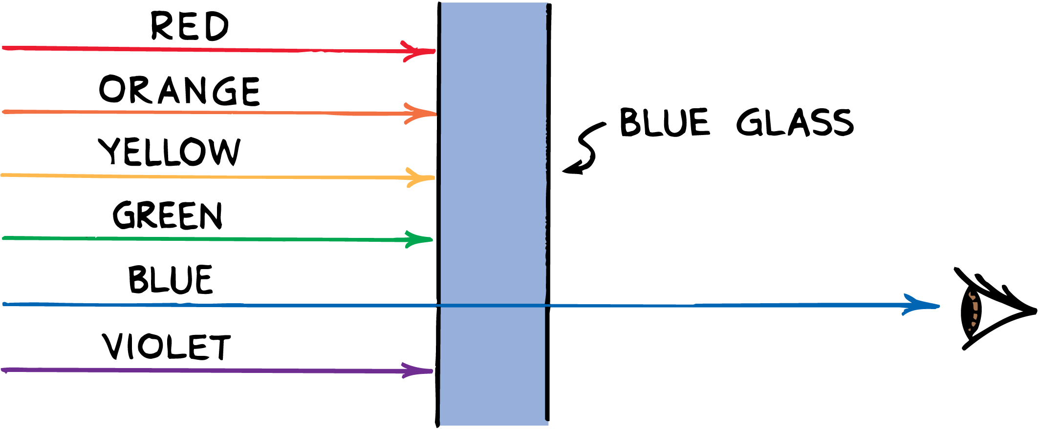
28.3 Color by Transmission
Blue glass transmits only energy of the frequency of blue light; energy of the other frequencies is absorbed and warms the glass.

Slide 29
28.3 Color by Transmission
The material in the glass that selectively absorbs colored light is known as a pigment.
Electrons in the pigment atoms selectively absorb light of certain frequencies in the illuminating light.
Other frequencies are reemitted from atom to atom in the glass.
Ordinary window glass is colorless because it transmits light of all visible frequencies equally well.

Slide 30
28.3 Color by Transmission
What determines the color of a transparent object?

Slide 31
28.4 Sunlight
Yellow-green light is the brightest part of sunlight.

Slide 32
28.4 Sunlight
White light from the sun is a composite of all the visible frequencies. The brightness of solar frequencies is uneven.
The lowest frequencies of sunlight, in the red region, are not as bright as those in the middle-range yellow and green region.
Humans evolved in the presence of sunlight and we are most sensitive to yellow-green.
The blue portion of sunlight is not as bright, and the violet portion is even less bright.

Slide 33
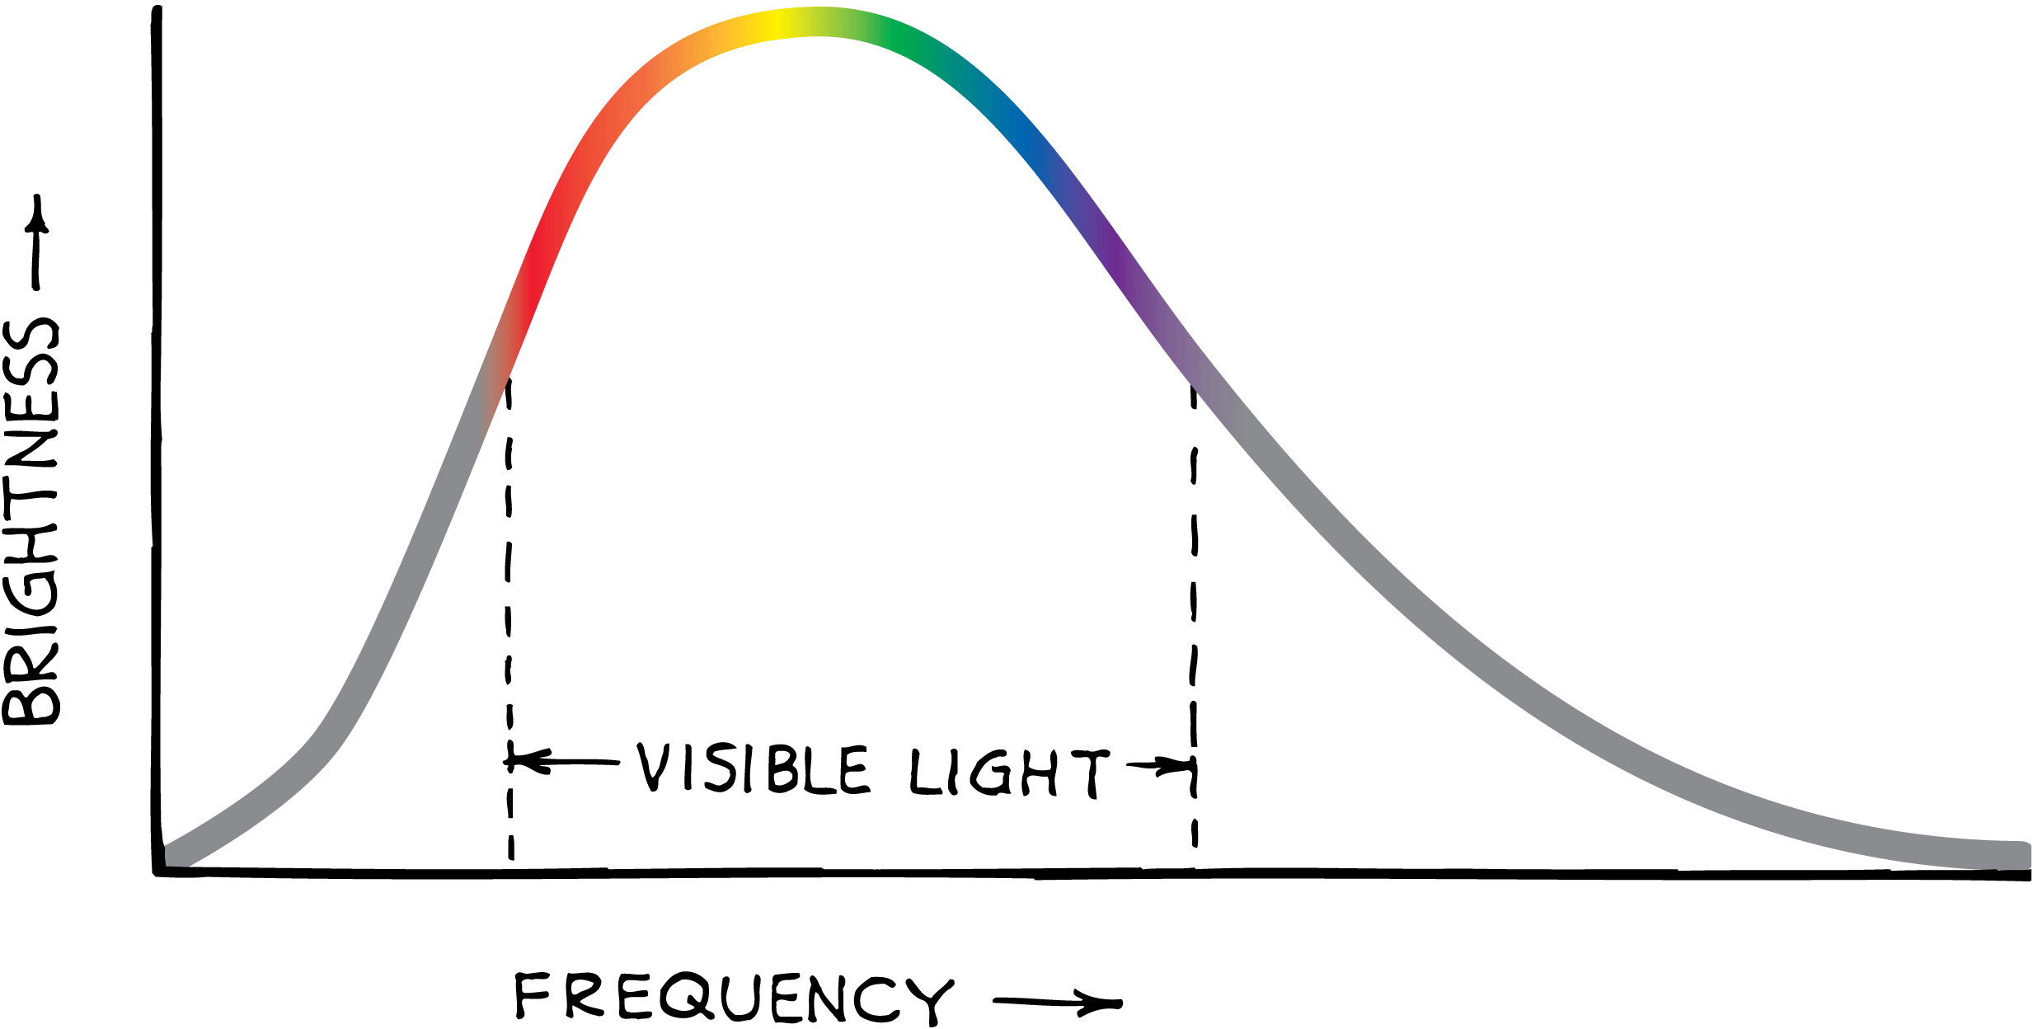
28.4 Sunlight
The radiation curve of sunlight is a graph of brightness versus frequency. Sunlight is brightest in the yellow-green region.

Slide 34
28.4 Sunlight
Which visible frequencies make up the brightest part of sunlight?

Slide 35
28.5 Mixing Colored Light
You can make almost any color at all by overlapping red, green, and blue light and adjusting the brightness of each color of light.

Slide 36
28.5 Mixing Colored Light
Light of all the visible frequencies mixed together produces white.
White also results from the combination of only red, green, and blue light.
Red and green light alone overlap to form yellow.
Red and blue light alone produce the bluish-red color called magenta.
Green and blue light alone produce the greenish-blue color called cyan.

Slide 37
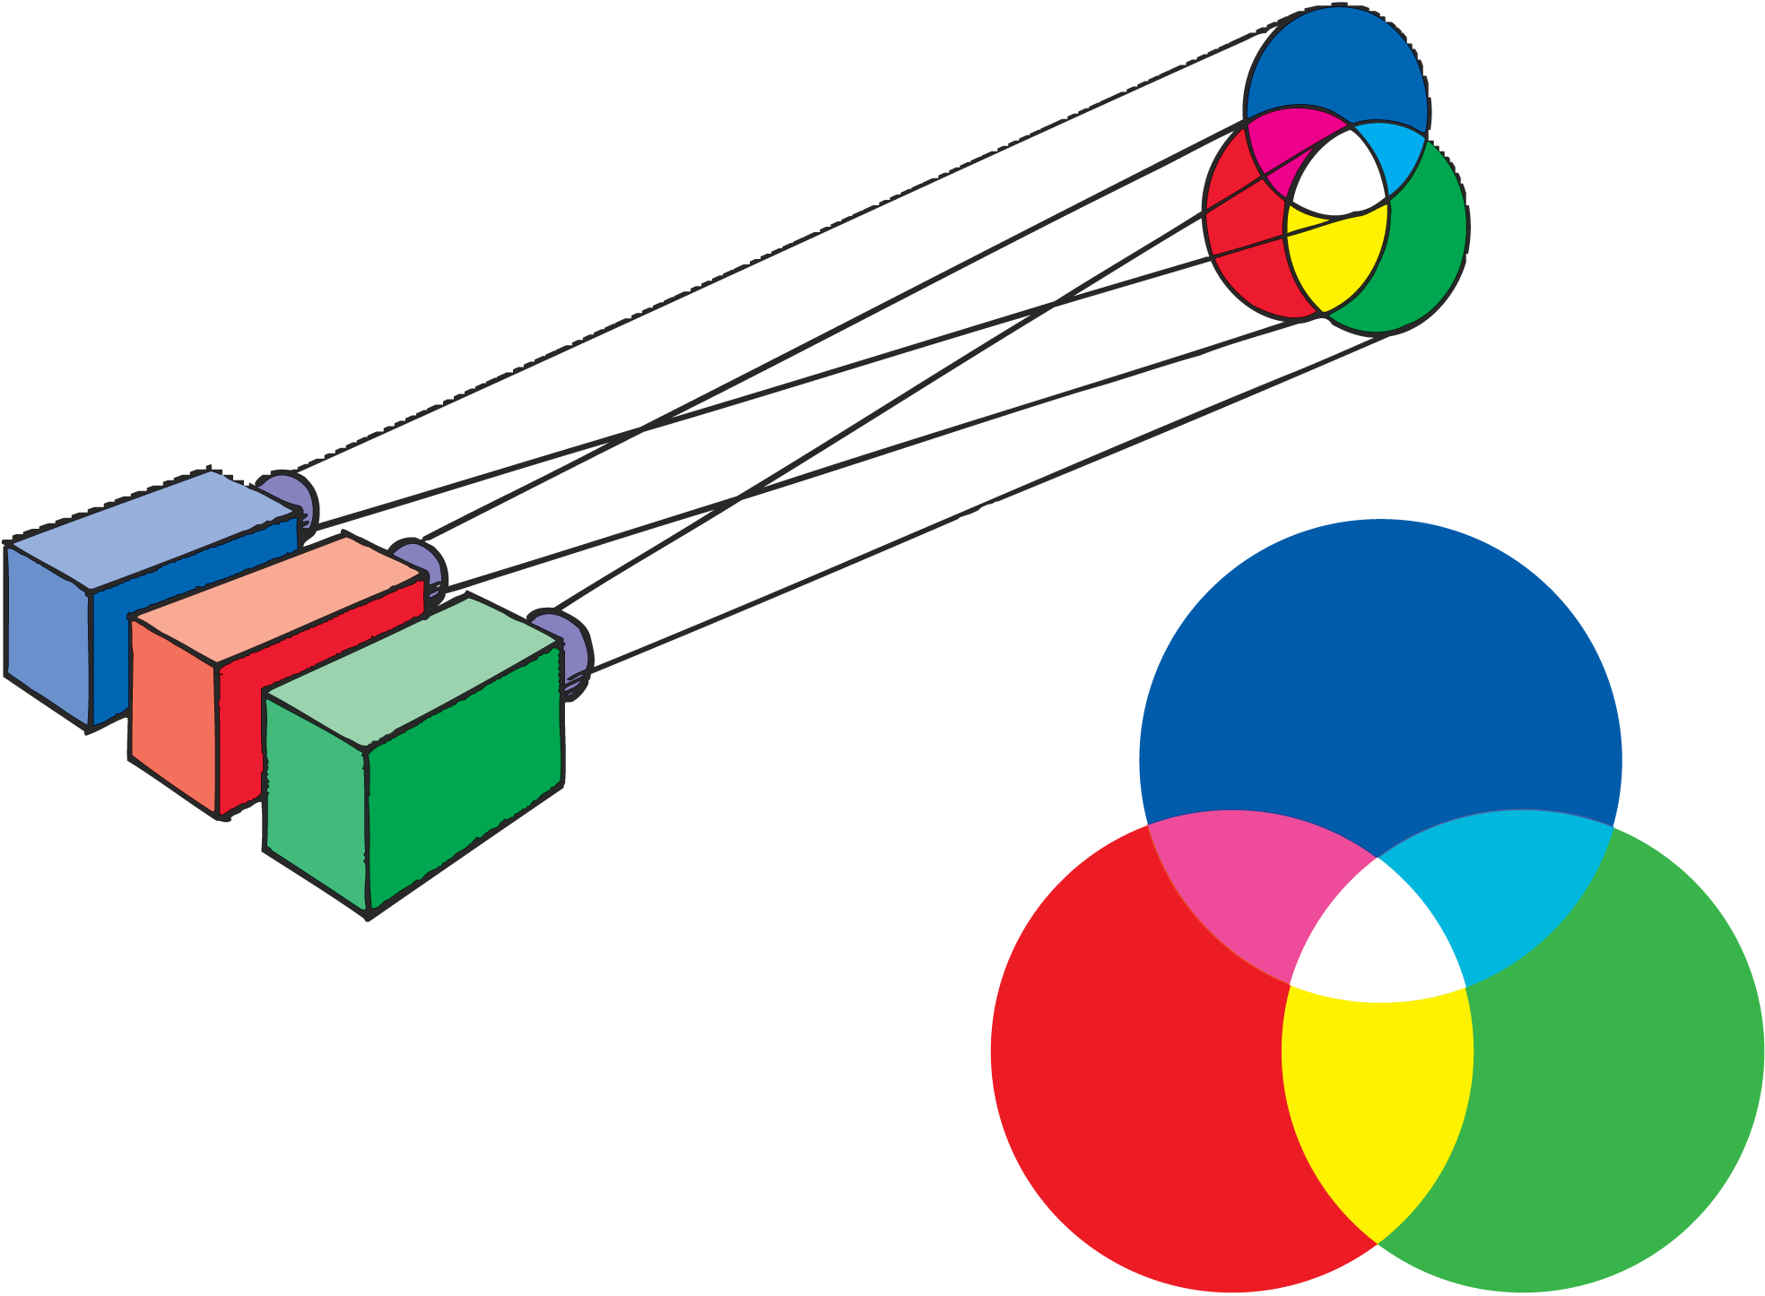
28.5 Mixing Colored Light
When red light, green light, and blue light of equal brightness are projected on a white screen, the overlapping areas appear different colors.

Slide 38
28.5 Mixing Colored Light
The frequencies of white light can be divided into three regions:
the lower-frequency red end
the middle-frequency green part
the higher-frequency blue end
Low and middle frequencies combine to form yellow to the human eye. The middle and high frequencies appear greenish blue (cyan). The low and high frequencies appear bluish red (magenta).

Slide 39
28.5 Mixing Colored Light
The low-frequency, middle-frequency, and high-frequency parts of white light appear red, green, and blue.
To the human eye, red + green = yellow; red + blue = magenta; green + blue = cyan.

Slide 40
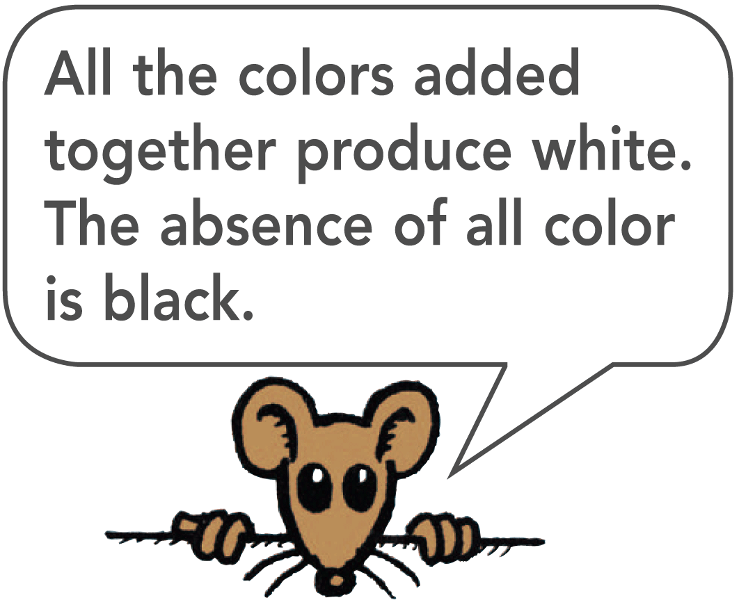
28.5 Mixing Colored Light
This amazing phenomenon is due to the way the human eye works.
The three colors do not have to be red, green, and blue, although those three produce the highest number of different colors.
For this reason, red, green, and blue are called the additive primary colors.

Slide 41
28.5 Mixing Colored Light
Color television is based on the ability of the human eye to see combinations of three colors as a variety of different colors.
The picture is made up of tiny spots, each less than a millimeter across.
When the screen is lit, some of the spots are red, some green, and some blue.
At a distance the mixtures of these colors provide a complete range of colors, plus white.

Slide 42
28.5 Mixing Colored Light
think!
What color does red light plus blue light make?

Slide 43
28.5 Mixing Colored Light
think!
What color does red light plus blue light make?
Answer:
Magenta

Slide 44
28.5 Mixing Colored Light
Which three visible frequencies combine to form almost any color?

Slide 45
28.6 Complementary Colors
Every color has some complementary color that when added to it will produce white.

Slide 46
28.6 Complementary Colors
When two of the three additive primary colors are combined:
red + green = yellow
red + blue = magenta
blue + green = cyan
When we add in the third color, we get white:
yellow + blue = white
magenta + green = white
cyan + red = white

Slide 47
28.6 Complementary Colors
When two colors are added together to produce white, they are called complementary colors.
Yellow and blue are complementary because yellow is the combination of red and green.
Red, green, and blue light together appear white.
By similar reasoning we see that magenta and green are complementary colors, as are cyan and red.

Slide 48
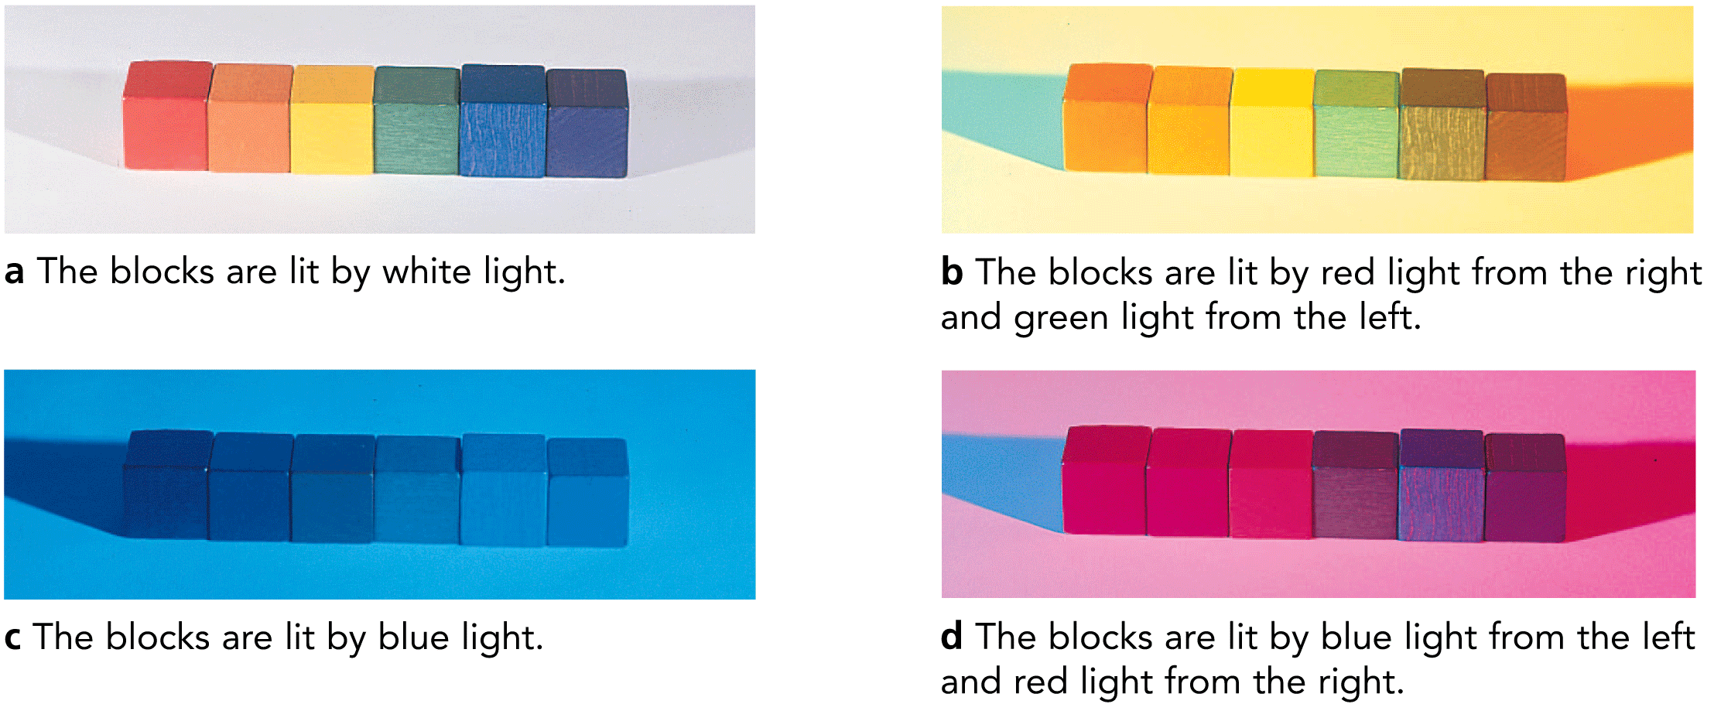
28.6 Complementary Colors
Six blocks and their shadows appear as different colors depending on the color of light that illuminates them.

Slide 49
28.6 Complementary Colors
Begin with white light and subtract some color from it. The resulting color appears to be the complement of the one subtracted.
Some of the light incident upon an object is absorbed. The part that is absorbed is in effect subtracted from the incident light.
For example, if white light falls on a pigment that absorbs red light, the light reflected appears cyan.
Subtract a color from white light and you have the complementary color.

Slide 50
28.6 Complementary Colors
When white light passes through all three transparencies, light of all frequencies is blocked (subtracted) and we have black.

Slide 51
28.6 Complementary Colors
think!
What color does white light minus yellow light appear?

Slide 52
28.6 Complementary Colors
think!
What color does white light minus yellow light appear?
Answer:
Blue

Slide 53
28.6 Complementary Colors
think!
What color does white light minus green light appear?

Slide 54
28.6 Complementary Colors
think!
What color does white light minus green light appear?
Answer:
Magenta

Slide 55
28.6 Complementary Colors
What happens when you combine any color with its complementary color?

Slide 56
28.7 Mixing Colored Pigments
When paints or dyes are mixed, the mixture absorbs all the frequencies each paint or dye absorbs.

Slide 57
28.7 Mixing Colored Pigments
Red and green paint do not combine to form yellow as red and green light do.
The mixing of paints and dyes is an entirely different process from the mixing of colored light.
Paints and dyes contain particles of pigment that produce colors by absorbing light of certain frequencies and reflecting others.

Slide 58
28.7 Mixing Colored Pigments
When paints or dyes are mixed, the mixture absorbs all the frequencies each paint or dye absorbs.
Blue paint, for example, reflects mostly blue light, but also violet and green; it absorbs red, orange, and yellow light.
Yellow paint reflects mostly yellow light, but also red, orange, and green; it absorbs blue and violet light.

Slide 59
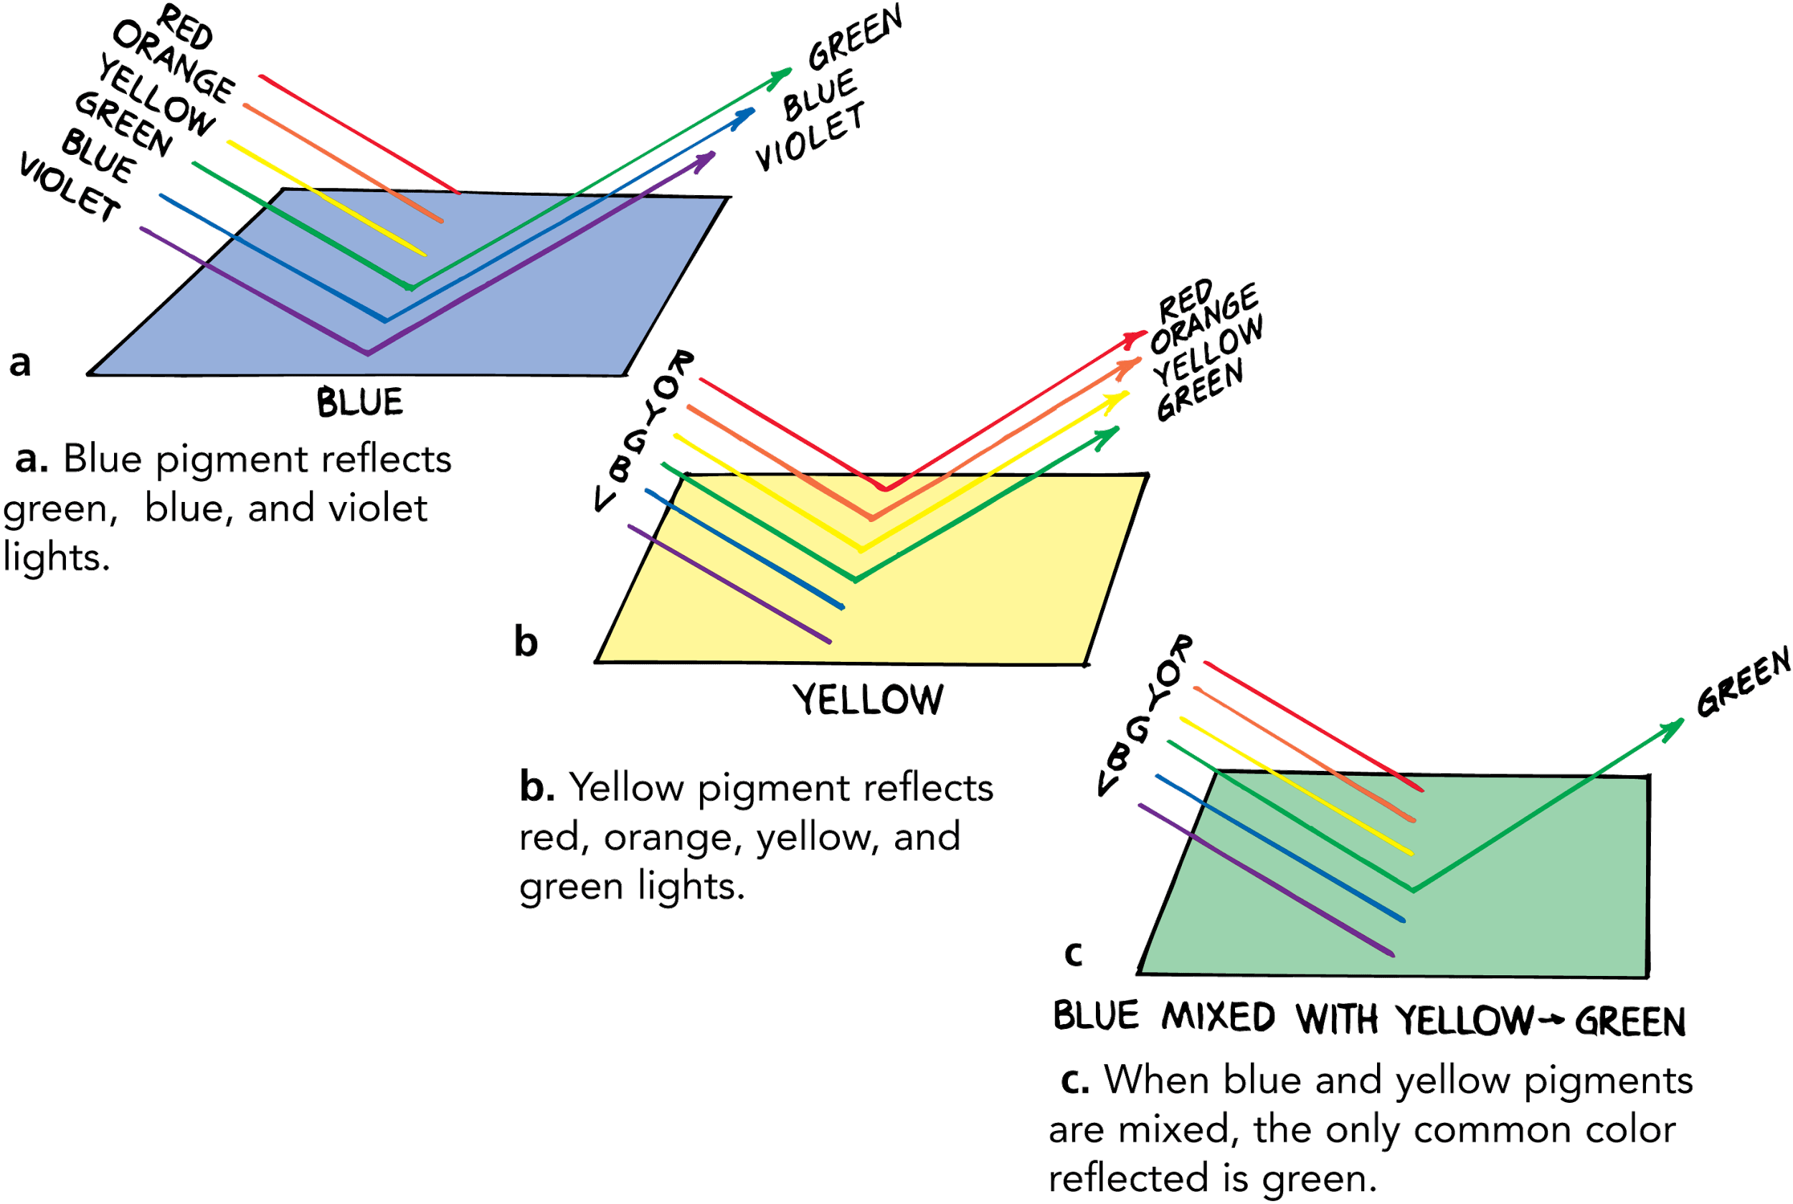
28.7 Mixing Colored Pigments
When blue and yellow paints are mixed, then between them they absorb all the colors except green.
This process is called color mixing by subtraction.

Slide 60
28.7 Mixing Colored Pigments
Mixing colored light is called color mixing by addition.
When you cast lights on a stage, you use the rules of color addition, but when you mix paint, you use the rules of color subtraction.

Slide 61
28.7 Mixing Colored Pigments
The three colors most useful in color mixing by subtraction are:
magenta (bluish red)
yellow
cyan (greenish blue)
Magenta, yellow, and cyan are the subtractive primary colors, used in printing illustrations in full color.

Slide 62
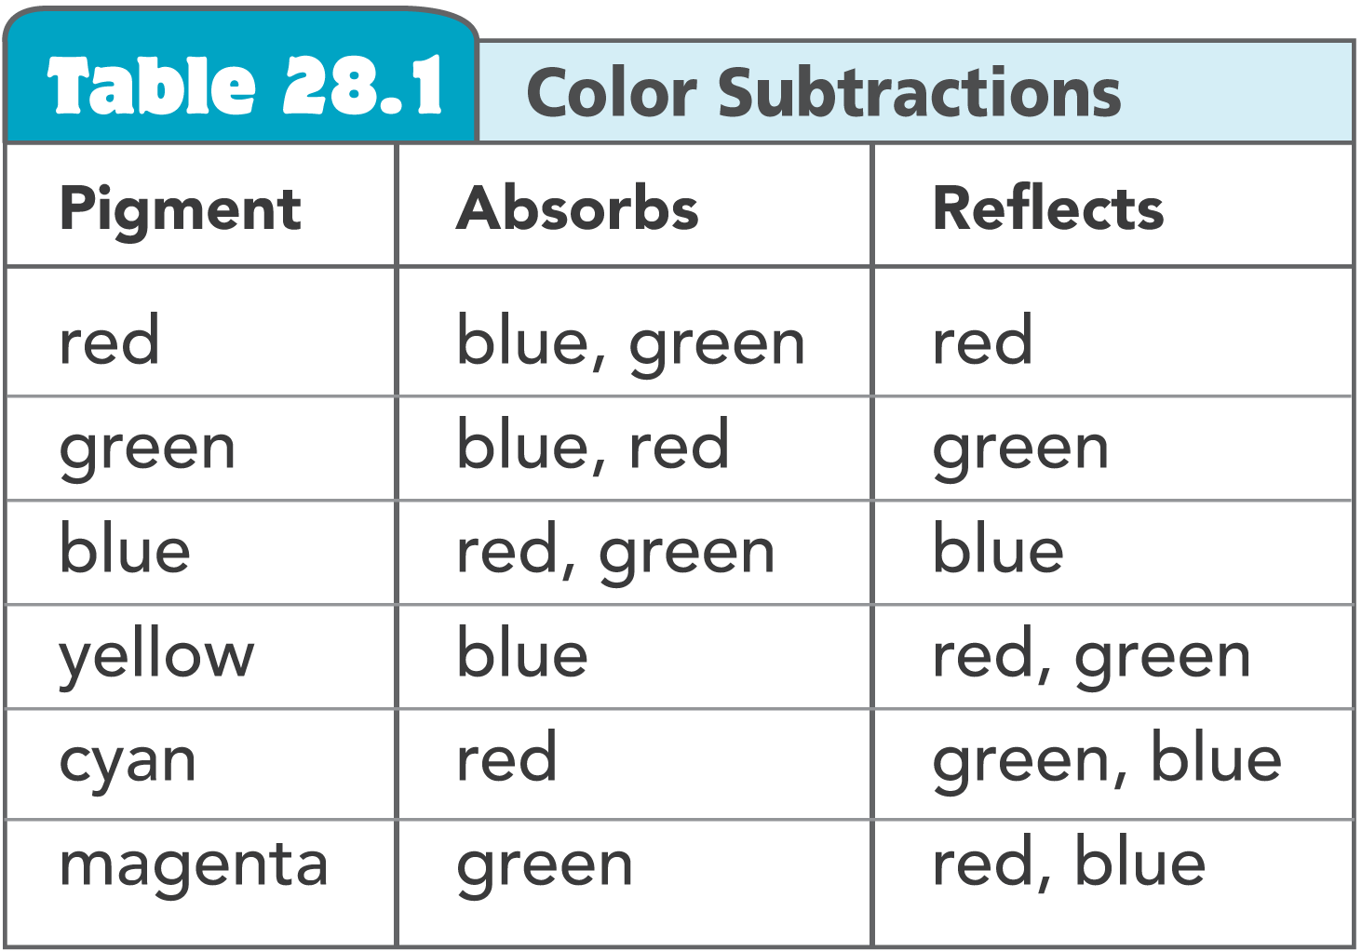
28.7 Mixing Colored Pigments

Slide 63
28.7 Mixing Colored Pigments
Color printing is done on a press that prints each page with four differently colored inks (magenta, yellow, cyan, and black).
Each color of ink comes from a different plate, which transfers the ink to the paper.
The ink deposits are regulated on different parts of the plate by tiny dots.
The overlapping dots of three colors plus black give the appearance of many colors.

Slide 64
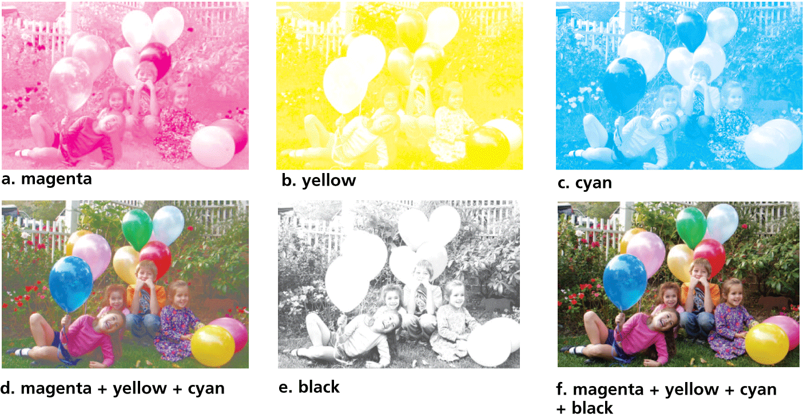
28.7 Mixing Colored Pigments
Only four colors of ink are used to print color illustrations and photographs—magenta, yellow, cyan, and black.

Slide 65
28.7 Mixing Colored Pigments
Which visible frequencies are absorbed by a mixture of paints or dyes?

Slide 66
28.8 Why the Sky Is Blue
The sky is blue because its component particles scatter high-frequency light.

Slide 67
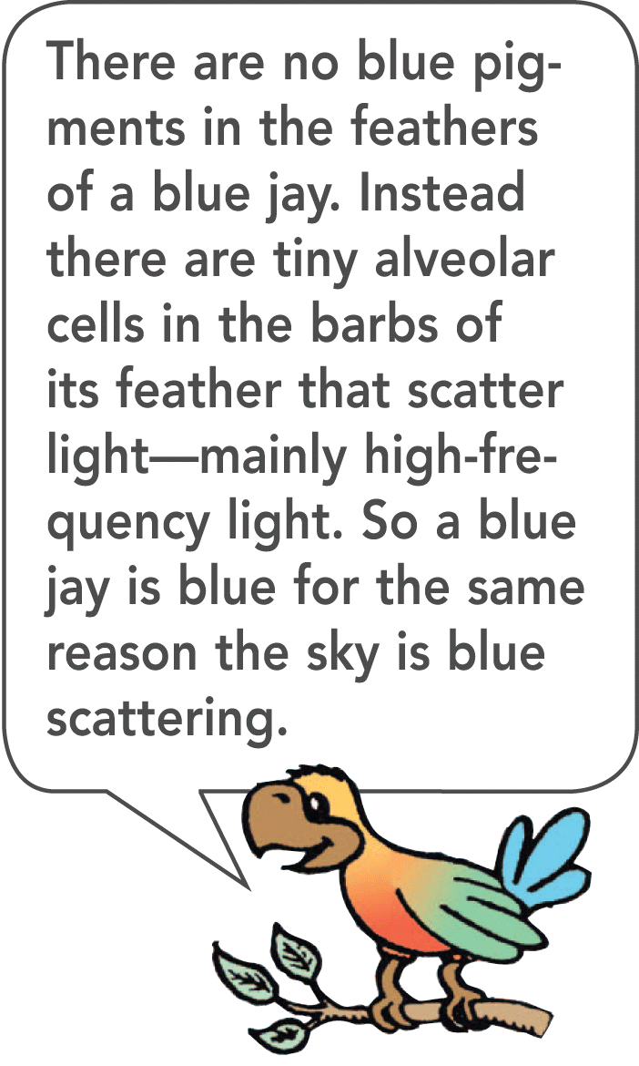
28.8 Why the Sky Is Blue
Scattering is a process in which sound or light is absorbed and reemitted in all directions.
Light is scattered by molecules and larger specks of matter that are far apart from one another in the atmosphere.

Slide 68
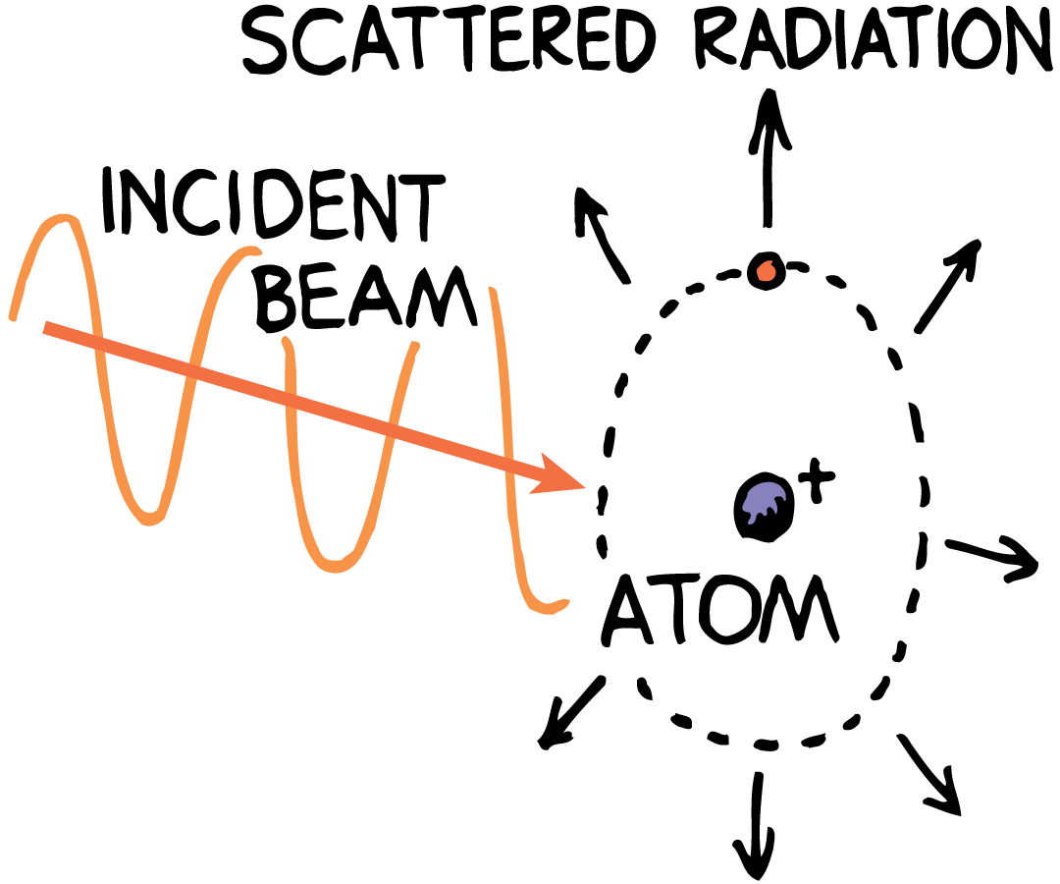
28.8 Why the Sky Is Blue
A beam of light falls on an atom and causes the electrons in the atom to move temporarily in larger orbits. The more vigorously oscillating electrons reemit light in various directions.

Slide 69
28.8 Why the Sky Is Blue
The Sky
Atoms and molecules reemit light waves. Very tiny particles do the same.
The nitrogen and oxygen molecules and the tiny particles that make up the atmosphere are like tiny bells that “ring” with high frequencies when energized by sunlight.
Like the sound from bells, the light is sent in all directions.

Slide 70
28.8 Why the Sky Is Blue
Most ultraviolet light is absorbed by a layer of ozone gas in the upper atmosphere. The rest is scattered by atmospheric particles and molecules.

Slide 71
28.8 Why the Sky Is Blue
Of the visible frequencies, violet light is scattered the most, followed by blue, green, yellow, orange, and red, in that order.
Violet light is scattered more than blue but our eyes are not very sensitive to violet light.
Our eyes are more sensitive to blue, so we see a blue sky.

Slide 72
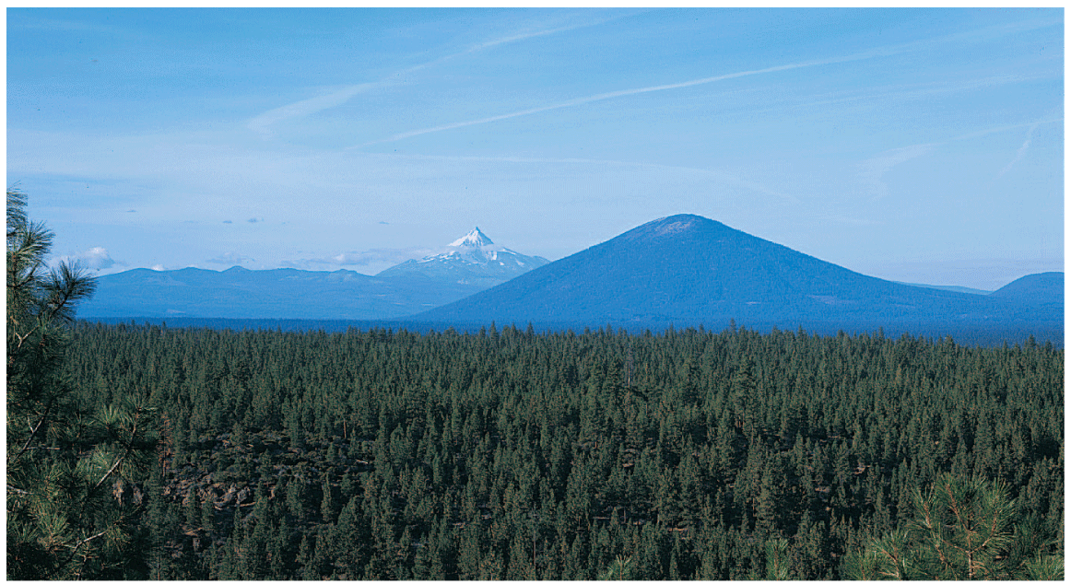
28.8 Why the Sky Is Blue

Slide 73
28.8 Why the Sky Is Blue
The blue of the sky varies under different conditions.
Where there are a lot of particles larger than oxygen and nitrogen molecules, the lower frequencies of light are scattered more.
This makes the sky less blue, and it takes on a whitish appearance.
After a heavy rainstorm, when the particles have been washed away, the sky becomes a deeper blue.

Slide 74
28.8 Why the Sky Is Blue
The higher that one goes into the atmosphere, the fewer molecules there are in the air to scatter light.
The sky appears darker.
When there are no molecules, as on the moon, for example, the “sky” is black.

Slide 75
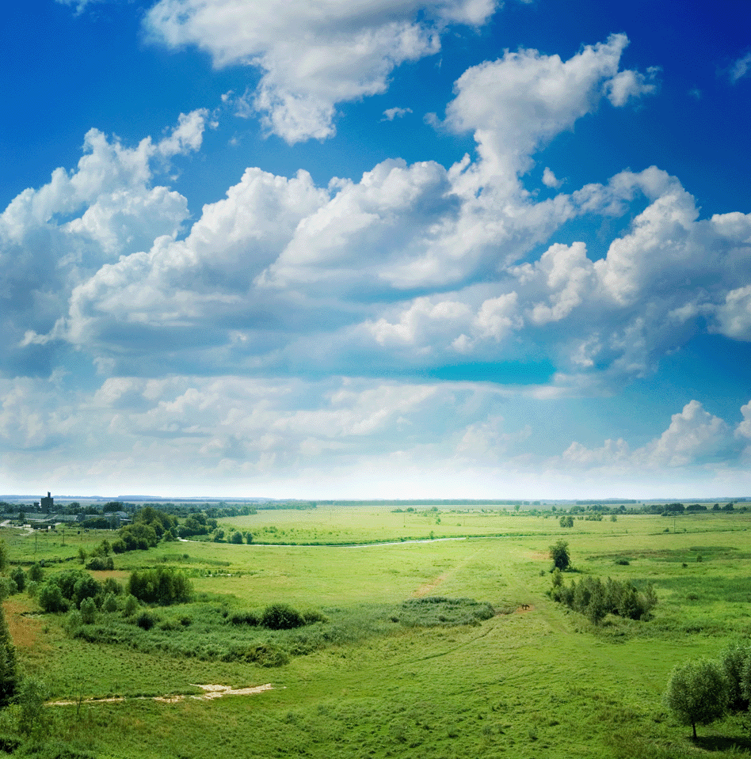
28.8 Why the Sky Is Blue
The Clouds
Water droplets in a variety of sizes—some of them microscopic—make up clouds.
The different-size droplets result in a variety of frequencies for scattered light: low frequencies from larger droplets and high frequencies from tinier droplets of water molecules. The overall result is a white cloud.

Slide 76
28.8 Why the Sky Is Blue
Why is the sky blue?

Slide 77
28.9 Why Sunsets Are Red
By the time a beam of light gets to the ground at sunset, all of the high-frequency light has already been scattered. Only the lower frequencies remain, resulting in a red sunset.

Slide 78
28.9 Why Sunsets Are Red
The lower frequencies of light are scattered the least by nitrogen and oxygen molecules.
Red, orange, and yellow light are transmitted through the atmosphere more readily than violet and blue.
Red light, which is scattered the least, passes through more atmosphere without interacting than light of any other color.
At dawn and at sunset, sunlight reaches us through a longer path through the atmosphere than at noon.

Slide 79
28.9 Why Sunsets Are Red
At noon sunlight travels through the least amount of atmosphere, so a relatively small amount of light is scattered.
As the sun is lower in the sky, the path through the atmosphere is longer, and more blue is scattered from the sunlight.
Less and less blue remains in the sunlight that reaches Earth.
The sun appears progressively redder, going from yellow to orange, and finally, red.

Slide 80
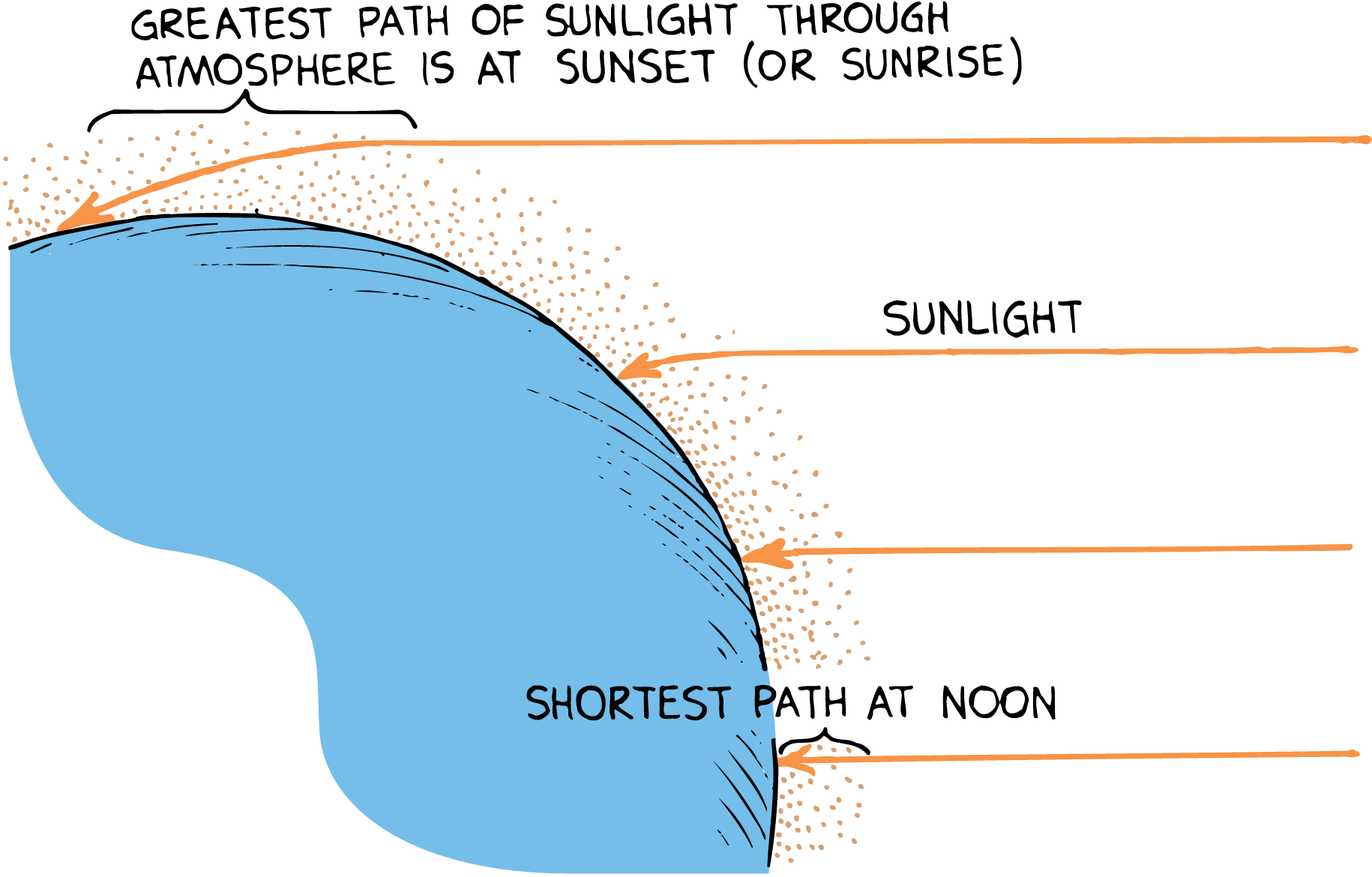
28.9 Why Sunsets Are Red
By the time a beam of sunlight gets to the ground at sunset, only the lower frequencies survive, producing a red sunset.

Slide 81
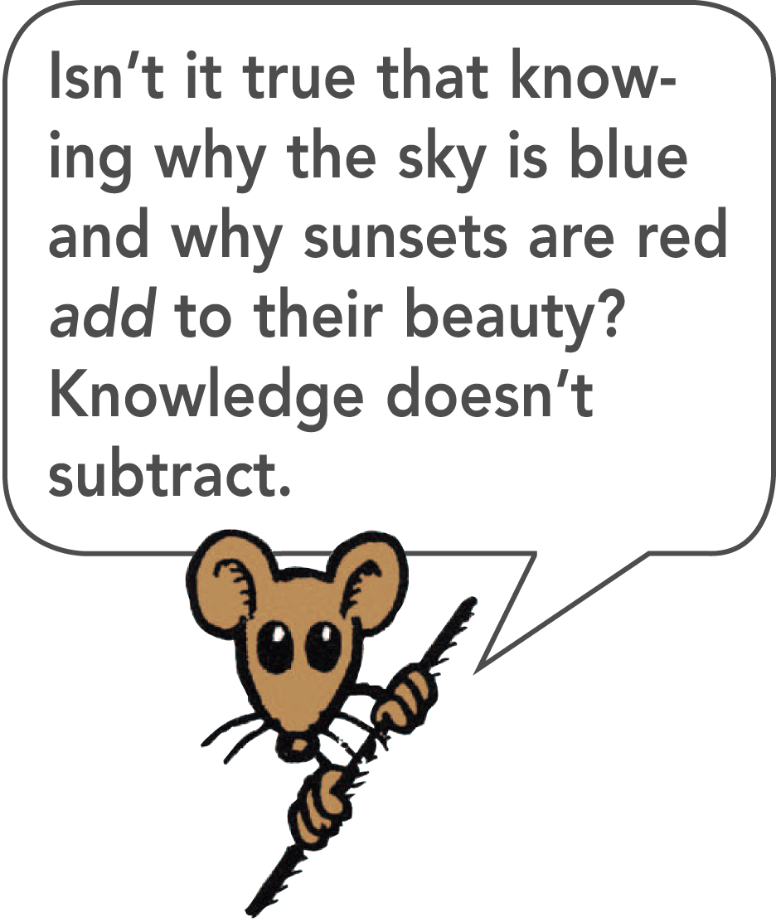
28.9 Why Sunsets Are Red
The colors of the sun and sky are consistent with our rules for color mixing.
When blue is subtracted, the complementary color that is left is yellow.
The subtraction of violet leaves orange.
When green is subtracted, magenta is left.
The relative amounts of scattering depend on atmospheric conditions, changing from day to day for a variety of sunsets.

Slide 82
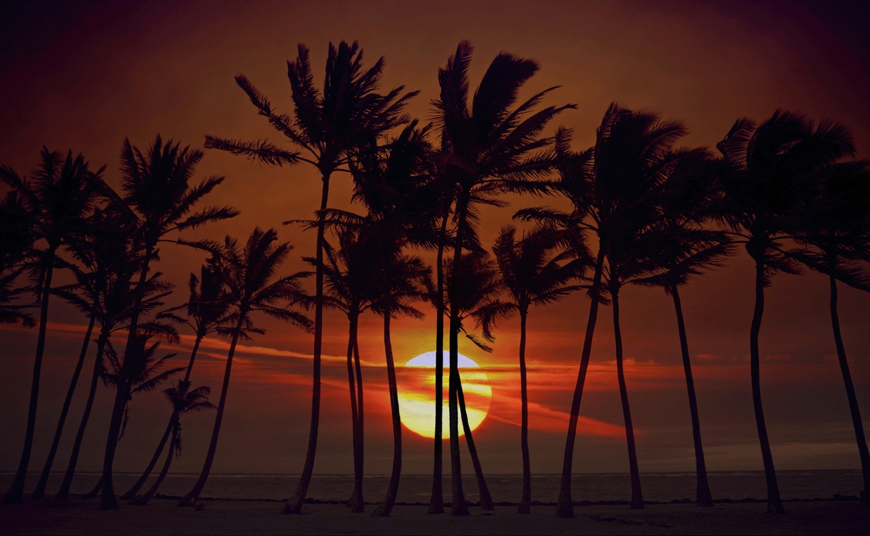
28.9 Why Sunsets Are Red

Slide 83
28.9 Why Sunsets Are Red
The sunset sky is red because of the absence of high-frequency light.
You see the scattered blue when the background is dark, but not when the background is bright because the scattered blue is faint.
When you look from Earth’s surface at the atmosphere against the darkness of space, the atmosphere is sky blue.
When astronauts look down through the same atmosphere to the bright surface of Earth, they do not see the same blueness.

Slide 84
28.9 Why Sunsets Are Red
think!
If molecules in the sky scattered low-frequency light more than high-frequency light, how would the colors of the sky and sunsets appear?

Slide 85
28.9 Why Sunsets Are Red
think!
If molecules in the sky scattered low-frequency light more than high-frequency light, how would the colors of the sky and sunsets appear?
Answer:
If low frequencies were scattered more, red light would be scattered out of the sunlight on its long path through the atmosphere at sunset, and the sunlight to reach your eye would be predominantly blue and violet.

Slide 86
28.9 Why Sunsets Are Red
think!
Distant dark mountains are bluish in color. What is the source of this blueness? (Hint: What is between you and the mountains you see?)

Slide 87
28.9 Why Sunsets Are Red
think!
Distant dark mountains are bluish in color. What is the source of this blueness? (Hint: What is between you and the mountains you see?)
Answer:
If you look at distant dark mountains, very little light from them reaches you, and the blueness of the atmosphere between you and the mountains predominates. The blueness is of the low-altitude “sky” between you and the mountains.

Slide 88
28.9 Why Sunsets Are Red
Why are sunsets red?

Slide 89
28.10 Why Water Is Greenish Blue
Water is greenish blue because water molecules absorb red.

Slide 90
28.10 Why Water Is Greenish Blue
We often see a beautiful deep blue when we look at the surface of a lake or the ocean.
That is not the color of water. It is the reflected color of the sky.
The color of water itself, as you can see by looking at a piece of white material under water, is a pale greenish blue.

Slide 91
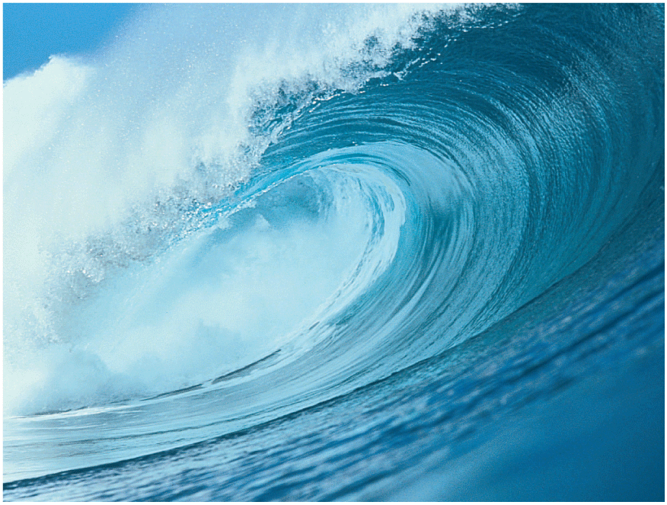
28.10 Why Water Is Greenish Blue
Ocean water is cyan because it absorbs red. The froth in the waves is white because its droplets of many sizes scatter many colors.

Slide 92
28.10 Why Water Is Greenish Blue
Water is transparent to nearly all the visible frequencies of light.
Water molecules absorb infrared waves because they resonate to the frequencies of infrared.
The energy of the infrared waves is transformed into kinetic energy of the water molecules.
Infrared is a strong component of the sunlight that warms water.

Slide 93
28.10 Why Water Is Greenish Blue
Water molecules resonate somewhat to the visible-red frequencies. This causes a gradual absorption of red light by water.
A 15-m layer of water reduces red light to a quarter of its initial brightness. There is very little red light in the sunlight that penetrates below 30 m of water.
The complementary color of red is cyan—a greenish-blue color. In seawater, everything at these depths looks greenish blue.

Slide 94
28.10 Why Water Is Greenish Blue
The sky is blue because blue from sunlight is reemitted in all directions by molecules in the atmosphere.
Water is greenish blue because water molecules absorb red.
The colors of things depend on what colors are reflected by molecules, and also by what colors are absorbed by molecules.

Slide 95
28.10 Why Water Is Greenish Blue
think!
Distant snow-covered mountains reflect a lot of light and are bright. But they sometimes look yellowish, depending on how far away they are. Why are they yellow? (Hint: What happens to the reflected white light as it travels from the mountain to you?)

Slide 96
28.10 Why Water Is Greenish Blue
think!
Distant snow-covered mountains reflect a lot of light and are bright. But they sometimes look yellowish, depending on how far away they are. Why are they yellow? (Hint: What happens to the reflected white light as it travels from the mountain to you?)
Answer:
Distant snow-covered mountains often appear a pale yellow because the blue in the white light from the snowy mountains is scattered on its way to you. The complementary color left is yellow.

Slide 97
28.10 Why Water Is Greenish Blue
Why is water greenish blue?

Slide 98
28.11 The Atomic Color Code—Atomic Spectra
After an excited atom emits light, it returns to its normal state.

Slide 99
28.11 The Atomic Color Code—Atomic Spectra
Every element has its own characteristic color when it emits light.
The color is a blend of various frequencies of light. Light of each frequency is emitted when the electrons change energy states.
Electrons have well-defined energy levels—lower energy near the atomic nucleus and higher energy farther from the nucleus.
When an atom absorbs external energy, one or more of its electrons is boosted to a higher energy level.

Slide 100
28.11 The Atomic Color Code—Atomic Spectra
The energized atom is in an excited state. An excited state is a state with greater energy than the atom’s lowest energy state.
The excited state is only momentary, for the electron is quickly drawn back to its original or a lower level.
When this electron transition occurs, the atom emits a pulse of light—a photon.

Slide 101
28.11 The Atomic Color Code—Atomic Spectra
Light is emitted by excited atoms.

Slide 102
28.11 The Atomic Color Code—Atomic Spectra
The different electron orbits in an atom are like steps in energy levels.

Slide 103
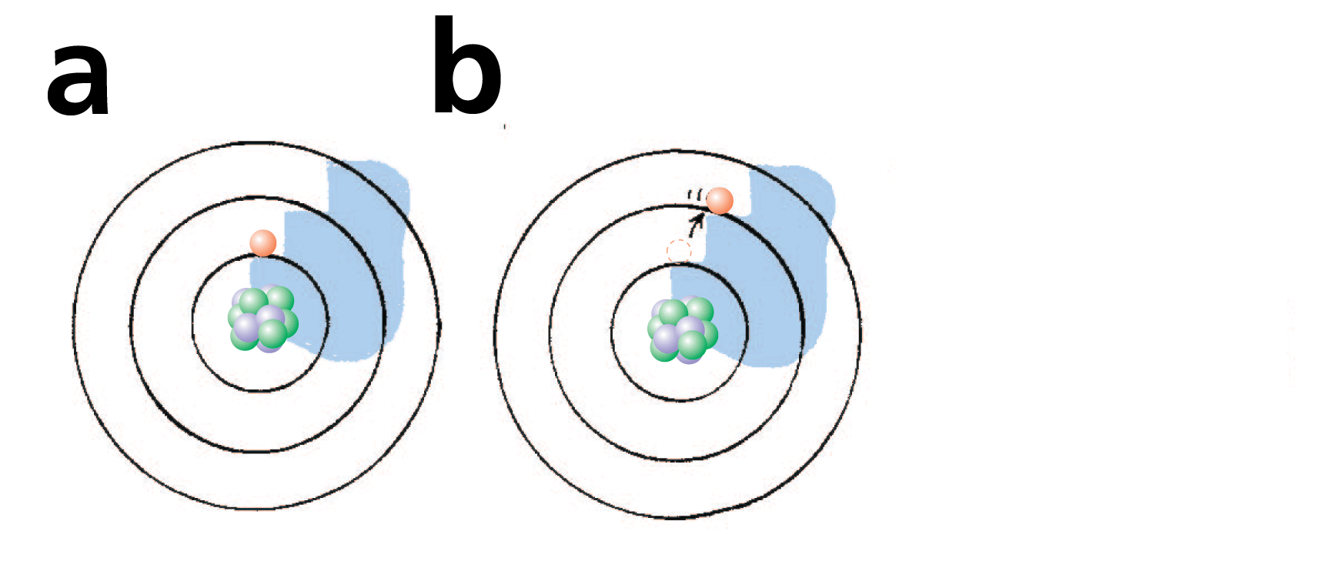
28.11 The Atomic Color Code—Atomic Spectra
The different electron orbits in an atom are like steps in energy levels.
When an electron is raised to a higher level, the atom is excited.

Slide 104
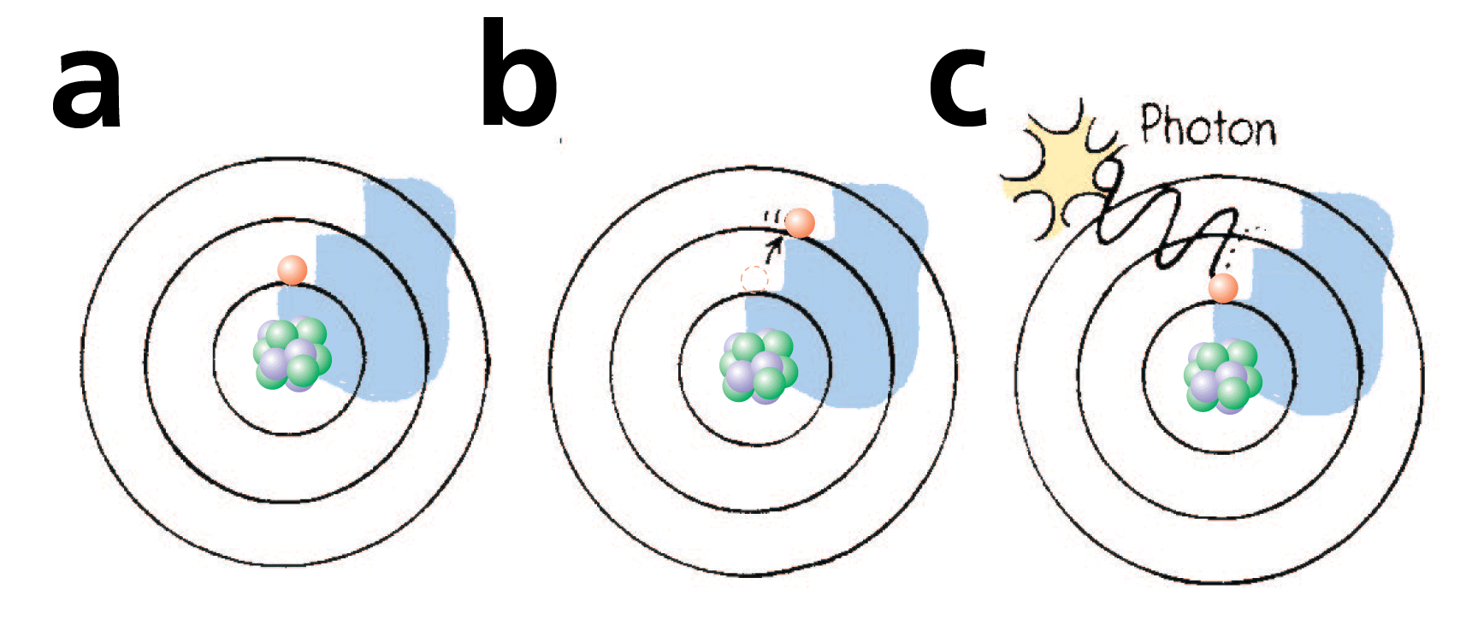
28.11 The Atomic Color Code—Atomic Spectra
The different electron orbits in an atom are like steps in energy levels.
When an electron is raised to a higher level, the atom is excited.
When the electron returns to its original level, it releases energy in the form of light.

Slide 105
28.11 The Atomic Color Code—Atomic Spectra
Relating Frequency and Energy
The frequency of the emitted photon, or its color, is directly proportional to the energy transition of the electron.
f ~ E
A photon carries an amount of energy that corresponds to its frequency. Red light from neon gas, for example, carries a certain amount of energy. A photon of twice the frequency has twice as much energy and is found in the ultraviolet part of the spectrum.

Slide 106
28.11 The Atomic Color Code—Atomic Spectra
When many atoms in a material are excited, many photons with many different frequencies are emitted.
They correspond to electron transitions between different levels.
Measuring the frequencies of light in a spectrum is also measuring the relative energy levels in the atom emitting that light.
The frequencies, or colors, of light emitted by elements are the “fingerprints” of the elements.

Slide 107
28.11 The Atomic Color Code—Atomic Spectra
Analyzing Light
The light from glowing elements can be analyzed with an instrument called a spectroscope.
A spectroscope displays the spectra of the light from hot gases and other light sources. (Spectra is the plural of spectrum.)
The spectra of light sources are viewed through a magnifying eyepiece.

Slide 108
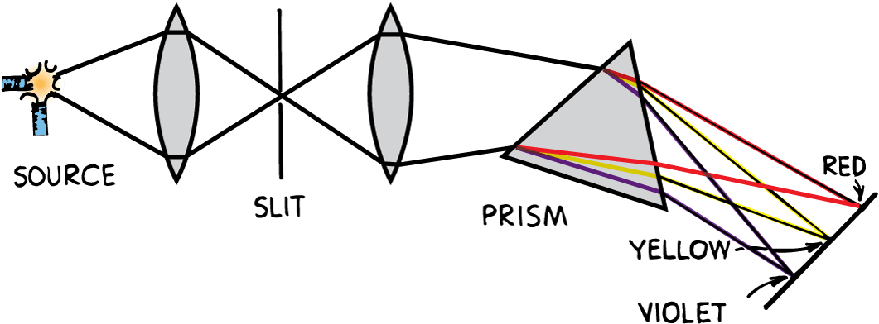
28.11 The Atomic Color Code—Atomic Spectra
A fairly pure spectrum is produced by passing white light through a thin slit, two lenses, and a prism.

Slide 109
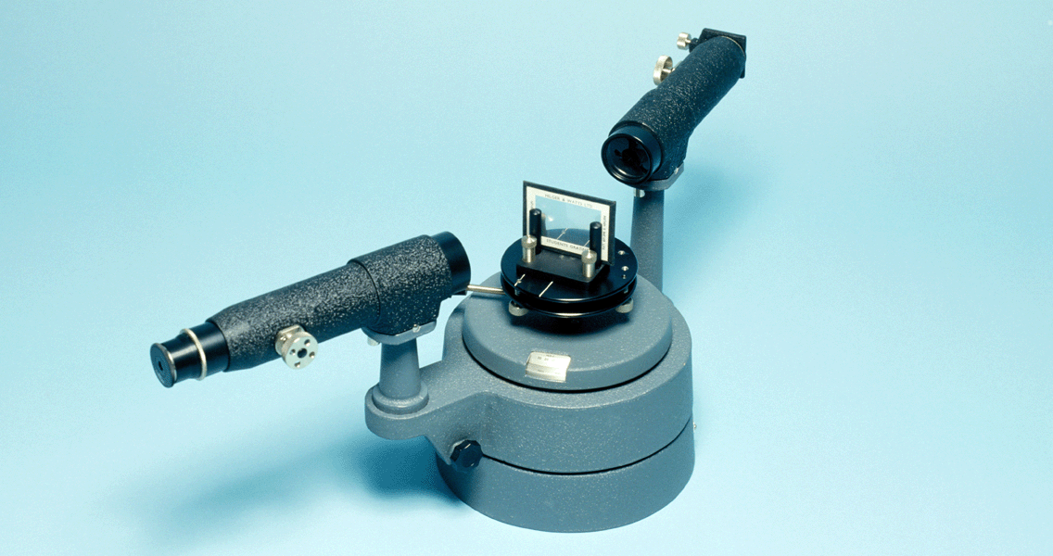
28.11 The Atomic Color Code—Atomic Spectra
A spectroscope separates light into its constituent frequencies. Light illuminates the thin slit at the left, and then it is focused by lenses onto either a diffraction grating (shown) or a prism on the rotating table in the middle.

Slide 110
28.11 The Atomic Color Code—Atomic Spectra
When light from a glowing element is analyzed through a spectroscope, the colors are the composite of a variety of different frequencies of light.
The spectrum of an element appears not as a continuous band of color but as a series of lines.
Each line corresponds to a distinct frequency of light in a line spectrum.

Slide 111
28.11 The Atomic Color Code—Atomic Spectra
An incandescent bulb has a continuous spectrum. Three elements: hydrogen, sodium, and mercury have different line spectra.

Slide 112
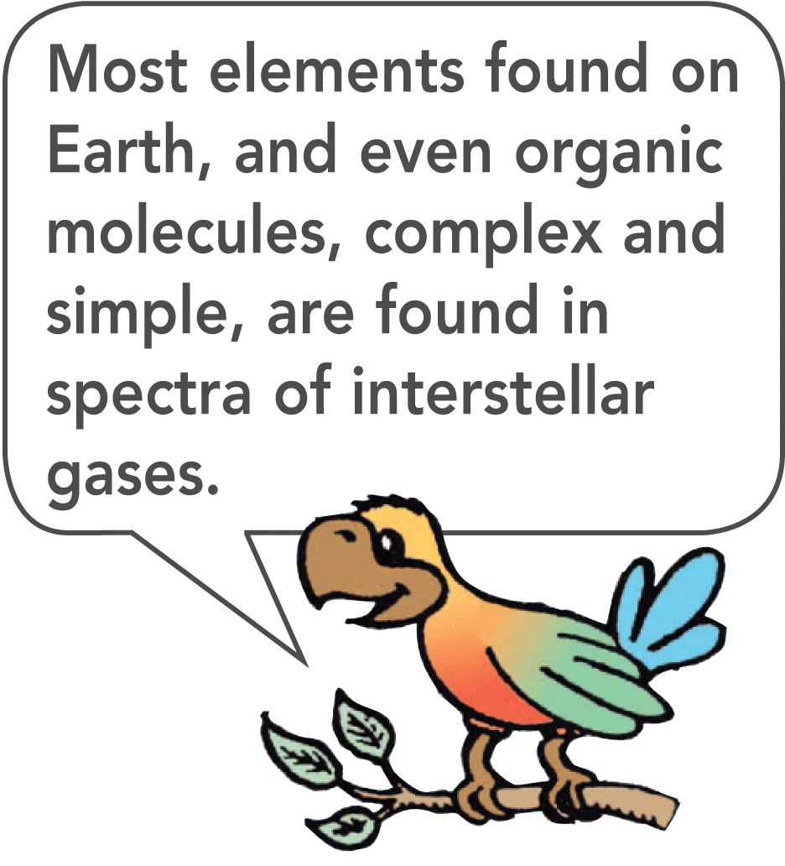
28.11 The Atomic Color Code—Atomic Spectra
Much of the information that physicists have about atomic structure is from the study of atomic spectra.
The atomic composition of common materials, the sun, and distant galaxies is revealed in the spectra of these sources.
The element helium, the second most common element in the universe, was discovered through its “fingerprint” in sunlight.

Slide 113
28.11 The Atomic Color Code—Atomic Spectra
What happens to an excited atom after it emits light?

Slide 114
Assessment Questions
Black is
a combination of all the colors of the spectrum.
a combination of two or more appropriate colors.
light when a prism is held upside down.
the absence of light.

Slide 115
Assessment Questions
Black is
a combination of all the colors of the spectrum.
a combination of two or more appropriate colors.
light when a prism is held upside down.
the absence of light.
Answer: D

Slide 116
Assessment Questions
To say that rose petals are red is to say that they
absorb red.
reflect red.
emit red.
transmit red.

Slide 117
Assessment Questions
To say that rose petals are red is to say that they
absorb red.
reflect red.
emit red.
transmit red.
Answer: B

Slide 118
Assessment Questions
The color light that gets through a piece of transparent blue glass is
blue.
yellow, the opposite color of blue.
actually green.
red minus magenta.

Slide 119
Assessment Questions
The color light that gets through a piece of transparent blue glass is
blue.
yellow, the opposite color of blue.
actually green.
red minus magenta.
Answer: A

Slide 120
Assessment Questions
The solar radiation curve is
the path the sun takes at nighttime.
a plot of amplitude versus frequency for sunlight.
a plot of brightness versus frequency of sunlight.
a plot of wavelength versus frequency of sunlight.

Slide 121
Assessment Questions
The solar radiation curve is
the path the sun takes at nighttime.
a plot of amplitude versus frequency for sunlight.
a plot of brightness versus frequency of sunlight.
a plot of wavelength versus frequency of sunlight.
Answer: C

Slide 122
Assessment Questions
When red and blue light are overlapped, the color produced is
magenta.
yellow.
cyan.
white.

Slide 123
Assessment Questions
When red and blue light are overlapped, the color produced is
magenta.
yellow.
cyan.
white.
Answer: A

Slide 124
Assessment Questions
The complementary color of blue is
magenta.
yellow.
cyan.
white.

Slide 125
Assessment Questions
The complementary color of blue is
magenta.
yellow.
cyan.
white.
Answer: B

Slide 126
Assessment Questions
For mixing pigments or dyes, the primary colors are magenta, cyan, and
red.
green.
yellow.
blue.

Slide 127
Assessment Questions
For mixing pigments or dyes, the primary colors are magenta, cyan, and
red.
green.
yellow.
blue.
Answer: C

Slide 128
Assessment Questions
The blueness of the daytime sky is due mostly to light
absorption.
transmission.
reflection.
scattering.

Slide 129
Assessment Questions
The blueness of the daytime sky is due mostly to light
absorption.
transmission.
reflection.
scattering.
Answer: D

Slide 130
Assessment Questions
The redness of a sunrise or sunset is due mostly to light that has not been
absorbed.
transmitted.
scattered.
polarized.

Slide 131
Assessment Questions
The redness of a sunrise or sunset is due mostly to light that has not been
absorbed.
transmitted.
scattered.
polarized.
Answer: C

Slide 132
Assessment Questions
The greenish blue of ocean water is due mostly to the absorption of
infrared light.
ultraviolet light.
polarized light.
scattered light.

Slide 133
Assessment Questions
The greenish blue of ocean water is due mostly to the absorption of
infrared light.
ultraviolet light.
polarized light.
scattered light.
Answer: A

Slide 134
Assessment Questions
The frequency of an emitted photon is related to its
amplitude.
polarization.
momentum.
energy.

Slide 135
Assessment Questions
The frequency of an emitted photon is related to its
amplitude.
polarization.
momentum.
energy.
Answer: D

