Slide 1
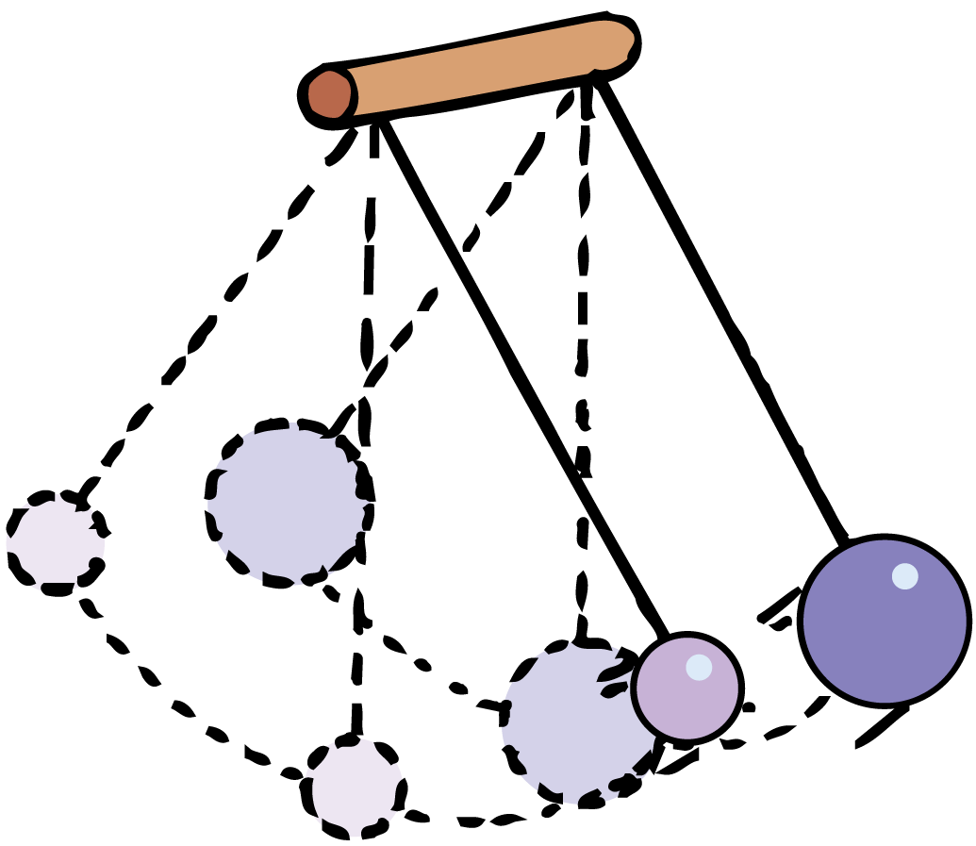
Waves transmit energy through space and time.

Slide 2
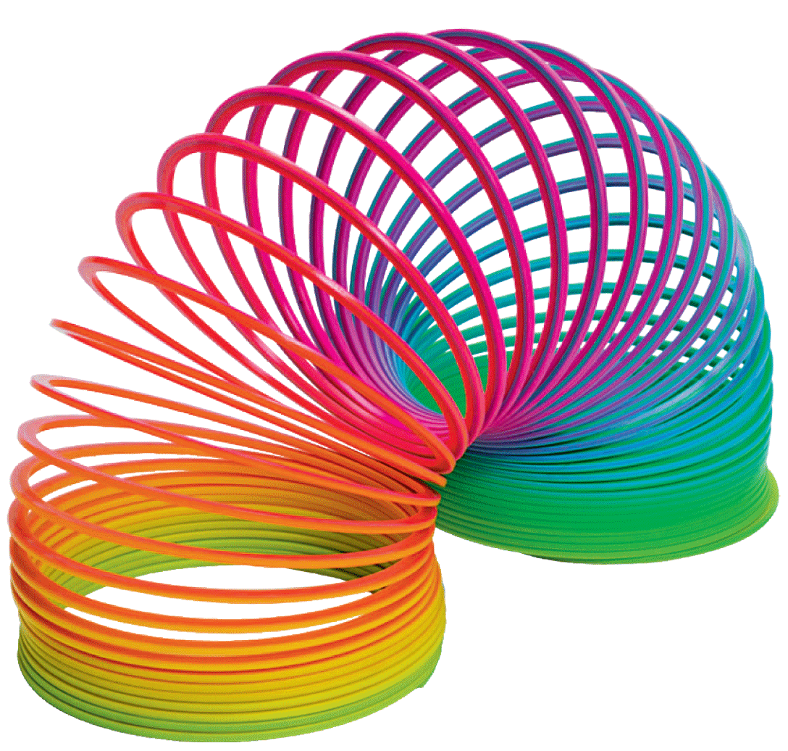
A repeating back-and-forth motion about an equilibrium position is a vibration. A disturbance that is transmitted progressively from one place to the next with no actual transport of matter is a wave. Light and sound are both forms of energy that move through space as waves.

Slide 3
25.1 Vibration of a Pendulum
The period of the pendulum depends only on the length of a pendulum and the acceleration of gravity.

Slide 4
25.1 Vibration of a Pendulum
A stone suspended at the end of a string is a simple pendulum.
Pendulums swing back and forth with such regularity that they have long been used to control the motion of clocks.
The time of a back-and-forth swing of the pendulum is its period.
Galileo discovered that the period of a pendulum depends only on its length—its mass has no effect.

Slide 5
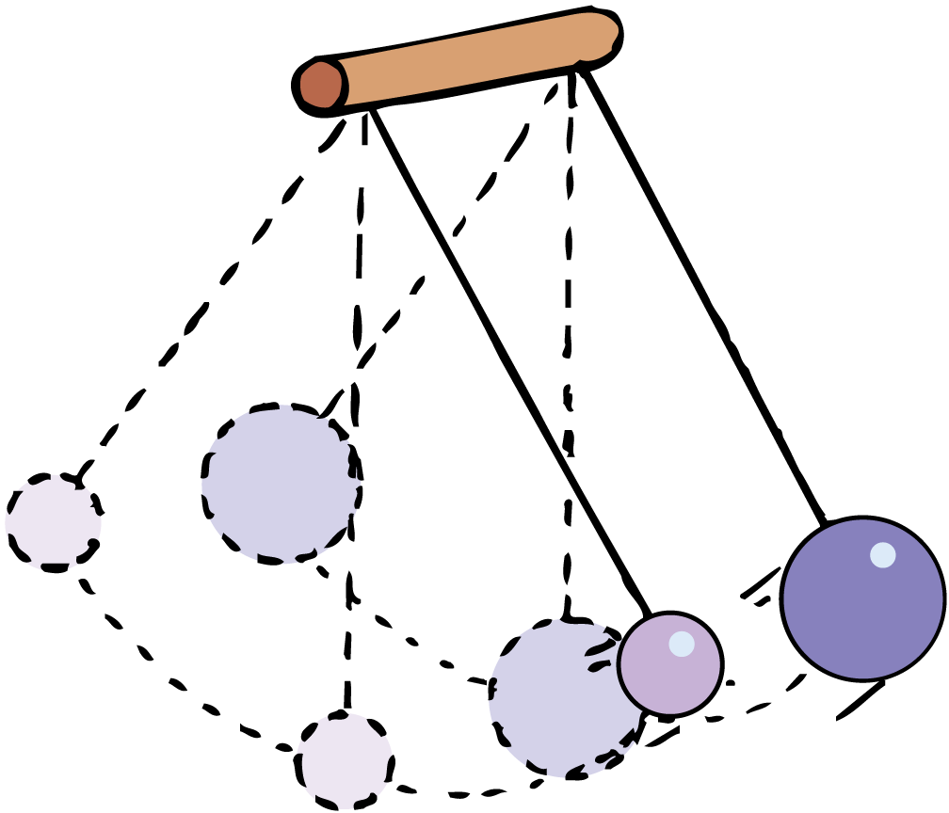
25.1 Vibration of a Pendulum
Two pendulums of the same length have the same period regardless of mass.

Slide 6
25.1 Vibration of a Pendulum
A long pendulum has a longer period than a shorter pendulum.
It swings back and forth more slowly—less frequently—than a short pendulum.
Just as a long pendulum has a greater period, a person with long legs tends to have a slower stride than a person with short legs.
Giraffes and horses run with a slower gait than do short-legged animals such as hamsters and mice.

Slide 7
25.1 Vibration of a Pendulum
What determines the period of a pendulum?

Slide 8
25.2 Wave Description
The source of all waves is something that vibrates.

Slide 9
25.2 Wave Description
The back-and-forth vibratory motion—called oscillatory motion—of a swinging pendulum is called simple harmonic motion.
A sine curve is a pictorial representation of a wave.

Slide 10
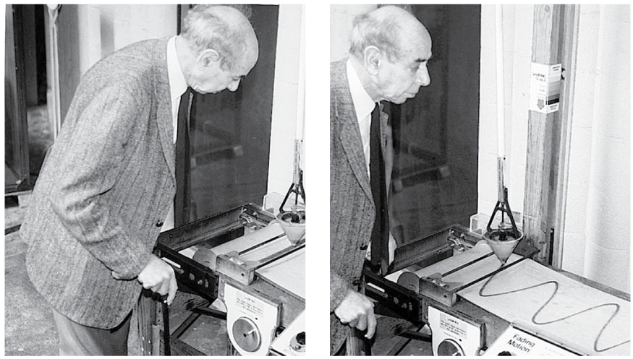
25.2 Wave Description
Frank Oppenheimer demonstrates that a pendulum swinging back and forth traces out a straight line over a stationary surface, and a sine curve when the surface moves at constant speed.

Slide 11
25.2 Wave Description
The Parts of a Wave
A weight attached to a spring undergoes simple harmonic motion.
A marking pen attached to the bob traces a sine curve on a sheet of paper that is moving horizontally at constant speed.
A sine curve is a pictorial representation of a wave.

Slide 12
25.2 Wave Description
The high points on a wave are called crests.
The low points on a wave are called troughs.
The term amplitude refers to the distance from the midpoint to the crest (or trough) of the wave.
The amplitude is the maximum displacement from equilibrium.

Slide 13
25.2 Wave Description
The wavelength of a wave is the distance from the top of one crest to the top of the next one.
Equivalently, the wavelength is the distance between successive identical parts of the wave.
The wavelengths of waves at the beach are measured in meters, the ripples in a pond in centimeters, of light in billionths of a meter.

Slide 14
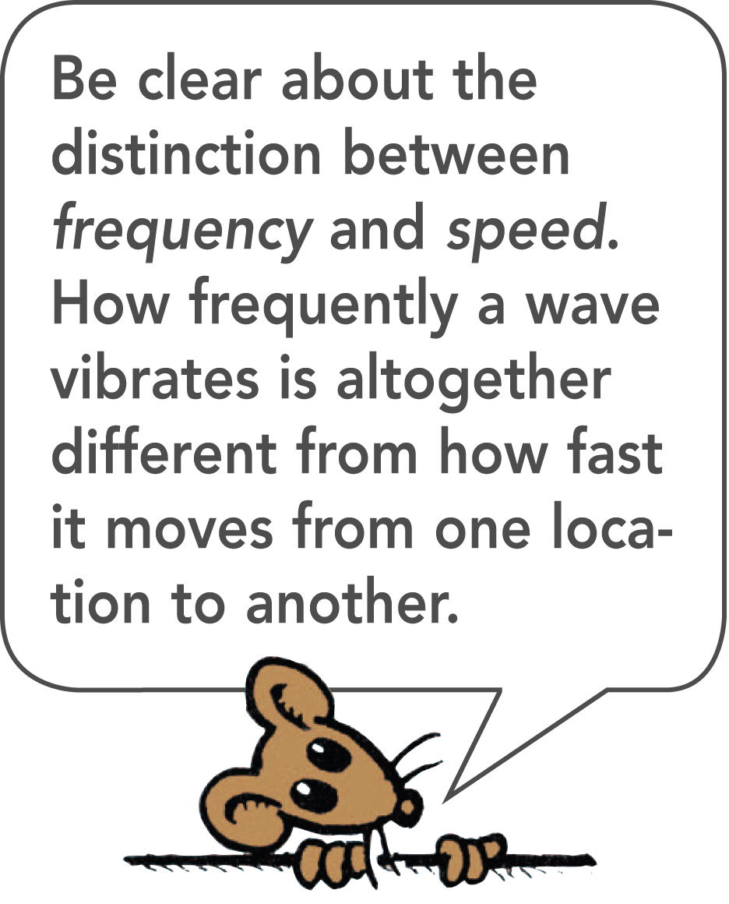
25.2 Wave Description
Frequency
The number of vibrations an object makes in a unit of time is an object’s frequency.
The frequency specifies the number of back-and-forth vibrations in a given time (usually one second).

Slide 15
25.2 Wave Description
A complete back-and-forth vibration is one cycle.
If a vibration occurs in one second, the frequency is one cycle per second; if two vibrations occur in one second, the frequency is two cycles per second.
The frequency of the vibrating source and the frequency of the wave it produces are the same.

Slide 16
25.2 Wave Description
The unit of frequency is called the hertz (Hz).
A frequency of one cycle per second is 1 hertz, two cycles per second is 2 hertz, and so on. Higher frequencies are measured in
kilohertz (kHz—thousands of hertz)
megahertz (MHz—millions of hertz)
gigahertz (GHz—billions of hertz)

Slide 17
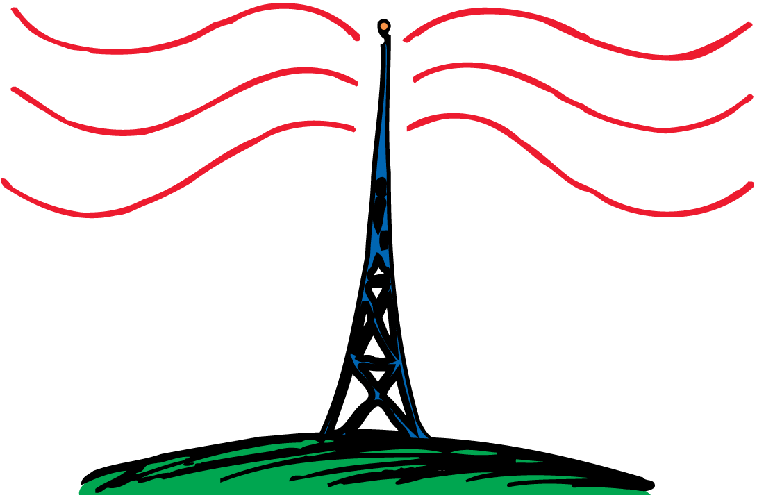
25.2 Wave Description
Electrons in the antenna of an AM radio station at 960 kHz vibrate 960,000 times each second, producing 960-kHz radio waves.

Slide 18
25.2 Wave Description
If the frequency of a vibrating object is known, its period can be calculated, and vice versa. Suppose, for example, that a pendulum makes two vibrations in one second. Its frequency is 2 Hz. The time needed to complete one vibration—that is, the period of vibration—is 1/2 second. As you can see below, frequency and period are inverses of each other:

Slide 19
25.2 Wave Description
think!
What is the frequency in vibrations per second of a 100-Hz wave?

Slide 20
25.2 Wave Description
think!
What is the frequency in vibrations per second of a 100-Hz wave?
Answer:
A 100-Hz wave vibrates 100 times/s.

Slide 21
25.2 Wave Description
What is the source of all waves?

Slide 22
25.3 Wave Motion
The energy transferred by a wave from a vibrating source to a receiver is carried by a disturbance in a medium.

Slide 23
25.3 Wave Motion
Most information gets to us in some form of wave.
Sound is energy that travels to our ears in the form of a wave.
Light is energy that comes to our eyes in the form of a different kind of wave (an electromagnetic wave).
The signals that reach our radio and television sets also travel in the form of electromagnetic waves.

Slide 24
25.3 Wave Motion
When energy is transferred by a wave from a vibrating source to a distant receiver, no matter is transferred between the two points.
Think about the very simple wave produced when one end of a horizontally stretched string is shaken up and down.
Each part of the string moves up and down and the disturbance moves horizontally along the length of the string.
The disturbance moves, not parts of the string itself.

Slide 25
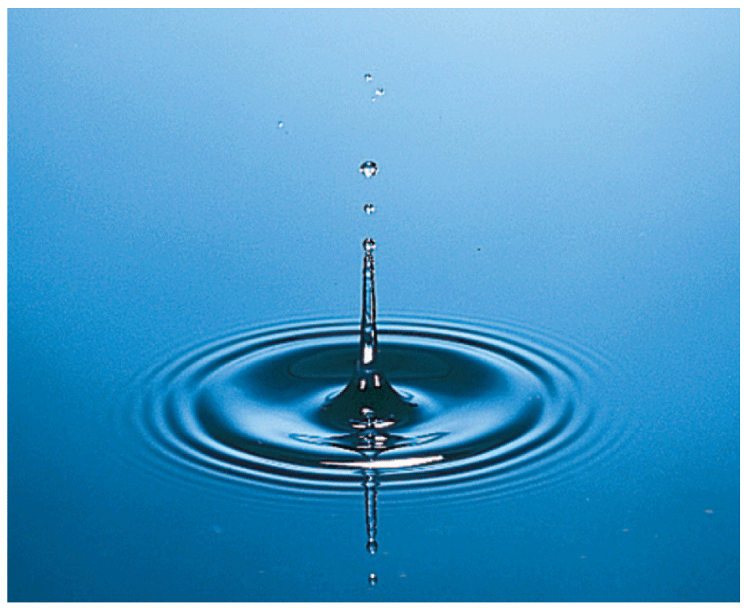
25.3 Wave Motion
Drop a stone in a quiet pond and you’ll produce a wave that moves out from the center in an expanding circle.
It is the disturbance that moves, not the water.

Slide 26
25.3 Wave Motion
When someone speaks to you from across the room, the sound wave is a disturbance in the air that travels across the room.
The air molecules themselves do not move along.
The air, like the rope and the water in the previous examples, is the medium through which wave energy travels.
Energy is not transferred by matter moving from one place to another within the medium.

Slide 27
25.3 Wave Motion
think!
The Sears Tower in Chicago sways back and forth at a frequency of about 0.1 Hz. What is its period of vibration?

Slide 28
25.3 Wave Motion
think!
The Sears Tower in Chicago sways back and forth at a frequency of about 0.1 Hz. What is its period of vibration?
Answer: The period is

Slide 29
25.3 Wave Motion
How does a wave transfer energy?

Slide 30
25.4 Wave Speed
You can calculate the speed of a wave by multiplying the wavelength by the frequency.

Slide 31
25.4 Wave Speed
The speed of a wave depends on the medium through which the wave moves.
Whatever the medium, the speed, wavelength, and frequency of the wave are related.

Slide 32
25.4 Wave Speed
If the wavelength is 1 meter, and one wavelength per second passes the pole, then the speed of the wave is 1 m/s.

Slide 33
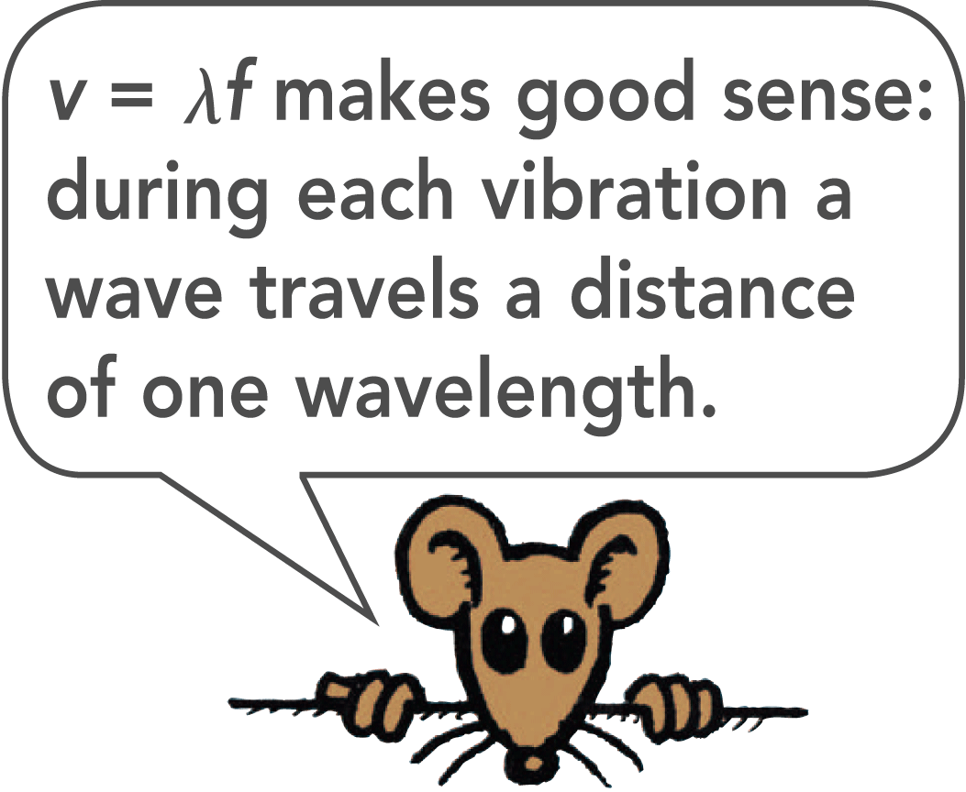
25.4 Wave Speed
If the wavelength is 3 meters and if two crests pass a stationary point each second, then 3 meters × 2 waves pass by in 1 second.
The waves therefore move at 6 meters per second.
v = λf
where v is wave speed, λ is wavelength, and f is wave frequency.

Slide 34
25.4 Wave Speed
In air, the product of wavelength and frequency is the same for every frequency of sound.
That’s why you don’t hear the high notes in a chord before you hear the low notes. The sounds all reach you at the same time.
Long wavelengths have low frequencies, and short wavelengths have high frequencies.

Slide 35
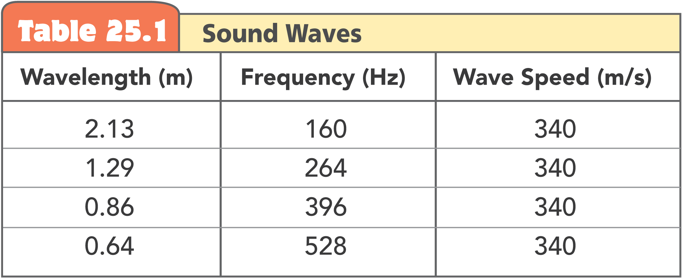
25.4 Wave Speed
Wavelength and frequency vary inversely to produce the same wave speed for all sounds.

Slide 36
25.4 Wave Speed
think!
If a water wave vibrates up and down two times each second and the distance between wave crests is 1.5 m, what is the frequency of the wave? What is its wavelength? What is its speed?

Slide 37
25.4 Wave Speed
think!
If a water wave vibrates up and down two times each second and the distance between wave crests is 1.5 m, what is the frequency of the wave? What is its wavelength? What is its speed?
Answer:
The frequency of the wave is 2 Hz; its wavelength is 1.5 m; and its wave speed is

Slide 38
25.4 Wave Speed
think!
What is the wavelength of a 340-Hz sound wave when the speed of sound in air is 340 m/s?

Slide 39
25.4 Wave Speed
think!
What is the wavelength of a 340-Hz sound wave when the speed of sound in air is 340 m/s?
Answer:
The wavelength must be 1 m.
Then wave speed = (1 m) × (340 Hz) = 340 m/s.

Slide 40
25.4 Wave Speed
How do you calculate the speed of a wave?

Slide 41
25.5 Transverse Waves
Waves in the stretched strings of musical instruments and the electromagnetic waves that make up radio waves and light are transverse.

Slide 42
25.5 Transverse Waves
Suppose you create a wave along a rope by shaking the free end up and down.
The motion of the rope is at right angles to the direction in which the wave is moving.
Whenever the motion of the medium is at right angles to the direction in which a wave travels, the wave is a transverse wave.

Slide 43
25.5 Transverse Waves
What are some examples of transverse waves?

Slide 44
25.6 Longitudinal Waves
Sound waves are longitudinal waves.

Slide 45
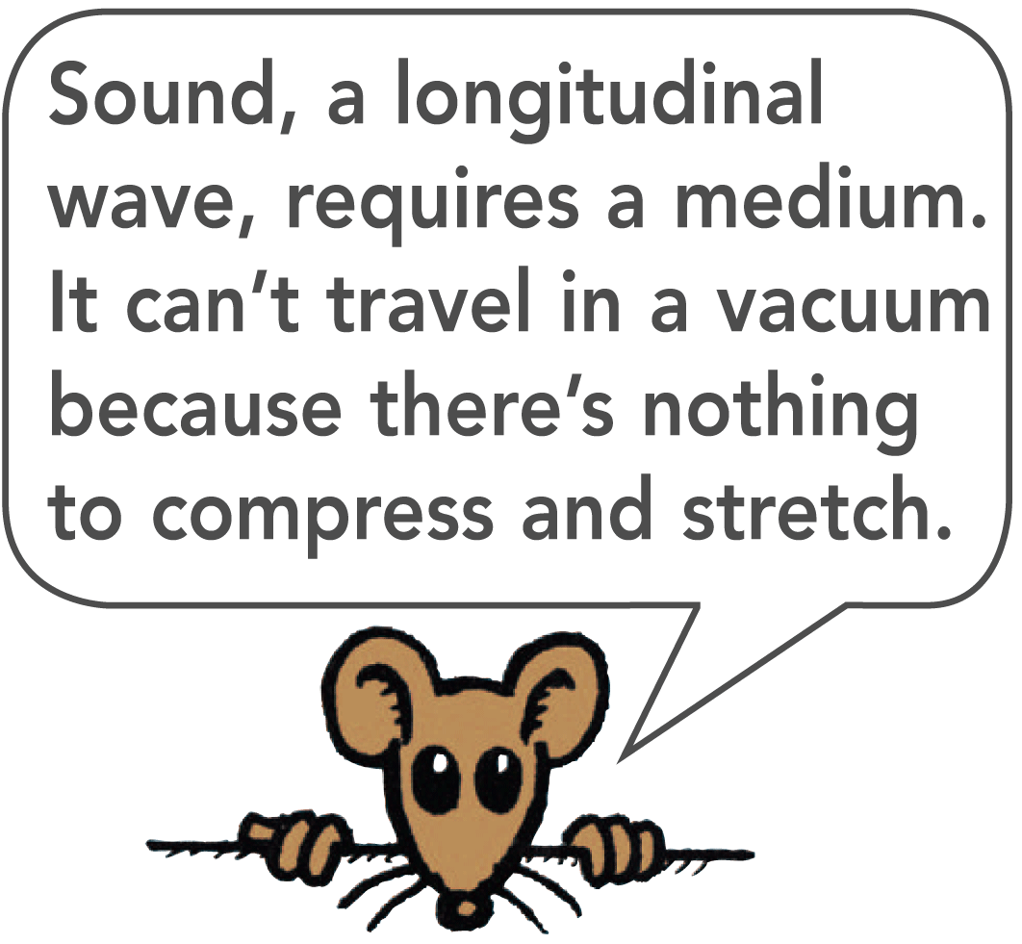
25.6 Longitudinal Waves
Sometimes the particles of the medium move back and forth in the same direction in which the wave travels.
When the particles oscillate parallel to or along the direction of the wave, the wave is a longitudinal wave.

Slide 46
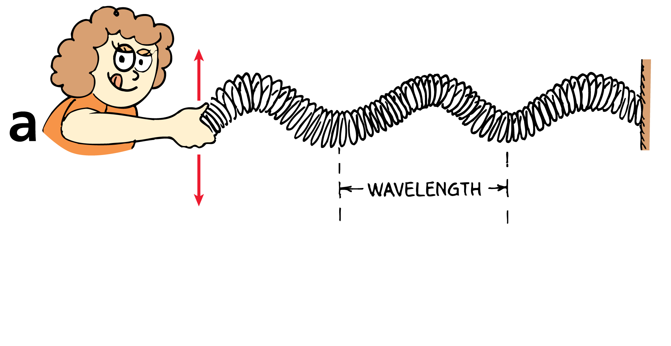
25.6 Longitudinal Waves
Both transverse and longitudinal waves can be demonstrated with a loosely coiled spring.
When the end of a coiled spring is shaken up and down, a transverse wave is produced.

Slide 47
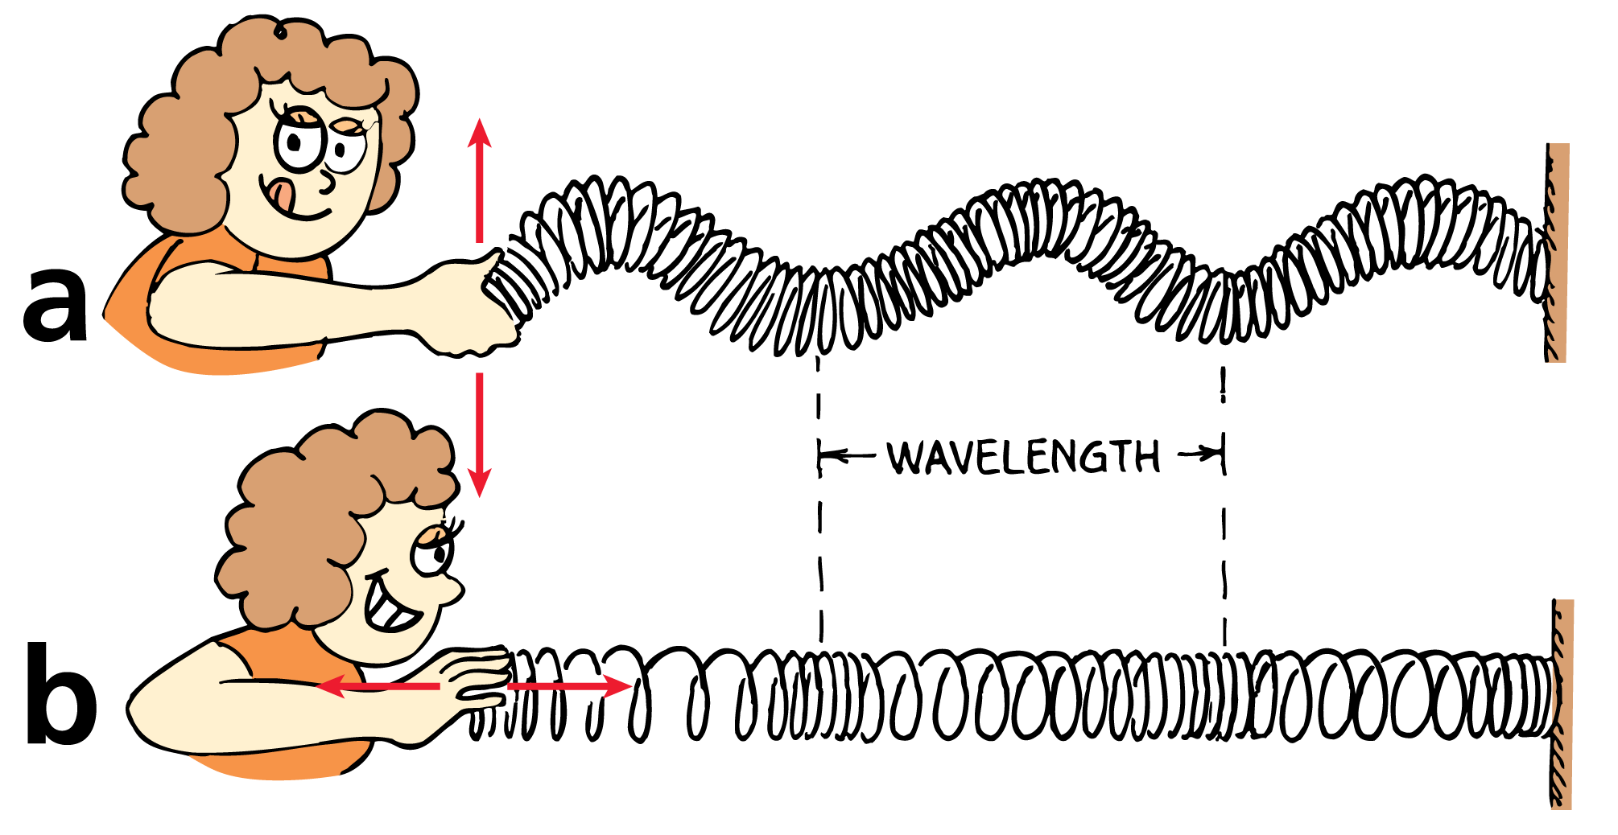
25.6 Longitudinal Waves
Both transverse and longitudinal waves can be demonstrated with a loosely coiled spring.
When the end of a coiled spring is shaken up and down, a transverse wave is produced.
When it is shaken in and out, a longitudinal wave is produced.

Slide 48
25.6 Longitudinal Waves
What is an example of a longitudinal wave?

Slide 49
25.7 Interference
Interference patterns occur when waves from different sources arrive at the same point—at the same time.

Slide 50
25.7 Interference
A material object will not share its space with another object, but more than one wave can exist at the same time in the same space.
If you drop two rocks in water, the waves produced by each can overlap and form an interference pattern.
An interference pattern is a regular arrangement of places where wave effects are increased, decreased, or neutralized.

Slide 51
25.7 Interference
In constructive interference, the crest of one wave overlaps the crest of another and their individual effects add together.
The result is a wave of increased amplitude, called reinforcement.
In destructive interference, the crest of one wave overlaps the trough of another and their individual effects are reduced.
The high part of one wave fills in the low part of another, called cancellation.

Slide 52
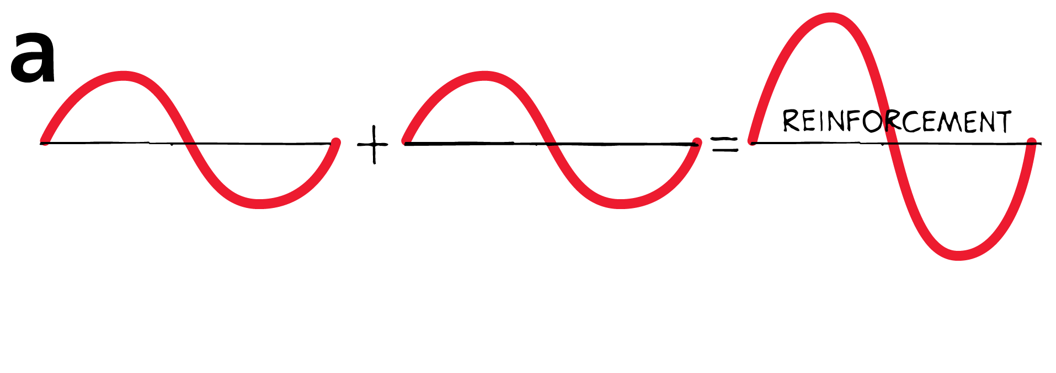
25.7 Interference
In constructive interference, the waves reinforce each other to produce a wave of increased amplitude.

Slide 53
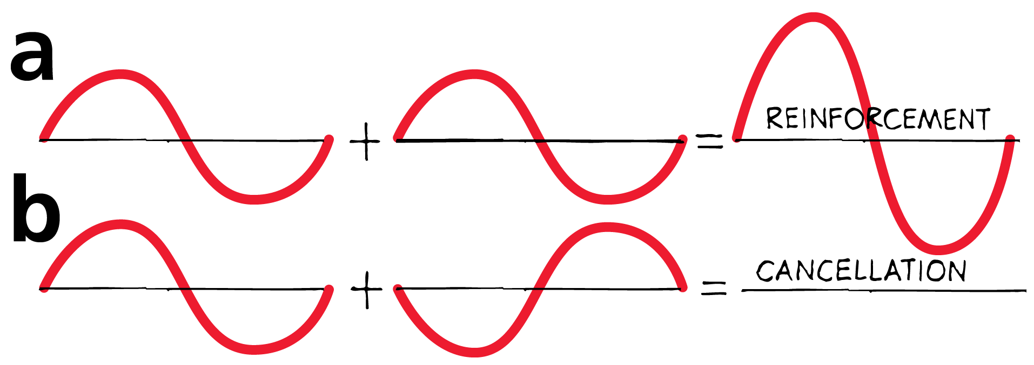
25.7 Interference
In constructive interference, the waves reinforce each other to produce a wave of increased amplitude.
In destructive interference, the waves cancel each other and no wave is produced.

Slide 54
25.7 Interference
Wave interference is easiest to see in water as an interference pattern.
When waves are out of phase, the crests of one wave overlap the troughs of another to produce regions of zero amplitude.
When waves are in phase, the crests of one wave overlap the crests of the other, and the troughs overlap as well.

Slide 55
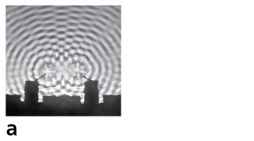
25.7 Interference
Two overlapping water waves produce an interference pattern.

Slide 56
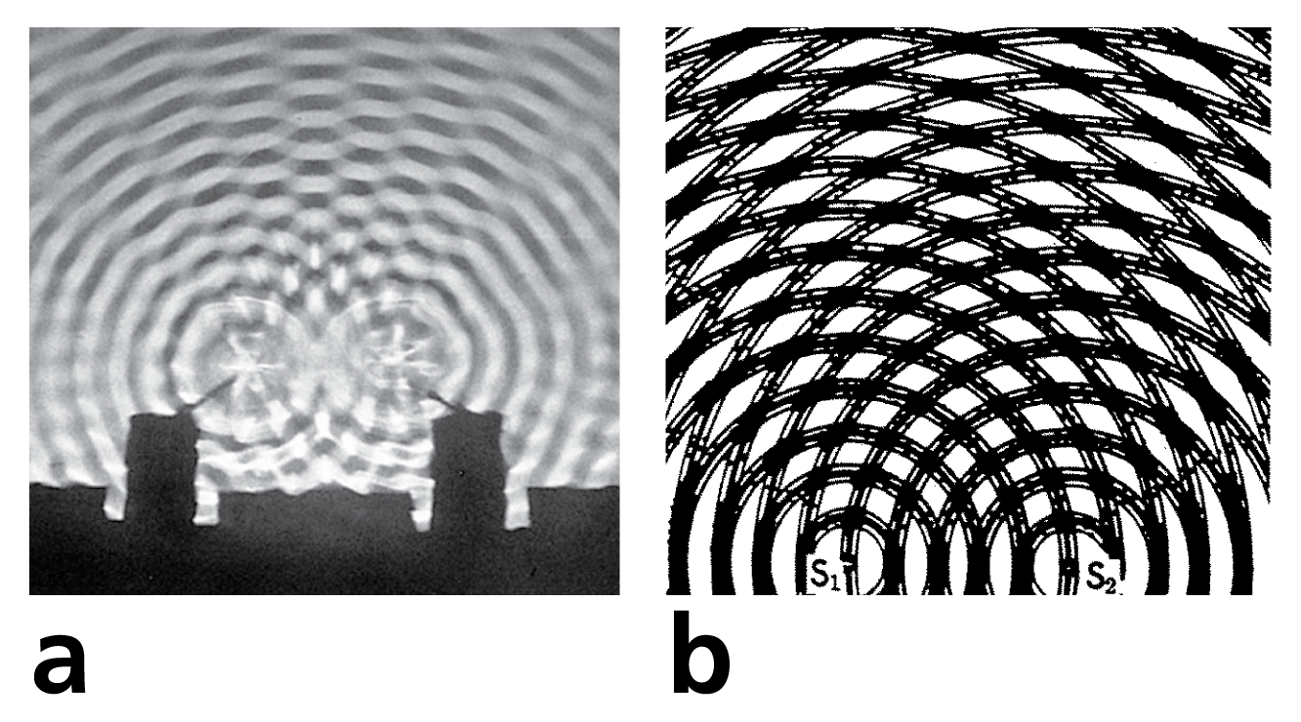
25.7 Interference
Two overlapping water waves produce an interference pattern.
Overlapping concentric circles produce a pictorial representation of an interference pattern.

Slide 57
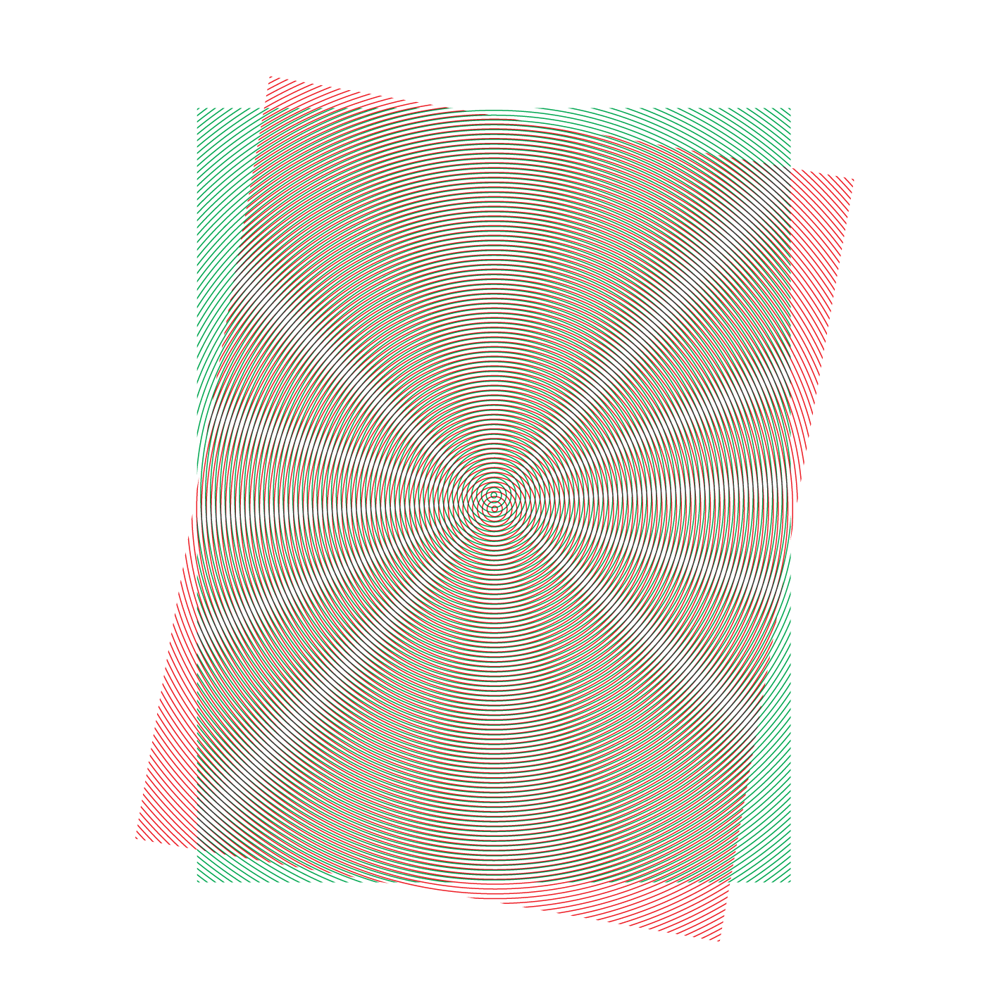
25.7 Interference
Interference patterns are nicely illustrated by the overlapping of concentric circles printed on a pair of clear sheets.
When the sheets overlap with their centers slightly apart, a moiré pattern is formed, similar to the interference pattern of waves.
A slight shift in the sheets produces noticeably different patterns.

Slide 58
25.7 Interference
Interference is characteristic of all wave motion, whether the waves are water waves, sound waves, or light waves.

Slide 59
25.7 Interference
What causes interference patterns?

Slide 60
25.8 Standing Waves
A standing wave forms only if half a wavelength or a multiple of half a wavelength fits exactly into the length of the vibrating medium.

Slide 61
25.8 Standing Waves
Produce a wave by tying a rope to a wall and shaking the free end up and down. The wave reflects back along the rope to you.
By shaking the rope just right, you can cause the incident (original) and reflected waves to form a standing wave.
A standing wave is a wave that appears to stay in one place—it does not seem to move through the medium.

Slide 62
25.8 Standing Waves
Certain parts of a standing wave remain stationary.
Nodes are the stationary points on a standing wave. Hold your fingers on either side of the rope at a node, and the rope will not touch them.
The positions on a standing wave with the largest amplitudes are known as antinodes.
Antinodes occur halfway between nodes.

Slide 63
25.8 Standing Waves
Standing waves are the result of interference.
When two waves of equal amplitude and wavelength pass through each other in opposite directions, the waves are always out of phase at the nodes.
The nodes are stable regions of destructive interference.

Slide 64
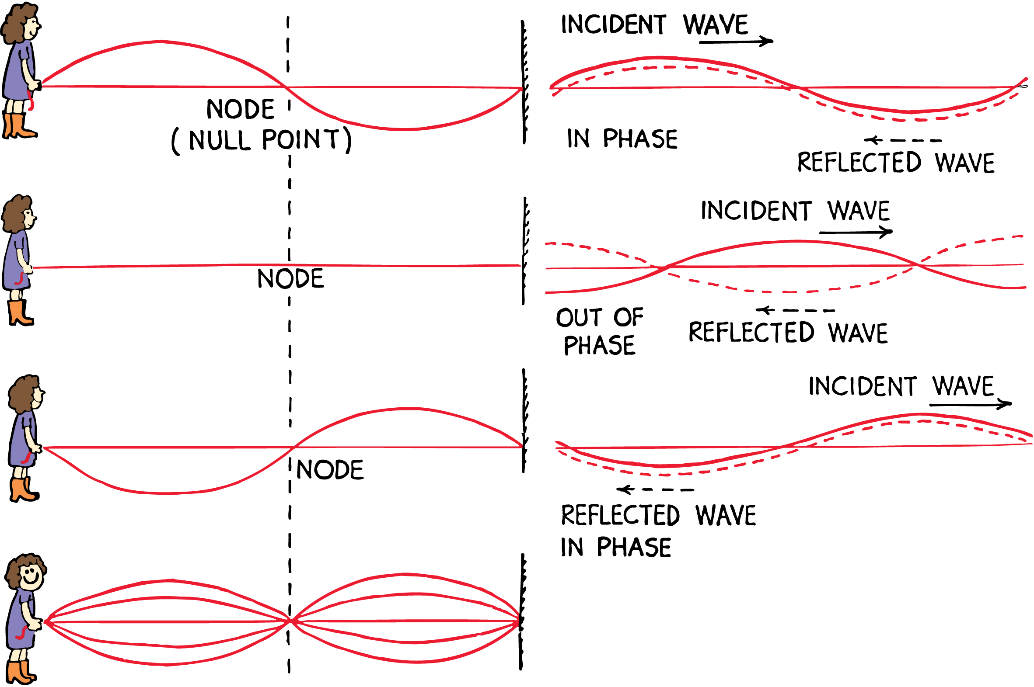
25.8 Standing Waves
The incident and reflected waves interfere to produce a standing wave. The nodes are places that remain stationary.

Slide 65
25.8 Standing Waves
You can produce a variety of standing waves by shaking the rope at different frequencies.
Once you find a frequency that produces a standing wave, double or triple frequencies will also produce a standing wave.

Slide 66
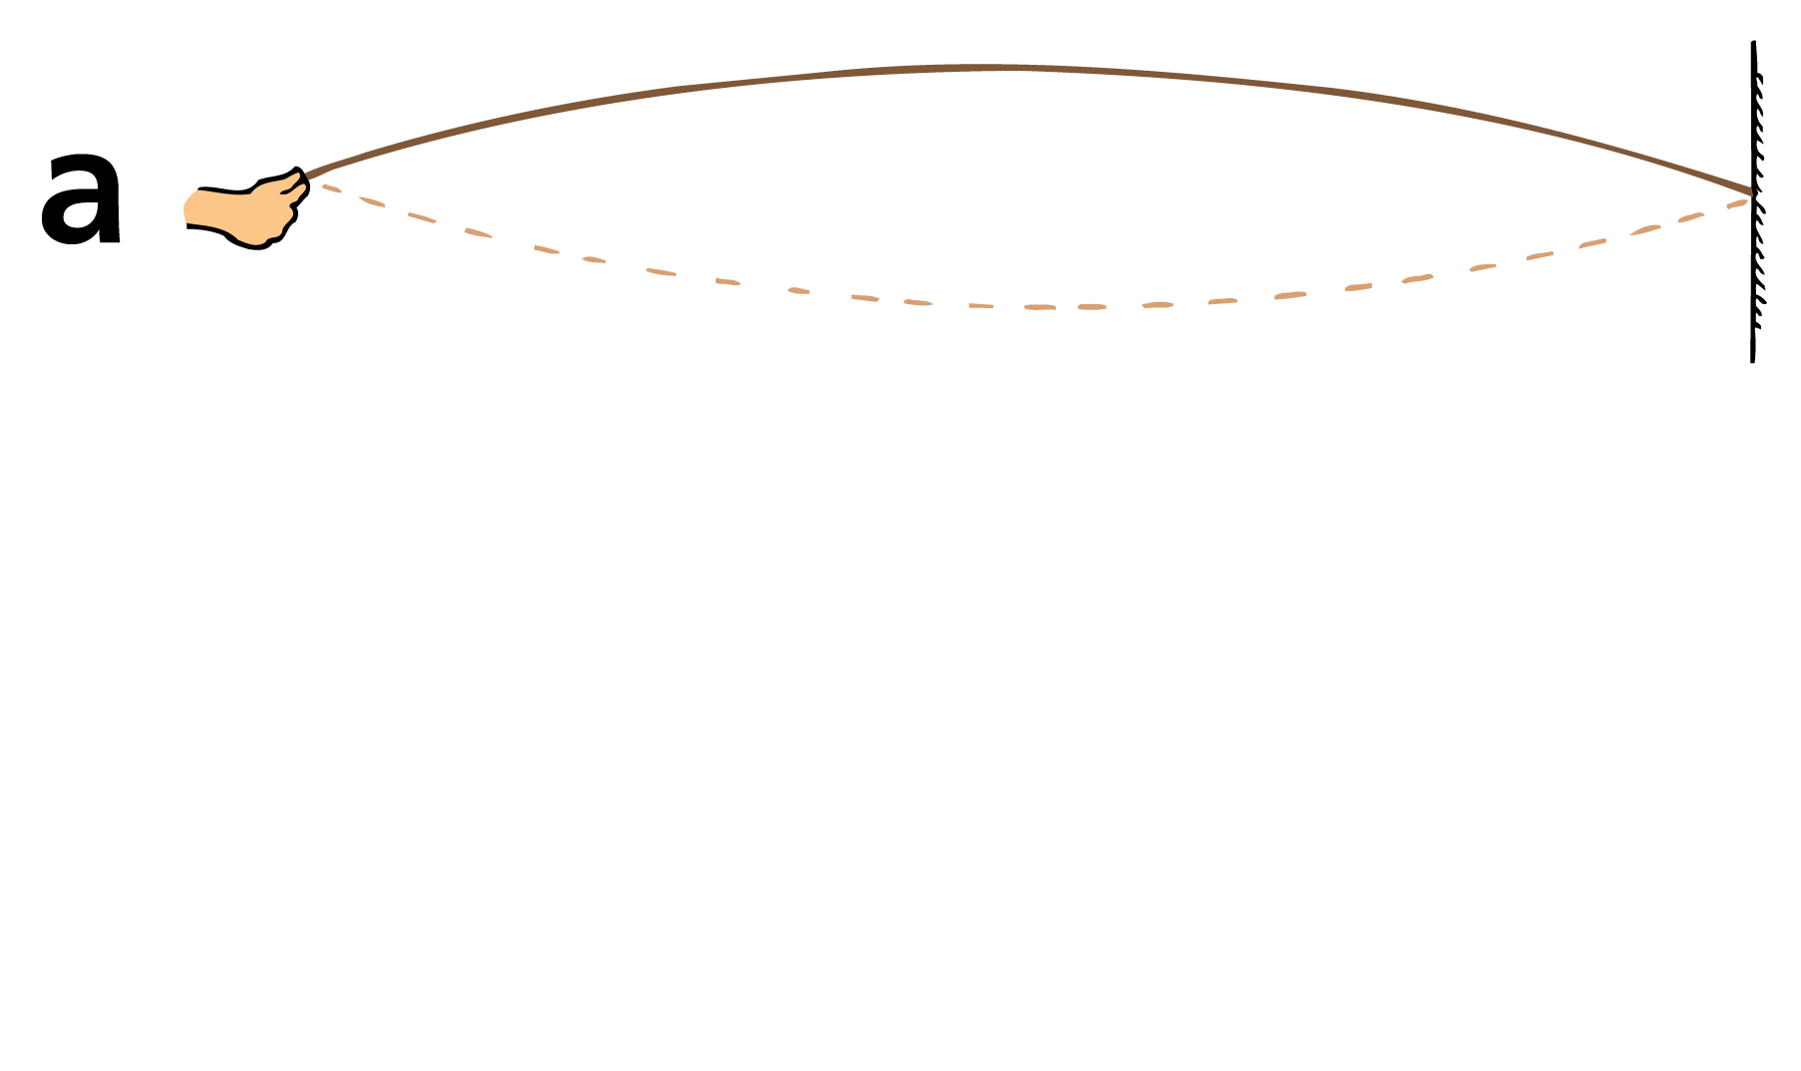
25.8 Standing Waves
Shake the rope until you set up a standing wave of ½ wavelength.

Slide 67
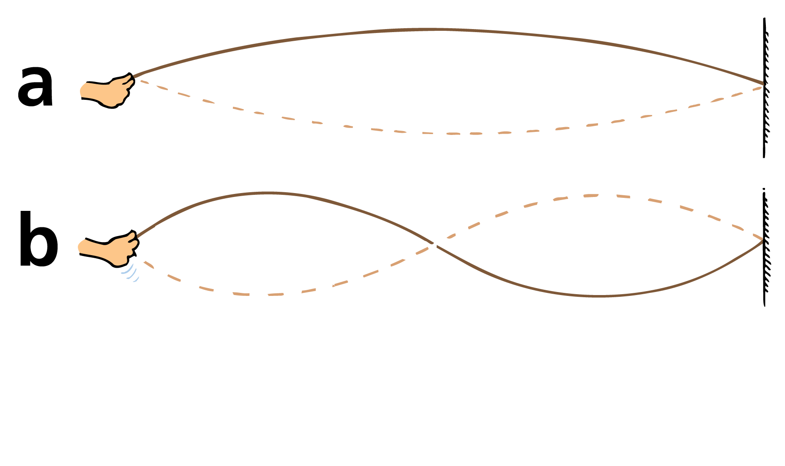
25.8 Standing Waves
Shake the rope until you set up a standing wave of ½ wavelength.
Shake with twice the frequency and produce a standing wave of 1 wavelength.

Slide 68
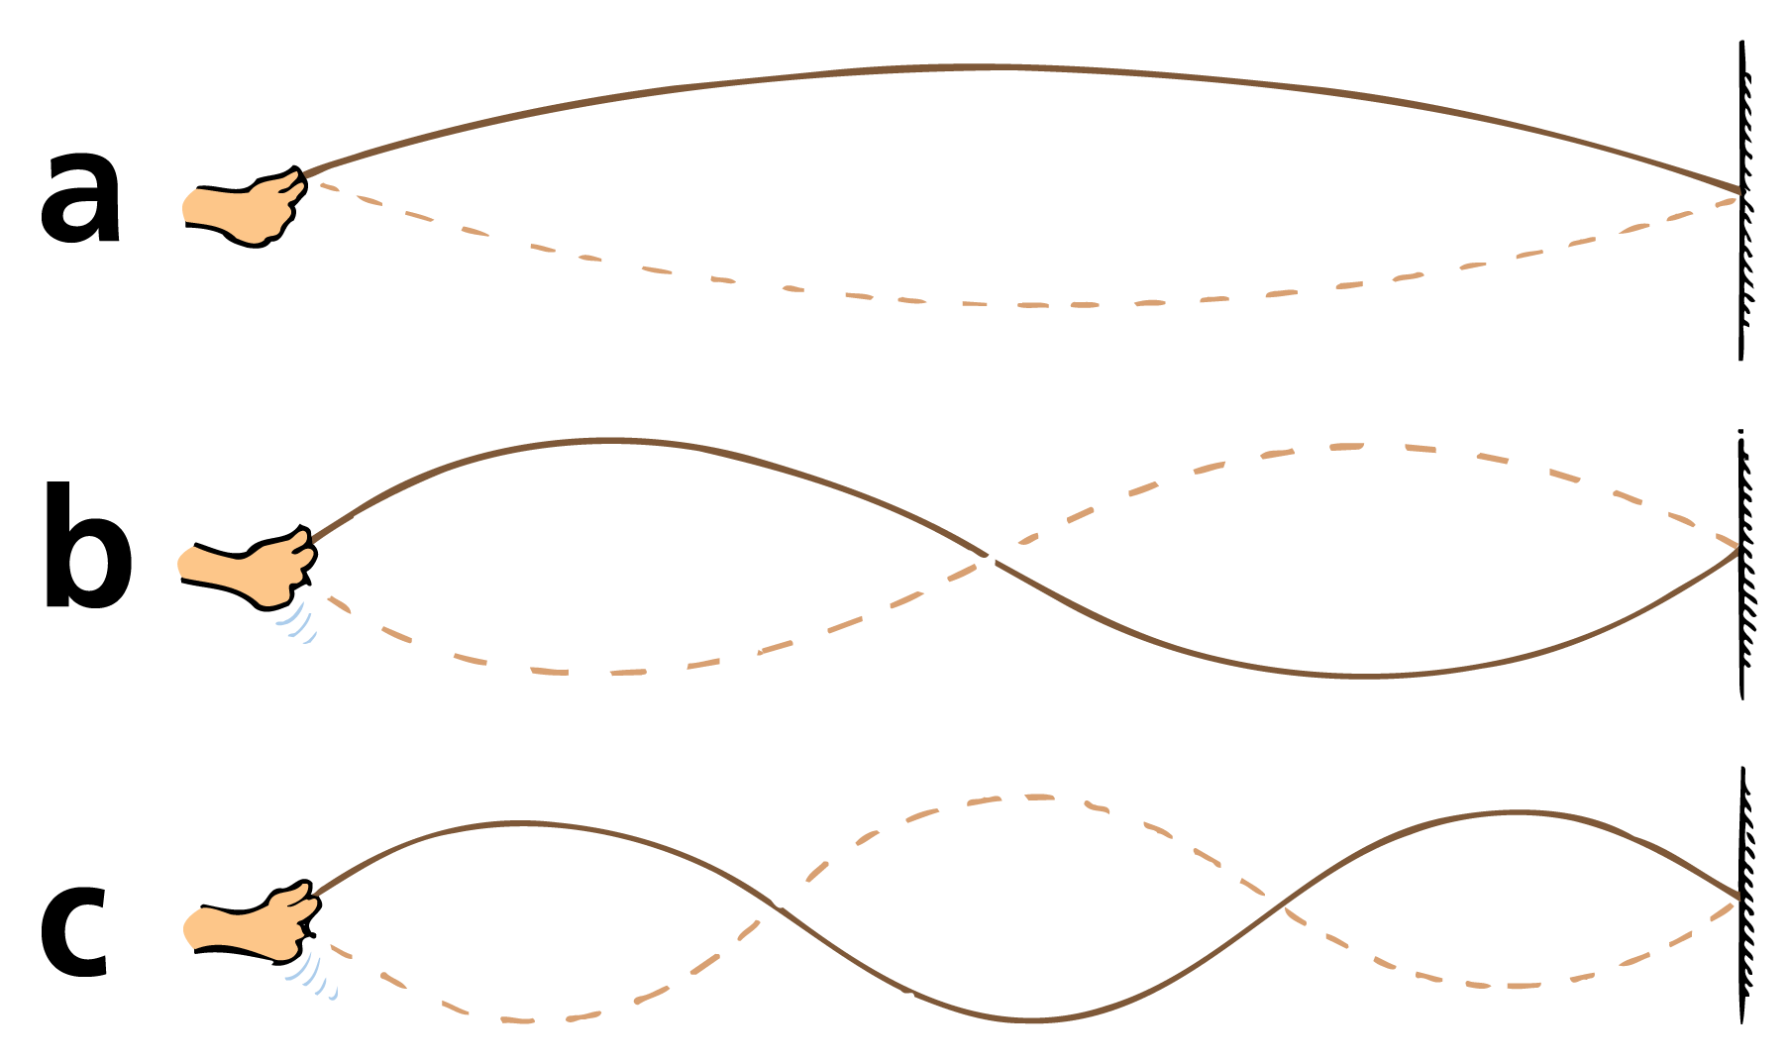
25.8 Standing Waves
Shake the rope until you set up a standing wave of ½ wavelength.
Shake with twice the frequency and produce a standing wave of 1 wavelength.
Shake with three times the frequency and produce a standing wave of 1 ½ wavelengths.

Slide 69
25.8 Standing Waves
Standing waves are set up in the strings of musical instruments that are struck.
They are set up in the air in an organ pipe and the air of a soda-pop bottle when air is blown over the top.
Standing waves can be produced in either transverse or longitudinal waves.

Slide 70
25.8 Standing Waves
think!
Is it possible for one wave to cancel another wave so that the combined amplitude is zero? Explain your answer.

Slide 71
25.8 Standing Waves
think!
Is it possible for one wave to cancel another wave so that the combined amplitude is zero? Explain your answer.
Answer:
Yes. This is called destructive interference. In a standing wave, for example, parts of the wave have no amplitude—the nodes.

Slide 72
25.8 Standing Waves
At what wavelengths can a standing wave form in a vibrating medium?

Slide 73
25.9 The Doppler Effect
As a wave source approaches, an observer encounters waves with a higher frequency. As the wave source moves away, an observer encounters waves with a lower frequency.

Slide 74
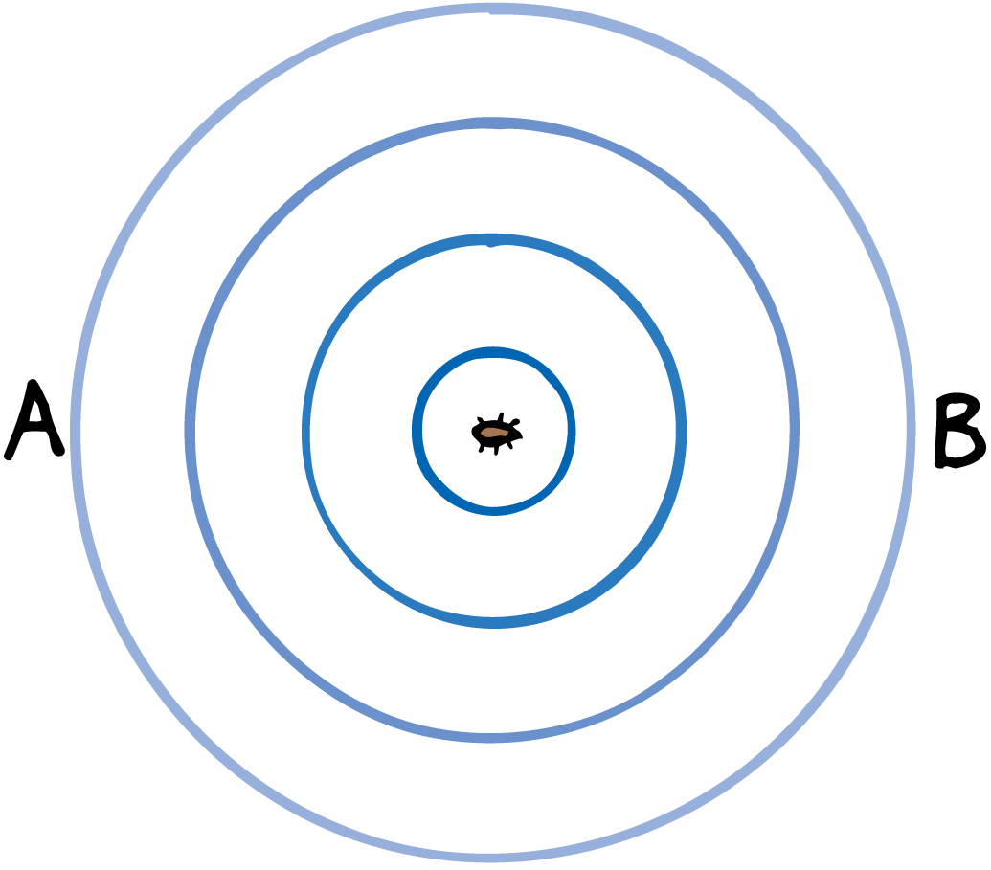
25.9 The Doppler Effect
Imagine a bug jiggling its legs and bobbing up and down in the middle of a quiet puddle.
The crests of the wave it makes are concentric circles, because the wave speed is the same in all directions.
If the bug bobs in the water at a constant frequency, the wavelength will be the same for all successive waves.
The wave frequency is the same as the bug’s bobbing frequency.

Slide 75
25.9 The Doppler Effect
Suppose the jiggling bug moves across the water at a speed that is less than the wave speed.
The wave pattern is distorted and is no longer concentric.
The center of the outer crest is made when the bug is at the center of that circle.
The center of the next smaller crest was made when the bug was at the center of that circle, and so forth.

Slide 76
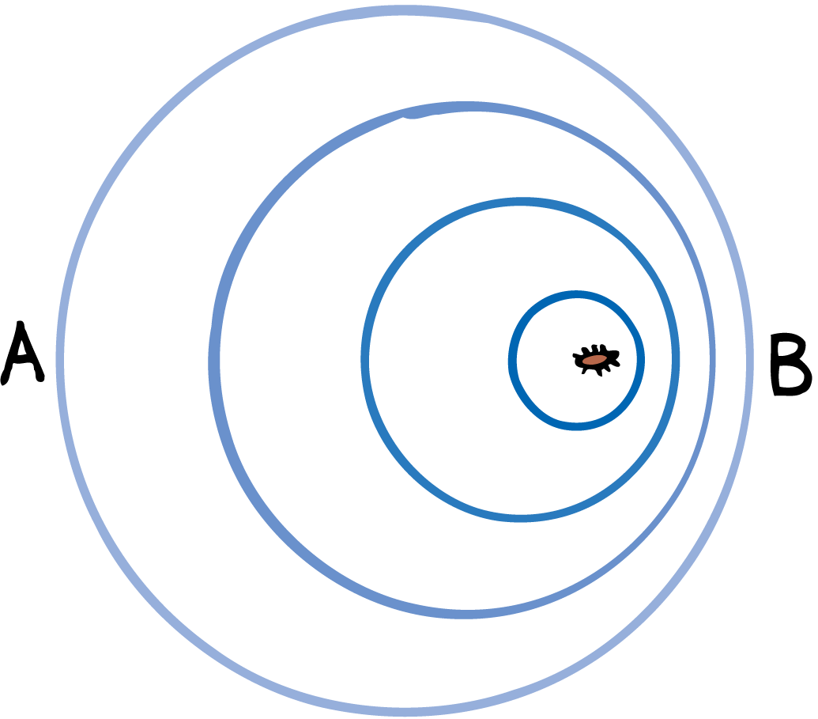
25.9 The Doppler Effect
The bug maintains the same bobbing frequency as before.
However, an observer would encounter a higher frequency if the bug is moving toward the observer.
This is because each successive crest has a shorter distance to travel so they arrive more frequently.

Slide 77
25.9 The Doppler Effect
If the bug is moving away from the observer, on the other hand, there is a lower frequency.
There is a longer time between wave-crest arrivals.
Each crest has to travel farther than the one ahead of it due to the bug’s motion.

Slide 78
25.9 The Doppler Effect
This apparent change in frequency due to the motion of the source (or receiver) is called the Doppler effect.
The greater the speed of the source, the greater will be the Doppler effect.

Slide 79
25.9 The Doppler Effect
Sound
The Doppler effect causes the changing pitch of a siren.
When a firetruck approaches, the pitch sounds higher than normal because the sound wave crests arrive more frequently.
When the firetruck passes and moves away, you hear a drop in pitch because the wave crests are arriving less frequently.

Slide 80
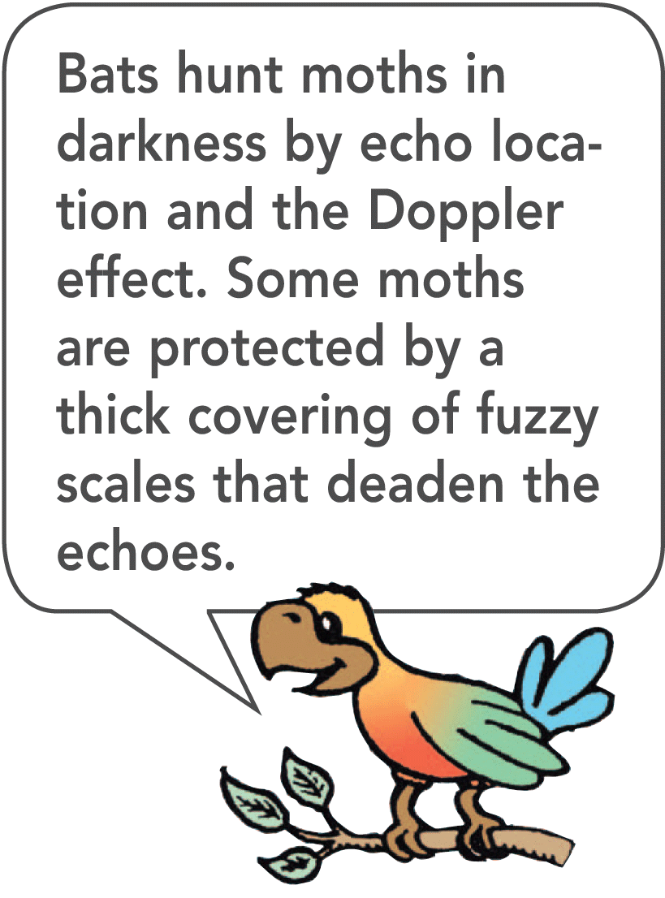
25.9 The Doppler Effect
Police use the Doppler effect of radar waves to measure the speeds of cars on the highway.
Radar waves are electromagnetic waves.
Police bounce them off moving cars. A computer built into the radar system compares the frequency of the radar with the frequency of the reflected waves to find the speed of the car.

Slide 81
25.9 The Doppler Effect
Light
The Doppler effect also occurs for light.
When a light source approaches, there is an increase in its measured frequency.
When it recedes, there is a decrease in its frequency.

Slide 82
25.9 The Doppler Effect
Increasing frequency is called a blue shift, because the increase is toward the high-frequency, or blue, end of the spectrum.
Decreasing frequency is called a red shift, referring to the low-frequency, or red, end of the color spectrum.
Distant galaxies show a red shift in their light. A measurement of this shift enables astronomers to calculate their speeds of recession.

Slide 83
25.9 The Doppler Effect
think!
When a source moves toward you, do you measure an increase or decrease in wave speed?

Slide 84
25.9 The Doppler Effect
think!
When a source moves toward you, do you measure an increase or decrease in wave speed?
Answer:
Neither! It is the frequency of a wave that undergoes a change, not the wave speed.

Slide 85
25.9 The Doppler Effect
How does the apparent frequency of waves change as a wave source moves?

Slide 86
25.10 Bow Waves
A bow wave occurs when a wave source moves faster than the waves it produces.

Slide 87
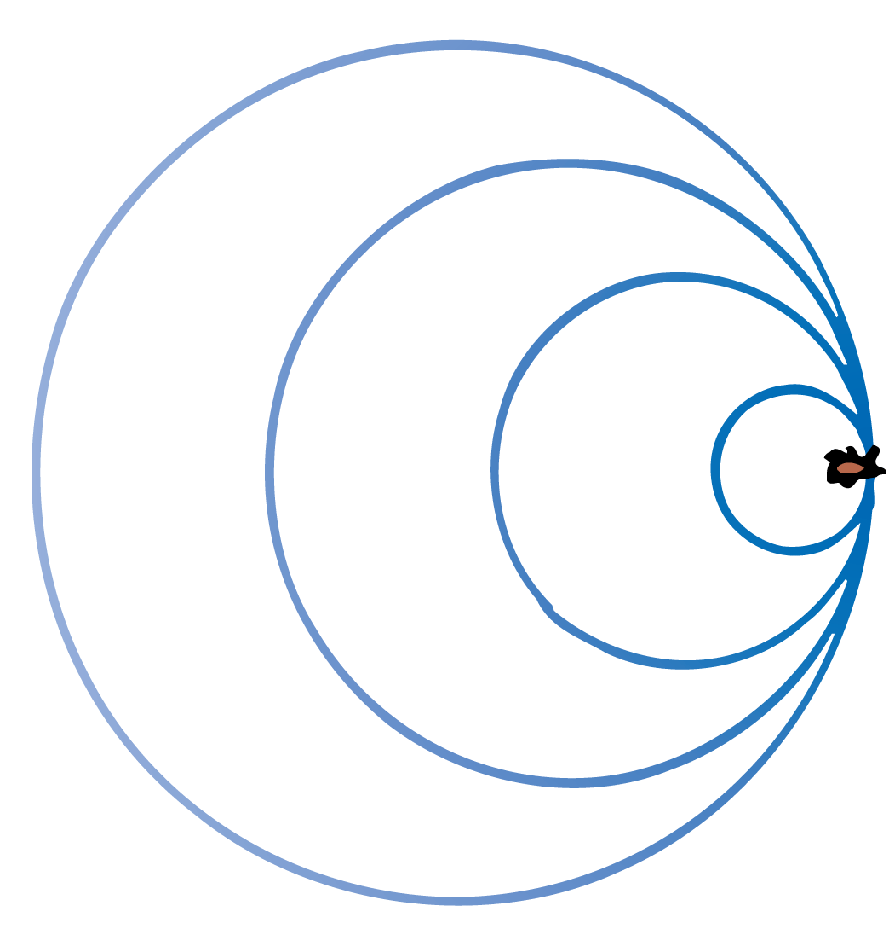
25.10 Bow Waves
When the speed of the source in a medium is as great as the speed of the waves it produces, something interesting happens.
The waves pile up.
If the bug swims as fast as the wave speed, it will keep up with the wave crests it produces.
The bug moves right along with the leading edge of the waves it is producing.

Slide 88
25.10 Bow Waves
The same thing happens when an aircraft travels at the speed of sound.
The overlapping wave crests disrupt the flow of air over the wings, so that it is harder to control the plane when it is flying close to the speed of sound.

Slide 89
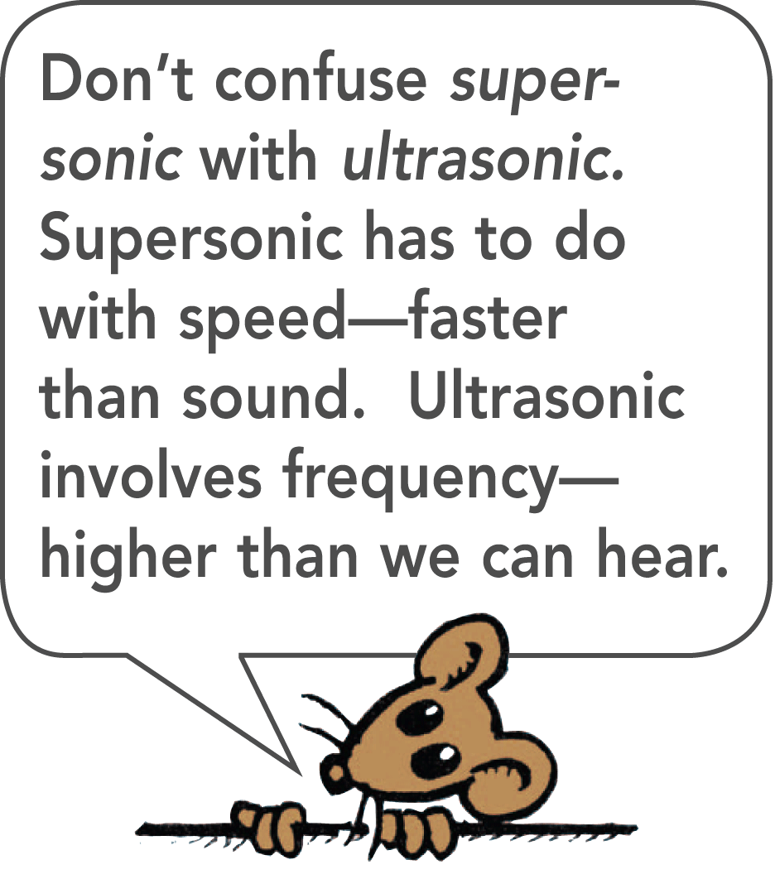
25.10 Bow Waves
When the plane travels faster than sound, it is supersonic.
A supersonic airplane flies into smooth, undisturbed air because no sound wave can propagate out in front of it.
Similarly, a bug swimming faster than the speed of water waves is always entering into water with a smooth, unrippled surface.

Slide 90
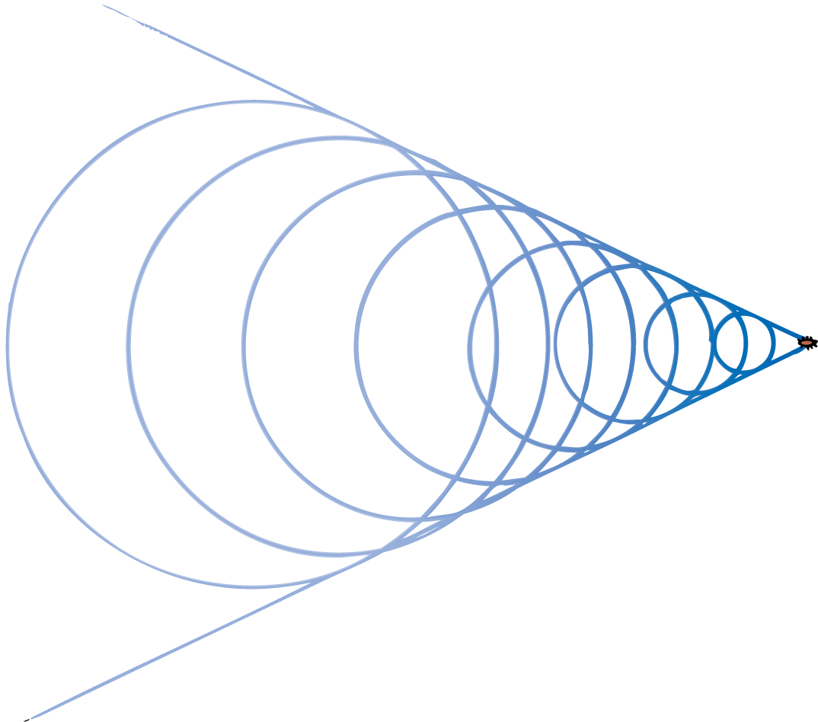
25.10 Bow Waves
When the bug swims faster than wave speed, it outruns the wave crests it produces.
The crests overlap at the edges, and the pattern made by these overlapping crests is a V shape, called a bow wave.
The bow wave appears to be dragging behind the bug.
The familiar bow wave generated by a speedboat is produced by the overlapping of many circular wave crests.

Slide 91
25.10 Bow Waves
v= speed of bug
v_{w}= wave speed
The wave patterns made by a bug swimming at successively greater speeds change. Overlapping at the edges occurs only when the source travels faster than wave speed.

Slide 92
25.10 Bow Waves
What causes a bow wave?

Slide 93
25.11 Shock Waves
A shock wave occurs when an object moves faster than the speed of sound.

Slide 94
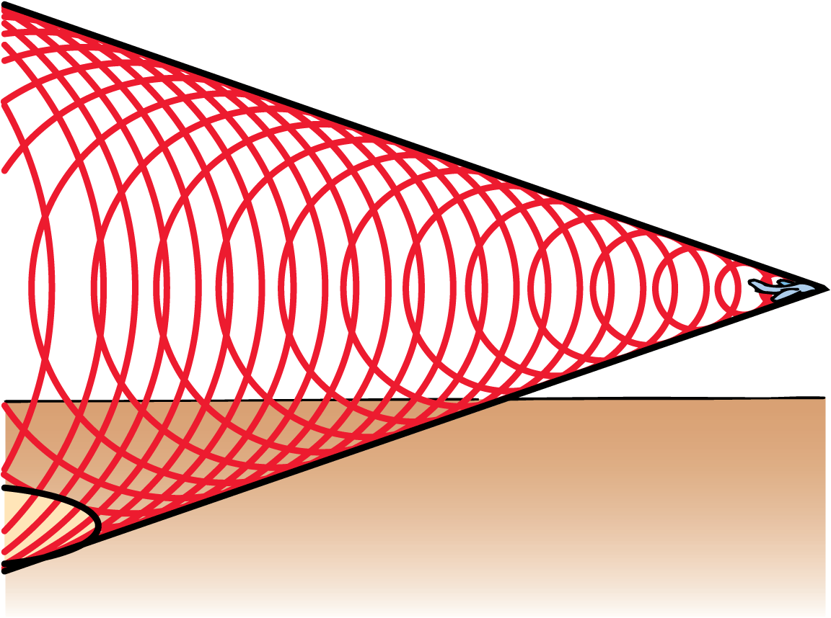
25.11 Shock Waves
A speedboat knifing through the water generates a two-dimensional bow wave.
A supersonic aircraft similarly generates a shock wave.
A shock wave is a three-dimensional wave that consists of overlapping spheres that form a cone.
The conical shock wave generated by a supersonic craft spreads until it reaches the ground.

Slide 95
25.11 Shock Waves
The bow wave of a speedboat that passes by can splash and douse you if you are at the water’s edge.
In a sense, you can say that you are hit by a “water boom.”
In the same way, a conical shell of compressed air sweeps behind a supersonic aircraft.
The sharp crack heard when the shock wave that sweeps behind a supersonic aircraft reaches the listeners is called a sonic boom.

Slide 96
25.11 Shock Waves
We don’t hear a sonic boom from a subsonic aircraft.
The sound wave crests reach our ears one at a time and are perceived as a continuous tone.
Only when the craft moves faster than sound do the crests overlap and encounter the listener in a single burst.
Ears cannot distinguish between the high pressure from an explosion and the pressure from many overlapping wave crests.

Slide 97
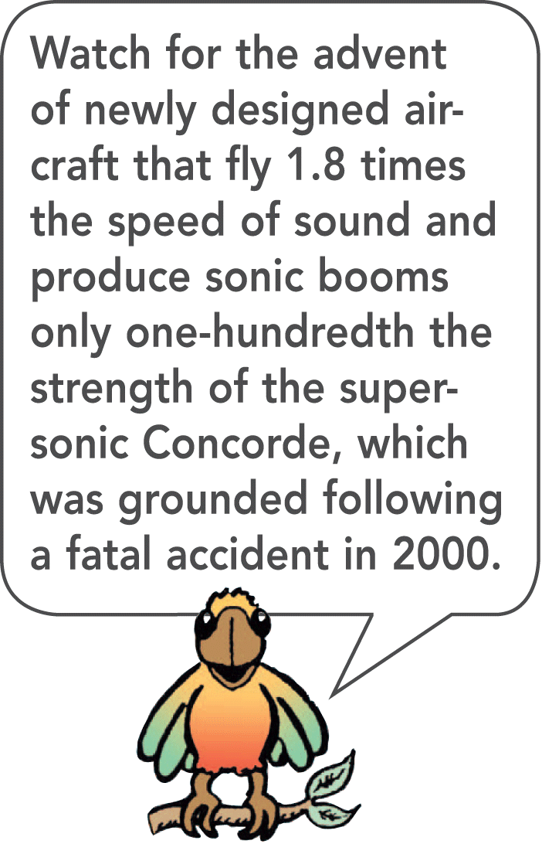
25.11 Shock Waves
A common misconception is that sonic booms are produced only at the moment that the aircraft surpasses the speed of sound.
In fact, a shock wave and its resulting sonic boom are swept continuously behind an aircraft traveling faster than sound.

Slide 98
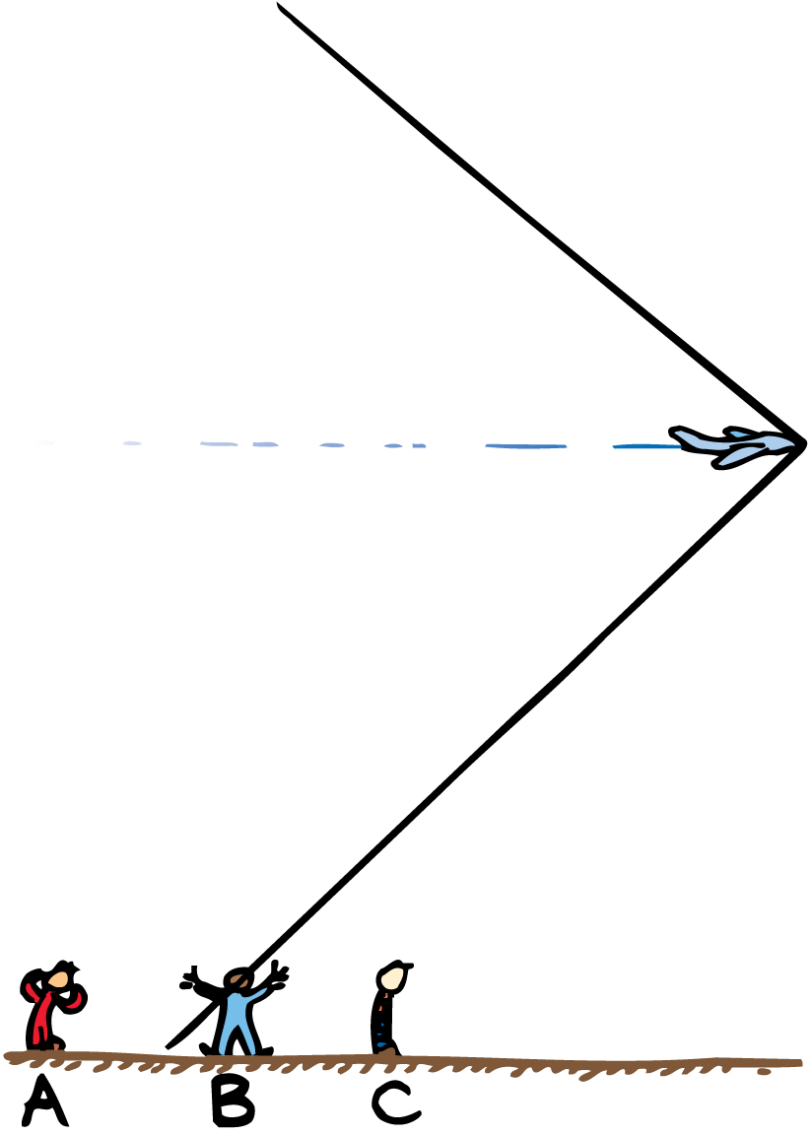
25.11 Shock Waves
The shock wave has not yet encountered listener C, but is now encountering listener B, and has already passed listener A.

Slide 99
25.11 Shock Waves
A supersonic bullet passing overhead produces a crack, which is a small sonic boom.
When a lion tamer cracks a circus whip, the cracking sound is actually a sonic boom produced by the tip of the whip.
Snap a towel and the end can exceed the speed of sound and produce a mini sonic boom.
The bullet, whip, and towel are not in themselves sound sources. When they travel at supersonic speeds, sound is generated as waves of air at the sides of the moving objects.

Slide 100
25.11 Shock Waves
What causes a shock wave?

Slide 101
Assessment Questions
The time it takes for a pendulum to swing to and fro is considered its
frequency.
period.
wavelength.
amplitude.

Slide 102
Assessment Questions
The time it takes for a pendulum to swing to and fro is considered its
frequency.
period.
wavelength.
amplitude.
Answer: B

Slide 103
Assessment Questions
The frequency of a wave is the inverse of its
frequency.
period.
wavelength.
amplitude.

Slide 104
Assessment Questions
The frequency of a wave is the inverse of its
frequency.
period.
wavelength.
amplitude.
Answer: B

Slide 105
Assessment Questions
A wave transfers
amplitude.
wavelength.
frequency.
energy.

Slide 106
Assessment Questions
A wave transfers
amplitude.
wavelength.
frequency.
energy.
Answer: D

Slide 107
Assessment Questions
The speed of a wave can be found by multiplying its frequency by the
period.
wavelength.
amplitude.
density of the medium that carries the wave.

Slide 108
Assessment Questions
The speed of a wave can be found by multiplying its frequency by the
period.
wavelength.
amplitude.
density of the medium that carries the wave.
Answer: B

Slide 109
Assessment Questions
The vibrations along a transverse wave move in a direction
along the wave in the same direction.
perpendicular to the wave.
parallel to the wave.
along the wave in the opposite direction.

Slide 110
Assessment Questions
The vibrations along a transverse wave move in a direction
along the wave in the same direction.
perpendicular to the wave.
parallel to the wave.
along the wave in the opposite direction.
Answer: B

Slide 111
Assessment Questions
The vibrations along a longitudinal wave move in a direction
along and parallel to the wave.
perpendicular to the wave.
below the wave.
above the wave.

Slide 112
Assessment Questions
The vibrations along a longitudinal wave move in a direction
along and parallel to the wave.
perpendicular to the wave.
below the wave.
above the wave.
Answer: A

Slide 113
Assessment Questions
Interference is characteristic of
only sound waves.
only light waves.
only water waves.
all waves.

Slide 114
Assessment Questions
Interference is characteristic of
only sound waves.
only light waves.
only water waves.
all waves.
Answer: D

Slide 115
Assessment Questions
Standing waves
appear to be constantly moving.
are the result of waves overlapping in phase and out of phase.
form only in multiples of three.
do not increase with increasing frequency.

Slide 116
Assessment Questions
Standing waves
appear to be constantly moving.
are the result of waves overlapping in phase and out of phase.
form only in multiples of three.
do not increase with increasing frequency.
Answer: B

Slide 117
Assessment Questions
The Doppler effect changes the
frequency due to motion.
speed of sound due to motion.
speed of light due to motion.
radar waves in a police car.

Slide 118
Assessment Questions
The Doppler effect changes the
frequency due to motion.
speed of sound due to motion.
speed of light due to motion.
radar waves in a police car.
Answer: A

Slide 119
Assessment Questions
Bow waves are produced by waves of water
moving faster than the source producing them.
destructively interfering.
moving slower than the source producing them.
moving at the same speed as the source producing them.

Slide 120
Assessment Questions
Bow waves are produced by waves of water
moving faster than the source producing them.
destructively interfering.
moving slower than the source producing them.
moving at the same speed as the source producing them.
Answer: C

Slide 121
Assessment Questions
Shock waves are produced by waves of sound
constructively interfering.
destructively interfering.
moving faster than the source producing them.
that never overlap.

Slide 122
Assessment Questions
Shock waves are produced by waves of sound
constructively interfering.
destructively interfering.
moving faster than the source producing them.
that never overlap.
Answer: A

